Slide 1
Maths Counts Insights into Lesson Study

Slide 2
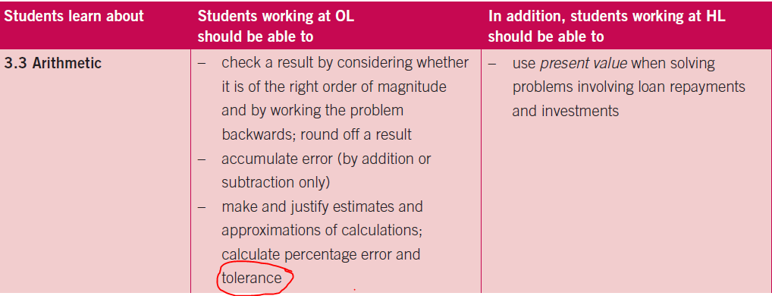
Loreto Abbey Dalkey
Tim Page and Joanne McBreen
Transition Year or Senior Cycle
Introducing Tolerance and Error (Leaving cert. 3.3)

Slide 3
Insights into Lesson Study
Introduction: Focus of Lesson
Student Learning : What we learned about students’ understanding based on data collected
Teaching Strategies: What we noticed about our own teaching
Strengths & Weaknesses of adopting the Lesson Study process

Slide 4
Introduction
Introducing Tolerance and Error
How we planned the lesson:
We considered areas where misconceptions might occur.
Chose activities that would help with understanding the key concepts.
Prepared materials

Slide 5
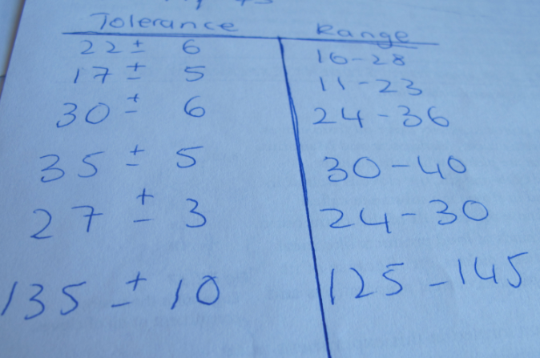
Introduction
Introducing Tolerance and Error
Resources used:
Multi Packs of Smarties (With varying amounts in the boxes)
Sheets to fill in
Strips of paper
Rulers
A metre stick

Slide 6
Introduction
Format of our class:
Students counted the Smarties in the boxes.
Class discussion: Did the company make a mistake?
Students directed to the average contents written on the box, followed by discussion as to what this means.
Concept of Tolerance Interval introduced and $±$ a number. Different tolerance levels in different situations discussed.
Students complete Tolerance Intervals to Range conversions.
Students measure 95 cm from their strips of paper and cut this amount of their strips. ( 1 group measures it with a meter stick rather than ruler)
Resulting measurements compared.
Class discussion re precision and the tolerance level of measuring with the metre stick as opposed to a ruler.

Slide 7
Introduction
Learning Outcomes:
We wanted students:
To be able to differentiate between tolerance and error.
To understand tolerance in a real world context.
To understand tolerance in measurement and how it relates to precision.

Slide 8
Introduction

Slide 9
Introduction
Good site for greatest possible error
http://ie.ixl.com/math/year-3/greatest-possible-error

Slide 10
Introduction
Definition of words:
Tolerance Interval: An acceptable range of values within which a measurement can deviate.
Precision: The precision of any measuring instrument is determined by the smallest unit it can measure.
Acceptable Error vs. An unacceptable error (mistake)

Slide 11
Introduction
Why did we choose to focus on this mathematical area?
Can be a difficult topic for some students
Many new key words
Lends itself well to context-based questions
Error
Percentage Error
Tolerance
Tolerance Interval
Range
Precision
Accumulated Error

Slide 12
Introduction
Enduring understandings:
How companies arrive at an acceptable tolerance interval.
The context determines the tolerance interval.
That they know what is meant by $x±2$ etc.
That they understand tolerance in measurement and how it relates to precision.

Slide 13
Reflections on the Lesson
Student Learning : What we learned about students’ understanding based on data collected
Teaching Strategies: What we noticed about our own teaching

Slide 14
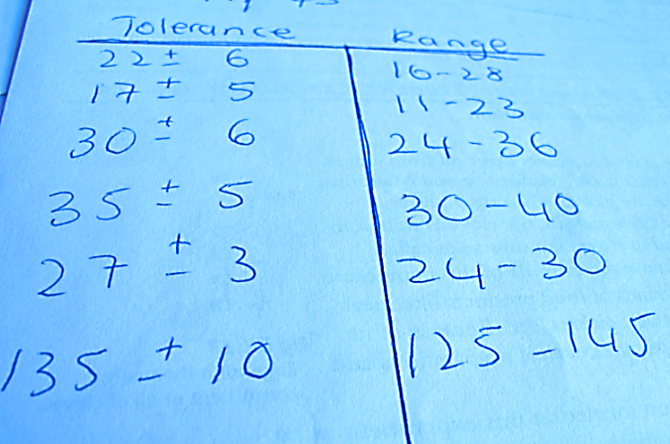
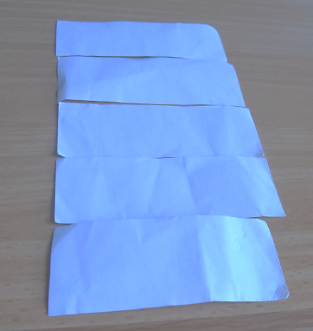
Student Learning
Data Collected from the Lesson:
Samples of work were collected
Observers noticed class engaged well with the exercises
Students developed the concept of a good and bad machine themselves.
Half of the groups completed sheet correctly without assistance
Groups assisted each other

Slide 15
Student Understanding
What we learned about the way different students understand the content of this topic?
Some students need to use manipulatives.
Students need relevant examples.
First hand experience of measurement using different instruments enable students to understand precision.

Slide 16
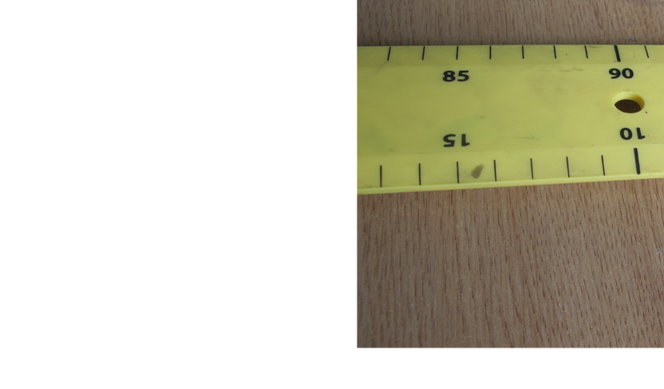
Effective Student Understanding
What effective understanding of this topic looks like:
Students understand what is meant by average contents.
Students should be able to give the acceptable range.
Students know what measurements
are acceptable given the precision
of the instrument being used.

Slide 17
Student Learning
Misconceptions/ Knowledge Gap
It was OK for the Smarties to be above the average, but not below.
Some students had difficulty distinguishing between a tolerable error in measurement and an unacceptable error (mistake).
Some students did not see that measurement is only as precise as the instrument available.

Slide 18
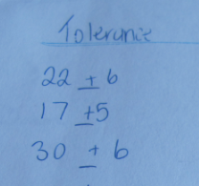
Common Misconceptions
The concept of $±$ a number.

Slide 19
Common Misconceptions
Any instrument is a suitable measurement tool.

Slide 20
Common Misconceptions
Acceptable errors and Unacceptable errors are not the same thing.

Slide 21
Common Misconceptions
Different tolerance levels apply in different situations
Not all measurements have a tolerance e.g. a Weetabix box states it contains 24 Weetabix then you get 24 or it is an unacceptable error.

Slide 22
Addressing Misconceptions
Recommendations:
Get students to suggest tolerance levels for various situations.
Get students to estimate a length of 95 cm first.
All groups use a metre stick and then a ruler.

Slide 23
Summary
The understandings we gained regarding students’ learning of Tolerance and Error as a result of being involved in the research lesson
Short topic that has the potential for a lot of confusion

Slide 24
Summary
What did we learn about this content to ensure we had a strong conceptual understanding of this topic?
Students need to understand precision

Slide 25
Teaching Strategies
What did I notice about my own teaching?
Tends to be too focused on students getting the correct answer rather than the method.
Need to elicit information from the class
Benefits of lesson planning as a group.
Benefits of peer teaching.

Slide 26
Teaching Strategies
Was it difficult to facilitate and sustain communication and collaboration during the lesson?
Students worked well in their groups and groups shared with each other.
Keeping lesson on track.
Teacher needs a very clear understanding of the topic and what you are aiming to teach the students.

Slide 27
Teaching Strategies
Was it difficult to ask questions to provoke students’ deep thinking?
Asking the students for examples.
Ask students to explain what a tolerance of plus or minus 3 means in a context
Are you going to get the same answer with both instruments?

Slide 28
Teaching Strategies
How did I engage and sustain students’ interest and attention during the lesson?
Word Bank on the board
Group work
Short discussions and summaries

Slide 29
Teaching Strategies
How did I assess what students knew and understood during the lesson?
Class discussion
Encouraged group work
Circulated the room and listened to group discussions
Samples of students’ work

Slide 30
Teaching Strategies
How did I put closure to the lesson?
Did not put full closure, but recapped on the topic required
Talked about the Key words

Slide 31
Teaching Strategies
What understandings have I developed regarding teaching strategies for this topic as a result of my involvement in Lesson Study?
Benefits of student discussion
Learning from misconceptions

Slide 32
Teaching Strategies
What changes would I make in the future, based on what I have learned in my teaching, to address students’ misconceptions?
Use weight in addition to length
Work backwards from our measurements to a tolerance level
Get each group to estimate 95 cm first.

Slide 33
Reflections on Lesson Study Process
Strengths & Weaknesses
As a mathematics team how has Lesson Study impacted on the way we work with other colleagues?
It was a joint effort and would like to be able to develop more resources to this standard.
Benefits of feedback from a colleague.
Nice to have the time to work collaboratively with a colleague.
Had covered this topic in previous years using a very theory based approach, but found this method very enjoyable both for teacher and students.
Improved student understanding.

Slide 34
Reflections on Lesson Study Process
Strengths & Weaknesses
Personally, how has Lesson Study supported my growth as a teacher.
Time-consuming to prepare, but leaves the teacher with more time to interact during the lesson.
Recommendations as to how Lesson Study could be integrated into a school context.
Irish teachers do not share enough with the rest of the country. We need more Teaching and Learning Plans.
Urgent need to facilitate on-line sharing of methodologies between maths teachers.

