Slide 2
INDEX
Student Activity 1: | Introduction
Student Activity 2: | Angles in the first quadrant 0° < θ < 90°
Student Activity 3: | Angles in the second quadrant 90° < θ < 180°
Student Activity 4: | Angles in the third quadrant 180° < θ < 270°
Student Activity 5: | Angles in the fourth quadrant 270° < θ < 360°
Student Activity 6: | Summary on finding trig functions of all angles
Student Activity 7: | Solving trig equations
Reflection & Appendix

Slide 3
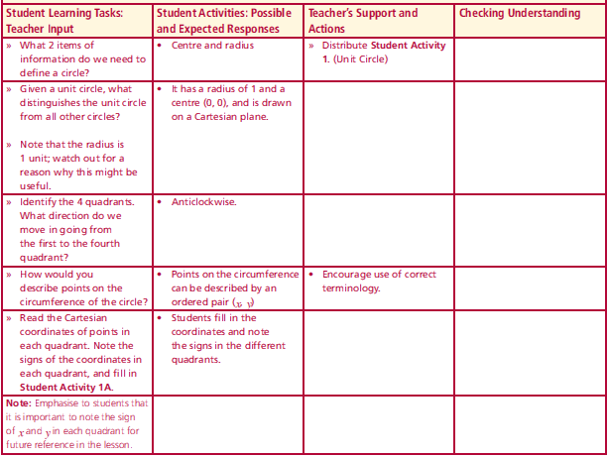
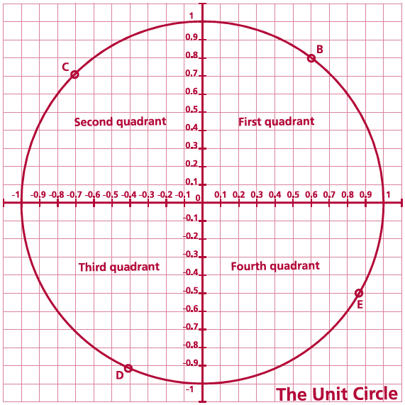
Student Activity 1: Introduction
What 2 items of information do we need to define a circle?
Given a unit circle, what distinguishes the unit circle from all other circles?
Identify the 4 quadrants. What direction do we move in going from the first to the fourth quadrant?
How would you describe points on the circumference of the circle?
Read the Cartesian coordinates of points in each quadrant.
Lesson interaction

Slide 4
Student Activity 1
The unit circle – A circle whose centre is at (0,0) and whose radius is 1
Any point on the circumference of the circle can be described by an ordered pair (x,y).
The coordinates of B are (0.6, 0.8)
What are the coordinates of C, D, and E?
C = ___ , D =___ , E =____.

Slide 5
In which quadrant are both x and y positive? _____________________________
In which quadrant is x negative and y positive? ___________________________
In which quadrant is x positive and y negative? ___________________________
In which quadrant is x negative and y negative? ___________________________
Angles in standard position - the vertex is at the origin, with the initial ray as the positive direction of the x-axis, and the other ray forming the angle is the terminal ray.

Slide 6
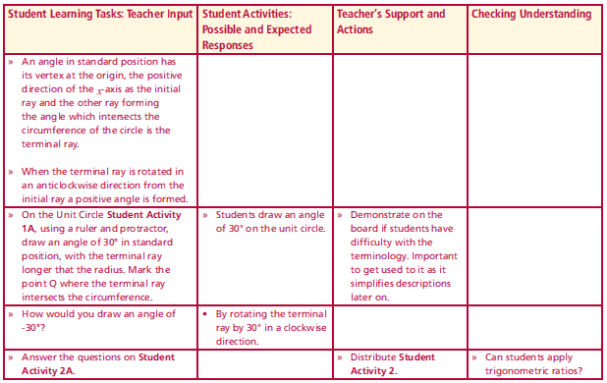
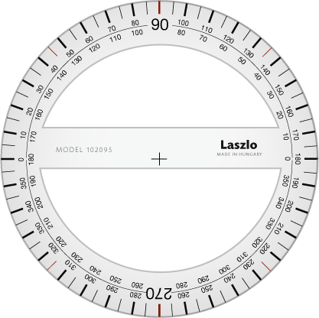
Student Activity 1B Angles in the first quadrant 0° < θ < 90°
Lesson interaction
Draw an angle of 30° in standard position on the unit circle on Student Activity Sheet 1A. Mark the initial ray and the terminal ray. Label the point where the terminal ray meets the circumference as Q.
The coordinates of Q are ______________________________________________
$$Q$$
How would you draw an angle of -30°?

Slide 7
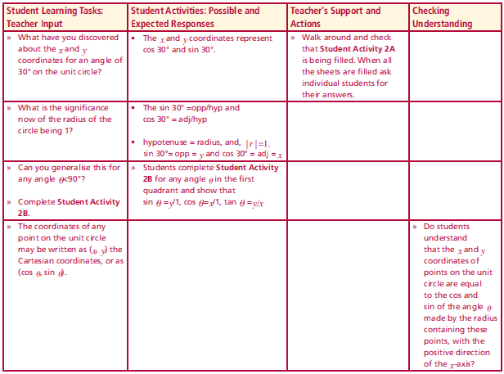
Student Activity 2A
Drop a perpendicular from Q to the x-axis to construct a right angled triangle with one vertex at (0, 0), as shown in the diagram.
What is the length of the hypotenuse? _______
What is the length of the opposite? __________
What is the length of the adjacent? __________
Using trigonometric ratios, (not a calculator), calculate the sin 30°, cos 30°and the tan 30°.
sin 30° =________
cos 30° =________
tan 30° =________
Compare these with the values of the x and y
coordinates of Q. What do you notice about the
x and y coordinates of Q and the trigonometric functions sin 30°,cos 30° and tan 30°?
Check the answers using a calculator.
sin 30° =____ cos 30° =____ tan 30° =_____
Lesson interaction
$$Q$$
Lesson interaction

Slide 8
Student Activity 2A
What have you discovered about the x and y coordinates for an angle of 30° on the unit circle?
What is the significance now of the radius of the circle being 1?
Can you generalise this for any angle θ<90°?
Lesson interaction
$$Q$$
Lesson interaction

Slide 9
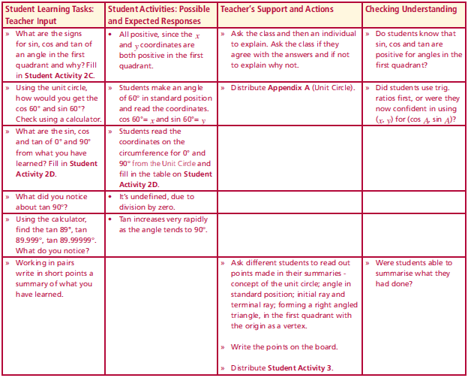
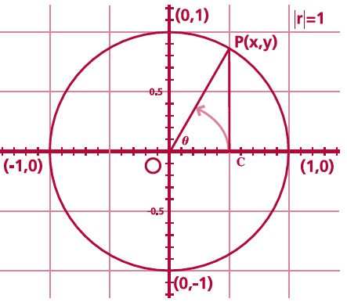
Student Activity 2B Application to any angle in the first quadrant 0° < θ < 90°
sin θ =________
cos θ =________
tan θ =________
Lesson interaction
Lesson interaction
The coordinates of any point on the unit circle may be written as
(x, y) the Cartesian coordinates,
or as (cos θ, sin θ).

Slide 10
Student Activity 2C Application to any angle in the first quadrant 0° < θ < 90°
Lesson interaction
What signs will $sinθ$, $cosθ$ and $tanθ$ have in the first quadrant?
Why have $sinθ$ , $cosθ$ and $tan$ $θ$ got these signs in the first quadrant?
Trigonometric functions | Sign in the first Quadrant
$$sin⁡θ$$
$$cos θ$$
$$tan θ$$
Lesson interaction
Using the unit circle, how would you get the cos 60° and sin 60°?
Check using a calculator.

Slide 11
Student Activity 2D
Mark angles of 0° and 90° degrees in standard position on the unit circle, and from what you have just learned, without using a calculator, write down the sin, cos, and tan of 0° and 90°.
Lesson interaction
$$θ°$$ | $$0°$$ | $$90°$$
Coordinates on the unit circle
$$cosθ$$
$$sinθ$$
$$tanθ$$
What did you notice about tan 90°?
Using the calculator, find the tan 89°, tan89.999°, tan 89.99999°.
What do you notice?
Working in pairs write a summary of what you have learned.

Slide 12
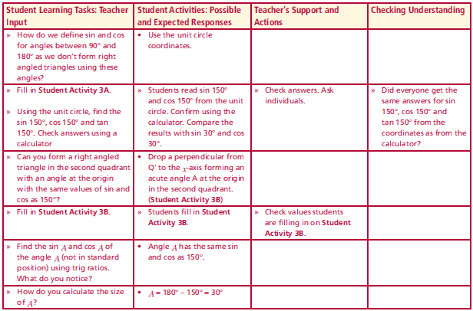
Student Activity 3A Angles in the second quadrant 90° < θ < 180°
How do we define sinθ and cosθ for angles between 90° and 180° as we don’t form right angled triangles using these angles?
Lesson interaction
$$Q′$$
On the unit circle on Appendix A, mark an angle of 150° in standard position. Read the x and y coordinates of the point Q’, where the terminal ray intersects the circumference.

Slide 13
Student Activity 3A Angles in the second quadrant 90° < θ < 180°
Lesson interaction
(x, y) of point Q’ are _____________________
Using what you have learned about the coordinates of points on the circumference of
the unit circle, fill in the following:
cos 150° = ___ sin 150° = ___ tan 150° = ___
Check these values using the calculator.
cos 150° = ____ sin 150° = ____ tan 150° =____
Compare with
cos 30° = ____ sin 30° = ____ tan 30° = _____
$$Q′$$

Slide 14
Student Activity 3B Angles in the second quadrant 90° < θ < 180°
Drop a perpendicular from point Q’, to the negative direction of the x- axis, to make a right angled triangle, with angle A at the origin.
What is the value of A in degrees?
_________________________________
_________________________________
$$Q′$$
A

Slide 15
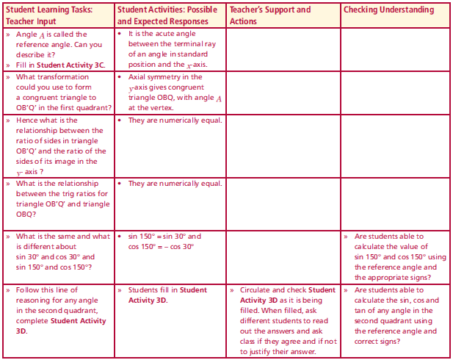
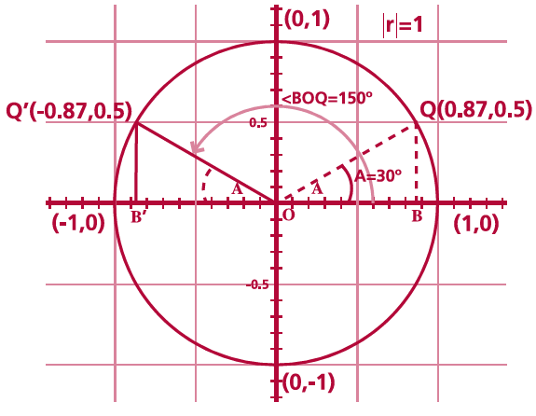
Student Activity 3B Angles in the second quadrant 90° < θ < 180°
Lesson interaction
Using the trigonometric ratios on triangle OB’Q’, what is sin A = ________
Cos A = ________
A
Student Activity 3C
A is called the reference angle. Describe the reference angle? ______________________________________________________________________________________________________________________________

Slide 16
Student Activity 3D
What do you notice about the sin and cos of the reference angle and the sin 150° and cos 150°? _______________________________________
What is the image of triangle OB’Q’ by reflection in the y- axis? ___________________________
What is the relationship between triangle OB’Q’ and its image in the y- axis? ________________
_______________________________________
Hence what is the relationship between ratio of sides in triangle OB’Q’ and the ratio of the sides of its image in the y- axis? _________________
_______________________________________
Lesson interaction

Slide 17
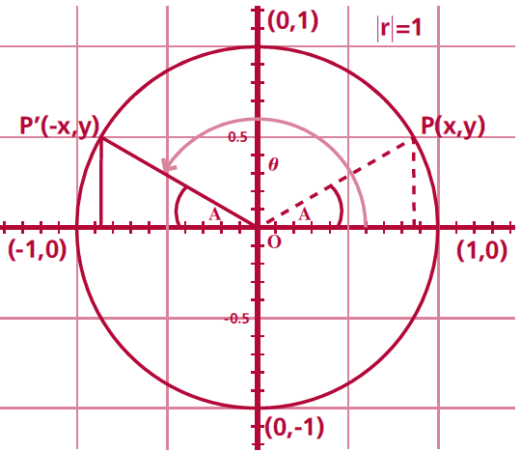
Student Activity 3D
Therefore 150° in the second quadrant has a reference angle of ___ in the first quadrant
sin 150° =________ sin 30° =________
cos 150° =________ cos 30° =________
Application to any angle in the second quadrant
Sin θ= _________
Cos θ= _________
Tan θ= _________
Sin A= opp/hyp = ____ (A in the 2nd quadrant)
Cos A= adj/hyp = ____ (A in the 2nd quadrant)
Sin A = ____ (A in the 1st quadrant)
Cos A = ____ (A in the 1st quadrant)
Express A in terms of θ and 180 $°$ _______________________________________
Equation (i)
$180° − θ$

Slide 18
Student Activity 3D
Equation (i) A = 180$°$ - θ
Write down the relationship between sin θ in the second quadrant and sin A in the first quadrant _______________________________
_______________________________________
Rewrite the answer using equation (i) above _______________________________________
Write down the relationship between cos θ and the second quadrant cos A in the first quadrant ______________________________________________________________________________
Rewrite the answer using equation (i) above _______________________________________

Slide 19
Student Activity 3D
Fill in the signs for cos and sin and tan of an angle in the second quadrant.
Using the reference angle, how would you calculate the sin 130$°$, cos 130$°$, tan 130$°$? _____________________________________________________
______________________________________________________________
Using the reference angle, how would you calculate the sin 110$°$, cos 110$°$, tan 110$°$? _____________________________________________________
______________________________________________________________
Using the reference angle, how would you calculate the sin 170$°$, cos 170$°$, tan 170$°$? _____________________________________________________
______________________________________________________________
Trigonometric functions | Sign in the second quadrant
$$cosθ$$
$$sinθ$$
$$tanθ$$

Slide 20
Student Activity 3D
Mark an angle of 180$°$ degrees in standard position on the unit circle, and using coordinates, not a calculator, write down the sin, cos, and tan of 180$°$. Check the answers using a calculator.
$$θ°$$ | $$180°$$
Coordinates on the unit circle
$$cosθ$$
$$sinθ$$
$$tanθ$$

Slide 21
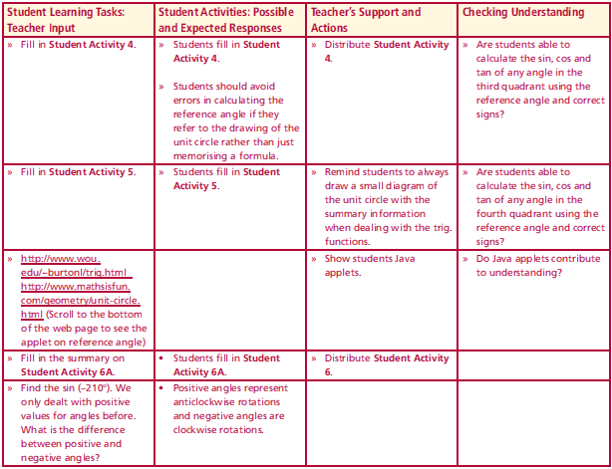
Student Activity 4 Angles in the third quadrant 180° < θ < 270°
On the unit circle on Appendix A, mark an angle of 210° in standard position. Read the x and y coordinates of the point Q’’, where the terminal ray intersects the circumference.
(x, y) of point Q’’ are _____________________
Using what you have learned about the coordinates of points on the circumference of
the unit circle, fill in the following:
cos 210° = ___ sin 210° = ___ tan 210° = ____
Check these values using the calculator.
cos 210° = ____ sin 210° = ____ tan 210° =____
Compare with
cos 30° = ____ sin 30° = ____ tan 30° = _____
Lesson interaction
$$Q′′$$
21:39

Slide 22
Student Activity 4 Angles in the third quadrant 180° < θ < 270°
Drop a perpendicular from point Q’’, to the negative direction of the x- axis, to make a right angled triangle OB’Q’’. What is the value of
A in degrees? ____
Using the trigonometric ratios on triangle OB’Q’’, what is
Sin A =_____ , cos A =_____
A is called the Reference angle. Describe the
reference angle?________________________
What do you notice about the sin and cos of the
reference angle and sin 210° and cos 210°? ______________________________________________________________________________
A
$$Q′′$$

Slide 23
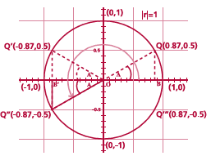
Student Activity 4 Angles in the third quadrant 180° < θ < 270°
What is the image of triangle OB’Q’’ by S₀ ? ______________________________________
What is the relationship between triangle OB’Q’’ and its image by S₀?_______________
Hence what is the relationship between ratio of sides in triangle OB’Q’’ and the ratio of the sides of its image by S₀? ___________________
_______________________________________
Therefore 210° in the third quadrant has a reference angle of _____ in the first quadrant.
sin 210° = _______ sin 30° = _______,
cos 210° = _______ cos 30°= _______
A

Slide 24
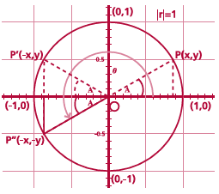
Student Activity 4 Angles in the third quadrant 180° < θ < 270°
Application to any angle in the third quadrant.
Sin θ = _____________
Cos θ = _____________
Tan θ = _____________
Sin A = opp/hyp = ____ (A in the 3rd quadrant)
Cos A = adj/hyp = ____ (A in the 3rd quadrant)
Sin A = ____ (A in the 1st quadrant)
Cos A = ____ (A in the 1st quadrant)
A

Slide 25
Student Activity 4
Equation (i)
180° + θ
Express A in terms of θ and 180$°$.
____________________________
Write down the relationship between sin θ and the sin A in the third quadrant and then rewrite the answer using equation (i) above. _____________________________________________________________
_____________________________________________________________
Write down the relationship between cos θ and the cos A in the third quadrant and then rewrite the answer using equation (i) above. __________________________________________________________________________________________________________________________
Write down the relationship between tan θ and the tan A in the third quadrant and then rewrite the answer using equation (i) above. __________________________________________________________________________________________________________________________Fill in the signs for cos and sin and tan of an angle in the third quadrant

Slide 26
Student Activity 4
Equation (i) A = 180$°$ + θ
Fill in the signs for cos and sin and tan of an angle in the third quadrant
Using the reference angle, calculate the sin, cos and tan of 220°. __________________________________________________________________________________________________________________________
Trigonometric functions | Sign in the third quadrant
$$cosθ$$
$$sinθ$$
$$tanθ$$

Slide 27
Student Activity 4
Equation (i) A = 180$°$ + θ
Mark an angle of 270° degrees in standard position on the unit circle, and using coordinates, not a calculator, write down the sin, cos, and tan of 270°. Check the answers using a calculator
$$θ°$$ | $$270°$$
Coordinates on the unit circle
$$cosθ$$
$$sinθ$$
$$tanθ$$

Slide 28
Student Activity 5 Angles in the fourth quadrant 270° < θ < 360°
On the unit circle on Appendix A, mark an angle of 330° in standard position. Read the x and y coordinates of the point Q’’’, where the terminal ray intersects the circumference.
(x, y) of point Q’’’ are _____________________
Using what you have learned about the coordinates of points on the circumference of
the unit circle, fill in the following:
cos 330° = ___ sin 330° = ___ tan 330° = ___
Check these values using the calculator.
cos 330° = ____ sin 330° = ____ tan 330° =____
Compare with
cos 30° = ____ sin 30° = ____ tan 30° = _____
$$Q′′′$$
21:39

Slide 29
Student Activity 5 Angles in the fourth quadrant 270° < θ < 360°
Drop a perpendicular from point Q’’’, to the positive direction of the x- axis, to make a right angled triangle OBQ’’’. What is the value of
A in degrees? ____
Using the trigonometric ratios on triangle OBQ’’’, what is
Sin A =_____ , cos A =_____
A is called the Reference angle. Describe the
reference angle?________________________
What do you notice about the sin and cos of the
reference angle and sin 330° and cos 330°? ______________________________________________________________________________
A
$$Q′′′$$

Slide 30
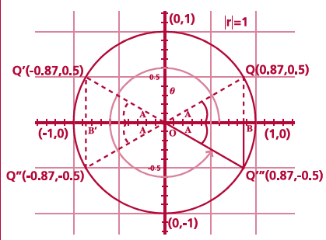
Student Activity 5 Angles in the fourth quadrant 270° < θ < 360°
What is the image of triangle OBQ’’’ by S_{x} ? ______________________________________
What is the relationship between triangle OBQ’’’ and its image by S_{x}?_______________
Hence what is the relationship between ratio of sides in triangle OBQ’’’ and the ratio of the sides of its image by S_{x}? ___________________
_______________________________________
Therefore 330° in the fourth quadrant has a reference angle of _____ in the first quadrant.
sin 330° = _______ sin 30° = _______,
cos 330° = _______ cos 30°= _______
A

Slide 31
Student Activity 5 Angles in the fourth quadrant 270° < θ < 360°
Application to any angle in the fourth quadrant.
Sin θ = _____________
Cos θ = _____________
Tan θ = _____________
Sin A = opp/hyp = ____ (A in the 4th quadrant)
Cos A = adj/hyp = ____ (A in the 4th quadrant)
Sin A = ____ (A in the 1st quadrant)
Cos A = ____ (A in the 1st quadrant)
A

Slide 32
Student Activity 5
Equation (i)
360° - θ
Express A in terms of θ and 360°. ______________________________________
Write down the relationship between sin θ and the sin A in the fourth quadrant and then rewrite the answer using equation (i) above. _____________________________________________________________
_____________________________________________________________
Write down the relationship between cos θ and the cos A in the fourth quadrant and then rewrite the answer using equation (i) above. __________________________________________________________________________________________________________________________
Write down the relationship between tan θ and the tan A in the fourth quadrant and then rewrite the answer using equation (i) above. __________________________________________________________________________________________________________________________

Slide 33
Student Activity 5
Equation (i) A = 360 - θ
Fill in the signs for cos and sin and tan of an angle in the fourth quadrant
Using the reference angle, calculate the sin, cos and tan of 315$°$. __________________________________________________________________________________________________________________________
Trigonometric functions | Sign in the fourth quadrant
$$cosθ$$
$$sinθ$$
$$tanθ$$

Slide 34
Student Activity 5
Equation (i) A = 360 - θ
Mark an angle of 360$°$ degrees in standard position on the unit circle, and using coordinates, not a calculator, write down the sin, cos, and tan of 360$°$. Check the answers using a calculator
$$θ°$$ | $$360°$$
Coordinates on the unit circle
$$cosθ$$
$$sinθ$$
$$tanθ$$

Slide 35
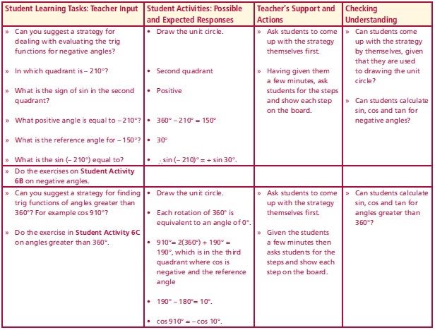
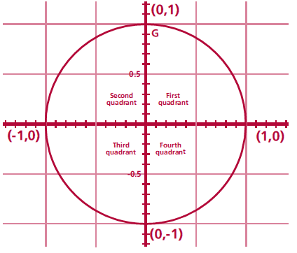
Student Activity 6A Summary on finding trig functions of all angles
Lesson interaction
Fill in on the unit circle, in each quadrant, the first letter of the trigonometric function which is positive in each quadrant. Mark in an angle θ and its reference angle A for each quadrant. Use a different unit circle for each situation. Fill in also in each quadrant, the formula for the reference angle given an angle θ in that quadrant.
Lesson interaction
A
S
A
A
A
A
T
C
0º < θ < 90º Ref angle = θ
θ = A
90º < θ < 180º
Ref angle
θ = 180º - A
180º < θ < 270º
Ref angle
θ = 180º + A
270º < θ < 360º
Ref angle
θ = 360º - A

Slide 36
Student Activity 6A Summary on finding trig functions of all angles
Lesson interaction
Fill in on the unit circle, in each quadrant, the first letter of the trigonometric function which is positive in each quadrant. Mark in an angle θ and its reference angle A for each quadrant. Use a different unit circle for each situation. Fill in also in each quadrant, the formula for the reference angle given an angle θ in that quadrant.
Lesson interaction
S A
T C

Slide 37
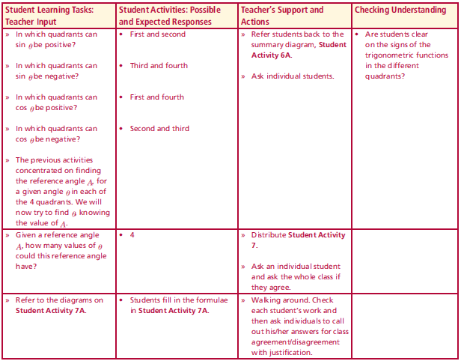
Student Activity 6B Negative angles
Lesson interaction
Find the sin ( –210°). We only dealt with positive values for angles before.
What is the difference between positive and negative angles?
Can you suggest a strategy for dealing with evaluating the trig functions for negative angles?
In which quadrant is – 210°?
What is the sign of sin in the second quadrant?
What positive angle is equal to – 210°?
What is the reference angle for – 150°?
What is the sin ( – 210°) equal to?
Lesson interaction
S A
T C

Slide 38
Student Activity 6B Negative angles
Lesson interaction
Find, without using the calculator. Show steps.
sin (–120º) _______________________________________________________
cos (–120º) _______________________________________________________
tan (–120º) _______________________________________________________
Find, without using the calculator. Show steps.
sin 450º __________________ sin 1250º ____________________ cos 450º __________________ cos 1250º____________________ tan 450º __________________ tan 1250º ____________________
Student Activity 6C
Angles greater than 360º
Lesson interaction

Slide 39
Student Activity 7
In which quadrants can sin θ be positive?
In which quadrants can sin θ be negative?
In which quadrants can cos θ be positive?
In which quadrants can cos θ be negative?
The previous activities concentrated on finding the reference angle A, for a given angle θ in each of the 4 quadrants.
We will now try to find θ, knowing the value of A.
Given a reference angle A, how many values of θ could this reference angle have?
Lesson interaction

Slide 40
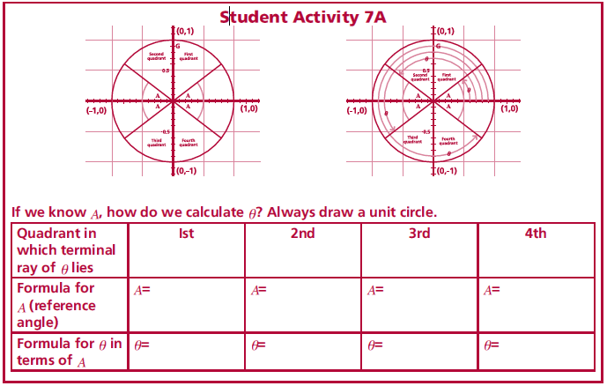
Student Activity 7
Lesson interaction

Slide 41
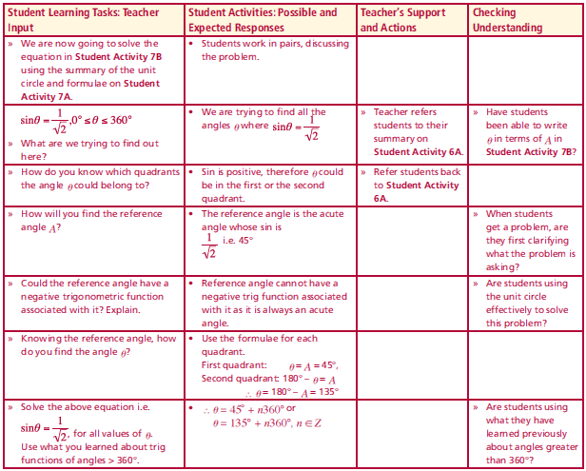
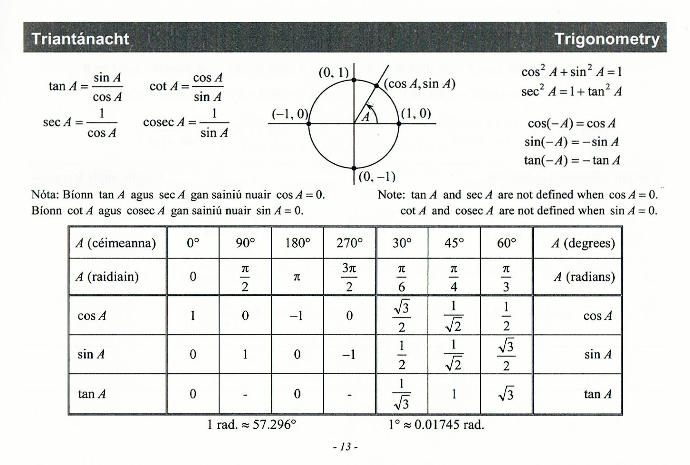
Student Activity 7B Solving trig equations
S A
T C
Lesson interaction
Solve the equation cos θ= $\frac{1}{\sqrt{2}}$ where $0°<θ<360°$(use Tables)
What are we trying to find? ________________________________________
In what quadrants could θ be located and why? _______________________
______________________________________________________________
As the reference angle is acute what sign will the trig functions of reference angles have? ___________________________________________________
What is the value of the reference angle (the acute angle with this value of cos)? _________________________________________________________
Knowing the reference angle, what are the possible values of θ? ______________________________________________________________
Solve the equation $\sin{θ}=−\frac{\sqrt{3}}{2}$
Page 13

Slide 42
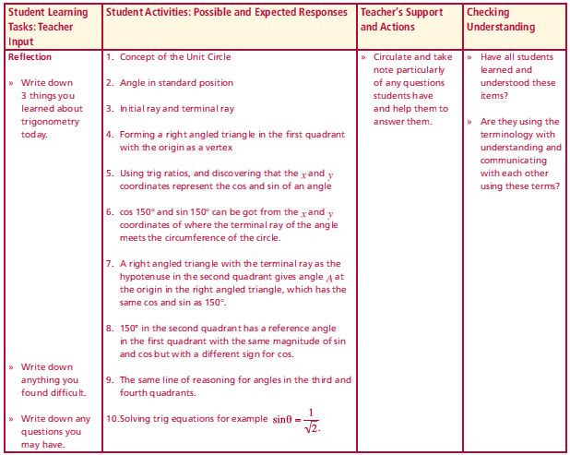
Reflection
Lesson interaction
Write down 3 things you learned about trigonometry today.
Write down anything you found difficult.
Write down any questions you may have.

Slide 43
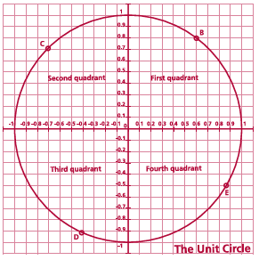
Appendix A

