Slide 1
The diagram represents the sets: Natural Numbers $ℕ,$ Integers $ℤ,$Rational Numbers$ℚ and$Real Numbers ℝ. Insert each of the following numbers in the correct place on the diagram: 5$, 1+\sqrt{2}, −9.6403915..…, −$ $\frac{1}{2}$, 6.$\dot{3}\dot{6}$ , 2$π$, -3, $\sqrt[3]{8}$, 0 and -$\sqrt{3}.$
ℝ
ℚ
ℚ
ℤ
ℕ
ℕ
Notes:
Adapt this to include whatever numbers you wish.

Slide 2
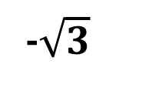
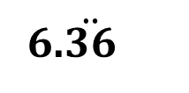
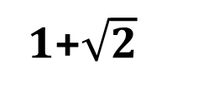
The diagram represents the sets: Natural Numbers $ℕ,$ Integers $ℤ,$Rational Numbers$ℚ and$Real Numbers ℝ. Insert each of the following numbers in the correct place on the diagram: 5$, 1+\sqrt{2}, −9.6403915..…, −$ $\frac{1}{2}$, 6.$\dot{3}\dot{6}$, 2$π$ , -3, $\sqrt[3]{8}$ , 0 and -$\sqrt{3}.$
ℝ
1+$\sqrt{2}$
ℚ
ℤ
ℕ
6.$\ddot{36}$
-3
$$\sqrt[3]{8}$$
$$−\frac{1}{2}$$
5
$$2π$$
0
-$\sqrt{3}$
-9.6403915…
Notes:
70/11=6.36363….

