Slide 1
Aistriú
&
Scálú
Notes:
Cliceáil le nótaí a bhreacadh

Slide 2
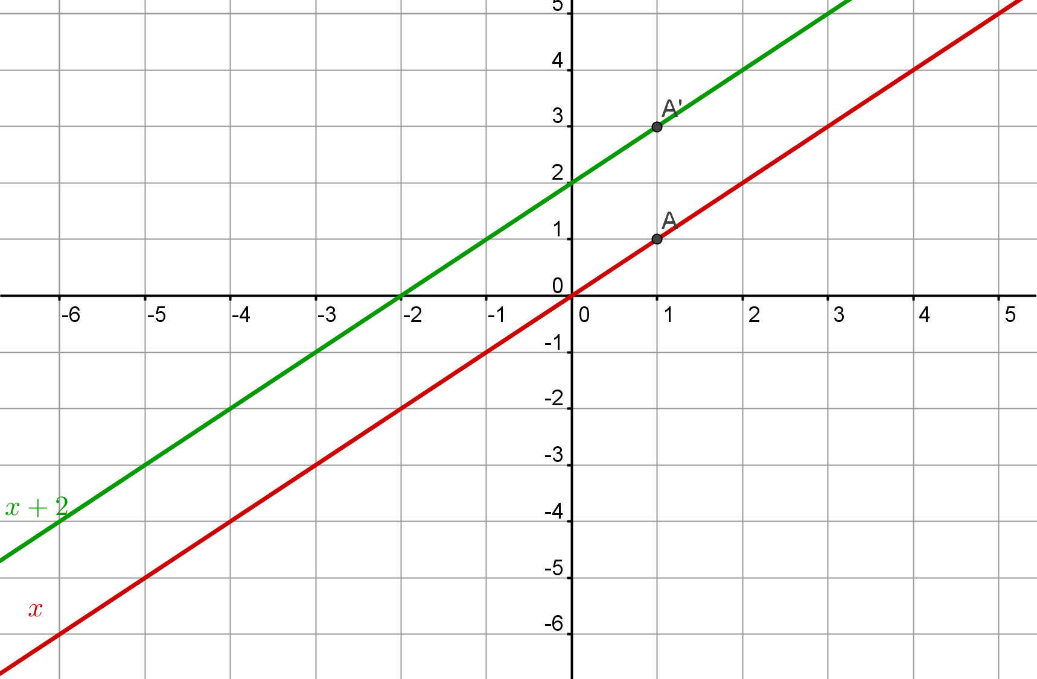
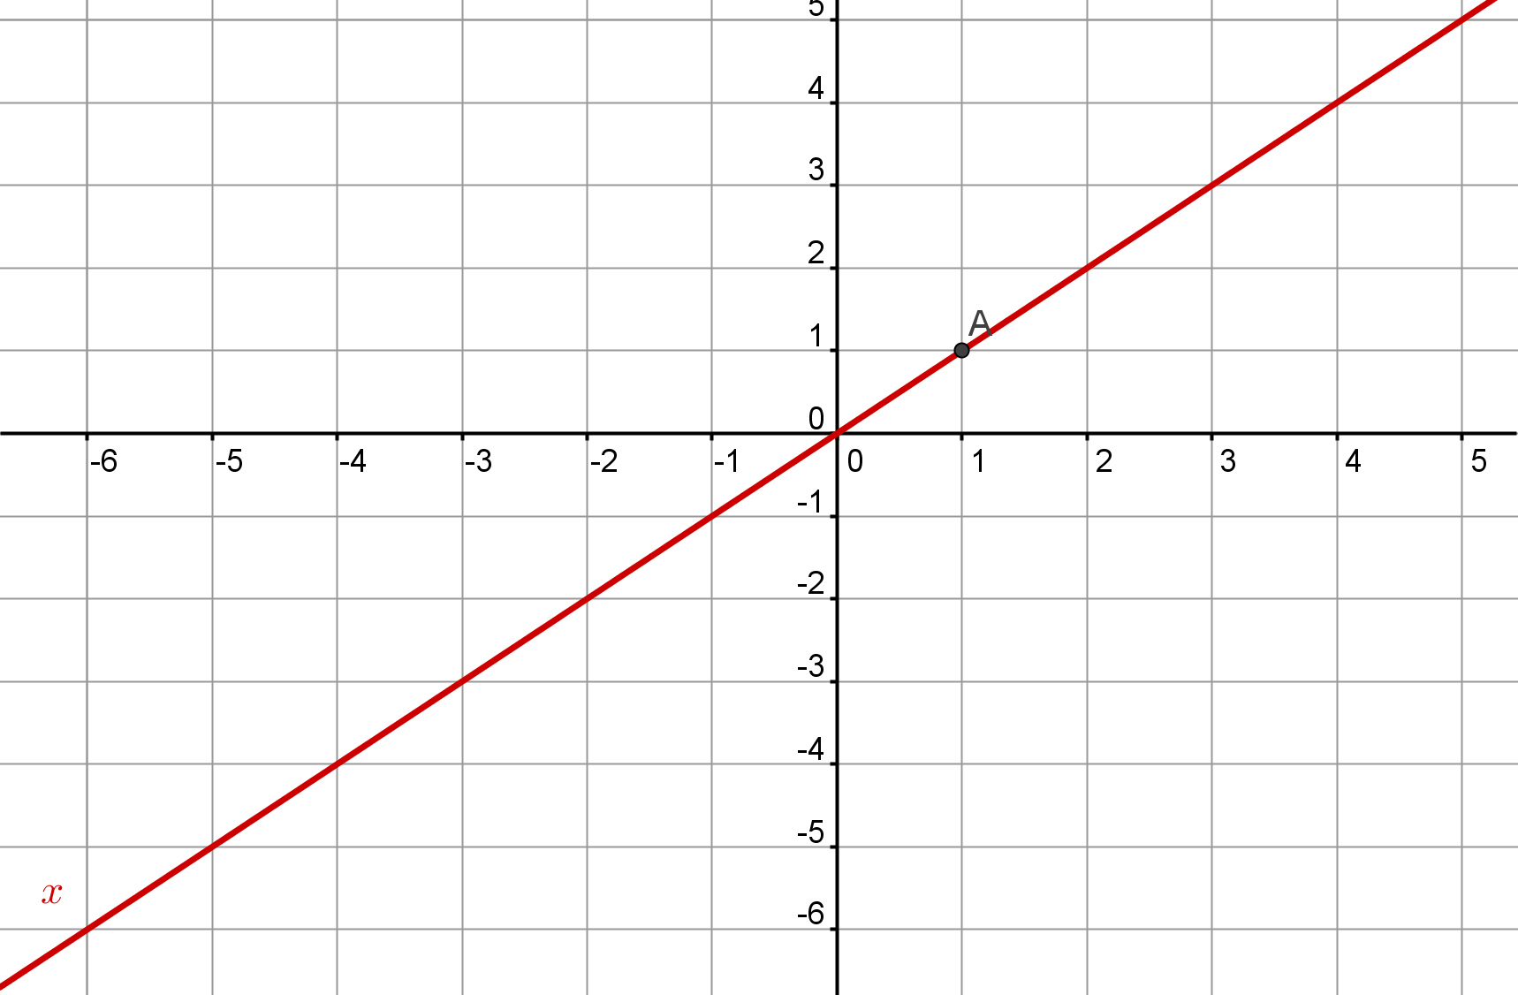
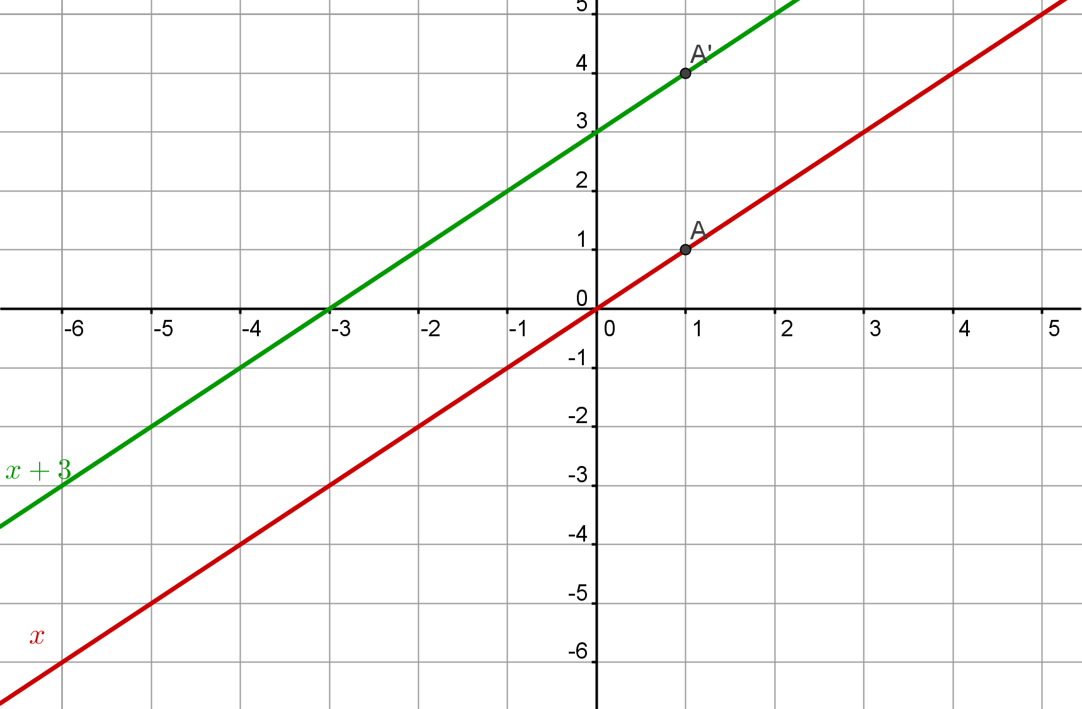
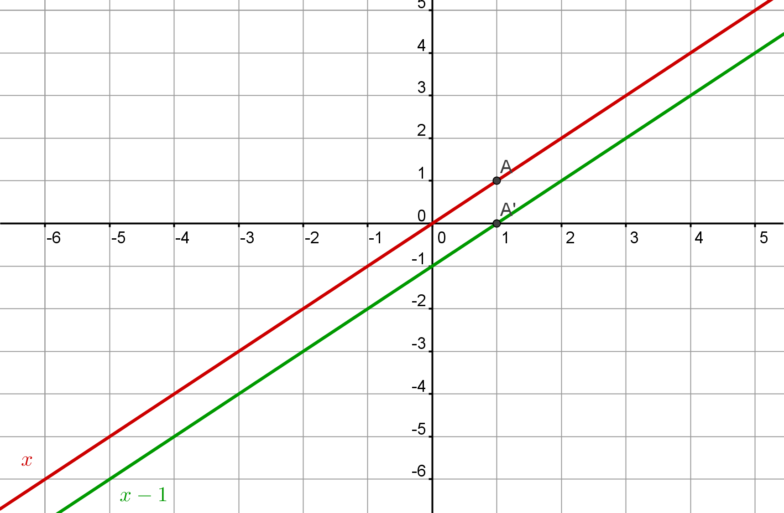
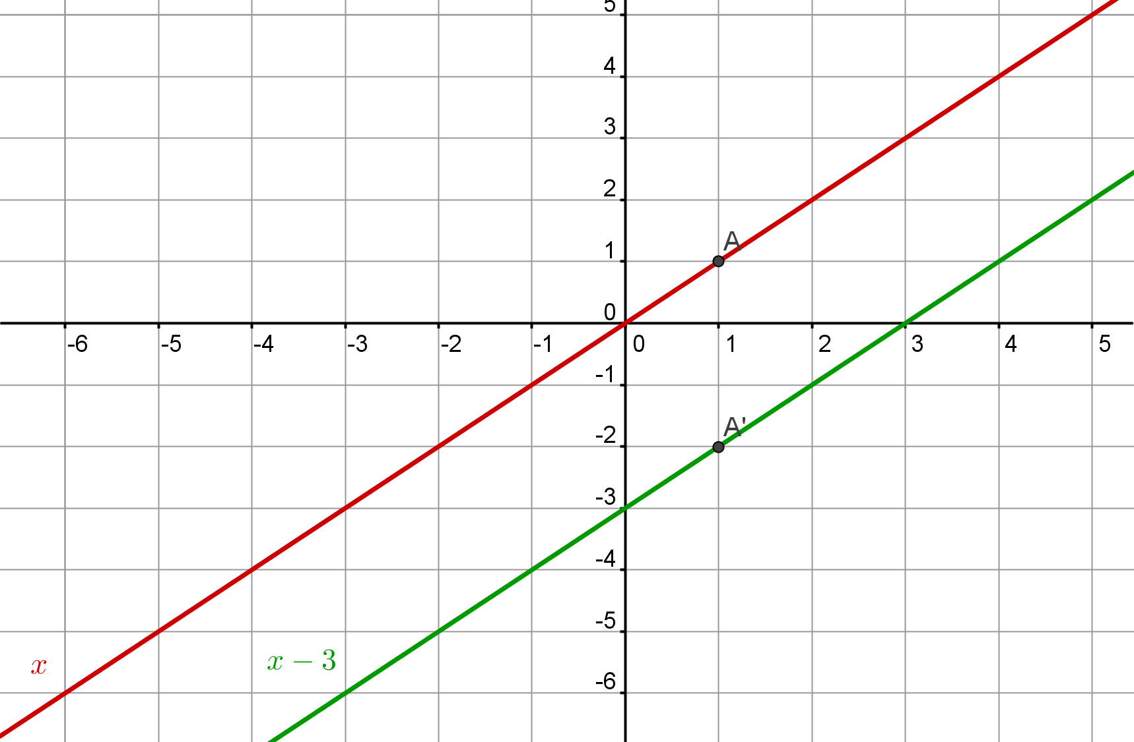
Notes:
Cliceáil le nótaí a bhreacadh

Slide 3
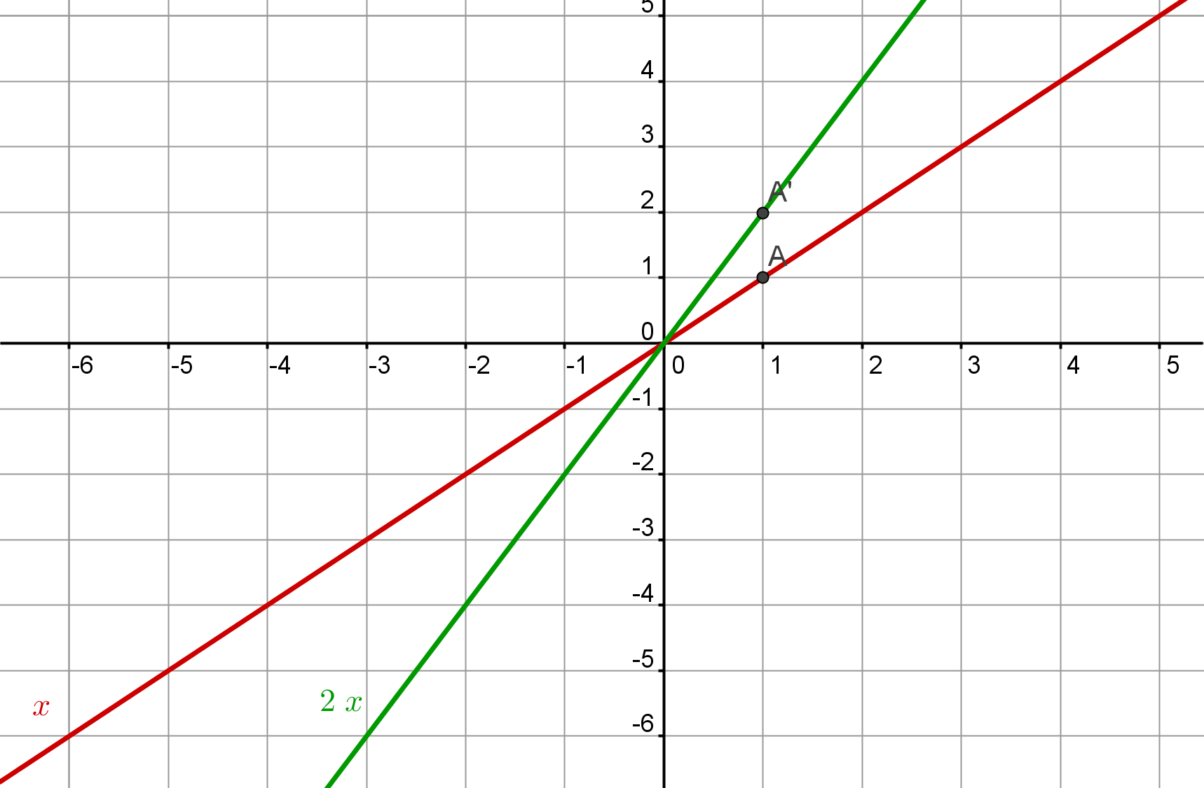
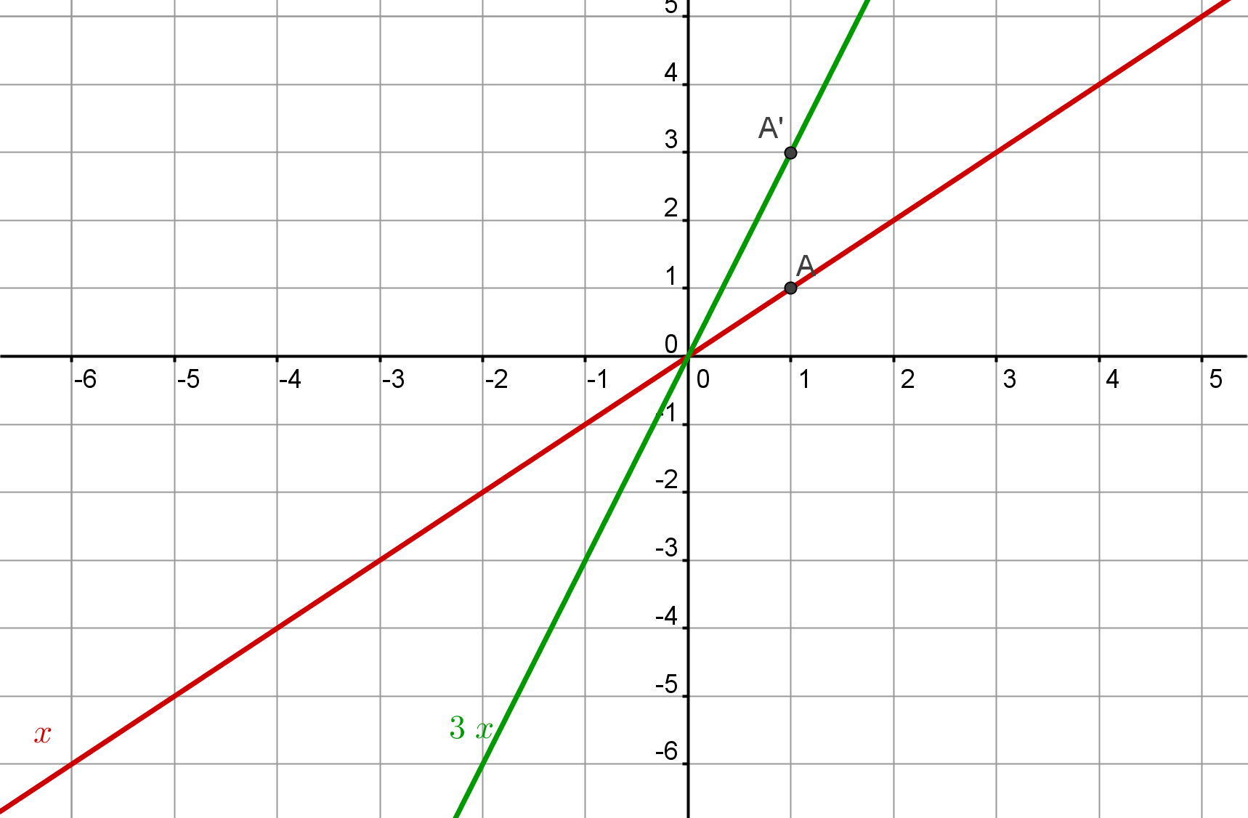
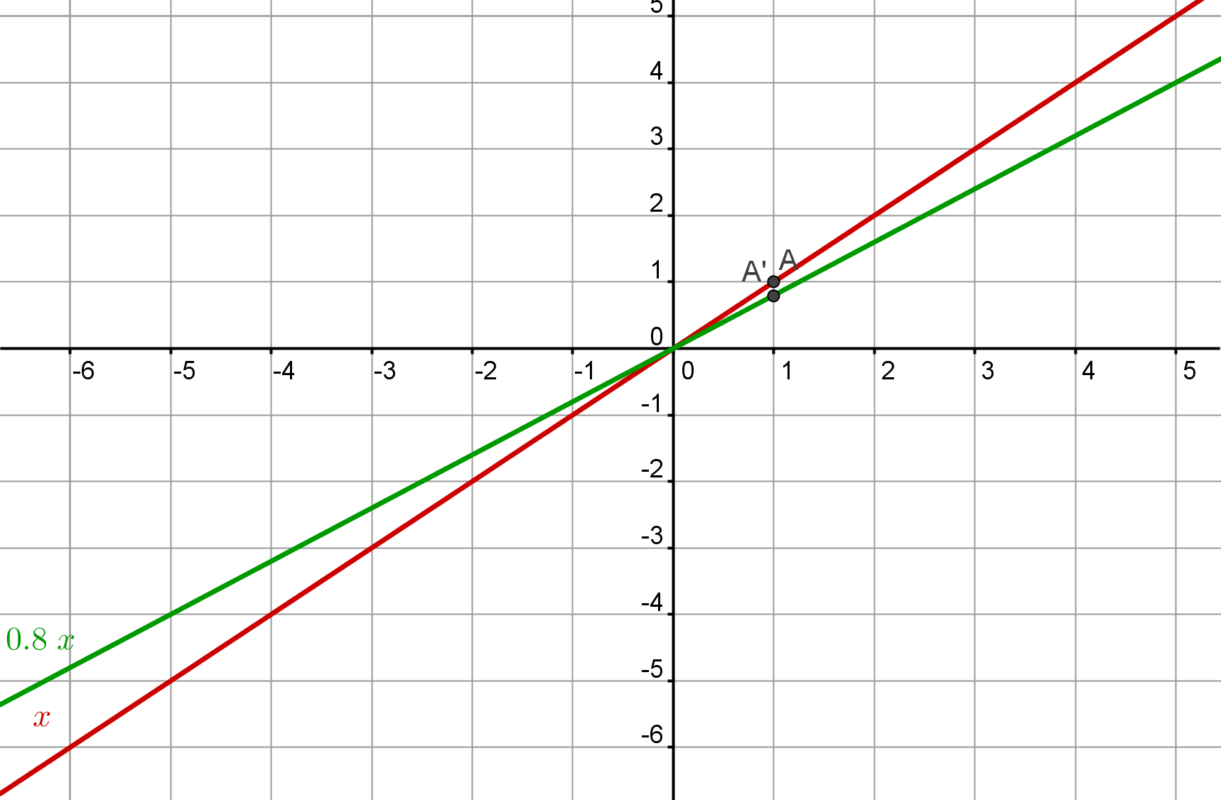
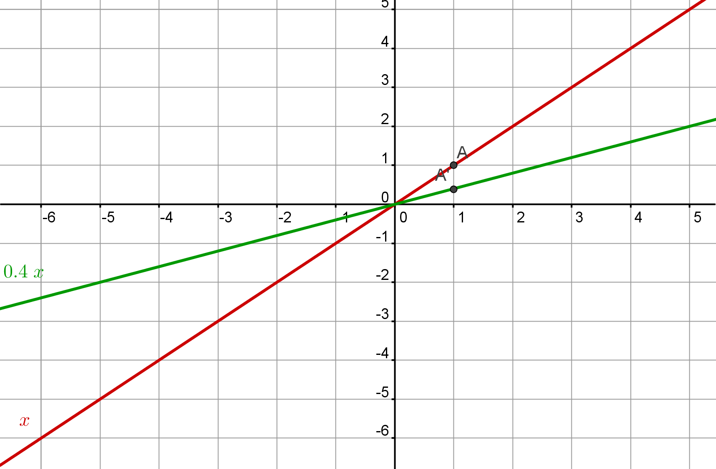
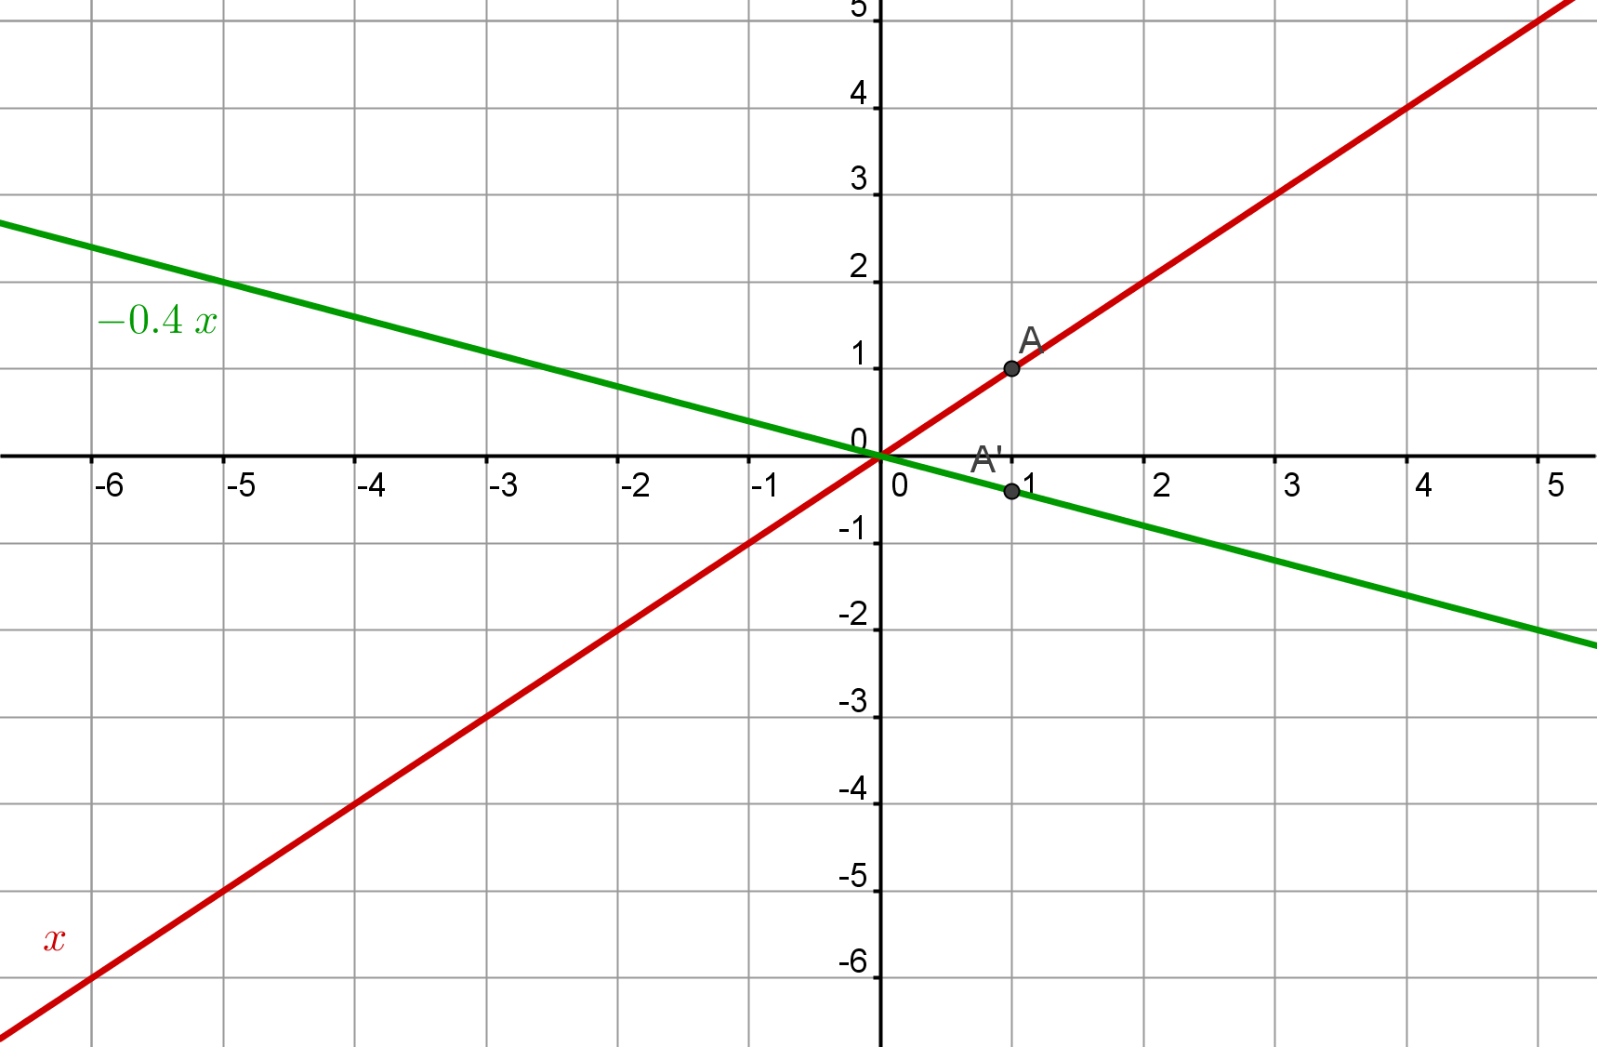
Notes:
Cliceáil le nótaí a bhreacadh

Slide 4
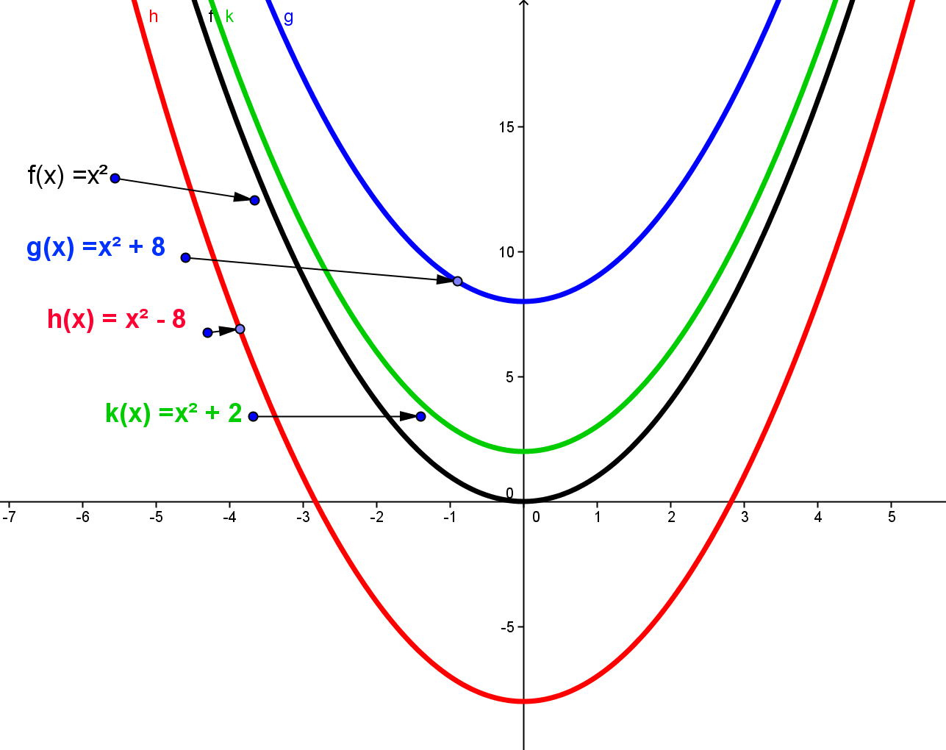
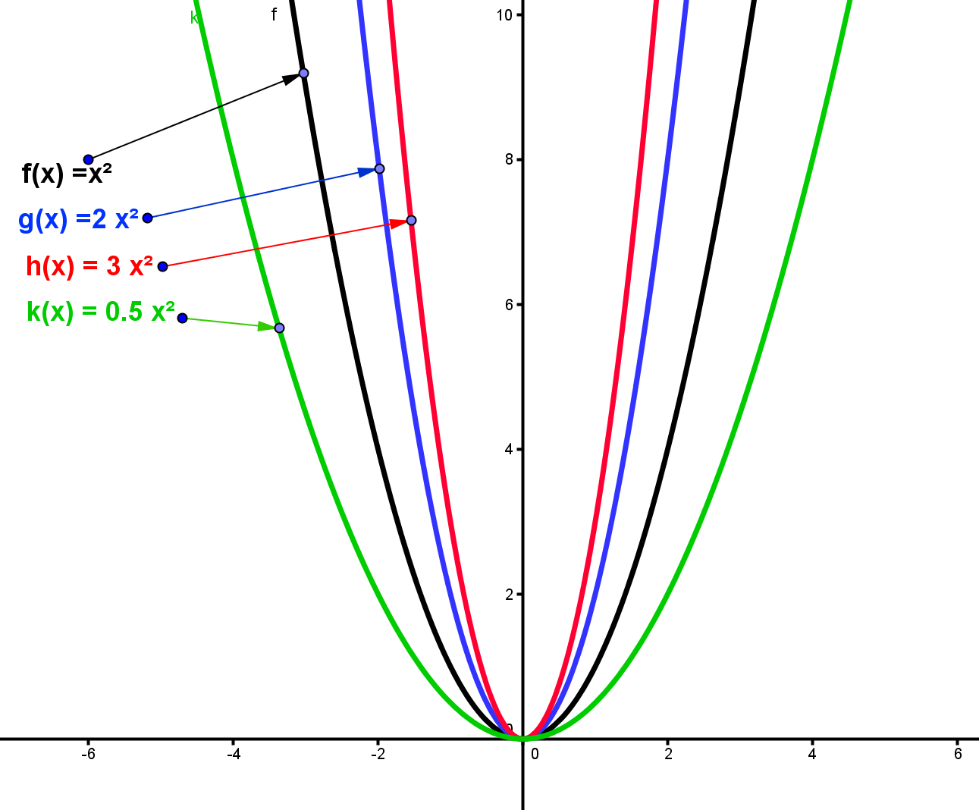
Aistriú
agus
Scálú
Feidhmeanna
Notes:
Cliceáil le nótaí a bhreacadh

Slide 5
Gníomhaíocht 1
Gníomhaíocht A | Leathanach 31
Gníomhaíocht B
Gníomhaíocht C | Leathanach 32
Gníomhaíocht D
Gníomhaíocht E | Leathanach 33
Gníomhaíocht F
Gníomhaíocht G | Leathanach 34
Notes:
Cliceáil le nótaí a bhreacadh

Slide 6
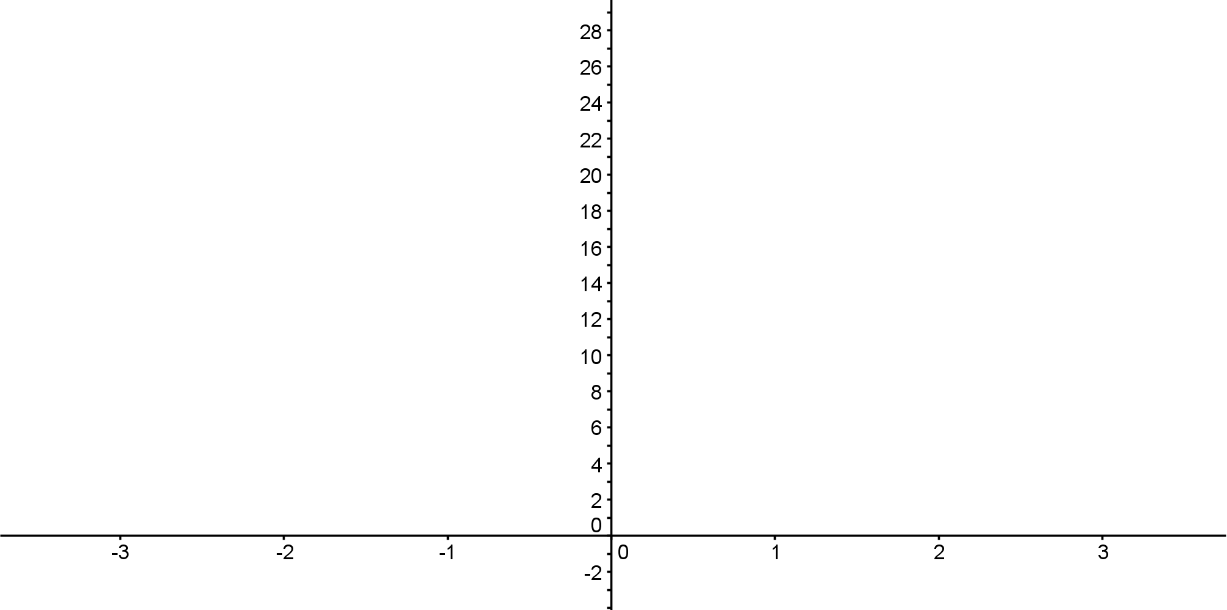
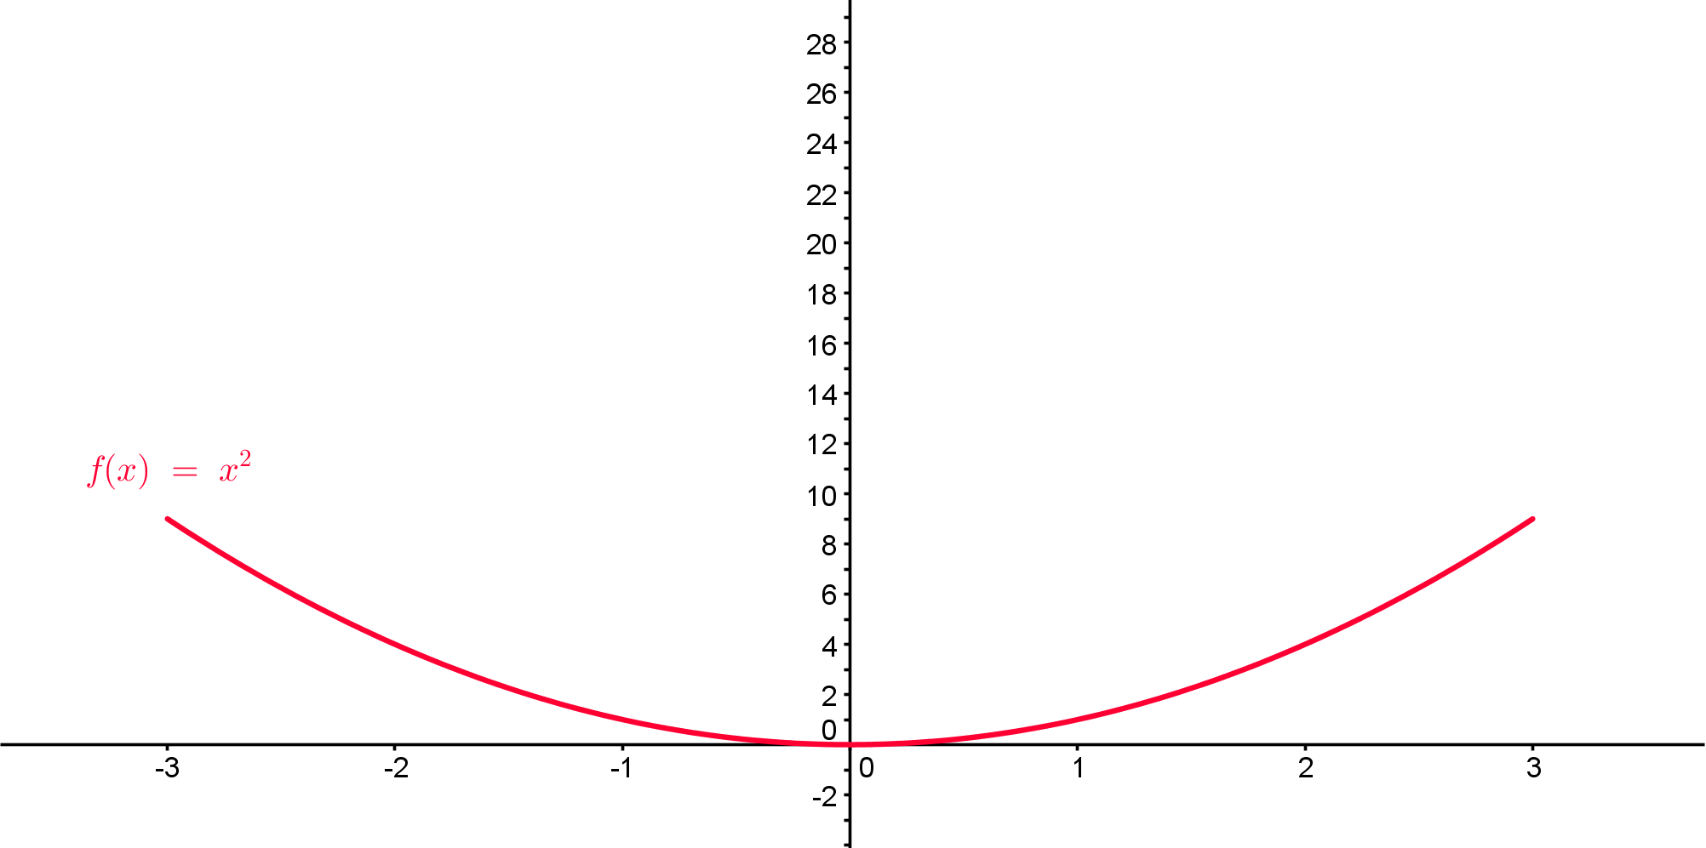
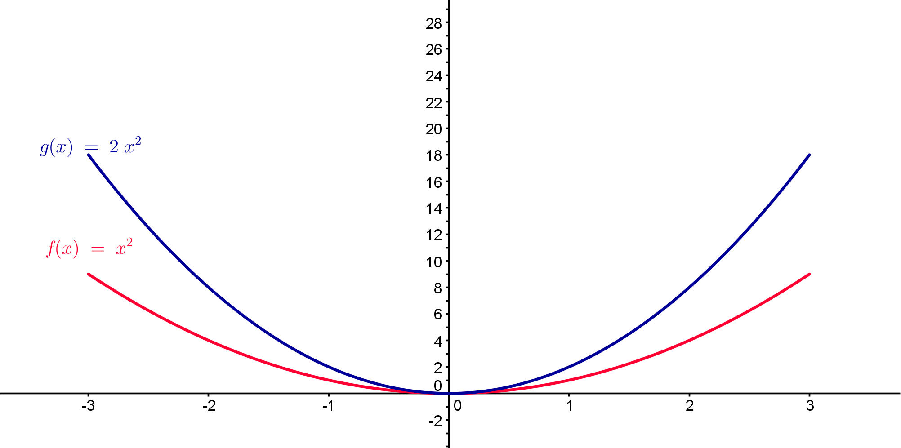
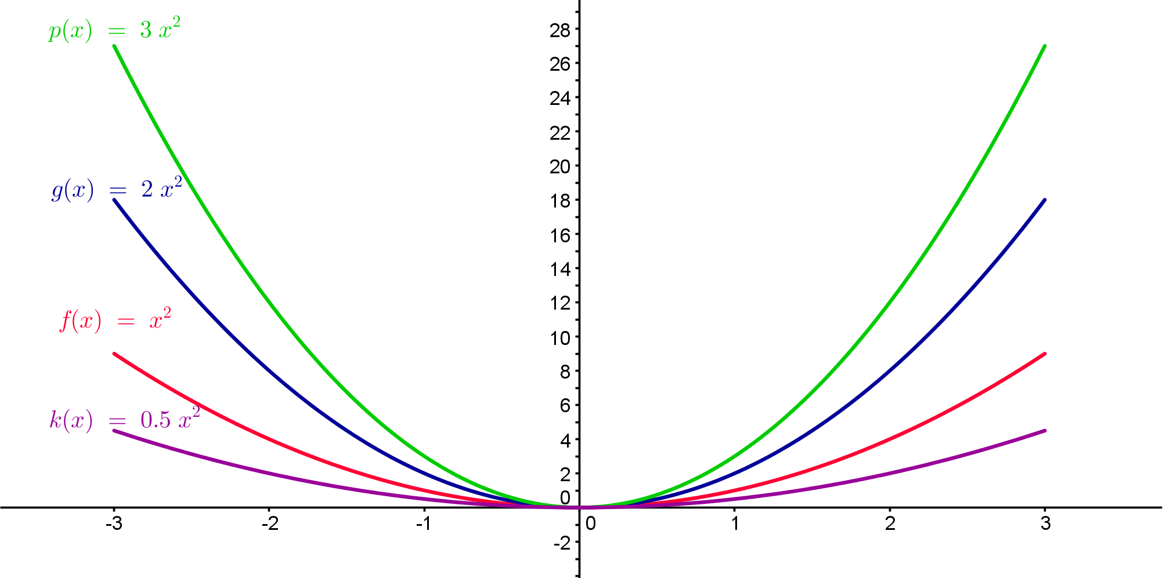
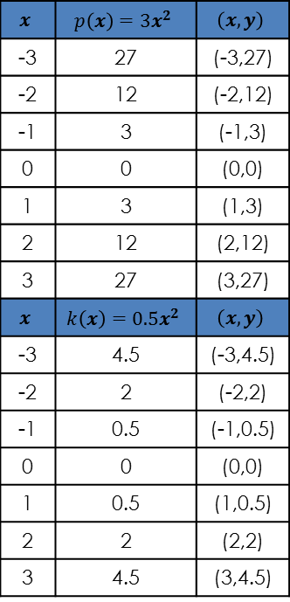
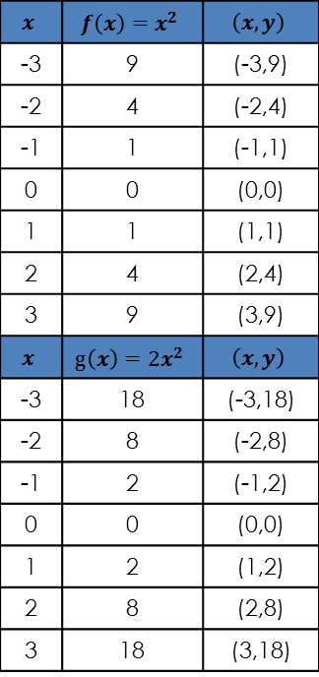
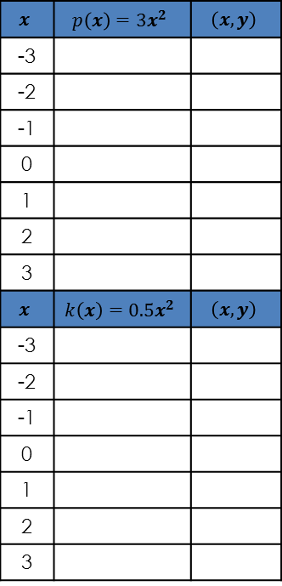
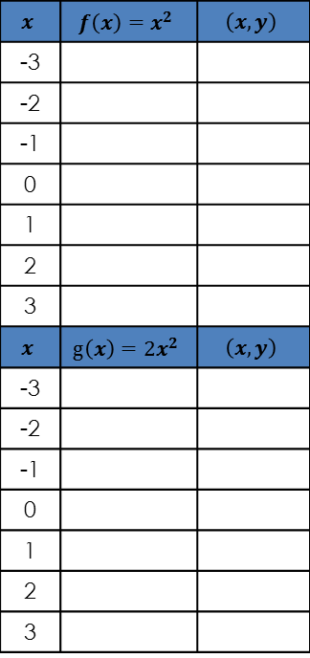

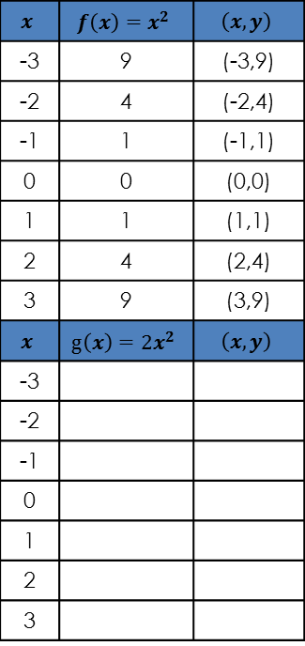
Trasfhoirmiú na Cothromóide Cearnaí
Gníomhaíocht 1A $f\left(x\right)=ax^{2}$
$$x$$ | $$f\left(x\right)=x^{2}$$ | $$\left(x,y\right)$$
-3
-2
-1
0
1
2
3
$$x$$ | $$g\left(x\right)=2x^{2}$$ | $$\left(x,y\right)$$
-3
-2
-1
0
1
2
3
$$x$$ | $$f\left(x\right)=x^{2}$$ | $$\left(x,y\right)$$
-3 | 9 | (-3,9)
-2 | 4 | (-2,4)
-1 | 1 | (-1,1)
0 | 0 | (0,0)
1 | 1 | (1,1)
2 | 4 | (2,4)
3 | 9 | (3,9)
$$x$$ | $$g\left(x\right)=2x^{2}$$ | $$\left(x,y\right)$$
-3 | 18 | (-3,18)
-2 | 8 | (-2,8)
-1 | 2 | (-1,2)
0 | 0 | (0,0)
1 | 2 | (1,2)
2 | 8 | (2,8)
3 | 18 | (3,18)
$$x$$ | $$f\left(x\right)=x^{2}$$ | $$\left(x,y\right)$$
-3 | 9 | (-3,9)
-2 | 4 | (-2,4)
-1 | 1 | (-1,1)
0 | 0 | (0,0)
1 | 1 | (1,1)
2 | 4 | (2,4)
3 | 9 | (3,9)
$$x$$ | $$g\left(x\right)=2x^{2}$$ | $$\left(x,y\right)$$
-3
-2
-1
0
1
2
3
$$x$$ | $$p\left(x\right)=3x^{2}$$ | $$\left(x,y\right)$$
-3
-2
-1
0
1
2
3
$$x$$ | $$k\left(x\right)={0.5x}^{2}$$ | $$\left(x,y\right)$$
-3
-2
-1
0
1
2
3
$$x$$ | $$p\left(x\right)=3x^{2}$$ | $$\left(x,y\right)$$
-3 | 27 | (-3,27)
-2 | 12 | (-2,12)
-1 | 3 | (-1,3)
0 | 0 | (0,0)
1 | 3 | (1,3)
2 | 12 | (2,12)
3 | 27 | (3,27)
$$x$$ | $$k\left(x\right)={0.5x}^{2}$$ | $$\left(x,y\right)$$
-3 | 4.5 | (-3,4.5)
-2 | 2 | (-2,2)
-1 | 0.5 | (-1,0.5)
0 | 0 | (0,0)
1 | 0.5 | (1,0.5)
2 | 2 | (2,2)
3 | 4.5 | (3,4.5)
Cén éifeacht a bhíonn ag “a” ar $g(x)=af(x)=ax2 ?$
31
Notes:
Cliceáil le nótaí a bhreacadh

Slide 7
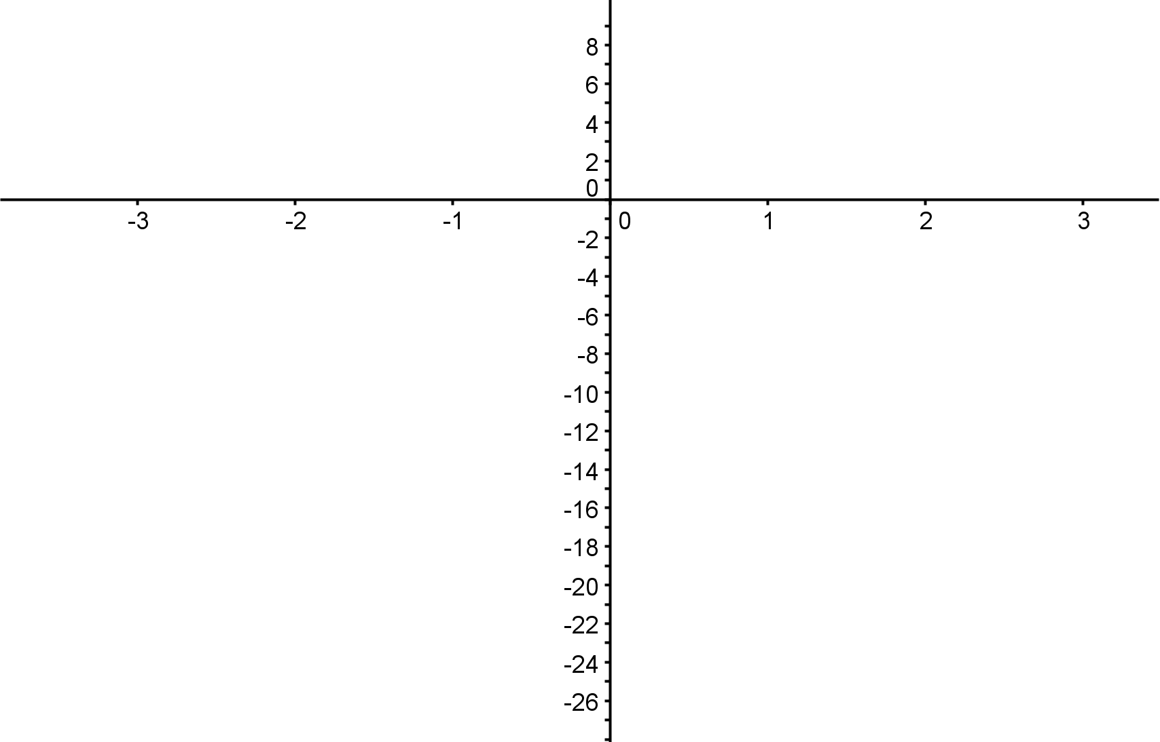
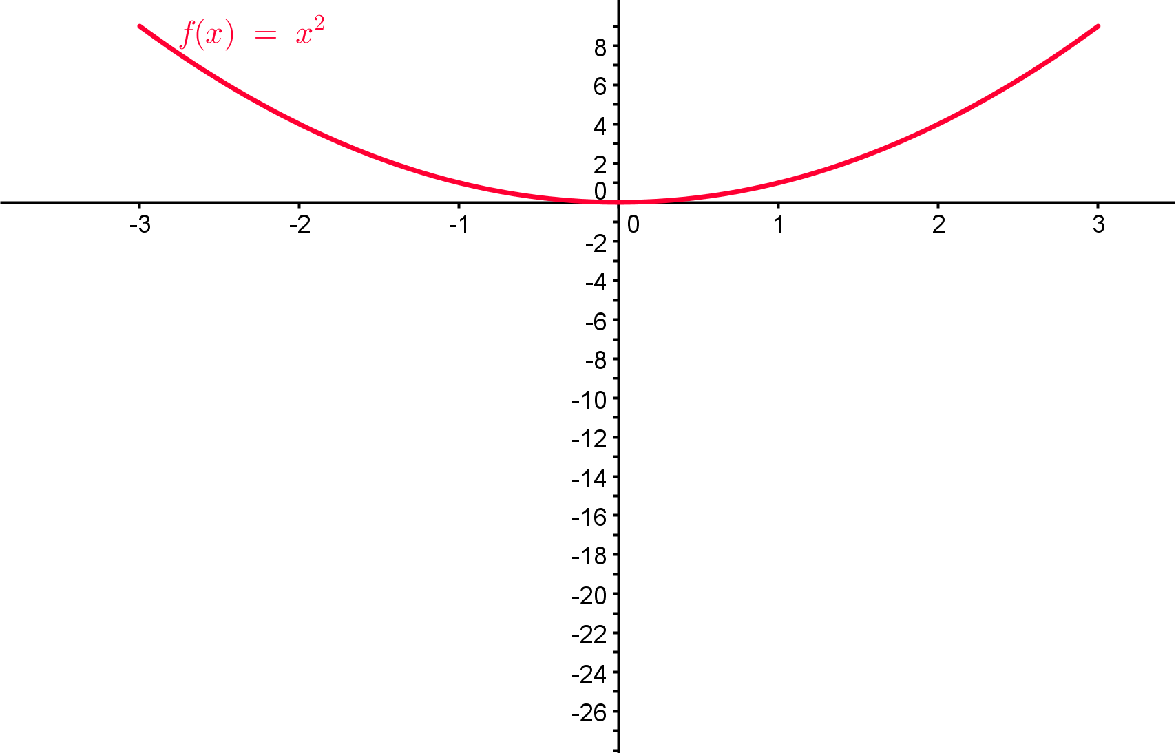
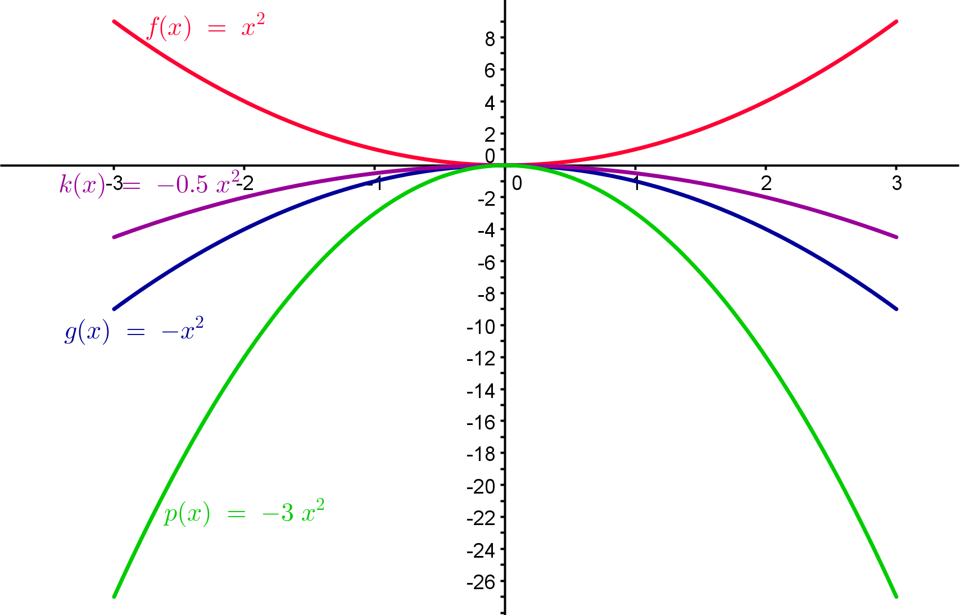

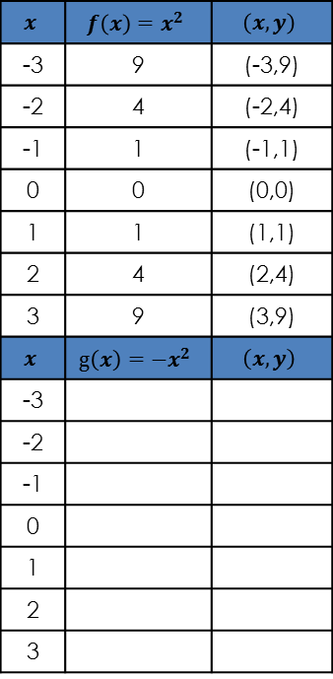
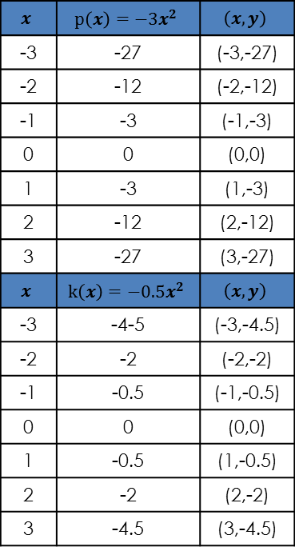
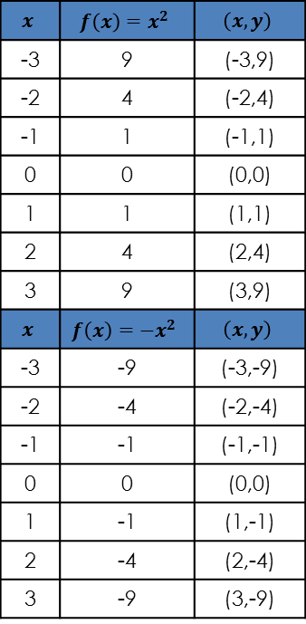
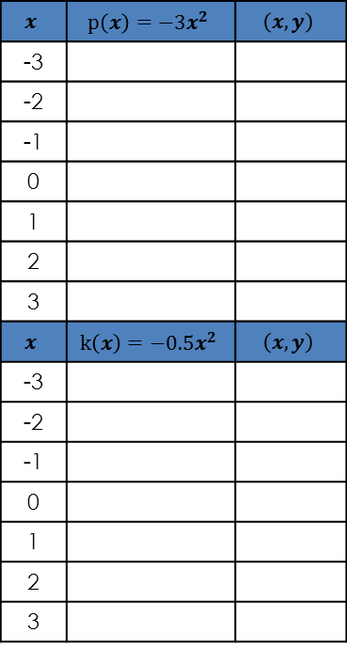
Trasfhoirmiú na Cothromóide Cearnaí
Gníomhaíocht 1B $f\left(x\right)=ax^{2}$
$$x$$ | $$f\left(x\right)=x^{2}$$ | $$\left(x,y\right)$$
-3 | 9 | (-3,9)
-2 | 4 | (-2,4)
-1 | 1 | (-1,1)
0 | 0 | (0,0)
1 | 1 | (1,1)
2 | 4 | (2,4)
3 | 9 | (3,9)
$$x$$ | $$f\left(x\right)=−x^{2}$$ | $$\left(x,y\right)$$
-3 | -9 | (-3,-9)
-2 | -4 | (-2,-4)
-1 | -1 | (-1,-1)
0 | 0 | (0,0)
1 | -1 | (1,-1)
2 | -4 | (2,-4)
3 | -9 | (3,-9)
$$x$$ | $$f\left(x\right)=x^{2}$$ | $$\left(x,y\right)$$
-3 | 9 | (-3,9)
-2 | 4 | (-2,4)
-1 | 1 | (-1,1)
0 | 0 | (0,0)
1 | 1 | (1,1)
2 | 4 | (2,4)
3 | 9 | (3,9)
$$x$$ | $$g\left(x\right)=−x^{2}$$ | $$\left(x,y\right)$$
-3
-2
-1
0
1
2
3
$$x$$ | $$p\left(x\right)=−3x^{2}$$ | $$\left(x,y\right)$$
-3
-2
-1
0
1
2
3
$$x$$ | $$k\left(x\right)={−0.5x}^{2}$$ | $$\left(x,y\right)$$
-3
-2
-1
0
1
2
3
$$x$$ | $$p\left(x\right)=−3x^{2}$$ | $$\left(x,y\right)$$
-3 | -27 | (-3,-27)
-2 | -12 | (-2,-12)
-1 | -3 | (-1,-3)
0 | 0 | (0,0)
1 | -3 | (1,-3)
2 | -12 | (2,-12)
3 | -27 | (3,-27)
$$x$$ | $$k\left(x\right)=−{0.5x}^{2}$$ | $$\left(x,y\right)$$
-3 | -4-5 | (-3,-4.5)
-2 | -2 | (-2,-2)
-1 | -0.5 | (-1,-0.5)
0 | 0 | (0,0)
1 | -0.5 | (1,-0.5)
2 | -2 | (2,-2)
3 | -4.5 | (3,-4.5)
Cén éifeacht a bhíonn ag “a” ar $g(x)=af(x)=ax2 ?$
31
Notes:
Cliceáil le nótaí a bhreacadh

Slide 8
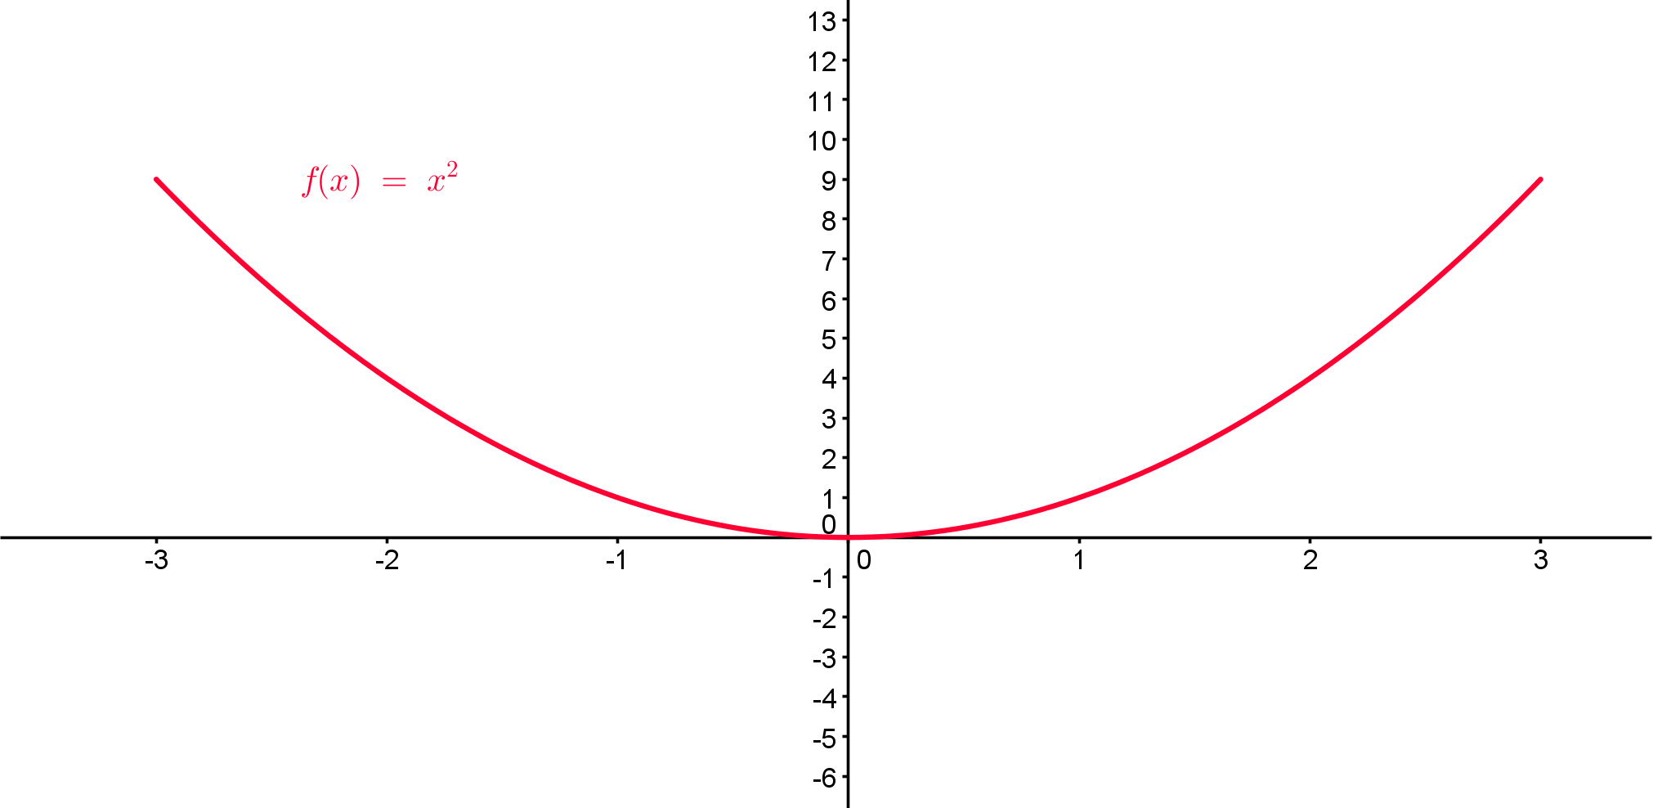
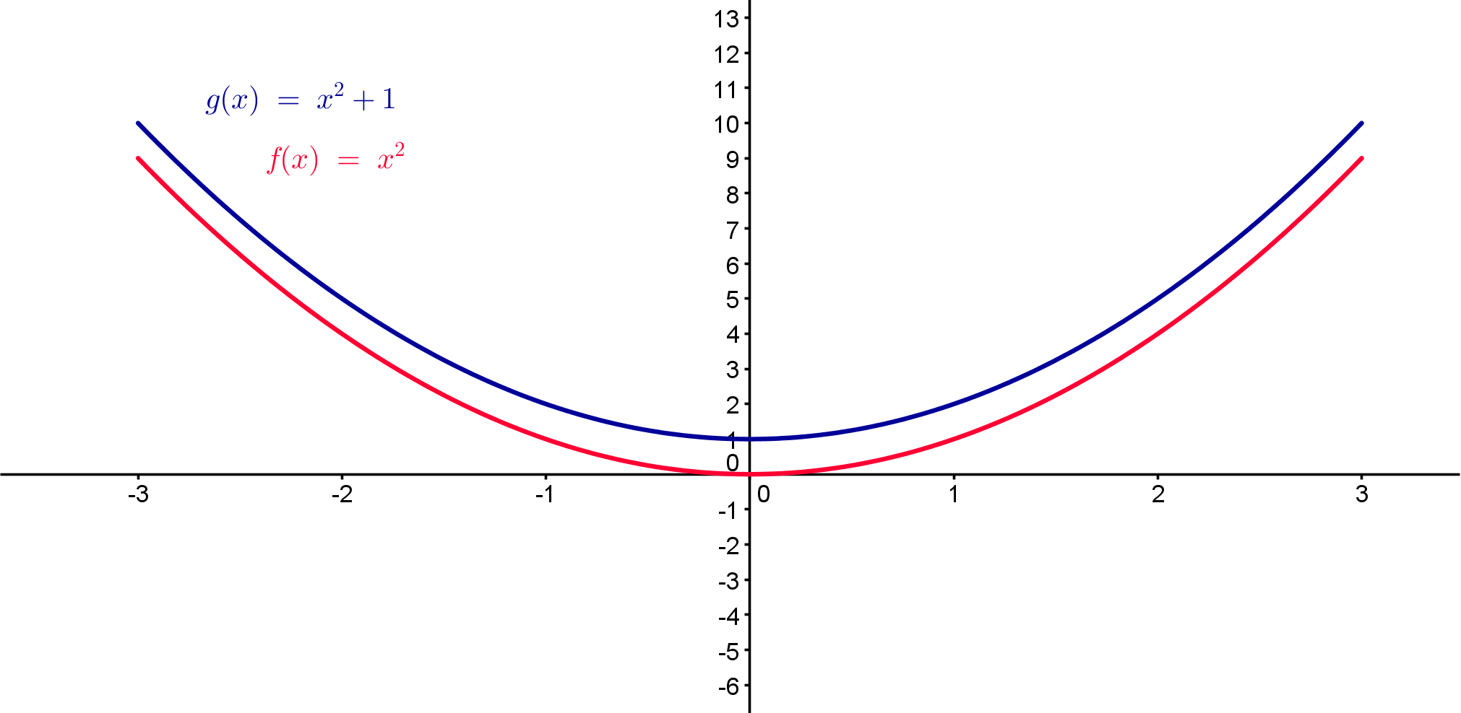
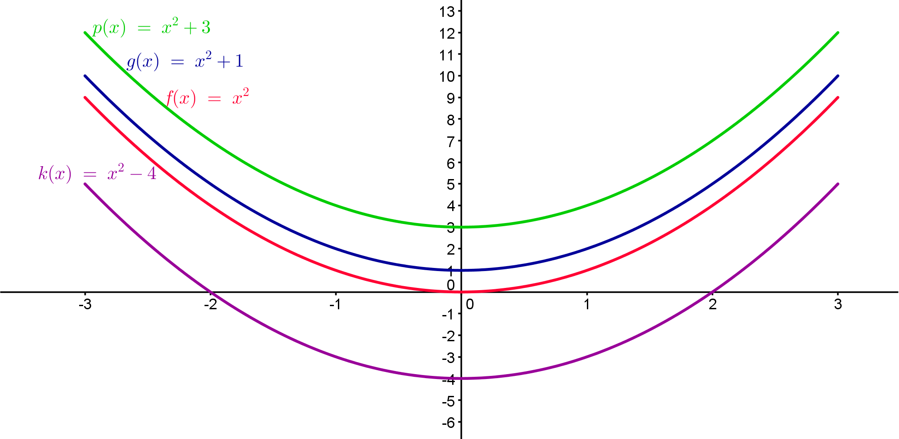
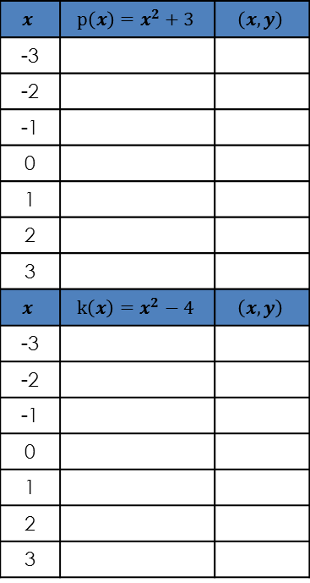
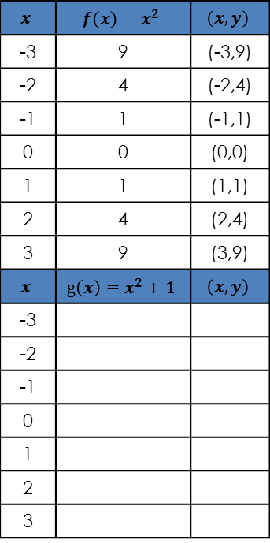
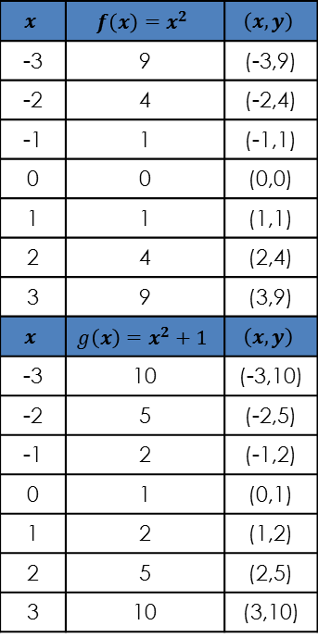
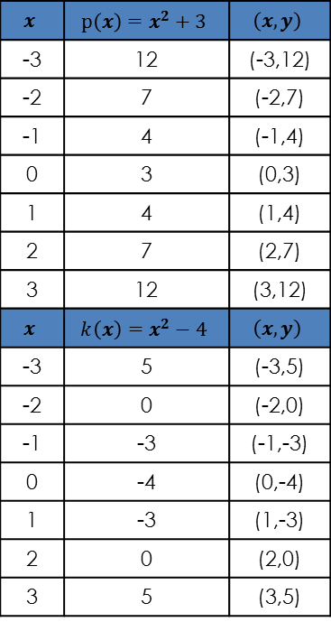

Trasfhoirmiú na Cothromóide Cearnaí
Gníomhaíocht 1C $f\left(x\right)=x^{2}+c$
$$x$$ | $$f\left(x\right)=x^{2}$$ | $$\left(x,y\right)$$
-3 | 9 | (-3,9)
-2 | 4 | (-2,4)
-1 | 1 | (-1,1)
0 | 0 | (0,0)
1 | 1 | (1,1)
2 | 4 | (2,4)
3 | 9 | (3,9)
$$x$$ | $$g\left(x\right)=x^{2}+1$$ | $$\left(x,y\right)$$
-3 | 10 | (-3,10)
-2 | 5 | (-2,5)
-1 | 2 | (-1,2)
0 | 1 | (0,1)
1 | 2 | (1,2)
2 | 5 | (2,5)
3 | 10 | (3,10)
$$x$$ | $$f\left(x\right)=x^{2}$$ | $$\left(x,y\right)$$
-3 | 9 | (-3,9)
-2 | 4 | (-2,4)
-1 | 1 | (-1,1)
0 | 0 | (0,0)
1 | 1 | (1,1)
2 | 4 | (2,4)
3 | 9 | (3,9)
$$x$$ | $$g\left(x\right)=x^{2}+1$$ | $$\left(x,y\right)$$
-3
-2
-1
0
1
2
3
$$x$$ | $$p\left(x\right)=x^{2}+3$$ | $$\left(x,y\right)$$
-3
-2
-1
0
1
2
3
$$x$$ | $$k\left(x\right)=x^{2}−4$$ | $$\left(x,y\right)$$
-3
-2
-1
0
1
2
3
$$x$$ | $$p\left(x\right)=x^{2}+3$$ | $$\left(x,y\right)$$
-3 | 12 | (-3,12)
-2 | 7 | (-2,7)
-1 | 4 | (-1,4)
0 | 3 | (0,3)
1 | 4 | (1,4)
2 | 7 | (2,7)
3 | 12 | (3,12)
$$x$$ | $$k\left(x\right)=x^{2}−4$$ | $$\left(x,y\right)$$
-3 | 5 | (-3,5)
-2 | 0 | (-2,0)
-1 | -3 | (-1,-3)
0 | -4 | (0,-4)
1 | -3 | (1,-3)
2 | 0 | (2,0)
3 | 5 | (3,5)
Cén éifeacht a bhíonn ag “c” ar $g\left(x\right)= f\left(x\right)+c = x2 +c$ ?
32
Notes:
Cliceáil le nótaí a bhreacadh

Slide 9
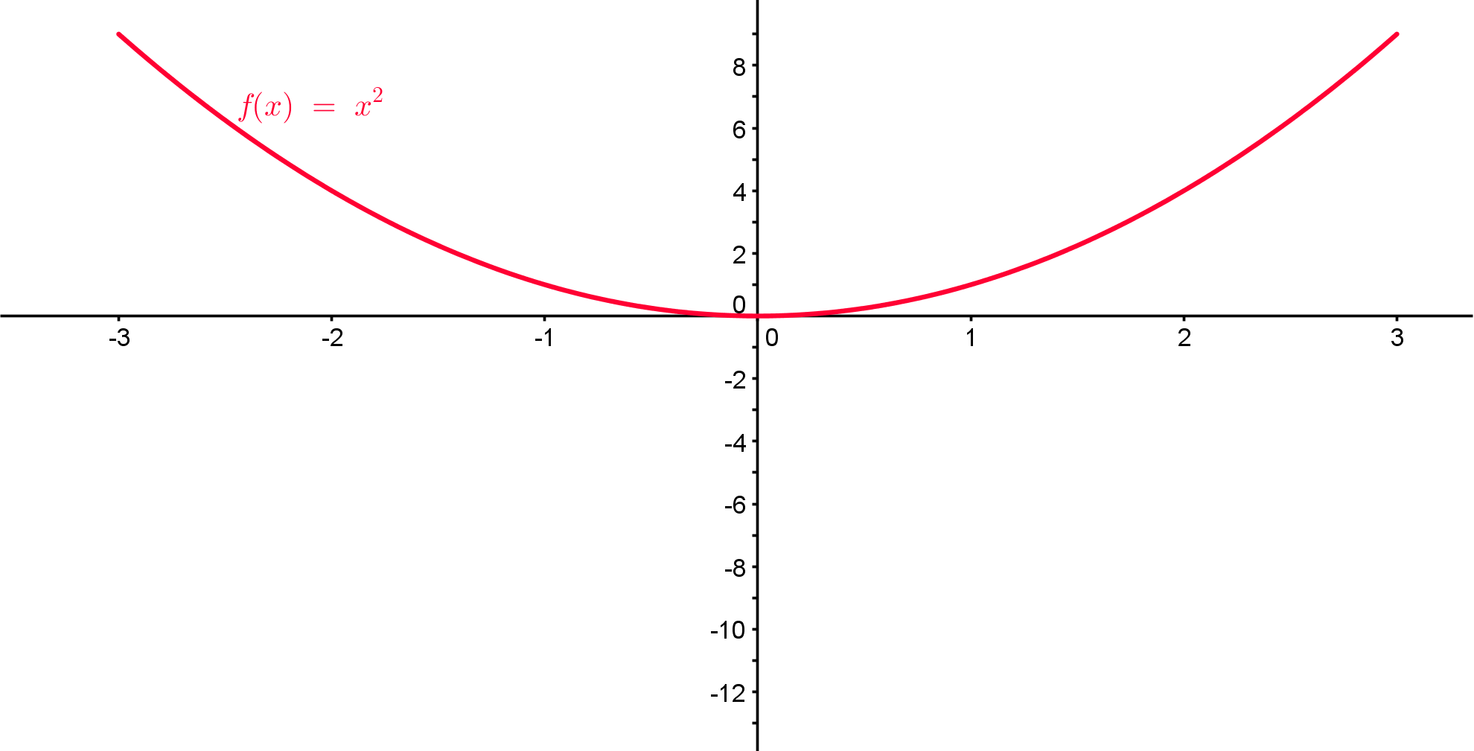
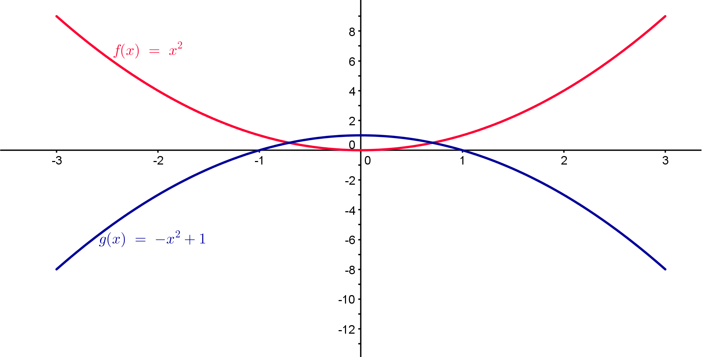
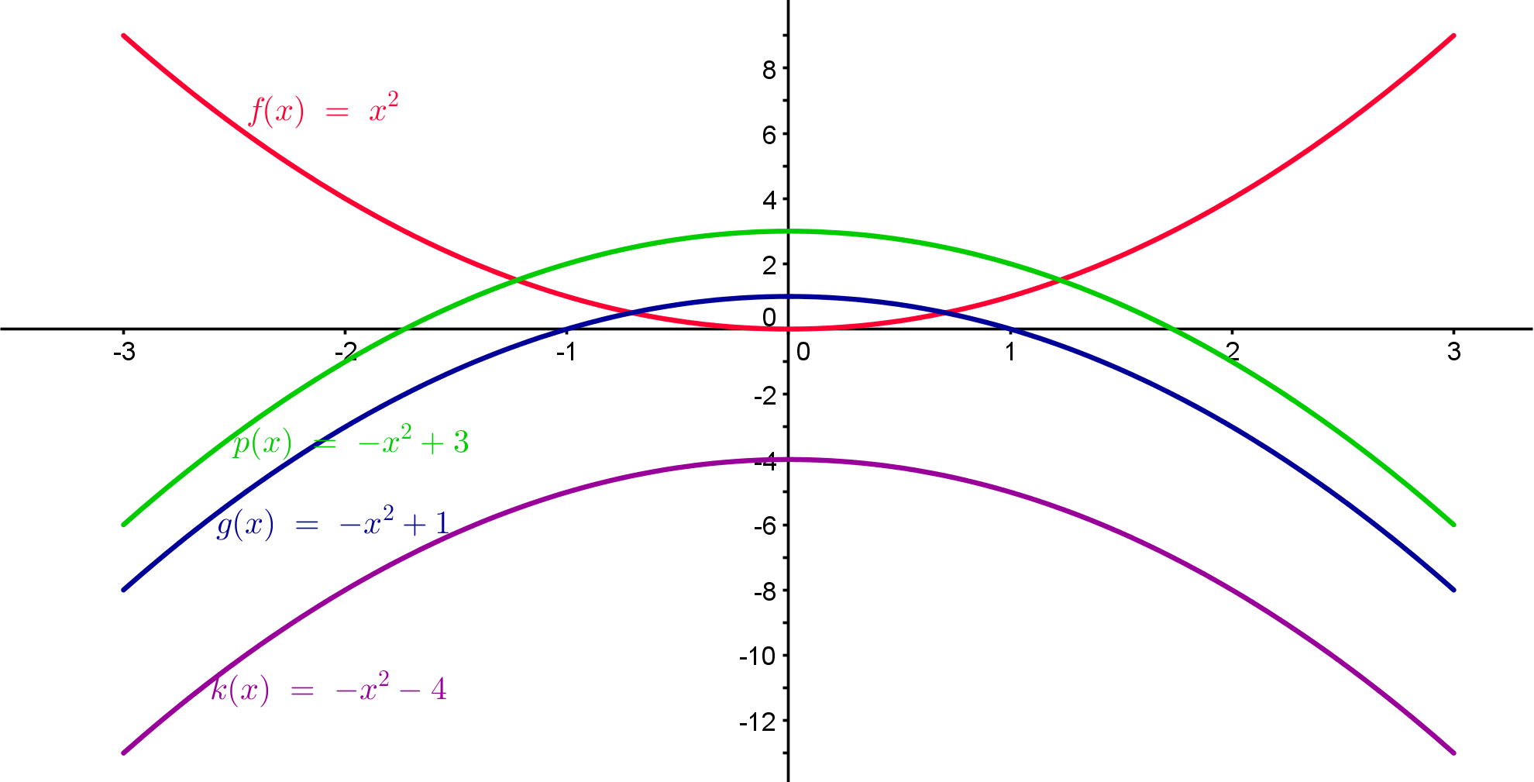
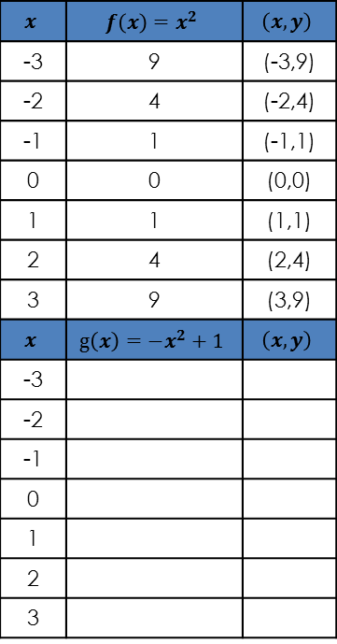
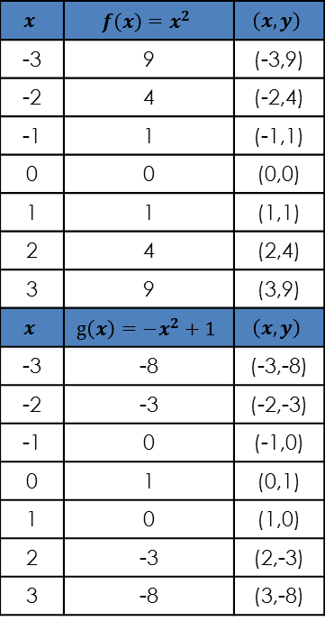
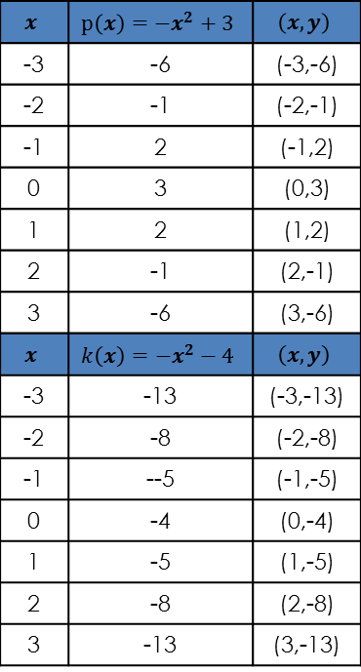

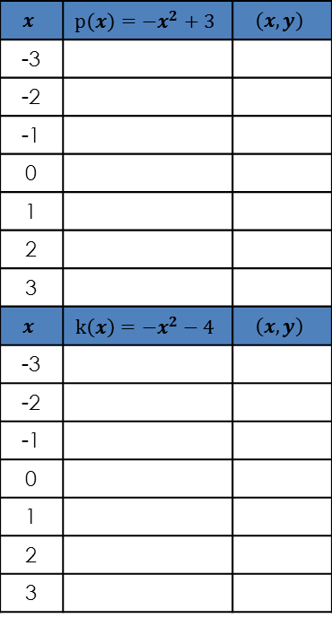
Trasfhoirmiú na Cothromóide Cearnaí
Gníomhaíocht 1D $f\left(x\right)=−x^{2}+c$
$$x$$ | $$f\left(x\right)=x^{2}$$ | $$\left(x,y\right)$$
-3 | 9 | (-3,9)
-2 | 4 | (-2,4)
-1 | 1 | (-1,1)
0 | 0 | (0,0)
1 | 1 | (1,1)
2 | 4 | (2,4)
3 | 9 | (3,9)
$$x$$ | $$g\left(x\right)={−x}^{2}+1$$ | $$\left(x,y\right)$$
-3 | -8 | (-3,-8)
-2 | -3 | (-2,-3)
-1 | 0 | (-1,0)
0 | 1 | (0,1)
1 | 0 | (1,0)
2 | -3 | (2,-3)
3 | -8 | (3,-8)
$$x$$ | $$f\left(x\right)=x^{2}$$ | $$\left(x,y\right)$$
-3 | 9 | (-3,9)
-2 | 4 | (-2,4)
-1 | 1 | (-1,1)
0 | 0 | (0,0)
1 | 1 | (1,1)
2 | 4 | (2,4)
3 | 9 | (3,9)
$$x$$ | $$g\left(x\right)={−x}^{2}+1$$ | $$\left(x,y\right)$$
-3
-2
-1
0
1
2
3
$$x$$ | $$p\left(x\right)=−x^{2}+3$$ | $$\left(x,y\right)$$
-3
-2
-1
0
1
2
3
$$x$$ | $$k\left(x\right)=−x^{2}−4$$ | $$\left(x,y\right)$$
-3
-2
-1
0
1
2
3
$$x$$ | $$p\left(x\right)={−x}^{2}+3$$ | $$\left(x,y\right)$$
-3 | -6 | (-3,-6)
-2 | -1 | (-2,-1)
-1 | 2 | (-1,2)
0 | 3 | (0,3)
1 | 2 | (1,2)
2 | -1 | (2,-1)
3 | -6 | (3,-6)
$$x$$ | $$k\left(x\right)=−x^{2}−4$$ | $$\left(x,y\right)$$
-3 | -13 | (-3,-13)
-2 | -8 | (-2,-8)
-1 | --5 | (-1,-5)
0 | -4 | (0,-4)
1 | -5 | (1,-5)
2 | -8 | (2,-8)
3 | -13 | (3,-13)
Cén éifeacht a bhíonn ag “c” ar $g(x)=f(x)+c=−x^{2}+c$ ?
32
Notes:
Cliceáil le nótaí a bhreacadh

Slide 10
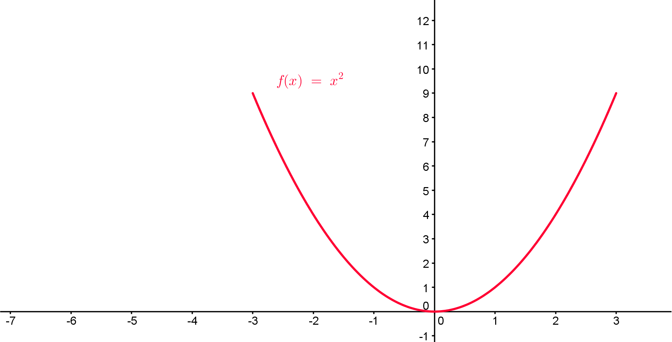
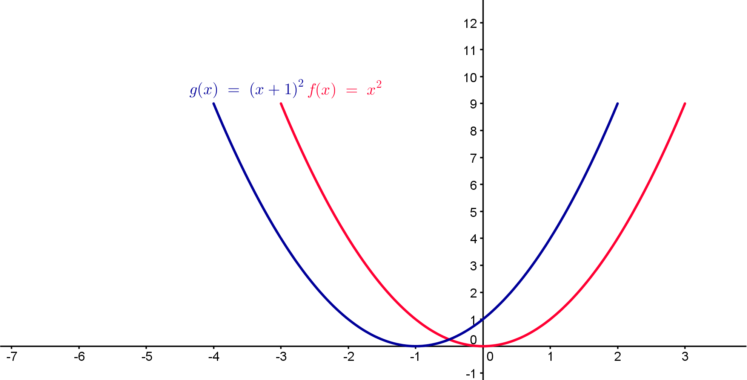
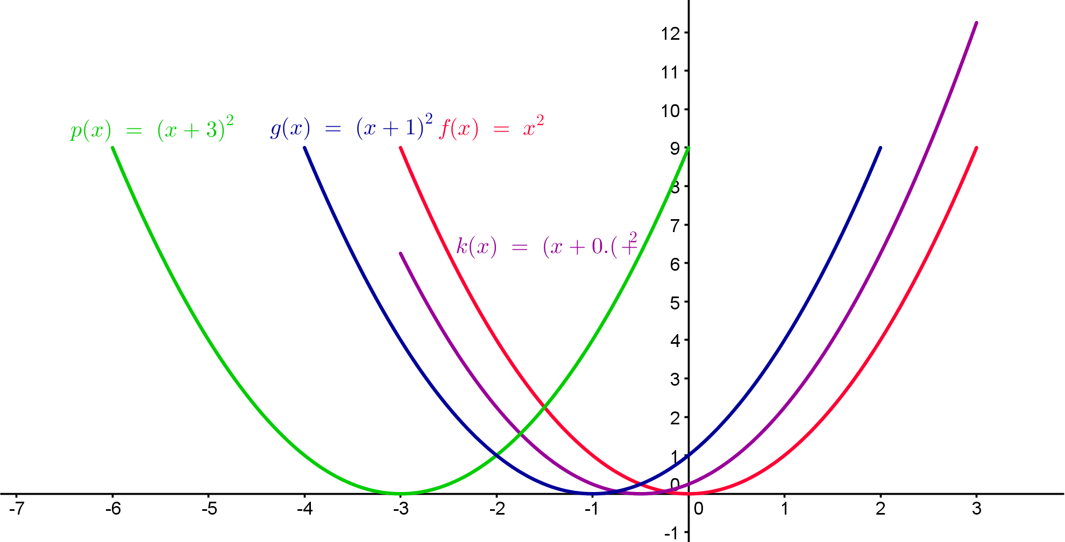
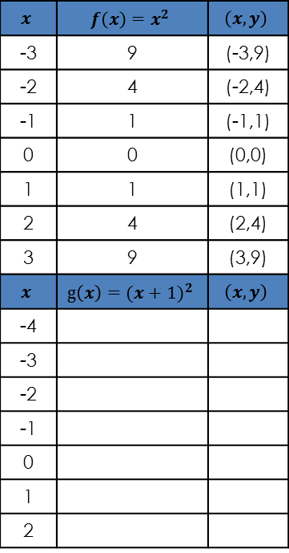

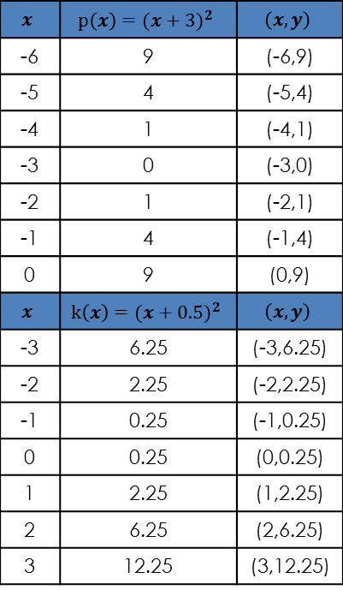
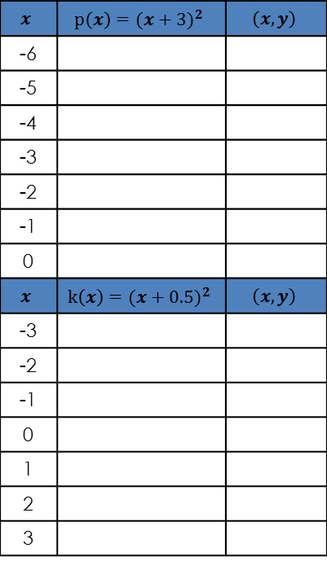
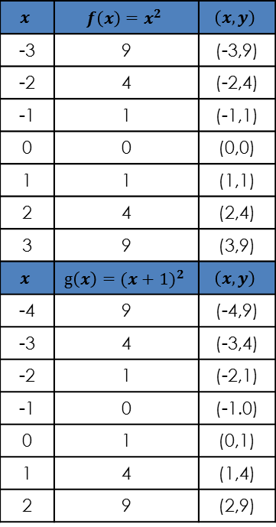
Trasfhoirmiú na Cothromóide Cearnaí
Gníomhaíocht 1E $f\left(x\right)=({x+a)}^{2}$
$$x$$ | $$f\left(x\right)=x^{2}$$ | $$\left(x,y\right)$$
-3 | 9 | (-3,9)
-2 | 4 | (-2,4)
-1 | 1 | (-1,1)
0 | 0 | (0,0)
1 | 1 | (1,1)
2 | 4 | (2,4)
3 | 9 | (3,9)
$$x$$ | $$g\left(x\right)={(x+1)}^{2}$$ | $$\left(x,y\right)$$
-4
-3
-2
-1
0
1
2
$$x$$ | $$f\left(x\right)=x^{2}$$ | $$\left(x,y\right)$$
-3 | 9 | (-3,9)
-2 | 4 | (-2,4)
-1 | 1 | (-1,1)
0 | 0 | (0,0)
1 | 1 | (1,1)
2 | 4 | (2,4)
3 | 9 | (3,9)
$$x$$ | $$g\left(x\right)={(x+1)}^{2}$$ | $$\left(x,y\right)$$
-4 | 9 | (-4,9)
-3 | 4 | (-3,4)
-2 | 1 | (-2,1)
-1 | 0 | (-1.0)
0 | 1 | (0,1)
1 | 4 | (1,4)
2 | 9 | (2,9)
$$x$$ | $$p\left(x\right)=({x+3)}^{2}$$ | $$\left(x,y\right)$$
-6
-5
-4
-3
-2
-1
0
$$x$$ | $$k\left(x\right)=({x+0.5)}^{2}$$ | $$\left(x,y\right)$$
-3
-2
-1
0
1
2
3
$$x$$ | $$p\left(x\right)=({x+3)}^{2}$$ | $$\left(x,y\right)$$
-6 | 9 | (-6,9)
-5 | 4 | (-5,4)
-4 | 1 | (-4,1)
-3 | 0 | (-3,0)
-2 | 1 | (-2,1)
-1 | 4 | (-1,4)
0 | 9 | (0,9)
$$x$$ | $$k\left(x\right)=({x+0.5)}^{2}$$ | $$\left(x,y\right)$$
-3 | 6.25 | (-3,6.25)
-2 | 2.25 | (-2,2.25)
-1 | 0.25 | (-1,0.25)
0 | 0.25 | (0,0.25)
1 | 2.25 | (1,2.25)
2 | 6.25 | (2,6.25)
3 | 12.25 | (3,12.25)
Cén éifeacht a bhíonn ag “a” ar $g\left(x\right)=f\left(x+a\right)={\left(x+a\right)}^{2}$ ?
33
Notes:
Cliceáil le nótaí a bhreacadh

Slide 11
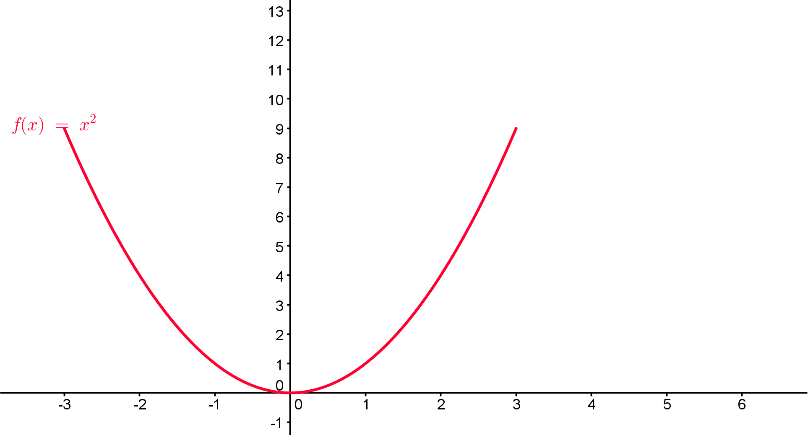







Trasfhoirmiú na Cothromóide Cearnaí
Gníomhaíocht 1F $f\left(x\right)=({x−a)}^{2}$
$$x$$ | $$f\left(x\right)=x^{2}$$ | $$\left(x,y\right)$$
-3 | 9 | (-3,9)
-2 | 4 | (-2,4)
-1 | 1 | (-1,1)
0 | 0 | (0,0)
1 | 1 | (1,1)
2 | 4 | (2,4)
3 | 9 | (3,9)
$$x$$ | $$g\left(x\right)={(x−1)}^{2}$$ | $$\left(x,y\right)$$
-2
-1
0
1
2
3
4
$$x$$ | $$f\left(x\right)=x^{2}$$ | $$\left(x,y\right)$$
-3 | 9 | (-3,9)
-2 | 4 | (-2,4)
-1 | 1 | (-1,1)
0 | 0 | (0,0)
1 | 1 | (1,1)
2 | 4 | (2,4)
3 | 9 | (3,9)
$$x$$ | $$g\left(x\right)={(x−1)}^{2}$$ | $$\left(x,y\right)$$
-2 | 9 | (-3,9)
-1 | 4 | (-2,4)
0 | 1 | (-1,1)
1 | 0 | (0,0)
2 | 1 | (1,1)
3 | 4 | (2,4)
4 | 9 | (3,9)
$$x$$ | $$p\left(x\right)=({x−3)}^{2}$$ | $$\left(x,y\right)$$
0
2
3
4
5
6
$$x$$ | $$k\left(x\right)=({x−0.5)}^{2}$$ | $$\left(x,y\right)$$
-3
-2
-1
0
1
2
3
$$x$$ | $$p\left(x\right)=({x−3)}^{2}$$ | $$\left(x,y\right)$$
0 | 9 | (0,9)
1 | 4 | (1,4)
2 | 1 | (2,1)
3 | 0 | (3,0)
4 | 1 | (4,1)
5 | 4 | (5,4)
6 | 9 | (6,9)
$$x$$ | $$k\left(x\right)=({x−0.5)}^{2}$$ | $$\left(x,y\right)$$
-3 | 12.25 | (-3,12.25)
-2 | 6.25 | (-2,6.25)
-1 | 2.25 | (-1,2.25)
0 | 0.25 | (0,0.25)
1 | 0.25 | (1,0.25)
2 | 2.25 | (2,2.25)
3 | 6.25 | (3,6.25)
Cén éifeacht a bhíonn ag “a” ar $g\left(x\right)=f\left(x−a\right)={\left(x−a\right)}^{2}$ ?
33
Notes:
Cliceáil le nótaí a bhreacadh

Slide 12










Trasfhoirmiú na Cothromóide Cearnaí
Gníomhaíocht 1G $f\left(x\right)=({x+a)}^{2}±c?$
$$x$$ | $$f\left(x\right)=x^{2}$$ | $$\left(x,y\right)$$
-3 | 9 | (-3,9)
-2 | 4 | (-2,4)
-1 | 1 | (-1,1)
0 | 0 | (0,0)
1 | 1 | (1,1)
2 | 4 | (2,4)
3 | 9 | (3,9)
$$x$$ | $$g\left(x\right)={(x+1)}^{2}$$ | $$\left(x,y\right)$$
-4
-3
-2
-1
0
1
2
$$x$$ | $$f\left(x\right)=x^{2}$$ | $$\left(x,y\right)$$
-3 | 9 | (-3,9)
-2 | 4 | (-2,4)
-1 | 1 | (-1,1)
0 | 0 | (0,0)
1 | 1 | (1,1)
2 | 4 | (2,4)
3 | 9 | (3,9)
$$x$$ | $$g\left(x\right)={(x+1)}^{2}$$ | $$\left(x,y\right)$$
-4 | 9 | (-4,9)
-3 | 4 | (-3,4)
-2 | 1 | (-2,1)
-1 | 0 | (-1,0)
0 | 1 | (0,1)
1 | 4 | (1,4)
2 | 9 | (2,9)
$$x$$ | $$p\left(x\right)=({x+1)}^{2}+2$$ | $$\left(x,y\right)$$
-4
-3
-2
-1
0
1
2
$$x$$ | $$k\left(x\right)=({x+1)}^{2}−2$$ | $$\left(x,y\right)$$
-4
-3
-2
-1
0
1
2
$$x$$ | $$p\left(x\right)=({x+1)}^{2}+2$$ | $$\left(x,y\right)$$
-4 | 11 | (-4,11)
-3 | 6 | (-3,6)
-2 | 3 | (-2,3)
-1 | 2 | (-1,2)
0 | 3 | (0,3)
1 | 6 | (1,6)
2 | 11 | (2,11)
$$x$$ | $$k\left(x\right)=({x+1)}^{2}−2$$ | $$\left(x,y\right)$$
-4
-3
-2
-1
0
1
2
$$x$$ | $$p\left(x\right)=({x+1)}^{2}+2$$ | $$\left(x,y\right)$$
-4 | 11 | (-4,11)
-3 | 6 | (-3,6)
-2 | 3 | (-2,3)
-1 | 2 | (-1,2)
0 | 3 | (0,3)
1 | 6 | (1,6)
2 | 11 | (2,11)
$$x$$ | $$k\left(x\right)=({x+1)}^{2}−2$$ | $$\left(x,y\right)$$
-4 | 7 | (-4,7)
-3 | 2 | (-3,2)
-2 | -1 | (-2,-1)
-1 | -2 | (-1,-2)
0 | -1 | (0,-1)
1 | 2 | (1,2)
2 | 7 | (2,7)
Cén éifeacht a bhíonn ag “a” agus “c” ar
$g(x)=f\left(x+a\right)±c=({x+a)}^{2}±c$ ?
34
Notes:
Cliceáil le nótaí a bhreacadh

Slide 13










Gníomhaíocht 2
35

Slide 14

Gníomhaíocht 2
Graf | Feidhm | Uasluach/Íosluach áitiúil
1 | $$f\left(x\right)=x^{2}$$ | íosluach (0,0)
2 | $$f\left(x\right)={2x}^{2}$$ | íosluach (0,0)
3 | $$f\left(x\right)={−2x}^{2}$$ | uasluach (0,0)
4 | $$f\left(x\right)=x^{2}+3$$ | íosluach (0,3)
5 | $$f\left(x\right)=x^{2}−1$$ | íosluach (0,-1)
6 | $$f\left(x\right)={−x}^{2}−1$$ | uasluach (0,-1)
7 | $$f\left(x\right)={−x}^{2}+3$$ | uasluach (0,3)
8 | $$f\left(x\right)={(x+1)}^{2}$$ | íosluach (-1,0)
9 | $$f\left(x\right)={(x−3)}^{2}$$ | íosluach (3,0)
10 | $$f\left(x\right)={(x+1)}^{2}+2$$ | íosluach (-1,2)
35

Slide 15











Gníomhaíocht 2
35

Slide 16

Gníomhaíocht 2
Graf | Feidhm | Uasluach/Íosluach áitiúil
1 | $$f\left(x\right)=x^{2}$$
11 | $$f\left(x\right)=x^{2}+1$$ | Íosluach (0,1)
12 | $$f\left(x\right)={4x}^{2}$$ | Íosluach (0,0)
13 | $$f\left(x\right)={(x−2)}^{2}$$ | Íosluach (2,0)
14 | $$f\left(x\right)={−3x}^{2}$$ | Uasluach (0,0)
15 | $$f\left(x\right)={−x}^{2}+2$$ | Uasluach (0,-1)
16 | $$f\left(x\right)={(x+3)}^{2}−2$$ | Íosluach (-3,-2)
17 | $$f\left(x\right)={(x−2)}^{2}+3$$ | Íosluach (2,3)
18 | $$f\left(x\right)=2^{x}+3$$
19 | $$f\left(x\right)=4{(2}^{x})$$
20 | $f\left(x\right)$=sin(x)+5
35

Slide 17

Gníomhaíocht 2
Graf | Feidhm | Uasluach/Íosluach áitiúil
1 | $$f\left(x\right)=x^{2}$$
11
12
13
14
15
16
17
18
19
20
35

Slide 18



Gníomhaíocht 3
$A: f\left(x\right)=x^{2}−4x−5$
$$B: f\left(x\right)=(x−5)(x+1)$$
$$C: f\left(x\right)=({x−2)}^{2}−9$$
Cé acu an fhormáid is fearr?
An féidir linn athrú ó fhormáid amháin go formáid eile agus ar ais?
36
Notes:
Cliceáil le nótaí a bhreacadh

Slide 19







Gníomhaíocht 3
$$x$$ | $$y=x^{2}−4x−5$$ | $$\left(x,y\right)$$
-2 | 7 | (-2,7)
-1 | 0 | (-1,0)
0 | -5 | (-1,5)
1 | -8 | (1,-8)
2 | -9 | (2,9)
3 | -8 | (3,-8)
4 | -5 | (4,-5)
5 | 0 | (5,0)
6 | 7 | (6,7)
$$x$$ | $$y=x^{2}−4x−5$$ | $$\left(x,y\right)$$
-2
-1
0
1
2
3
4
5
6
$$x$$ | $$y=(x−5)(x+1)$$ | $$\left(x,y\right)$$
-2 | 7 | (-2,7)
-1 | 0 | (-1,0)
0 | -5 | (-1,5)
1 | -8 | (1,-8)
2 | -9 | (2,9)
3 | -8 | (3,-8)
4 | -5 | (4,-5)
5 | 0 | (5,0)
6 | 7 | (6,7)
$$x$$ | $$y=(x−5)(x+1)$$ | $$\left(x,y\right)$$
-2
-1
0
1
2
3
4
5
6
$$x$$ | $$y={(x−2)}^{2}−9$$ | $$\left(x,y\right)$$
-2 | 7 | (-2,7)
-1 | 0 | (-1,0)
0 | -5 | (-1,5)
1 | -8 | (1,-8)
2 | -9 | (2,9)
3 | -8 | (3,-8)
4 | -5 | (4,-5)
5 | 0 | (5,0)
6 | 7 | (6,7)
$$x$$ | $$y={(x−2)}^{2}−9$$ | $$\left(x,y\right)$$
-2
-1
0
1
2
3
4
5
6
4. Cé acu de na míreanna eolais ó gach ceann de na feidhmeanna faoi seach ba chabhair dúinn dá mbeadh graf na féidhme á sceitseáil againn?
36
Notes:
Cliceáil le nótaí a bhreacadh

Slide 20



Is é an comhéifeacht de “b” i gcothromóidí cearnaí ná fána an líne thadhaill ag an y-idirlíne

Slide 21


Gníomhaíocht 4
Meaitseáil
Grafanna
Notes:
Cliceáil le nótaí a bhreacadh

Slide 22







Meaitseáil Grafanna: Gníomhaíocht 4 – Réitigh
F | S | CS | TP | I | R | G
$$y=(x−4)(x+2)$$ | $$y=x^{2}−2x−8$$ | $$y=({x−1)}^{2}−9$$ | Local min at (1,-9) | $$x=0 ,$$ $$y=−8$$ | $$y=0$$ $$x=−2$$ $$or 4$$
$$y=(x−3)(x−3)$$ | $$y=x^{2}−6x+9$$ | $$y=({x−3)}^{2}$$ | Local min at (3,0) | $$x=0$$ $$y=9$$ | $$y=0$$ $$x=3$$
$$y=(x+1)(3−x)$$ | $$y=−x^{2}+2x+3$$ | $$y=−({x−1)}^{2}+4$$ | Local max at (1,4) | $$x=0 ,$$ $$y=3$$ | $$y=0$$ $$x=−1$$ $$or 3$$
$$y=(x+2)(x+4)$$ | $$y=x^{2}+6x+8$$ | $$y=({x+3)}^{2}−1$$ | Local min at (-3,-1) | $$x=0,$$ $$y=8$$ | $$y=0$$ $$x=−2$$ $$or −4$$
$$y=(x−4)(x−6)$$ | $$y=x^{2}−10x+24$$ | $$y=({x−5)}^{2}−1$$ | Local min at (5,-1) | $$x=0 ,$$ $$y=24$$ | $$y=0$$ $$x=4$$ $$or 6$$
$$y=(x−2)(6−x)$$ | $$y=−x^{2}+8x−12$$ | $$y=−({x−4)}^{2}+4$$ | Local max at (4,4) | $$x=0 ,$$ $$y=−12$$ | $$y=0$$ $$x=2$$ $or$ $6$
F | S | CS | TP | I | R | G
F5 | S5 | V3 | TP3 | Y3 | R2 | G1
F1 | S3 | V6 | TP6 | Y1 | R5 | G2
F3 | S1 | V4 | TP1 | Y5 | R1 | G3
F2 | S2 | V5 | TP4 | Y2 | R6 | G4
F6 | S4 | V1 | TP2 | Y6 | R4 | G5
F4 | S6 | V2 | TP1 | Y4 | R3 | G6
Notes:
Cliceáil le nótaí a bhreacadh

Slide 23

Acmhainn Nua don ATAL ar www.projectmaths.ie
Taiscéaladh Grafanna Triantánúla
Notes:
Cliceáil le nótaí a bhreacadh

Slide 24

Notes:
Cliceáil le nótaí a bhreacadh

Slide 25

Fón : 087-2860666
/ 021- 4870362
Ríomhphost:
mmoynihan@eircom.net

