Slide 1
Finding Correlation Coefficient
&
Line of Best Fit

Slide 2


We first need to make sure the calculator is CLeaR
of all previous content

Slide 3






We first need to make sure the calculator is CLeaR
of all previous content
3: All
Yes
Reset All

Slide 4


Statistical and Regression Calculations
Put the calculator into STAT mode

Slide 5









We have 2 variables so Select
Enter the Rainfall row first pressing
after each one.
Go to the top of the next column
Enter each frequency pressing
After each one
Once they have all been entered press

Slide 6


We now need to analyse the statistics we have input

Slide 7





1: Type 2: Data
change the type of data Edit the data
3: Sum 4: Var
1: How many terms
5: Regression 2(5): Mean of data
3(6): Population Standard
Deviation
For the Line of Best fit 4(7): Sample Standard
1: y intercept Deviation
2: Slope
3: Correlation Coefficient 6: Max Min
4: Estimated value of x for
a given value of y
5: Estimated value of y for
a given value of x Find Max/Min for each column
Once you have chosen your required output you need to press

Slide 8




We want to find the correlation coefficient
Which is part of regression
5
And we use the letter r

Slide 9




To find the Equation for the line of Best Fit
Y = A + B x
A
A= 8.66
B
B = -1.12
Line of Best Fit
y = 8.66 – 1.12x

Slide 10





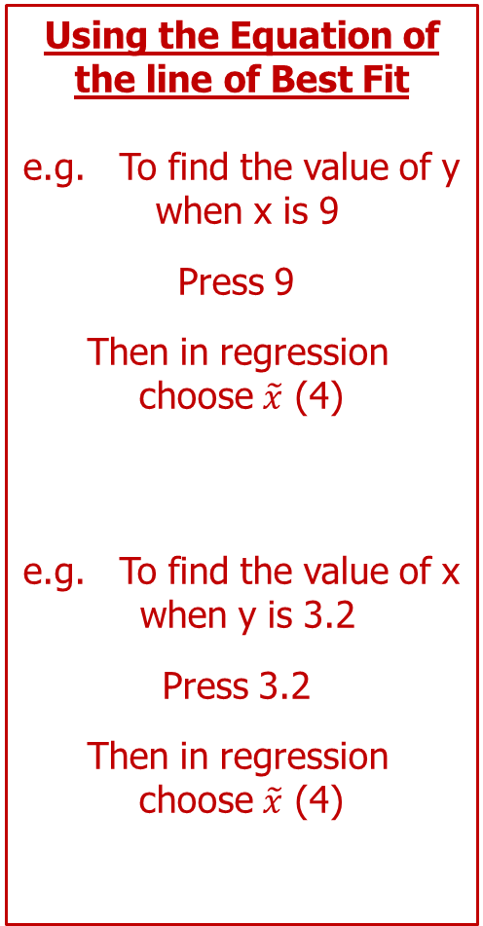
Using the Equation of
the line of Best Fit
e.g. To find the value of y
when x is 9
Press 9
Then in regression
choose $\tilde{x}$ (4)
e.g. To find the value of x
when y is 3.2
Press 3.2
Then in regression
choose $\tilde{x}$ (4)

Slide 11
Questions
1. The marks of 7 pupils in two Maths papers are as follows :
a) Plot the marks on a scatter graph.
(Paper 1 marks on the horizontal axis and
Paper 2 marks on the vertical axis)
b) Is there any correlation between the marks on Paper 1
and Paper 2 ?
  Use your calculator to find the Correlation coefficient
  d) Find the equation of the Line of Best Fit for the data
Eve achieves a score of 6 on Test A. Use the line of best fit
to give an estimate of her score on Test B.
Objective : To practise stating correlation.

Slide 12
Answers
1. Yes there is positive correlation between Paper1 and
Paper 2.

Slide 13
Top Gear are doing a review of cars. The table below shows
the engine size of a car in litres and the distance it travelled in
km on one litre of petrol.
Top Gear want to know if there is any correlation between
engine size and distance travelled.
a) Plot the marks on a scatter graph.
b) Is there any correlation between the Engine Size and Distance
  Use your calculator to find the Correlation coefficient
  d) Find the equation of the Line of Best Fit for the data
e) A car has a 2.3 litre engine. How far would you expect
it to go on one litre of petrol ?

Slide 14
Answers
2. Yes there is negative correlation between engine size and the distance travelled on one litre of petrol.

