Slide 1
Factors & Prime Factors

Slide 2
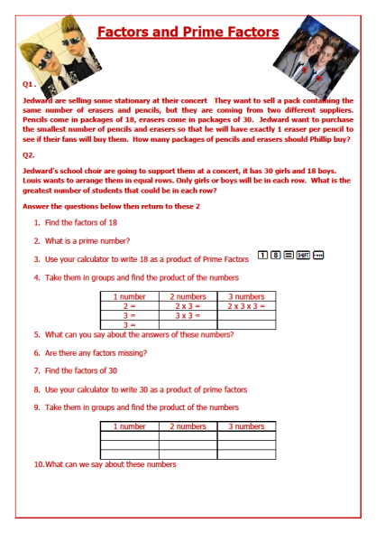
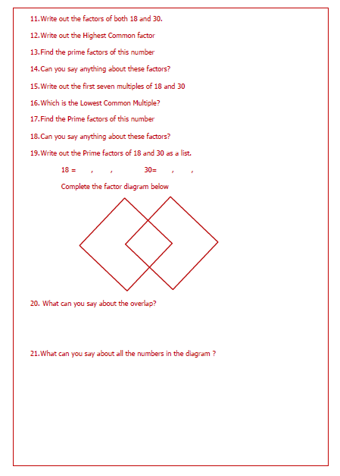

Slide 3
Factors and Prime Factors
Jedward are selling some stationary at their concert. They want to sell a pack containing the same number of erasers and pencils, but they are coming from two different suppliers. Pencils come in packages of 18, erasers come in packages of 30. Jedward want to purchase the smallest number of pencils and erasers so that he will have exactly 1 eraser per pencil to see if their fans will buy them. How many packages of pencils and erasers will Jedward be able to make?
Jedward’s school choir are going to support them at a concert, it has 30 girls and 18 boys. Louis wants to arrange them in equal rows. Only girls or boys will be in each row. What is the greatest number of students that could be in each row?
Answer the questions below then return to these.

Slide 4
Find the factors of 18
What is a prime number?
Use your calculator to write 18 as a product of Prime Factors
Take them in groups and find the product of the numbers
What can you say about the answers of these numbers?
Are there any factors missing?
1
8
=
SHIFT
0
,,,
1 number | 2 numbers | 3 numbers
2 | 2 x 3 | 2 x 3 x 3
3 | 3 x 3
3

Slide 5
Are there any factors missing?
Find the factors of 30
Use your calculator to write 30 as a product of prime factors
Take them in groups and find the product of the numbers
What can we say about these numbers
Write out the factors the numbers that are common to both 18 and 30.
1 number | 2 numbers | 3 numbers

Slide 6
Write out the factors of 18 and 30.
Write out the Highest Common factor
Find the Prime factors of this number
Can you say anything about these factors?
Write out the first seven multiples of 18 and 30
Which is the Lowest Common Multiple of 18 and 30?

Slide 7
What is the Lowest Common Multiple of 18 and 30?
Find the Prime factors of this number
Can you say anything about these factors?
Write out the Prime factors of 18 and 30 as a list.
repeating factors if required
18 = , , 30= , ,
20. Complete the factor diagram

Slide 8
19. Write out the Prime factors of 18 and 30 as a list.
18 = , , 30= , ,
20. Complete the factor diagram
What can you say about the numbers in the overlap of the
Prime factor diagram?
What can you say about the union of the Venn diagram?

Slide 9
Find the factors of 18
What is a prime number?
Use your calculator to write 18 as a product of Prime Factors
Take them in groups and find the product of the numbers
What can you say about the answers of these numbers?
Are there any factors missing?
= 1, 2, 3, 6, 9, 18
A number that has exactly two different factors
= 2 x 3²
1
8
=
SHIFT
0
= 2 x 3 x 3
,,,
1 number | 2 numbers | 3 numbers
1 number | 2 numbers | 3 numbers
2 = 2 | 2 x 3 = 6 | 2 x 3 x 3 = 18
3 = 3 | 3 x 3 = 9
3 = 3
= They are all factors of 18

Slide 10
Are there any factors missing?
Find the factors of 30
Use your calculator to write 30 as a product of prime factors
Take them in groups and find the product of the numbers
What can we say about these numbers
Write out the factors the numbers that are common to both 18 and 30.
= 1
= 1, 2, 3, 5, 6, 10, 15, 30
= 2 x 3 x 5
1 number | 2 numbers | 3 numbers
1 number | 2 numbers | 3 numbers
2 = 2 | 2 x 3 = 6 | 2 x 3 x 5 = 30
3 = 3 | 2x 5 = 10
5 = 5 | 3 x 5 = 15
= They are all factors of 30

Slide 11
Write out the factors of 18 and 30.
Write out the Highest Common factor
Find the Prime factors of this number
Can you say anything about these factors?
Write out the first seven multiples of 18 and 30
Which is the Lowest Common Multiple of 18 and 30?
18 = {1, 2, 3, 6, 9, 18)
30 = {1, 2, 3, 5, 6, 10, 15, 30)
HCF = 6
6 = 2 x 3
They are both common to the prime factors of 18 and 30
18 = {18, 36, 54, 72, 90, 108, 126
30 = {30 , 60, 90, 120, 150, 180, 210}
LCM = 90

Slide 12
What is the Lowest Common Multiple of 18 and 30?
Find the Prime factors of this number
Can you say anything about these factors?
Write out the Prime factors of 18 and 30 as a list.
repeating factors if required
18 = , , 30= , ,
LCM = 90
90 = 2 x 3² x 5
It contains all the factors of 18 and 30
2 3 3 2 3 5
20. Complete the factor diagram

Slide 13
19. Write out the Prime factors of 18 and 30 as a list.
18 = , , 30= , ,
2
3
2 3 3 2 3 5
3
2
3
5
20. Complete the Prime factor diagram
[18] [30]
What can you say about the numbers in the overlap of the
Prime factor diagram?
What can you say about the union of the Venn diagram?
= 2 x 3
= 6
( which is the same as the HCF)
= 2 x 3 x 3 x 5
= 90
( which is the same as the LCM)

Slide 14
Factors and Prime Factors
Jedward are selling some stationary at their concert They want to sell a pack containing the same number of erasers and pencils, but they are coming from two different suppliers. Pencils come in packages of 18, erasers come in packages of 30. Jedward want to purchase the smallest number of pencils and erasers so that he will have exactly 1 eraser per pencil to see if their fans will buy them. How many packages will Jedward be able to make?
Jedward’s school choir are going to support them at a concert, it has 30 girls and 18 boys. Louis wants to arrange them in equal rows. Only girls or boys will be in each row. What is the greatest number of students that could be in each row?
Answer the questions below then return to these.
= 90
= 6

Slide 15
Complete the worksheet ‘Application of HCF and LCM’
For each question
Find the Prime Factors of each number
Draw a Prime factor diagram
Remember
Product of numbers in the Overlap = HCF
Product of numbers in the Whole diagram = LCM

Slide 16
E.g. 1
Kamal has 6 cans of regular soda and 15 cans of diet soda. He wants to create some identical refreshment tables that will operate during the American football game. He also doesn't want to have any sodas left over. What is the greatest number of refreshment tables that Kamal can stock?
6 = 2 x 3
6 = { 2, 3 }
15 = 3 x 5
15 = { 3, 5 }
[6] [15]
2
3
5
HCF =
3
the greatest number of refreshment tables = 3

Slide 17
E.g. 3
Sapphire and Abe are shelving books at a public library. Sapphire shelves 5 books at a time, whereas Abe shelves 6 at a time. If they end up shelving the same number of books, what is the smallest number of books each could have shelved
5 = 5
5 = { 5 }
6 = 2 x 3
15 = { 2, 3}
[5] [6]
2
3
5
LCM =
5 x 2 x 3
smallest number of books = 30

Slide 18
E.g.3 Kiara baked 30 oatmeal cookies and 48 chocolate chip cookies to package in plastic containers for her teacher friends at school. She wants to divide the cookies into identical containers so that each container has the same number of each kind of cookie. If she wants each container to have the greatest number of cookies possible, how many plastic containers does she need?
30 = 2 x 3 x 5
30 = { 2, 3, 5 }
48 = 2 x 2 x 2x 2 x 3
48 = { 2, 2, 2, 2, 3 }
[6] [15]
2
3
2
2
5
HCF =
2 x 3
she needs 6 plastic containers

Slide 19
