Slide 2
Project Maths: Use of Casio Calculators
BIMDAS
CURSOR KEYS
MODE
SETUP
MEMORIES
GENERAL FUNCTIONS
SEXIGESIMAL
PRIME FACTORS
CLEAR MEMORY
RANDOM
POLAR $↔$RECTANGULAR
STATISTICS MODE
TABLE MODE
VERIFY MODE
KNOWING YOUR CALCULATOR

Slide 3
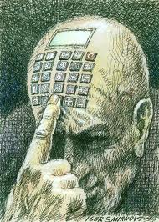
fx-83GT PLUS

Slide 4
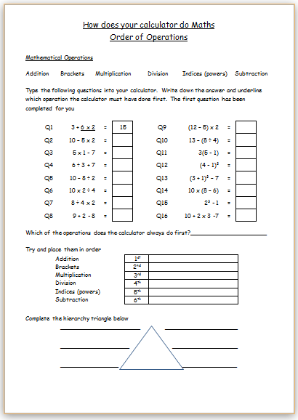
BIMDAS
Worksheet
☞

Slide 5
This allows me to access all the alternate functions written in yellow above the key

Slide 6
This allows me to access all the alternate functions written in Red
above the key

Slide 7
An indicator in the upper right corner indicates that enough memory exists for me to use a previous calculation
This cursor allows me to navigate through a
Menu,
a current or a previous
calculation

Slide 8
General Calculations
Statistical and Regression Calculations
Generation of a number table
based on an expression
Verify Calculations
This allows me to change the mode of the calculator

Slide 9
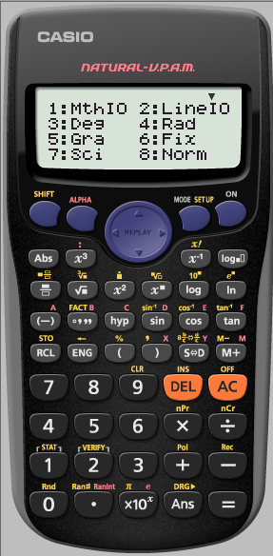
Natural Display
Linear Display
If we press the shift Key before we press this key we can alter the way the calculator is
SET UP
If we press the shift Key before we press this key we can alter the way the calculator is
SET UP
1 MthIO 2 LineIO Specifies the display format.
Natural Display (MthIO)
Causes fraction, irrational numbers, and other expressions to
be displayed as they are written on the paper.
Linear Display (LineIO) causes fractions and other expressions
to be displayed in a single line.

Slide 10
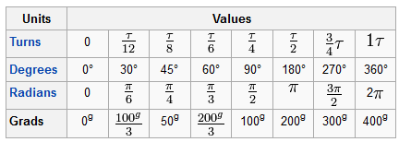
3 Deg 4 Rad 5 Gra Specifies degrees, radians or grads as the angle unit for value input and calculation result display.
Note: D R G are displayed on the top line of the calculator

Slide 11
6 Fix 7 Sci 8 Norm Specifies the number of digits for display of a calculation result
Fix: The value you specify (from 0 to 9) controls the number of decimal places for displayed calculation results. Calculation results are rounded off to the specified digit before being displayed.
e.g. 100 ÷ 7 = 14.286 (Fix 3)
= 14.29 (Fix 2)
Sci: Scientific notation The value you specify (from 1 to 10) controls the number of
decimal places for displayed calculation results. Calculation results are rounded off to the specified digit before being displayed.
e.g. 100 ÷ 7 = 1.4286 x 10¹ (Sci 5)
= 1.429 x 10¹ (Sci 4)
Norm: Selecting one of the two available settings (Norm1, Norm 2) determines the range in which the results will be displayed in non-exponential format. Outside the specified range results are displayed using exponential format
Norm 1: 10⁻² > |x|, |x| ≥ 10¹⁰ Norm 2: 10⁻⁹ > |x|, |x| ≥ 10¹⁰
E.g. 1 ÷ 100 = 5 x 10⁻³ (Norm 1)
= 0.005 (Norm 2)

Slide 12
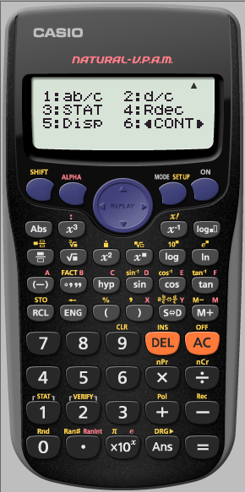
An indicator in the upper right corner indicates that another menu exists below the current one
An indicator in the upper right corner indicates that another menu exists above the current one

Slide 13
❑ 1 ab/c  2 d/c Specifies either mixed fraction (ab/c) or improper fraction (d/c) for display of fractions in calculation results
❑ 3 STAT 1 ON ; 2 OFF Specifies whether or not to display a FREQ (frequency ) column in the STAT Mode Stat Editor.
❑ 4 Rdec 1 ON ; 2 OFF Specifies whether or not to display calculation results using recurring decimal form.
5 Disp 1 Dot ; 2 Comma Specifies whether to display a dot or a comma for the calculation reskt decimal point. A dot is always displayed during input.
Note: when dot is selected as the decimal point, the separator for multiple results is a comma(,). When comma is selected, the separator is a semicolon (:).
❑ 6  CONT  Adjusts display contrast.

Slide 14
Different types of Memory
Answer Memory (ANS)
The last calculation result obtained is stored in ANS (answer) memory.
ANS memory contents are updated whenever a new calculation result is displayed

Slide 15
E.g. 1 Find the area for the triangle below
to 1 d.p
As we have just worked this out. It is stored as ANS we do not need to type it in again
$$area =\frac{1}{2}ab$$
15cm
a
c
$area =\frac{1}{2}(5\sqrt{5}$)(10)
$area =$55.9${cm}^{2}$
b
10cm
$$c^{2}=a^{2}+b^{2}$$
$${(15)}^{2}=a^{2}+{(10)}^{2}$$
$$−100$$
$225=a^{2}+$100
$$−100$$
$$125=a^{2}$$
$$5\sqrt{5}=a^{2}$$

Slide 16
E.g. 1 Find the area for the triangle below
to 1 d.p
As we have just worked this out. It is stored as ANS we do not need to type it in again
12cm
15cm
a
c
$$area =\sqrt{s\left(s−a\right)(s−b)(s−c)}$$
b
10cm
$$area =\sqrt{18.5\left(18.5−12\right)(18.5−10)(18.5−15)}$$
$$area=$$
$area =$59.8${cm}^{2}$
s $=$ $\frac{a + b + c}{2}$
s $=$ $\frac{12 +10 +15}{2}$
s $=18.5$

Slide 17
Stores numbers in a given Memory of the calculator

Slide 18
Different types of Memory
Independent Memory
You can add calculation results to or subtract results from independent memory. The M appears on the display when there is any value other than zero stored in independent memory
To clear the contents of M.
We Store 0 as M
To add the result of 12 + 16 to M
To subtract the result of 2 + 7 from M
To recall the contents of the memory
OR

Slide 19
E.g. Alan (14), Brendan(12) and Ciaran(10) share €20 in the ratio of their ages. How much do they each receive
A : B : C
14: 12 : 10
$$36 sh=20$$
$$1sh= \frac{20}{36}$$
Store this as
your memory
We can add this straight to the memory by pressing M+ as no memory is currently stored
OR
We can always STORE a number and this over rides any previous memory
$$14sh=€7.78$$
$$14sh=$$
$$12sh=€6.67$$
10$sh=€5.56$

Slide 20
To assign a number to a letter we store it.
E.g. Assign the constant of
Gravitational acceleration
9.80665 m/s² to the value A
Pre-set Variables
A B C D E F X and Y are Variables we can assign values to and can use in calculations
I can use this in a calculation when required
N.B the letters are in red
E.g. A body starts falling from rest. Find its velocity after 5 seconds to 2 decimal places
e.g.
$$v=u+at$$
$$v=0+A\left(5\right)$$
$$v=49.03m/s$$

Slide 21
E.g. 1 Store the values for A, b and c into
the memory of your calculator for
the triangle below.
Use the Cosine rule to find [xy].
E.g. 2 Input values for a, b and c into
the memory of your calculator for
the quadratic equation below
and solve it.
$$3x^{2}+2x−4=0$$
X
y z
10cm
$$x=\frac{−b±\sqrt{b^{2}−4ac}}{2a}$$
a
15cm
c
A
$x=0.86 or x= −1.54$
35⁰
b
$$a^{2}=b^{2}+c^{2}−2bc CosA$$
$a^{2}$= 79.25438671
$a$ = 8.90

Slide 22
Allows us to find the Absolute value of a calculation.
(This can also be used when using the Table mode for graphing functions)

Slide 23
Multi Statements
The colon character
:
can connect two or more expression and execute them in sequence from left to right when you press =
May be useful when doing ratio

Slide 24
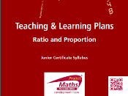
E.g. Amanda (8), Bernie (5) and Claire (7) ate 100 Easter eggs in the ratio of their ages. How many did they each eat?
A : B : C
8 : 5 : 7
20 $sh=100$
$$1sh= \frac{100}{20}$$
$1sh=$ 5 eggs
$$8 sh=40eggs$$
5 $sh=25 eggs$
7 $sh=35 eggs$

Slide 25
Factorial
e.g.
6! = 6 x 5 x 4 x 3 x 2 x 1
= 120
Finds the reciprocal of a number

Slide 26
Allows us input mixed fractions
Allows us input fractions

Slide 27
Allows us to input a recurring decimal
$$E.g 2.\dot{3}$$

Slide 28
☞
Logs

Slide 29
Write 512 in the form 2^{n}
Means
What power must I raise 2 to give me 512?
Logs

Slide 30
A bus leaves Dublin at 12:50 an arrives in Donegal at 16:40. How long did the journey take?
3hrs 50 mins
3.83 hrs
Degree, Minute , Second allows mathematical operations between sexagesimal and decimal values, displaying the result as a sexagesimal value

Slide 31
E.g. Find the Prime Factors of 5880.
type it in pressing = after
We want FACTors
Allows us to find the Prime Factors of any given number
N.B. need to be in COMP MODE
Use your calculator to find the Prime Factors of
57
47
1
What can you say about 47 and 1?

Slide 32
Prime numbers introduction
☞
HCF & LCM
Jedward
Allows us to find the Prime Factors of any given number
☞

Slide 33
Write 512 in the form 2^{n}
Allows us to find the Prime Factors of any given number

Slide 34
Trig functions
Ensure students can set up the calculator into Degrees
or
Hyperbolic trigonometric functions
Allows us to change angle format between Degrees, Radians and Grads without changing the Set up of the calculator.

Slide 35
Recalls numbers stored in a given Memory of the calculator

Slide 36
Transforms a displayed value into engineering notation.
Note that exponents occur only in multiples of positive and negative 3. Engineering notation only allows multiples of 3 as exponents.
Each time pressed afterwards, the decimal point will move three places to the right
Once in engineering notation the decimal point will move three places to the left

Slide 37
E.g. Find 25% of 62
Uses %

Slide 38
Places a comma in expressions like
Ranint and Pol/Rec

Slide 39
Transforms between standard fractions, recurring decimal
(if applicable)
and given decimal value ( to 10 digits)

Slide 40
Transforms between mixed fraction and top heavy fraction

Slide 41
To add a result to the Independent Memory M

Slide 42
To subtract a result from the Independent Memory M

Slide 43
Clears All current calculations

Slide 44
To insert an item into a previous calculation

Slide 45
To CLEAR contents
Set up (retains Memories)
Memory
All

Slide 46
☞
☞
Combinations

Slide 47
Permutations

Slide 48
Obtains statistical value from input data

Slide 49
Gives a choice of statements when in verify mode

Slide 50
E.g. Express 1+ 2i in the Polar form
Rectangular coordinates are of the form (x,y)
Polar coordinates are of the form ( r, θ).
Pol converts Rectangular to Polar
Rec converts Polar to Rectangular

Slide 51
These values are automatically stored as
X and Y
We can RCL them and use them in a later question
RCL X
RCL Y

Slide 52
Normally the calculator will retain answers to fifteen digits for internal calculations
e.g when Fix 3 is selected
20÷3 = 6.667
But the calculator retains 6.66666666666667 for internal calculations.
In the case of
Rnd (20÷3) =6.667
(with Fix 3),
both the displayed value and the calculators internal value become 6.667
The argument of this function is made a decimal and then rounded in accordance with the current number of display digits setting
(Norm, Fix or Sci).

Slide 53
RAN#
Generates a pseudo random number
0 < x < 1
The result is displayed as a fraction when Natural Display
is selected
Ran#
☞

Slide 54
Ranint
Ranint#(a,b)
Generates a random integer within the range a and b
Ranint
☞

Slide 55
Allows us to use the constant 𝜋
Allows us to input the constant e
Allows us to use Scientific Notation

Slide 56
Errors

Slide 57
Errors

Slide 58
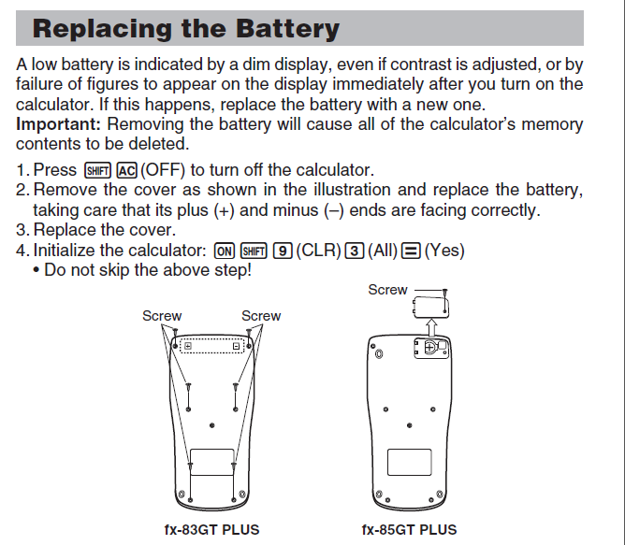

Slide 59
Mode
Statistical and Regression Calculations
This allows me to change the mode of the calculator

Slide 60
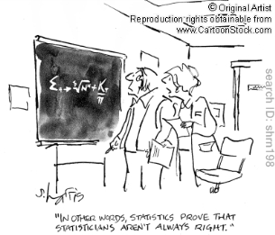
Mode
Statistical and Regression Calculations
Mean, Max, Min
from Data
☞
Mean, Max, Min
from a frequency Table
☞
Mean from a Grouped frequency Table
☞
Finding Correlation Coefficient & Line of Best Fit
☞

Slide 61
Generation of a number table
based on an expression
Table Mode
☞

Slide 62
VERIFY MODE
☞
Verify Calculations

Slide 63
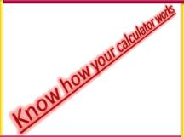
Knowing how your calculator works
☞

Slide 65
Project Maths: Use of Casio Calculators
BIMDAS
CURSOR KEYS
MODE
SETUP
MEMORIES
GENERAL FUNCTIONS
SEXIGESIMAL
PRIME FACTORS
CLEAR MEMORY
RANDOM
POLAR $↔$RECTANGULAR
STATISTICS MODE
TABLE MODE
VERIFY MODE
KNOWING YOUR CALCULATOR

