Slide 1
Combinations Practical Applications from
two different groups
How many different committees is it possible to make a committee of 4 men and 3 woman from a group of 6 men and 4 women
6
c
=
15
4
4
c
=
4
3
Total = 15 x 4
= 60

Slide 2
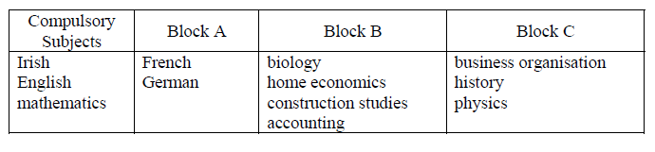
In a certain school the examination subjects for senior students are grouped as follows:
As well as taking all three of the compulsory subjects, each student must choose
one subject from Block A, two from Block B and one from Block C.
(i) In choosing two subjects from Block B, how many different selections are possible?
(ii) In choosing the full range of subjects, how many different selections are possible?
(iii) One student has already decided to do German and construction studies.
How many different selections of the remaining subjects are possible for this
student?

Slide 3
In a certain school the examination subjects for senior students are grouped as follows:
As well as taking all three of the compulsory subjects, each student must choose
one subject from Block A, two from Block B and one from Block C.
In choosing two subjects from Block B, how many different selections are possible?
(ii) In choosing the full range of subjects, how many different selections are possible?
(iii) One student has already decided to do German and construction studies.
How many different selections of the remaining subjects are possible for this student?
4
c
2
=
6
2
2 x 6 x 3
c
=
2
4
3
=
1
c
=
6
c
=
3
Total
2
1
= 36
3
3
=
3 x 3
c
=
3
c
1
=
3
Total
1
= 9

Slide 4

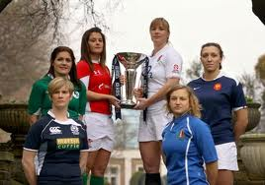
12.6 Practical Applications from two different groups
How many different ways is it possible to make a committee of 5 people from a group of 4 men and 6 women if
There are no restrictions
It must include one woman and one man
It must include 4 men
It must include at least 3 women
(i)
10
c
=
252
5

Slide 5


(ii) It must include one woman and one man
8
c
=
56
3

Slide 6



(ii) It must include 4 men
6
c
=
6
1

Slide 7

(iv) It must include at least 3 women
3 women
7
c
=
21
2
4 women
6
c
=
6
1
Total = 21 + 6
= 27
5 women
5
c
=
0
0

