Slide 2
INDEX
 Student Activity 1: Drawing a Scatter Plot
 Student Activity 2: Correlation coefficient
 Student Activity 3: Interpreting the data and
the Correlation Coefficient
 Student Activity 4: Calculating the Correlation Coefficient (HL)
and Causation (OL)
 Student Activity 5: Line of Best Fit (HL only)
 Student Activity 6: Outliers (HL Only)

Slide 3
Student Activity 1
Do you think there is a link between the size of an engine and the fuel efficiency of a particular car?
Why is fuel efficiency important?
What does your sentence mean?
Would fuel efficiency influence your choice of car?
Can you think of other pairs of variables that may be linked?
Why do you think there is a link between the variables you have chosen?

Slide 4
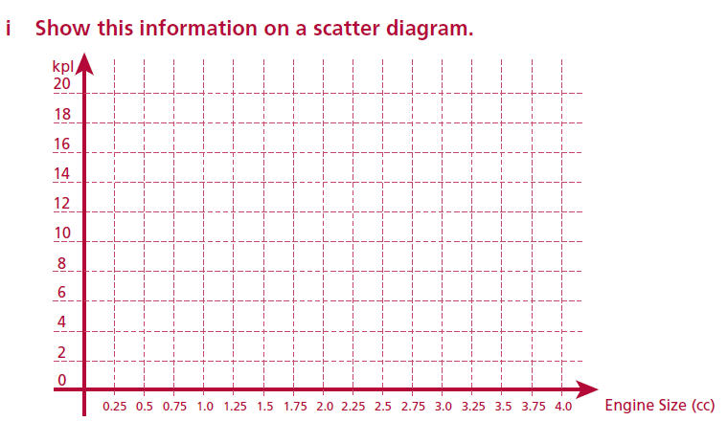
Student Activity 1
Drawing a scatter plot
Below is some recent research about engine sizes. This data shows the
engine size and the fuel economy of a range of petrol car.
How strong do you think
the relationship is?

Slide 5
ii Describe, in your own words the relationship between the engine size and fuel economy of these cars. ___________________________________________________________________________________________________________________________________________________________________________________________________________________________
iii A car manufacturer produces a new car with a 1.8 litre engine and a fuel efficiency of 17 kilometres per litre. Plot this car’s performance on your scatter plot. If you were interested in buying a new car that was fuel efficient with this size engine would you buy this car? Write a short comment.
_________________________________________________________________________
_________________________________________________________________________
_________________________________________________________________________

Slide 6
INDEX
 Student Activity 1: Drawing a Scatter Plot
 Student Activity 2: Correlation coefficient
 Student Activity 3: Interpreting the data and
the Correlation Coefficient
 Student Activity 4: Calculating the Correlation Coefficient (HL)
and Causation (OL)
 Student Activity 5: Line of Best Fit (HL only)
 Student Activity 6: Outliers (HL Only)

Slide 7
How could you measure the strength of the relationship?
To check mathematically if there is a relationship we calculate or are given the correlation coefficient.
The correlation coefficient (r) measures the linear relationship between
variables. The coefficient lies between 1 and -1 and if the coefficient is greater 0.6 than we say there is a strong positive correlation and if the coefficient is smaller -0.6 than we say there is a strong negative correlation.

Slide 8
Note: There is no universally accepted criterion for applying the adjectives
“strong”, “moderate” and “weak” to correlation coefficients. State Examinations Commission (January 2010). Report on the Trialling of Leaving Certificate Sample Papers for Phase 1 Project Maths, . http://www.examinations.ie/schools/Report_on_Trial_final.pdf [accessed September 2011].
The following is a guide:
Range of values of correlation coefficient -1≤ r ≤1
Strong positive correlation 0.6 ≤ r ≤ 1
Weak positive correlation 0 < r < 0.6
Weak negative correlation -0.6 < r < 0
Strong negative correlation -1 ≤ r ≤ −0.6

Slide 9
What type of correlation do we have if the correlation coefficient is -0.43?
What type of correlation do we have if the correlation coefficient is 0.74?
What type of correlation do we have if the correlation coefficient is 0.03?
What type of correlation do we have if the correlation coefficient is -0.81?
What type of correlation do we have if the correlation coefficient is -0.61?
What do you think the correlation coefficient would be for the scatter plot
in Student Activity 1?
Why is the coefficient here negative?
Could it be -0.4?

Slide 10
Draw a scatter plot that would have a strong positive correlation?
Draw a scatter plot that would have a strong negative correlation?
Draw a scatter plot that would have a correlation close to 0?

Slide 11
Student Activity 2A
Correlation Coefficient: The scale
(i) On the number line below shade in the possible values of the correlation coefficient.
(ii) On the number line below shade in the possible values of the correlation coefficient that indicate a strong positive correlation.
(iii) On the number line below shade in the possible values of the correlation coefficient that indicate a weak positive correlation.
(iv) On the number line below shade in the possible values of the correlation coefficient that indicate a strong negative correlation
(v) On the number line below shade in the possible values of the correlation coefficient that indicate a weak negative correlation

Slide 12
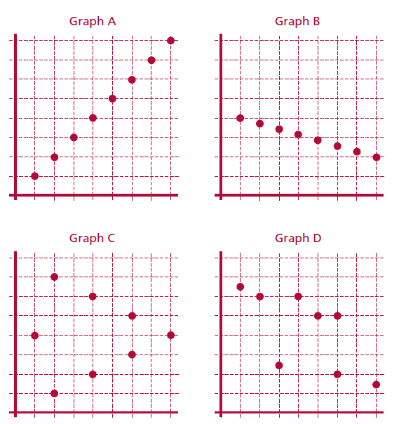
Student Activity 2B
Matching Correlations Coefficients to scatter plots
The table shows the correlations for the four graphs below. Match each graph to the
correlation coefficient.
D
A
B
C

Slide 13
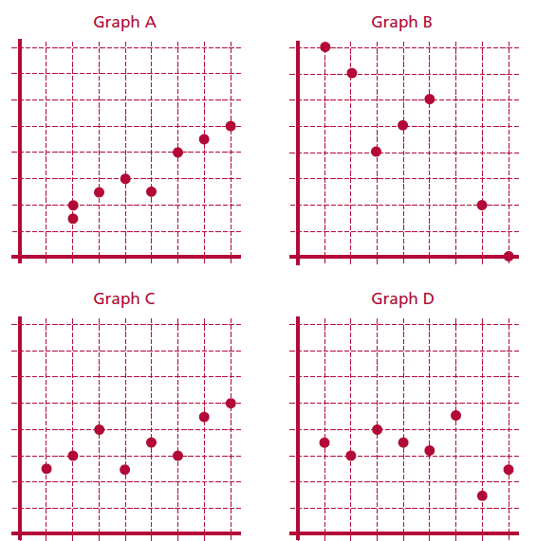
Matching Correlations Coefficients to scatter plots
The table shows the correlations for the four graphs below. Match each graph to the
correlation coefficient.
C
B
A
D

Slide 14
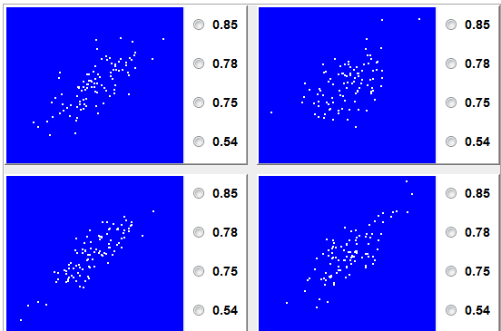

Slide 15
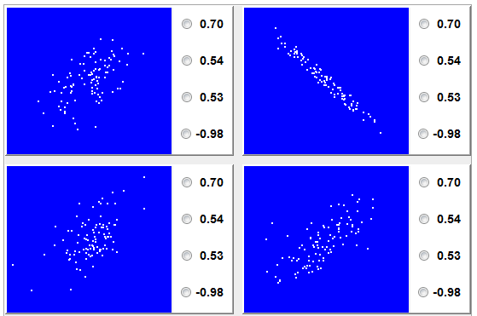

Slide 16
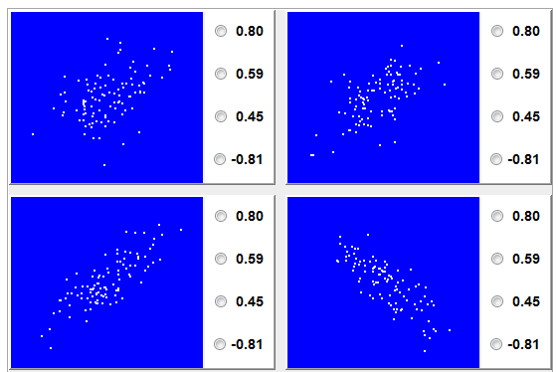
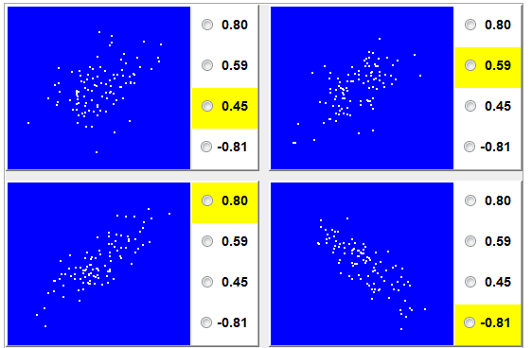

Slide 17
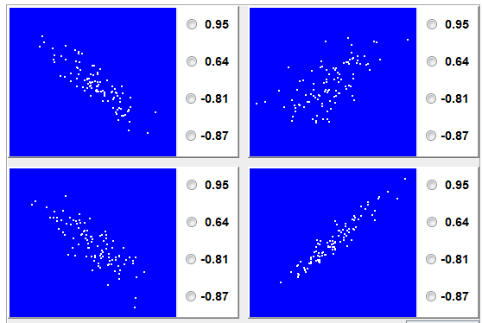
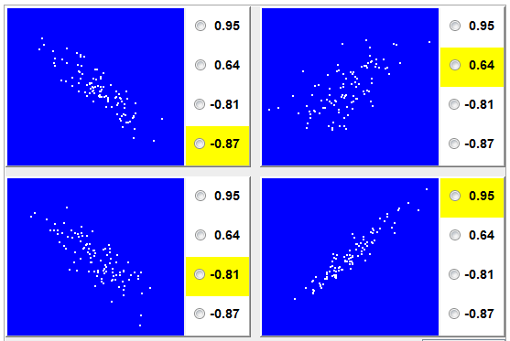

Slide 18
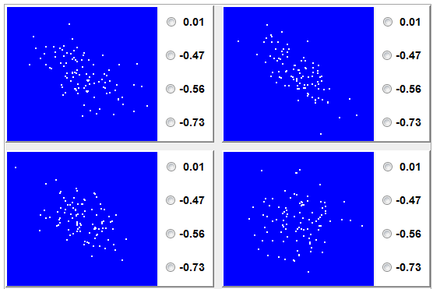
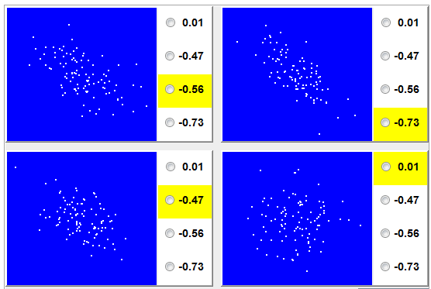

Slide 19
INDEX
 Student Activity 1: Drawing a Scatter Plot
 Student Activity 2: Correlation coefficient
 Student Activity 3: Interpreting the data and
the Correlation Coefficient
 Student Activity 4: Calculating the Correlation Coefficient (HL)
and Causation (OL)
 Student Activity 5: Line of Best Fit (HL only)
 Student Activity 6: Outliers (HL Only)

Slide 20
In Student Activities 2 we were matching Correlation coefficients to graphs now we are going to interpret the correlation so we can make statements about the linear links between variables.
What is a linear relationship?
What is a variable?

Slide 21
Student Activity 3A
Interpreting the data and the Correlation Coefficient
An ice cream seller records the maximum daily temperature and the number of ice
creams she sells each day. Her results for a period of ten days are shown in the table.
(i) Display the data in a way that allows you to examine the relationship between the
two variables.

Slide 22
The correlation coefficient here is 0.98. With this in mind and looking at the
Scatter plot which of the following statements is correct. Give a reason for your answer.
A. As the temperature increases ice cream sales increase.
B. As the temperature increases ice cream sales tend to increase.
C. There is no evidence of a linear relationship between temperature and ice cream sales.
D. As the temperature increases ice cream sales decrease.
E. As the temperature increases ice cream sales tend to decrease.
Choice: __________________________________________________________________
Reason for your answer: ____________________________________________________ __________________________________________________________________________________________________________________________________________________
(iii) If the correlation coefficient had been 0.4 which of the above statements would be
correct.
Choice: ___________________________________________________________________
(iv) If the correlation coefficient had been -0.7 which of the above statements would be
correct?
Choice:___________________________________________________________________

Slide 23
A. As the temperature increases ice cream sales increase.
B. As the temperature increases ice cream sales tend to increase.
C. There is no evidence of a linear relationship between temperature and ice cream sales.
D. As the temperature increases ice cream sales decrease.
E. As the temperature increases ice cream sales tend to decrease.
(iii) If the correlation coefficient had been 0.4 which of the above statements would be correct.
Choice: ____________________________________________________________________
(iv) If the correlation coefficient had been -0.7 which of the above statements would be correct?
Choice: ____________________________________________________________________
(v) Identify two statements that are always incorrect no matter what the value of the correlation coefficient is. Give a reason for your answer.
Choices:____________________________________________________________________
Reason for you’re answer:______________________________________________________
___________________________________________________________________________

Slide 24
Student Activity 3B
Interpreting the data and the Correlation Coefficient
Here are the results of some other research with their correlation coefficients:
Pick the appropriate statement for each survey and give a reason for your answer.
1. In a survey the correlation coefficient between engine size and fuel economy was
found to be -0.9.
A. As the engine size increases fuel efficiency increases.
B. As the engine size increases fuel efficiency tends to increase.
C. There is no evidence of a linear relationship between engine size and fuel efficiency.
D. As the engine size increases fuel efficiency decreases.
E. As the engine size increases fuel efficiency tends to decrease.
Choices: ___________________________________________________________________
Reason for your answer:_______________________________________________________
____________________________________________________________________________________________________________________________________________________________________________________________________________________________________
2. In a survey the correlation between the numbers of hours per week students spent studying and their performance in an exam was 0.7.

Slide 25
2. In a survey the correlation between the numbers of hours per week students spent studying and their performance in an exam was 0.7.
A. As the number of hours spent studying increases student exam performance increases.
B. As the number of hours spent studying increases student exam performance tends to increase.
C. There is no evidence of a linear relationship between the number of hours spent studying and student exam performance.
D. As the number of hours spent studying increases student exam performance decreases.
E. As the number of hours spent studying increases student exam performance tends to decrease.
Choices: ________________________________________________________________________
Reason for your answer:____________________________________________________
________________________________________________________________________

Slide 26
Student Activity 3C
Interpreting the data and
the Correlation Coefficient
Here are the results of some other research with their correlation coefficients:
In a survey the correlation between the heights of male students and their shoe sizes was -0.01.
(ii) In the 1960’s the U.S. army undertook research into the relationship between a
man’s height and the chances of him receiving a promotion. The results showed that
the correlation between a man’s height and his chance of promotion was 0.8.
Pretend you are a journalist, write a sentence based on the value of the correlation
coefficients in (i) and (ii) above.
__________________________________________________________________________
__________________________________________________________________________
__________________________________________________________________________
__________________________________________________________________________
__________________________________________________________________________
__________________________________________________________________________
__________________________________________________________________________
__________________________________________________________________________
__________________________________________________________________________
__________________________________________________________________________

Slide 27
INDEX
 Student Activity 1: Drawing a Scatter Plot
 Student Activity 2: Correlation coefficient
 Student Activity 3: Interpreting the data and
the Correlation Coefficient
 Student Activity 4: Calculating the Correlation Coefficient (HL)
and Causation (OL)
 Student Activity 5: Line of Best Fit (HL only)
 Student Activity 6: Outliers (HL Only)

Slide 28
Student Activity 4
Calculating the Correlation Coefficient (HL)
and Causation (OL)
For each of the following sets of data calculate the correlation coefficient and write a
conclusion.
Note: In some of the surveys below there are strong correlations but this does not always imply causation. In some cases there may be a lurking variable that can explain the strong correlation. For example in the last 10 years there is a strong positive correlation between the sales of cars and the sales of electrical items. Can we say a rise in the sale of cars tends to lead to a rise in the sale of electrical items? No we cannot. The lurking variable here is the performance of the economy as a whole. Correlation does not always imply causation.

Slide 29
Look back at Student 3A. In this activity there was a strong correlation between temperature and ice cream sales. Are there any other variables that can influence ice cream sales?
It does however seem reasonable that the rise in temperature does have an effect on ice cream sales. We can say here that the strong positive correlation does indicate that temperature rises causes increased sales of ice cream.

Slide 30
Using your calculator calculate the correlation coefficient and write a conclusion.
(i) Roller coasters get their speed as a result of dropping down a steep incline. The table below gives height of a drop and the speed achieved for different roller coasters around the world.
Correlation Coefficient:_______________________________________________________
Conclusion:_________________________________________________________________________________________________________________________________________
(ii) The table shows the number of units of electricity used in heating a house on ten
different days and the average temperature for each day.
Correlation Coefficient:_______________________________________________________
Conclusion:_________________________________________________________________________________________________________________________________________

Slide 31
(iii) The table shows the number washing machines sold on 8 different months in an electrical supply shop and the number of dishwashers sold for each of those months.
Correlation Coefficient:_______________________________________________________
Conclusion:_________________________________________________________________________________________________________________________________________
(iv) The table shows the average number of hours spent daily by students watching
television and the average mark they achieved in their summer exams.
Correlation Coefficient:_______________________________________________________
Conclusion:_________________________________________________________________________________________________________________________________________

Slide 32
INDEX
 Student Activity 1: Drawing a Scatter Plot
 Student Activity 2: Correlation coefficient
 Student Activity 3: Interpreting the data and
the Correlation Coefficient
 Student Activity 4: Calculating the Correlation Coefficient (HL)
and Causation (OL)
 Student Activity 5: Line of Best Fit (HL only)
 Student Activity 6: Outliers (HL Only)

Slide 33
If you were to draw a line to show the direction in these patterns where would you draw them?
The lines we have been trying to find are called the line of best fit. This is the line that is the closest fit to the data.
Note: We draw this line only when we have a strong positive or strong negative correlation.

Slide 34
Student Activity 5
Line of Best Fit (HL only)
The following table shows the weekly rainfall (x cm) and the number of tourists
(y thousand) visiting a certain beauty spot, for 9 successive weeks.
(i) Draw a scatter plot for this data.

Slide 35
(ii) Find the mean rainfall $\overline{x }$._________________________________________
(iii) Find the mean number of tourists $\overline{y}$. ________________________________
(iv) Plot the point $\left(\overline{x},\overline{y}\right)$. Draw lines parallel to the x-axis and y-axis through this point.
(v) This splits the scatter plot into 4 quadrants. In which quadrants do you find the most points?________________________________________________
__________________________________________________________________
__________________________________________________________________
Draw a line of best fit. Draw an oval around the data. The line must go through $\left(\overline{x},\overline{y}\right)$.
The line of best fit should go through the two quadrants that contain the most data points.
(vii) On the 10th week there was 4cm of rainfall. Use your line of best fit to estimate the number of tourists that had visited the beauty spot in the 10th week._________________________________________________________
__________________________________________________________________

Slide 36
On the 10th week there was 4cm of rainfall. Use your line of best fit to estimate
the number of tourists that had visited the beauty spot in the 10th week.____________
________________________________________________________________________
(viii) By picking appropriate points find the slope of the line of best fit._________________
(ix) Interpret the slope in the context of rainfall and number of tourists._______________
___________________________________________________________________________
___________________________________________________________________________
___________________________________________________________________________
(x) Find the equation of the line of best fit and use it to check your answer to part vii._
___________________________________________________________________________
___________________________________________________________________________
___________________________________________________________________________
____________________________________________________________________________
(xi) The manager of the café at this beauty spot has to plan staffing levels. A mix of
full time and part time staff are employed. In the light of the information above
and the fact that the correlation coefficient is -0.77 what advice would you give the
manager?_______________________________________________________________
____________________________________________________________________________
___________________________________________________________________________
____________________________________________________________________________
______________________________________________________________________________

Slide 37
INDEX
 Student Activity 1: Drawing a Scatter Plot
 Student Activity 2: Correlation coefficient
 Student Activity 3: Interpreting the data and
the Correlation Coefficient
 Student Activity 4: Calculating the Correlation Coefficient (HL)
and Causation (OL)
 Student Activity 5: Line of Best Fit (HL only)
 Student Activity 6: Outliers (HL Only)

Slide 38
Sometimes when we do a scatter plot we can come across a result that is out of step with the rest of the data. Just because the piece of data does not “fit” this does not mean it is wrong. Data like this are called outliers and can have a major effect on the correlation coefficient and the line of best fit.

Slide 39
Student Activity 6
Outliers (HL Only)
A Company surveyed 12 of its employees. Below is a table of their year’s experience
with the company and their income
(i) Draw a scatter plot of the data.

Slide 40
(ii) Circle one or more outliers.
(iii) Calculate the correlation coefficient for all the data._ __________________________
(iv) Remove the outlier and calculate the correlation coefficient.____________________
What do you notice? ____________________________________________________
__________________________________________________________________________
__________________________________________________________________________
(v) Draw your line of best fit for all the data and draw the line of best fit when the
outlier is removed.
(vi) What effect, if any, does removing the outlier have on the line of best fit?__________
__________________________________________________________________________
__________________________________________________________________________
__________________________________________________________________________

Slide 41
INDEX
 Student Activity 1: Drawing a Scatter Plot
 Student Activity 2: Correlation coefficient
 Student Activity 3: Interpreting the data and
the Correlation Coefficient
 Student Activity 4: Calculating the Correlation Coefficient (HL)
and Causation (OL)
 Student Activity 5: Line of Best Fit (HL only)
 Student Activity 6: Outliers (HL Only)

