Slide 2
INDEX
 Student Activity 1: Area of Uncertainty
 Student Activity 2: Phrases
 Student Activity 3: Probability Scale

Slide 3
Section A: Student Activity 1
1. Which class has more girls? Which class has the greater proportion of girls?
2. You are a Manchester Utd. fan. Which class, 1A or 1B, would you prefer to be in? Explain.
3. Simplify the following ratio
9 : 15
60 : 84
0.25 : 0.8
0.4 kg : 500g
$$\frac{5}{2}:\frac{5}{4}$$
$$\text{3}\frac{1}{2}:1.4$$
$$\text{ 4}:\frac{5}{8}$$

Slide 4
3. Simplify the following ratio
9 : 15
60 : 84
0.25 : 0.8
0.4 kg : 500g
$$\frac{5}{2}:\frac{5}{4}$$
$$\text{3}\frac{1}{2}:1.4$$
$$\text{ 4}:\frac{5}{8}$$
4. Six students in a class of 32 are absent. Find the ratio of
a) The number absent to the number present
b) The number absent to the total number of students in the class
c) The number present to the total number of students in the class
Which ratios could be written as fractions? Explain your answer.
5. Two baby snakes are measured in the zoo. One measures 8cm and the other measures 12cm. Two weeks later they are measured again and the first one now measures 11cm while the second one measures 15cm. Did the snakes grow in proportion? Explain your answer.

Slide 5
Section B: Student Activity 2
Divide €20 between Patrick and Sarah in the ratio 3:2
2. Divide €20 between Patrick and Sarah in the ratio 4:3. Give your answer to the nearest cent.
3. A sum of money is divided between Laura and Joan in the ratio
2:3. Laura gets €8. How much did Joan get?
4. Joe earns €3,500 per month. The ratio of the amount he saves to the amount he spends is 2:5. How much does he spend? Work out how much he saves in two different ways.
5. The total area of a site is 575m2. Anne is building a house on the site. The ratio of house area to garden area is 5:8. Find the area of the garden.
6. Julianne and Kevin inherit €5,500. Julianne is 24 and Kevin is 9. The money is to be divided in the ratio of their ages. How much will each receive?

Slide 6
6. Julianne and Kevin inherit €5,500. Julianne is 24 and Kevin is 9. The money is to be divided in the ratio of their ages. How much will each receive?
7. In class A, $\frac{3}{4}$ of the class watch American Idol. In class B, $\frac{9}{10}$of the class watch American Idol. What is the ratio of the students who do not watch American Idol in class A to those who do not watch American Idol in class B?
8. In a 1,000ml mixture of fruit concentrate and water there is 40ml of fruit concentrate.
a. What is the ratio of the amount of fruit concentrate to the amount of water?
b. If 200ml of concentrate is added to the mixture, what is the ratio of the amount of fruit concentrate to the total volume of mixture.
c. What is the ratio of concentrate to water in the new mixture?
9. Two containers, one large and one small, contain a total of 4 kilograms of bath salts. One quarter of the bath salts from the large container is transferred to the small container so that the ratio of bath salts in the large container to that in the small one becomes 3:2. How many kilograms of bath salts were originally in each container?

Slide 7
Section C: Student Activity 3
1. The heights of Derek, Alan and Jim are 1.7m, 180cm and 150cm.
Find the ratio of the heights of Derek, Alan and Jim.
2. €45 is divided among 4 children in the ratio 1:2:3:9. How much did each child receive?
3. An apartment has an area of 47m². It is divided into living, sleeping and dining areas in the ratio of $\frac{1}{5}:\frac{1}{4}:\frac{1}{3}$.
What is the area of the smallest section?
4. If a:b:c = 5:10:9, divide 3700 in the ratio $\frac{1}{a}:\frac{1}{b}:\frac{1}{c}$.
5. €144 is divided between Jean, Alice and Kevin. Jean gets half as much as Alice and one third as much as Kevin. How much does each of them get?
6. Write a similar question to Q1 and solve.

Slide 8
6. Write a similar question to Q1 and solve.
7. Write a similar question to Q2 and solve.
8. Write a similar question to Q3 and solve.
9. Write a similar question to Q4 and solve.
10. Write a similar question to Q5 and solve.

Slide 9
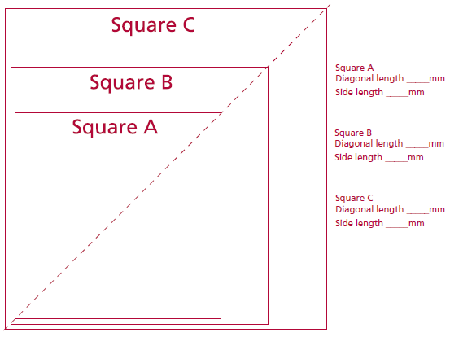
Section D: Student Activity 4
Measure the length of the side of each square in mm and the length of the diagonal in mm. Find the ratio of the length of the diagonal to the length of the side and write the equivalent ratio in the form x:1 where x is written correct to one decimal place.

Slide 10
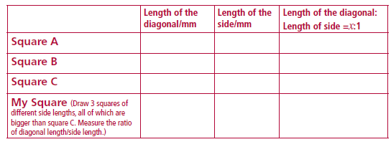
Section D: Student Activity 4
Measure the length of the side of each square in mm and the length of the diagonal in mm. Find the ratio of the length of the diagonal to the length of the side and write the equivalent ratio in the form x:1 where x is written correct to one decimal place.
What pattern have you observed?

Slide 11
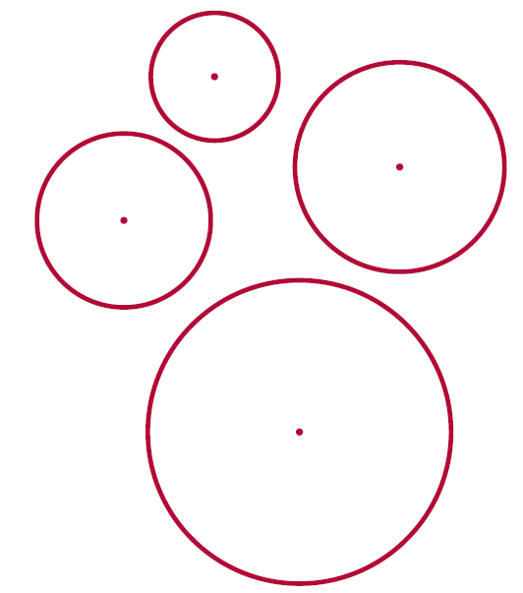
Section D: Student Activity 4
Measure the lengths of the diameters and circumferences of the following circles to the nearest millimetre. Find the ratio of the length of the circumference to the length of the diameter. What do you notice?
Draw another circle with a different diameter and again find the ratio of circumference to diameter. What do you notice? Put findings into a table of values.

Slide 12
Section F: Student Activity 5

Slide 13
Section F: Student Activity 5
The nautilus starts out as a very small animal, which only needs a very small shell. As it grows it needs a bigger shell. Using squared paper, we can model a spiral growth using a square of side 1 unit in which we draw a ¼ circle representing the growth of the spiral.
As the spiral grows, draw another square of side 1 on top of the first one and draw ¼ of a circle in this, continuing on from the first quarter circle.
For the next stage of growth draw a square of side 2 beside the 2 small squares and draw a quarter circle in this square to represent the continued growth of the spiral.
Next draw a square of side 3 onto the rectangle formed by the first 3 squares and again draw a quarter circle in this square to show the continued growth of the spiral.
Then, a square of side 5 is annexed onto the 4 squares, (which forms a rectangle), and again the quarter circle is drawn to represent the spiral growth.
This pattern carries on, continuously annexing a square of side equal to the longer side of the last rectangle formed, (the sum of the sides of the last two squares formed), and filling a quarter circle into this square. ]
The spiral shape which we get is not a true spiral as it is made up of fragments which are parts of circles but it is a good approximation of spirals which are often seen in nature, like that of the nautilus shell.

Slide 14
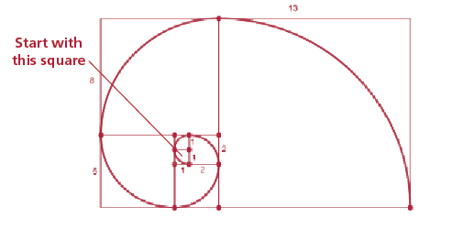
Then, a square of side 5 is annexed onto the 4 squares, (which forms a rectangle), and again the quarter circle is drawn to represent the spiral growth.
This pattern carries on, continuously annexing a square of side equal to the longer side of the last rectangle formed, (the sum of the sides of the last two squares formed), and filling a quarter circle into this square. ]
The spiral shape which we get is not a true spiral as it is made up of fragments which are parts of circles but it is a good approximation of spirals which are often seen in nature, like that of the nautilus shell.

Slide 15
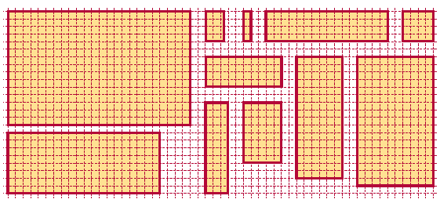
Section G: Student Activity 6
Which rectangles look-alike or are similar? Make a guess first and write down your guesses at the bottom of the page. Then justify by taking measurements of lengths of sides of each rectangle; short side (S) first, then longer side (L). (Use the length of a unit square on the grid as a unit of measurement.) Are there any odd ones out?

Slide 16
My guesses on which rectangles look-alike:_______________________
Having filled in the table above, which rectangles do I now think look-alike or are similar?
Put them into groups and say why you put them into these groups.
Group 1: ___________________ Why? ____________________________________
Group 2: ___________________ Why? ____________________________________
Group 3: ___________________ Why? ____________________________________

Slide 17
Section L: Student Activity 7
1. In which of the following examples is the ratio of the number of apples to
the number of cents the same? How will you compare them?
Make out tables for the following questions to show the information given.
2. A shop is selling 4 apples for €2.
a) How much does one apple cost? b) How many apples will I get for €1?
c) How much will 7 apples cost?
3. If copies cost €5 for 10 copies, what will 25 copies cost? Work this out by
unit rate and by another method.
4. Luke bought 10 pens for €2.40. What would 12 pens cost him at the same
rate? Show two methods of working out the answer.
5. Five out of every eight students in a local college are living away from
home. Of the 200 students studying mathematics in the college, how
many will be living away from home if the same ratio is maintained?

Slide 18
5. Five out of every eight students in a local college are living away from home. Of the 200 students studying mathematics in the college, how many will be living away from home if the same ratio is maintained?
6. Elaine can cycle 4km in 14.7 minutes. How far can she cycle in 23 minutes if she keeps cycling at the same rate?
7. The Arts Council is funding a new theatre for the town. They have a scaled down model on show in the local library. The building is rectangular in shape. The dimensions of the model are 1m x 0.75m. If the longer side of the actual building is to be 40m, what will be the length of the shorter side? What is the ratio of the floor area of the actual building to the floor area of the model?
8. Aidan cycles 4km in 12 minutes. Karen can cycle 2km in 5 minutes. Which of them is cycling fastest? Explain. Give at least three different methods for finding the answer.
9. Which is the stronger coffee or do any of the following represent the same strength coffee?
a) 3 scoops of coffee added to 12 litres of water
b) 2 scoops of coffee added to 8 litres of water
c) 4 scoops of coffee added to 13 litres of water

Slide 19
Section M: Student Activity 8
1. Find the value of x in the following proportions:
a) 8:3 = 24:x b) 9:2 = x:12 c) 3:x = 15:10
d) x:6 = 6:18 e) 9:12 = 6:x f) 3:2 = (x+5):x
2. Eight cows graze a field of 2 hectares. Express this rate as hectares/cow.
Express it as cows/hectare.
3. The average fuel consumption of Joe’s Audi A1 1.4 TF SI is approximately 18 km/litre. Joe fills the tank with 40 litres of fuel. How far can Joe travel before the tank is empty? The average CO2 emission rate is 126 g/km. How many grams of CO2 are emitted by the car in consuming 40 litres of fuel?
4. If I travel 700km in 3.5 hours, express this as a rate in:
a) kilometres per hour b) kilometres per second c) metres per second
5. The speed of sound is approximately 340 m/s. Express this speed in km/hour.
6. Usain Bolt won the 200m in the Beijing Olympics in 19.30 seconds breaking Michael Johnson’s 1996 record by two hundredths of a second. What was his average speed in km/hour? What was Johnson’s average speed in km/hour?

Slide 20
5. The speed of sound is approximately 340 m/s. Express this speed in km/hour.
6. Usain Bolt won the 200m in the Beijing Olympics in 19.30 seconds breaking Michael Johnson’s 1996 record by two hundredths of a second. What was his average speed in km/hour? What was Johnson’s average speed in km/hour?
7. The legendary American racehorse Seabiscuit completed the 1.1875 mile long course at Pimlico Race Track in 1 minute 56.6 seconds. This was a track record at the time. What was his average speed in miles/hour correct to one decimal place?
8. Marian drives at a speed of 80km/hr for ¾ of an hour and at 100 km/ hour for 1.5 hours.
a) What distance has she travelled in total?
b) What is her average speed in km/hour?
9. Derek took half an hour to drive from Tullamore to Athlone. His average speed for the entire journey was 80km/hour. If his speed for 1/5 of the journey was 120 km/hour, find:
a) the time taken to drive this section of the journey
b) what his speed was, in km/hour, to the nearest whole number, for
the remainder of the journey if it was completed at a constant speed.

Slide 21
Section M: Student Activity 8
Homework/Class work
1. Patrick ran 4 laps of a track in 10 minutes. Ian ran 8 laps in 21 minutes.
Who ran fastest? Explain.
2. Compare the performance of 2 players, David and Andy. David scored 20 goals out of 40 shots at goal whereas Andy scored 25 goals out of 50 shots at goal.
3. In the car park there are 12 silver cars and 8 blue cars.
a) What is the ratio of silver cars to blue cars in its simplest terms?
b) What is the ratio of blue cars to silver cars in its simplest terms?
4. Which is the better deal: €18 for 3 bracelets or €30 for 5 bracelets?
5. Which is the better deal: 4 hours worked for €12 or 7 hours worked for €28? Discuss.

Slide 22
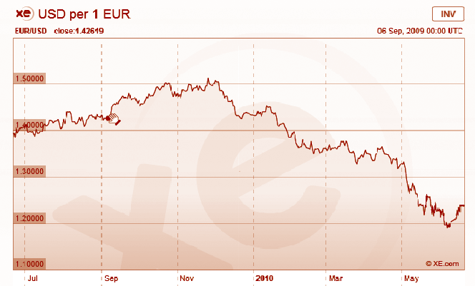
Section M: Student Activity 9
For currency conversion rates see: www.xe.com
Jean has a sister in America whom she planned to visit in May 2010. She had been watching the currency markets from July 2009 to May 2010 to decide when to buy US dollars (US$) for her trip.
a) When should she have bought dollars to give her the maximum amount of dollars for her euro in this period. Using the above chart, for reference
http://www.xe.com/currencycharts/?from=EUR&to=USD&view=1Y
b) Estimate from the chart the exchange rate at that time in US$/€.
c) How many US$ would she have got for €500 at that exchange rate?
d) Jean returned to Ireland in mid June 2010. Looking at the trend in the above chart do you think it was wise for her to change her leftover dollars to euro immediately? Explain.

Slide 23
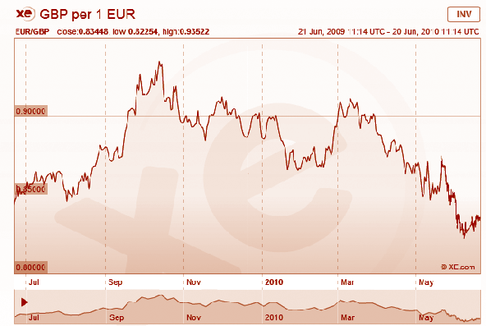
2. Some shoppers in the south of Ireland decided to shop in Northern
Ireland due to changes in the currency exchange rate between the euro
and pound sterling. Using the chart below, can you decide when they
would have benefited most from this decision? Justify your answer.

Slide 24
3. Tom works for Agrimachines in Carlow. He has made a deal with a customer in Northern Ireland to sell him a machine for €15,000. At the time the deal was made the euro was worth £0.89. When the customer was paying a short time later the euro had fallen from £0.89 to £0.83. Was this good news for the customer? Justify your answer by calculating how much he would have paid in pounds sterling at both exchange rates.
4. Without using a calculator determine how much a machine costing €10,000 in Carlow would cost a customer in Northern Ireland when the exchange rate is £0.83/€. How much would a machine costing €5,000 in Carlow cost in Northern Ireland at the same exchange rate? Hence, how many £ sterling correspond to €15,000?
5. Colette is a currency trader for National Bank. Each day she buys and sells currencies in order to make a profit. In order to trade profitably she needs to know the conversion rates for several currencies. Can you help her answer some of the questions she has to deal with on a particular day? (If you wish, you can insert the actual conversion rates on the day you are doing these questions by checking on www.xe.com or any other relevant site or source of information.)
a) Colette knows that on a particular day €1 buys 112.177 Japanese Yen. How much would it cost Colette’s bank to buy 1,000,000 Yen? Use a table to show the information.

Slide 25
a) Colette knows that on a particular day €1 buys 112.177 Japanese Yen. How much would it cost Colette’s bank to buy 1,000,000 Yen? Use a table to show the information.
b) The Thailand Baht (THB) is at a low of 0.38 Mexican Pesos (MXN). How many
THB can Colette purchase for 1,000,000 MXN?
c) Colette knows that one euro will buy 1.42 Australian Dollars (AUD). How many euros will 1AUD buy? The Australian Dollar has dropped from 1.79 AUD/€ to 1.42 AUD /€. Is this a good time for Colette to trade AUD for euro or euro for AUD? Justify your answer.
d) €1 will buy 57 Indian Rupees (INR). €1 will buy US$1.24 (USD). How many INR will one USD buy? Before calculating, predict whether it will be more or less than 57 INR.
e) Colette went on a trip to London. While shopping there, she saw a pair of shoes identical to a pair she had bought in Dublin for €88. In the London shop they cost £76. She knew that the exchange rate was £0.83/€. Which city was giving the better deal on the shoes? Explain.
f) From London Colette was due to visit Switzerland and then Norway. She decided to cancel her trip to Norway and changed the 1,000 Norwegian Kroner (NOK) she had for Swiss Francs (CHF). At the currency exchange she received 174.22 CHF for her 1,000 NOK (no commission charge included). How many Norwegian Kroner did 1 Swiss Franc buy?
g) Her hotel room in Zurich cost her 179 Swiss Francs per night. How much is this in euro if the exchange rate was €1 = 1.23 Swiss Francs? Predict first whether the answer in euro will be greater than or less than €179

Slide 26
e) Colette went on a trip to London. While shopping there, she saw a pair of shoes identical to a pair she had bought in Dublin for €88. In the London shop they cost £76. She knew that the exchange rate was £0.83/€. Which city was giving the better deal on the shoes? Explain.
f) From London Colette was due to visit Switzerland and then Norway. She decided to cancel her trip to Norway and changed the 1,000 Norwegian Kroner (NOK) she had for Swiss Francs (CHF). At the currency exchange she received 174.22 CHF for her 1,000 NOK (no commission charge included). How many Norwegian Kroner did 1 Swiss Franc buy?
g) Her hotel room in Zurich cost her 179 Swiss Francs per night. How much is this in euro if the exchange rate was €1 = 1.23 Swiss Francs? Predict first whether the answer in euro will be greater than or less than €179

Slide 27
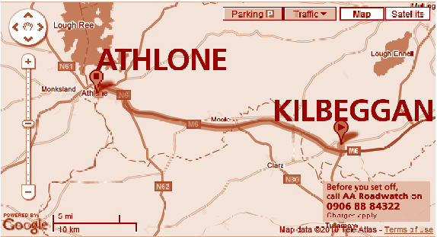
Section M: Student Activity 10
1. It takes 30 people 60 working days to build a small bridge. How many people
are needed if the bridge is to be built in 40 working days, assuming that they
all work at the same rate. First decide whether your answer will be more or
less than 30. How long would it take one person to build the bridge if it were
possible for them to do it alone?
2. Using the scale given on the
map to the right, work out the
distance between Kilbeggan and
Athlone in both km and miles.
Use this to find the approximate
ratio of miles to km in the form
1:n. Check that your answer is
close to the true ratio.
3. A prize of €10,000 is shared among 20 people. How much does each person
get? How much would each person get if the prize were shared among 80
people?

Slide 28
3. A prize of €10,000 is shared among 20 people. How much does each person
get? How much would each person get if the prize were shared among 80
people?
4. A group of workers in an office do the Lotto each week. One week they
won €400 and they received €16 each in prize money. If the prize had been
€2,800, how much would each one have received? Solve this problem in two
different ways.
5. A group of five tourists have sailed to a remote island, which has been cut off
from the mainland due to stormy weather. They have enough food for 5 days
if they eat 1kg per day. How many days will their food last if they eat (i) 200g
per day (ii) 1.5kg per day?
6. The scale on a map is 1: 20,000. Find the distance in centimetres on the map
representing an actual distance of 1km.
7. A room needs 500 tiles measuring 15cm x 15cm to cover the floor. How many
tiles measuring 25cm x 25cm would be needed to tile the same floor?
8. Two students go on holidays planning to spend €40 per day for a holiday
lasting 8 days. They end up spending €60 per day. How many days can the
money last at this rate of spending?
9. Mark drives home in 2 hours if he drives at an average speed of 75km/h. If he
drives at an average speed of 80km/h, how long will the journey take him?
10. The water supply for a community is stored in a water tower. A pumping
station can fill the tower’s tank at 600 litres per minute in 3 hours if no water
is being drawn from the tank. How long will the tank take to fill if water
is being drawn off at the rate of (i) 200 litres per minute (ii) 400 litres per
minute?

Slide 29
7. A room needs 500 tiles measuring 15cm x 15cm to cover the floor. How many
tiles measuring 25cm x 25cm would be needed to tile the same floor?
8. Two students go on holidays planning to spend €40 per day for a holiday
lasting 8 days. They end up spending €60 per day. How many days can the money last at this rate of spending?
9. Mark drives home in 2 hours if he drives at an average speed of 75km/h. If he
drives at an average speed of 80km/h, how long will the journey take him?
10. The water supply for a community is stored in a water tower. A pumping
station can fill the tower’s tank at 600 litres per minute in 3 hours if no water is being drawn from the tank. How long will the tank take to fill if water is being drawn off at the rate of (i) 200 litres per minute (ii) 400 litres per minute?

Slide 30
Section O: Student Activity 11
1. A chef can make 3 apple tarts in an hour. His helper can make 3 apple tarts in 2 hours. They need to make 27 apple tarts. How long will this take them working together?
2. Two taps are filling a bath. It takes one tap 4 minutes to fill the bath and the other tap 5 minutes. How long will it take to fill the bath with both taps filling at the given rates?
3. Olive has a report to type which is 10,000 words long. She can type at an average speed of 50 words per minute. How long will it take her to type the report typing at this speed? Her friend George can type at 60 words per minute. She gives George 3/5 of the report to type while she types the remainder. How long will it take now to type the report?
4. One combine harvester can harvest a field of corn in 4.5 hours. Another
harvester can harvest the same field in 3 hours. If the farmer uses the two
harvesters at the same time how long will it take to harvest the entire field?
5. A fruit grower estimates that his crop of strawberries should yield 70 baskets.
His three children agree to pick the strawberries. On average, one child can
pick 2 baskets in 1.5 hours, another child can pick 4 baskets in 2.5 hours and
his third child can pick 5 baskets in 4 hours. How long will it take the 3 of
them working together to pick 70 baskets of the fruit?
6. Write a question that involves combining 2 different rates.
7. Write a question that involves combining 3 different rates.

Slide 31
4. One combine harvester can harvest a field of corn in 4.5 hours. Another
harvester can harvest the same field in 3 hours. If the farmer uses the two
harvesters at the same time how long will it take to harvest the entire field?
5. A fruit grower estimates that his crop of strawberries should yield 70 baskets.
His three children agree to pick the strawberries. On average, one child can pick 2 baskets in 1.5 hours, another child can pick 4 baskets in 2.5 hours and his third child can pick 5 baskets in 4 hours. How long will it take the 3 of them working together to pick 70 baskets of the fruit?
6. Write a question that involves combining 2 different rates.
7. Write a question that involves combining 3 different rates.

Slide 32
Section J: Appendix 1: Partitioning

