Slide 1
Using your calculator
Using Ran#
Using Ranint
Finding Standard Deviation
Finding Correlation Coefficient
Go
Go
Go
Go

Slide 2
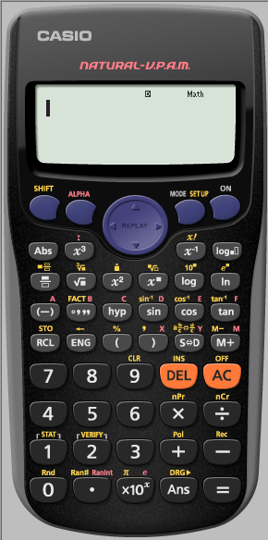
Random Sampling using Ran#
The Ran#: Generates a pseudo random number to 3 decimal places that is less than 1.
i.e. it generates a random number in the range [0, 1]
Ran# is in Yellow

Slide 3
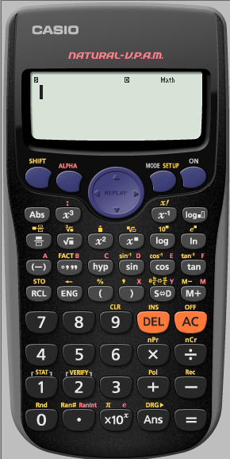
Random Sampling using Ran#

Slide 4
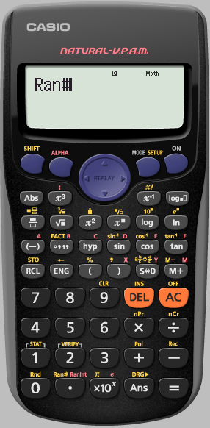
Random Sampling using Ran#
To keep generating a random 3 digit number between
[0,1]
we repeatedly press
=

Slide 5
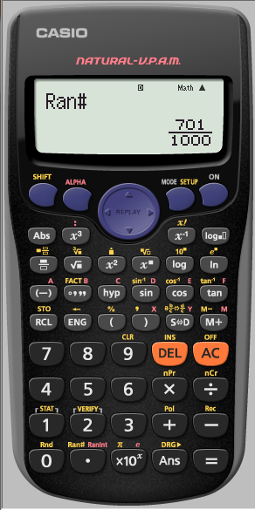
Random Sampling using Ran#

Slide 6
Random Sampling using Ran#
The calculator automatically displays in Natural display.
If we are generating lots of numbers this may become annoying.
We need to Set UP the calculator into Linear Display
(as a single line …Decimals)

Slide 7
Random Sampling using Ran#

Slide 8
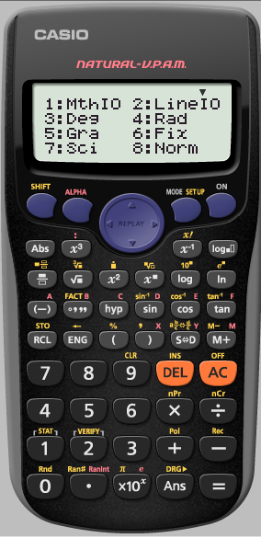
Random Sampling using Ran#
We want it Linear

Slide 9
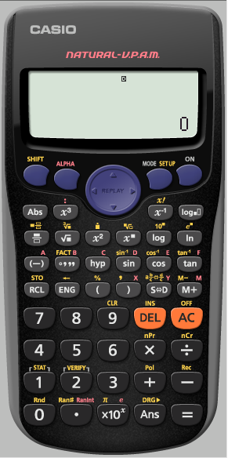
Random Sampling using Ran#
we want a random number again

Slide 10
Random Sampling using Ran#

Slide 11
Random Sampling using Ran#
To keep generating a random 3 digit number between
[0,1]
we repeatedly press
=

Slide 12
Random Sampling using Ran#

Slide 13
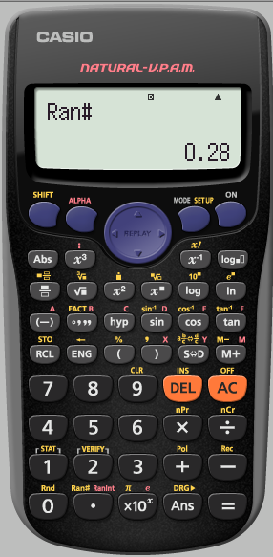
Random Sampling using Ran#

Slide 14
Using Ran# to generate a random whole number within a given interval
[1,200]
If we multiply the randomly generated number by 199 then
199 x [0, 1] = [0, 199]
To get it between 1 and 200 we must add 1
199 x [0, 1] + 1 = [1, 200]
But we must first SET UP the calculator to Fix to 0 decimal place

Slide 15
But we must first SET UP the calculator to Fix to 0 decimal place

Slide 16
But we must first SET UP the calculator to Fix to 0 decimal place

Slide 17
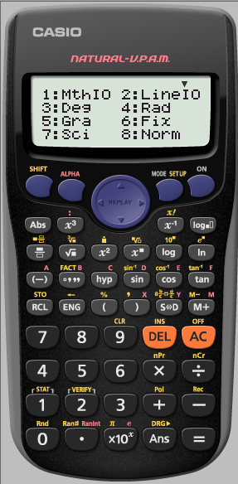
But we must first SET UP the calculator to Fix to 0 decimal place

Slide 18
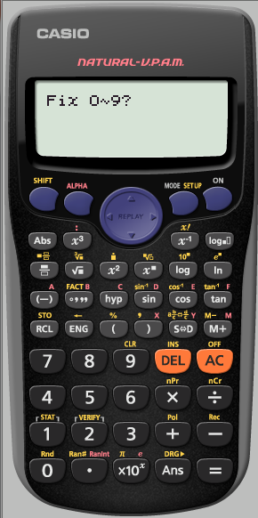
But we must first SET UP the calculator to Fix to 0 decimal place

Slide 19
The calculator tells us it has been
SET UP
To
Fix
We now need to tell it what we want
199 x [0, 1] + 1

Slide 21
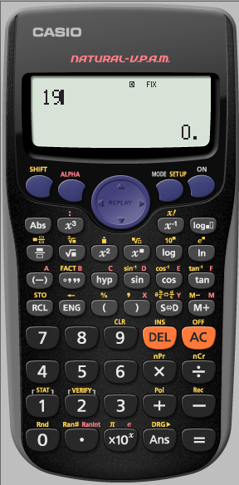

Slide 22
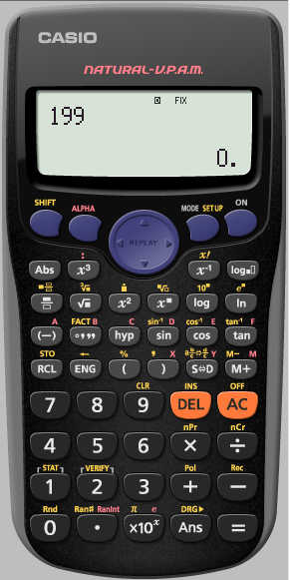

Slide 23
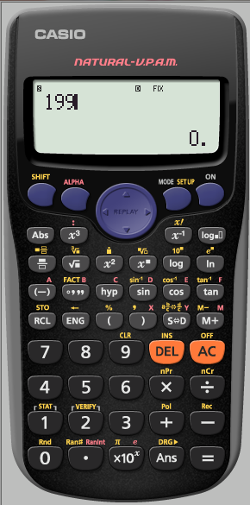

Slide 24
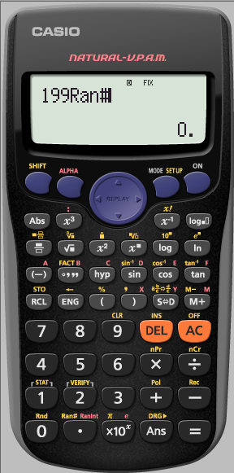

Slide 26
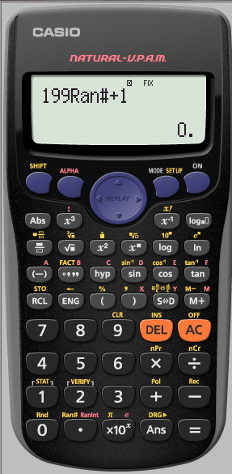

Slide 29
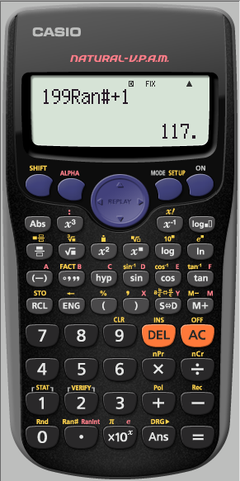

Slide 30
Using your calculator
Using Ran#
Using Ranint
Finding Standard Deviation
Finding Correlation Coefficient
Go
Go
Go
Go

Slide 31
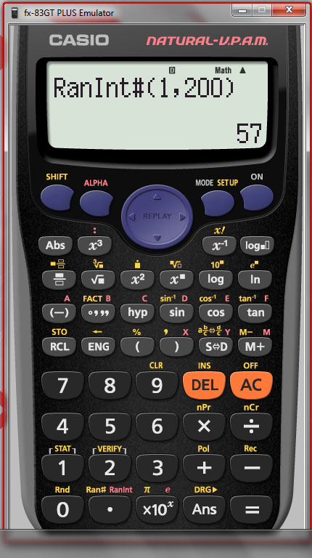
Generating whole numbers in a given interval [1,200] using Ranint

Slide 32
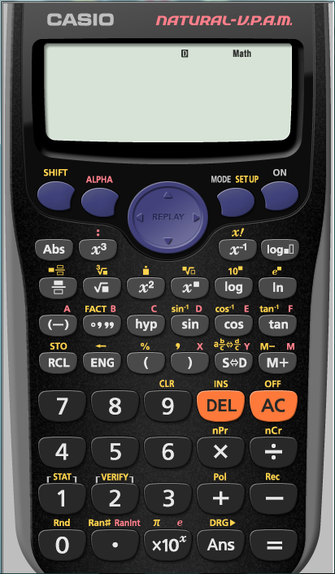
Using Ranint
Ranint is in Red

Slide 33
Using Ranint

Slide 34
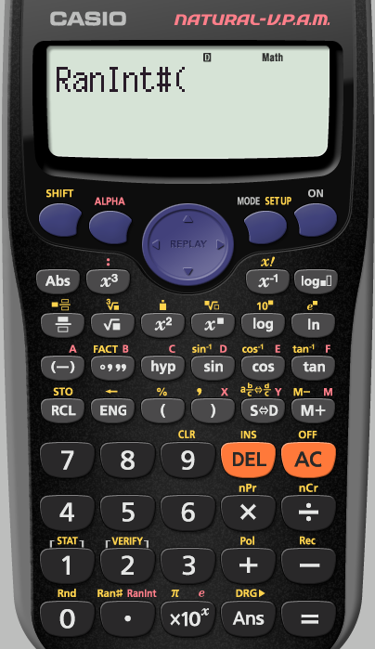
Using Ranint
We want our interval to be
[1,200]

Slide 35
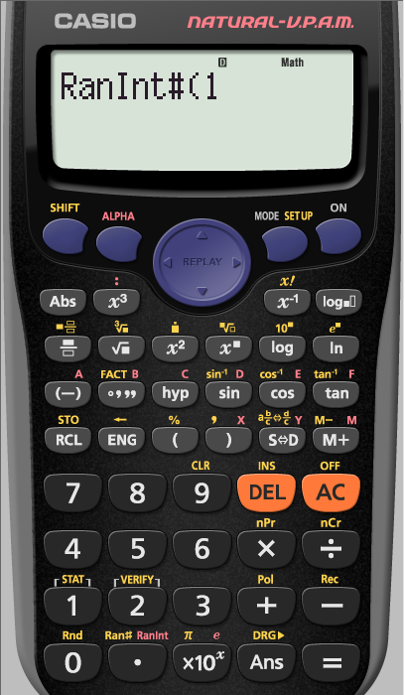
Using Ranint
The comma is here in yellow

Slide 36
Using Ranint
The comma is here in yellow

Slide 37
Using Ranint

Slide 38
Using Ranint

Slide 39
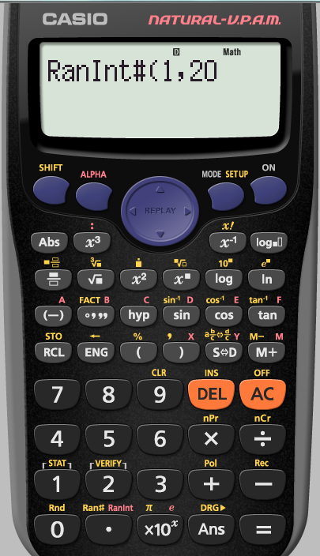
Using Ranint

Slide 40
Using Ranint
The bracket is here

Slide 41
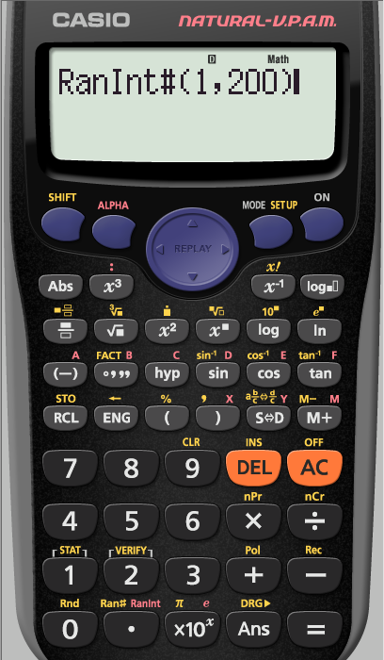
Using Ranint
To keep generating a random 3 digit number between
[1,200]
we repeatedly press
=

Slide 42
Using Ranint

Slide 43
Using Ranint

Slide 44
Using your calculator
Using Ran#
Using Ranint
Finding Standard Deviation
Finding Correlation Coefficient
Go
Go
Go
Go

Slide 45
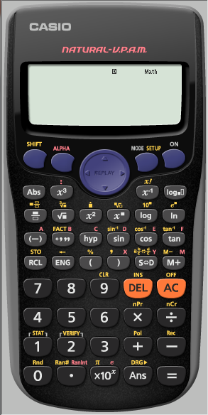
Finding Standard Deviation
Find the Standard Deviation
of 6,5,5,4,5,5,6,5 and 4
We first need to make sure
the calculator is clear of all
previous content

Slide 46
Finding Standard Deviation
Find the Standard Deviation
of 6,5,5,4,5,5,6,5 and 4
We first need to make sure
the calculator is clear of all
previous content

Slide 47
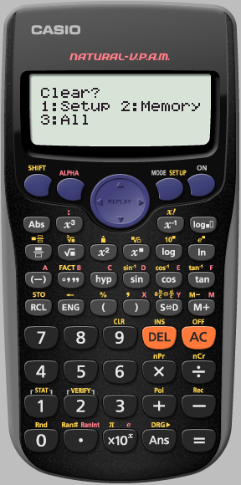
Finding Standard Deviation
Find the Standard Deviation
of 6,5,5,4,5,5,6,5 and 4
We want to clear ALL

Slide 48
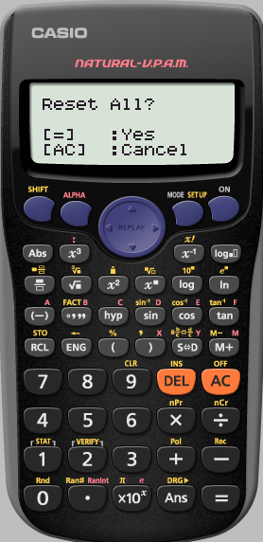
Finding Standard Deviation
Find the Standard Deviation
of 6,5,5,4,5,5,6,5 and 4
Yes reset all

Slide 49
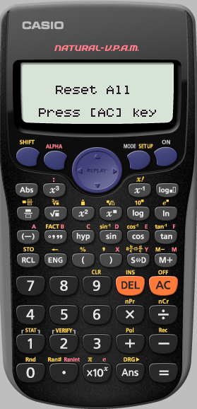
Finding Standard Deviation
Find the Standard Deviation
of 6,5,5,4,5,5,6,5 and 4
We really do agree
AC

Slide 50
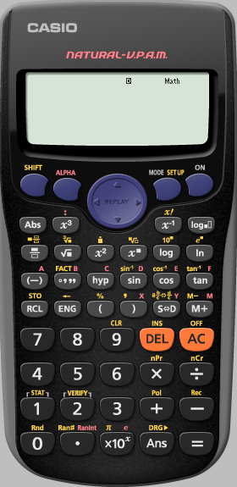
Finding Standard Deviation
Find the Standard Deviation
of 6,5,5,4,5,5,6,5 and 4
We want the calculator
in stats mode

Slide 51
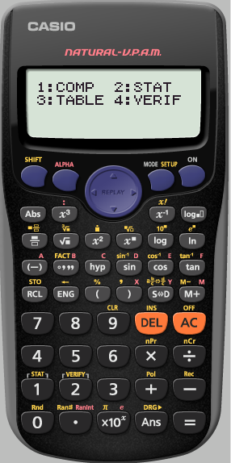
Finding Standard Deviation
Find the Standard Deviation
of 6,5,5,4,5,5,6,5 and 4
We want the calculator
in stats mode

Slide 52
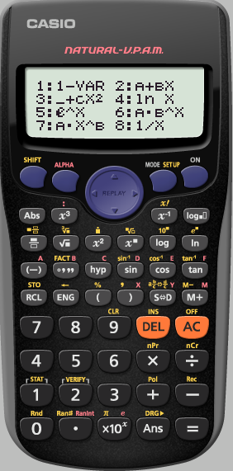
Finding Standard Deviation
Find the Standard Deviation
of 6,5,5,4,5,5,6,5 and 4
We only have 1 variable

Slide 53
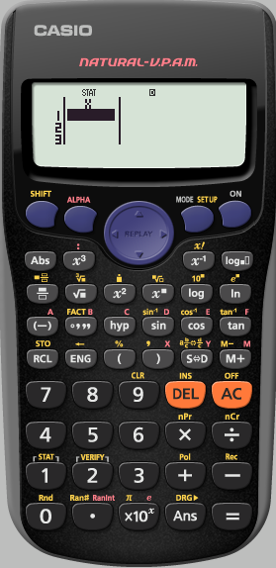
Finding Standard Deviation
Find the Standard Deviation
of 6,5,5,4,5,5,6,5 and 4
We now input
our data pressing
=
after each term

Slide 54
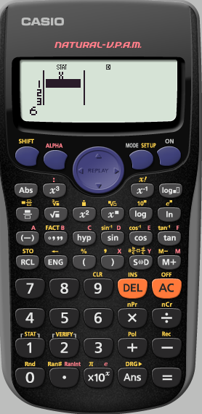
Finding Standard Deviation
Find the Standard Deviation
of 6,5,5,4,5,5,6,5 and 4

Slide 55
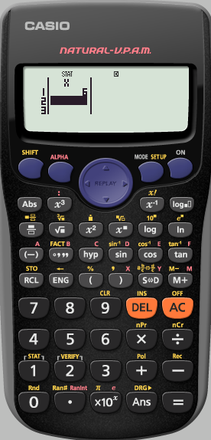
Finding Standard Deviation
Find the Standard Deviation
of 6,5,5,4,5,5,6,5 and 4

Slide 56
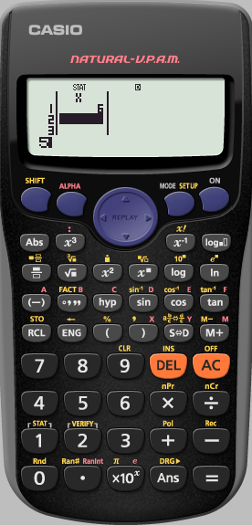
Finding Standard Deviation
Find the Standard Deviation
of 6,5,5,4,5,5,6,5 and 4

Slide 57
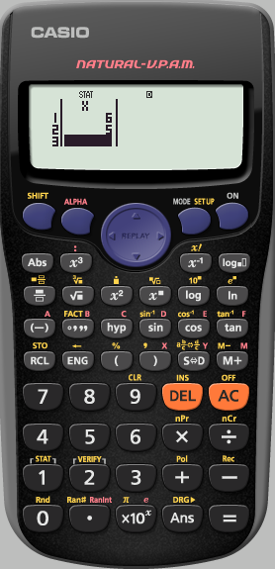
Finding Standard Deviation
Find the Standard Deviation
of 6,5,5,4,5,5,6,5 and 4
Repeat this process
until the data is entered

Slide 58
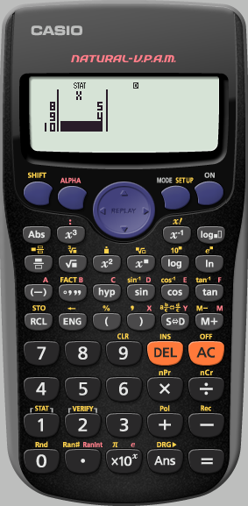
Finding Standard Deviation
Find the Standard Deviation
of 6,5,5,4,5,5,6,5 and 4
We have finished inputting the data.
We now need to get to where we can analyse it
Press AC

Slide 59
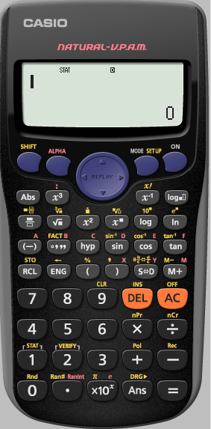
Finding Standard Deviation
Find the Standard Deviation
of 6,5,5,4,5,5,6,5 and 4
We need to analyse
the stats we have input

Slide 60
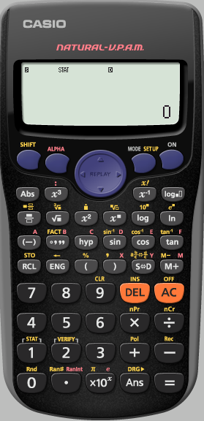
Finding Standard Deviation
Find the Standard Deviation
of 6,5,5,4,5,5,6,5 and 4
We need to analyse
the stats we have input

Slide 61
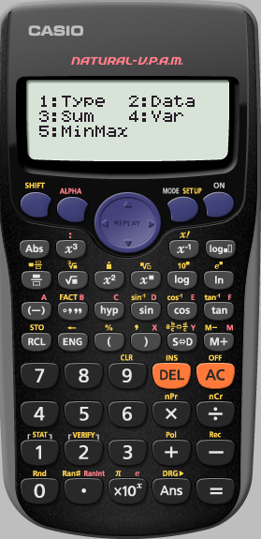
Finding Standard Deviation
Find the Standard Deviation
of 6,5,5,4,5,5,6,5 and 4
We want to see the
Variance

Slide 62
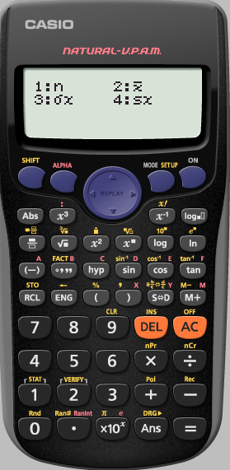
Finding Standard Deviation
Find the Standard Deviation
of 6,5,5,4,5,5,6,5 and 4
We want the
standard Deviation
σx

Slide 63
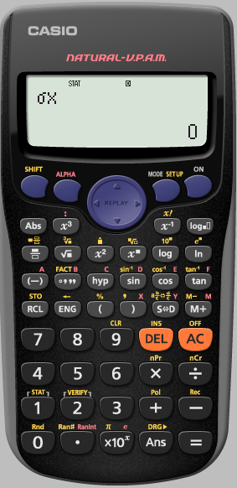
Finding Standard Deviation
Find the Standard Deviation
of 6,5,5,4,5,5,6,5 and 4

Slide 64
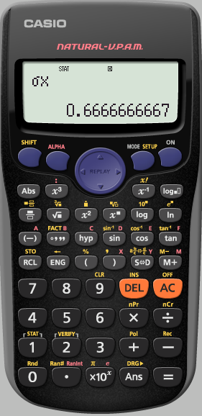
Finding Standard Deviation
Find the Standard Deviation
of 6,5,5,4,5,5,6,5 and 4
This is the
standard deviation
of the data set
To see more analysis details,
analyse the data again

Slide 65
Using your calculator
Using Ran#
Using Ranint
Finding Standard Deviation
Finding Correlation Coefficient
Go
Go
Go
Go

Slide 66
Finding Correlation Coefficient
Find the Correlation Coefficient for the following data
We first need to make sure
the calculator is clear of all
previous content
Rainfall (x cm) | 4.5 | 3.0 | 5.2 | 5.0 | 2.1 | 0 | 0 | 1.2 | 3.2
No. of tourists (1000’s | 5.0 | 8.0 | 0.8 | 4.2 | 4.8 | 7.4 | 9.4 | 8.6 | 2.6
Finding Correlation Coefficient

Slide 67
Rainfall (x cm) | 4.5 | 3.0 | 5.2 | 5.0 | 2.1 | 0 | 0 | 1.2 | 3.2
No. of tourists (1000’s | 5.0 | 8.0 | 0.8 | 4.2 | 4.8 | 7.4 | 9.4 | 8.6 | 2.6
We first need to make sure
the calculator is clear of all
previous content
Finding Correlation Coefficient

Slide 68
Rainfall (x cm) | 4.5 | 3.0 | 5.2 | 5.0 | 2.1 | 0 | 0 | 1.2 | 3.2
No. of tourists (1000’s | 5.0 | 8.0 | 0.8 | 4.2 | 4.8 | 7.4 | 9.4 | 8.6 | 2.6
We want to clear All
Finding Correlation Coefficient

Slide 69
Rainfall (x cm) | 4.5 | 3.0 | 5.2 | 5.0 | 2.1 | 0 | 0 | 1.2 | 3.2
No. of tourists (1000’s | 5.0 | 8.0 | 0.8 | 4.2 | 4.8 | 7.4 | 9.4 | 8.6 | 2.6
Yes Reset all
Finding Correlation Coefficient

Slide 70
Rainfall (x cm) | 4.5 | 3.0 | 5.2 | 5.0 | 2.1 | 0 | 0 | 1.2 | 3.2
No. of tourists (1000’s | 5.0 | 8.0 | 0.8 | 4.2 | 4.8 | 7.4 | 9.4 | 8.6 | 2.6
We really do agree
AC
Finding Correlation Coefficient

Slide 71
Rainfall (x cm) | 4.5 | 3.0 | 5.2 | 5.0 | 2.1 | 0 | 0 | 1.2 | 3.2
No. of tourists (1000’s | 5.0 | 8.0 | 0.8 | 4.2 | 4.8 | 7.4 | 9.4 | 8.6 | 2.6
We want the calculator
in stats mode
Finding Correlation Coefficient

Slide 72
Rainfall (x cm) | 4.5 | 3.0 | 5.2 | 5.0 | 2.1 | 0 | 0 | 1.2 | 3.2
No. of tourists (1000’s | 5.0 | 8.0 | 0.8 | 4.2 | 4.8 | 7.4 | 9.4 | 8.6 | 2.6
We want the calculator
in stats mode
Finding Correlation Coefficient

Slide 73
Rainfall (x cm) | 4.5 | 3.0 | 5.2 | 5.0 | 2.1 | 0 | 0 | 1.2 | 3.2
No. of tourists (1000’s | 5.0 | 8.0 | 0.8 | 4.2 | 4.8 | 7.4 | 9.4 | 8.6 | 2.6
We have 2 variables
Finding Correlation Coefficient

Slide 74
1 2 3 4 5 6 7 8 9
Rainfall (x cm) | 4.5 | 3.0 | 5.2 | 5.0 | 2.1 | 0 | 0 | 1.2 | 3.2
No. of tourists (1000’s | 5.0 | 8.0 | 0.8 | 4.2 | 4.8 | 7.4 | 9.4 | 8.6 | 2.6
Useful to write the
numbers 1,2,3,…
above each row so
as we can check
we are correct
We now input the first
row of the data
into the first column
of the table
pressing =
after each term
Finding Correlation Coefficient

Slide 75
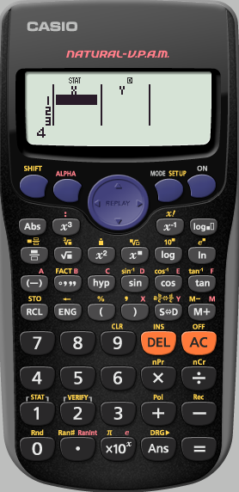
1 2 3 4 5 6 7 8 9
Rainfall (x cm) | 4.5 | 3.0 | 5.2 | 5.0 | 2.1 | 0 | 0 | 1.2 | 3.2
No. of tourists (1000’s | 5.0 | 8.0 | 0.8 | 4.2 | 4.8 | 7.4 | 9.4 | 8.6 | 2.6
Finding Correlation Coefficient

Slide 76
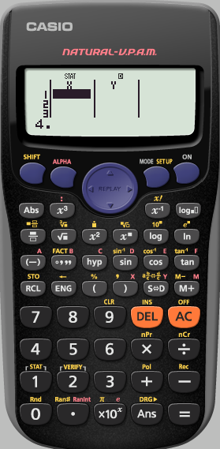
1 2 3 4 5 6 7 8 9
Rainfall (x cm) | 4.5 | 3.0 | 5.2 | 5.0 | 2.1 | 0 | 0 | 1.2 | 3.2
No. of tourists (1000’s | 5.0 | 8.0 | 0.8 | 4.2 | 4.8 | 7.4 | 9.4 | 8.6 | 2.6
Finding Correlation Coefficient

Slide 77
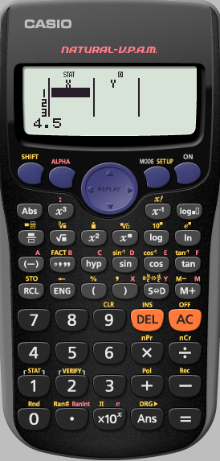
1 2 3 4 5 6 7 8 9
Rainfall (x cm) | 4.5 | 3.0 | 5.2 | 5.0 | 2.1 | 0 | 0 | 1.2 | 3.2
No. of tourists (1000’s | 5.0 | 8.0 | 0.8 | 4.2 | 4.8 | 7.4 | 9.4 | 8.6 | 2.6
Finding Correlation Coefficient

Slide 78
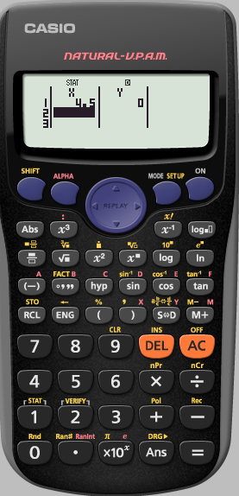
1 2 3 4 5 6 7 8 9
Rainfall (x cm) | 4.5 | 3.0 | 5.2 | 5.0 | 2.1 | 0 | 0 | 1.2 | 3.2
No. of tourists (1000’s | 5.0 | 8.0 | 0.8 | 4.2 | 4.8 | 7.4 | 9.4 | 8.6 | 2.6
Finding Correlation Coefficient

Slide 79
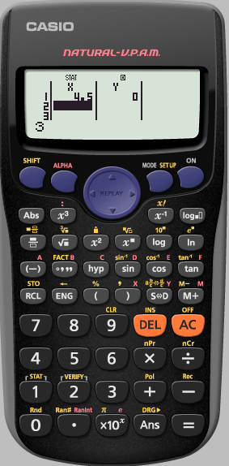
1 2 3 4 5 6 7 8 9
Rainfall (x cm) | 4.5 | 3.0 | 5.2 | 5.0 | 2.1 | 0 | 0 | 1.2 | 3.2
No. of tourists (1000’s | 5.0 | 8.0 | 0.8 | 4.2 | 4.8 | 7.4 | 9.4 | 8.6 | 2.6
Finding Correlation Coefficient

Slide 80
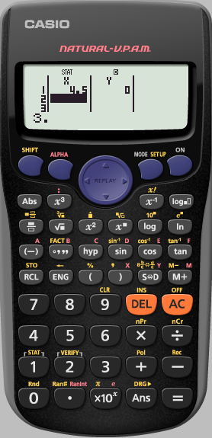
1 2 3 4 5 6 7 8 9
Rainfall (x cm) | 4.5 | 3.0 | 5.2 | 5.0 | 2.1 | 0 | 0 | 1.2 | 3.2
No. of tourists (1000’s | 5.0 | 8.0 | 0.8 | 4.2 | 4.8 | 7.4 | 9.4 | 8.6 | 2.6
Finding Correlation Coefficient

Slide 81
1 2 3 4 5 6 7 8 9
Rainfall (x cm) | 4.5 | 3.0 | 5.2 | 5.0 | 2.1 | 0 | 0 | 1.2 | 3.2
No. of tourists (1000’s | 5.0 | 8.0 | 0.8 | 4.2 | 4.8 | 7.4 | 9.4 | 8.6 | 2.6
Finding Correlation Coefficient

Slide 82
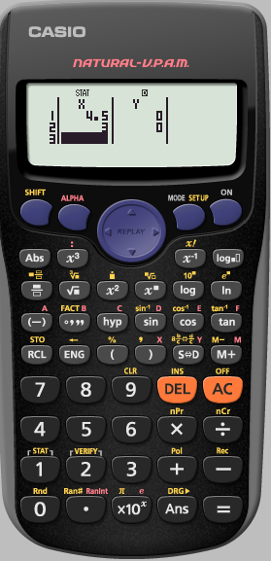
1 2 3 4 5 6 7 8 9
Rainfall (x cm) | 4.5 | 3.0 | 5.2 | 5.0 | 2.1 | 0 | 0 | 1.2 | 3.2
No. of tourists (1000’s | 5.0 | 8.0 | 0.8 | 4.2 | 4.8 | 7.4 | 9.4 | 8.6 | 2.6
Repeat this process
until the first row
has been entered
Finding Correlation Coefficient

Slide 83
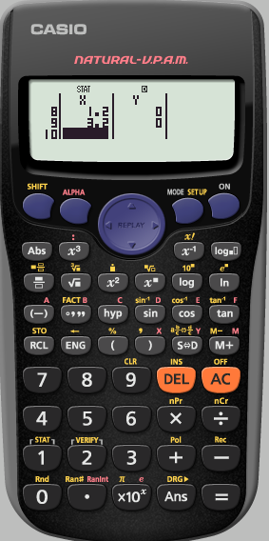
1 2 3 4 5 6 7 8 9
Rainfall (x cm) | 4.5 | 3.0 | 5.2 | 5.0 | 2.1 | 0 | 0 | 1.2 | 3.2
No. of tourists (1000’s | 5.0 | 8.0 | 0.8 | 4.2 | 4.8 | 7.4 | 9.4 | 8.6 | 2.6
Use the cursor
keys to enter
the data from
the second row
Finding Correlation Coefficient

Slide 84
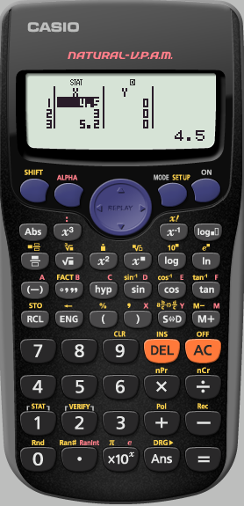
1 2 3 4 5 6 7 8 9
Rainfall (x cm) | 4.5 | 3.0 | 5.2 | 5.0 | 2.1 | 0 | 0 | 1.2 | 3.2
No. of tourists (1000’s | 5.0 | 8.0 | 0.8 | 4.2 | 4.8 | 7.4 | 9.4 | 8.6 | 2.6
Press the right cursor
Finding Correlation Coefficient

Slide 85
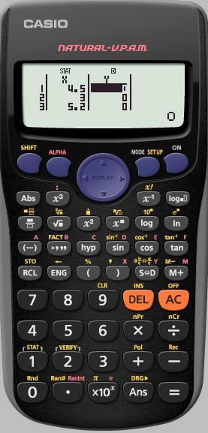
1 2 3 4 5 6 7 8 9
Rainfall (x cm) | 4.5 | 3.0 | 5.2 | 5.0 | 2.1 | 0 | 0 | 1.2 | 3.2
No. of tourists (1000’s | 5.0 | 8.0 | 0.8 | 4.2 | 4.8 | 7.4 | 9.4 | 8.6 | 2.6
Finding Correlation Coefficient

Slide 86
1 2 3 4 5 6 7 8 9
Rainfall (x cm) | 4.5 | 3.0 | 5.2 | 5.0 | 2.1 | 0 | 0 | 1.2 | 3.2
No. of tourists (1000’s | 5.0 | 8.0 | 0.8 | 4.2 | 4.8 | 7.4 | 9.4 | 8.6 | 2.6
Input the data from
the second row
Finding Correlation Coefficient

Slide 87
1 2 3 4 5 6 7 8 9
Rainfall (x cm) | 4.5 | 3.0 | 5.2 | 5.0 | 2.1 | 0 | 0 | 1.2 | 3.2
No. of tourists (1000’s | 5.0 | 8.0 | 0.8 | 4.2 | 4.8 | 7.4 | 9.4 | 8.6 | 2.6
We have finished
inputting the data.
We now need to
analyse the STATS
Press AC
Finding Correlation Coefficient

Slide 88
1 2 3 4 5 6 7 8 9
Rainfall (x cm) | 4.5 | 3.0 | 5.2 | 5.0 | 2.1 | 0 | 0 | 1.2 | 3.2
No. of tourists (1000’s | 5.0 | 8.0 | 0.8 | 4.2 | 4.8 | 7.4 | 9.4 | 8.6 | 2.6
We need to analyse
the stats we have input
Finding Correlation Coefficient

Slide 89
1 2 3 4 5 6 7 8 9
Rainfall (x cm) | 4.5 | 3.0 | 5.2 | 5.0 | 2.1 | 0 | 0 | 1.2 | 3.2
No. of tourists (1000’s | 5.0 | 8.0 | 0.8 | 4.2 | 4.8 | 7.4 | 9.4 | 8.6 | 2.6
We need to analyse
the stats we have input
Finding Correlation Coefficient

Slide 90
1 2 3 4 5 6 7 8 9
Rainfall (x cm) | 4.5 | 3.0 | 5.2 | 5.0 | 2.1 | 0 | 0 | 1.2 | 3.2
No. of tourists (1000’s | 5.0 | 8.0 | 0.8 | 4.2 | 4.8 | 7.4 | 9.4 | 8.6 | 2.6
We want use Regression
Finding Correlation Coefficient

Slide 91
1 2 3 4 5 6 7 8 9
Rainfall (x cm) | 4.5 | 3.0 | 5.2 | 5.0 | 2.1 | 0 | 0 | 1.2 | 3.2
No. of tourists (1000’s | 5.0 | 8.0 | 0.8 | 4.2 | 4.8 | 7.4 | 9.4 | 8.6 | 2.6
We want the
Correlation Coefficient
r
Finding Correlation Coefficient

Slide 92
1 2 3 4 5 6 7 8 9
Rainfall (x cm) | 4.5 | 3.0 | 5.2 | 5.0 | 2.1 | 0 | 0 | 1.2 | 3.2
No. of tourists (1000’s | 5.0 | 8.0 | 0.8 | 4.2 | 4.8 | 7.4 | 9.4 | 8.6 | 2.6
Press
=
Finding Correlation Coefficient

Slide 93
1 2 3 4 5 6 7 8 9
Rainfall (x cm) | 4.5 | 3.0 | 5.2 | 5.0 | 2.1 | 0 | 0 | 1.2 | 3.2
No. of tourists (1000’s | 5.0 | 8.0 | 0.8 | 4.2 | 4.8 | 7.4 | 9.4 | 8.6 | 2.6
We have the
Correlation Coefficient
of the data
To see more analysis details
analyse the
STAT
Finding Correlation Coefficient

Slide 94
The line of Best Fit
The calculator uses
y = A + Bx
Instead of
y = mx + c
1: A → the y intercept
2: B → the Slope
Using the Equation of
the line of Best Fit
e.g. To find the value of y
when x is 9
Press 9
Then in regression
choose $\tilde{x}$ (4)
e.g. To find the value of x
when y is 3.2
Press 3.2
Then in regression
choose $\tilde{x}$ (4)

Slide 95
Using your calculator
Using Ran#
Using Ranint
Finding Standard Deviation
Finding Correlation Coefficient
Go
Go
Go
Go

