Slide 1
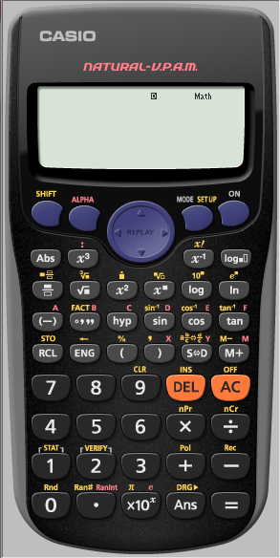
e.g. Write 5880 as a product of Prime Factors
We first need to let the calculator work with the number 5880
So we enter it
pressing
=
after

Slide 2
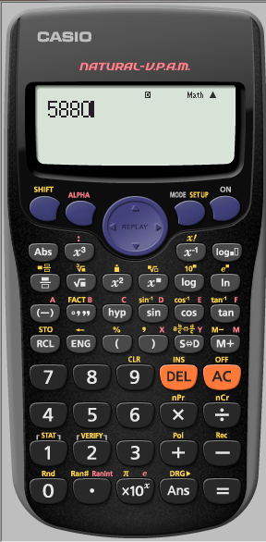
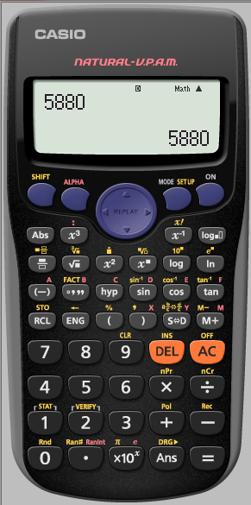
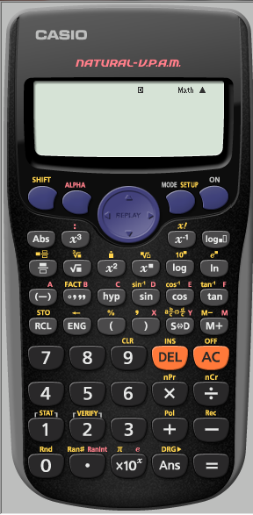

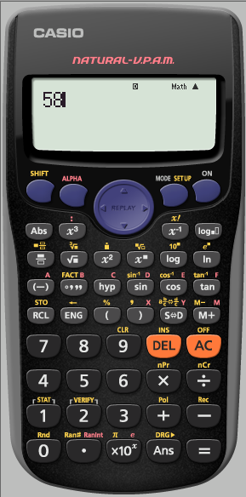

e.g. Write 5880 as a product of Prime Factors
We first need to let the calculator work with 5880
So we enter it
pressing
=
after

Slide 3
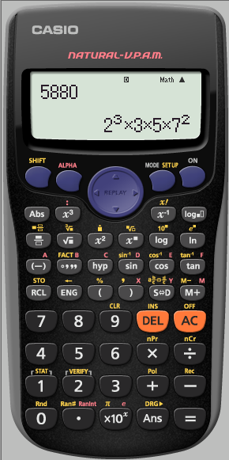
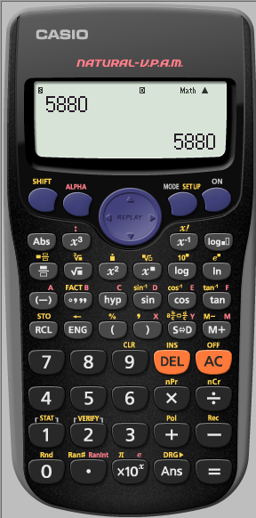
e.g. Write 5880 as a product of Prime Factors
We want to write the number as a product of Prime FACTors

