Slide 1
Finding the Mean
& the
Standard Deviation

Slide 2
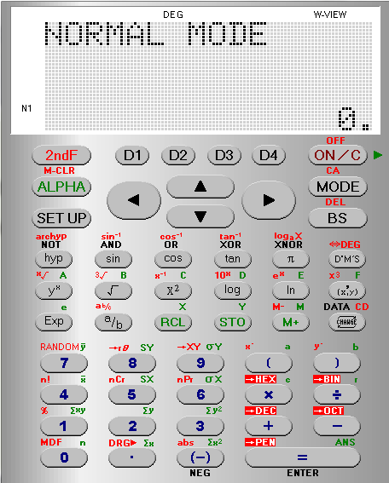
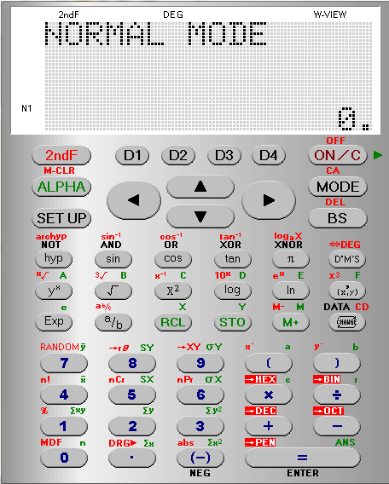
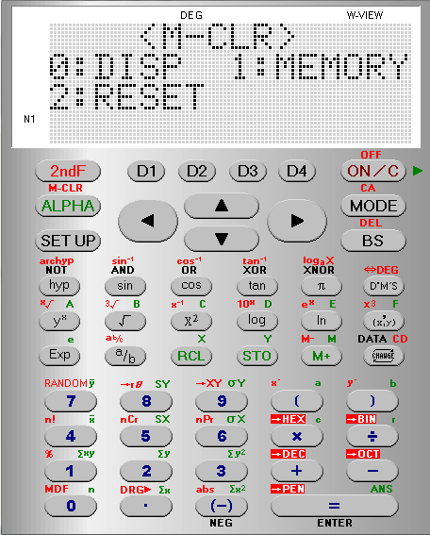
We want to
M CLR
the calculator to
Clear its Memory

Slide 3
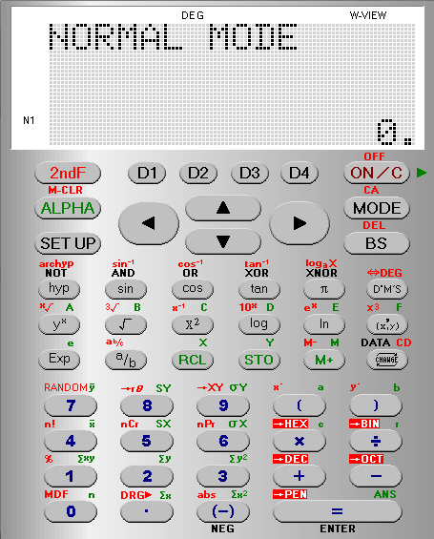
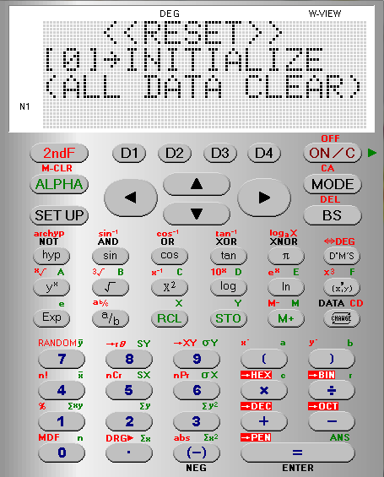

We want to
M CLR
the calculator to
Clear its Memory

Slide 4
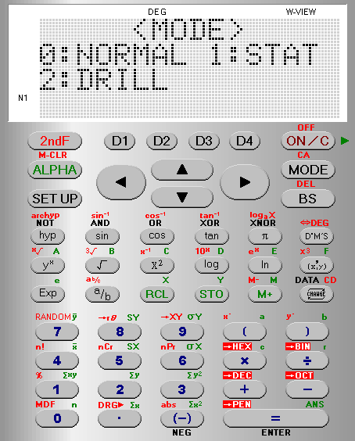
We want the calculator
in STATS mode

Slide 5
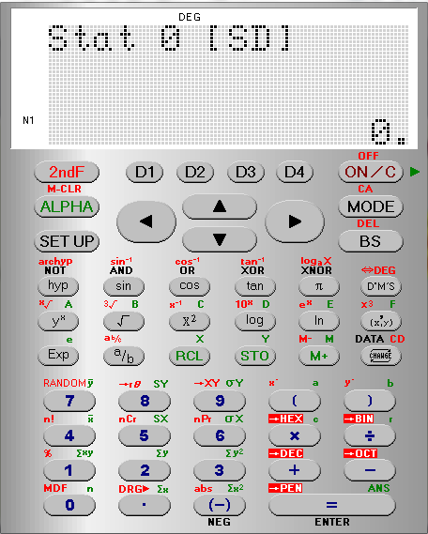
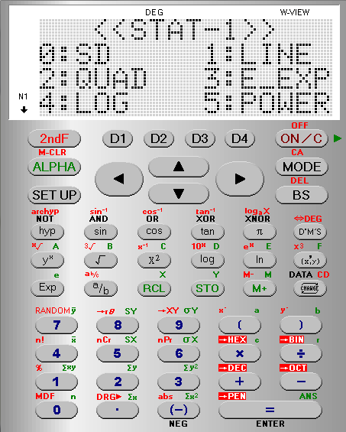
We want to find Single Variable Statistics
choose
SD

Slide 6
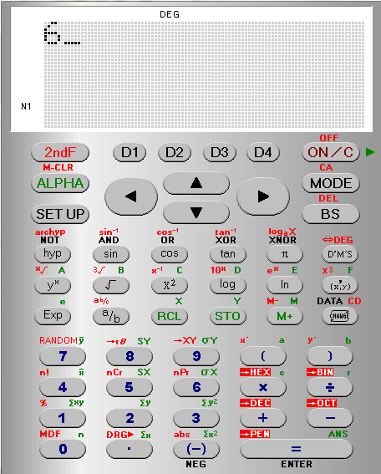
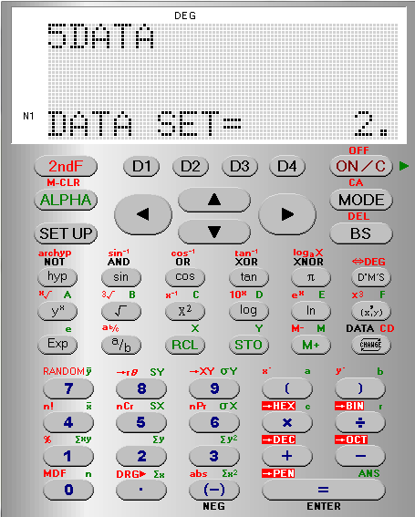
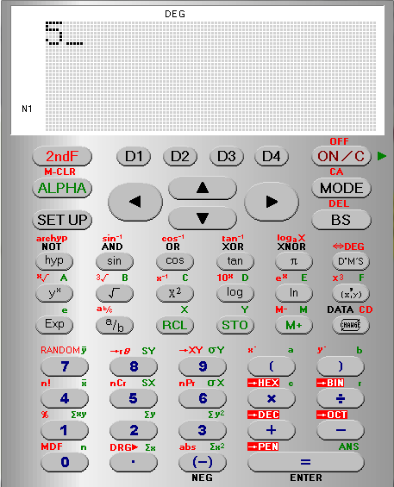
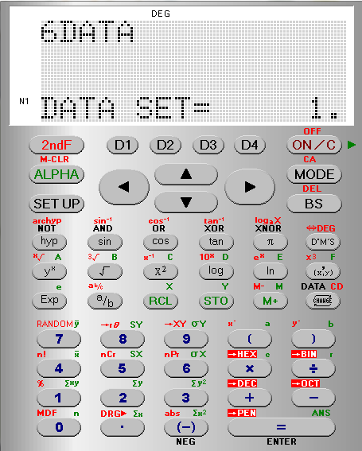
We enter each term pressing DATA after each one

Slide 7
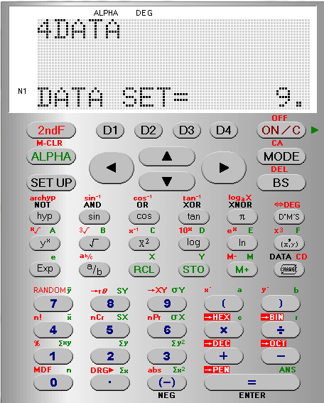
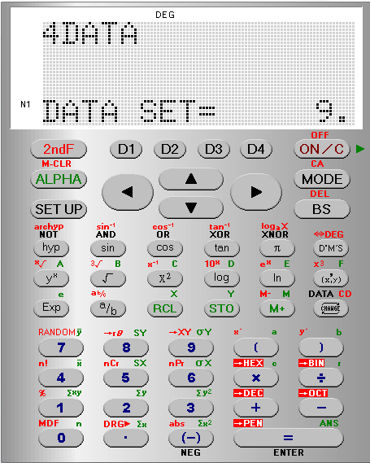

Slide 8
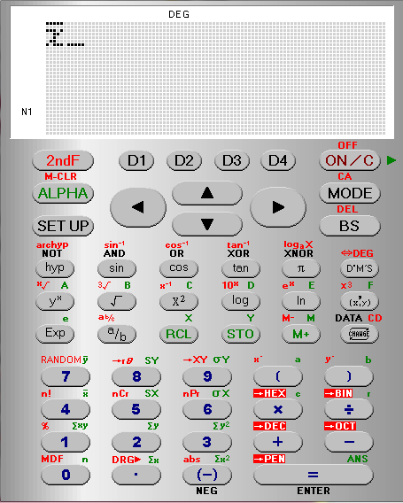
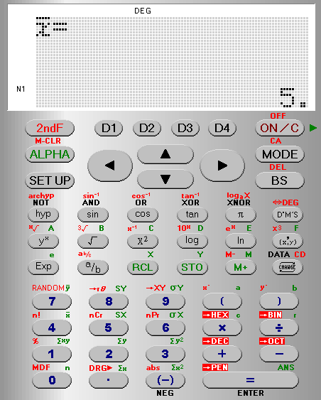
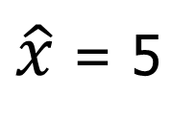

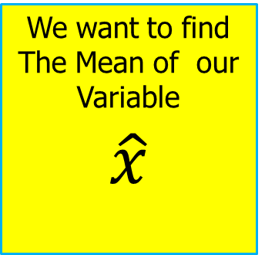
We want to find The Mean of our Variable
$$\hat{x}$$
$\hat{x}$ = 5
$$x$$

Slide 9
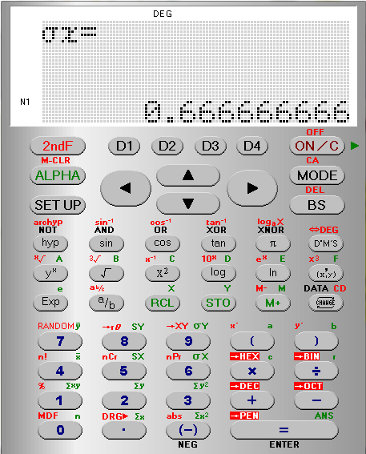
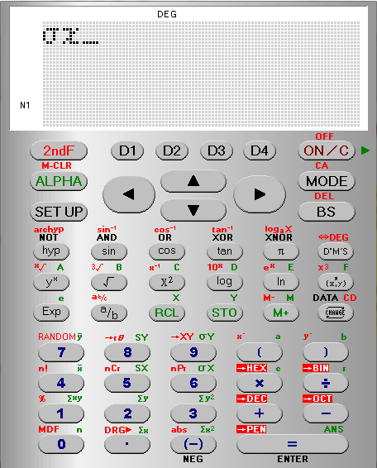
We want the
standard Deviation
σx
Its in Green so press ALPHA FIRST
The Standard Deviation = 0.67

Slide 10
E.g 1 The frequency table of the monthly salaries of 20 people
is shown below.
a) Calculate the mean of the salaries of the 20 people.
b) Calculate the standard deviation of the salaries of the 20
people.
salary(in €) | frequency
3500 | 5
4000 | 8
4200 | 5
4300 | 2

Slide 11
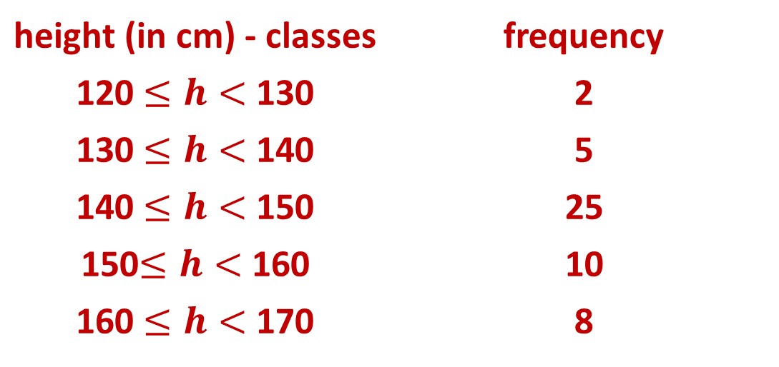
E.g 2. The following table shows the grouped data,
in classes, for the heights of 50 people.
a) Calculate the mean of the salaries of the 20 people.
b) Calculate the standard deviation of the salaries of
the 20 people
height (in cm) - classes | frequency
120 $≤h<$ 130 | 2
130 $≤h<$ 140 | 5
140 $≤h<$ 150 | 25
150$≤h<$ 160 | 10
160 $≤h<$ 170 | 8

Slide 12
E.g3. Consider the following three data sets A, B and C.
A = {9,10,11,7,13}
B = {10,10,10,10,10}
C = {1,1,10,19,19}
a) Calculate the mean of each data set.
b) Calculate the standard deviation of each data set.
c) Which set has the largest standard deviation?
d) Is it possible to answer question c) without
calculations of the standard deviation?

Slide 13
E.g 4.A given data set has a mean μ and a standard deviation σ.
a) What are the new values of the mean and the standard
deviation if the same constant k is added to each data
value in the given set? Explain.
b) What are the new values of the mean and the standard
deviation if each data value of the set is multiplied by
the same constant k? Explain.
E.g 5 If the standard deviation of a given data set is equal to
zero, what can we say about the data values included in
the given data set?

