Slide 1
Random Sampling using RANDOM

Slide 2
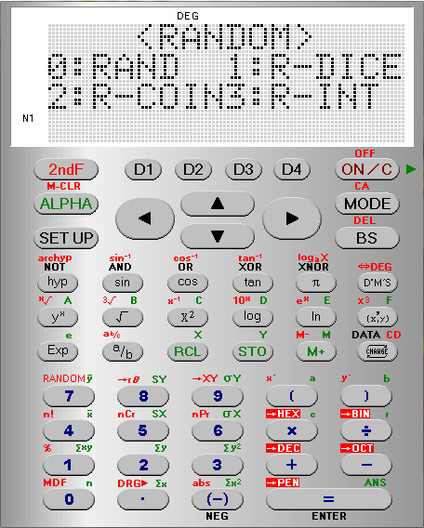
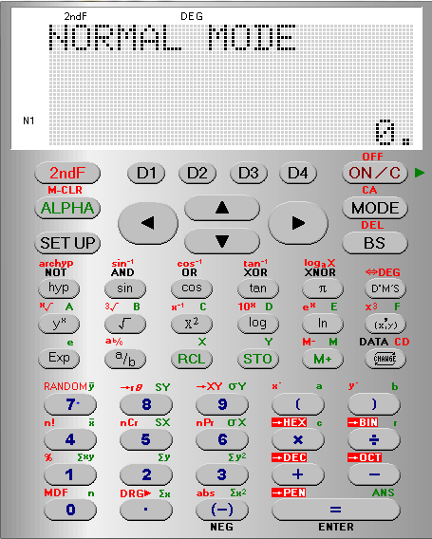
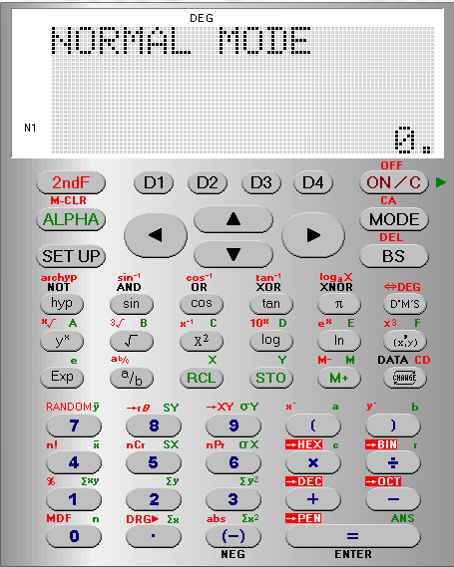
Random Sampling using RANDOM
Random: Generates a pseudo random number to 3 decimal places that is less than 1.
i.e. it generates a random number in the range [0, 1]
RANDOM
is in Red

Slide 3
Random Sampling using RANDOM
We want to choose a RANDom number [0,1]
R – DICE [1,6]
R-COINS [1,2]
R-INT [0,99]

Slide 4
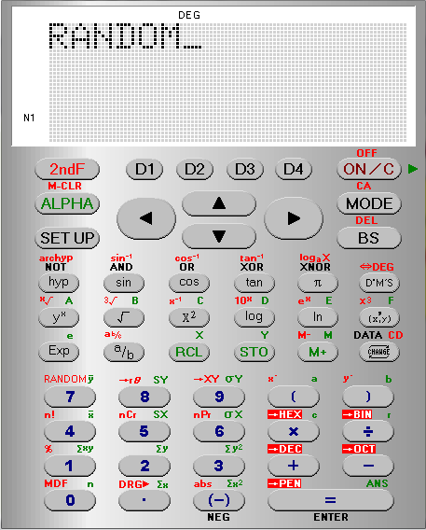
Random Sampling using RANDOM
To keep generating a random 3 digit number between
[0,1]
we repeatedly press
=

Slide 5
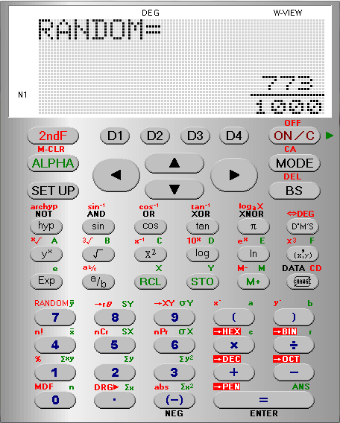
Random Sampling using RANDOM

Slide 6
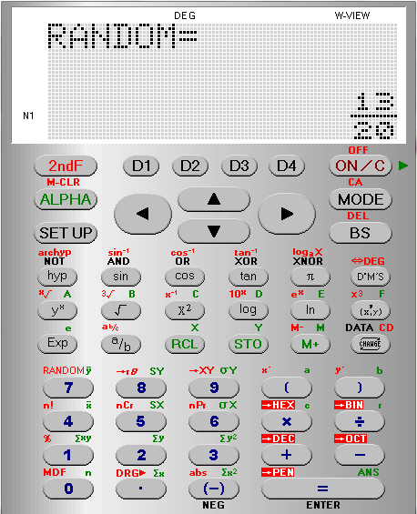
Random Sampling using RANDOM
The calculator automatically displays in
W View
If we are generating lots of numbers this may become annoying.
We need to SET UP the EDITOR into Linear Display
(as a single line …Decimals)

Slide 7
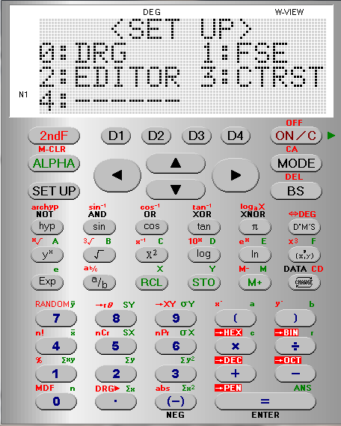
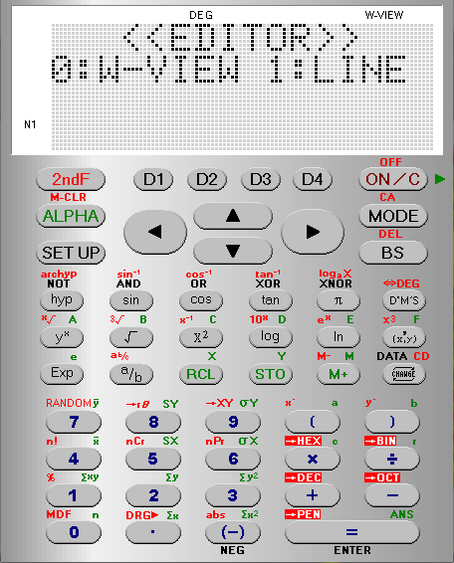
Random Sampling using RANDOM
The calculator automatically displays in
W View
If we are generating lots of numbers this may become annoying.
We need to
SET UP the EDITOR into LINEar Display
(as a single line …Decimals)

Slide 8
Random Sampling using RANDOM
We need to generate a RANDOM number again RANDOM
is in Red

Slide 9
Random Sampling using RANDOM
We want to choose a RANDom number

Slide 10
Random Sampling using RANDOM
To keep generating a random 3 digit number between
[0,1]
we repeatedly press
=

Slide 11
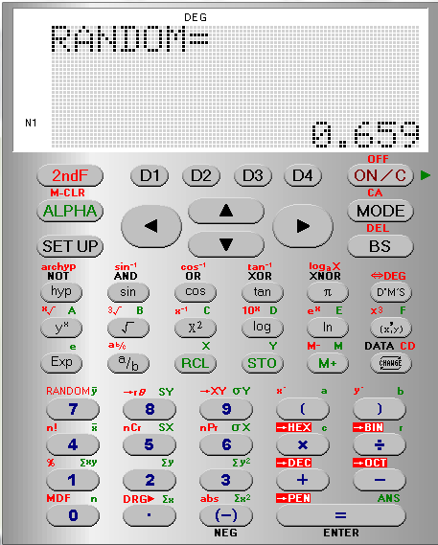
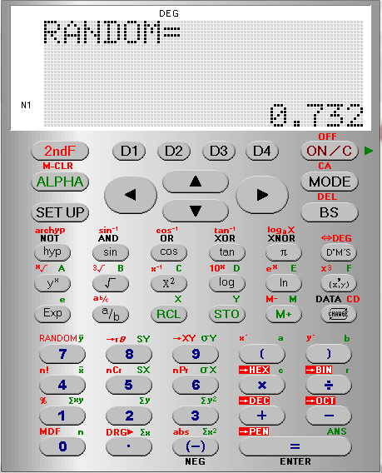
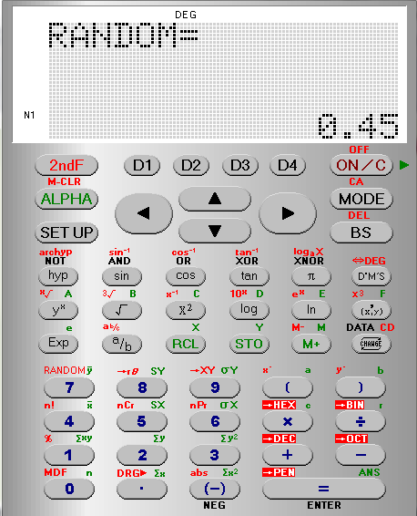
Random Sampling using RANDOM

Slide 12
Random Sampling using RANDOM
for an interval [1,200]
If we multiply the randomly generated number by 199 then
199 x [0, 1] = [0, 199]
To get it between 1 and 200 we must add 1
199 x [0, 1] + 1 = [1, 200]
But we must first SET UP the calculator to Fix to 0 decimal place

Slide 13
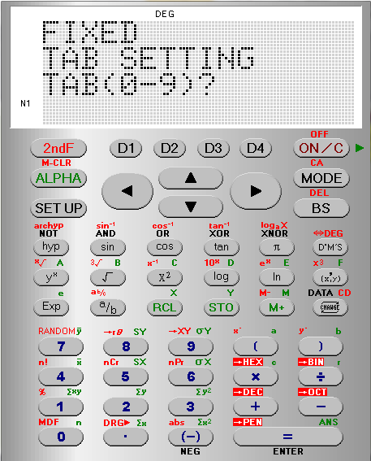
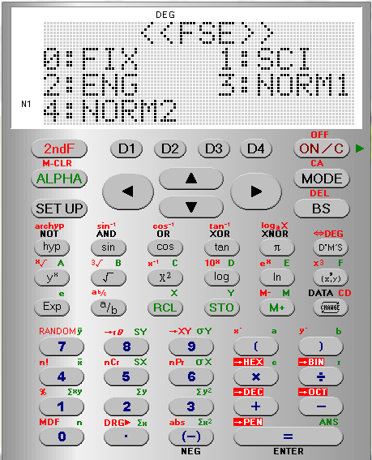
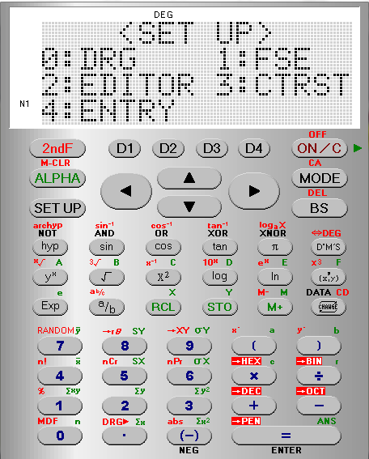
Random Sampling using RANDOM for an interval [1,200]
But we must first SET UP the calculator to Fix to 0 decimal place
We want
0
decimal places

Slide 14
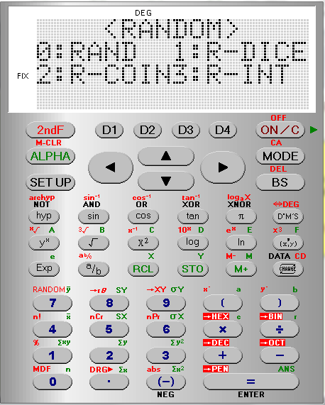
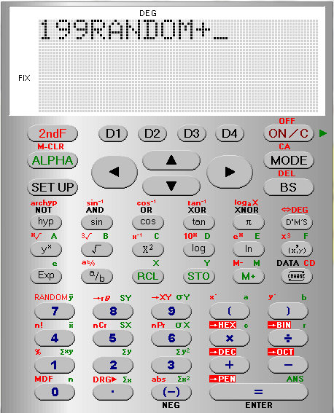
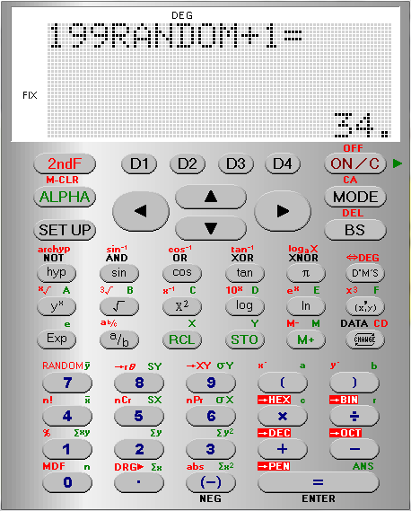
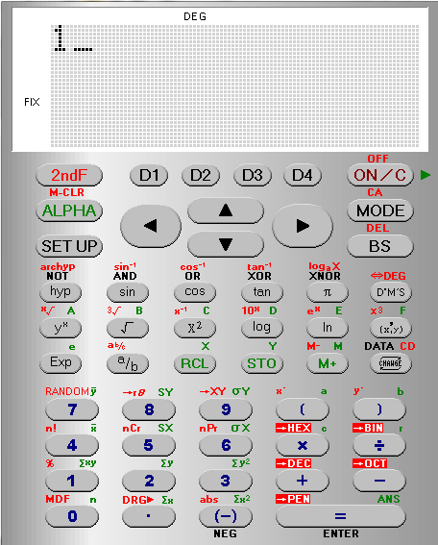
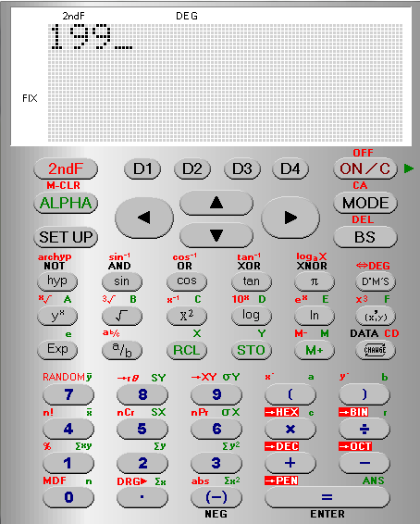
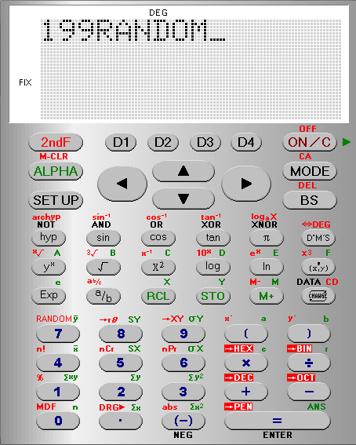
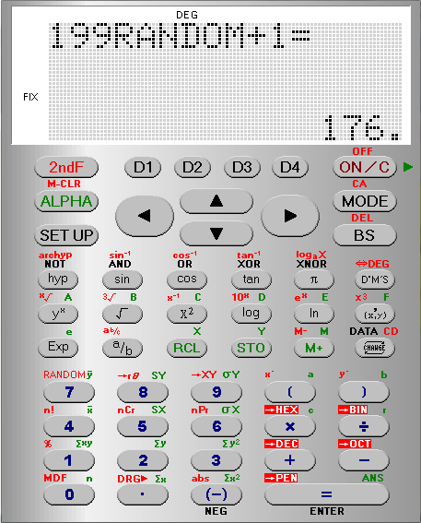
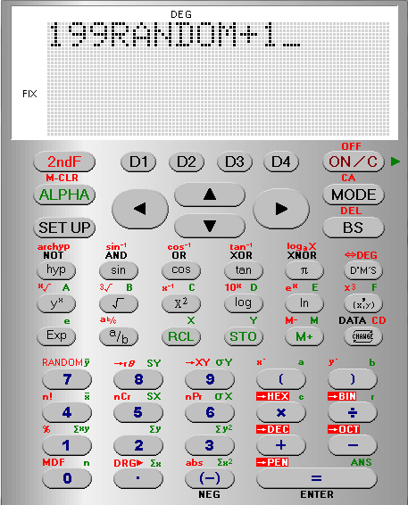
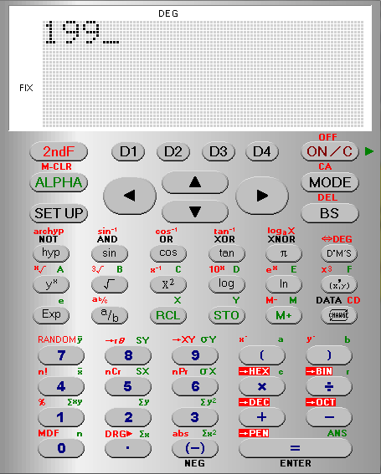
Random Sampling using RANDOM for an interval [1,200]
The calculator tells us it has been
SET UP
To
Fix
We now need to tell it what we want
199 x [0, 1] + 1

