Slide 1
Maths Counts Insights into Lesson Study

Slide 2
St Mark’s Community School
Sandra Fay, Irene Stone, Sharon Mack
First year Junior Cert
An Introduction to Patterns

Slide 3
Insights into Lesson Study
Introduction: Focus of Lesson
Student Learning: What we learned about students’ understanding based on data collected
Teaching Strategies: What we noticed about our own teaching
Strengths & Weaknesses of adopting the Lesson Study process

Slide 4
Introduction
Topic investigated: An Introduction to Patterns
How we planned the lesson:
We discussed the topic, methodology and probing questions for the teacher.
We decided to use the material on patterns available at http://www.projectmaths.ie/teachers/strand4-junior.asp.
We decided to introduce the class using Unifix Cubes.
We photocopied sheets in advance of the class.

Slide 5
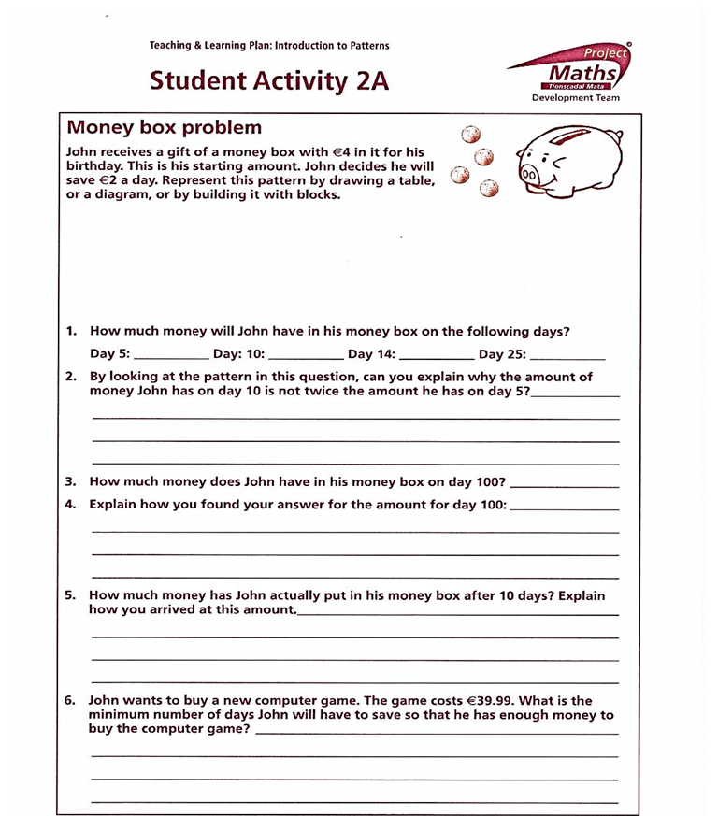
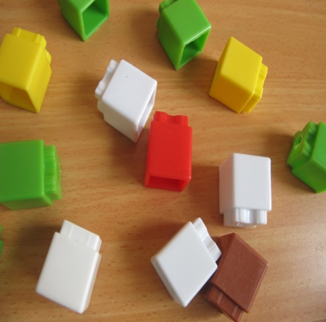
Introduction
Resources used:
Chalk and talk
Unifix cubes
Worksheets

Slide 6
Introduction
Learning Outcomes:
What is a pattern?
How to complete a table
Start value / Day 0
The change (difference) in the table and how to calculate this
How to tell if it is a linear pattern; constant change
Explaining in your own words what the pattern in the table is
Extending the pattern to days not shown in the table

Slide 7
Introduction
Why did we choose to focus on this mathematical area?
We wanted to investigate approaches to introducing this topic.
We realised that a strong introduction to patterns is needed to show students the importance of future predictions for all strands.
Patterns is not a stand-alone topic.

Slide 8
Introduction
Patterns
Number
Algebra
Functions
Trigonometry
Calculus
Area and Volume
Co-ordinate Geometry

Slide 9
Introduction
Enduring understandings of this lesson:
Understand patterns; spot, calculate and represent patterns in tables and graphs.
Describe in words what the pattern is and how it is arrived at.
Set a good foundation for algebra.
Place emphasis on the change, for future understanding of functions and calculus.

Slide 10
Reflections on the Lesson
Student Learning : What we learned about students’ understanding based on data collected
Teaching Strategies: What we noticed about our own teaching

Slide 11
Student Learning
Data Collected from the Lesson:
Academic, e.g. samples of students’ work
Motivation
Social Behaviour

Slide 12
Student Understanding
What we learned about the way different students understand the content of this topic?
Students like and benefit from an atmosphere, where they are encouraged to discuss and compare.
The importance of making connections with prior knowledge for example skip counting and collinear points.
Students liked explaining their approaches to solving the problems and their peers showed great interest.
Students benefit from peer assessment.

Slide 13
Student Understanding
Some students need to be encouraged to give explanations in writing.

Slide 14
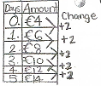
Effective Student Understanding
What effective understanding of this topic looks like:

Slide 15
Student Learning
Student Learning :
We learned:
The engagement and enjoyment of Discovery Learning.
Students themselves can make connections with prior knowledge.
Some students prefer graphic representations.
Skip Counting

Slide 16
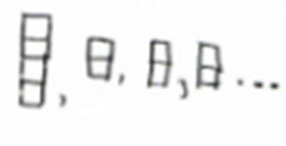
Student Learning
Misconceptions/ Knowledge Gap
Some students ignored the initial amount in the box.
Some students had difficulty with Start being called Day 0.
When using blocks to represent the money problem some students had 4, 2, 2, 2, 2.
Some students thought that, given Day 25 was $€$54, then day 100 was $54(4)=€216$.

Slide 17
Common Misconceptions
Some students get the calculations correct yet fail to give any explanation

Slide 18
Common Misconceptions
Correct answer, but incomplete explanation:

Slide 19
Common Misconceptions
Inconsistency in answers and explanations:

Slide 20
Common Misconceptions
Some students had difficulty distinguishing between the total amount that was in the box vs. what amount was actually put in the box by John.

Slide 21
Common Misconceptions
Some students see their own mistakes through discussion with peers and their teachers.

Slide 22
Common Misconceptions
This student has not moved to multiplication:

Slide 23
Common Misconceptions
Some students still use

Slide 24
Addressing Misconceptions
Recommendations
The adjustments you have made, or would make in the future:
We would spend more time on students completing the table.
Bring more students to the board to discuss their answers, especially the worded answers.
Collect work on the day, and on the next day show samples of correct and incorrect work and discuss.
Spend time relating the change in the table to the question.
Bring in the concept of constants and variables at this stage.
Put greater emphasis on the Linear Pattern.

Slide 25
Summary
The understandings we gained regarding students’ learning as a result of being involved in the research lesson:
Inconsistency in answers
Some students prefer to go the long way:
Some students are good at explaining in words and some are good at explaining graphically and mathematically.

Slide 26
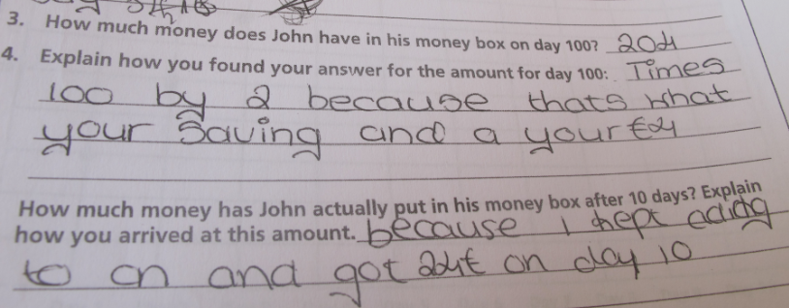
Summary
What did we learn about this content to ensure we had a strong conceptual understanding of this topic?
Sometimes it is difficult to understand students’ thinking. Might get a simple part incorrect and the more difficult correct.

Slide 27
Teaching Strategies
Discussion and comparison (Peer Learning)
Peer Student Teaching and Assessment
Teacher observation during the class

Slide 28
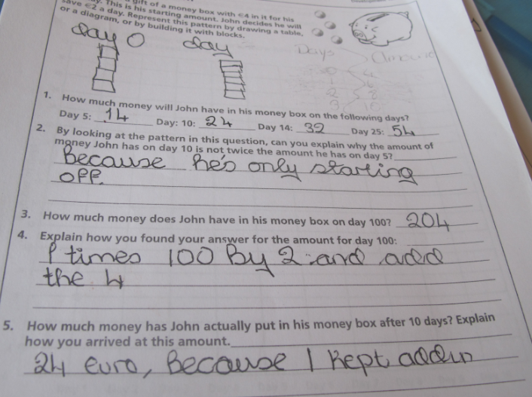
Teaching Strategies
What did I notice about my own teaching?
What was difficult?
I do not spend enough time on the explanations with the students.
For me to understand that I am actually saving time by bringing students to the board.
Less chalk and talk.

Slide 29
Teaching Strategies
Was it difficult to facilitate and sustain communication and collaboration during the lesson?
Have a variety of activities available to students to explore patterns.
Freedom to answer question 1 by method of choice.

Slide 30
Teaching Strategies
Was it difficult to ask questions to provoke students’ deep thinking?
Not difficult to ask questions, but difficult to provoke deep thinking.
For example, “How much money has John actually put in his money box after 10 days? Explain how you arrived at this amount.”

Slide 31
Teaching Strategies
How did I engage and sustain students’ interest and attention during the lesson?
Less chalk and talk.
Encouraged students to share and discuss their ideas with their classmates.
Students encouraged to explain their answers on the board.

Slide 32
Teaching Strategies
How did I assess what students knew and understood during the lesson?
Students compared answers and were encouraged to discuss discrepancies

Slide 33
Teaching Strategies
How did I put closure to the lesson?
I cleared up misconceptions.
How did the change relate to the question?
We talked about the start amount.
I asked students to describe the pattern in words.

Slide 34
Teaching Strategies
What understandings have I developed regarding teaching strategies for this topic as a result of my involvement in Lesson Study?
Patterns is the foundation for so many other sections of the syllabus.
What changes would I make in the future, based on what I have learned in my teaching, to address students’ misconceptions?
Spend more time on Day 0.
Spend more time on questions that demand explanations.

Slide 35
Teaching Strategies
Patterns
Number
Algebra
Functions
Trigonometry
Calculus
Area and Volume
Co-ordinate Geometry

Slide 36
Reflections on Lesson Study Process
Strengths & Weaknesses
As a mathematics team how has Lesson Study impacted on the way we work with other colleagues?
It encouraged us to collaborate more.
Sharing ideas makes one grow as a teacher.
With an extra teacher in the room it was easier to see students’ work (peer observation).

Slide 37
Reflections on Lesson Study Process
Strengths & Weaknesses
Personally, how has Lesson Study supported my growth as a teacher?
It reminded me of the benefits of reading the Teaching and Learning Plans (and other online resources) every time I introduce this topic.
It reminded me of the benefits of collaborating with colleagues.

Slide 38
Reflections on Lesson Study Process
Strengths & Weaknesses
Recommendations as to how Lesson Study could be integrated into a school context.
School planning time could be used to facilitate lesson study groups.
Challenge is to observe other classes.
Double up on concurrent classes and move to a bigger area, e.g. the library.

