Slide 1





Maths Counts
Insights into Lesson Study

Slide 2

St. Patricks College, Gardiners Hill, Cork City
Caitriona O Connell, Fiona Fahey, Helen Lambe
5th Years
Linking Patterns through the Strands.

Slide 3
Planning the lesson
Topic we investigated: Patterns across the strands
How we planned the lesson as a group: met as a group, decided the topic and class groups
Resources we used : worksheets, GeoGebra files, visualiser, rulers

Slide 4
Why did we choose to focus on this mathematical area?
When teaching coordinate geometry it was evident that students failed to make any link between the previous studied topic of patterns and sequences and series.
We feel that it is important for students to be aware of links between strands .
To illustrate the importance of graphing in problem solving

Slide 5
Patterns throughout the syllabus
Strand 2 : Co-ordinate Geometry – finding
slope, y-intercept, equation of a line
Strand 3 : Number Systems – arithmetic sequences
Strand 4 : Algebra – patterns and relationships in words and numbers.
Strand 5 : Functions – calculus, rates of change, slopes of tangent lines.

Slide 6


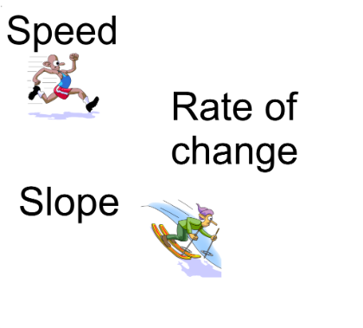
Example of Pattern Questions

Slide 7
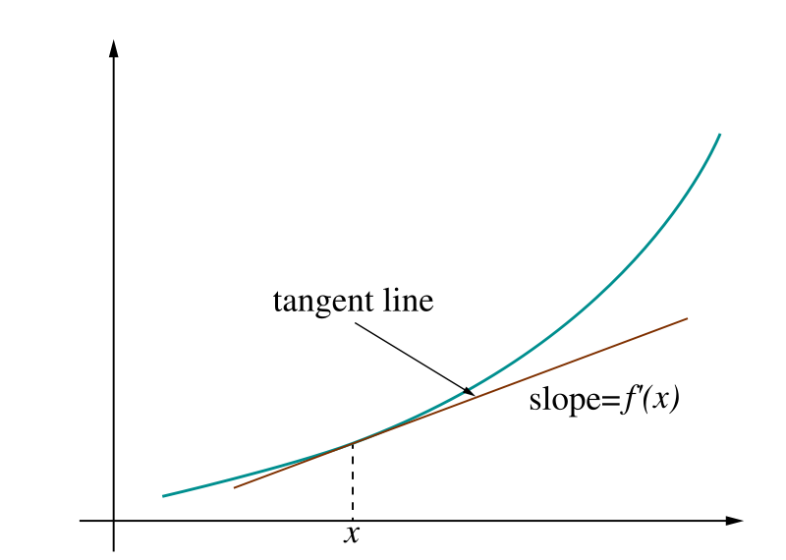

Slide 8

Lets draw a graph

Slide 9
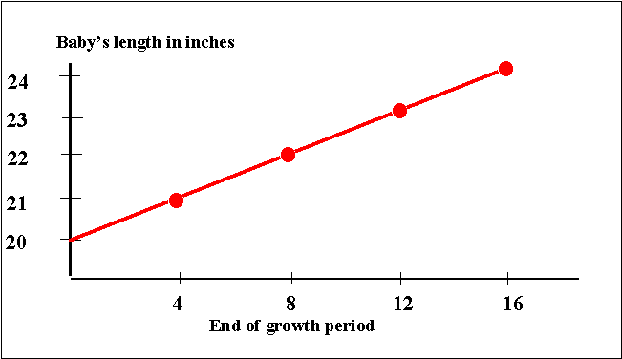

Slide 10
Worksheets
Pink = Higher Level
Blue = Ordinary Level
Orange = Foundation Level

Slide 11
Learning Outcomes
Find the first term and the common difference of a linear pattern
Continuing the pattern and illustrating if applicable
Graph the linear pattern
Find the n^{th} term of a pattern (through analysis and using formula)
Finding higher terms of the pattern from formula
Investigation of higher terms
Linking slope with common difference
To further students concepts of T₀ and T₁ and the implications on the y-intercept of the graph.
Relating the equation of the line to T_{n}.
Discussing the properties of proportionality i.e starting at the origin or elsewhere on the y-axis.
Determining if a pattern is directly or indirectly proportional.

Slide 12
Teacher expectations from students
Interpreting a written problem and hence extracting the relevant information needed to illustrate the pattern.
To alleviate common misconceptions surrounding the y-intercept and if the graph actually starts at the y-intercept or not.
The realisation that a direct/indirect proportionality is very easy to determine from a graph through inspection.
To show students that validation of their work is crucial.
A negative slope is directly related to a decreasing pattern and vice versa.
To consolidate the relationship between slope and rate of change to facilitate the teaching of calculus.

Slide 13
Teaching Strategies
Peer Learning
Group work
Discovery Learning
Scaffolding if necessary
Differentiation ( excluding higher order example for Foundation level)

Slide 14
Student Learning
Data Collected from the Lesson:
Academic: e.g. samples of students’ work
Motivation: students engaged well with the worksheets and stayed on task throughout the lesson.
Social Behaviour: worked well in groups, willing to discuss the questions well within their groups, students were confident enough to display their own work to their peers on the visualiser.

Slide 15
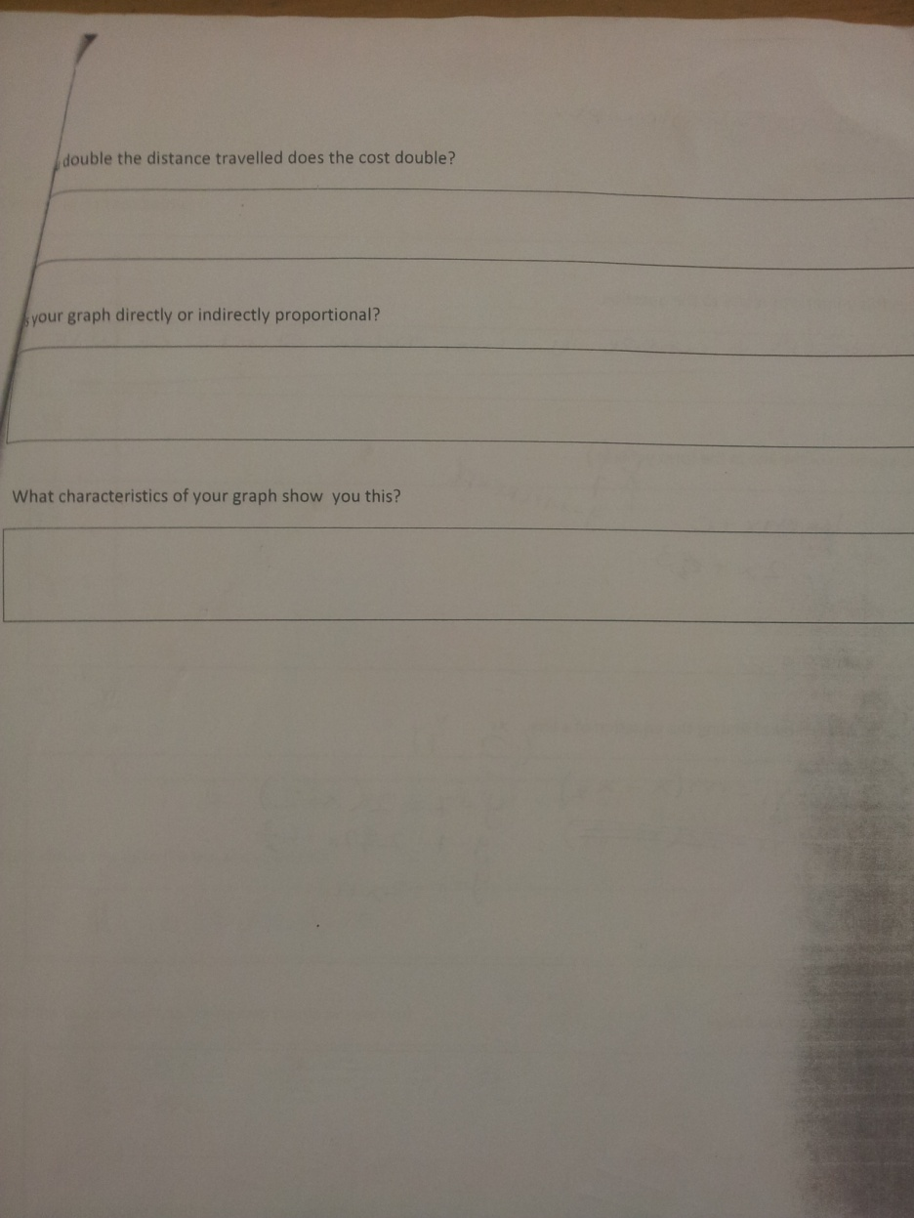
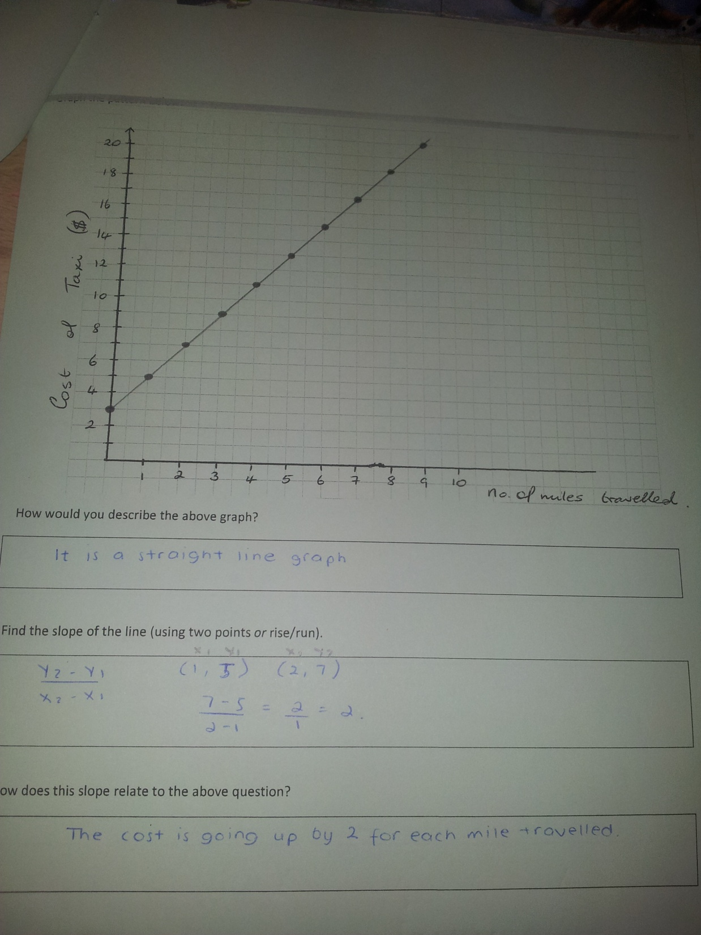
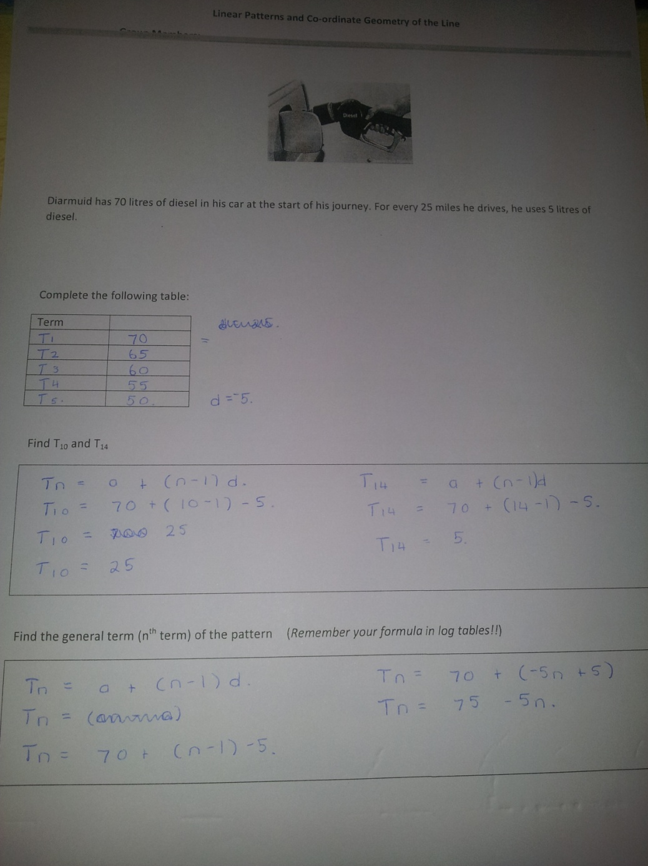
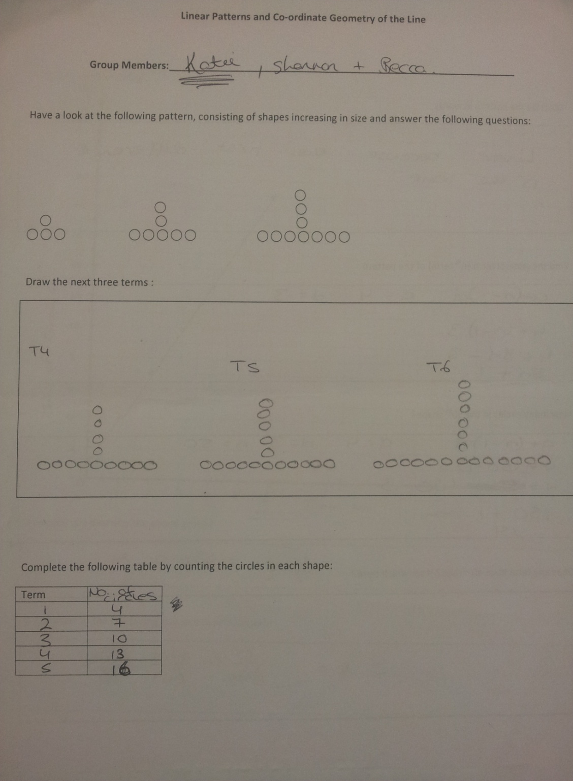
Reflections on the Lesson
Student Learning : What we learned about students’ understanding based on data collected
Good understanding
Continuing the pattern
Finding the first term and common difference
Finding the nth terms
Connecting slope with the common difference
Describing the pattern in words
Answering questions once the questions were started
Poor Understanding
Which term to start at : 0 or 1
Proportionality
Explaining answers and drawing conclusions
Questions not completed

Slide 16
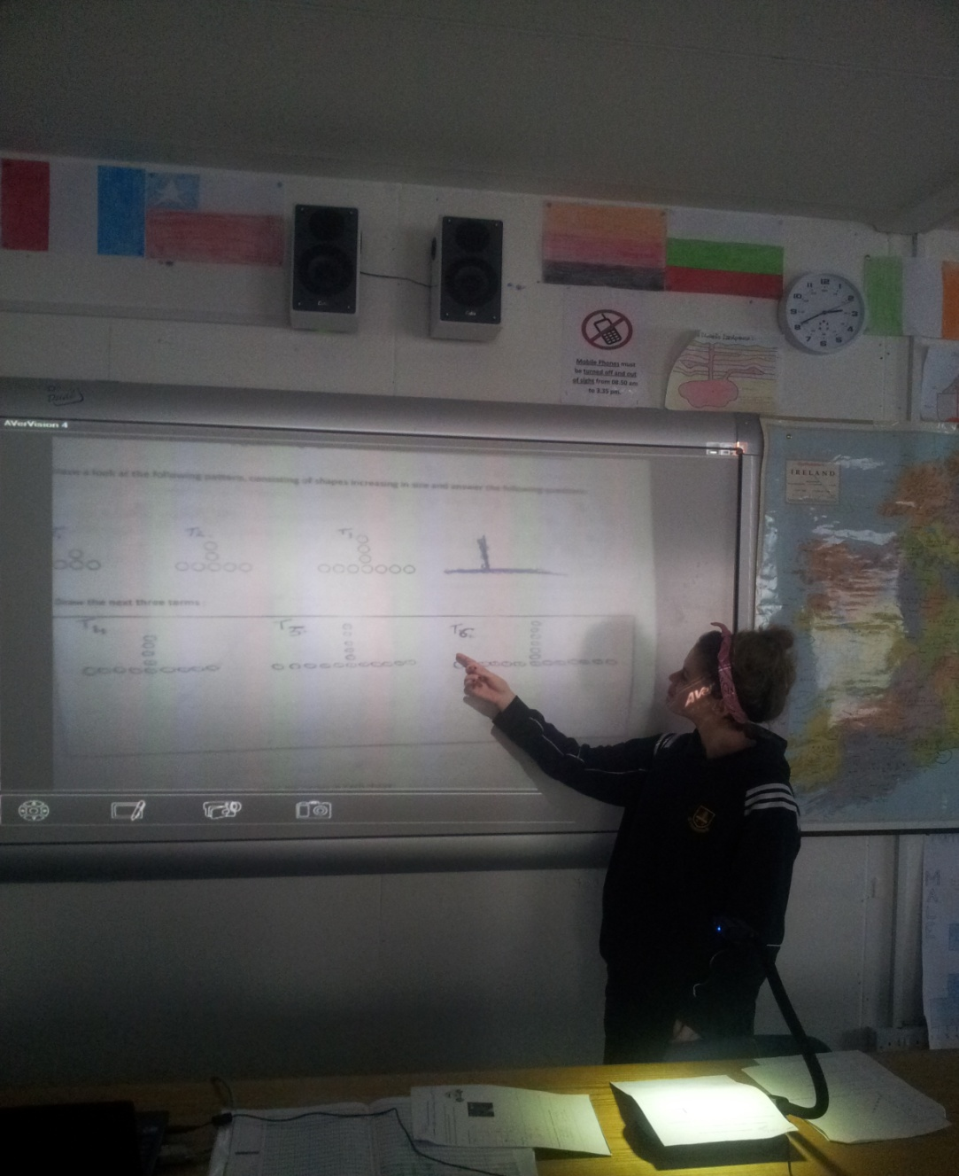
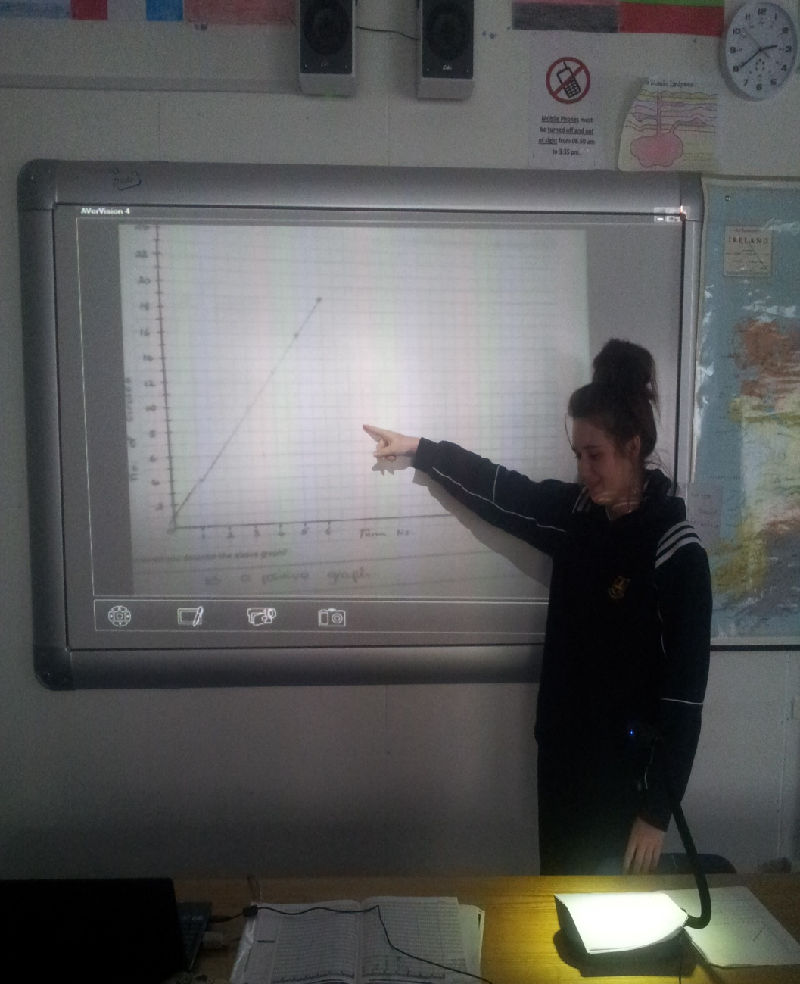
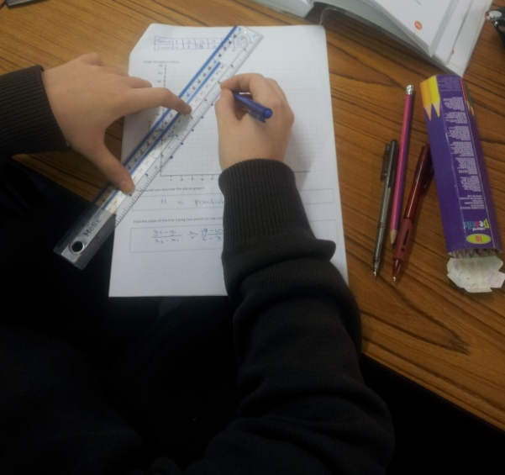
Students at work

Slide 17
Student Understanding
What we learned about the way different students understand the content of this topic?
Higher Level | Ordinary Level | Foundation Level
Were successful with patterns example but struggled with connecting term numbers with distance travelled. | Needed some scaffolding with proportionality and finding the y-intercept. | Needed constant supervision and guidance

Slide 18
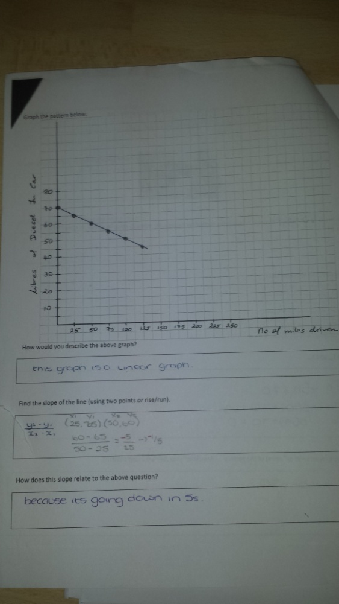
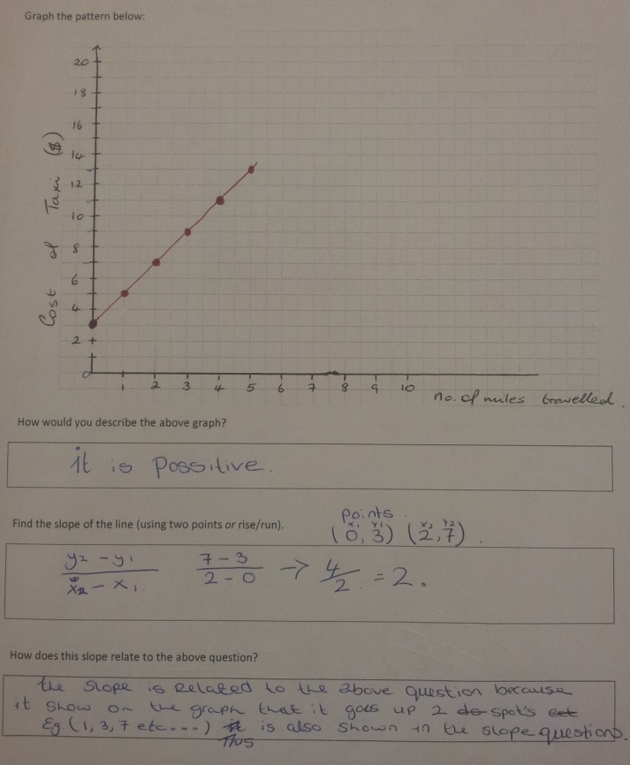
Effective Student Understanding

Slide 19
Common Misconceptions
Starting with term 0 or term 1 and hence drawing the y-intercept on a graph.
Students were unaware that all linear graphs do not represent direct proportion.

Slide 20
Addressing Misconceptions
Recommendations
Spend more time on promoting understanding of the formula
Grouping should have been more structured and differentiated in
ability so that there was a natural leader in each group.
Before this class students made no connection between sequences and series and coordinate geometry, we feel that this lesson illustrated these links.
Easier worksheet necessary for Foundation level students or less questions on these worksheets.
A quick revision class before this lesson would have lessened the need for the teacher to scaffold.

Slide 21
Teaching Strategies
What did I notice about my own teaching?
What was difficult?
Standing back and not intervening too much.
Not giving answers too easily
When students were struggling it was difficult to get to each group and to keep them on task. This is where better group organisation may have helped.
There were plenty of opportunities to test students understandings of linear patterns.

Slide 22
Teaching Strategies
How did I assess what students knew and understood during the lesson?
When students were presenting their work at the visualiser the teacher asked the group a ‘what if’ question.
Student worksheets.
The amount of help needed from the teacher.
The questions being asked during the task.

Slide 23
Closing the lesson
As teachers we discussed what were the key elements we would like students to retain.
We closed the lesson with a quick recap questioning these main elements.
slope = rate of change = first difference
How a + (n −1)d relates to y =mx + c
Direct proportion versus indirect proportion
Y-intercept = t = 0
Positive slope = increasing pattern/graph
Negative slope = decreasing pattern/graph

Slide 24
Reflections on Lesson Study Process
We were given the opportunity to work with each other, this helped us to try different teaching strategies.
It allowed us to gain an insight into how all students at different levels learn.
We would revise and repeat this lesson again next year, as overall it worked well and is an essential lesson to link strands together.

