Slide 1
Maths Counts Insights into Lesson Study

Slide 2
Our Lady’s College, Greenhills, Drogheda, Co. Louth.
Maths Department, Our Lady’s College
Geometry in Context
Transition Year and Ordinary Level Junior Cert

Slide 3
Insights into Lesson Study
1. Introduction: Focus of Lesson
2. Student Learning: What we learned about students’ understanding based on data collected
3. Teaching Strategies: What we noticed about our own teaching
4. Strengths & Weaknesses of adopting the Lesson Study process

Slide 4
Introduction
Topic investigated: Geometry in Context
Why did we choose to focus on this mathematical area?
Aims of Project Maths:
Greater understanding of mathematical concepts and real-life applications of maths.
Geometry Constructions:
A rich area for possible applications, but a limited number of example questions available.

Slide 5
SEC Feedback 2011
Feedback from the SEC on the 2011 Leaving Certificate Examinations for Phase 2 of Project Maths in the Initial Schools:
“At all levels, questions that required understanding of concepts caused considerably more difficulty than those testing the execution of routine skills presented in a familiar way.”
“ Many candidates had difficulty coping with questions that required the application of their knowledge and skills in a different context from the one in which those skills were developed.”

Slide 6
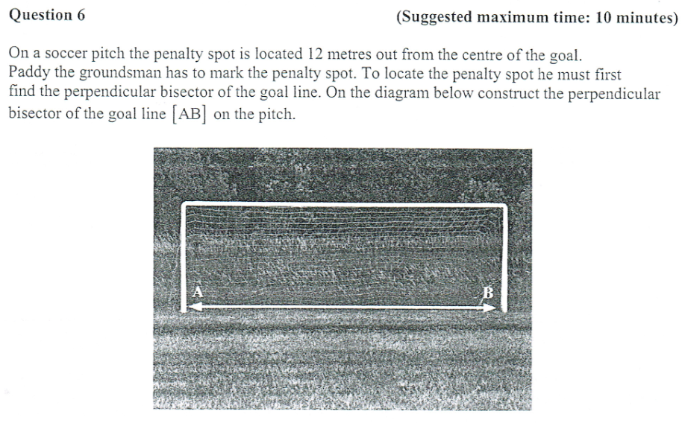
JC Ordinary Level Mock Question 2013

Slide 7
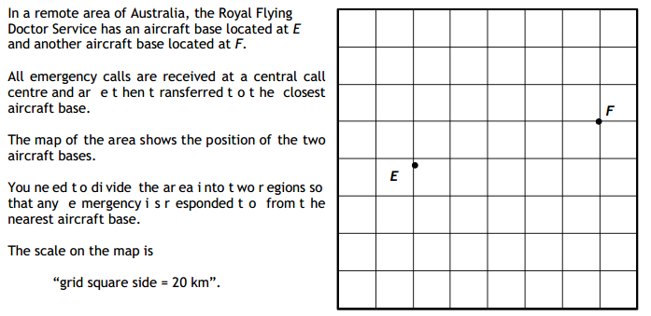
Workshop 6

Slide 8
Learning Outcomes
Students should improve in the following areas:
Making the connections between Geometry constructions and the real-life applications of these
Recognising the correct constructions to use for context based problems
Ability to draw on different areas of maths to solve different parts of a problem

Slide 9
How we planned the lesson:
Discussed ideas for new resources and possible applications of different constructions
Planned to revise Geometry Constructions in the conventional way first
Group work and classroom discussion would be key
Decided to incorporate questions drawing on other areas of maths, e.g. Trigonometry, Area and Volume, Algebra, etc.

Slide 10
Introduction
Enduring understandings
The importance of Geometry Constructions in the areas of Building, Engineering, Landscaping, Design and, most importantly, the uses of them in their everyday lives, e.g. dividing up lunch, sport, and road markings.
Rather than studying mathematical topics in isolation, many areas of maths can be drawn on to solve a problem.

Slide 11
Resources used in the Lessons
PowerPoint Slides

Slide 12
Resources used in the Lesson
PowerPoint Slides

Slide 13
Resources used in the Lesson
PowerPoint Slides

Slide 14
Resources used in the Lesson
PowerPoint Slides

Slide 15
Resources used in the Lesson
PowerPoint Slides

Slide 16
Resources used in the Lesson
PowerPoint Slides

Slide 17
Resources used in the Lesson
PowerPoint Slides

Slide 18
Resources used in the Lesson
PowerPoint Slides

Slide 19
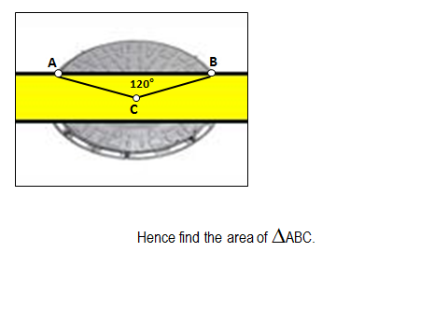
Resources used in the Lesson
PowerPoint Slides

Slide 20
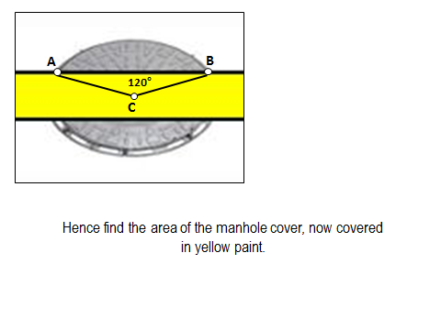
Resources used in the Lesson
PowerPoint Slides

Slide 21
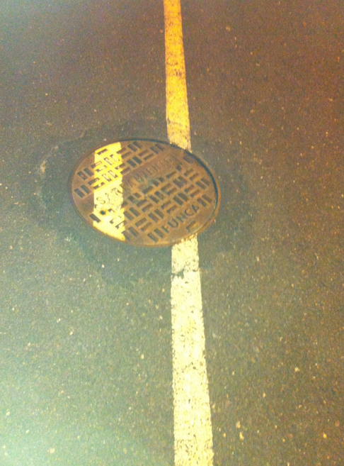
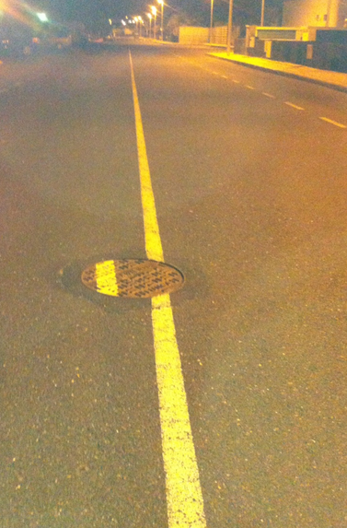
Resources used in the Lesson

Slide 23
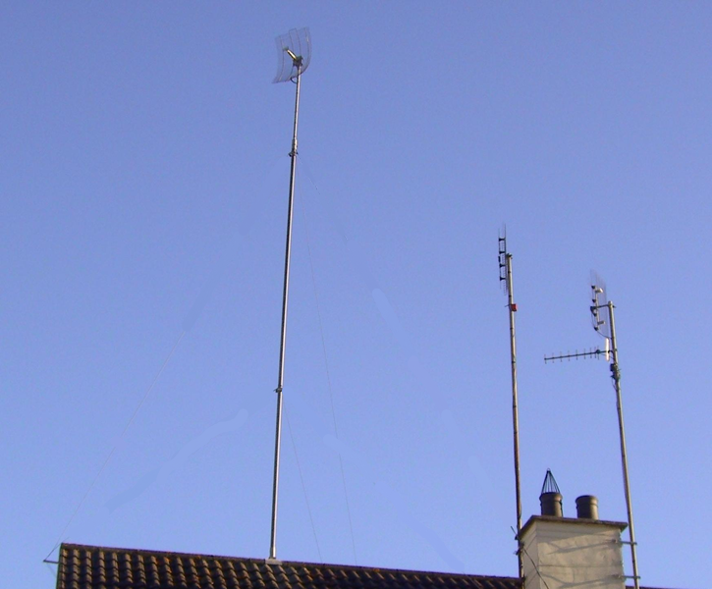
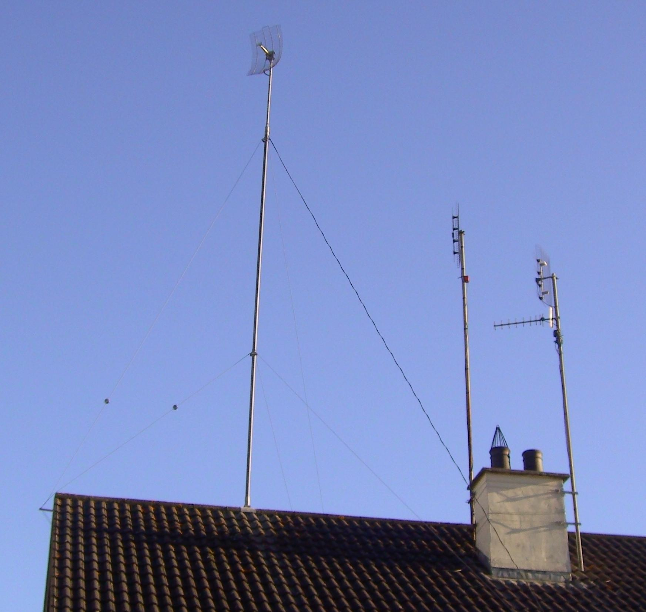
A
B
12 metres
c
G
F
E
9 metres
D

Slide 25
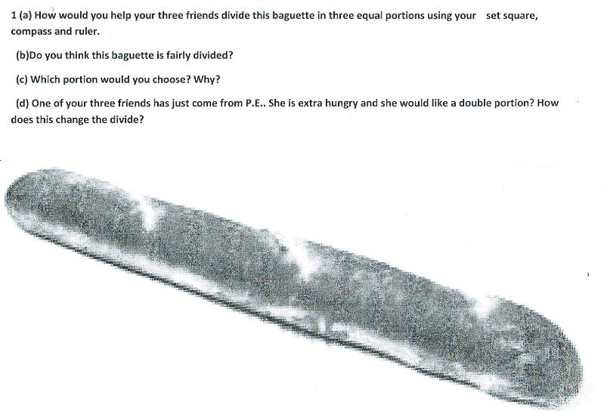
Worksheet

Slide 26
Reflections on the Lesson
2. Student Learning : What we learned about students’ understanding based on data collected
3. Teaching Strategies: What we noticed about our own teaching

Slide 27
Student Learning
Data Collected from the Lesson:
Samples of Students’ Work
Level of engagement in the lesson
Discussion with students during and following the lesson

Slide 28
Student Understanding
What we learned about the way different students understand the content of this topic?
Students believed the topic to have limited use in their lives outside the classroom prior to the lesson.
Students learn more by discovery in this area of maths, according to them.
They find constructions more interesting when they see them in context.

Slide 29
Effective Student Understanding
What effective understanding of this topic looks like:
Students giving further examples of applications of a particular construction
A greater willingness to approach similar questions following the lesson
Students enjoying the construction of dividing a roll into 3 equal parts

Slide 30
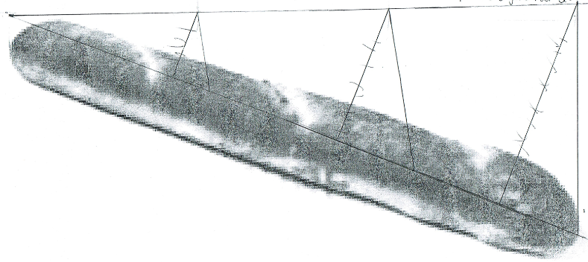
Common Misconceptions

Slide 31
Common Misconceptions
b) Do you think this baguette is fairly divided?

Slide 32
Common Misconceptions
c) Which portion would you choose? Why?

Slide 33
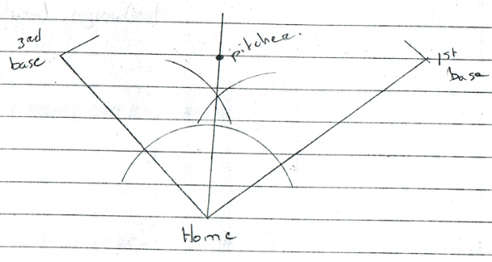
Common Misconceptions

Slide 34
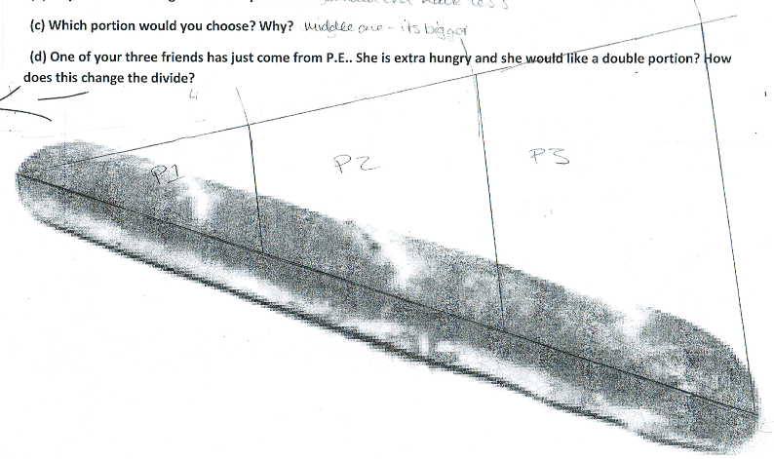
Different Approaches

Slide 35
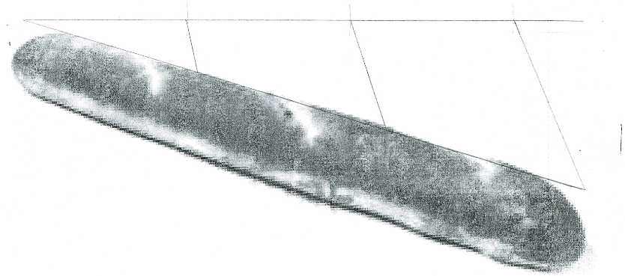
Different Approaches

Slide 36
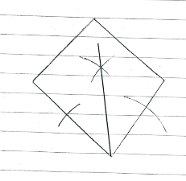
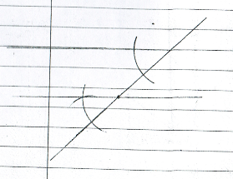
Different Approaches

Slide 37
Addressing Misconceptions
Recommendations
A worksheet to accompany PowerPoint slides
Smaller pictures on worksheets for easier use of small equipment and to avoid construction lines leaving the page
Allow students make and learn from mistakes

Slide 38
Summary
The understandings we gained regarding students’ learning GEOMETRY IN CONTEXT as a result of being involved in the research lesson
Students learn more by discovery and by making mistakes.
They worked best in pairs.
They like to see the real-life applications of maths.

Slide 39
Teaching Strategies
What did I notice about my own teaching?
What was difficult?
Allowing students to explore different ideas resulted in a lot of correct and incorrect approaches. These misconceptions took time to iron out.
Incorporating different areas of maths into the questions required side-step revision blitzes on cross-multiplication, Pythagoras’ Theorem, etc.

Slide 40
Teaching Strategies
Was it difficult to facilitate and sustain communication and collaboration during the lesson?
At first the active classroom and noise level made it difficult to determine whether students were staying on task.
As lesson progressed and I made my way around to each group, students became aware that they were responsible for their own learning.
They began to engage in and enjoy the lesson.

Slide 41
Teaching Strategies
How did I assess what students knew and understood during the lesson?
Questioning and discussion
Observing student work
Students explaining their work
Students giving other applications for each construction

Slide 42
Teaching Strategies
How did I put closure to the lesson?
A class discussion about other possible applications for each construction
What understandings have I developed regarding teaching strategies for this topic as a result of my involvement in Lesson Study?
Be prepared
Pair Work
Learn by discovery and by making mistakes

Slide 43
Teaching Strategies
What changes would I make in the future, based on what I have learned in my teaching, to address students’ misconceptions?
On completing each construction, ask students when might this construction be used in everyday life?
Use a worksheet to accompany PowerPoint slides.
Test out worksheets to make sure construction can be contained on page and picture is not too big or small for equipment.

Slide 44
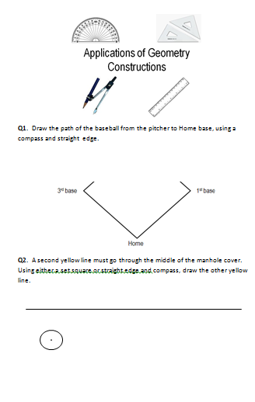
Worksheet to accompany PowerPoint

Slide 45
Reflections on Lesson Study Process
Strengths & Weaknesses
As a mathematics team how has Lesson Study impacted on the way we work with other colleagues?
We found working together, sharing ideas, trying out resources and giving feedback very constructive and rewarding. We have continued to swop, try out and improve on resources for other class groups.

Slide 46
Reflections on Lesson Study Process
Personally, how has Lesson Study supported my growth as a teacher?
The facilitator rather than the instructor
The importance of learning by discovery
The importance of collaborative teaching
Recommendations as to how Lesson Study could be integrated into a school context.
Literacy and Numeracy strategies
Share best practice and experience with other departments in the school

