Slide 1
Maths Counts Insights into Lesson Study

Slide 2
St Columba’s Comprehensive, Glenties
Team: Kathleen Molloy & Breege Melley
Topic: Introducing Integration
Class: Sixth year Higher Level

Slide 3
Insights into Lesson Study
Introduction: Focus of Lesson
Student Learning : What we learned about students’ understanding based on data collected
Teaching Strategies: What we noticed about our own teaching
Strengths & Weaknesses of adopting the Lesson Study process

Slide 4
Introduction
Why did we choose to focus on this mathematical area?
We wanted to rethink how we taught integration with an emphasis on conceptual understanding of integration as a process of finding the total (accumulated) change given the rate of change
We wanted students to understand integration as this “summing” process, achieved using area and not just as a set of procedures.
We wanted students from the beginning of the topic to see the use of integration in context.
We chose finding displacement from velocity as the initial context.

Slide 5
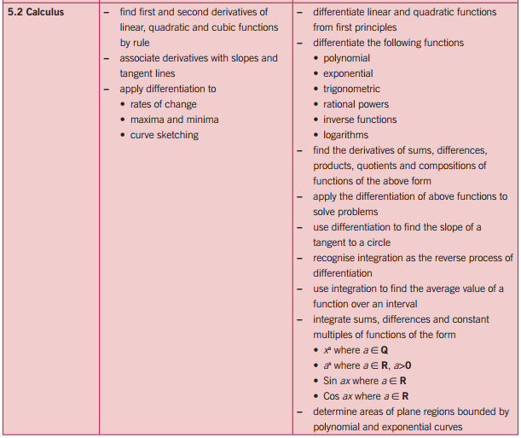
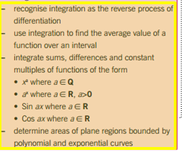

Slide 6
Introduction
Topic investigated: Introducing integration
How we planned the lesson
Resources used :
Prior knowledge
Questioning
Multi-representations: Story, table, graph, formula
Board work
Worksheet
Formulae and Tables booklet and
GeoGebra

Slide 7
Introduction
Prior knowledge:
Speed = $\frac{(change in) distance}{(change in) time}$ , displacement, velocity
Algebra and Geometry
Indices
Functions and function notation
Vertical shifting of functions from Junior Certificate
Trapezoidal rule for estimating area
Differential calculus

Slide 8
Introduction
Learning outcomes:
How to find the antiderivative of polynomial functions using the reverse process to differentiation. i.e. The antiderivative of $x^{n}=\frac{1}{x+1}x^{n+1}+C$
Displacement $s(t)$ = anti-derivative of velocity Displacement $s(t)$ = area under the graph of a velocity-time function
Hence anti-derivative of velocity can be used to find area under a velocity-time graph and hence to find displacement
That the process of finding area under a curve over an interval is known as integration

Slide 9
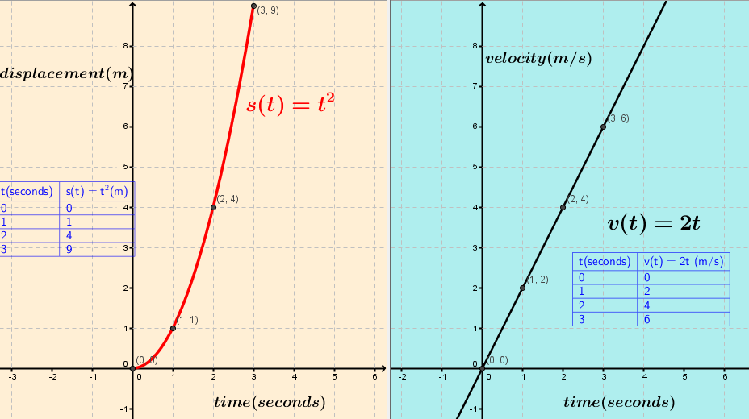
Lesson flow
Q. What information can be got from this graph?
The displacement after any time t.
CV
Q: What is the displacement after 3 seconds?
A: $s(3) = 3^{2}$= 9 metres
How do I find the velocity function $v(t$)? (rate of change of displacement)
A: Differentiate $s\left(t\right)=t^{2}$
$$v\left(t\right)=2t$$
Draw up a table of values for $v(t$) for $0≤t≤3, t∈Z$ and plot a graph.
Notes:
What information does each function and its graph give us?
The first one gives us the velocity of an object after any time t. Its initial velocity is 0.
The second function gives us the displacement of an object after any time t. Its initial value is 0.
How do we find displacement if we

Slide 10
Lesson flow
Q: What information does this graph give us?
Q. What information can be got from this graph?
A. The displacement after any time t.
Differentiating
Differentiating
How do I find the velocity function $v(t$)? (rate of change of displacement)
A. Find the derivative of the displacement function.
A: The velocity after any time $t$

Slide 11
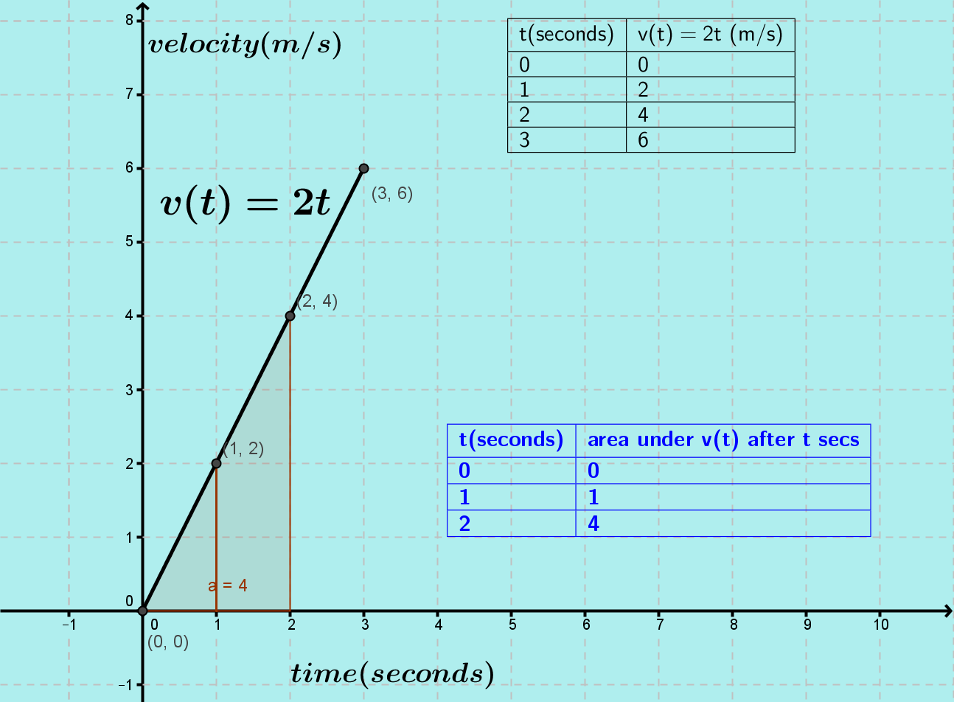
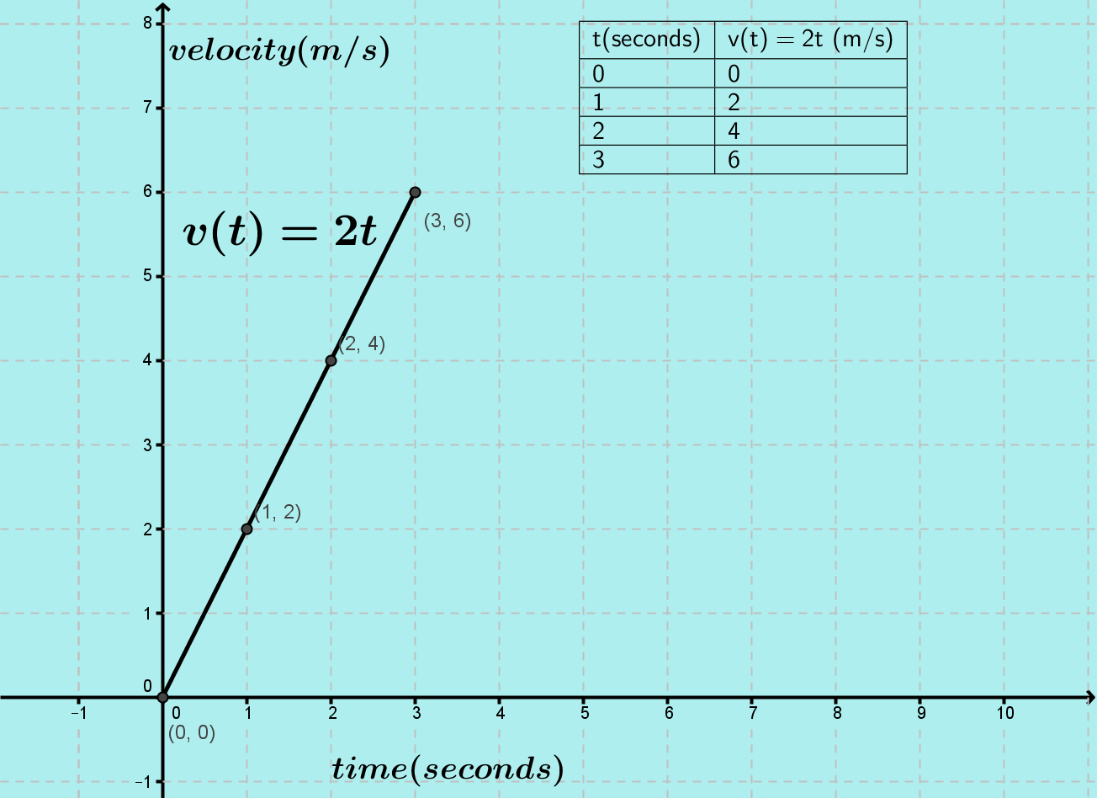
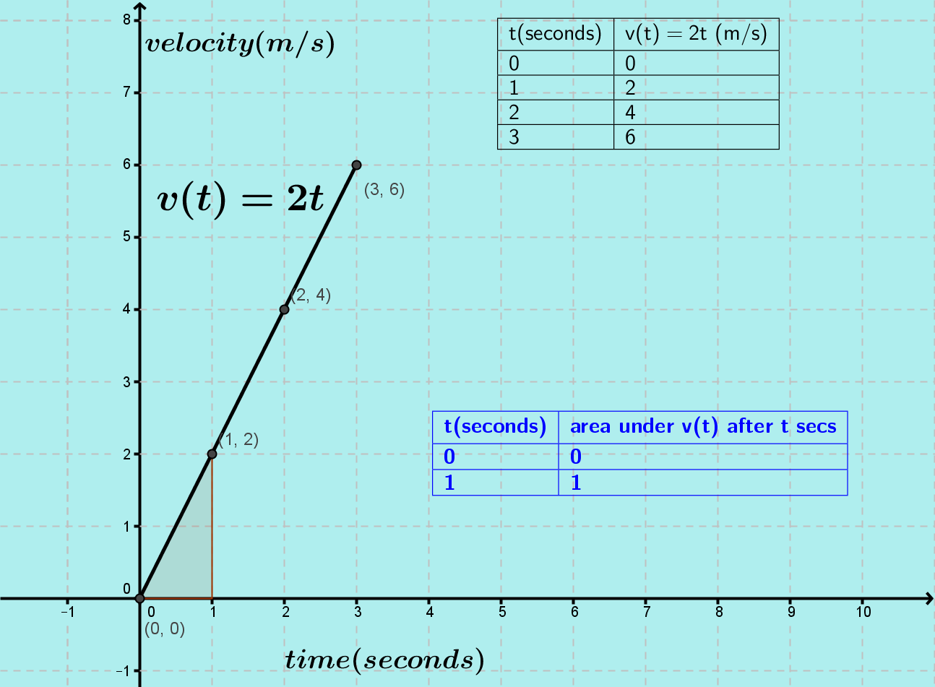
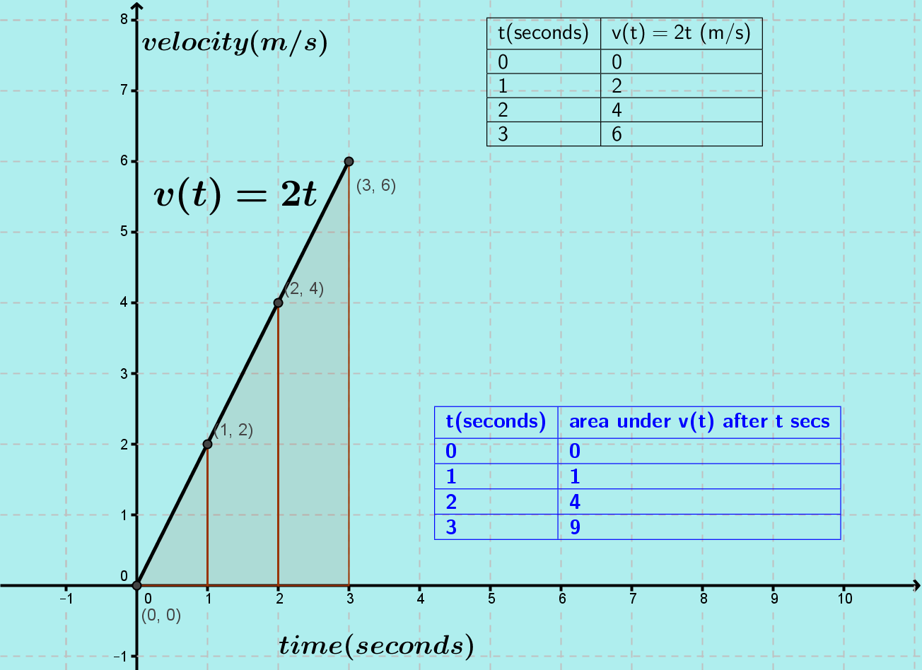
Suppose we want to find the area between the velocity-time graph $v\left(t\right)=2t,$and the $x$-axis, over an interval.
How do you find the area under the graph of $v(t)$from 0 - 1 s or 0 - 2 s or from 0 - 3 s?
Use the area of a triangle formula or the trapezoidal rule
How do you find the area from 1-2s and 2-3 s?
Use the area of a trapezium or subtract the area of two triangles.

Slide 12
Suppose we want to find the area between the velocity-time graph $v\left(t\right)=2t,$and the x-axis, over an interval.
How would you find the area under the graph of $v(t)$ if the graph was a curve?
Split the area into trapezia and use the trapezium rule to find the sum of the areas of the trapezia. This would give an approximate value of the area.

Slide 13
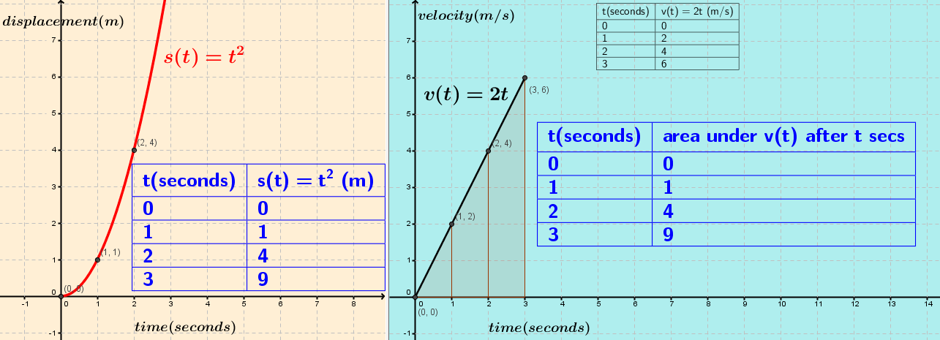
Lesson flow: What pattern do you notice?
Function for evaluating area
AREA
The area under the velocity-time graph over an interval of time on the x-axis is the displacement over that interval.
Can you make sense of this?
$$Area=0.5\left(height\right)\left(width\right)=\frac{1}{2}v\left(t\right)×∆t$$ Area = average velocity by change in time= change in displacement.
$$[ \left(\frac{m}{s}\right)\left(s\right)=metres \left(measure of distance\right)]$$

Slide 14
Lesson flow: What is integration?
Using area under a $v(t)$graph to find displacement
The process of finding area between the graph of a function and the $x$ (or $y$) – axis is called Integration .
The limiting value of the sum of the area of rectangles (simpler than trapezia), as the width of each rectangle becomes infinitely small, i.e. as (in this case) $∆t→$ 0, is the area under the curve over an interval [ab]
This is written as $\int_{a}^{b}{v\left(t\right)dt}$ and is known as the definite integral

Slide 15
Lesson flow: Recovering the rate of change function
How would we recover the displacement function if we only knew the velocity time function?
Not sure
How do you get velocity at an instant from displacement?
We get the derivative of the displacement function.
Can we recover the displacement function from the velocity function?
Reverse the differentiation process

Slide 16
Lesson flow: Reverse the differentiation process
Function
?
Differentiate
Derivative
What could we call the reverse process?

Slide 17
What is the opposite to “social “behaviour?
Anti-social behaviour

Slide 18
Lesson flow: Reverse the differentiation process
Function
Anti-differentiate
Differentiate
Derivative

Slide 19
Lesson flow
Differentiating
Differentiating
Anti-differentiating
-enables us to find area under a curve over an interval
The antiderivative gives us an area function

Slide 20
Lesson flow: What is an anti-derivative of $v(t) =2t?$
Q. What information can be got from this graph?
A. The displacement after any time t.
An antiderivative of $v(t) = 2t$ is $s\left(t\right)=t^{2}$
Q: How do we know that $s(t) = t^{2}$is an antiderivative of $v(t) = 2t$?
A: If we differentiate $s(t) = t^{2}$ we get the function $v\left(t\right)= 2t.$

Slide 21
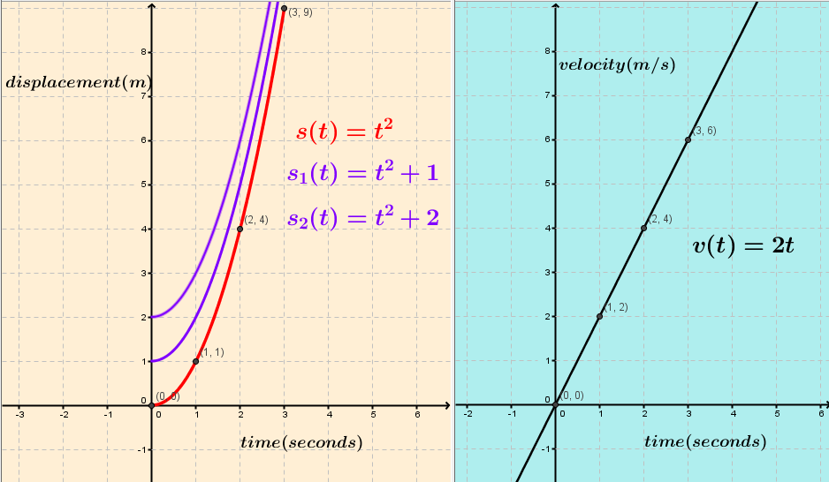
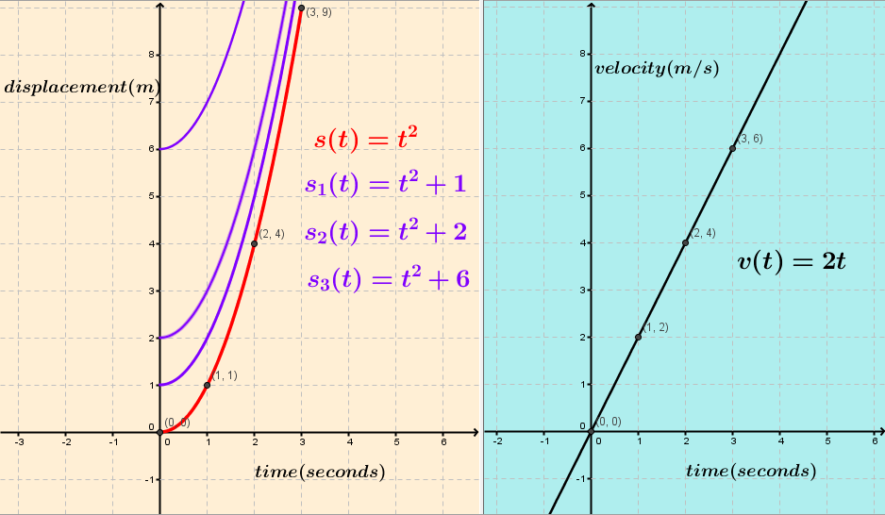
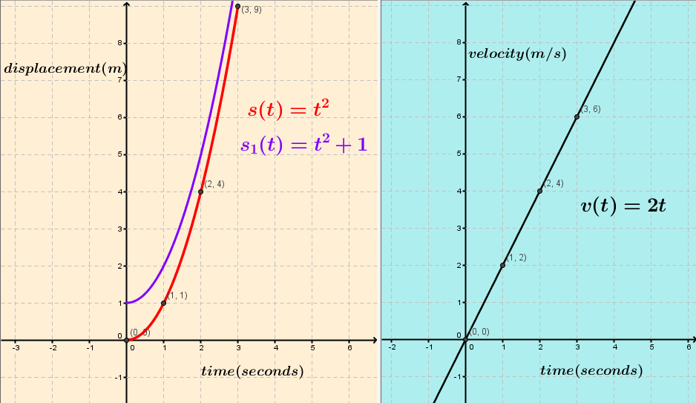
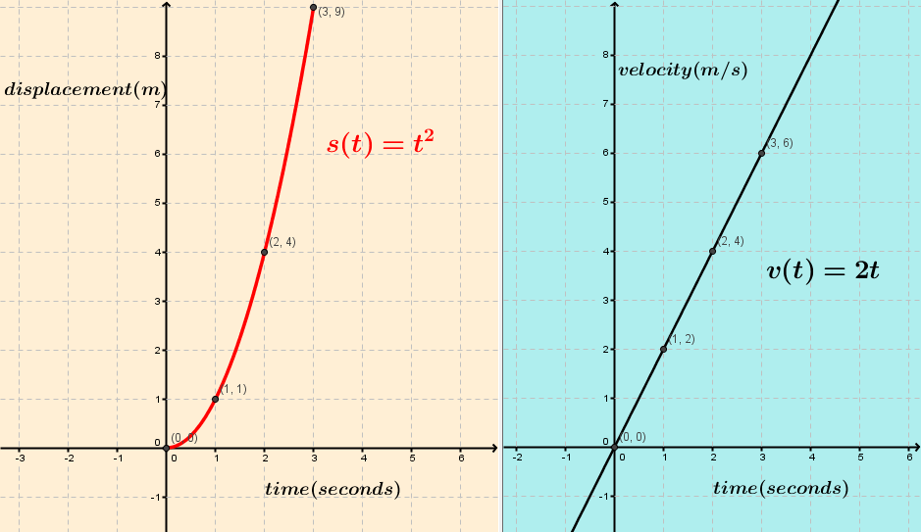
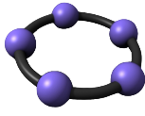
Lesson flow: Is ${s\left(t\right)=t}^{2}$ the only antiderivative of $v(t) =2t$?
The starting value is varying but the rate of change is the same.
What is the antiderivative of $v(t) =2t$?
$$s\left(t\right)=t^{2}+C,C∈R$$
Describe the antiderivative of $v\left(t\right)=2t.$
An infinite set of functions all of which have the same derivative, a.k.a. the indefinite integral $\int{f\left(x\right)dx}$

Slide 22
Anti-differentiate and check your answer
Displacement is a “named” antiderivative i.e. the antiderivative of velocity.
In the case of a function $f(x)$ the antiderivative is usually denoted by $F(x).$
Function $f(x)$ | Antiderivative $F(x)$ | Check: $$\frac{d}{dx}(F(x))=f(x)$$
$$f(x)=6x$$
$$f\left(x\right)=3x^{2}$$
$$f\left(x\right)=7x^{3}$$
$$f\left(x\right)=6$$
$$f(x) =x^{n}$$ | $$F\left(x\right)=\frac{1}{n+1}x^{n+1}+C$$ | $$x^{n}$$
$$f\left(x\right)=\frac{1}{x}$$
Oral work
Tables and Formulae booklet

Slide 23
Student Learning
Data Collected from the Lesson:
Academic e.g. samples of students’ work
Motivation
Social Behaviour

Slide 24
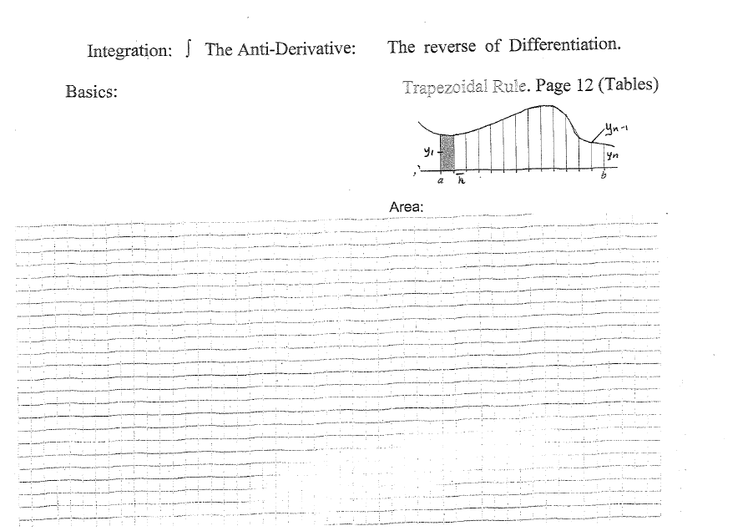
Worksheet

Slide 25
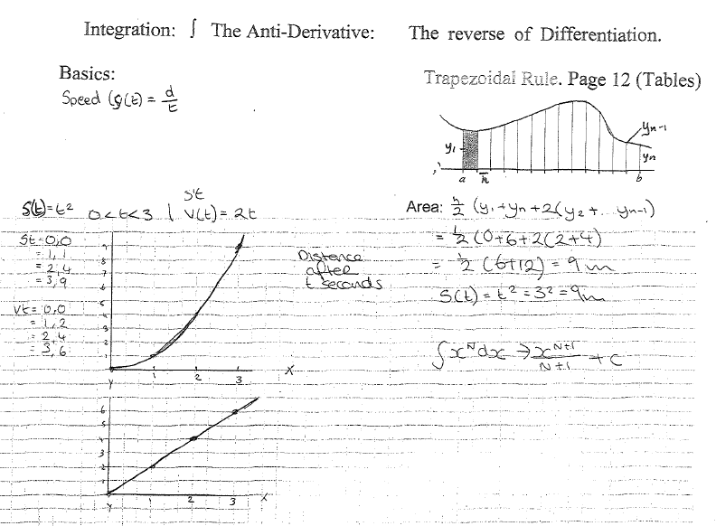
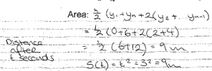
Student work
Correct units: area interpreted in context

Slide 26
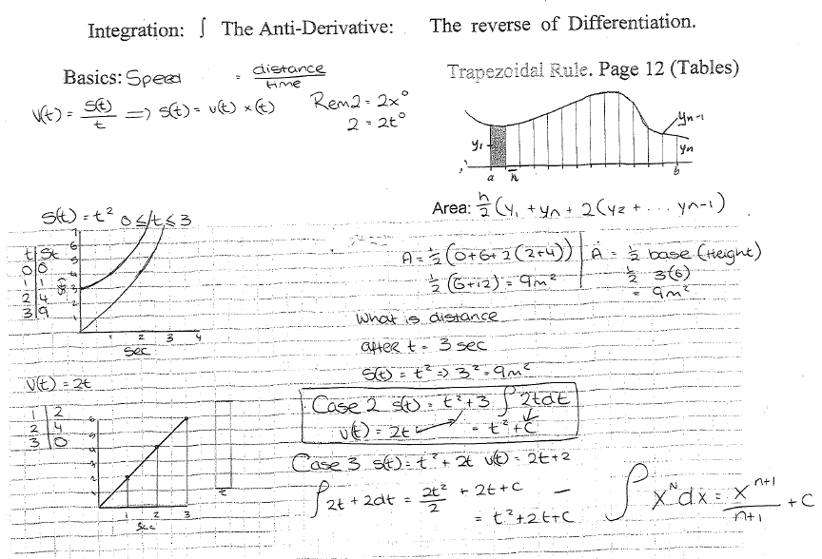
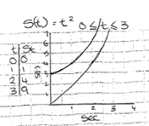
2 methods of finding area under v(t) curve
CV
Area under $v(t)$ graph = displacement

Slide 27
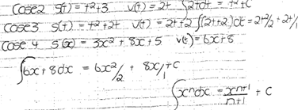
Arrived at by seeing a pattern:

Slide 28
Student worksheet (and board) at the end of the class

Slide 29
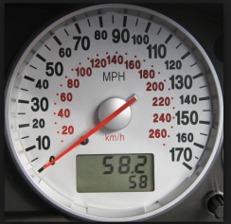
Real life………………..
Speedometers tell us our speed (rate of change of distance) at every instant.
We are also interested in how far we have travelled (total change in distance).

Slide 30
Common Misconceptions
Sometimes students forgot to include the constant when writing the antiderivative of a function
Some students, when asked to find the antiderivative of the function $f\left(x\right)=\frac{1}{x}$, rewrote it as $f\left(x\right)=x^{−1}$ and tried to apply the power rule!
Since area was used to calculate displacement, some students gave $m^{2}$as the unit for displacement instead of metres. $[Area=height ×width= \left(\frac{m}{s}\right)\left(s\right)=metres \left(measure of displacement\right)]$

Slide 31
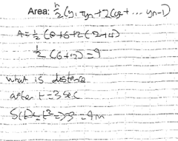
Units missing

Slide 32
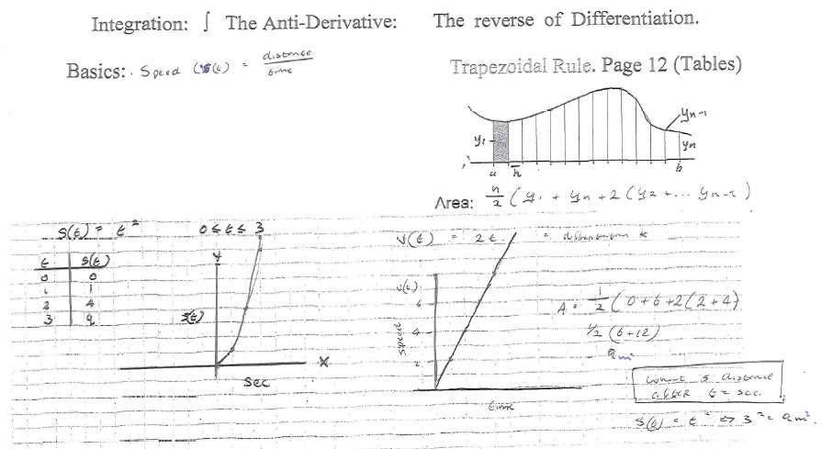
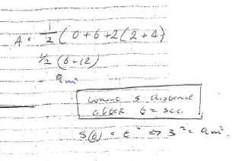
Student Learning
Issue with units

Slide 33
Recommendations
The adjustments you have made or would make in the future:
Students using GeoGebra to show that the antiderivative of a function is a set of functions.
(GeoGebra file will be available on the website)

Slide 34
Teaching Strategies
How did I engage and sustain students’ interest and attention during the lesson?
The lesson followed a “question and answer” format after the initial introduction
Students had activities to do on a regular basis:
Drawing graphs
Finding area under graphs
Pattern recognition
Making conclusions
Learning new skills and generalising those skills
The teaching strategies improved students’ confidence in their ability to construct new knowledge and this sustained their interest
The full sequence of the lesson being left on the board at the end of the lesson helped students see the big picture

Slide 35
Teaching Strategies
Was it difficult to facilitate and sustain communication and collaboration during the lesson?
No – students at this level were very motivated to learn and comfortable with asking questions and discussing with their fellow students.

Slide 36
Teaching Strategies
How did I put closure to the lesson?
I referred to the board work which summarised the lesson.
For homework: Practice of the skill of finding the antiderivative (indefinite integral) from the textbook and verifying answers.

Slide 37
Reflections on Lesson Study Process
Strengths & Weaknesses
As a mathematics team how has Lesson Study impacted on the way we work with other colleagues?
We are planning with common student misconceptions in mind.
We are focussing more on “how to” teach a topic and not just “what to teach”
We are planning with a view to achieving the objectives of the syllabus in tandem:
carry out procedures with understanding,
problem solve,
explain and justify reasoning,
feel confident in being able to do maths and seeing its relevance
We are very aware of making connections to prior and future knowledge, across and within strands, to the real world and if possible to other curricular areas.

Slide 38
Reflections on Lesson Study Process
Strengths & Weaknesses
Personally, how has Lesson Study supported my growth as a teacher?
I have seen the benefits of planning questions as well as worksheets for the introduction of a concept.
I have benefited from increased collaboration with colleagues and from having another teacher observe the learning in my classroom.

Slide 39
Reflections on Lesson Study Process
Strengths & Weaknesses
Recommendations as to how Lesson Study could be integrated into a school context.
Time to be allocated for planning
Time to be allocated for an observer to observe a class and for reflection after the class

