Slide 1





Maths Counts
Insights into Lesson Study

Slide 2

Moate Community School
Moate Community School: Mathematics Department
Target Group: Junior Cycle
Topic: Introducing Patterns – Second Year

Slide 3
Insights into Lesson Study
Introduction: Focus of Lesson
Student Learning : What we learned about students’ understanding based on data collected
Teaching Strategies: What we noticed about our own teaching
Strengths & Weaknesses of adopting the Lesson Study process

Slide 4
Introduction
Topic investigated : Introduction to Patterns
How we planned the lesson:
  Meetings and discussions with maths department
  It was decided to give priority to new material on syllabus, in this case “Patterns”
Resources used
  Internet
  Developed our own questions

Slide 5
Introduction
Learning Outcomes
  use tables to represent a repeating-pattern situation
  generalise and explain patterns and relationships in words and numbers
  write arithmetic expressions for particular terms in a sequence
  use tables, diagrams and graphs as tools for representing and analysing patterns and relations
  develop and use their own generalising strategies and ideas and consider those of others
  present and interpret solutions, explaining and justifying methods, inferences and reasoning
  find the underlying formula written in words from which the data is derived (linear relations only)

Slide 6
Introduction
Why did we choose to focus on this mathematical area?
It’s a new topic on the syllabus; as teachers, we decided it was important that we became more comfortable/familiar with the material and the desired learning outcomes.
As we had never taught this topic before, we were also keen to explore various methodologies which might enhance the understanding of the topic for students.

Slide 7
Introduction
Enduring understandings
What we wanted the students to “get”
Answer the question actually asked (not the one they would like to be asked)
Help the students to develop “stay-ability” and “self start” practices with unfamiliar questions
Obviously, we wanted students to develop Problem Solving Skills
Finally, by the end of the session, we hoped that students would begin to see connections between different mathematical topics, e.g. Patterns → Coordinate geometry → Slope, etc.

Slide 8
Reflections on the Lesson
Student Learning : What we learned about students’ understanding based on data collected
Teaching Strategies: What we noticed about our own teaching

Slide 9
Student Learning
Data Collected from the Lesson:
Academic, e.g. samples of students’ work
Motivation
Social Behaviour

Slide 10
Student Understanding
What we learned about the way different students understand the content of this topic?
We discovered students learned most effectively when
  content was introduced slowly - “one step at a time”
  they were able to visualise the problem (e.g. drawing graphs & tables)
  they were able to discuss the problem/story in class and relate it to real life experience

Slide 11
Effective Student Understanding
What effective understanding of this topic looks like:
So, what did the students do that showed “me” as a teacher that they understood the topic
  Asked lots of questions to try and make sense of the problem in
  their own mind
  Were able to graphically represent the problem, i.e. move from
  words/text to images
  Were able to explain the problem in their own words, and thus created
  a word representation (equation) without even realising that they had done this

Slide 12
Student Learning
Misconceptions/ Knowledge Gap
Students struggled with the concept of “Day 0” and “Day 1” when creating a table/ pattern.
Students had studied the Cartesian plane in first year, and we assumed that they knew how to graph lines in the positive quadrant in the plane – however, we were mistaken, and had to recap on basic graphing skills and concepts (scales, distance, etc).
Slope (as a rate of change) had to be discussed.

Slide 13
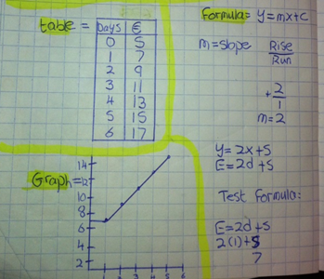
Common Misconceptions
What's the error here?
Incorrect scaling of the y-axis

Slide 14
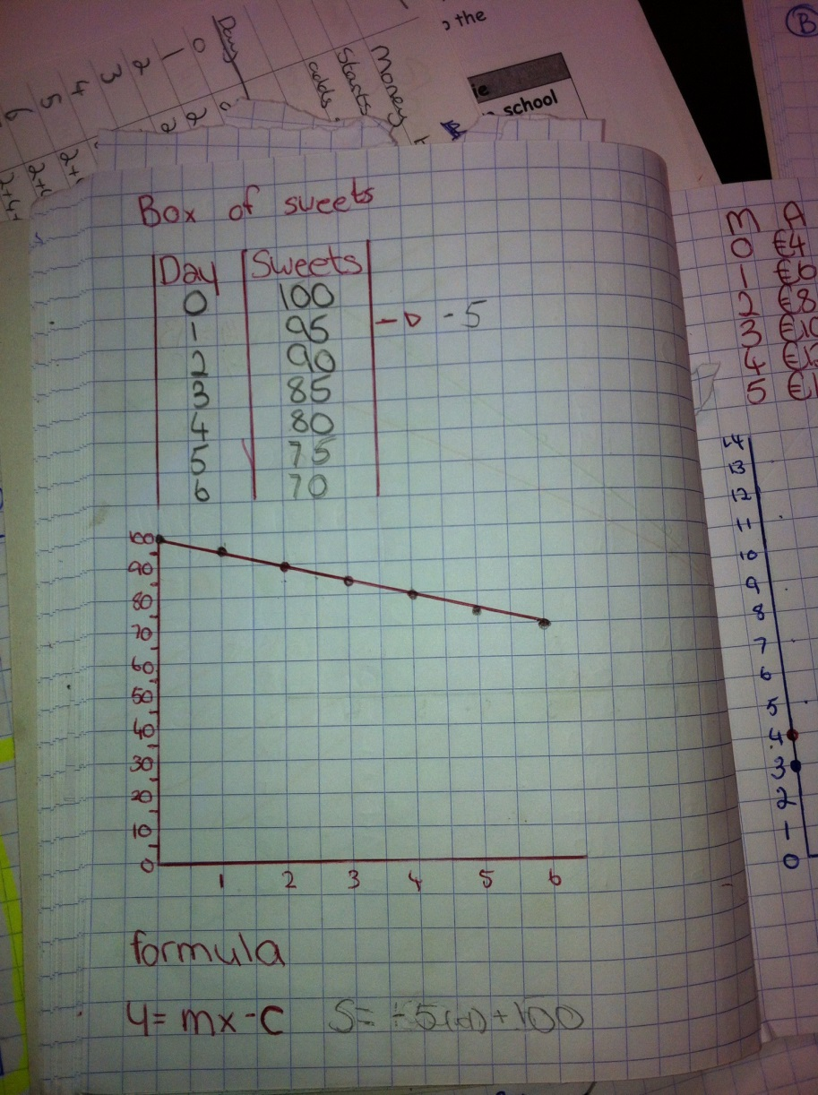
Common Misconceptions
What's the error here?
Axes not labelled, y-axis a different scale to x-axis, Student may think their answer is incorrect, but is it?

Slide 15
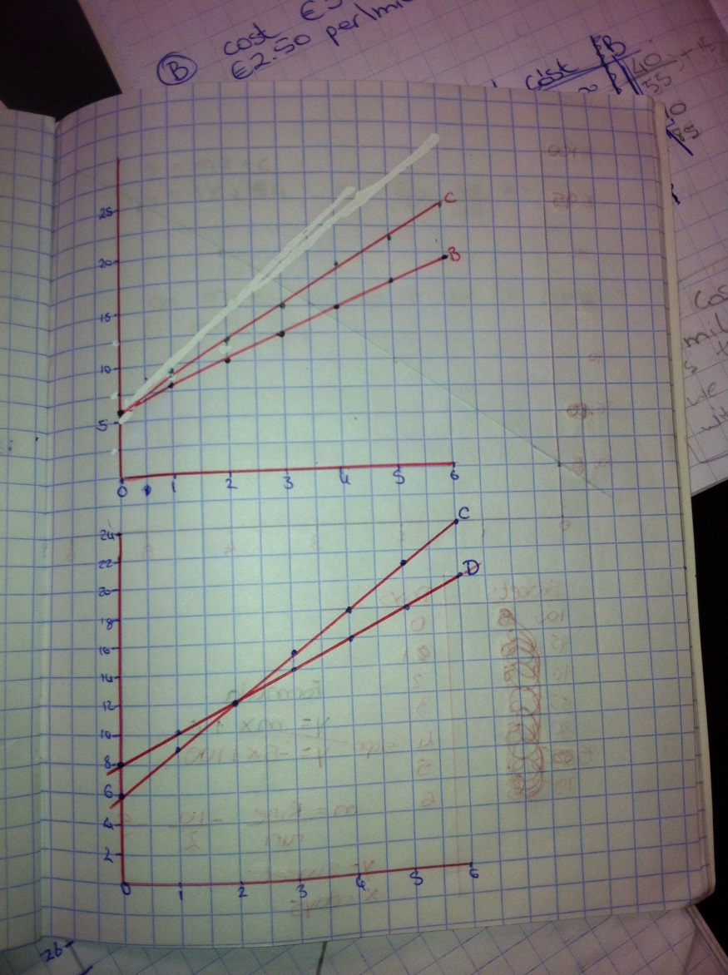
Common Misconceptions
Graph not labelled

Slide 16


Common Misconceptions
What's the error here?
Axis (y) labelled incorrectly (inverted)

Slide 17
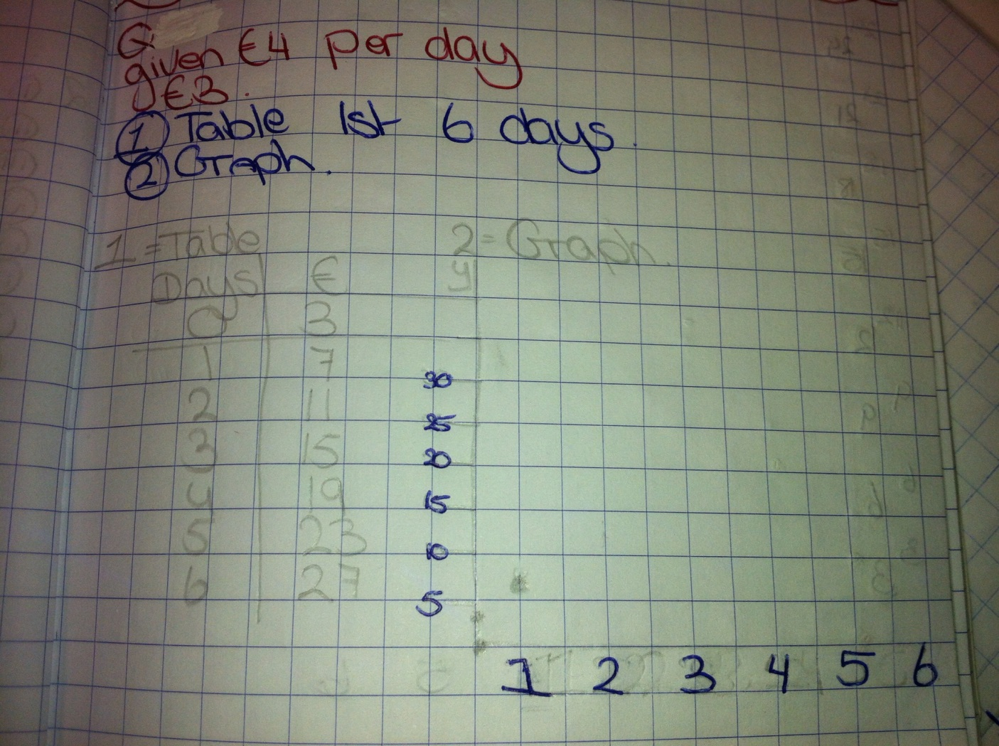


Common Misconceptions
Incorrect scale chosen for y-axis. Points plotted incorrectly.
Student failed to recognise graph should be linear, based on data from table

Slide 18
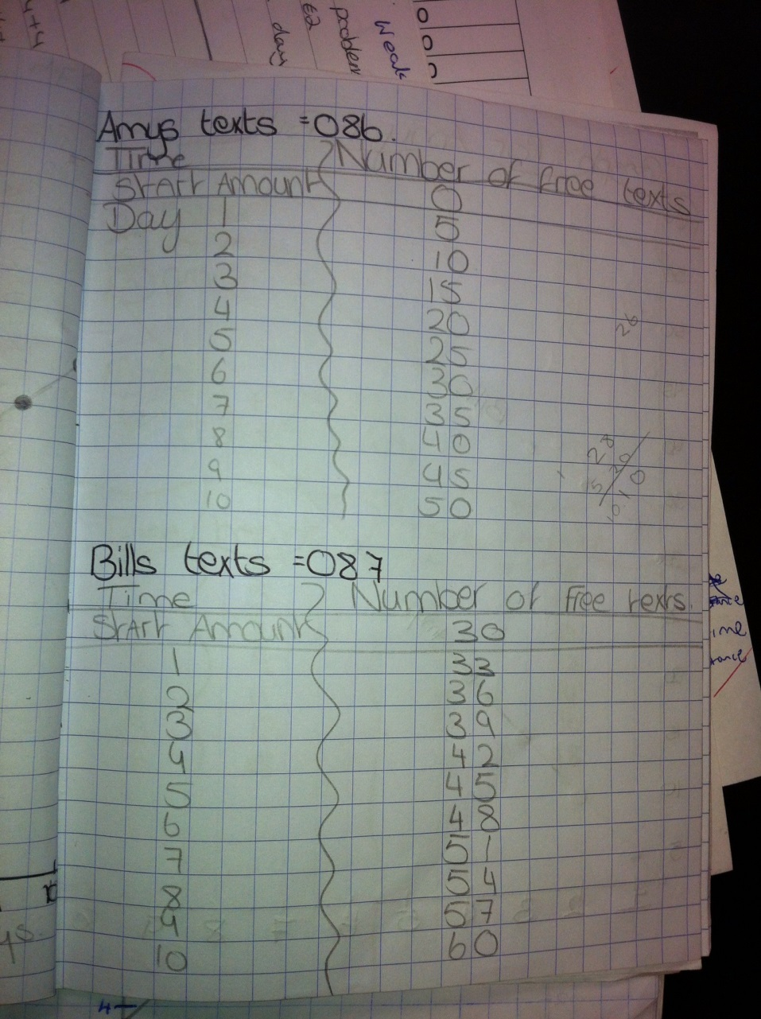
Common Misconceptions
No day 0 used “Start Amount”

Slide 19
Addressing Misconceptions
Recommendations
The adjustments I would make in the future
  Ensure students have good knowledge of graphs
  Ensure students understand concept of slope as a rate of change
  Spend a little more time discussing starting value (e.g. difference between day 0 and day 1)
  The first time: I provided “Project Title”, however, this year, students had to create and decide on their own Project Title

Slide 20
Summary
The understandings we gained regarding students’ learning Patterns as a result of being involved in the research lesson
  Students need to be introduced to this topic slowly at the start; once they understand the basic concepts they are able to link all sections of the topic together.
  It is important to allow students to initiate discussion with teacher/each other regarding various parts of the topic, e.g. “What does this mean?”, “How come?”, “What would happen if…?”
  Discovered that students used a variety of methods and discussion amongst each other to arrive at the same answer, without teacher “guidance”, e.g. tables, graphs, equations all used to discover a solution.

Slide 21
Summary
What did we learn about this content to ensure we had a strong conceptual understanding of this topic?
The first time we (teachers) saw this topic, we noticed that there were 2 different ways to teach patterns, depending on how the question was phrased (e.g. Number form: complete the sequence 1,4,9,16... ). However, we also encountered “Story Problems” which required us to develop a different teaching strategy.
  We had to do extra research to ensure we had a concrete understanding of what the syllabus meant by “Patterns”; this lead to a lot of discussion within the maths dept.

Slide 22
Teaching Strategies
What did I notice about my own teaching?
What was difficult?
  Initially it was more difficult, because:
    Normally maths involved finding a formula and “subbing in” information. This “standardised” form of questioning was now removed.
    Students (and myself) needed a much deeper understanding of the topic and be able to relate it to concrete situations
    Sometimes it was difficult to find the source of a student’s misconception.
    This took a lot more preparation time than normal as the formula had to match with the graph and errors would confuse students.
    If an initial misconception took root, it was difficult to get students to “un-learn” the mistake.

Slide 23
Teaching Strategies
What did I notice about my own teaching?
BUT…
Once the students (and myself) developed a solid understanding of the concepts involved, the subject became much easier to teach, with very few errors experienced.
Students began to enjoy the topic. They developed more “stay-ability” and “self start” initiative when faced with unfamiliar questions (stories).
As a teacher I noticed that I was engaged in a lot more discussion with the students regarding the maths and its understanding.

Slide 24
Teaching Strategies
Was it difficult to facilitate and sustain communication and collaboration during the lesson?
Initially, yes, but as students gained understanding they grew in confidence and collaboration and communication improved greatly.
As we progressed through the topic, the lesson became more “student led” and there were numerous student discussions on the best/most efficient way to solve a problem.

Slide 25
Teaching Strategies
Was it difficult to ask questions to provoke students’ deep thinking?
This particular topic lends itself very well to higher order questions. So it wasn’t difficult.

Slide 26
Teaching Strategies
How did I engage and sustain students’ interest and attention during the lesson?
I provided questions that students could relate to and were interested in, e.g. Mobile Phone tariffs/ concert tickets, and set an assessment at the end where students had to complete a project and were allowed to choose their own topic (e.g. One Direction V Little Mix).

Slide 27
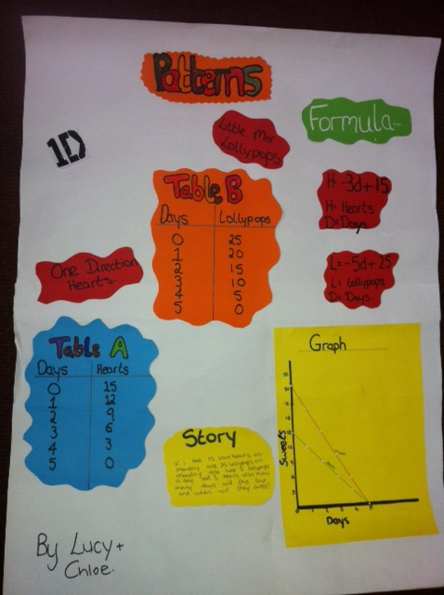

Slide 28
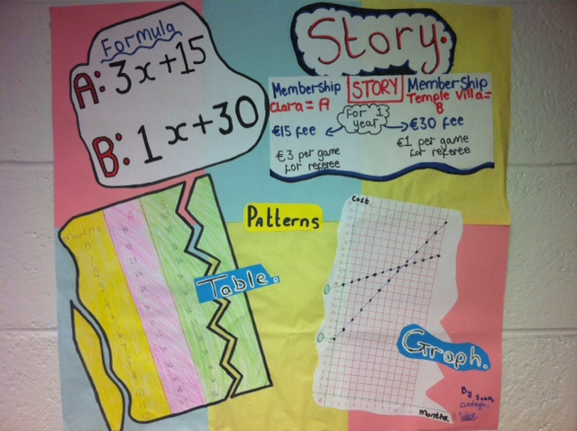
Teaching Strategies

Slide 29
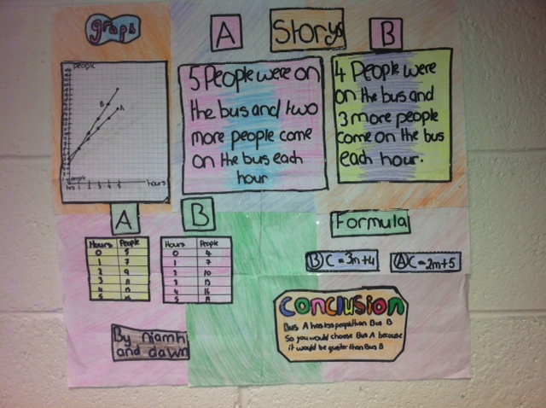
Teaching Strategies

Slide 30
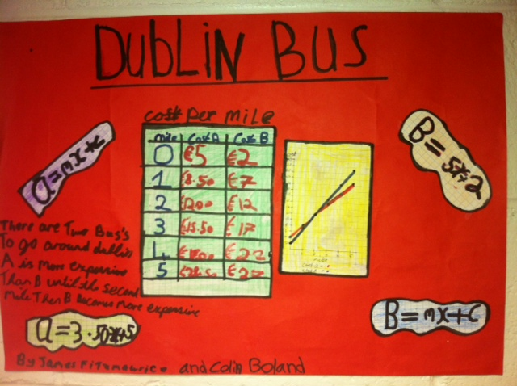
Teaching Strategies

Slide 31
Teaching Strategies
How did I assess what students knew and understood during the lesson?
During class time – Initiate discussion
Students had to create a “Story” around a graph
Class test based on previous exam papers
Group Work: Project which was 20% of mid-term exam

Slide 32
Teaching Strategies
How did I put closure to the lesson?
  Asked the students to summarise the main points of the topic
  Short Class test
  Students were required to complete (and present to peers) a project on the topic

Slide 33
Teaching Strategies
What understandings have I developed regarding teaching strategies for this topic as a result of my involvement in Lesson Study?
  It is important to allow students to discuss the topic; this made it much easier to identify misconceptions.
  Increase “wait-time” when looking for an answer from students.
  Ask more thought-provoking questions during the lesson.
  Ensure that I am very familiar with the topic.
  Discuss/ reflect on the lesson with other colleagues in the maths department.
  When setting assignments, students were far more engaged if the problems could be related to concrete situations in real life.
  Flag improvements which could be made for the next time I teach this topic.

Slide 34
Teaching Strategies
What changes would I make in the future, based on what I have learned in my teaching, to address students’ misconceptions?
Initial introduction of the topic is very important; spend some extra time (if needed) here to ensure students develop a solid understanding of basic concepts.
Check with the students what they already know (don’t assume that because it has been previously covered everyone understands it, e.g. basic graphing skills).
Don’t automatically tell the student where they have made an error; initiate discussion as to where/what the error might be.
Encourage group work, peer-peer learning for students.
Set assignments (e.g. mini project) where students must present their findings to the class; this improves standard of work received and promotes high levels of discussion.

Slide 35
Reflections on Lesson Study Process
Strengths & Weaknesses
As a mathematics team how has Lesson Study impacted on the way we work with other colleagues?
We collaborate a lot more
Share EVERY resource we have with each other
Created “Dropbox” to centralise electronic resources, also on school server
Discuss maths more (a LOT more!!)

Slide 36
Reflections on Lesson Study Process
Strengths & Weaknesses
Personally, how has Lesson Study supported my growth as a teacher?
I try to put every question into some relevant context for the students
I research maths a lot more than I used to, to help me find fresh ideas and approaches for use when teaching
I tend to reflect more on how lessons went (e.g. student interaction and discussion levels)

Slide 37
Reflections on Lesson Study Process
Strengths & Weaknesses
Recommendations as to how Lesson Study could be integrated into a school context
Share our experience with other subject departments.
Schools could set up a central repository (online) where all resources can be stored, added to and accessed by teachers.

