Slide 1
Maths Counts Insights into Lesson Study
1
Notes:
1

Slide 2
Coláiste Choilm Tullamore, Co. Offaly
Lesson Study Team:
Brendan McGlynn (Mathematics Co-ordinator)
Genieve Rowland
Eilish Kinsella
Leaving Certificate Mathematics
Literacy Techniques/Interventions in Mathematics.
2
Notes:
2

Slide 3
Insights into Lesson Study
Introduction: The aim of our lesson study was to try and improve students
understanding of key words in Statistics & Probability using a number of literacy interventions.
Student Learning : We discovered the following;
Students responded positively to peer learning.
Rote learning of definitions leads to poor learning outcomes for students.
Teaching Strategies: 3 main strategies
Vocabulary Instruction (General/Maths specific definitions)
Visualising & Summarising
Peer Learning/ Group Work

Slide 4
Insights into Lesson Study
Strengths:
Positive and enhanced learning outcomes for students.
Weaknesses:
Lessons did take more planning and did effect the scheme
of work in relation to timing.
However:
The extra time spent proved to be beneficial and we actually “saved” time by the end of the topic – less revision needed
4
Notes:
4

Slide 5
Introduction
Literacy Techniques/Interventions in Mathematics.
(Statistics & Probability)
With more emphasis on vocabulary in Project Maths we found students were
having difficulty explaining keywords and understanding the difference
between general and mathematical definitions. Misconceptions!
As a team we decided to implement 3 literacy techniques in one class and
teach another class vocabulary by traditional methods.
Both classes would be given a common literacy test and the results compared.
Mini whiteboards, posters and general classroom stationary were required.
5
Notes:
5

Slide 6
Introduction
Learning Outcomes
To understand the difference between general definitions and mathematical specific definitions.
To clear up any misconceptions students may have.
To be able to explain key terms in their own words.
Strand 1: Statistics & Probability
Student Misconceptions
Topic with a lot of vocabulary.
6
Notes:
6

Slide 7
Introduction
Enduring understandings
To understand that there is difference between the general meaning of a word and the mathematical meaning of a word. E.g. Volume = how loud something is, and Volume = the amount of space something takes up
Students understand the language of Probability & Statistics and how it is used in the real world.
To be able to apply mathematical concepts to everyday situations.
7

Slide 8
Reflections on the Lesson
Student Learning
Students involved in peer learning performed better than those who worked on their own.
Visualising a word helped students to explain the word in a written sentence.
Teaching Strategies
More student participation in their own learning.
Initiate more teacher/student and student/student discussion
Moving away from traditional ‘chalk & talk’
8
Notes:
8

Slide 9
Student Learning
Teaching Methodology
Students divided into groups of 2 and each group given a key word.
2 tasks –
Explain the meaning of the word using a diagram.
In your own words using written sentences.
Peer evaluation of student responses.
Majority of students engaged and enjoyed the lesson.
9
Notes:
9

Slide 10
Play Video
https://vimeo.com/76941908

Slide 11
Student Understanding
Students had positive learning outcomes working in pairs.
Students enjoyed evaluating other pupils responses.
Students appreciated other methods of learning over rote.
11
Notes:
11

Slide 12
Effective Student Understanding
Students were able to discuss and explain key words verbally in a clear and concise manner.
Students were able to explain the key word in a written sentence.
Students performed better in literacy examinations than those taught the keywords by rote.
Students were able to apply mathematical concepts to everyday situations.
12
Notes:
12

Slide 13
Student Learning
Misconceptions
Students had misconceptions between the general meaning of words and the mathematical meaning.
Difficulty relating mathematical concepts to everyday situations.
Most difficult word: Sample space
Difficulty relating statistical vocabulary to everyday situations.
13
Notes:
13

Slide 14
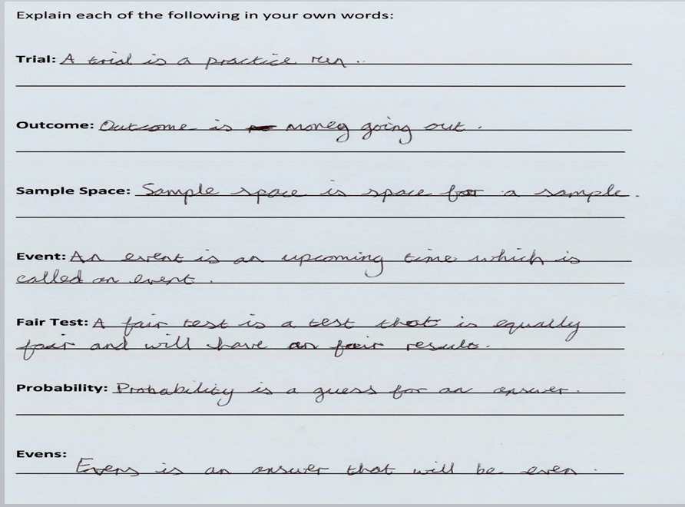
Effective Student Understanding
14
Notes:
14

Slide 15
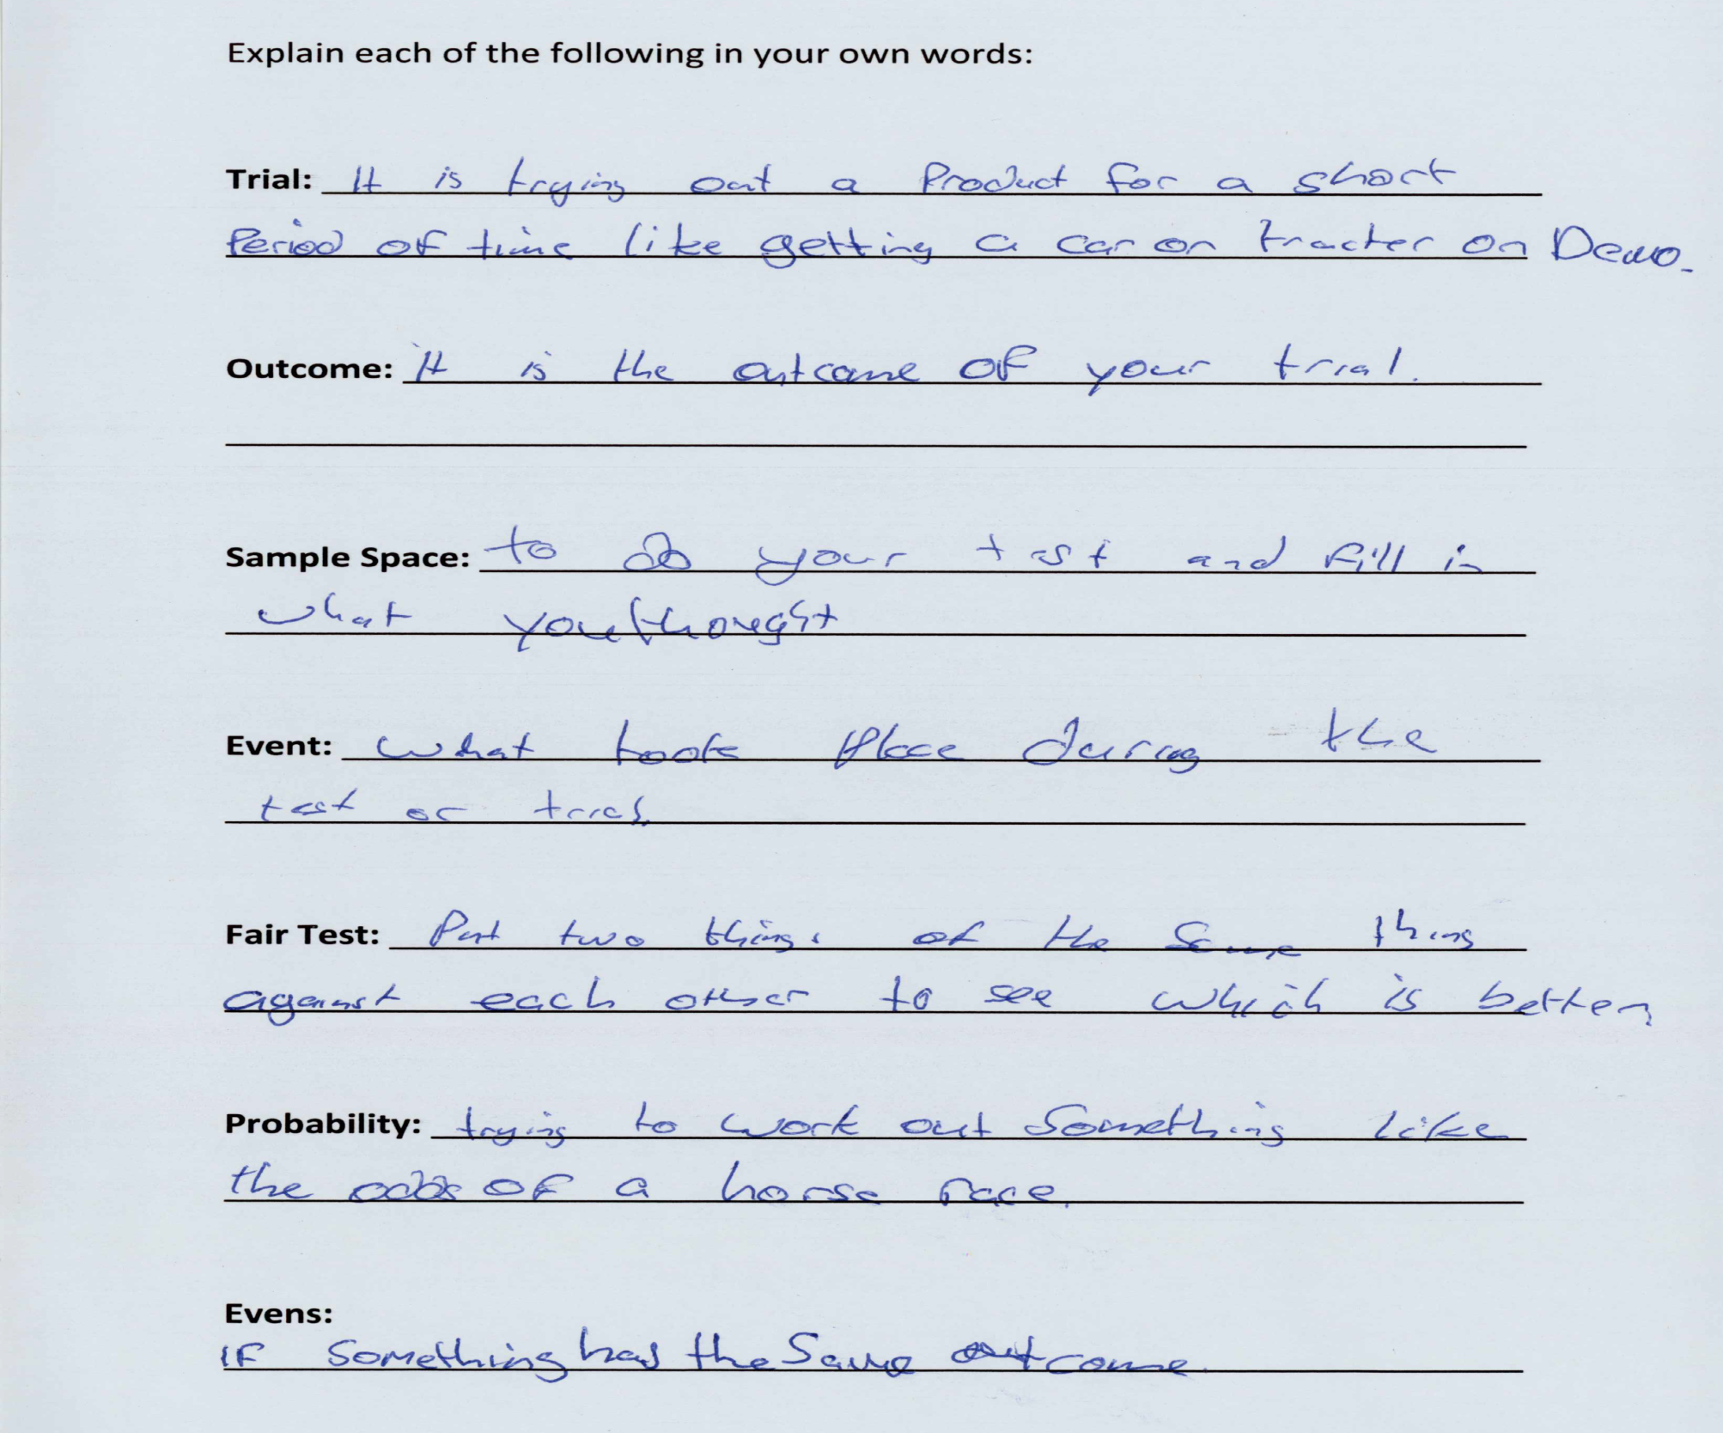
Effective Student Understanding
15
Notes:
15

Slide 16
Addressing Misconceptions
Recommendations
Discuss the mathematical meaning and the general meaning simultaneously.
Planned talk and discussion of key words is important.
Relate the key words to everyday examples.
Give students longer time to explain their picture and explanation.
Allow the students to develop a definition of each word.
Avoid giving the students the definition and then telling them to learn it “off by heart”.
Use simpler language during Maths class.
16
Notes:
16

Slide 17
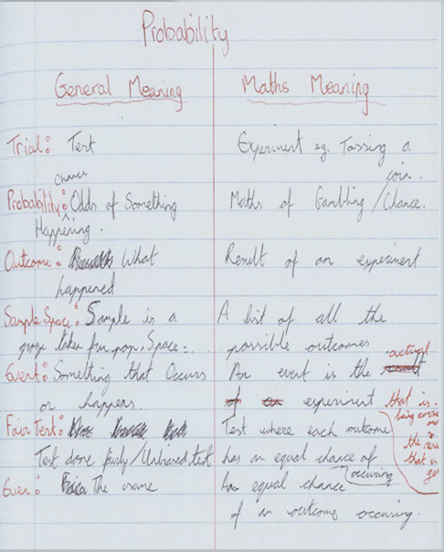
17
Notes:
17

Slide 18
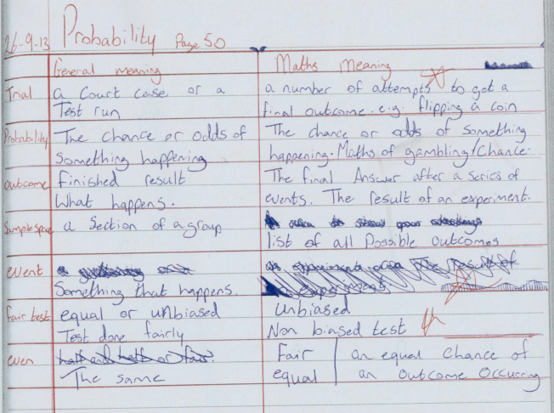
18
Notes:
18

Slide 19
Summary
Students learn best when they are involved in the learning process and not passive observers.
Students don’t like group work that doesn’t have a definite result / outcome.
Students like to use their own language when explaining key words.
Students don’t like mathematical concepts without applications to the real world.
Peer learning has positive outcomes for students.
19
Notes:
19

Slide 20
Summary
We learned as a department we need to focus on Mathematical literacy more.
Simpler language needs to be used in class.
Important link between Mathematical literacy and Pure Maths, i.e once students develop an understanding of the term, they must be able to perform the relevant mathematical procedures associated with it
Mathematical Literacy needs to be assessed as well as basic Mathematical skills and relevant operations associated with the terms.
20
Notes:
20

Slide 21
Teaching Strategies
What did I notice about my own teaching?
What was difficult?
Lessons did take longer and as a teacher you have to step back and allow the students develop their own understanding of words.
Group work must be planned well and classroom can be noisier than usual.
Instant feed back had to be given to the students responses.
Some students did find it difficult to discuss their answers with the whole class.
L
21
Notes:
21

Slide 22
Teaching Strategies
Was it difficult to facilitate and sustain communication and collaboration during the lesson?
It was important to have a time limit on each activity or students became bored.
Student pairings was important, strong with weak for peer learning.
Collaborative learning worked well with small classes 24, difficult with larger classes.
22
Notes:
22

Slide 23
Teaching Strategies
Was it difficult to ask questions to provoke students’ deep thinking?
Deep thinking questions were difficult for weaker students.
Working in groups did give them confidence to elicit a response.
Sometimes stronger students shouted out the answer to the question too early.
23
Notes:
23

Slide 24
Teaching Strategies
What changes would I make in the future, based on what I have learned in my teaching, to address students’ misconceptions?
Place a greater emphasis on Mathematical Literacy.
In future I will ensure more student involvement in the learning process.
Adjust the timing of lessons to facilitate more talk & discussion to eliminate misconceptions.
Allow more time for questioning to eliminate misconceptions.

Slide 25
Teaching Strategies
How did I engage and sustain students’ interest and attention during the lesson?
Talk & Discussion
Active Learning
Collaborative Learning
Encourage Self and Peer Evaluation
Class was student lead
Encourage students to think of some real life mathematical contexts for the word(s) they were working on.
25
Notes:
25

Slide 26
Teaching Strategies
How did I assess what students knew and understood during the lesson?
Assessment of student responses during the lesson.
Literacy examinations separate to mathematical procedures.
Students self evaluation.
Students created posters with definition of word and images
Discussion with students
Higher order questions, “How come?, When would?, What if?, Would that always be true?”
26
Notes:
26

Slide 27
Teaching Strategies
How did I put closure to the lesson?
Summarised - students wrote down the mathematical meaning for each key word and provided a mathematical context we agreed on as a class
What understandings have I developed regarding teaching strategies for this topic as a result of my involvement in Lesson Study?
Peer learning is a very effective strategy
Active learning has a very important part to play in Maths classes.
Use of simpler language in Maths class is important for weaker students.
Student involvement in developing a definition for a key word is very important.

Slide 28
Teaching Strategies
What changes would I make in the future, based on what I have learned in my teaching, to address students’ misconceptions?
Place a greater emphasis on Mathematical Literacy.
In future I will ensure more student involvement in the learning process.
Adjust the timing of lessons to facilitate more talk & discussion to eliminate misconceptions.
Allow more time for questioning to eliminate misconceptions.
28
Notes:
28

Slide 29
Reflections on Lesson Study Process
Strengths & Weaknesses
More discussion about teaching strategies within the department.
Class literacy results are now compared for the first time.
Literacy techniques that worked are shared with other departments.
Listening more to the students on how they learn best.
Class planning in Maths has improved.
Sharing teaching strategies more with teachers.
Personally, I found lesson study a positive experience.
29
Notes:
29

Slide 30
Conclusion
Mathematical Literacy techniques:
It will take a number of years before we have concrete proof of their effectiveness, but initial evidence is positive.
Literacy strategies used in this lesson plan will be integrated into Coláiste Choilm’s Literacy Plan.
30

