Slide 1
Maths Counts Insights into Lesson Study

Slide 2
St Mark’s Community School
Sharon Mack, Irene Stone and Gemma Fay
3rd Years
Problem Solving as a “Means” not an “End”
Normally we teach the skills of inequalities and then use these to solve problems.
In this approach, we introduced the problem first, solved it, then used the problem to introduce inequalities and used our prior knowledge of equations to solve them.

Slide 3
Insights into Lesson Study
Introduction: Focus of Lesson
Student Learning : What we learned about students’ understanding based on data collected
Teaching Strategies: What we noticed about our own teaching
Strengths & Weaknesses of adopting the Lesson Study process

Slide 4
Introduction
Topic investigated was Problem Solving as a “Means” not an “End”
How we planned the lesson:
The idea and methodology was used in the Project Maths workshop 8.
Studied the lesson
Decided how we would approach it and the timing of the lesson
Photocopied the sheets

Slide 5
Introduction
Topic investigated was Problem Solving as a “Means” not an “End”
Resources used:
Photocopied sheets with graph paper on the reverse
PowerPoint
Whiteboard

Slide 6
Introduction
Our problem
John has 18 ten-cent coins in his wallet and Owen has 22 five-cent coins in his wallet.
They each decide to take one coin per day
from their wallets and put it into their money box, until one of them has no more coins left in their wallet.
When does Owen have more money
than John in his wallet?

Slide 7
Introduction
Prior Knowledge:
Patterns
Tables, Graphs, words and formula
Slope (Change)
Variables and Constants
Equations

Slide 8
Introduction
Format of my lesson:
Students given an opportunity to read the problem
Students worked on the problem by a method of their choice
Teacher observed the students’ work and questioned them on their approaches
Drew a table on the board and through class discussion arrived at the formula for John and Owen
Represented the problem as $110−5d>180−10d$
Draw comparisons between the inequality and an equation
Solve the inequality using the skills of solving an equation
Brought the answer back to the context of the question

Slide 9
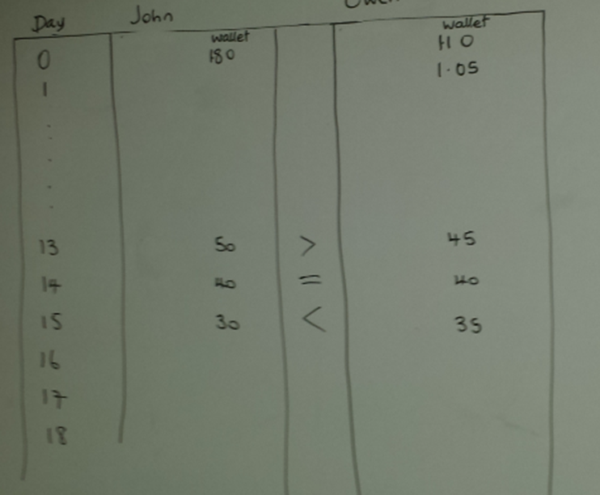
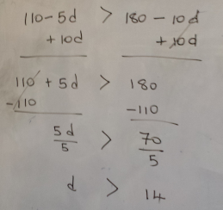
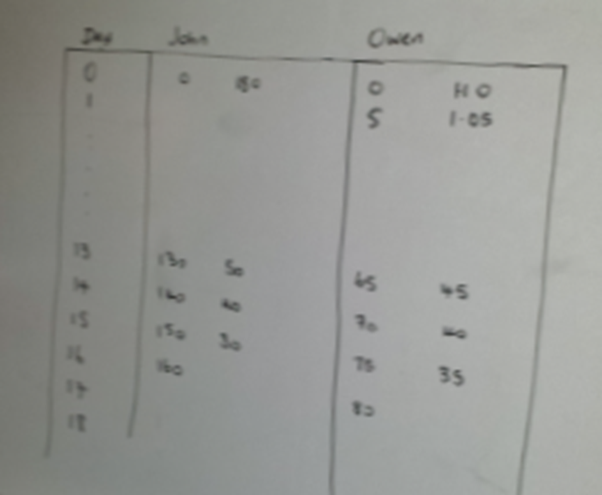
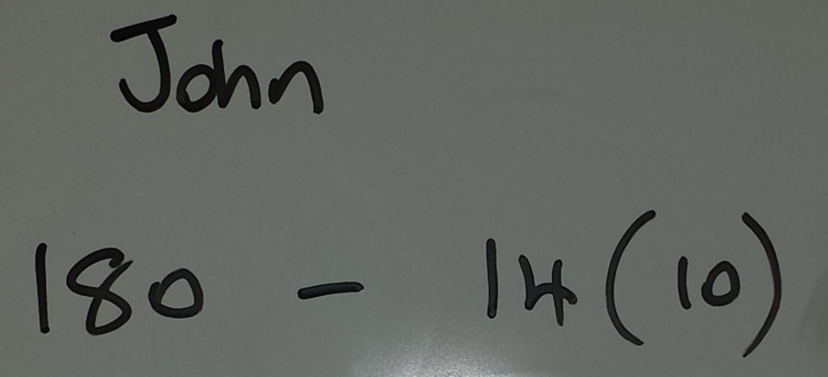
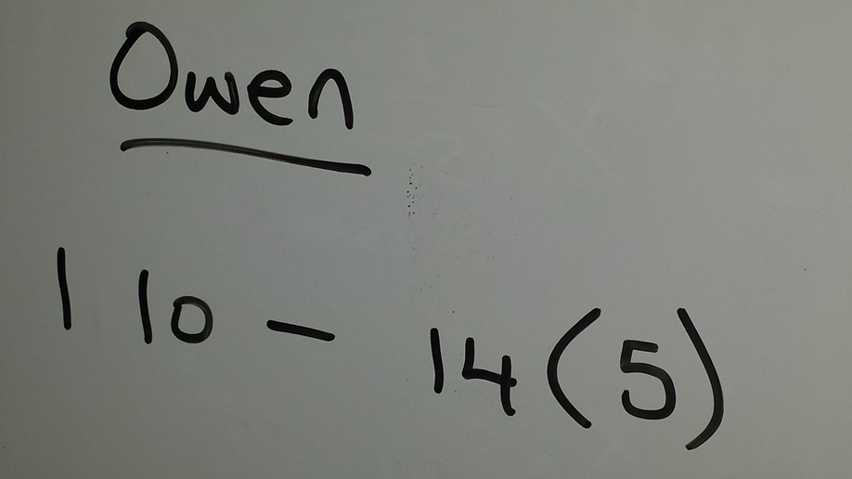
Introduction
Development of the inequality

Slide 10
Introduction
Learning Outcomes:
Practise their knowledge of patterns
More than one method to solve a problem
Concept of one expression being bigger or less than another expression
Relationship between equations and inequalities
How to solve inequalities
The necessity to bring all answers back to the context of the problem

Slide 11
Introduction
Why did we choose to focus on this mathematical area?
Needed to introduce inequalities and saw this approach and wanted to try it.

Slide 12
Introduction
Enduring understandings:
How patterns can be used to solve inequalities
The relationship between equations and inequalities
The ability to solve inequalities
More than one method to solve problems (List, Table, Graph and Formula)

Slide 13
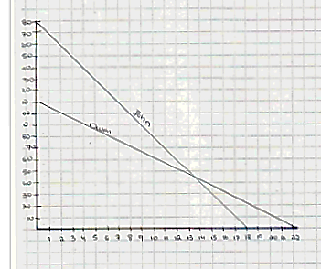
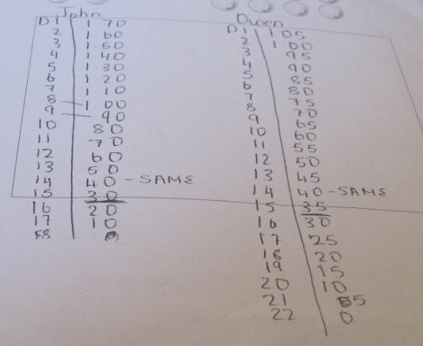
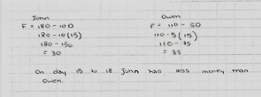
Introduction
More than one method to solve a problem

Slide 14
Reflections on the Lesson
Student Learning : What we learned about students’ understanding based on data collected
Teaching Strategies: What we noticed about our own teaching

Slide 15
Student Learning
Data Collected from the Lesson:
Academic e.g. samples of students’ work
Motivation
Social Behaviour

Slide 16
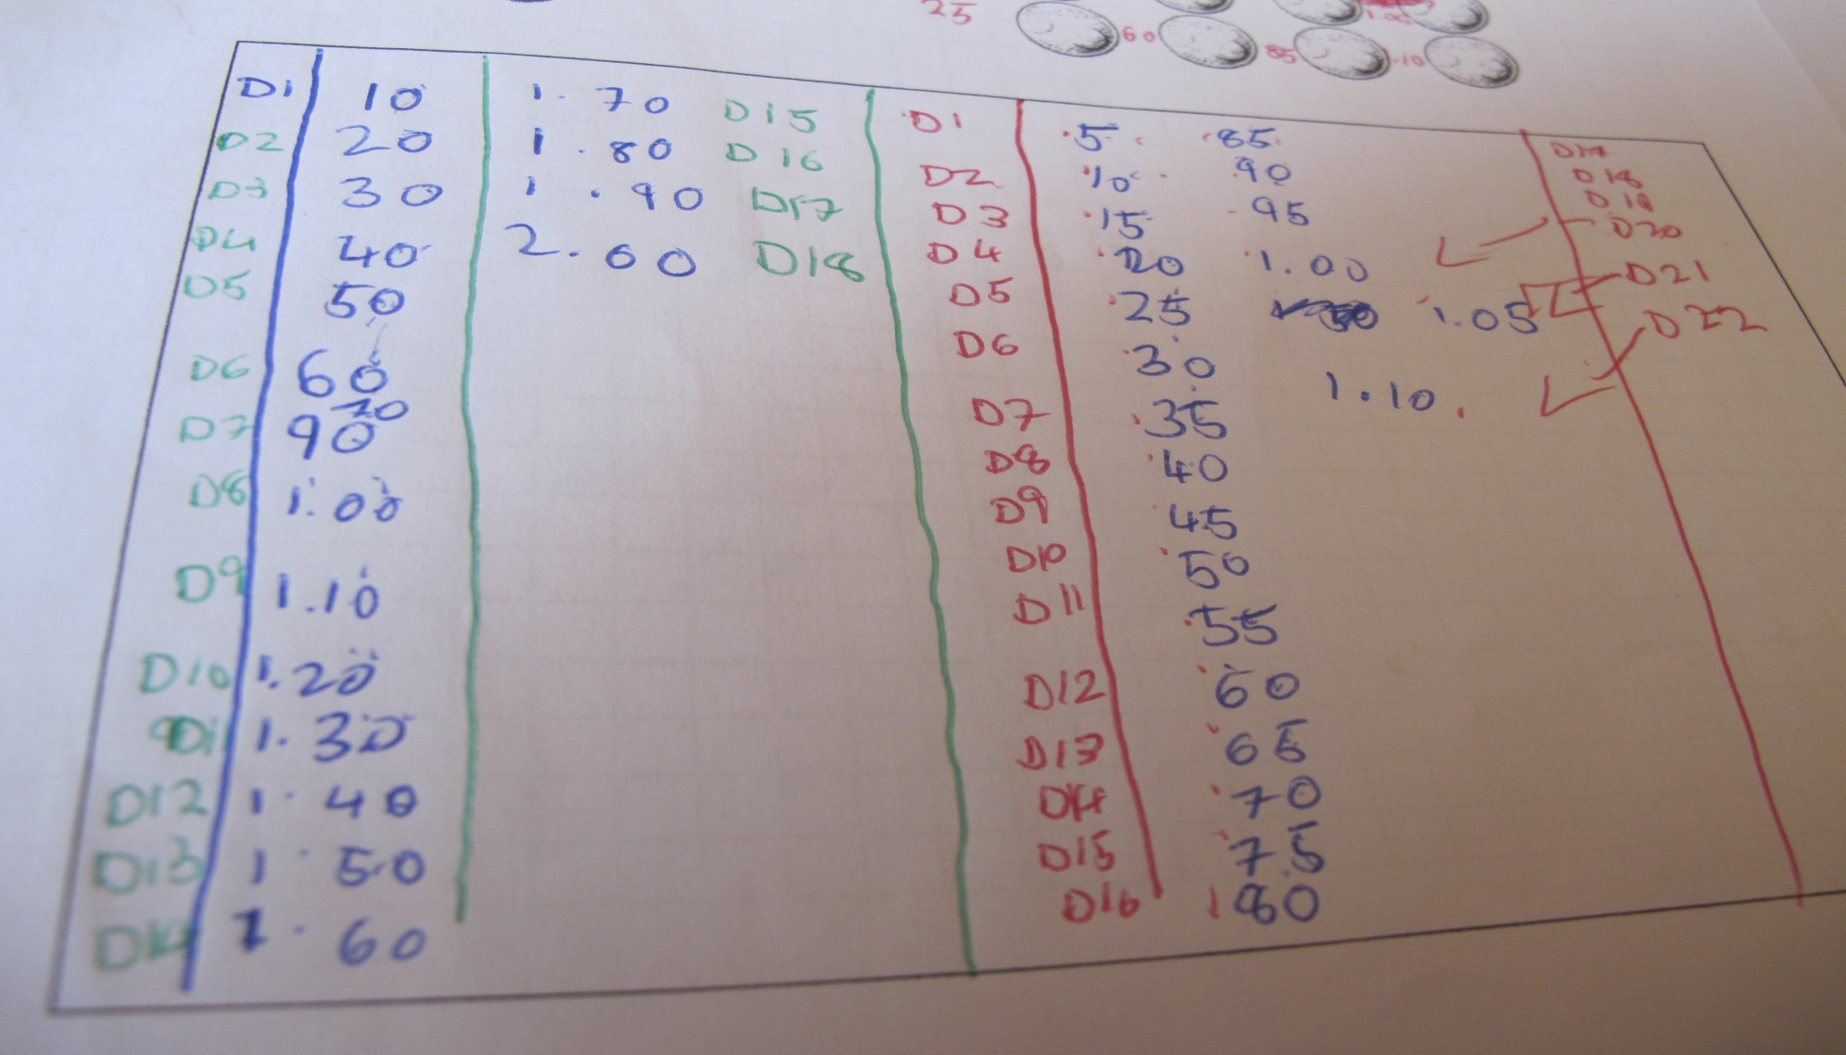
Student Understanding
What we learned about the way different students understand the content of this topic?
Some students were:
Reluctant to show their work in case it was incorrect.
Reluctant to use Algebra in the first instance.
Did not read the question correctly. Money box vs. wallet.

Slide 17
Effective Student Understanding
What effective understanding of this topic looks like:
Day 0 John has 180 and Owen 110.
John and Owen have the same amount of money on day 14.
Owen has more money on days 15,16,17 and 18.
John has no more money on day 18, so problem stops.
John’s formula is $180−10d$.
Owen’s formula is $110−5d$.
Owen is greater than John: $110−5d>180−10d.$
Apply their knowledge of solving equations to inequalities.

Slide 18
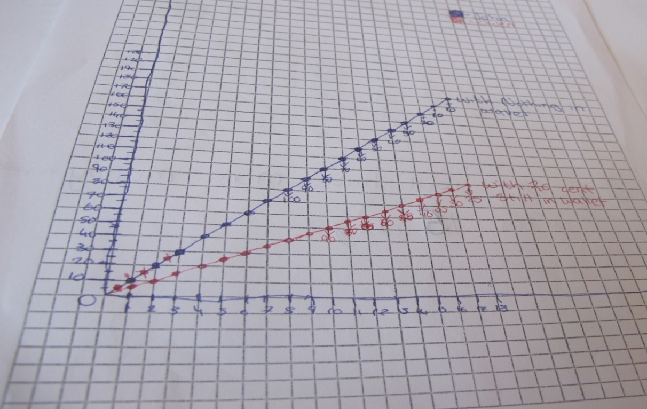
Student Learning
Misconceptions/ Knowledge Gap:
Graph going up done from the money box point of view. Also did not treat axis as lines

Slide 19
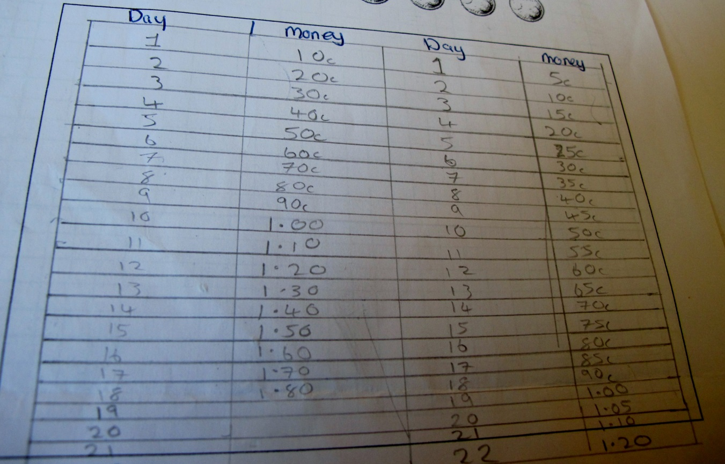
Common Misconceptions
Problem answered from wallet’s point of view rather than money box’s

Slide 20
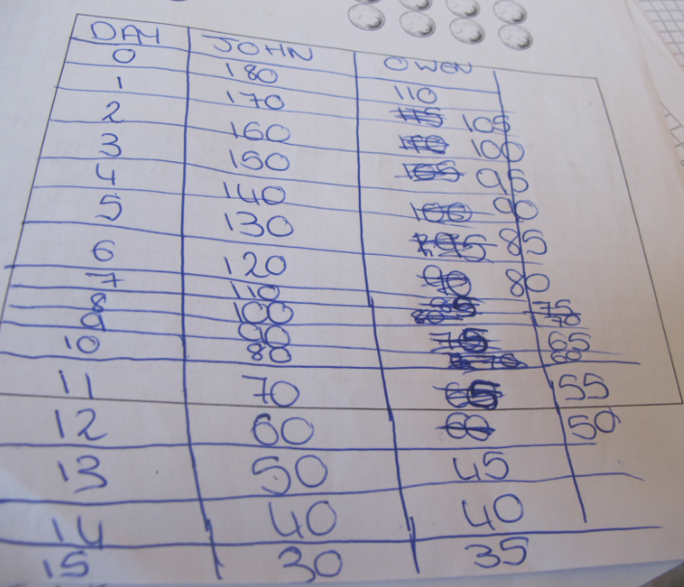
Common Misconceptions
Stopped at day 15

Slide 21
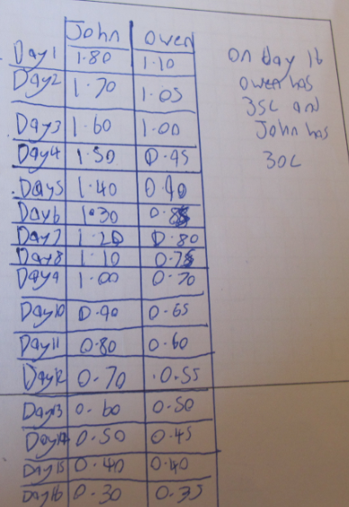
Common Misconceptions
John has 1.80 on Day 1 instead of Day 0

Slide 22
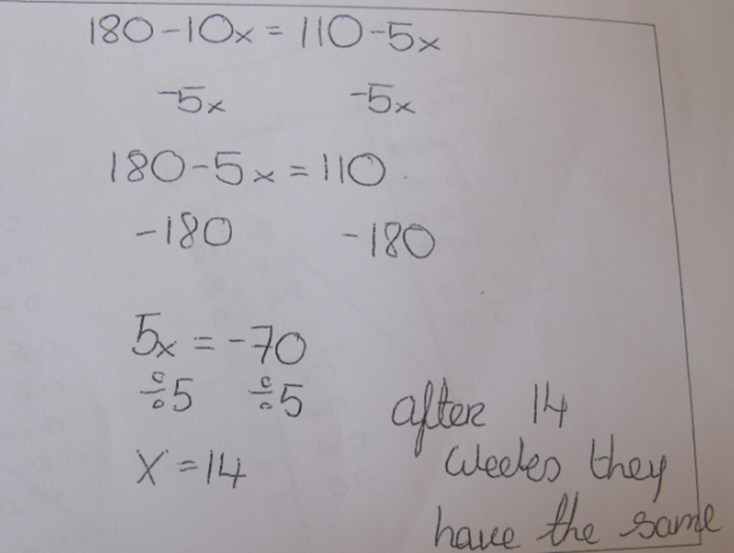
Common Misconceptions
Confused Algebra skills

Slide 23
Common Misconceptions
Did not read the question properly; got days and weeks mixed up.

Slide 24
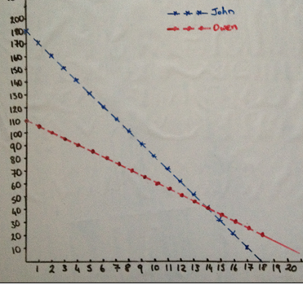
Common Misconceptions
Did not label the axes

Slide 25
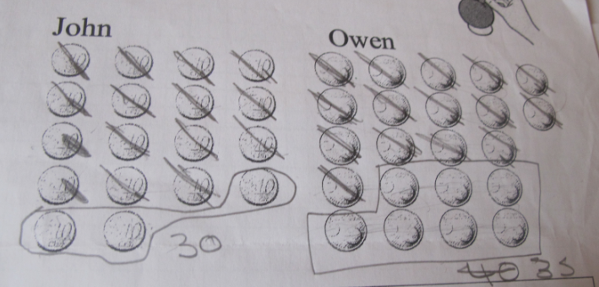
Common Misconceptions
The need to let this student know they are correct, but not all problems can be solved this way; hence we use inequalities

Slide 26
Addressing Misconceptions
Recommendations
Encouraged those who confused wallet and money box to re-read the problem during the class.
Have a money box and wallet in the class.
Encourage students to label axes

Slide 27
Summary
The understandings we gained regarding students’ learning as a result of being involved in the research lesson:
Students engaged with the problem and remained engaged when problem translated to algebra and the inequality.
Students also saw the difference between an equation and an inequality.
Some students used tables, others graphs and others formulas.

Slide 28
Summary
What did we learn about this content and approach to ensure we had a strong conceptual understanding of this topic?
How building on patterns can be used to introduce equations and inequalities.
Relationship between an equation and an inequality.
The need to encourage students to put the answer back into the context of question.

Slide 29
Teaching Strategies
What did I notice about my own teaching?
What was difficult?
Timing to complete the table
Not to intervene too soon
Some students’ lack of confidence to start the problem or discuss the problem

Slide 30
Teaching Strategies
Was it difficult to facilitate and sustain communication and collaboration during the lesson?
As some students answered from the money box’s point of view, I put the two sets of solutions on the board. I re-read the question and asked the students, which one we could use to find the answer to the problem.
Put the formula as Owen > John rather than John < Owen. Why?

Slide 31
Teaching Strategies
Was it difficult to ask questions to provoke students’ deep thinking?
What was happening to each person’s wallet?
Was it only day 15 that Owen had more money?
Why did we stop at day 18?
Difference in $110−5d= 180−10d$and
$110−5d>180−10d$?
How do I solve an equation?
What does $x>14$ mean in the context of this problem?

Slide 32
Teaching Strategies
How did I engage and sustain students’ interest and attention during the lesson?
Students engaged with the context of the question because they could relate to it.
Spotted misconceptions during the class and gave direction when required.

Slide 33
Teaching Strategies
How did I assess what students knew and understood during the lesson?
Students’ work showed their understanding of the problem.
Asked probing questions.
Students were working in groups and discussing the problem.

Slide 34
Teaching Strategies
How did I put closure to the lesson?
Showed how the problem could be solved by algebra. Solved the inequality.
Discussed the meaning of $x>14$ in the context of the problem.
While $x>14$ could mean 50, 50 did not answer this question in this context. Why?

Slide 35
Teaching Strategies
What understandings have I developed regarding teaching strategies for this topic as a result of my involvement in Lesson Study?
I never would have thought of using patterns as an introduction to inequalities, but now see it is a brilliant approach.
A slow lead-up to inequalities did not scare the students and they were still engaged at the end of the lesson.

Slide 36
Teaching Strategies
What changes would I make in the future, based on what I have learned in my teaching, to address students’ misconceptions?
Use a context-based question to introduce equations.
Encourage the students to spot patterns, where possible.

Slide 37
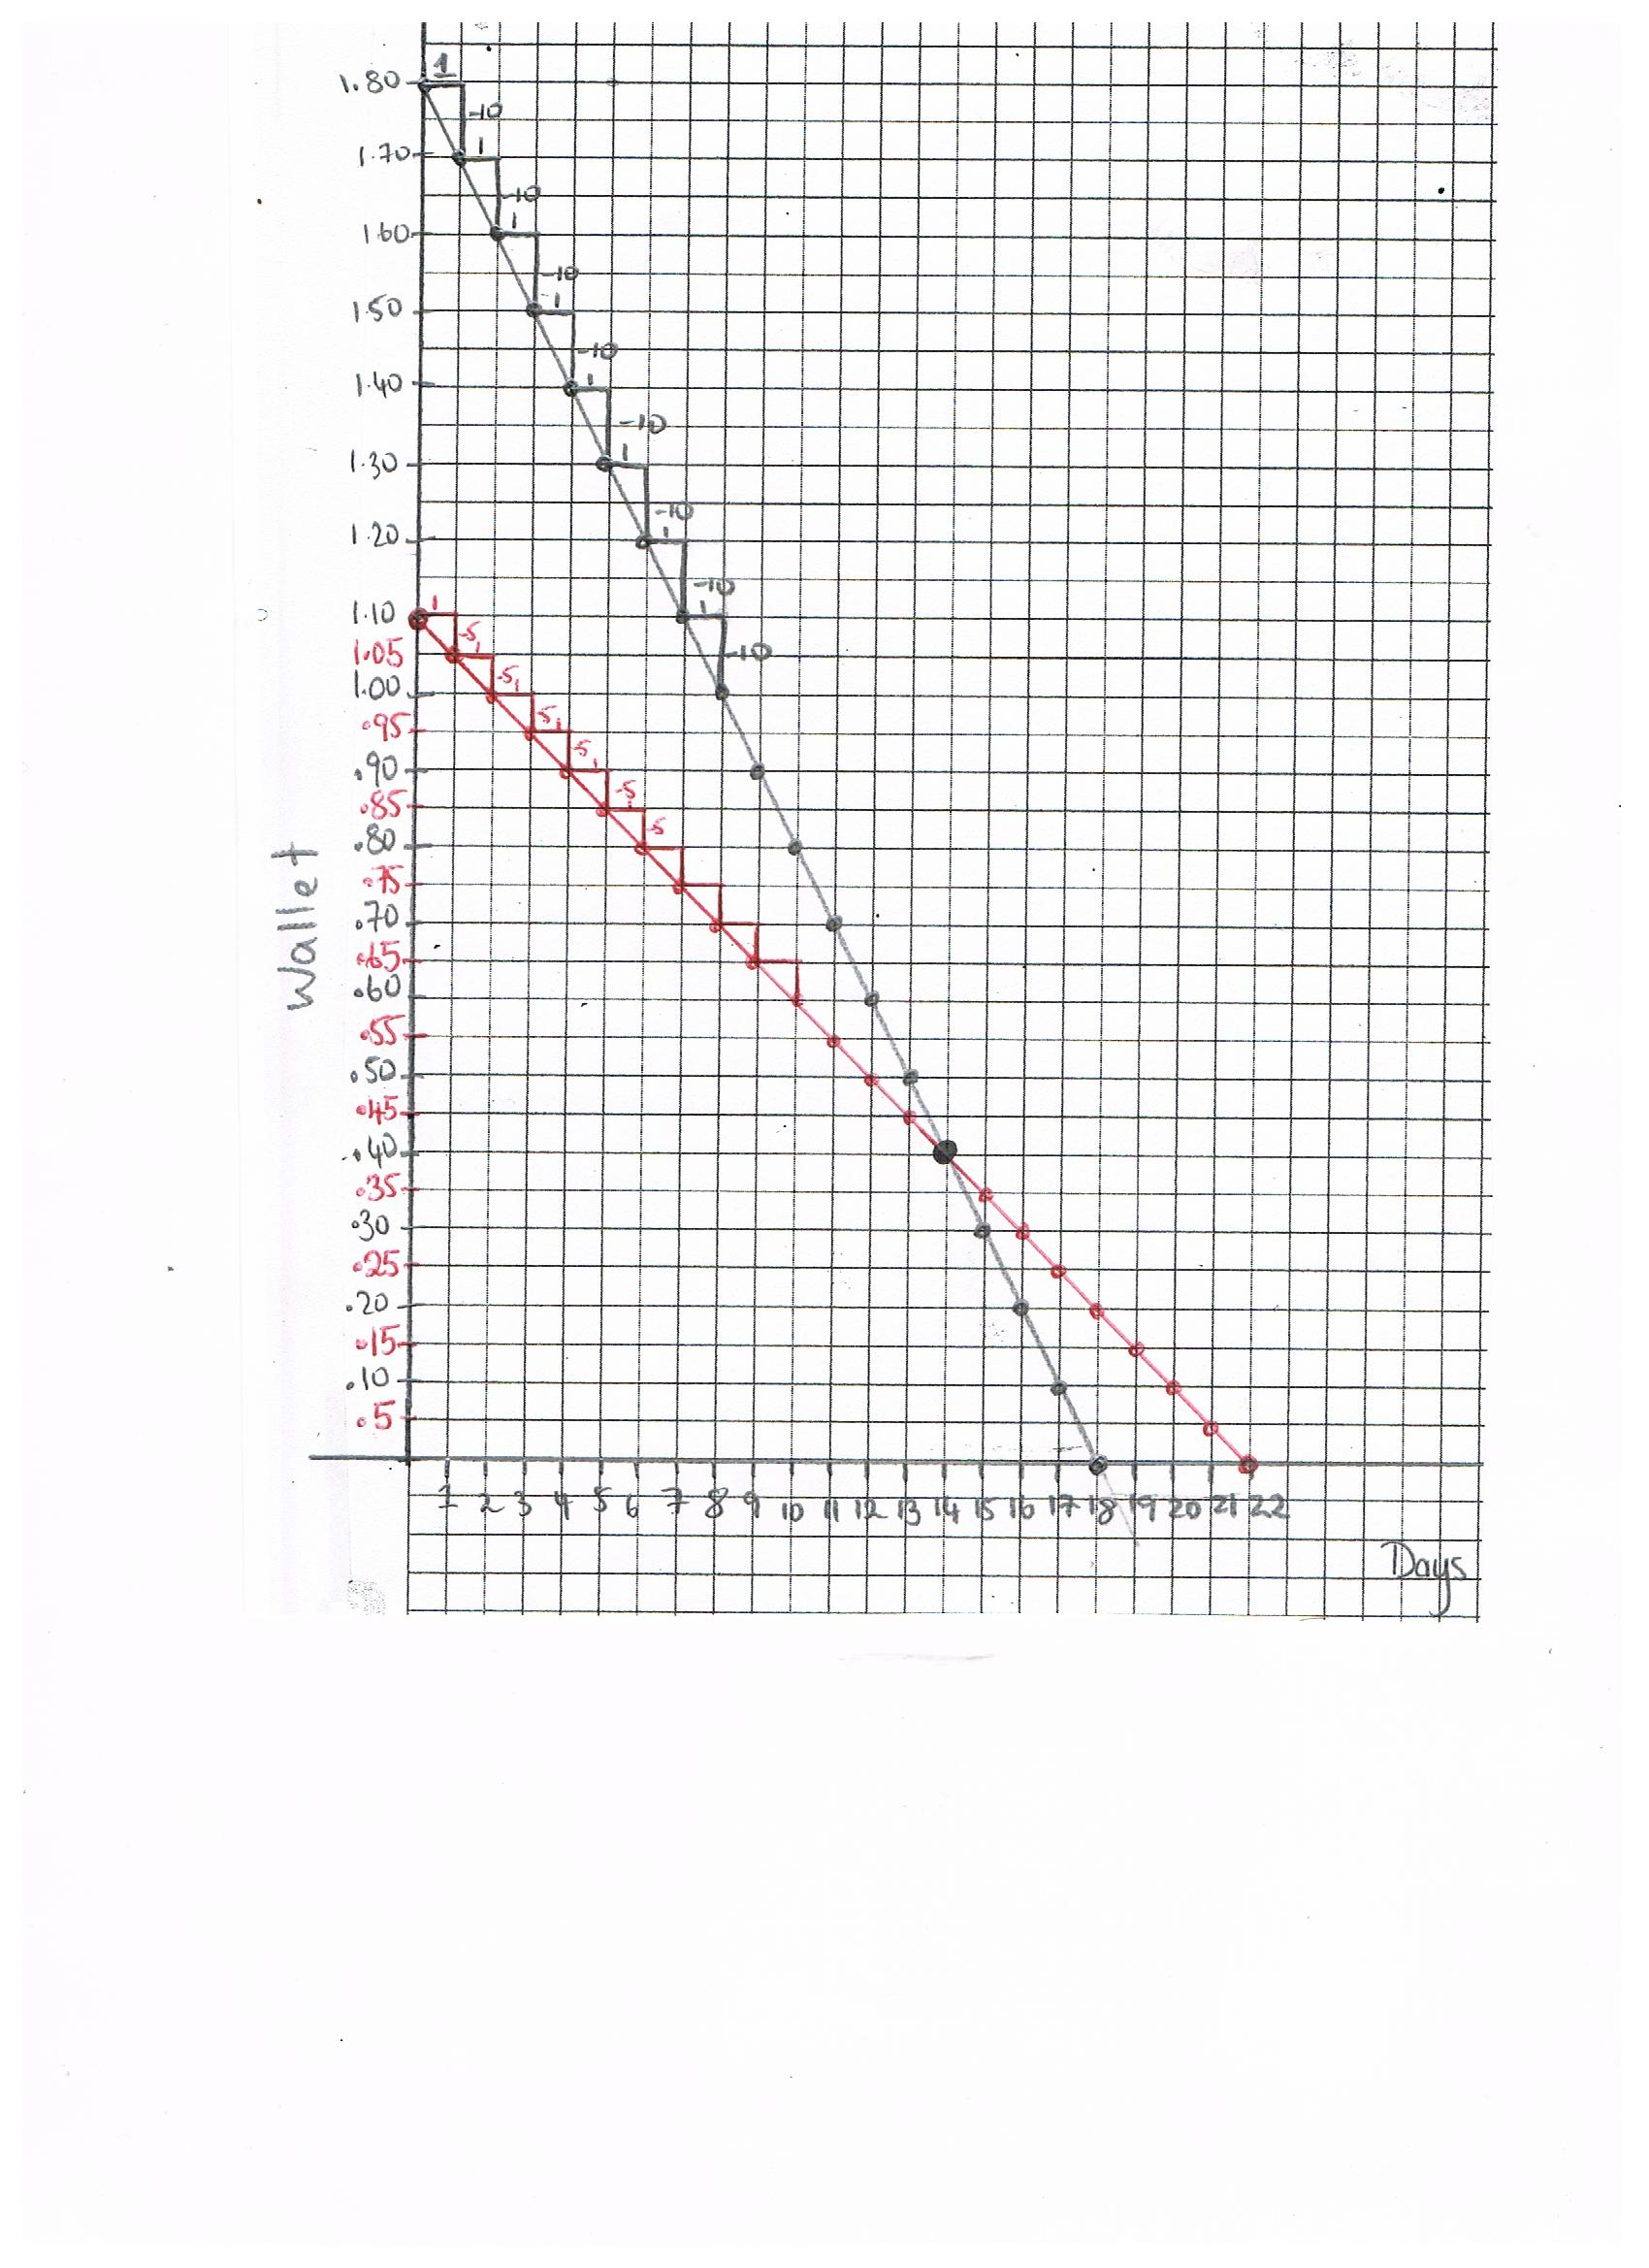
Teaching Strategies
In future relate the change in the diagram, to the slope of the graph

Slide 38
Reflections on Lesson Study Process
Strengths & Weaknesses
As a mathematics team how has Lesson Study impacted on the way we work with other colleagues?
Learned from my colleagues.
Liked feedback from my colleagues. Do not spot everything yourself. Good or Bad.

Slide 39
Reflections on Lesson Study Process
Strengths & Weaknesses
Personally, how has Lesson Study supported my growth as a teacher?
Confidence to be able to discuss ideas with my colleagues.
Easier to see the learning as an observer.
Privilege to see other teaching styles. Learning from each other.
Recommendations as to how Lesson Study could be integrated into a school context.
More timetabled time needed for department meetings.

