Slide 1





Maths Counts
Insights into Lesson Study

Slide 2

St. Patricks College, Gardiners Hill, Cork City
Yvonne Rice, Aileen Courtney, Fiona Murphy
TY Foundation level & 3rd year Ordinary Level
Ratio and Proportion

Slide 3
Insights into Lesson Study
Introduction: Focus of Lesson
Student Learning : What we learned about students’ understanding based on data collected
Teaching Strategies: What we noticed about our own teaching
Strengths & Weaknesses of adopting the Lesson Study process

Slide 4
Introduction
Learning Outcomes
Students will be able to apply their arithmetic skills to simplify simple ratios.
We want students to be able to recognise the use of ratios in a real-life context and allow them to use this knowledge to challenge themselves to solve some difficult word problems hence improving their literacy skills.

Slide 5
Introduction
Resources used
  Spider Diagram (Link)
  Ratio PowerPoint (Link)
  Activity Sheet (Link)
  Ratio Theme Park (extension)

Slide 6
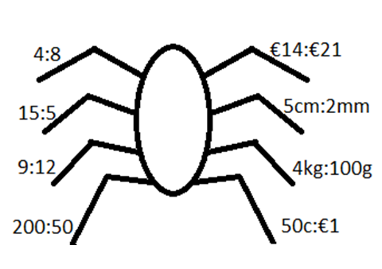
BACK

Slide 7
Some general rules
Look at the ratio and decide what each
number represents.
Find out what one part is worth.
Multiply this up amongst all the
components

Slide 8

Builders ratio
You mix concrete in the proportion of 3:1,
sand to cement.
This means we need 3 measures of sand
to one measure of cement.
If you have 3 bags of cement how
many bags of sand do you need?

Slide 9


Bakers ratio
A cake mixture is made by mixing flour,
butter and sugar in the ratio 4:1:2.
In the final mix 250g of sugar is used.
How much butter and flour is needed?

Slide 10


Hairdresser ratio
A hair colour is mixed in the ratio of
60mls of colour to 6mls of peroxide.
The salon uses 690mls of colour in a day.
How much peroxide does the salon use.
BACK

Slide 11
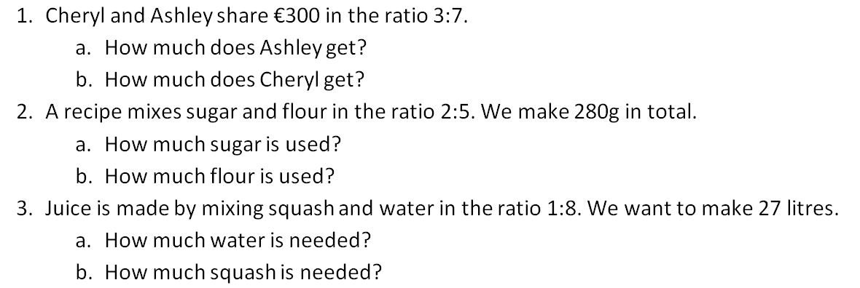
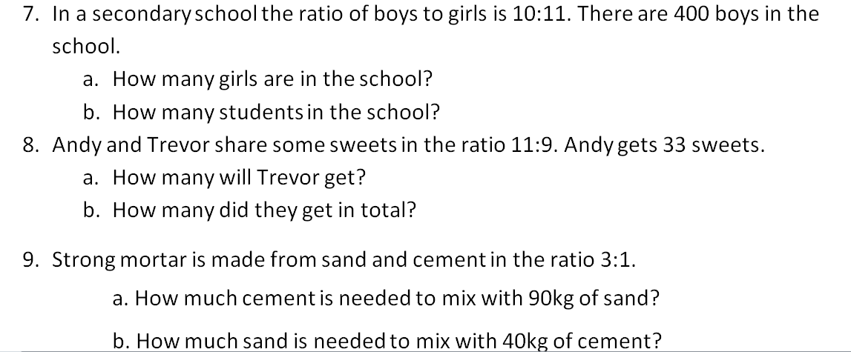
BACK

Slide 12
Introduction
Why did we choose to focus on this mathematical area?
Proportionality is believed to be vital for problem-solving and reasoning, which are key cognitive domains of mathematics teaching and learning.
Help students with basic operations i.e. operations on fractions, ratios, factors.
Make maths more applicable to daily life.

Slide 13
Reflections on the Lesson
Student Learning : What we learned about students’ understanding based on data collected
Teaching Strategies: What we noticed about our own teaching

Slide 14
Student Learning
Data Collected from the Lesson:
Academic e.g. samples of students’ work.
Motivation-Were students engaged with activity they were doing.
Social Behaviour: Group work and pair work.

Slide 15
Effective Student Understanding
What effective understanding of this topic looks like:
Questions related to money – students seemed to be more engaged when talking about money rather than theoretical use of ratios
Everyday examples - helped students to relate the topic to their own lives in a practical way

Slide 16
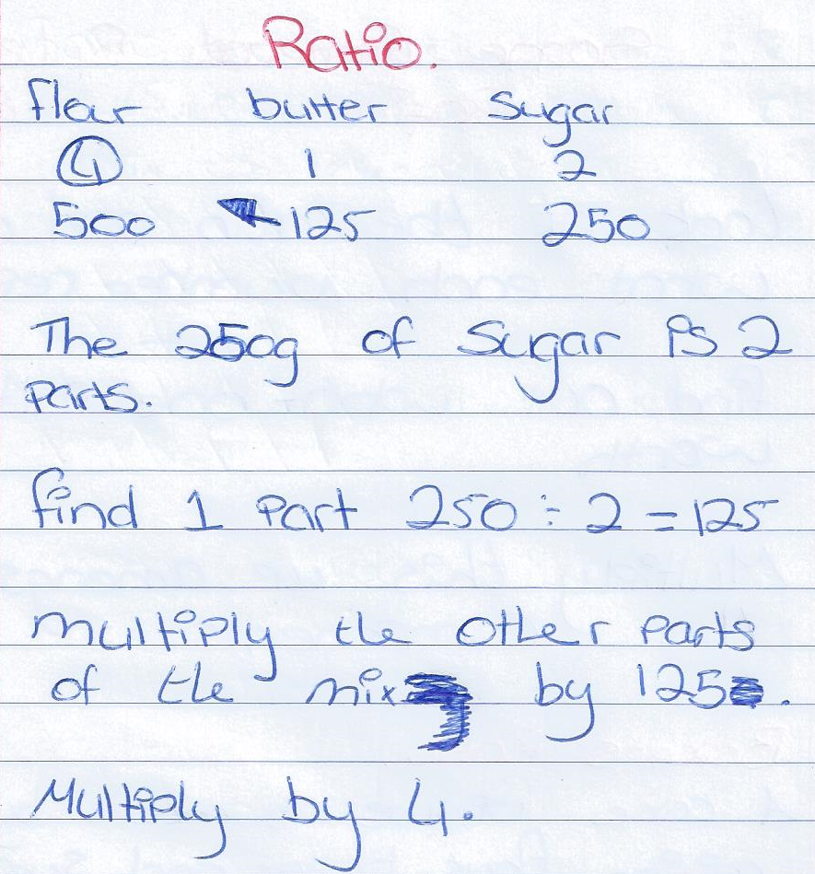
Student’s Work

Slide 17
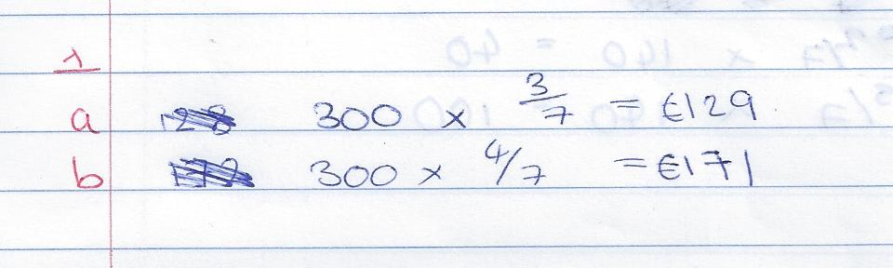
Common Misconceptions: 1
Incorrect formation of a fraction or Misinterpretation of the ratio as a fraction
1. Cheryl and Ashley share €300 in the ratio 3:7.
a. How much does Ashley get?
b. How much does Cheryl get?

Slide 18
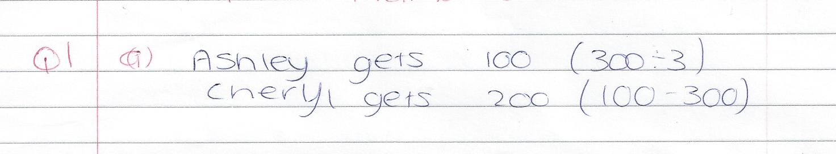
Common Misconceptions: 2
Forgetting to add ratio parts
1. Cheryl and Ashley share €300 in the ratio 3:7.
a. How much does Ashley get?
b. How much does Cheryl get?

Slide 19

Common Misconceptions: 3
Unable to Attempt the Question
7. In a secondary school the ratio of boys to girls is 10:11. There are 400 boys in the school.
  a. How many girls are in the school?
  b. How many students are in the school?

Slide 20
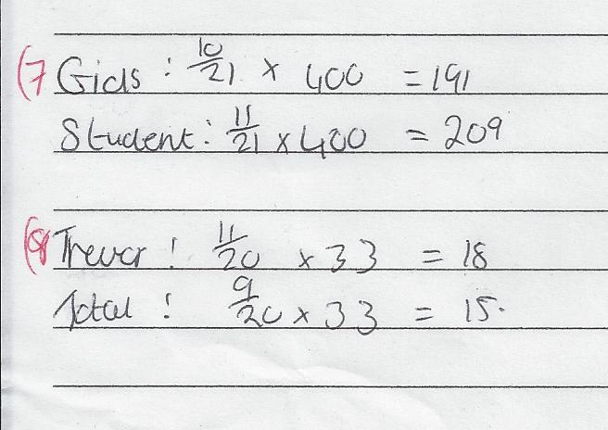
Common Misconceptions: 4
Not Reading : Not Understanding the Question
7. In a secondary school the ratio of boys to girls is 10:11. There are 400 boys in the school.
  a. How many girls are in the school?
  b. How many students are in the school?

Slide 21
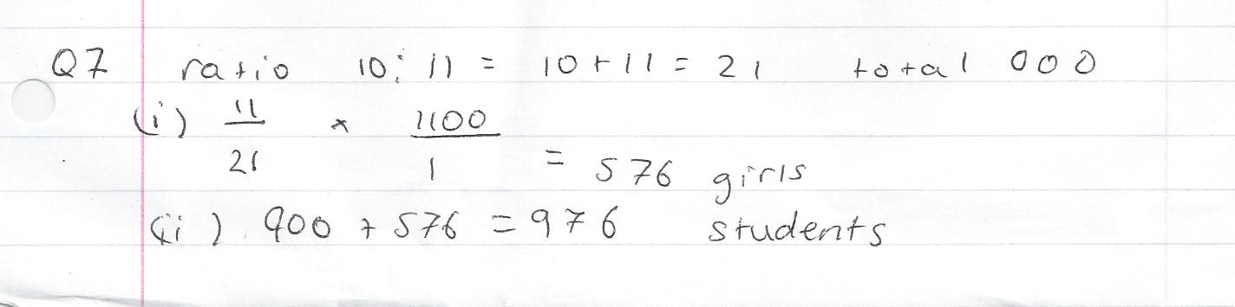
Common Misconceptions: 5
Inability to Work Backwards
7. In a secondary school the ratio of boys to girls is 10:11. There are 400 boys in the school.
  a. How many girls are in the school?
  b. How many students are in the school?

Slide 22
Addressing Misconceptions
Recommendations
Spider Starter & Working back method- Important to show a simplified example on board first.
Make sure the students know the meaning of the maths language beforehand and be able to work with fractions.
Important to get students to follow a specific strategy for solving a problem in their own words.
Students need to take ownership of their work and need to come up with their own examples in groups.
Smoothie Example, Shop Example

Slide 23
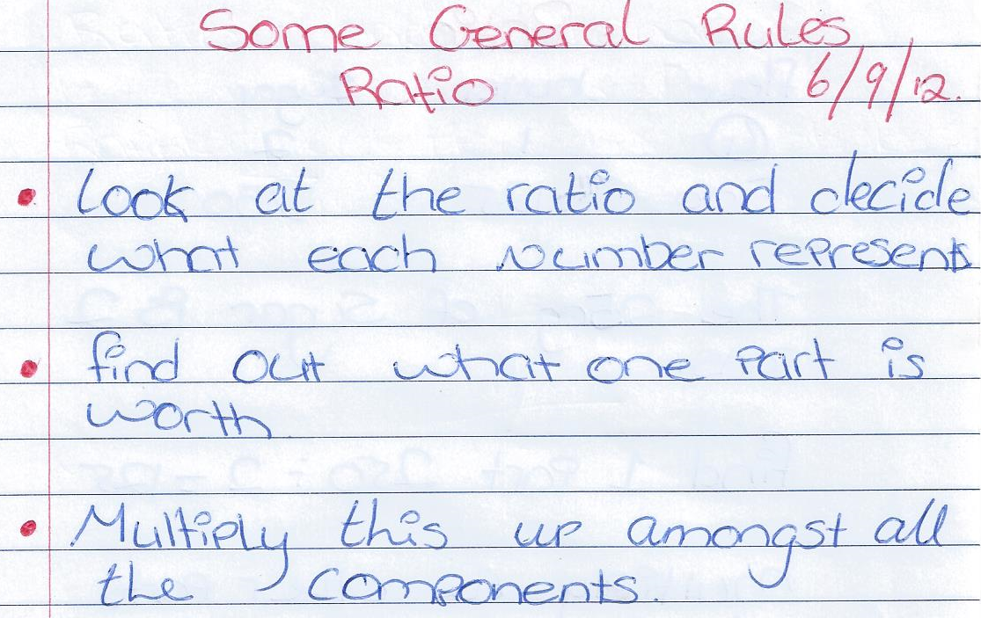
Student Strategy

Slide 24
Summary
The understandings we gained regarding students’ learning of Ratio and Proportion as a result of being involved in the research lesson
Students were afraid to be wrong or attempt answering a question.
Probing needs to be part of every class and needs to be familiar to the students.

Slide 25
Summary
What did we learn about this content to ensure we had a strong conceptual understanding of this topic?
Make sure the students know the meaning of the maths language beforehand and be able to work with fractions.
Past experience, research, discussion amongst teachers, self-reflection

Slide 26
Teaching Strategies
What did I notice about my own teaching?
When organising the lesson to pitch to the level of the students.
Some students are not good with fractions or separating parts especially if the answer was given and they had to work backwards.
Keeping them engaged and on task organising lesson had to make it simple enough for them
What is real life to these students? Student’s prior learning
Our assumptions… We think they can relate to normal everyday examples as been relevant to them e.g. cement example
Classroom management it is difficult to get around to all groups, especially to the lower ability students

Slide 27
Teaching Strategies
Was it difficult to facilitate and sustain communication and collaboration during the lesson?
Classroom management was not a problem during this class. It wasn’t difficult to communicate with students during tasks as the noise level during paired work was not high and there were no dominant groups.

Slide 28
Teaching Strategies
Was it difficult to ask questions to provoke students’ deep thinking?
Students did not volunteer answers at the start of the lesson due to lack of confidence. Later when students were more sure of their work they were eager to supply answers

Slide 29
Teaching Strategies
How did I engage and sustain students’ interest and attention during the lesson?
The inclusion of everyday examples and worksheets helped to keep students involved with the topic. Exercises were within students’ capabilities so all were engaged.
Pitching the tasks to the students abilities was an important factor in sustaining students’ attention.

Slide 30
Teaching Strategies
How did I assess what students knew and understood during the lesson?
Worksheets
PowerPoint
Probing questions

Slide 31
Teaching Strategies
How did I put closure to the lesson?
I recapped the steps we used to problem solve.
What changes would I make in the future, based on what I have learned in my teaching, to address students’ misconceptions?
Students need to take ownership of their work and need to come up with their own examples in groups.

Slide 32
Reflections on Lesson Study Process
Strengths & Weaknesses
As a mathematics team how has Lesson Study impacted on the way we work with other colleagues?
This was the first time we compared and contrasted 3rd Year Ordinary level with TY Foundation level and identified the same problems in both classes . Peer observation was beneficial in particular the discussion after the lesson to share ideas. It is important to cooperate and share resources.

Slide 33
Personally, how has Lesson Study supported our growth as teachers?
We have always collaborated as a department but this was a different and interesting type of collaboration. However finding the time for this can be demanding. It is a useful way to try out new resources.

Slide 34
Recommendations as to how Lesson Study could be integrated into a school context.
Lesson study can be difficult to organise for teachers who have classes timetabled simultaneously. We find that the syllabus is very long and it is difficult to achieve the learning outcomes in the time available.

