Slide 1
Maths Counts Insights into Lesson Study

Slide 2
Our Lady’s College, Greenhills, Drogheda, Co. Louth.
Aileen Hanratty & Maths Department
Senior Cycle
Necessity is the mother of invention: Real life applications of Mathematics

Slide 3
Insights into Lesson Study
Introduction: Focus of Lesson
Student Learning : What we learned about students’ understanding based on data collected
Teaching Strategies: What we noticed about our own teaching
Strengths & Weaknesses of adopting the Lesson Study process

Slide 4
Introduction
Topic investigated:
There is no singular topic investigated here. This presentation will deal with how various concepts in mathematics can be used in real life applications. Many strands of the syllabus will be explored, and connections within the various strands will become evident.
How we planned the lesson
In some cases it was necessity in others we had a discussion with the maths department

Slide 5
Introduction
How we planned the lesson
In some cases the mathematical learning outcomes arose through the necessity to understand them
In other cases the students had difficulty understanding concepts e.g. graph function and its derivative – slope function. New methodologies had to be developed to enhance student understanding of this topic

Slide 6
Introduction
Resources used
Too numerous to mention!
However the most important resources used throughout this lesson study were;
Time
Teachers
The students themselves and their willingness to engage with the activities

Slide 7
Introduction
Learning Outcomes
This presentation consists of 3 separate sessions
Geometry as a problem-solving tool
Hands-on approach to dimensions and Scale of Factor
Getting animated about differentials
Each session had different learning outcomes
The over riding theme is;
How mathematical concepts are related to everyday situations
Why it is important to understand various concepts in mathematics to enable students to complete these tasks
Why did we choose to focus on this mathematical area?
To allow students to discover that mathematics is not simply a subject they must study at school, but rather a skill they must develop to solve problems they will encounter in their everyday lives

Slide 8
Introduction
Enduring understandings
Mathematics is an important tool
It is not just a subject a school
If students develop a good understanding of mathematics at this stage in their lives, the skill will stay with them forever.

Slide 9
Session 1
Transition Year Project Maths
Aileen Hanratty, Una Rooney, Patricia Grimes
Using Geometry as a problem-solving tool
The following slides show the lesson study of how students solved a real-life practical problem using mathematics

Slide 10
Learning Outcomes
Students learned how to apply geometry of circles and cones to a practical craft
Students learned that mathematical knowledge can be applied to more than one facet of the student’s life (effective learning)
Students uncovered links to other disciplines and mathematical concepts

Slide 11
Learning Outcomes
How to make a cheerleaders skirt
Students learned that mathematical knowledge can be applied to more than one facet of the student’s life (effective learning)
Students uncovered links to other disciplines and mathematical concepts

Slide 12
The Problem…
How do you make Cheerleader skirts in different sizes, without a pattern?

Slide 13
You will need……
(a) a very large Compass (or a piece of string secured at one end will do)
(b) A calculator
(c) A roll of cheap curtain material or old sheets that students have at home.
(d) And some measurements.

Slide 14
Step 2:
Collect measurements from each student e.g. Size 8 or Size 10, 12, 14.
Each skirt will have to be cut a different size and the calculations will have to be adjusted for each batch of sizes.

Slide 15
The skirt design is one circle inside another:

Slide 16
If you know the waist size, using 2πr we can work out the radius and draw our inner circle.
Size 8 = 24 inches
Size 10 = 26 inches
Size 12 = 28 inches
Size 14 = 30 inches

Slide 17
For size 10:
2πr = 26”
πr = 13”
Radius = 4.1”
R=4.1

Slide 18
What size should the outer circle be?
You need to know the intended length of the skirt, leaving an extra two inches for a hem.
E.g. for size 10 the length without a hem or waist band should be at least 15 inches. If we add 2 inches for a hem, then the skirt length must be 17 inches.
What will be the radius of the larger circle?

Slide 19
The larger circle will be 21 inches approximately
Radius = 17” + 4.1” = 21.1”
4.1
17.0

Slide 20
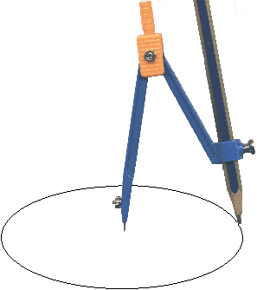
Now pick centre for the circle and draw both the larger and smaller circle

Slide 21
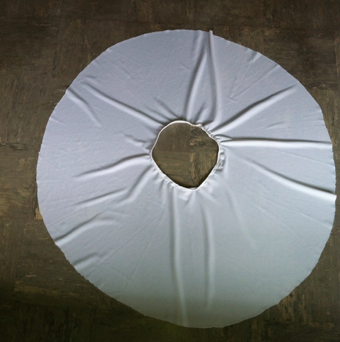
It is time to cut out your first skirt

Slide 22
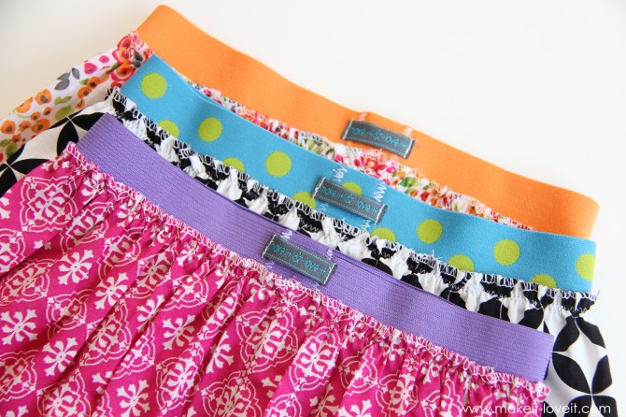
Now, add an elastic waist band

Slide 23
What will be the measurements for:
Size 8?
Size 12?
Size 14?

Slide 24
Convert sizes
Size 8 = 24”(circumference in inches)
24 = 2πr
12 = πr
3.8 = radius of inner circle
Now add 14” (length) + 2” (hem) = 16”
Radius of outer circle + 3.8” + 16” = 19.8”
Radius of outer circle = 19.8”

Slide 25
Case 2
If we wished to encase a waistband in the body of the skirt rather than add a waist band, how would this change our measurements?

Slide 26
We must use a smaller waist measurement so that when it is folded back by 1 inch, it folds to exactly the correct waist measurement

Slide 27
So for size 10 we use 3.1 inches for the inner circle. After snipping and folding back 1 inch all round, the radius becomes 4.1 inches, which gives a circumference (waistline) of 26 inches as before.
But what is the radius of the outer Circle?
i.e. How long should the skirt be?

Slide 28
Radius = 17 + 4.1 = 21.1” – exactly as before!
4.1
17

Slide 29
Cut out triangular shapes from the front of the skirt and replace with coloured pleats

Slide 30
Have a good show!

Slide 31
Reflections on the Lesson
Before we discuss this, we have another two topics to explore, I would prefer to provide a final overview of all the mathematics the students encountered.
The second topic I explored was
Hands-on approach to dimensions and Scale of Factor

Slide 32
Introduction
Hands-on approach to dimensions and Scale of Factor
Real-life application of scaling areas/volumes
Students’ difficulty visualising the problem
Teaching examples sometimes a bit abstract
Strength of the plan – practical insights
Weakness –relevance of the illustrative craft technique may be limited

Slide 33
Introduction: Scale Factor
ENDURING/EFFECTIVE LEARNING OUTCOMES
Students have a deeper understanding of the underlying concepts of dimensional scaling
Students have improved spatial reasoning and awareness
Students are able to apply this knowledge in examinations and real-life situations

Slide 34
CORE THEME
“Maths is not scary if you can touch it”
Prof. Daina Taimina, Cornell University, 2007

Slide 35
Prior Learning
ASSUMPTIONS
Students have previously learned:
what Enlargement and Scale of Factor mean
how to enlarge an image by a scale of factor in 2D
what an object and its image being Similar means
that corresponding sides of an object and its image are in the same ratio

Slide 36
Learning Outcomes
The students learn a new skill
How to make objects by crochet (Note: this is a transition year module)
This project involves working with teachers in any of the following areas:
Art and Craft
Home Economics
Mini Company
Gaisce (President’s Award)

Slide 37
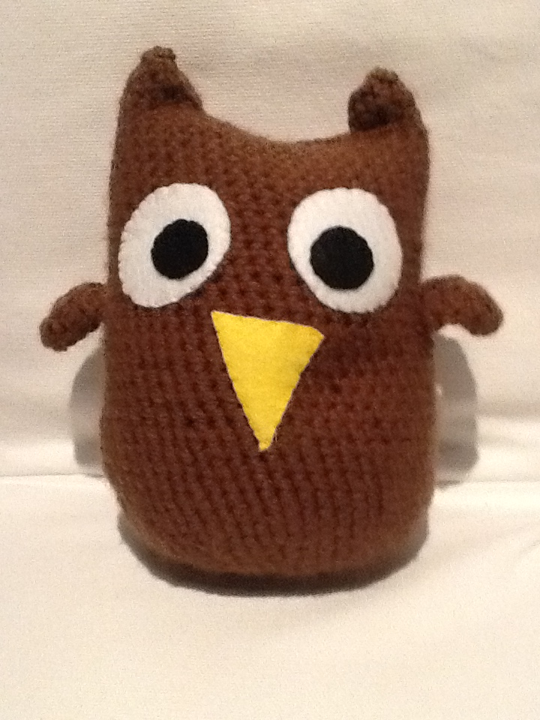
Learning Outcomes
Meet ‘Bill’….
Each student will crochet an owl with the same specified dimension using a pattern, wool and crochet hook provided.

Slide 38
Learning Outcomes
‘Bill’ is created by an algorithm…
Basic body pattern is radially symmetrical – like a vase
Formed from a spiral of interlocking knots in four distinct sections:
flat base
expanding curved surface
vertical tube
converging curved surface

Slide 39
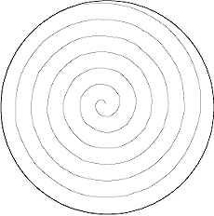
Learning Outcomes
Bill’s base
An initial circle of six crochet stitches which, when continued, spiral outwards adding six extra stitches to each revolution, resulting in a flat disk. (6, 12, 18, 24, 30… up to 60 stiches)

Slide 40
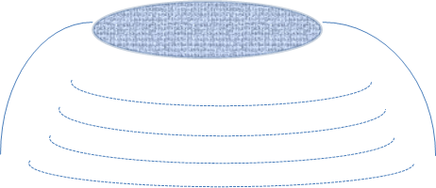
Learning Outcomes
Transition from base to helix
Once the flat base is wide enough, the pattern gradually changes from a horizontal spiral to a vertical helix by reducing the number of additional stitches per revolution. Instead of adding six extra, add five, then four, then three then two then one then none. The result is a locally-curved section rather like the surface of a bowl.

Slide 41
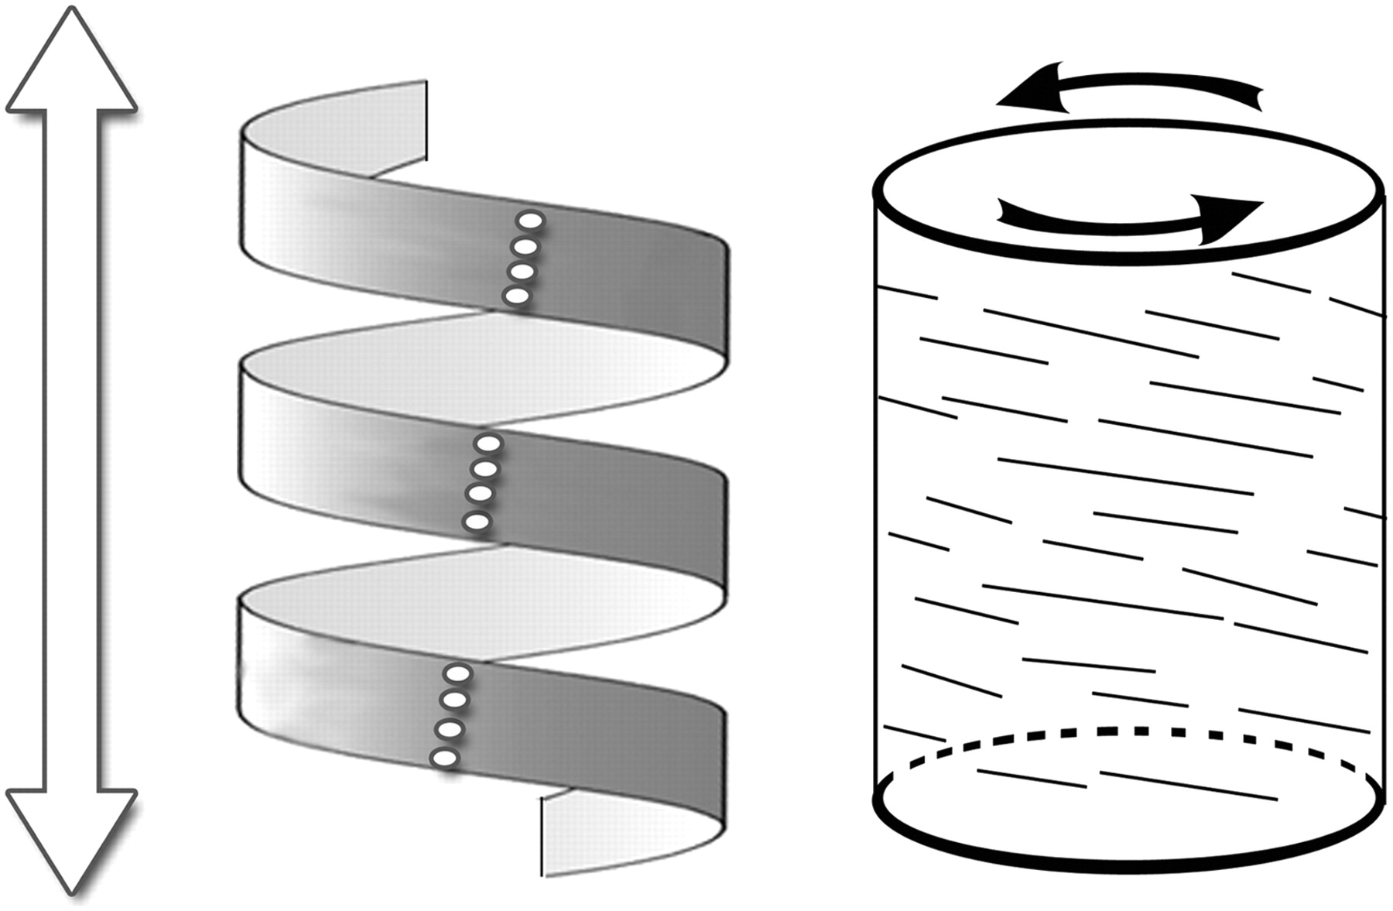
Helical section
For as long as the crochet pattern has the same number of stiches per revolution, each turn of the helix will have the same radius and will sit exactly above the previous one, resulting in a vertical cylinder shape.

Slide 42
Top Section
Approaching the top of the crocheted owl, the pattern will begin to narrow again. This is achieved as an inversion of the transition described previously. Instead of keeping the same number of stitches per turn, reduce by one, then by two, then by three … until the top opening is sufficiently narrow.

Slide 43
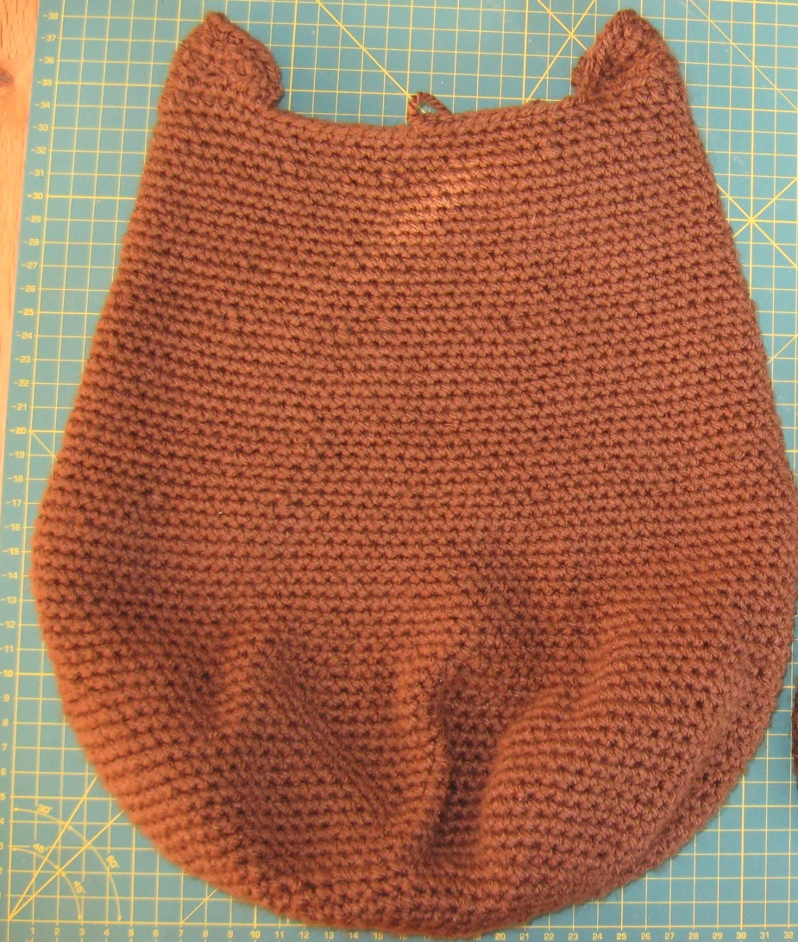
Before we stuff Bill….
Let’s find out an approximation of his area.
Having flattened him, we can use the Trapezoidal rule to make an estimate of his surface area remembering to multiply the result by two for front and back.
(Note: ideally we would take a measurement of the curved surface rather than flat surface area.)

Slide 44
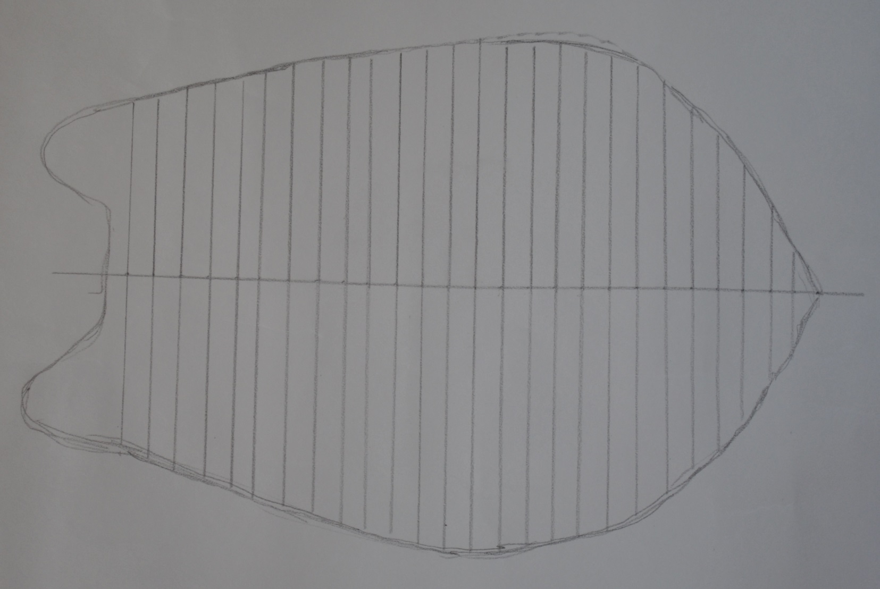
Here we have divided Bill’s flattened profile into trapezia, each of 10mm width.

Slide 45
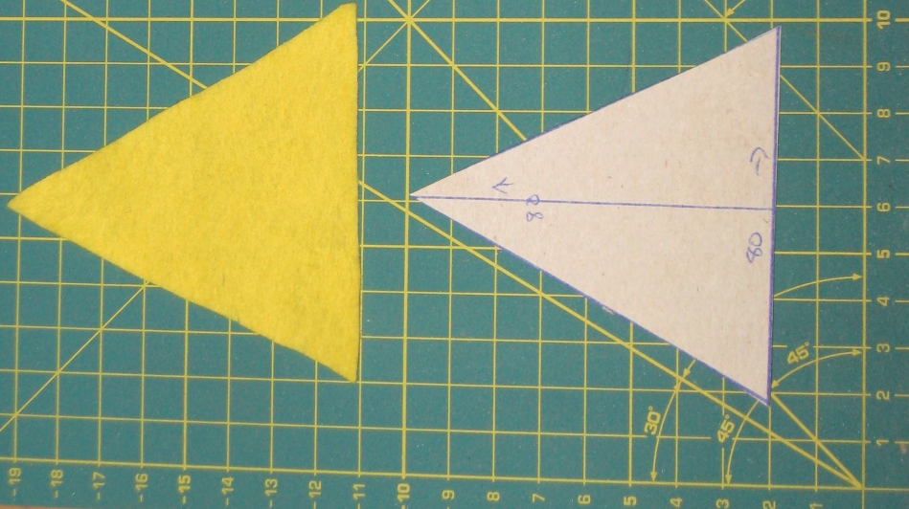
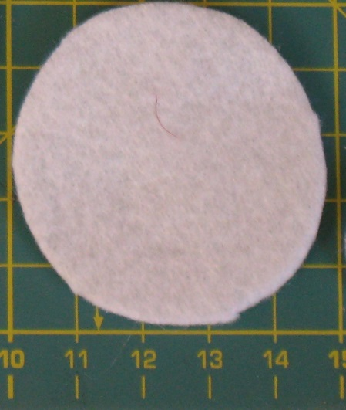
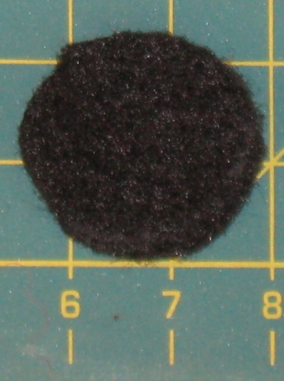
Make Bill’s eyes and beak
Area = ½ base x height
Area = πr²
Measure and then cut out the required circles and triangle from a sheet of felt.

Slide 46
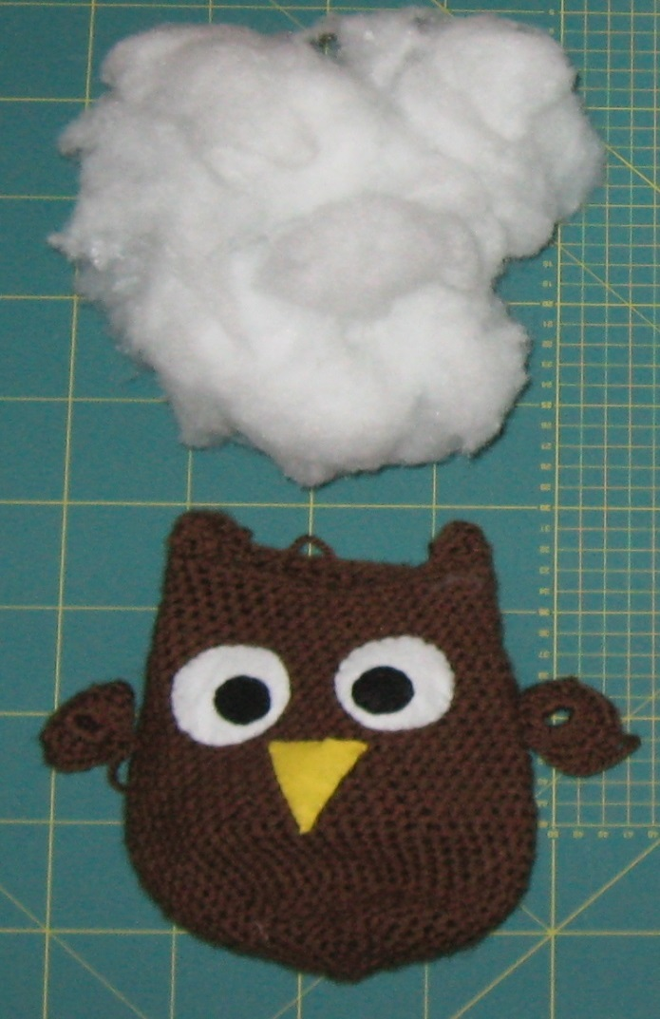
Then add the stuffing…
Weigh the amount of filling material needed to stuff Bill. (40 grams approx.)

Slide 47
We now make a second owl by applying a Scale of Factor.
Students are offered a choice:
scale to a factor of 2
or
scale to a factor of ½
(Some students may choose neither and decide to scale even larger than 2.)

Slide 48
Scale factor 2
We must adjust the pattern to take account of the increased scale.
Double the number of turns in the flat base spiral, thereby doubling its diameter. There will also be twice as many stitches per revolution in the helical section.
What size do we expect Bill to turn into when he becomes ‘Big Phil’?
Ask students to visualize his size before calculating how the volume and surface area will change

Slide 49
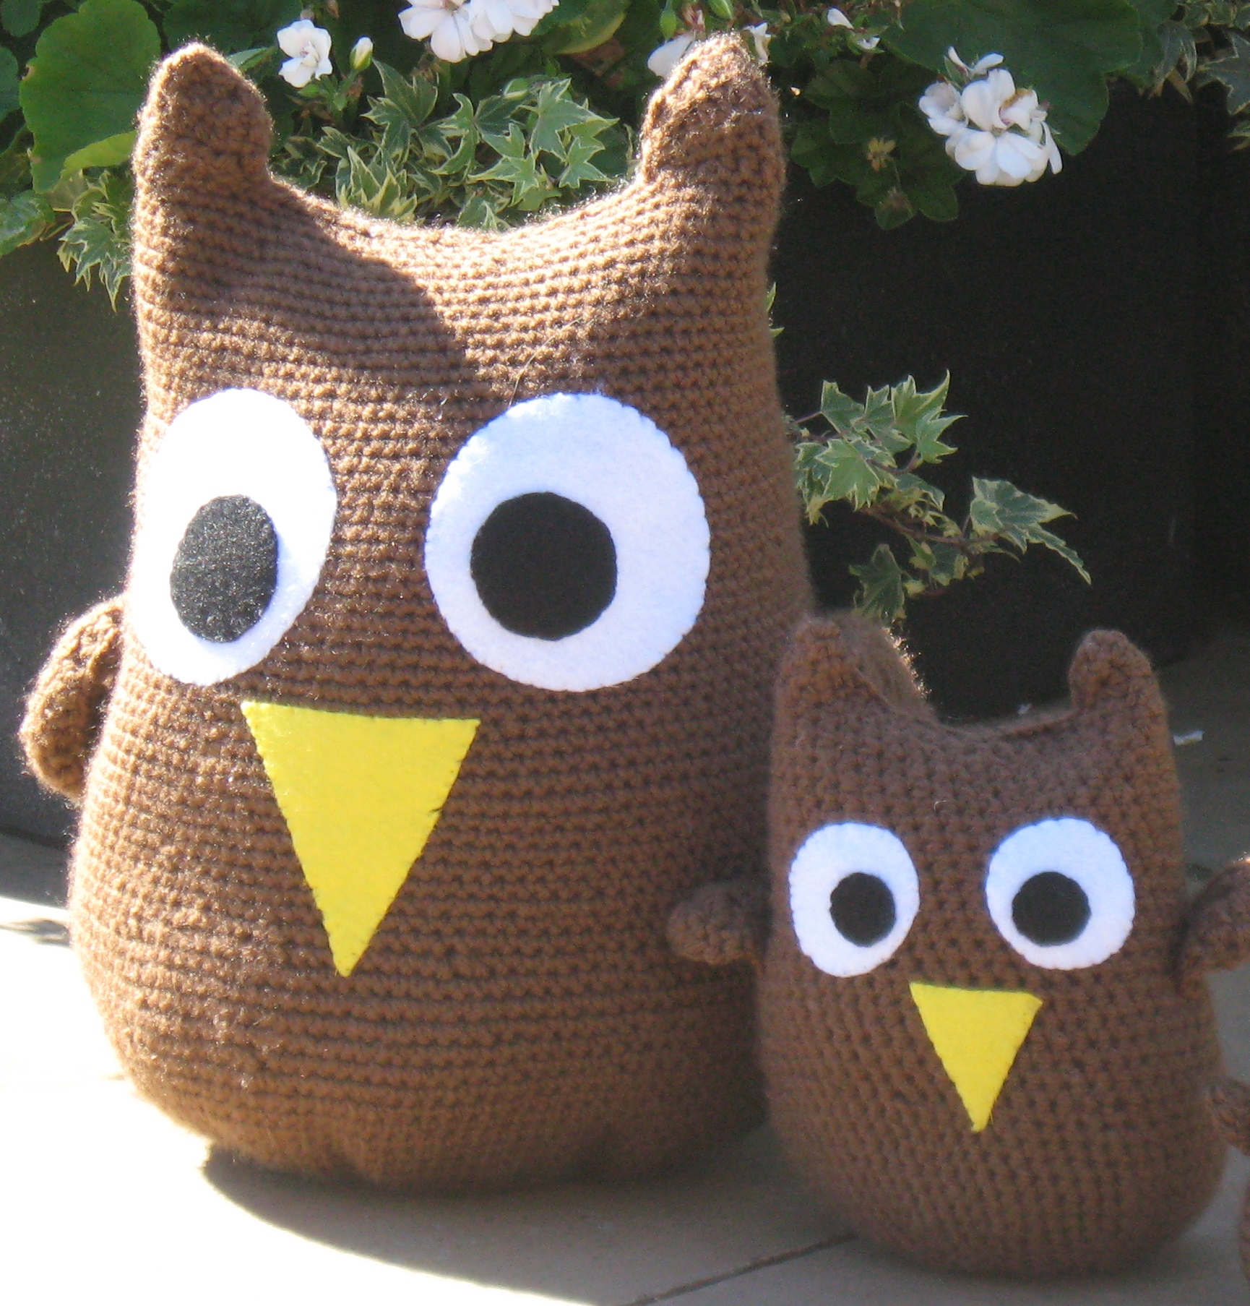

Slide 50
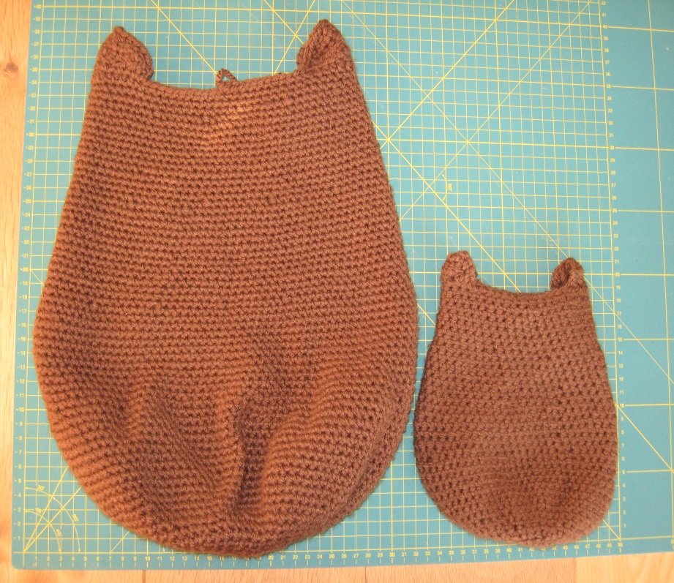
Phil’s surface area = the area of Bill x 2²
Big Phil should therefore be four times bigger in area than Bill.
This can be verified using the Trapezoidal Rule

Slide 51
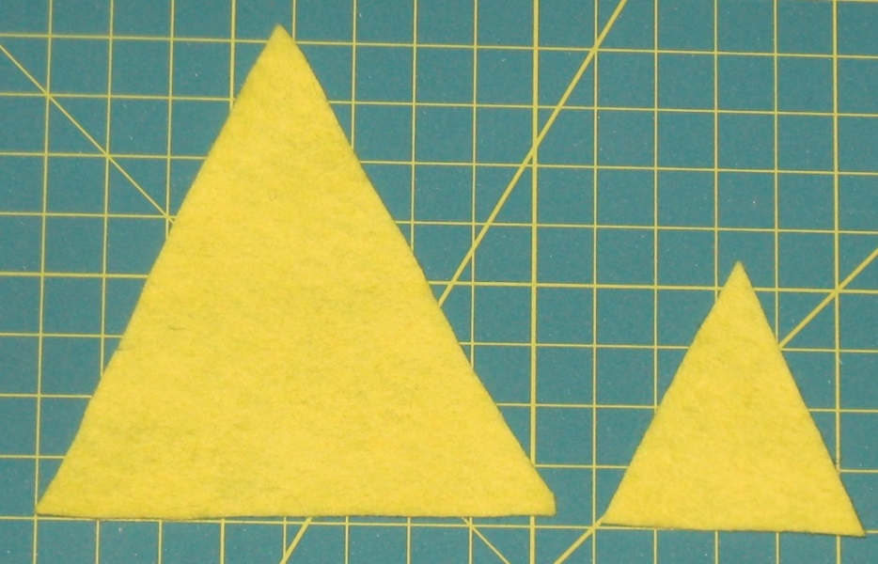
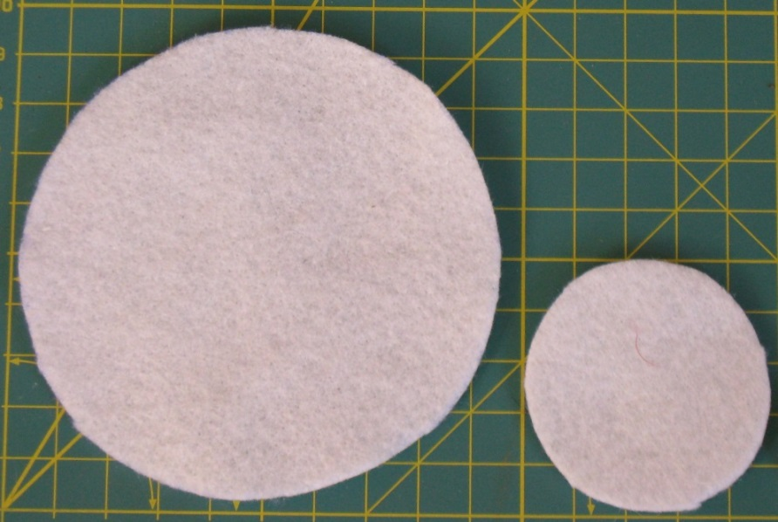
What size are Big Phil’s eyes and beak?
Students can draw and cut out Phil’s triangular beak using what they have learned about Similar triangles. The diameter of the eyeball circle will also double.
Hence the surface area of Big Phil’s eyes and beak should each be four times larger than Bill’s. (Verify using ½ base x height and πr²)

Slide 52
Three dimensional Scale of Factor
Can students now guess by what factor the volume of Big Phil has increased?
Does he have 2²= 4 or 2³ = 8 times the volume of Bill?
By a process of discussion, students should arrive at the conclusion that Phil will need 2³ times the volume of stuffing that Bill needed.
This hypothesis can be empirically tested as soon as the first student has completed and stuffed Big Phil. (The stuffing can be removed and weighed.)
Phil’s weight should be approximately 40 x 2³ = 320 grams.

Slide 53
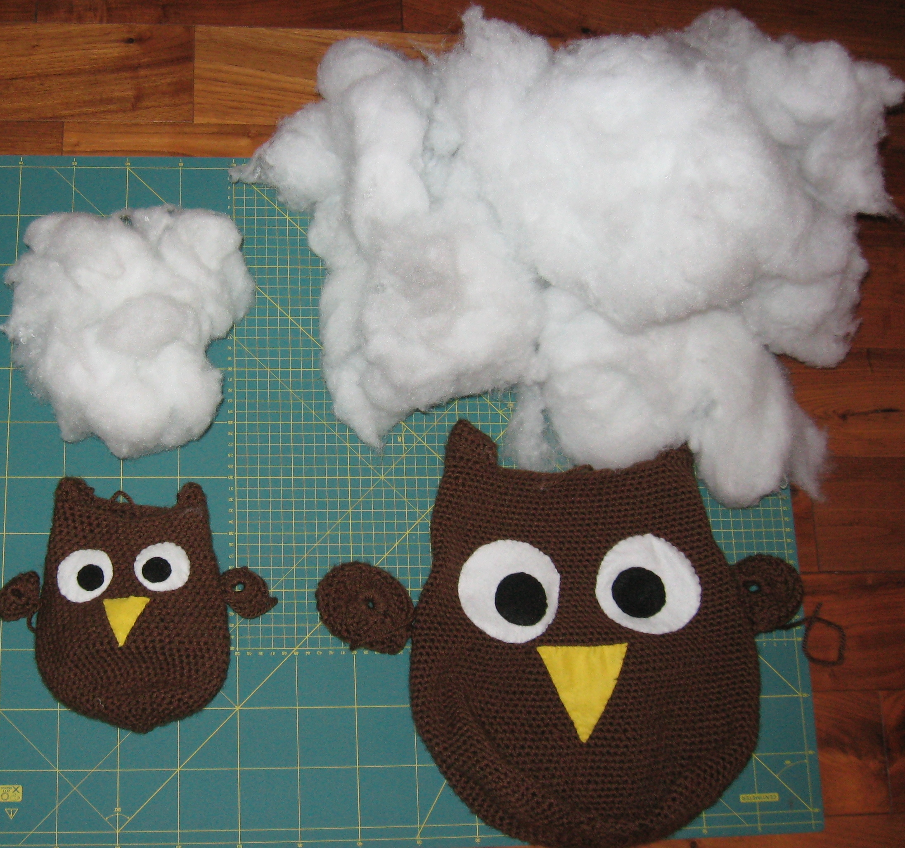

Slide 54
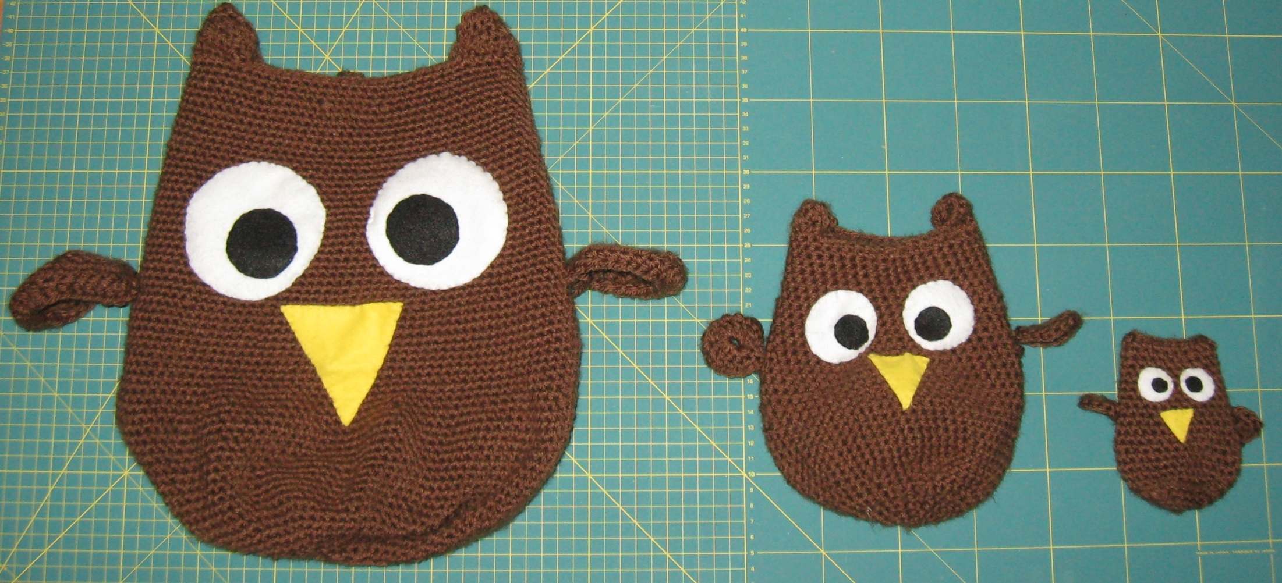
Scale of Factor ½
To crochet ‘Baby Dill’, simply halve the number of turns in the spiral base compared to Bill. Likewise, there will only be half the number of stitches per turn of the helix.
Dill’s surface area will be (½)² i.e. one quarter of Bill’s.

Slide 55
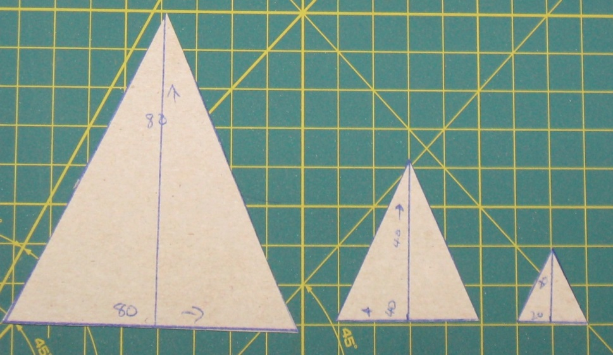
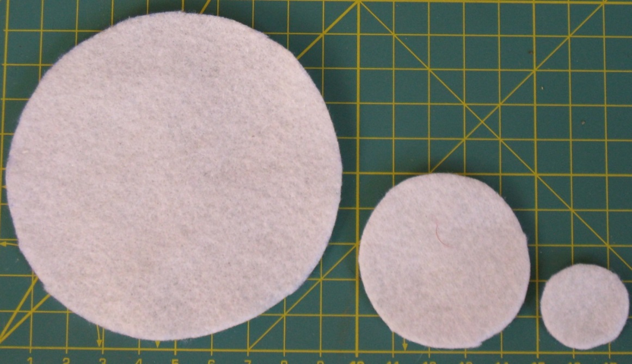
Scale of Factor ½ for eyes and beak
Students to check the areas using the formulae

Slide 56
Scale of Factor ½
How much filling will be needed to stuff Dill?
Based on the conclusions made about Big Phil, students should be able to see that Dill’s volume is (½)³ times that of Bill.
The required weight of stuffing is therefore:
40 x (½)³ = 5 grams.

Slide 57
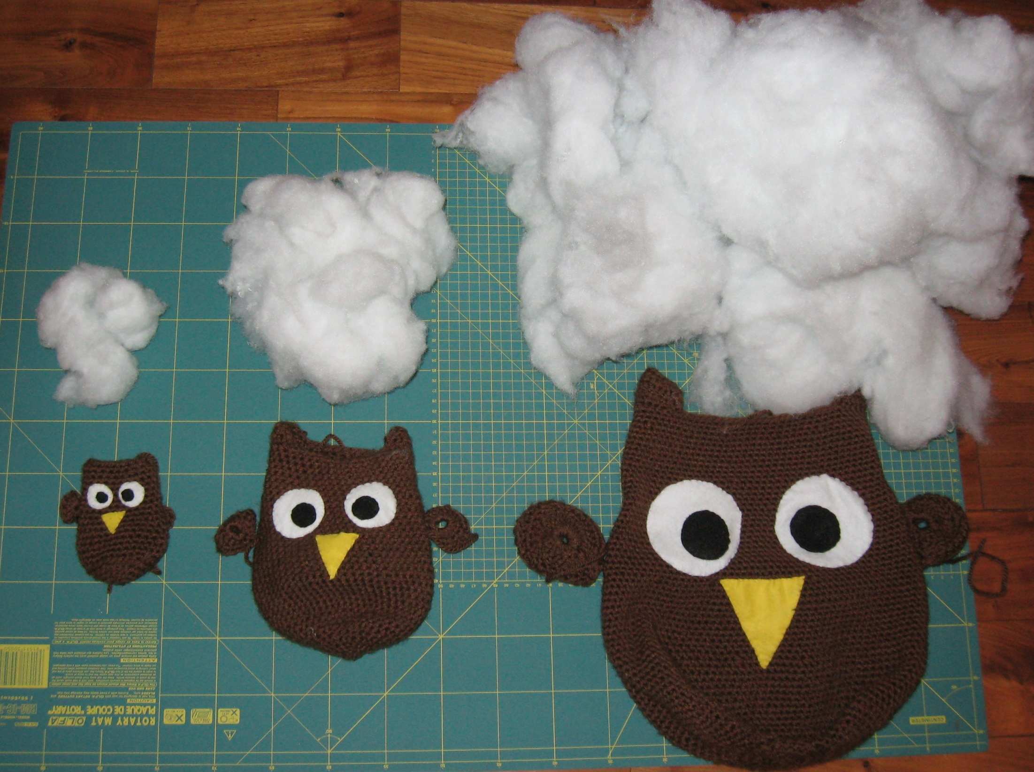

Slide 58
Finishing up
Eyes and beak to be sewn onto the helical section
Wings can be added, and students can include ornamental touches (flowers etc.) if they wish
Sew up the top hole and you are finally ready to make a….

Slide 59
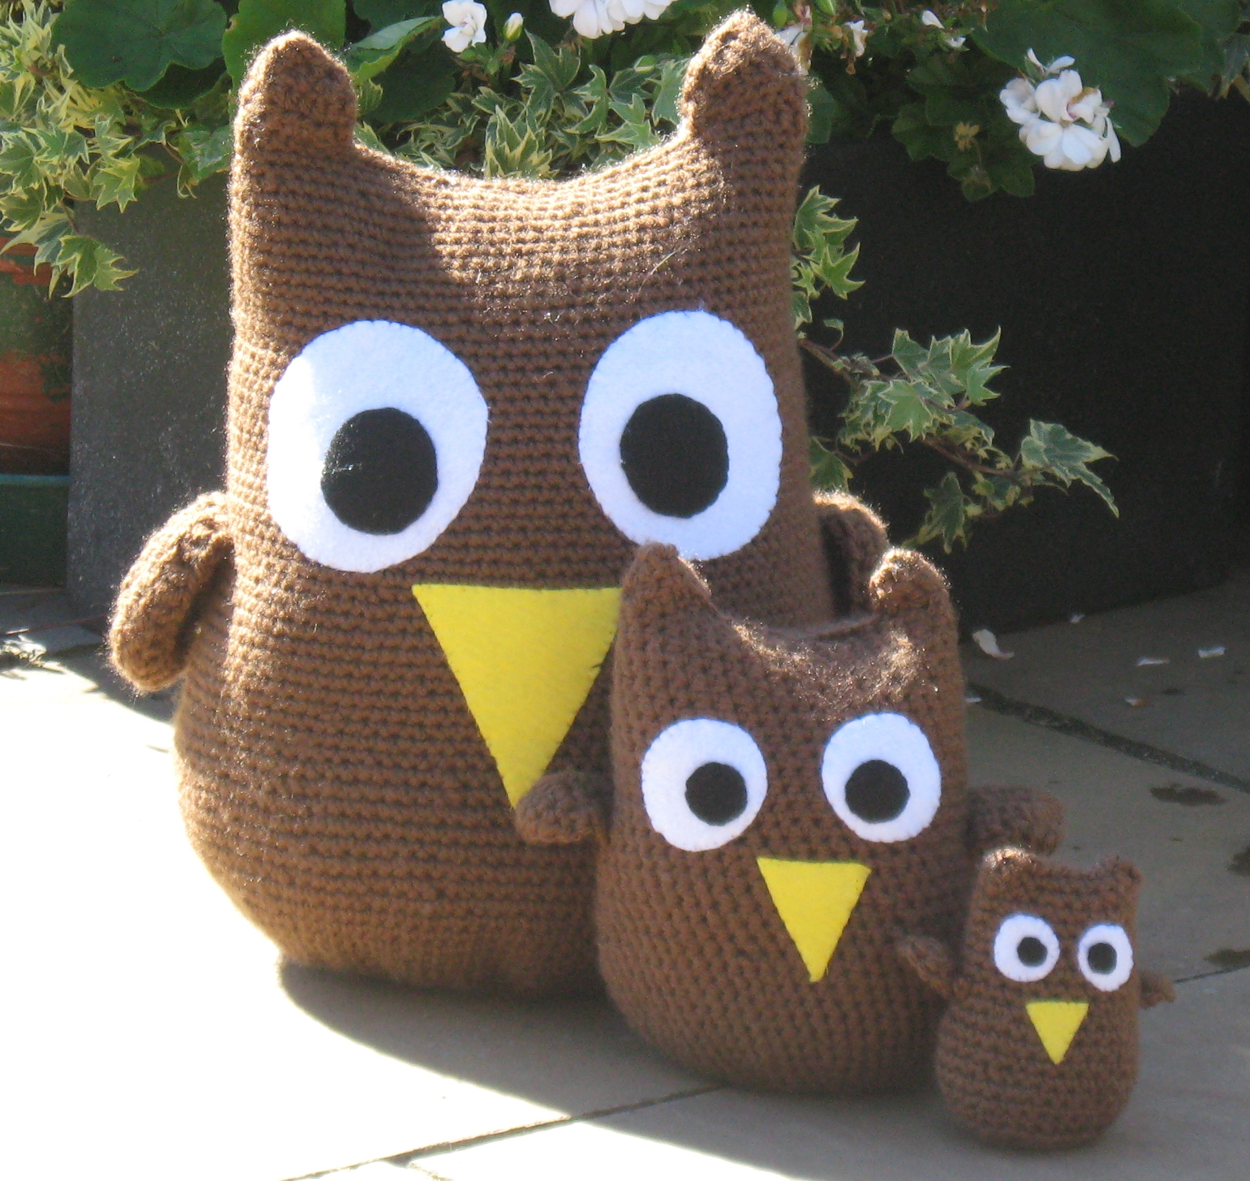
…Family Album!

Slide 60
What other areas of (more advanced) mathematics might also be explored?
The effect of varying arithmetic progressions in the crochet pattern
Changing other physical variables and investigating their effects on scale)
Thickness of wool
Size of crochet hook
Non-Euclidian geometry on the curved surfaces (where the angles of triangles sum to >180 degrees)
Visualising hyperbolic geometry using hyperbolic crochet patterns
www.youtube.com/watch?v=w1TBZhd-sN0

Slide 61
Introduction
Just before I get to the reflections of the lesson study, I have one more lesson to share with you.
Getting animated about differentials

Slide 62
Lesson Plan
To explain tangents as the local gradient of a curve
To use a strong visual analogy to reinforce the concepts of sign of slope, point of inflection and max/min turning points
To use humour to encourage students to think about other real-life applications of calculus

Slide 63
Learning Outcomes
Students gain an intuitive feel for tangents to curves
Students thereby overcome the perception that calculus is abstract and inaccessible

Slide 65
Did you get all that?
No?
Ok…….

Slide 66
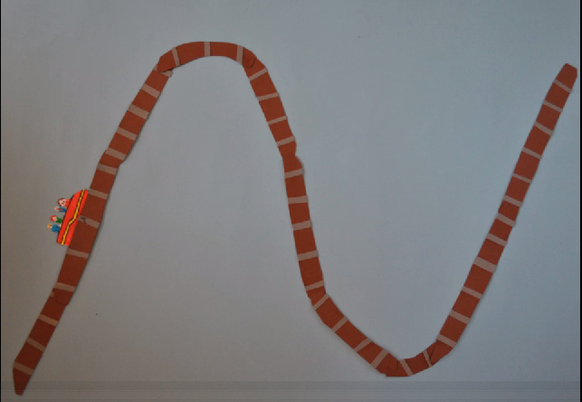
Play Video
https://vimeo.com/77002316

Slide 67
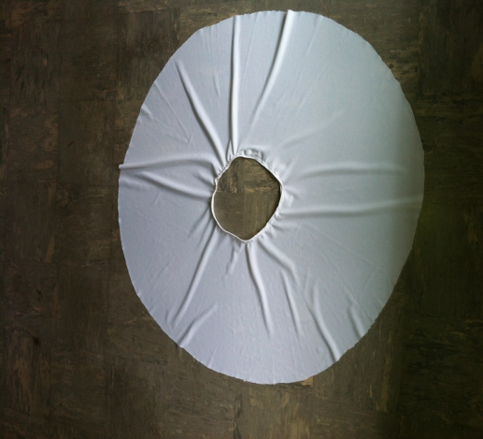
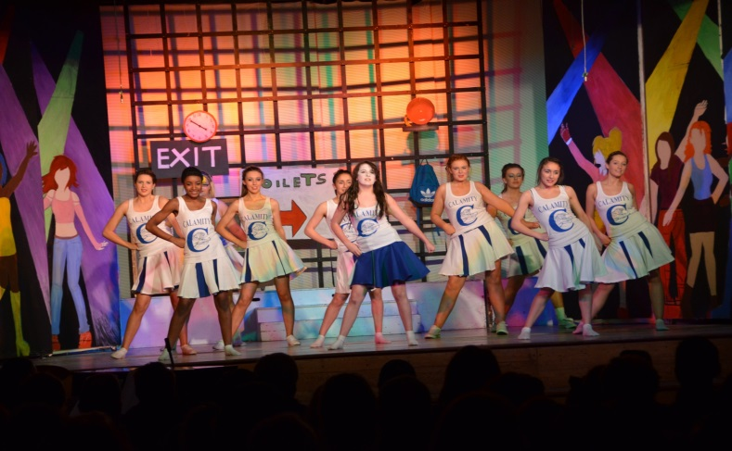
Student Learning
Data Collected from the Lesson(s):
Academic e.g. samples of students’ work Cheerleading skirts: 2 π r²

Slide 68
Student Learning
Data Collected from the Lesson:
Motivation:
In terms of session 1: The cheer leader skirts, the students were intrinsically motivated to find a way to complete the project as they were directly involved with the play.
If the costumes were not finished, it would reflect poorly on the overall production. Students didn’t even realise they were using mathematical formulas and ratios until half way through the process.

Slide 69
Student Learning
Data Collected from the Lesson:
Motivation:
For the Bill, Dil and Phil activities, students began to connect different areas of the syllabus together (area, volume, patterns, Cartesian plane etc) without even realising it. They discovered (by themselves) various relationships between increasing area, scale factor, volume and so on)

Slide 70
Student Learning
Data Collected from the Lesson:
Motivation:
In terms of Calculus, the graph function and slope function. My students were confused, when I showed them the video for the first time.. They didn’t get it! However it initiated a class discussion. Students started to talk (verbalise) what they thought might be happening. There were disagreements/ debates and discussion. However, once they viewed the video a few times, they developed an understanding of what the slope function was and how it was related to the rate of change compared to the actual graph function

Slide 71
Student Understanding
What we learned about the way different students understand the content of these topics?
Student like to discuss topics with eachother (peer to peer learning)
Students need to be able to relate mathematics to real life, or in some cases discovered that real life could be related to mathematics!
Allowing student discussion/questioning/ debating enhances the learning process

Slide 72
Effective Student Understanding
What effective understanding of this topic looks like:
In terms of our “Cheerleading skirt”.. The show went on ☺ because the students were able to mathematically work out the cutting of material, sizes and length ratio
Students physically created “Bill”, Dill” and “Phil” and understood the concepts of scale factor, area, volume etc
The video on the roller coaster was designed to elicit discussion and debate from students.. And it succeeded, I had to show the video a few times, but the learning outcome was achieved, students did have a solid understanding of the “Slope Function” and were able to explain exactly what was happening in relation to the initial function – Rate of change

Slide 73
Summary
The understandings we gained regarding students’ learning as a result of being involved in the research lesson
Students learn by doing
Important to allow time for students to discuss/debate various concepts e.g. roller coaster video
Mistakes are part of the “learning process” and a NOT a negative thing
Project Maths .. We must enjoy the process more and worry less about the end result, the process is where the learning/understanding occurs
Enjoyed working together, collaboration
Maths is a very clever problem solving tool

Slide 74
Summary
What did we learn about this content to ensure we had a strong conceptual understanding of this topic?
As a teacher I had to spend a lot of time researching material I thought I already knew.
This time was well spent as I made new connections in my own mind, discovered new concepts, and developed new methodologies

Slide 75
Teaching Strategies
What did I notice about my own teaching?
Was it difficult?
Intially, yes it was more difficult
More time needed
Much nosier classroom
Slower progress
Fell behind in our year plan for common tests

Slide 76
Teaching Strategies
BUT..
Had more conversations with students about mathematics
More questions asked by students, such as “ what if”, “how come “ “why”
Students did seem to develop an understanding of mathematical concepts, instead of just “learning a formula”
Students were much more engaged in class and a lot more discussion/ debate took place
Peer to peer learning became the norm

Slide 77
Teaching Strategies
Was it difficult to ask questions to provoke students’ deep thinking?
In short.. With the work we did.. It was the students who asked the “deeper” questions.. “what will we do if?, if I do this what will happen?, how can we know that?” and so on

Slide 78
Teaching Strategies
How did I engage and sustain students’ interest and attention during the lesson?
To be fair.. You’ve seen what I have done.. The students were engaged ☺ and they wanted to know what would happen.. If I pick a scale factor of a half, or two or maybe 4 how big will my puppet be?
The cheerleading skirts, if I make the wrong measurements, will we still have enough material?

Slide 79
Teaching Strategies
How did I assess what students knew and understood during the lesson?
Well, the show went on, the students had very little room for error when making the skirts
Bill, Dil and Phil were created
Students were able to verbalise /discuss and debate the difference between the slope function of a cubic graph and the graph function itself, they had developed and understanding how one was the initial function and the other was the rate of change and were able to explain it to me and each other

Slide 80
Teaching Strategies
What understandings have I developed regarding teaching strategies for this topic as a result of my involvement in Lesson Study?
Encourage hands on resources (whatever they may be)
Step back.. Allow students to make errors, then ask, what do you think might be wrong?
Encourage students to relate mathematical problems to real life contexts
Encourage students to develop problem solving skills

Slide 81
Reflections on Lesson Study Process
Strengths & Weaknesses
As a mathematics team how has Lesson Study impacted on the way we work with other colleagues?
We collaborate a lot more with each other and other departments within the school

Slide 82
Reflections on Lesson Study Process
Strengths & Weaknesses
Personally, how has Lesson Study supported my growth as a teacher?
I enjoy teaching maths a lot more, I am always thinking of “new ways” to approach a topic.
I have learned a lot more about the nature of mathematics and the numerous ways it can be applied to “Real life”

Slide 83
Reflections on Lesson Study Process
Strengths & Weaknesses
Recommendations as to how Lesson Study could be integrated into a school context.
The maths department intends to share all of our findings with the rest of the staff in the school

