Slide 1
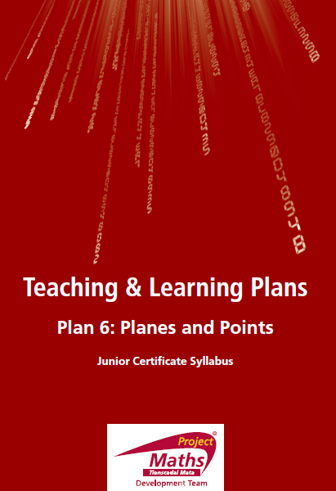

Slide 2
Join A to C. This is [AC]. Measure the length of [AC]. Write your answer in cm. and mm. _________________. How do we name the length of [AC]?________
2. Join D to E. This is [DE]. Measure the length of [DE]. Write your answer in cm.
and mm. _________________. How do we name the length of [DE]?__________
3. Draw line AB.
4. Draw ray [DE.
5. How big is a point?__________________________________________________

Slide 3
6. Write down the symbol for infinity._____________________________________
7. How many points are on a line?________________________________________
8. How many points do you need to know to define a line?____________________
Answer true/false to the following questions.
9. Line AB contains H.___________________________________________________
10. Line CD contains B__________________________________________________
11. Line AB and F lie in the same plane_____________________________________

Slide 4
12. A, B and H are collinear______________________________________________
13. C,D and B are collinear.______________________________________________
14. More than one line can be drawn through E and H?_______________________
15. More than one line can be drawn through B and D?_______________________
16. CG intersects EG at G________________________________________________

Slide 5
17. Points A,B,C,D,E,F,G,H all lie in the same plane which I will call X_____________
18. Points A,B,C,D,E,F,G,H are the only points in plane X.______________________
19. [CH is the same as [HC.______________________________________________
20. Line AB is the same as line BA.________________________________________

