Slide 1
Maths Counts Insights into Lesson Study

Slide 2
St Mark’s Community School
Mairead Murphy, Kevin Carey, Pat Brennan
Second year Junior Certificate
Taxation: Does your answer make sense?
Used taxation as an example of where students fail to check, if their answer is a possible solution to the question posed.

Slide 3
Insights into Lesson Study
Introduction: Focus of Lesson
Student Learning : What we learned about students’ understanding based on data collected
Teaching Strategies: What we noticed about our own teaching
Strengths & Weaknesses of adopting the Lesson Study process

Slide 4
Introduction
Topic investigated Taxation: Does your answer make sense?
How we planned the lesson:
Decided on taxation as the topic.
Discussed the methodology and divided the work load.
Designed the context-based questions.

Slide 5
Introduction
Resources used:
Whiteboard
Data projector
Interactive webpage to revise key words
Proposed solutions to the problems were printed, laminated, cut out and placed in envelopes
Chocolate Bar
Group work

Slide 6
Introduction
At the introduction we used a whole bar of chocolate as gross pay, piece broken off as the gross tax, tax credit as the piece of the gross tax you get back and net pay as the pieces you have left. Net tax as the piece you do not get back.

Slide 7
Introduction
Tax credit
Gross Pay
Gross Tax
Net Pay
Net Tax

Slide 8
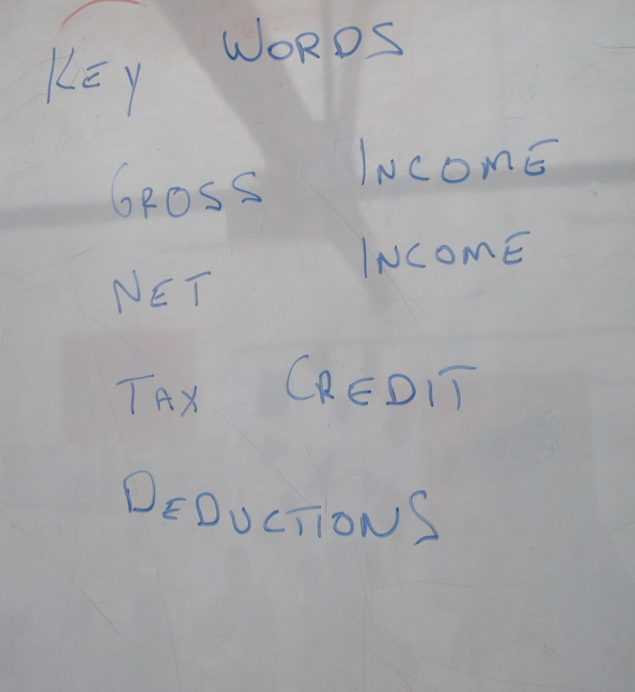
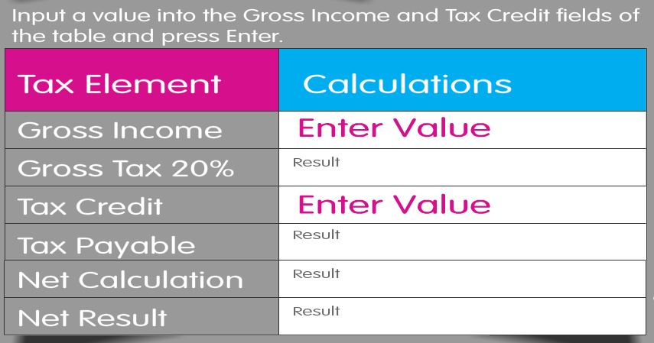
Introduction
On-line interactive ready reckoner used
Key words were added to the board as class progressed

Slide 9
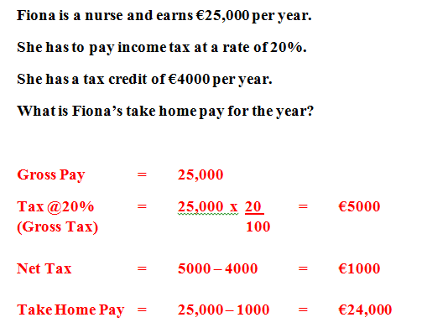
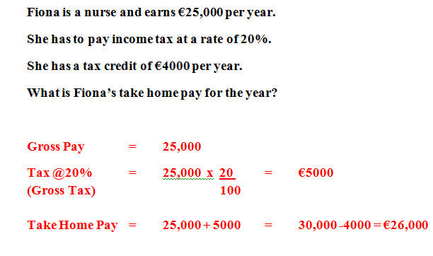
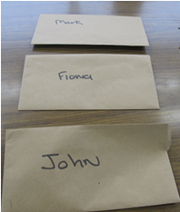
Introduction
5 proposed answers for each question only 1 correct
We had 4 envelopes each containing a question with 5 proposed answers to that question for each group. Envelope 1 distributed to each group followed by discussion, followed by envelope 2 etc.

Slide 10
Introduction
Why did we choose to focus on this mathematical area?
Common issue for many students; where students find an answer, but fail to examine if their answer is a possible solution to the initial problem.
Taxation was a topic recently covered.
Issue is very evident in taxation.
Easy for the students to see the consequences of not checking their answers.

Slide 11
Introduction
Enduring understandings:
Automatically check, if their answer is a correct solution.
Be able to explain, if their answer is correct/ incorrect using the proper vocabulary.
Encourage mathematical discussion among students.
Use and understand the key words related to taxation.

Slide 12
Reflections on the Lesson
Student Learning : What we learned about students’ understanding based on data collected.
Teaching Strategies: What we noticed about our own teaching.

Slide 13
Student Learning
Data Collected from the Lesson:
Academic
Motivation
Social Behaviour

Slide 14
Student Understanding
What we learned about the way different students understand the content of this topic?
Taxation is a subject to which many of our students have difficulty relating.
Poor understanding of the terms despite having covered this topic.
If asked to, students will check their answer as a possible solution, but don’t do it automatically.
Should not assume all students have the skills to fully engage in group work.

Slide 15
Effective Student Understanding
What effective understanding of this topic looks like:
While the focus was on the students’ learning to investigate their solutions, students also gained a deeper understanding of the topic of taxation.

Slide 16
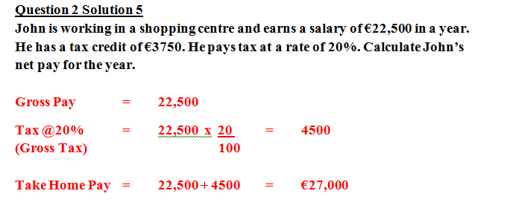
Student Learning
Misconceptions/ Knowledge Gap
Thought adding on the tax was the correct method
Earns €22,500 and saying take home pay is €27,000

Slide 17
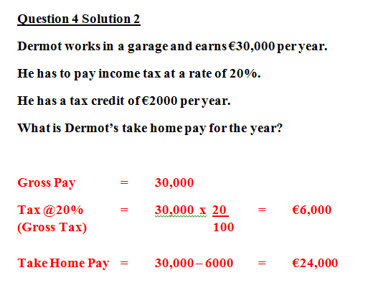
Common Misconceptions
Ignores the tax credit

Slide 18
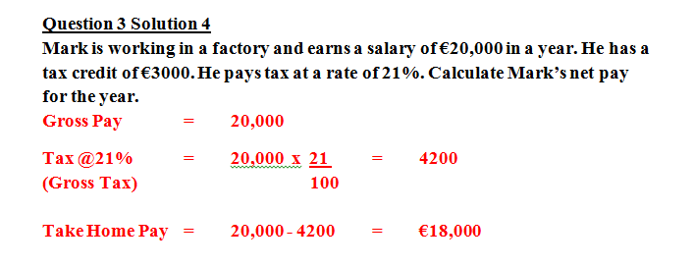
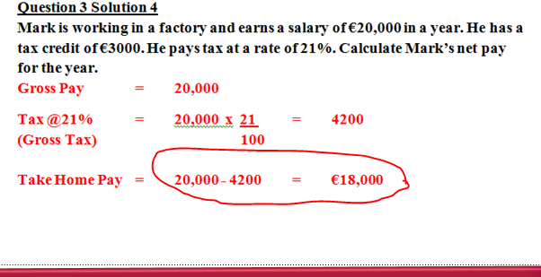
Common Misconceptions
Thought you ignored the tax credit plus incorrect calculation

Slide 19
Addressing Misconceptions
Recommendations
The adjustments you have made or would make in the future:
This lesson was also given to a higher level class and it proved a great revision exercise, however for a higher class multiplying by 1.2 would be more appropriate than multiplying by 20 and dividing by 100.
An understanding of the key words is vital.

Slide 20
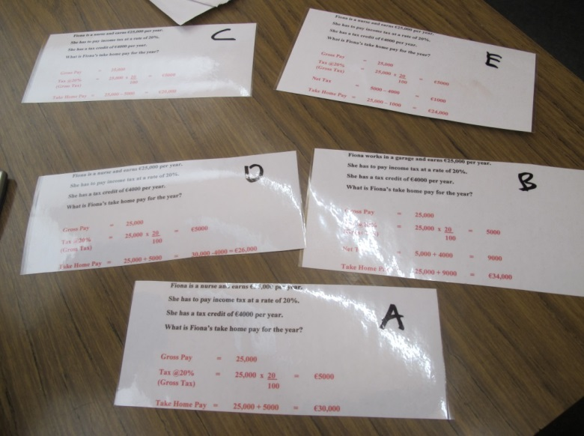
Summary
The understandings we gained regarding students’ learning as a result of being involved in the research lesson.
Students have to be trained to look at their answers.

Slide 21
Summary
What did we learn about this content to ensure we had a strong conceptual understanding of this topic?
Taxation was a perfect topic to train students to look at their answers and check if their answer is a possible solution.
When we arrived at third set of envelopes, it only took students 3 minutes to complete the task compared to 10 minutes for the first set.

Slide 22
Teaching Strategies
What did I notice about my own teaching?
Never assume prior knowledge.
The importance of hands-on resources.
Group work.

Slide 23
Teaching Strategies
Was it difficult to facilitate and sustain communication and collaboration during the lesson?
Overall students engaged well.
Hands on resources were very effective at holding students’ attention.

Slide 24
Teaching Strategies
Was it difficult to ask questions to provoke students’ deep thinking?
Possible solutions in the envelope prompted deep thinking discussion. Phases such as
“ Oh your take home pay cannot be greater than the Gross pay”.
“That answer is too high there- it cannot be that high”.
Understanding of the key words was vital.

Slide 25
Teaching Strategies
How did I engage and sustain students’ interest and attention during the lesson?
Making it relevant to every day life.
Chocolate bar.
Envelopes were only distributed one at a time.
Encouraged students to seek short cuts to eliminate wrong answers. If take home pay is greater than the gross pay discard that answer.
Peer teaching. Comments like:
“That is not how it is”
“Oh you are right”
“You cannot explain it like that- you have to use the right words”

Slide 26
Teaching Strategies
How did I assess what students knew and understood during the lesson?
Students had to use the proper vocabulary, when explaining to each other and the class/ teacher.
In addition to stating which solution was correct, students had to justify why the other answers were incorrect using the proper vocabulary.

Slide 27
Teaching Strategies
How did I put closure to the lesson?
At this point we pointed out to the students the importance of checking their answers as the mistakes that we deliberately included in the envelopes are the mistakes that they often make.
Continue to make this point anywhere it is relevant in future classes.

Slide 28
Teaching Strategies
What understandings have I developed regarding teaching strategies for this topic as a result of my involvement in Lesson Study?
Do not assume prior knowledge.
How difficult the topic of taxation is for the students.
Constant revision.
The need for patience.
Need for the students to articulate every word in the context of the problem.
The importance of group work.

Slide 29
Teaching Strategies
What changes would I make in the future, based on what I have learned in my teaching, to address students’ misconceptions?
Always remind students to ask the question: ‘is the answer I got a possible solution?’.
Must revise the key words before beginning problem solving in any topic.

Slide 30
Reflections on Lesson Study Process
Strengths & Weaknesses
As a mathematics team how has Lesson Study impacted on the way we work with other colleagues?
We enjoyed the whole process.
As teachers we need more time to develop student materials.
We can use this strategy for other topics.
There was an impact on behaviour in the class, when more than one teacher was present.

Slide 31
Reflections on Lesson Study Process
Strengths & Weaknesses
Personally, how has Lesson Study supported my growth as a teacher?
Never assume prior knowledge.
The importance of having the time to prepare resources and discuss the topic with my peers.

Slide 32
Reflections on Lesson Study Process
Strengths & Weaknesses
Recommendations as to how Lesson Study could be integrated into a whole-school context.
Time needs to be allocated to enable teachers to implement this model on a regular basis.

