Slide 1





Maths Counts
Insights into Lesson Study

Slide 2

Scoil Mhuire Kanturk
Mairead Guiney
Tomás Twomey
5th Year Higher Level
Carnival Games: Leaving Cert Probability

Slide 3
Insights into Lesson Study
Introduction: Focus of Lesson
Student Learning : What we learned about students’ understanding based on data collected
Teaching Strategies: What we noticed about our own teaching
Strengths & Weaknesses of adopting the Lesson Study process

Slide 4
Introduction
Topic investigated
Leaving Cert Probability and Statistics
Resources used
Edmodo
Geogebra
Photographs
Worksheets

Slide 5
Introduction
Develop a basis in probability and statistical understanding prior to exploring the topic in class
Generate data or source data from other sources including the internet
Evaluate the effectiveness of different displays in representing the findings of a statistical investigation

Slide 6
Reflections on the Lesson
Student Learning : What we learned about students’ understanding based on data collected
Teaching Strategies: What we noticed about our own teaching

Slide 7

Edmodo

Slide 8
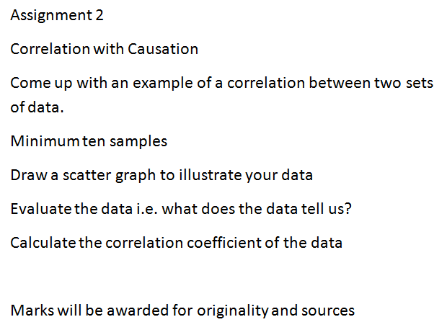
Statistics Assignment

Slide 9
Student Learning
Data Collected from the Lesson:
Motivation
Social Behaviour
Academic e.g. samples of students’ work

Slide 10
Effective Student Understanding
What effective understanding of this topic looks like:

Slide 11
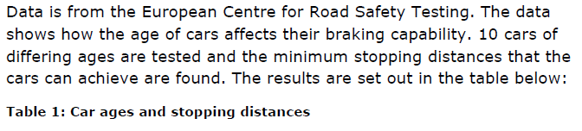
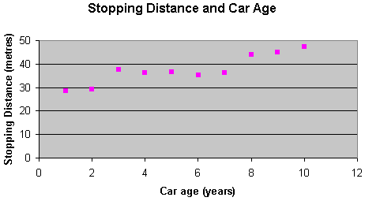
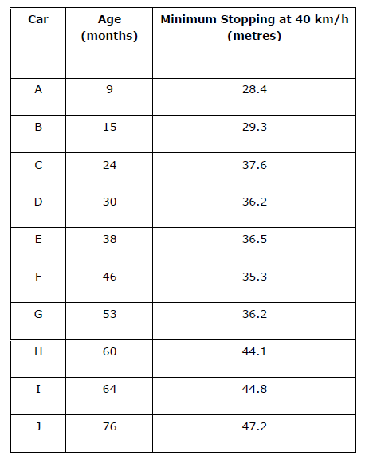
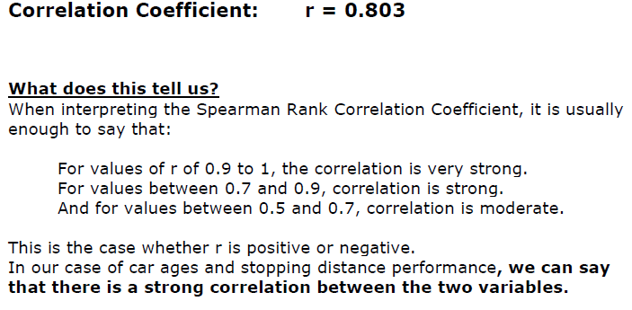

Slide 12
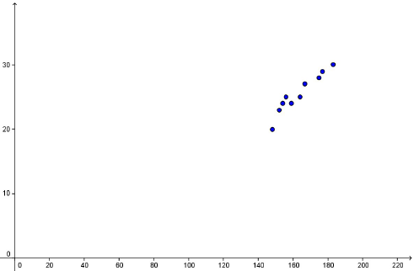
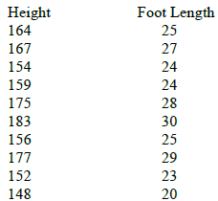

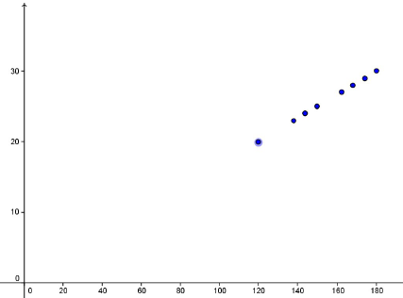

Slide 13
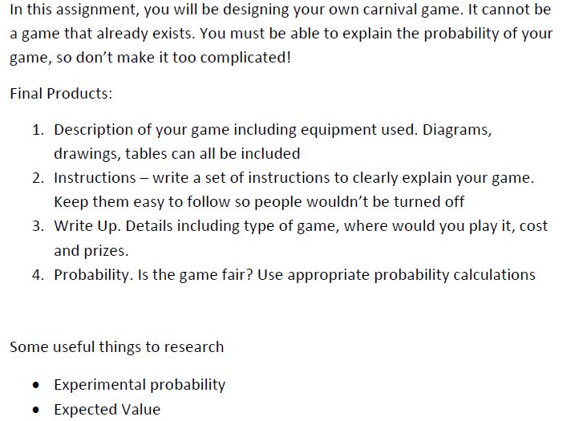
Assignment 3 – Carnival Games

Slide 14
Student Learning
Data Collected from the Lesson:
Motivation
Social Behaviour
Academic e.g. samples of students’ work

Slide 15
Examples of Students’ Work
What effective understanding of this topic looks like:

Slide 16
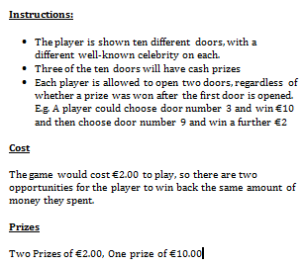
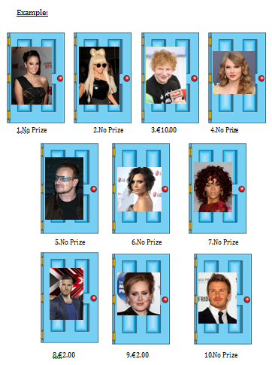

Slide 17
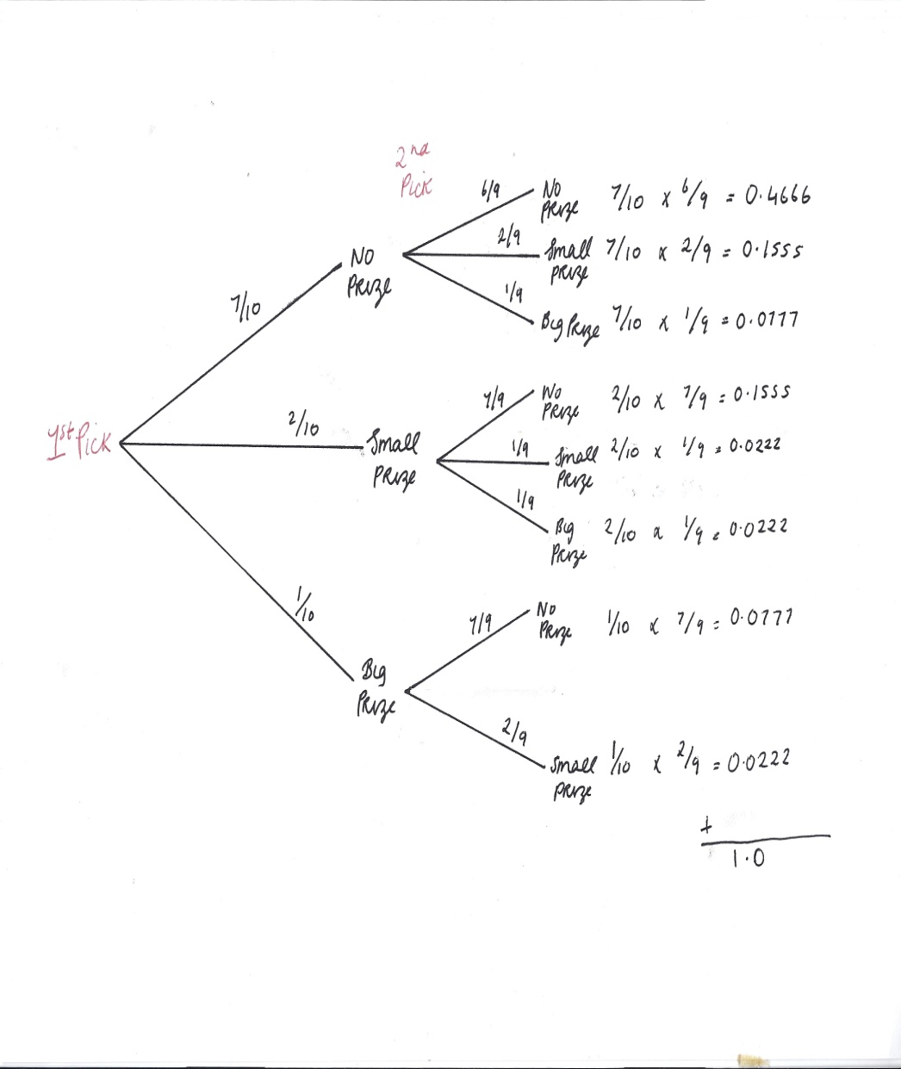
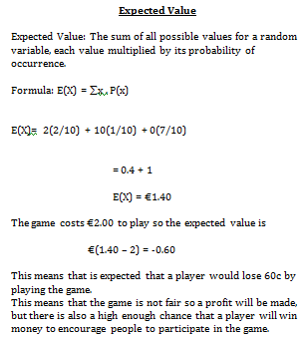

Slide 18
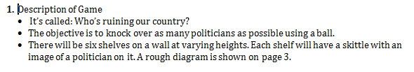

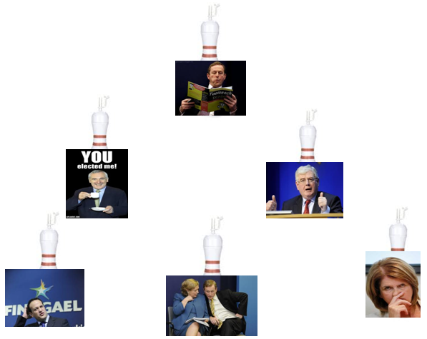

Slide 19
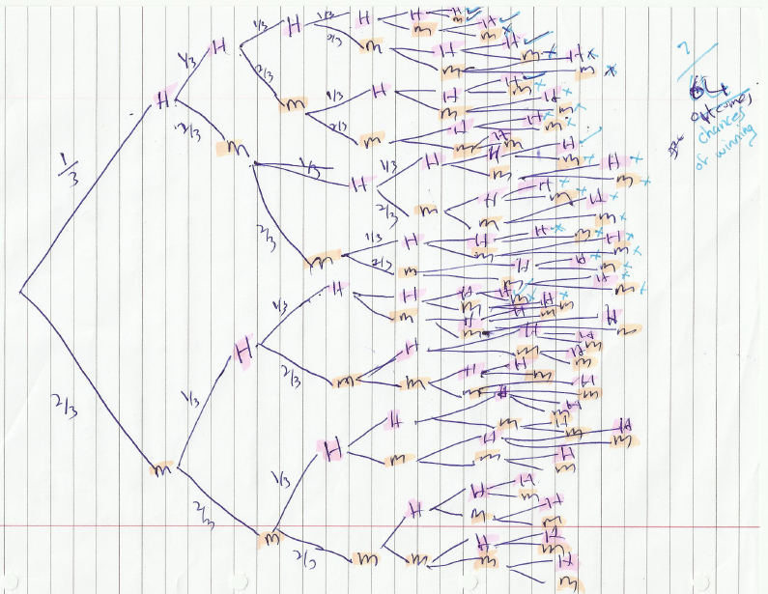

Slide 20
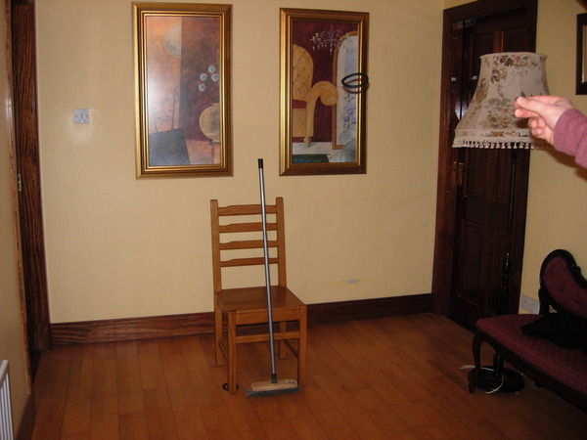
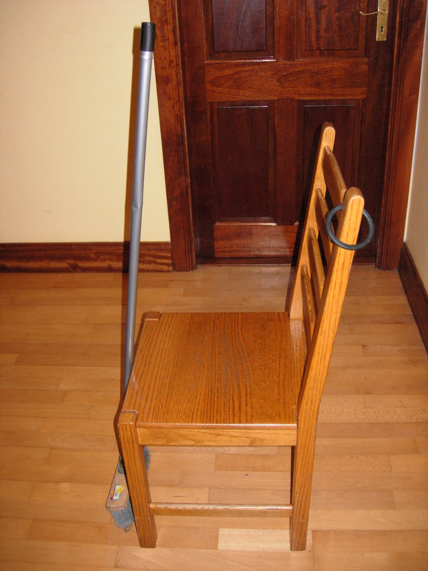

Slide 21
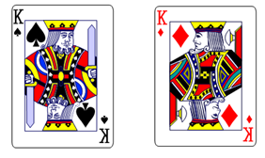


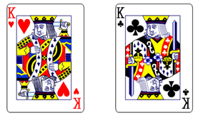



The Royal Guess
Winning Cards
Queen of Darkness!

Slide 22
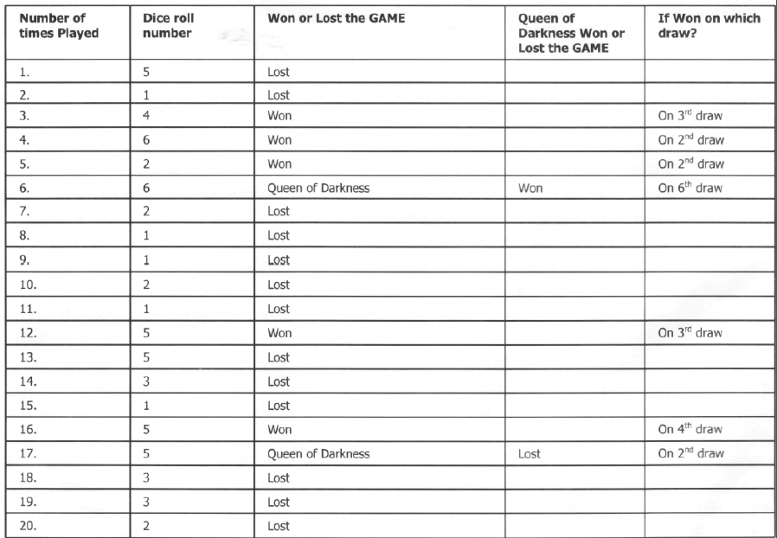
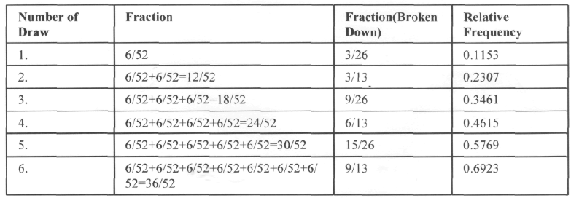

Slide 23
Summary of Student Learning
Misconceptions/ Knowledge Gap
Expected value when two or more events
Concept of combined probabilities
Bernoulli Trials

Slide 24
Misconceptions
Students realised their own misconceptions after completing various sections of Probability
One student resubmitted after misconceptions were highlighted

Slide 25
Summary
Once the topic was encountered in class the language and concepts were no longer alien to them which led to a greater understanding of the topic
Due to the initial method of learning students found recollection of the theory and concepts easier on revisiting the topic 12 months later

Slide 26
Summary
The understandings we gained regarding students’ learning in Statistics and Probability as a result of being involved in the research lesson
Understanding after submission of assignments aided to understanding of topic when addressed in class

Slide 27
Teaching Strategies
What did I notice about my own teaching?
We would prefer to get students to present their work to the class, which would allow for more discussion and understanding but the time constraints to complete the syllabus would not allow for this
Misconceptions were easier to deal with in a formal class setting as you could relate it to their own student work

Slide 28
Teaching Strategies
Was it difficult to facilitate and sustain communication and collaboration during the lesson?
Edmodo:
No online interaction due to competitiveness
Groups would communicate more

Slide 29
Teaching Strategies
What changes would I make in the future, based on what I have learned in my teaching, to address students’ misconceptions?
Social Behaviour (paired/group work)
Transition Year?

Slide 30
Reflections on Lesson Study Process
Strengths & Weaknesses
As a mathematics team how has Lesson Study impacted on the way we work with other colleagues?
Personally, how has Lesson Study supported my growth as a teacher?

