Slide 1





Maths Counts
Insights into Lesson Study

Slide 2

Wesley College
Gemma O’Dwyer, Patricia Lewis, Jenny Donohoe
Second Year
Array model and quadratic factorisation

Slide 3
Insights into Lesson Study
Introduction: Focus of Lesson
Student Learning : What we learned about students’ understanding based on data collected
Teaching Strategies: What we noticed about our own teaching
Strengths & Weaknesses of adopting the Lesson Study process

Slide 4
Introduction
Why did we choose to focus on this mathematical area?
Develop self-discovery teaching and learning.
Students have difficulty with this topic and sometimes do it in a mechanical way without understanding the topic.

Slide 5
Introduction
Array model and quadratic factorisation
How we planned the lesson:
Decided to use a self-discovery approach.
Students were asked to work in groups of two or three.
Designed worksheets based on array model.
A Dominoes exercise was also produced using the package Formulator Tarsia.

Slide 6
Introduction
Array model for multiplication used followed by pattern spotting leading to quadratic factorisation.
A series of lessons leading up to and continuing on from this lesson were developed.

Slide 7
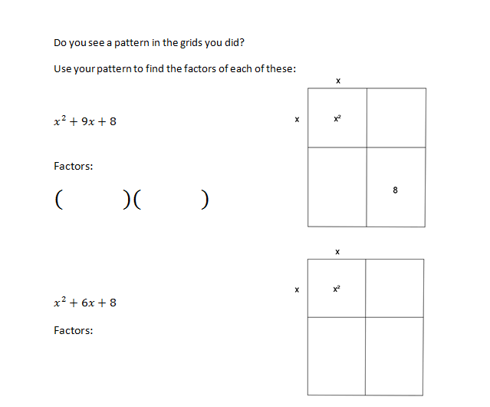
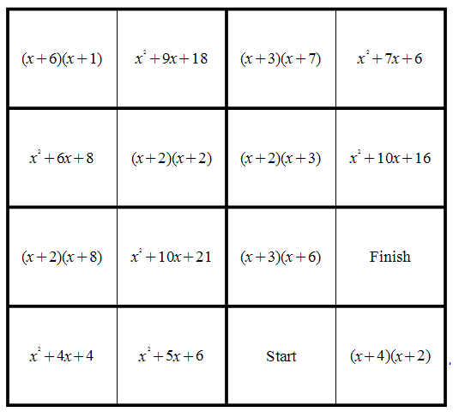
Introduction
Resources used :
Worksheets
Dominoes exercise

Slide 8
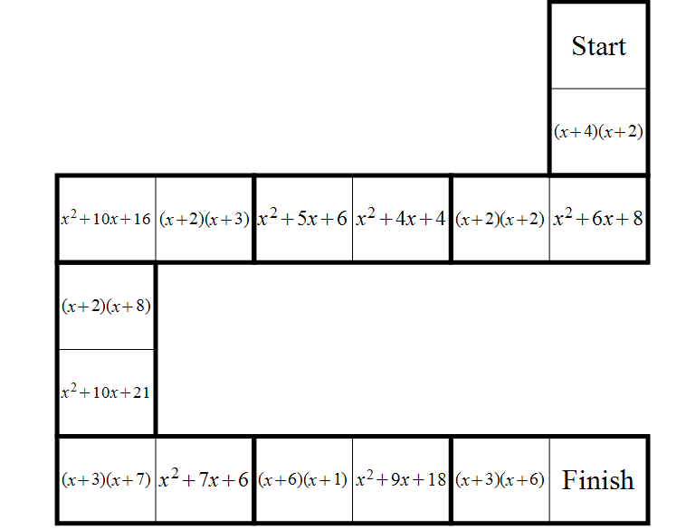
Dominoes exercise

Slide 9


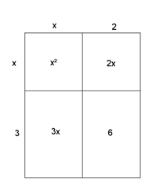
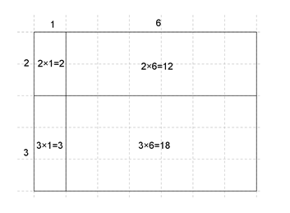
Introduction
Structure of the lesson:
Reviewed multiplication worksheet from previous lesson where pupils made observations.
Students were then asked to use observations to complete factorising worksheet.
Students progressed to the Dominoes exercise.
Review discussion (next class).

Slide 10
Introduction
Learning Outcomes:
Observe patterns in multiplication.
See link between multiplication and factorising.
Use visual method to increase understanding of factorisation.

Slide 11
Introduction
Enduring understandings:
Factorisation of quadratics and how it is the reverse of multiplication.
Greater understanding of algebra.

Slide 12
Reflections on the Lesson
Student Learning:
What we learned about students’ understanding based on data collected.
Teaching Strategies: What we noticed about our own teaching.

Slide 13
Student Learning
Data Collected from the Lesson:
Academic e.g. samples of students’ work
Motivation
Social Behaviour

Slide 14
Teacher Observations
Members of some of the groups listened to each other, but in other groups members went off on their own at the start. Eventually listened to each other and as result made progress.
When they saw other groups getting the Dominoes exercise they were inquisitive and motivated to finish.
Success lead to motivation.
Observing teachers were able to see the complete thought processes of a group, which is difficult in a normal teaching situation.

Slide 15
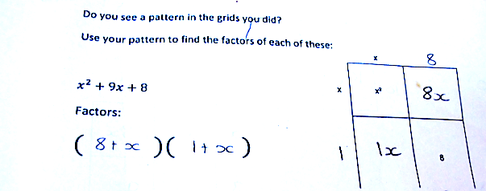
Student work

Slide 16
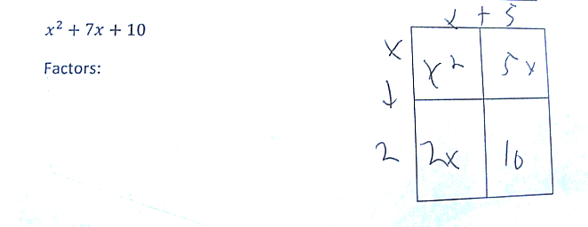
Student Work

Slide 17
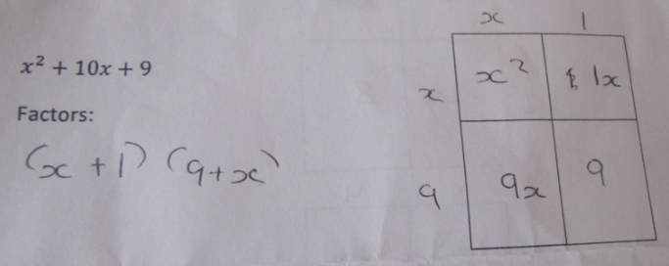
Observations of student’s work
Another way of writing the answer

Slide 18
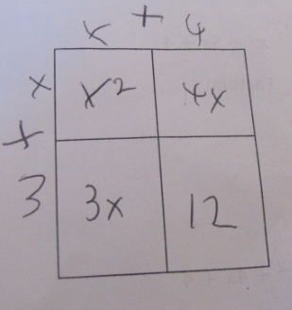
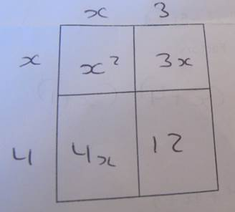
Observations of student’s work
Students need to realise both these are correct

Slide 19
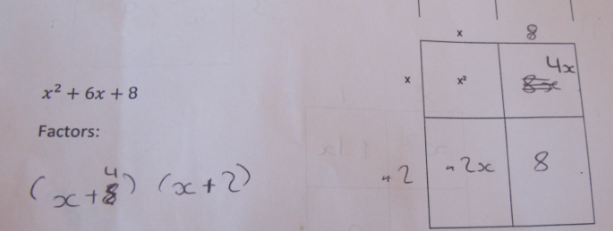
0bservation of student’s work
The need to train students to check their own work

Slide 20
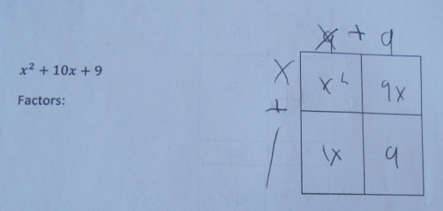
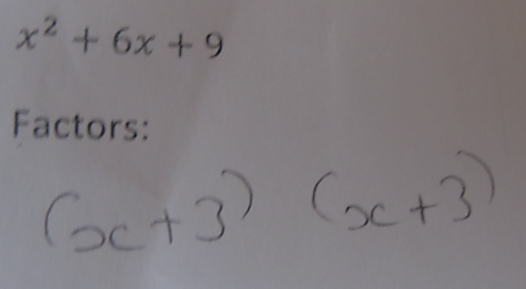
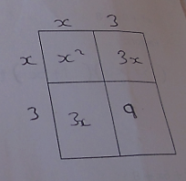
Observation of student’s work
Correct factors in table but failed to write them out

Slide 21
Student Understanding
What we learned about the way different students understand the content of this topic?
Visual
By action
Discussion
Structured

Slide 22
Effective Student Understanding
What effective understanding of this topic looks like:
Students should be able to find the factors, see patterns and understand the reasoning behind the factors.

Slide 23
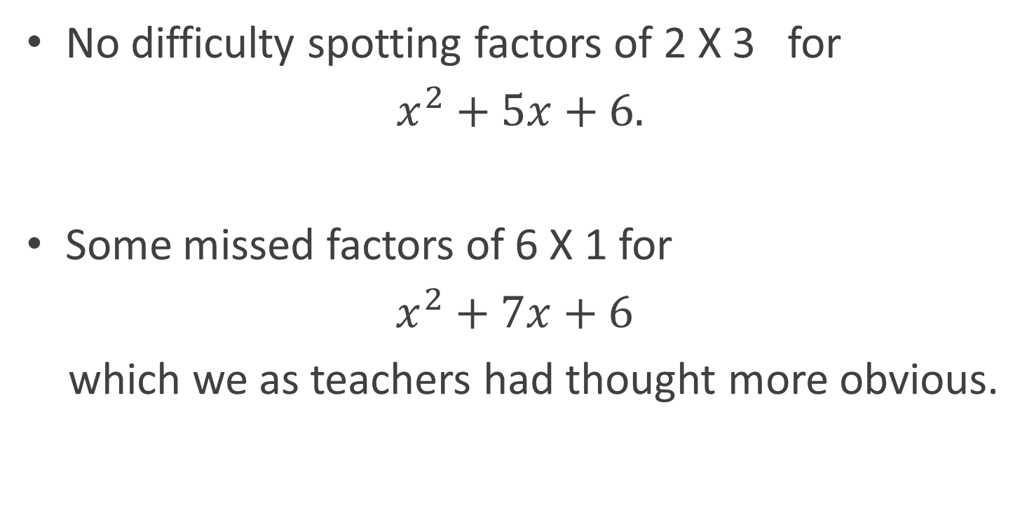
Common Misconceptions
No difficulty spotting factors of 2 X 3 for
$x^{2}+5x+6.$
Some missed factors of 6 X 1 for
$x^{2}+7x+6$
which we as teachers had thought more obvious.

Slide 24
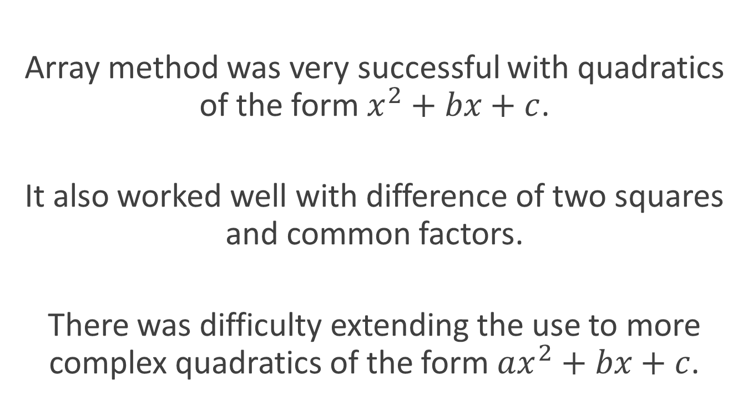
Follow-on problems

Slide 25
Addressing Problems
Recommendations
Develop further worksheets to deal with more complex quadratics.

Slide 26
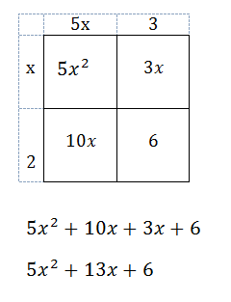
Addressing Problems
Worksheet 1

Slide 27
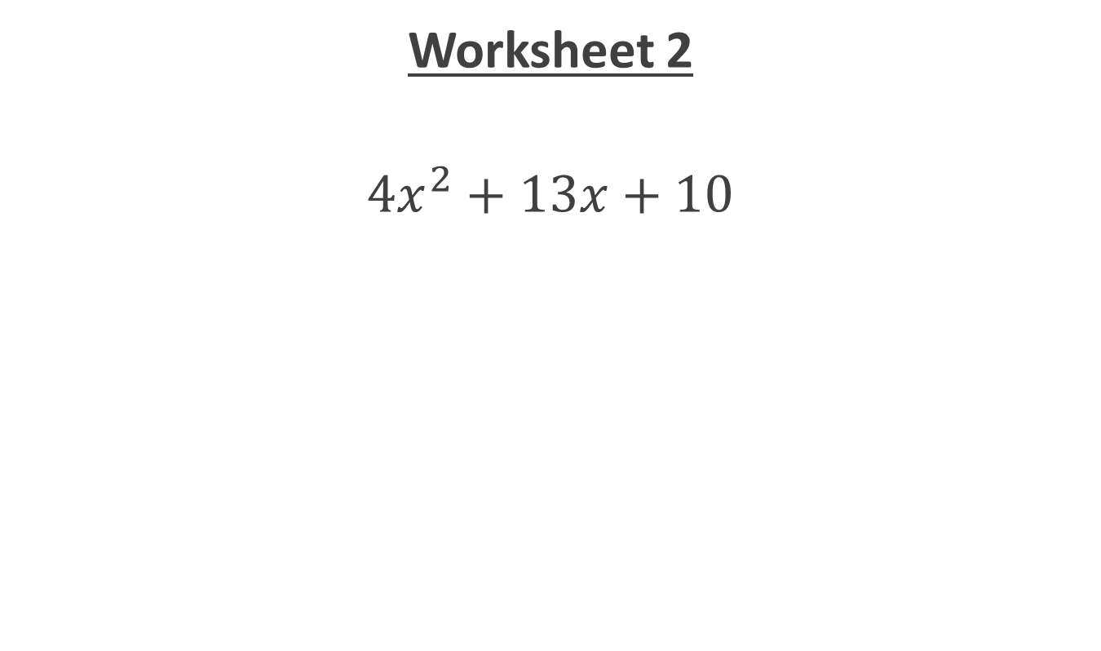
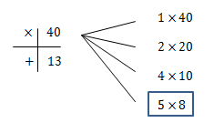
Addressing Problems

Slide 28

Addressing Problems
${4x}^{2}+13x+10$
${4x}^{2}+8x+5x+10$
4 $x$($x$+2)$+5(x+2)$
(4 $x$+5)$(x+2)$

Slide 29
Summary
The understandings we gained regarding students’ learning
This approach allowed students:
to have time to think
to work at their own rate
to work in groups and share ideas
to chat about Maths
to realise that they have the ability to learn independently and so build confidence.

Slide 30
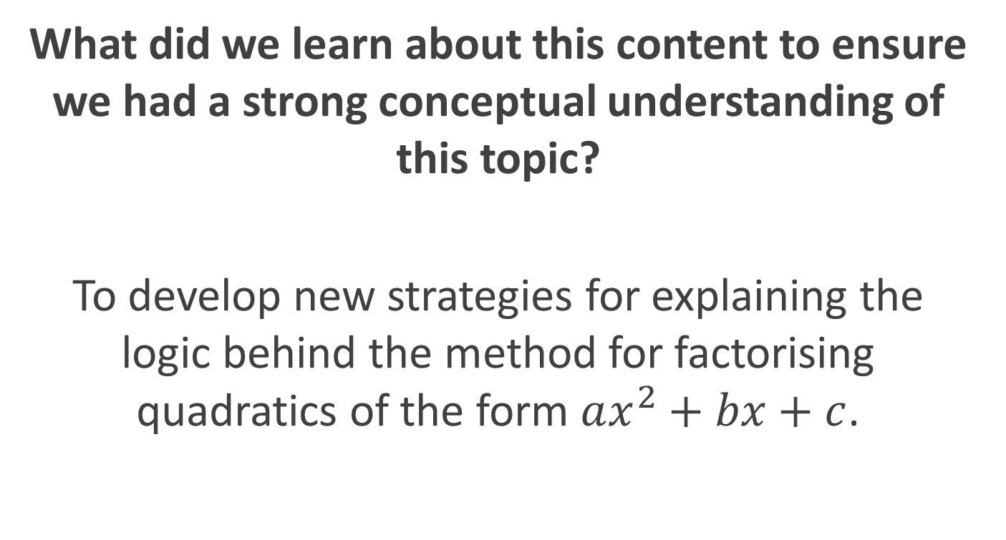
Summary

Slide 31
Teaching Strategies
What did I notice about my own teaching?
What was difficult?
  The need to be alert to all groups simultaneously, which is difficult in a classroom situation.

Slide 32
Teaching Strategies
Was it difficult to facilitate and sustain communication and collaboration during the lesson?
Finding the appropriate time to intervene in the student discussions. It was very easy to intervene too early or too late.

Slide 33
Teaching Strategies
Questions to provoke students’ deep thinking
What pattern did you see from yesterday?
Do you see any connection between the numbers in the expression and the factors?

Slide 34
Teaching Strategies
How did I engage and sustain students’ interest and attention during the lesson?
Self-discovery led to sense of achievement.
Motivation to get to Dominoes stage.

Slide 35
Teaching Strategies
How did I assess what students knew and understood during the lesson?
Completion of the worksheet correctly and being able to successfully complete the Dominoes exercise.

Slide 36
Teaching Strategies
How did I put closure to the lesson?
Completing the Dominoes exercise summarised the lesson.
Make up and factorise their own quadratics for homework.

Slide 37
Teaching Strategies
What understandings have I developed regarding teaching strategies for this topic as a result of my involvement in Lesson Study?
Success of self-discovery learning
Importance of visual aids to some students
Use of patterns to assist learning

Slide 38
Reflections on Lesson Study Process
Strengths & Weaknesses
As a mathematics team, how has Lesson Study impacted on the way we work with other colleagues?
Interesting to observe the workings of another classroom
Sharing ideas with others rather than working in isolation
Time allocated to discuss teaching methods, which we don’t often get an opportunity to do

Slide 39
Reflections on Lesson Study Process
Strengths & Weaknesses
Personally, how has Lesson Study supported my growth as a teacher?
Allowed more dedicated time to discuss teaching methods with colleagues
Develop a consistency in our approach
Shifting more ownership to students

Slide 40
Process
Recommendations as to how Lesson Study could be integrated into a school context.
Having parallel Maths classes allowed us to be free together to plan the lesson but also made mutual observation difficult.
Greater flexibility in the use of extra hours in schools could allow for lesson study.
Develop interschool sharing system for resources.

