Slide 1
Maths Counts Insights into Lesson Study

Slide 2
Presentation Secondary School, Listowel.
Helen Mc Carthy & Eimear White
Transformations of Functions in Second Year
2

Slide 3
Insights into Lesson Study
Introduction: Focus of Lesson
Student Learning : What we learned about students’ understanding based on data collected
Teaching Strategies: What we noticed about our own teaching
Strengths & Weaknesses of adopting the Lesson Study process
3

Slide 4
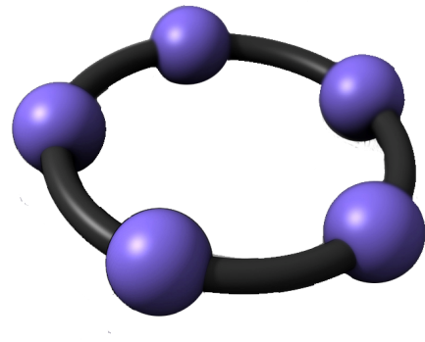
Introduction
Topic investigated Transformation of Functions
How we planned the lesson
Prior discussion
Checked syllabus
Prior knowledge (plotting points, quadrants, input, output)
Discussed resources and learning outcomes
Resources used:
4

Slide 5
Why Transformation of Functions?
New approach to this part of the maths syllabus for both teachers and students
To investigate the difficulties that could arise
To reflect and discuss other approaches to teaching this material in the future
5

Slide 6
Learning Outcomes
Students should understand the following:
f(x) = mx + c
What happens to a linear graph when
the coefficient of x is changed
the constant c is changed
f(x)= ax² + c
What happens to a quadratic graph when
the value of the coefficient of x² is changed
The value of the constant c is changed
6

Slide 7
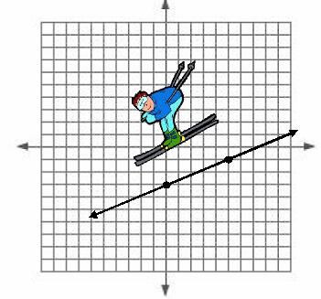
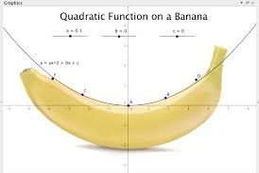
Learning Outcomes
To recognise linear and quadratic functions
To sketch these functions
To match graphs with their function.
Island Bridge, Listowel

Slide 8
Introduction to functions in classroom
Linear Functions
Input-output table, y = x (Parent Function)
Plot these coordinates and join them together.
Further functions y = x + 1, y = x + 2, y=x − 1….
Students explain what is happening in each function in relation to the parent function.
8

Slide 9
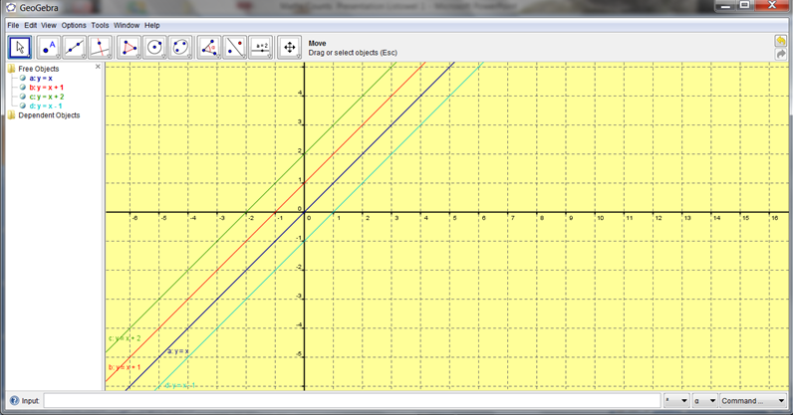
y = x: y =x + 1: y = x + 2: y = x −1

Slide 10
Homework
Using the same axis and the same scale, draw the following graphs
(i) y = − x (ii) y = − x − 1 (iii) y = − x − 2
in the domain $−3≤x≤3.$ Compare the three lines.
10

Slide 11
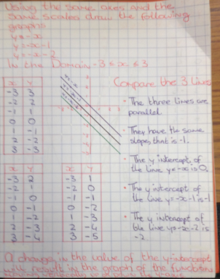
Student Answering

Slide 12
Further Linear Functions
Input-output table, y = x (Parent Function)
plot these coordinates and join them together.
Further functions y = 2x, y =3x, y = −x, y = −2x…
Students explain what is happening in each function in relation to the parent function.
12

Slide 13
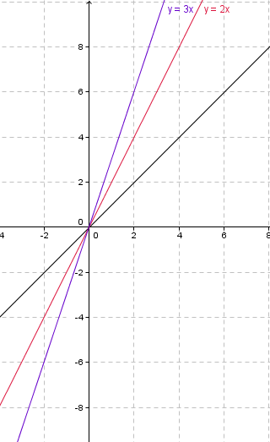
Student GeoGebra: Showing some solutions

Slide 14
Continuation of functions in classroom
Quadratic Functions
Input-output table, y = x² (Parent Function)
Plot these coordinates and join them together.
Further functions y = x² + 2, y = x² + 4, y = x² −3…
Students explain what is happening in each function in relation to the parent function.
14

Slide 15
Class Task
Using the same axis and the same scale, draw the following graphs
f(x)= x² (ii) g(x) = x² +2 (iii) h(x)= x² + 4
k(x)= x² − 3, in the domain $−4≤x≤4.$

Slide 16
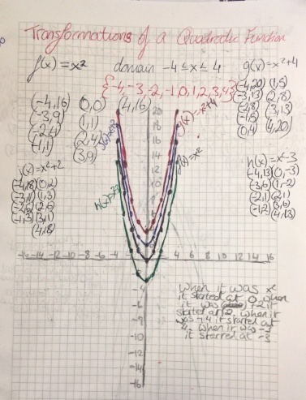
Student Answering

Slide 17
Homework
Using the same axis and the same scale, draw the following graphs
f(x)= − x² (ii) g(x) = − x² +2 (iii) h(x)= − x² − 4
k(x)= − x² + 3 In the domain $−4≤x≤4.$

Slide 18
Student Answering

Slide 19
Continuation of functions in classroom
Further functions in classroom y = 2x², y= 3x², …
Students explain what is happening in each function in relation to the parent quadratic function x².
For homework, the students were asked to draw f(x)= − x², g(x)= − 2x², h(x)= −0.5 x²
An example of good student homework is shown on the next slide.

Slide 20
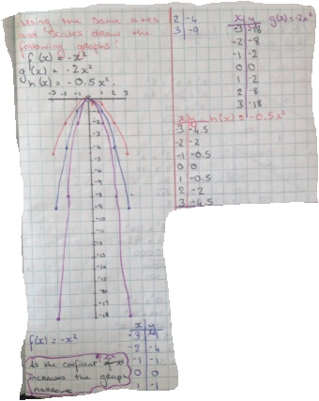

Slide 21
Extending the Learning
During the next class, students were further challenged in groups to draw the functions y = 2x² + 1, y = 2x² + 3, and y = 2x² − 1
They were then asked to give feedback to the whole class in relation to the double effect of both shifting and scaling.

Slide 22
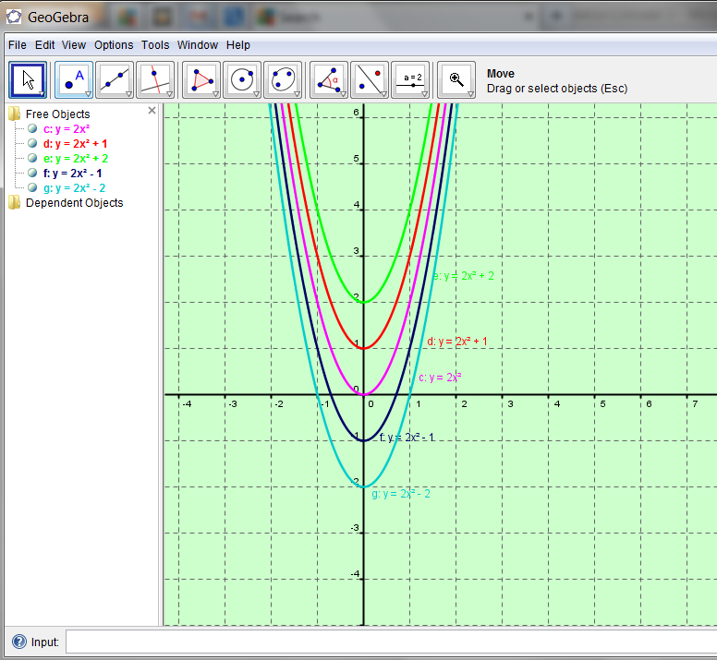
Demonstration of Shifting and Scaling by students using GeoGebra

Slide 23
Assessment
As the students were drawing and sketching
various graphs in the classroom and for homework
we were continually assessing their understanding.
Further assessment took place when we gave them
the matching and graph-completion exercises.

Slide 24
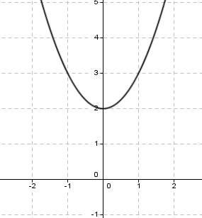
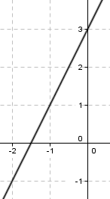
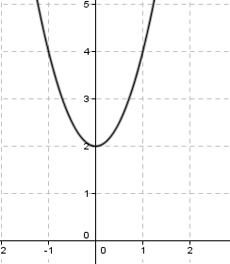
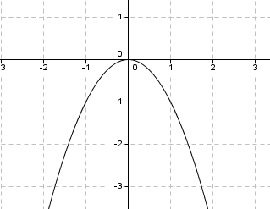
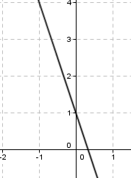
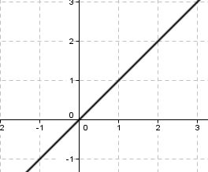
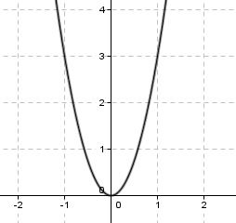
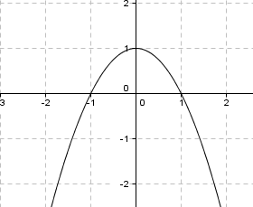
Question 1. Match the following functions with the graphs below
2x +3 (ii) − x² (iii) −3x+1 (iv) 3x² (v) x (vi) x² + 2
(vi) 2x² + 2 (vii) − x² + 1
A
B
C
D
E
F
H
G
24

Slide 25
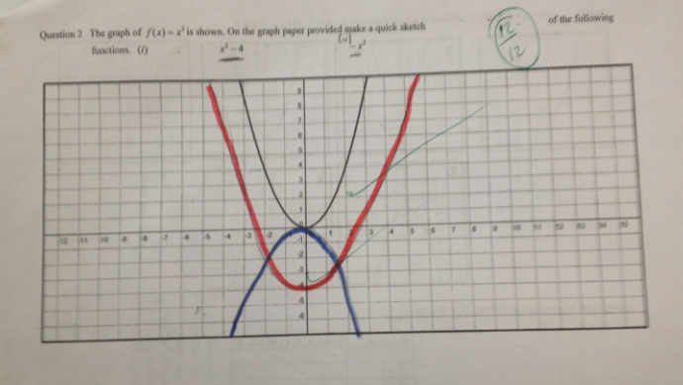
Question 2 The graph of f(x) = x² is shown. On the graph paper provided sketch the graph of the following functions.
x² − 4 (ii) − x²
25

Slide 26
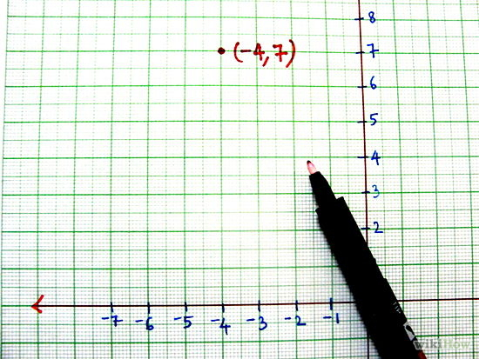
Reflections on the Lesson
Student Learning: What we learned about students’ understanding based on data collected.
Teaching Strategies: What we noticed about our own teaching.
26

Slide 27
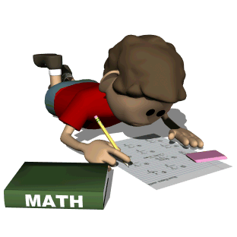
Student Understanding
Students needed to fully work through questions to comprehend transformations of functions.
Rather than just making a sketch of the function, students always compiled an input-output table.
They took ownership of their learning, they were fully engaged and involved by the practical element to this topic.

Slide 28
Student Understanding
Students needed to fully work through questions to comprehend transformations of functions.
Rather than just making a sketch of the function, students always compiled an input-output table.
They took ownership of their learning, they were fully engaged and involved by the practical element to this topic.
28

Slide 29
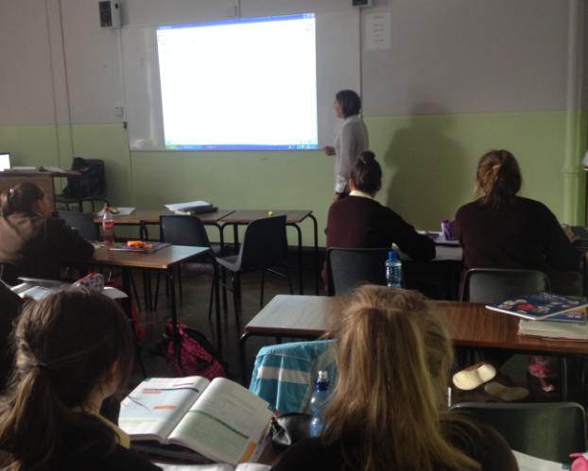
Student Learning
Misconceptions: Thought students would gain an understanding by the use of GeoGebra, but it was only when they completed the graphs themselves they gained a robust understanding.
29

Slide 30
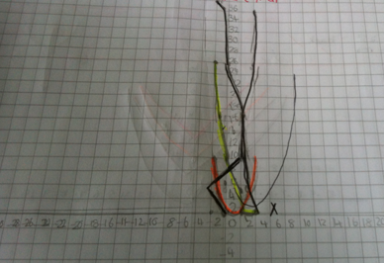
Common Misconceptions: 1
No sense of curve
Wrong axes scaling
30

Slide 31
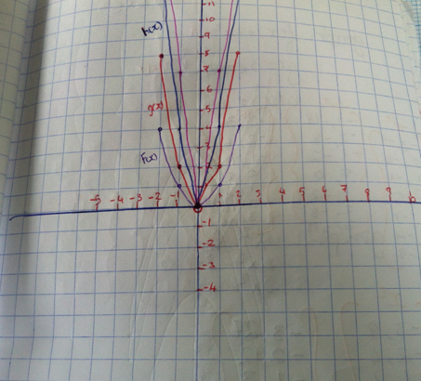
Common Misconceptions: 2
Straight lines used to join points.
31

Slide 32
Common Misconceptions: 3
No axes labelling
No points
No curve
32

Slide 33
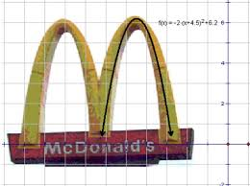
Addressing Misconceptions
Recommendations
The adjustments you have made or would make in the future:
emphasise the curve when sketching the quadratic graph.
33

Slide 34
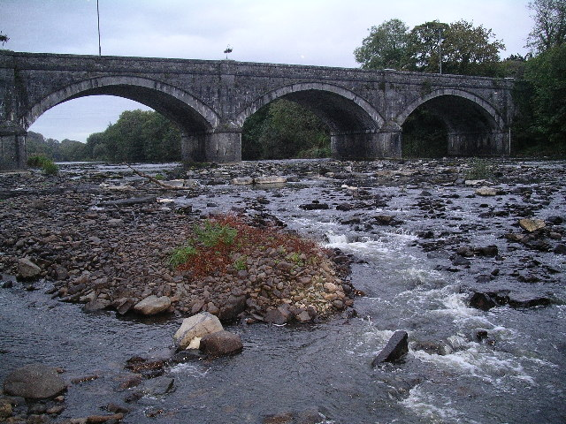
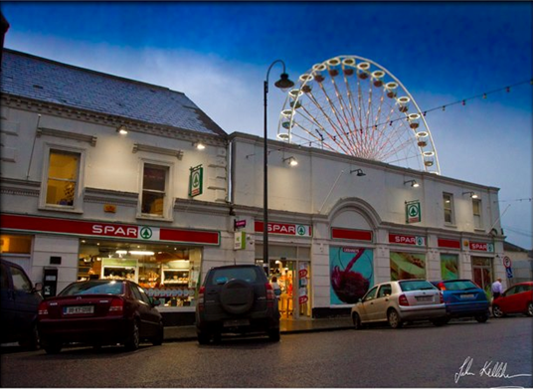
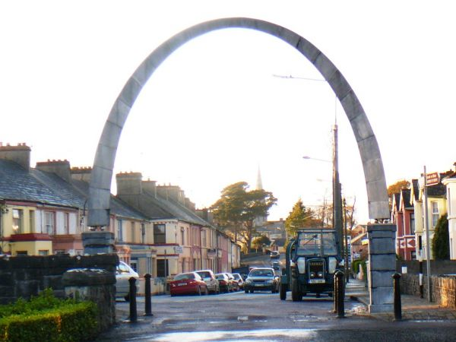
Real life curves in Listowel
Listowel Castle
Listowel Bridge
Millennium Arch, Listowel
Listowel Race Week Skyline
34

Slide 35
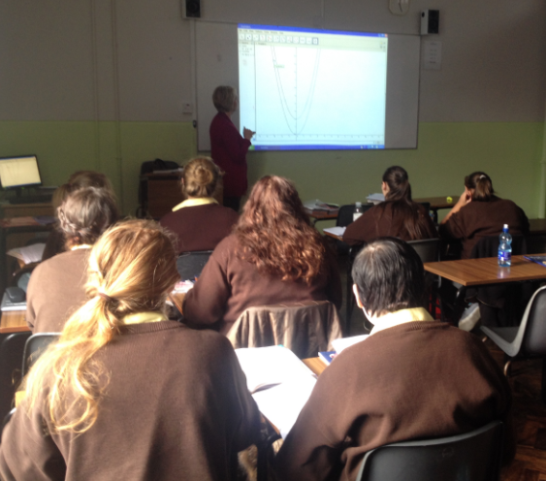
Summary
The understandings we gained regarding students’ learning was that they had to be actively involved.

Slide 36
Summary
The understandings we gained regarding students’ learning was that they had to be actively involved.
36

Slide 37
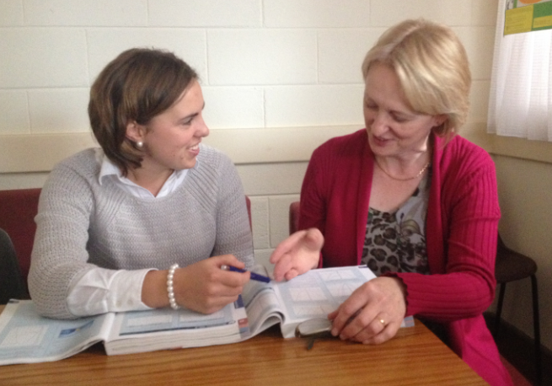
Teaching Strategies
We both noticed about our teaching:
Preparation work for each class
New concepts for students initially challenging
Slow and tedious
37

Slide 38
Teaching Strategies
Was it difficult to ask questions to provoke students’ deep thinking?
38

Slide 39
Teaching Strategies
How did I engage and sustain students’ interest and attention during the lesson?
Active learning
Investigation
Discovery
Self directed learning
Ownership
39

Slide 40
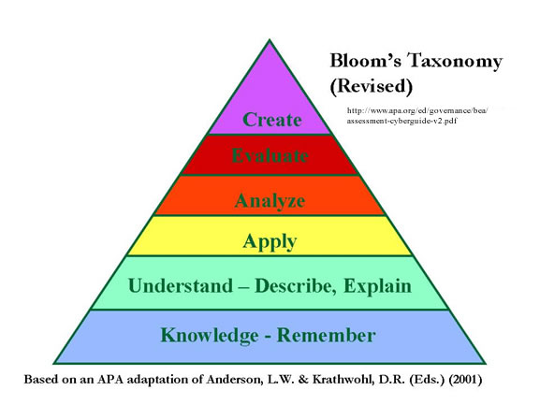
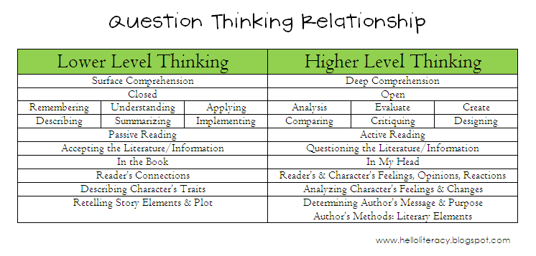
Teaching Strategies
How did I assess what students knew and understood during the lesson?
40

Slide 41
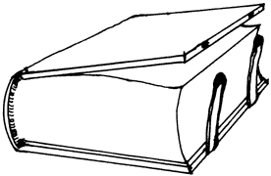
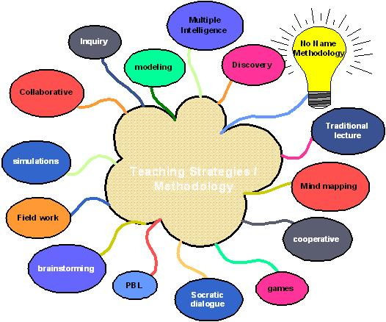
Teaching Strategies
closure to the lesson
future teaching strategies
changes
41

Slide 42
Reflections on Lesson Study Process
Strengths & Weaknesses
What we learned….
Growth as a teacher
Integrated into a school context
Benefit to students
42

Slide 43
Slán

Slide 44
Slán
44

