Slide 1
Maths Counts Insights into Lesson Study

Slide 2
Loreto Abbey Dalkey
Jenny Moran, Celine McCarthy, Michael Murphy and Breda Fallon
Transition year and Leaving Certificate classes
Use of Edmodo to Facilitate Teaching and Learning

Slide 3
Insights into Lesson Study
Introduction: Focus of Lesson
Student Learning : What we learned about students’ understanding based on data collected
Teaching Strategies: What we noticed about our own teaching
Strengths & Weaknesses of adopting the Lesson Study process

Slide 4
Introduction
Use of Edmodo to Facilitate Teaching and Learning
How we planned:
Signed up to the online platform www.edmodo.com
Spent time exploring its functionality
Explained to the students how to use it
On going uploading of files and monitoring throughout the year.

Slide 5
Introduction
Resources used:
Laptop/Computer/iPad
Projector
Range of teacher-created resources e.g. PowerPoints, worksheets, quizzes, tests etc.
Range of shared resources for example www.projectmaths.ie and www.mathsisfun.com
Range of online videos from www.youtube.com

Slide 6
Introduction
Teacher can monitor all activities
Teacher uploads material

Slide 7
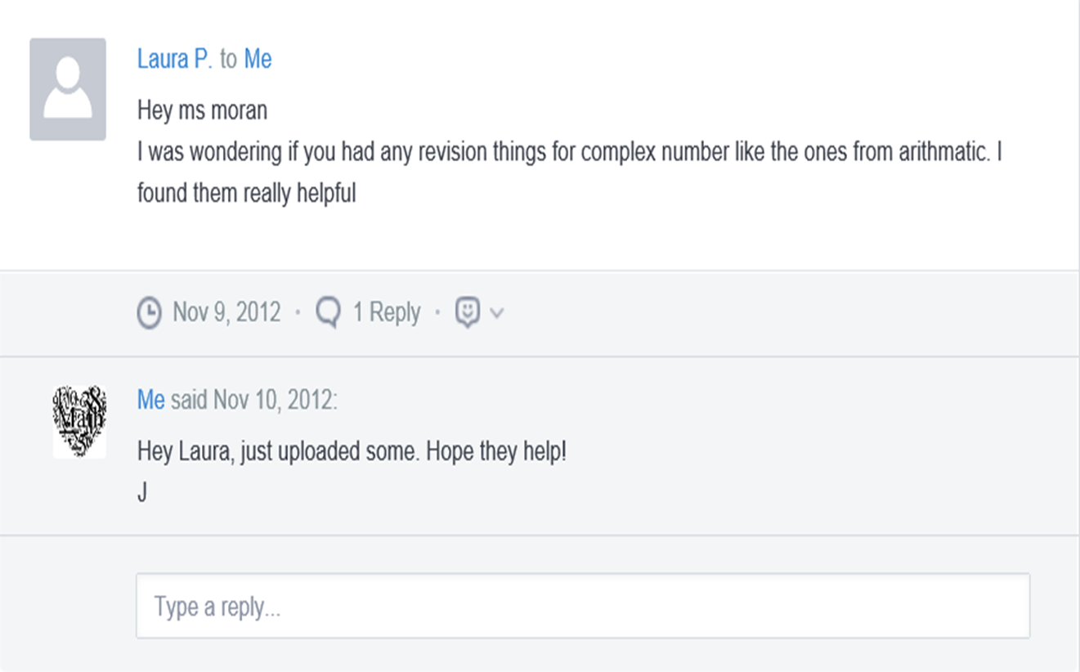
Introduction
Students ask teacher questions
Students ask each other questions

Slide 8
Introduction
Learning Outcomes:
Discuss maths in a safe teacher supported and moderated environment
Students to take autonomy for their own learning
Promote enjoyment of maths
Engage in projects that may not be feasible in class time

Slide 9
Introduction
Why did we choose to focus on this mathematical area?
Create a link between the social media generation of students with the classroom
Reduces the amount of photocopying
Absent students can be accommodated
Forum for students unable/unwilling to ask questions in class
Develop students’ ICT skills with an aim to promote digital literacy

Slide 10
Introduction
Enduring understandings:
Fosters independent self-directed learning
Caters for multiple learning styles
Shift from reliance on textbook
Promotion of peer discussion inline with current Project Maths teaching methodologies

Slide 11
Reflections on the Lesson
Student Learning : What we learned about students’ understanding based on data collected
Teaching Strategies: What we noticed about our own teaching

Slide 12
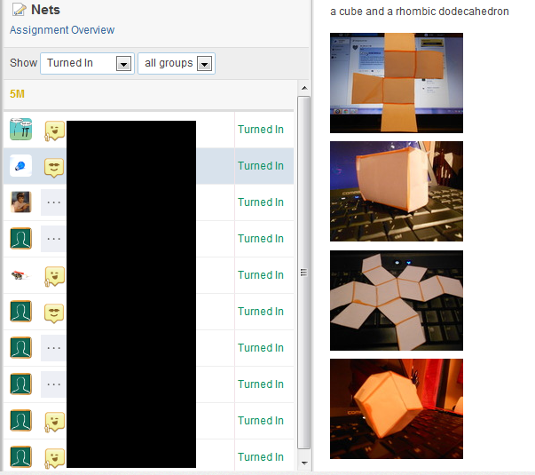
Student Learning
Data Collected from the Lesson:
Academic e.g. samples of students’ work
Motivation
Social Behaviour

Slide 13
Student Learning
Student Learning :
Teacher has instant insights into student misconceptions, single or group
Teacher has insights into student motivation
Students display their own knowledge by helping other students

Slide 14
Student Learning
What we learned about the way different students understand the content of this topic?

Slide 15
Student Learning

Slide 16
Student Learning

Slide 17
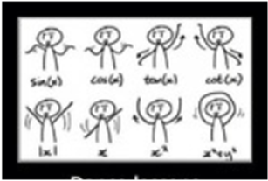
Student Learning
Teaching Strategies:
Time Saver
Clarification of misconceptions at time of topic, hence minimised problems later on
Reduced photocopying
Teacher-created tests/quizzes corrected automatically
Scope of mathematical assignment/task

Slide 18
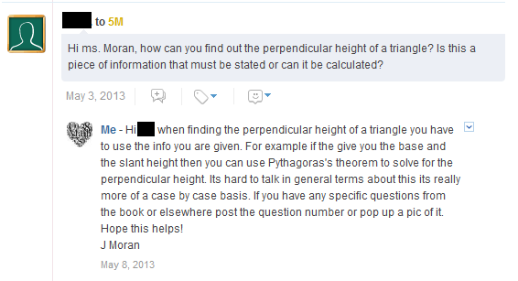
Effective Student Understanding
What effective understanding looks like:

Slide 19
Student Learning
Misconceptions/ Knowledge Gap
Tool for senior classes as autonomous learners require a certain maturity
Sometimes I delayed in responding to queries to allow for peer mentoring
Misuse/Overuse of Edmodo, constant questions regarding homework everyday from some students

Slide 20
Common Misconceptions

Slide 21
Addressing Misconceptions
Recommendations
Worthwhile to set up the Library system prior to start of term in conjunction with uploading ad hoc resources.
Require all students to post on first night to ensure they know how.
Incorporate further use of ICT in maths through presentations, video clips, audio files.
Encourage students to research useful resources themselves.

Slide 22
Student Reflections
Strengths:
Fun
Easy to use
Can get homework during holidays
Useful Websites and links
“I have found using Edmodo very helpful, especially when doing honours maths, a subject which requires as much outside resources as possible”
“Computing plays a large part in our lives and Edmodo is easy to use and allows us to ask questions at any time of day or night”

Slide 23
Student Reflections
Weaknesses:
Need Internet
App takes a lot of memory of phone
Can get homework during holidays
“If you go on (the Internet) you get distracted by other things e.g. Facebook ”
“If you don’t check it you miss out”

Slide 24
Summary
The understandings we gained regarding the Use of Edmodo to Facilitate Teaching and Learning as a result of being involved in Lesson Study:
Highlighted the effectiveness of catering to different styles of learning.
Students have the facility to safely ask questions on Edmodo directly to teacher or in group.

Slide 25
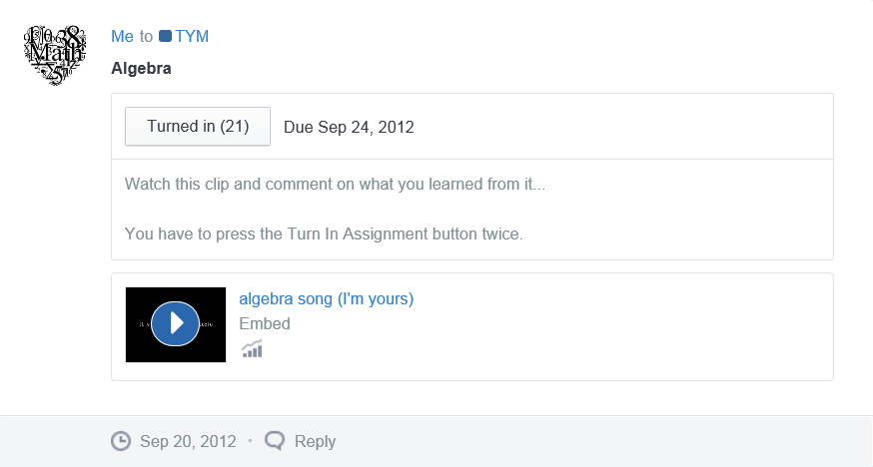
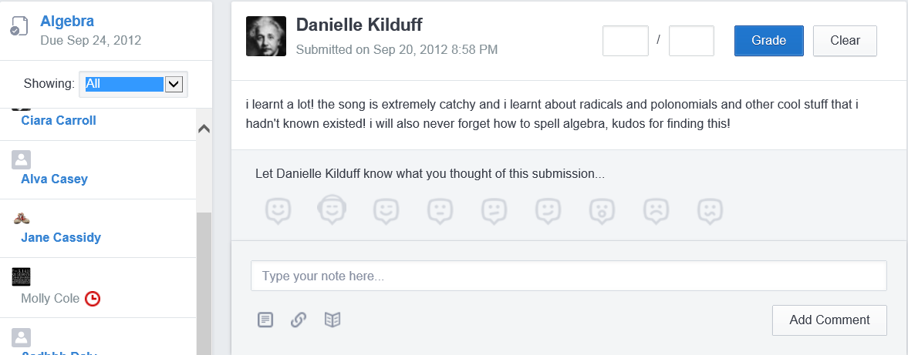
Summary

Slide 26
Summary
Increase in student engagement with mathematical activities
Insights into level of student motivation
Positively affected teacher workload – reduced repetitive tasks/queries
Students take ownership over their own learning
Students see the Internet to further their own mathematical knowledge

Slide 28
Teaching Strategies
What did I notice about my own teaching?
What was difficult?
Knowing what my own level of involvement should be.
Internet connectivity for students.

Slide 29
Teaching Strategies
Was it difficult to facilitate and sustain communication and collaboration during the year?
No, the level of student involvement increased as year progressed.
The extra time spent outside of the classroom was not time consuming and made the class time more productive.

Slide 30
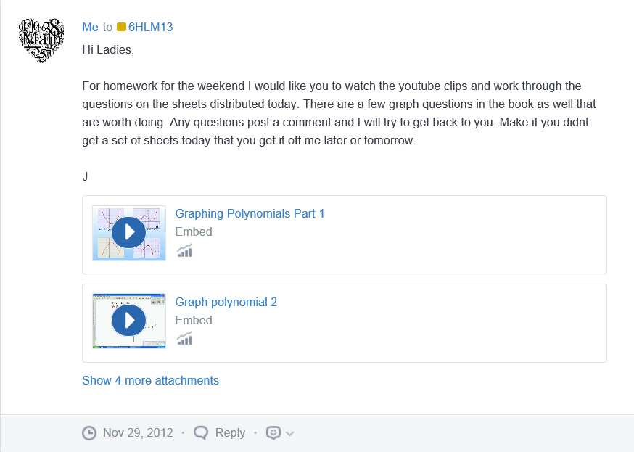
Teaching Strategies
Was it difficult to ask questions to provoke students’ deep thinking?
Time was needed to develop/sources activities, which suited the online environment.
Challenging to develop/source higher order questions.

Slide 31
Teaching Strategies
How did I engage and sustain students’ interest and attention during the year?
Use of a variety of formats for resources.
Scheduling and releasing of resources given in line with topic timeline.

Slide 32
Teaching Strategies
How did I assess what students knew and understood during the year?
Students posted queries at time of topic.
Fostered assessment for learning.
Students providing incorrect information to other students in response to a query could be seen.

Slide 33
Teaching Strategies
What understandings have I developed regarding teaching strategies for this topic as a result of my involvement in Lesson Study?
The benefit of using different formats of resources to ensure maximum student understanding.
The benefit of peer, experiential, mobile and problem based learning and how Edmodo facilitates this.

Slide 34
Teaching Strategies
What changes would I make in the future, based on what I have learned in my teaching, to address students’ misconceptions?
Further incorporate Edmodo into my pedagogy.

Slide 35
Reflections on Lesson Study Process
Strengths & Weaknesses
As a mathematics team how has Lesson Study impacted on the way we work with other colleagues?
Facilitates collaboration between colleagues in the mathematics department
Brainstorming with maths department on beneficial activities for teaching and learning

Slide 36
Reflections on Lesson Study Process
Strengths & Weaknesses
Personally, how has Lesson Study supported my growth as a teacher?
It has broadened my knowledge of teaching methodologies and how to cater to different styles of learning.
Time to reflect on student understanding

Slide 37
Reflections on Lesson Study Process
Strengths & Weaknesses
Recommendations as to how Lesson Study could be integrated into a school context.
Incorporate Lesson Study in whole-school planning

Slide 38
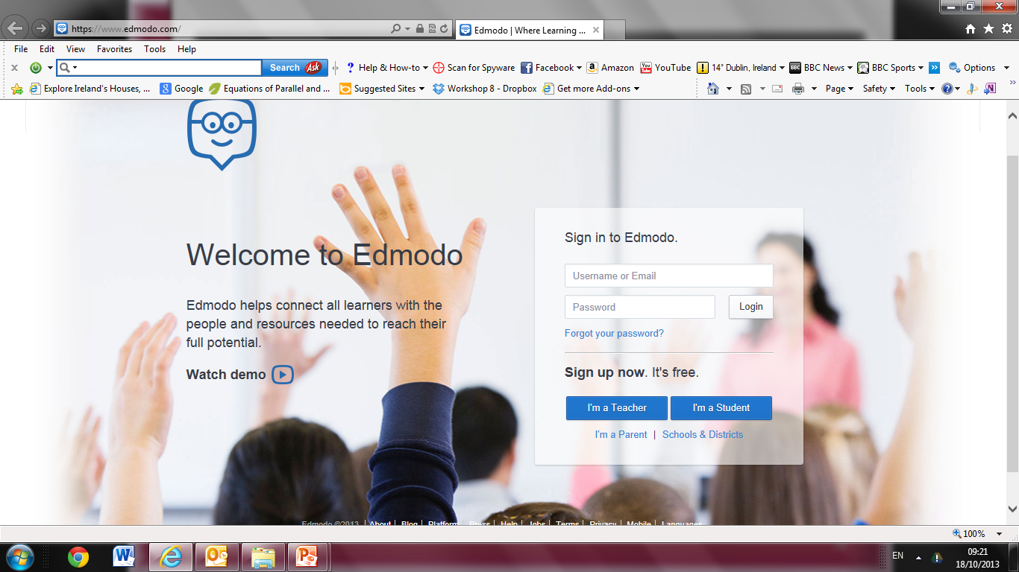
www.edmodo.com

