Slide 1
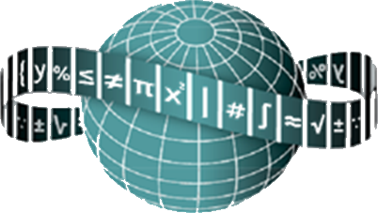
Maths Counts Insights into Lesson Study

Slide 2
St Columba’s Comprehensive, Glenties
Martin Regan & Breege Melley
GeoGebra and Constructions at LCOL
TY and LCOL

Slide 3
Insights into Lesson Study
Introduction: Focus of Lesson
Student Learning : What we learned about students’ understanding based on data collected
Teaching Strategies: What we noticed about our own teaching
Strengths & Weaknesses of adopting the Lesson Study process

Slide 4
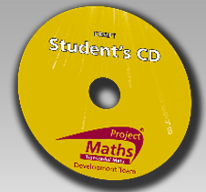
Introduction
Topic investigated : Constructions (i) using GeoGebra (ii) manually
How we planned the lesson
Resources used
GeoGebra
Worksheets
Student CD : www.projectmaths.ie
Website:http://www.mathopenref.com/tocs/constructionstoc.html
Paper, ruler, sharp pencil, compass

Slide 5
Introduction
Why did we choose to focus on this mathematical area?
We wanted students to use GeoGebra in the future as a problem solving tool. They needed to build up a skills base for this.
We wanted to increase students’ understanding of constructions by being able to quickly view multiple examples of one construction.
We felt students would enjoy the ICT approach to constructions and would generate more interest in the topic for them.

Slide 6
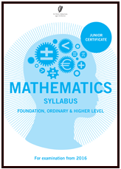
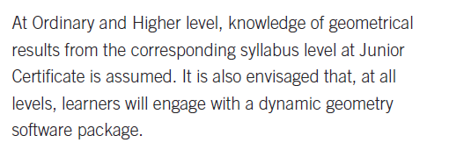
Introduction
Why did we choose to focus on this mathematical area?

Slide 7
Introduction
Learning Outcomes
Working knowledge of GeoGebra for geometry
Use GeoGebra for visualisation, aiding understanding and problem solving
Produce constructions ( perpendicular bisector of a line, circumcentre and circumcircle of obtuse, acute and right angled triangles) using GeoGebra
Appreciate that a construction produced using GeoGebra should be “indestructible” and to check for this by dragging the vertices
Produce accurate constructions manually using what was learned from GeoGebra

Slide 8
Introduction
Enduring understandings
The importance of using correct mathematical terminology -improving literacy alongside numeracy
The importance of accurate, clear work: GeoGebra gives excellent exemplars as a precursor to manual work
The use of colour to increase clarity
That discovery and exploration in a dynamic environment is a first step in problem solving
The importance of looking for patterns
That several examples supporting a statement do not constitute a proof.
Being able to produce accurate constructions manually with understanding.

Slide 9
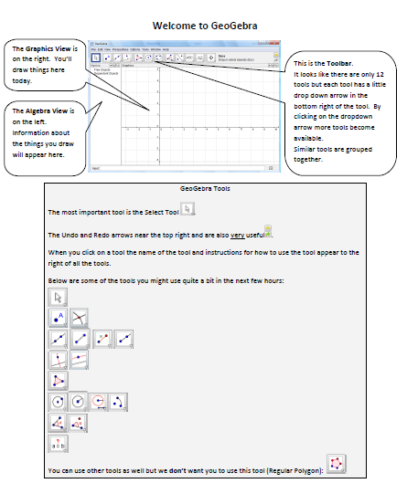
Introductory sheet: “Welcome to GeoGebra”

Slide 10
Introduction
Worksheet Tasks Using GeoGebra:
Construct a triangle and measure the lengths of sides and angles
Construct the perpendicular bisector of a line and verify
Construct the perpendicular bisectors of a triangle.
Construct the circumcentre of a triangle
Construct the circumcircle of a triangle
Write down the steps for constructing the circumcentre and circumcircle of a triangle
Manually:
Construct the circumcentre and circumcircle of a) acute b) obtuse and c) right angled triangles

Slide 11
Reflections on the Lesson
Student Learning : What we learned about students’ understanding based on data collected
Teaching Strategies: What we noticed about our own teaching

Slide 12
Student Learning
Data Collected from the Lesson:
Academic e.g. samples of students’ work
Motivation
Social Behaviour

Slide 13
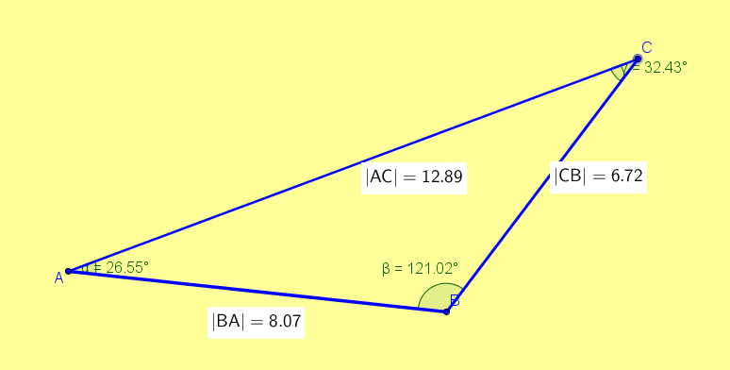
Worksheet + Student work
Task 1 – Constructing & Investigating Triangles
Undo button
Hide the axes (Toggle button)
Change background colour.
Draw a triangle ( line segment tool)
Change the colour of the sides. Make all the sides the same colour. (Select tool and Colour)
Measure lengths of sides (Distance or length)
Measure angles
Drag the vertices

Slide 14
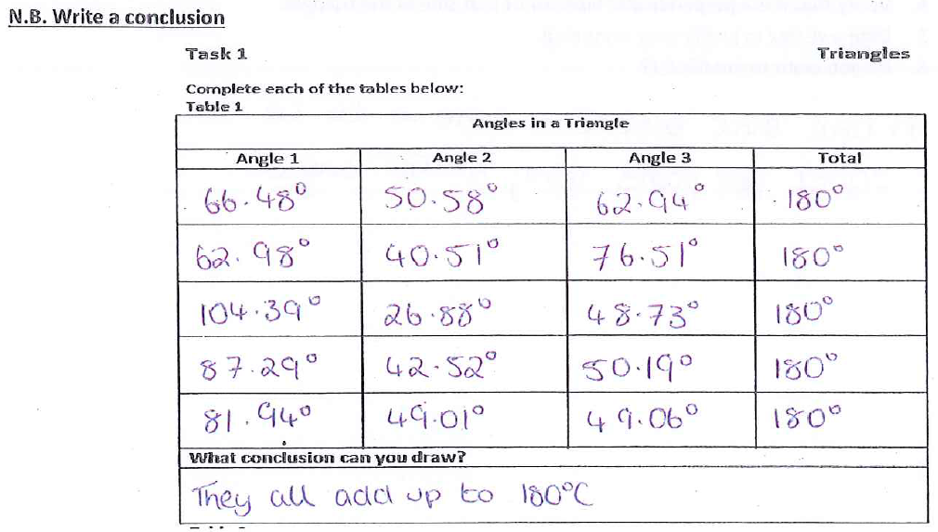
Student work
Answers sometimes lack precision

Slide 15
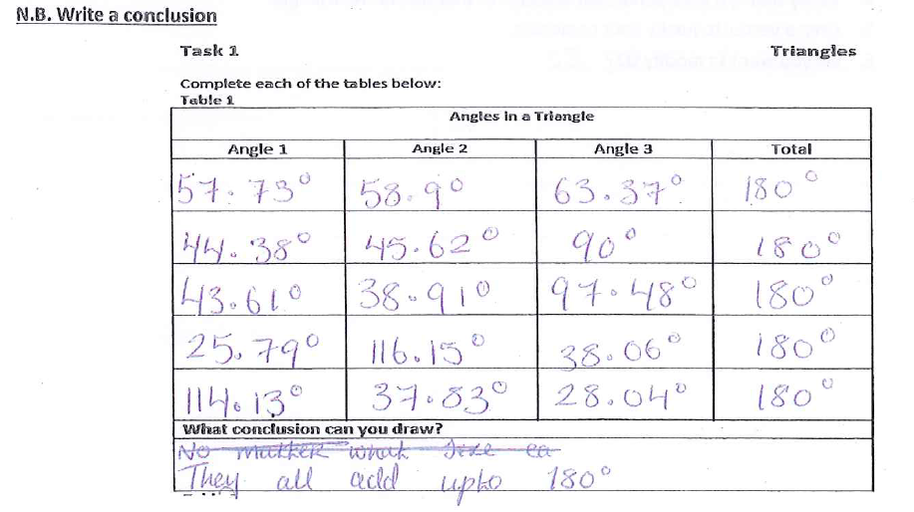
Student work

Slide 16
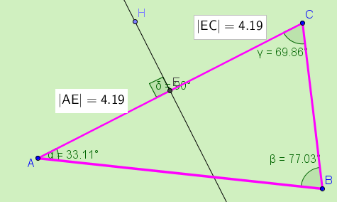
Worksheet + Student work
Task 2 – Perpendicular Bisector
What is meant by the perpendicular bisector of a line?
Find the perpendicular bisector tool in GeoGebra. (Hover over it to see how to use it.)
Construct the perpendicular bisector of one of the sides of the triangle.
Verify that it is a perpendicular bisector of that side of the triangle.
Drag a vertex to justify your reasoning.
Do you want to modify your answer
to Q1?

Slide 17
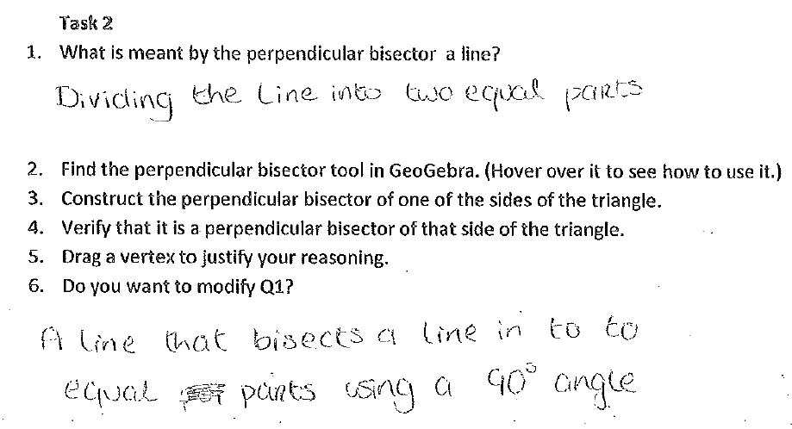
Student Work

Slide 18
Student Work

Slide 19
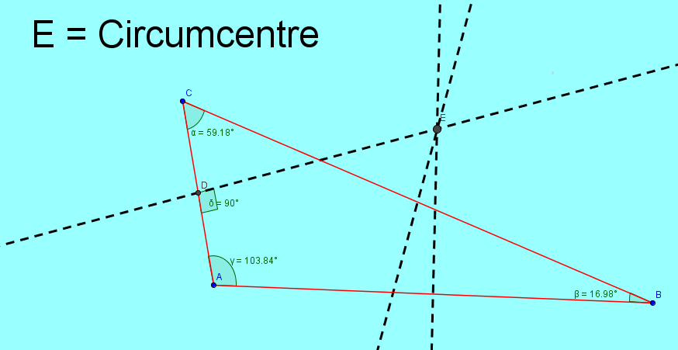
Worksheet + Student work
Task 3 - Circumcentre
Construct the perpendicular bisectors of all the sides of the triangles you have drawn.
Change the colour of the perpendicular bisectors of the sides. ( A different colour to triangle sides)
Drag a vertex.
What do you notice about the perpendicular bisectors of the triangle? N.B. Write down what you notice.
Label the point of intersection of the perpendicular bisectors (ABC tool and Toggle button)
Write down what you understand Circumcentre of a triangle to be.

Slide 20
Student work

Slide 21
Data collected

Slide 22
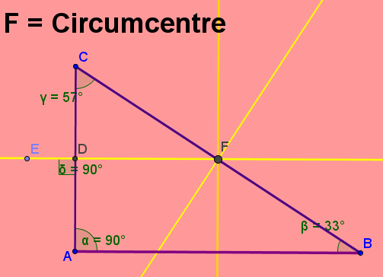
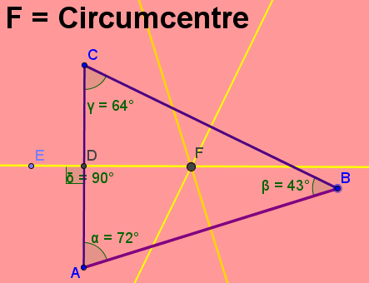
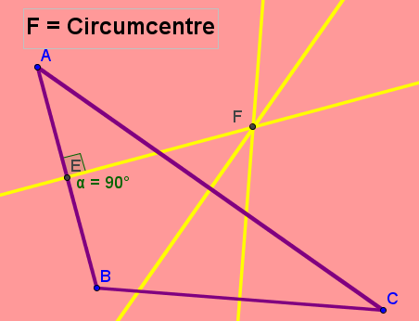
Worksheet + Student work
Task 4
Drag a vertex of the triangle and note the location of the circumcentre. Is it always inside the triangle?
When does the circumcentre move outside the triangle? Write an answer:
When is the circumcentre inside the triangle? Write an answer:
Is the circumcentre ever on one of the sides of the triangle? If so, when? Write an answer: Could you verify your answer?

Slide 23
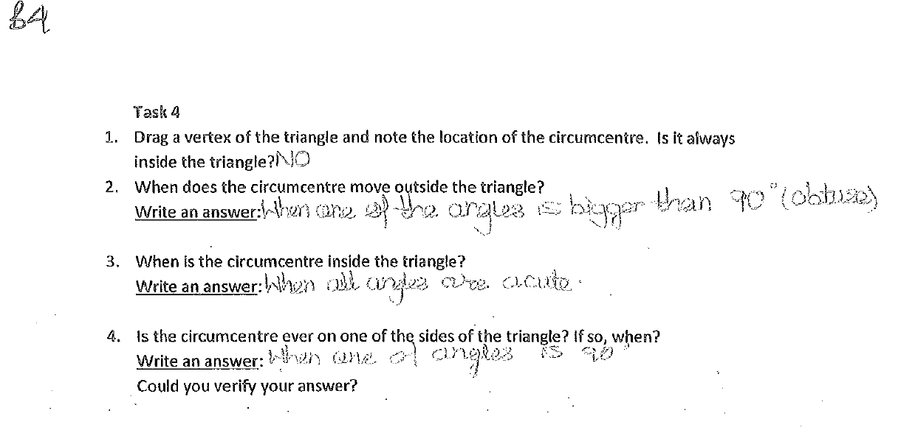
Student work

Slide 24
Student work

Slide 25
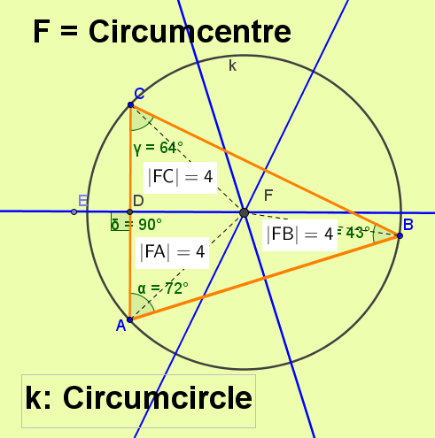
Worksheet + student work
Task 5 – Circumcircle
Investigate the relationship between the circumcentre and the three vertices of the triangle.
What I noticed:
By dragging a vertex, verify what you have noticed.
Using the circumcentre, is there any shape you can draw which passes through the three vertices of the triangle? What is this shape? ___________________
Construct the shape.
Label the shape.
Change the colour of the shape.

Slide 26
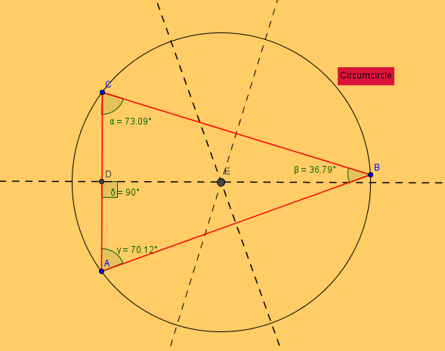
Student Work

Slide 27
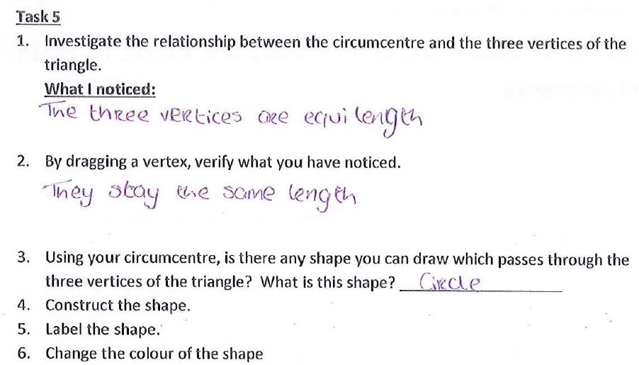
Student work

Slide 28
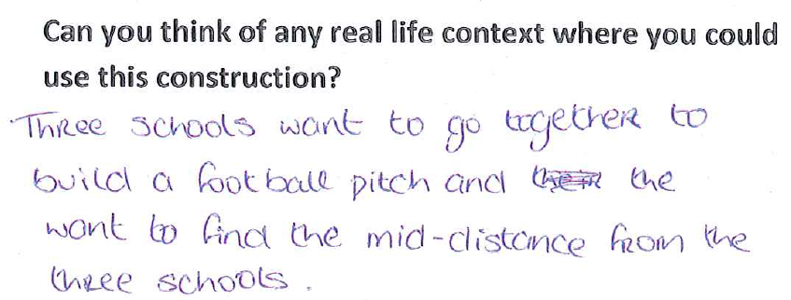
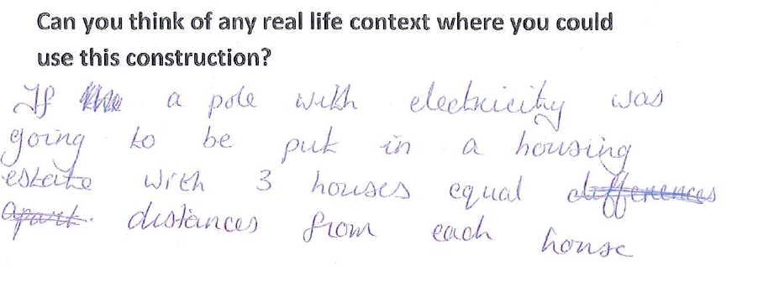
Student work

Slide 29
Task 6
Task 6 - Steps
Write down the steps you would use to construct (i) the circumcentre of a triangle (ii) the circumcircle of a triangle

Slide 30
Manual Construction
http://www.projectmaths.ie/students/cd-strand1and2/

Slide 31
Manual Construction
http://www.projectmaths.ie/students/cd-strand1and2/

Slide 32
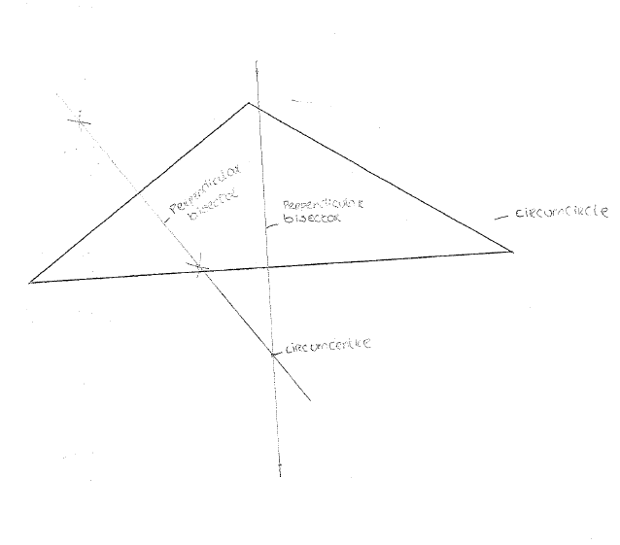
Student Work

Slide 33
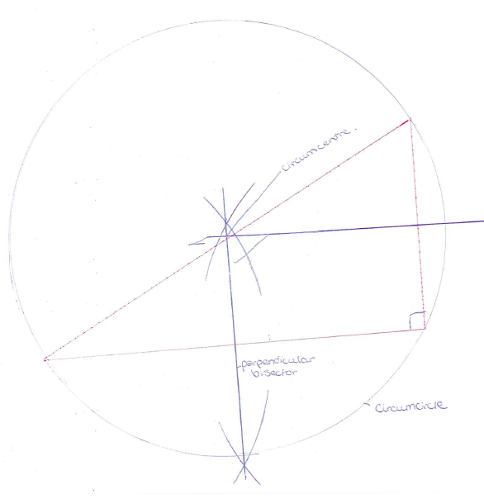
Student Work

Slide 34
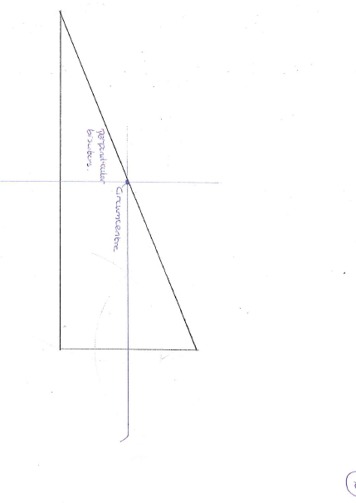
Student Work

Slide 35
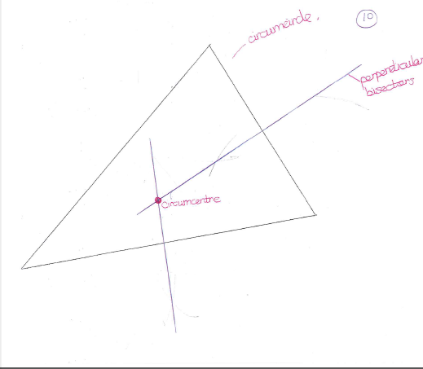
Student Work

Slide 36
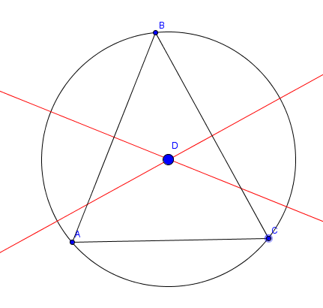
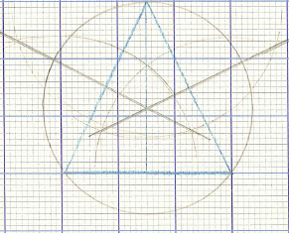
Student Learning

Slide 37
Reflections on the Lesson
Student Learning :
Students were very engaged when using ICT
Students worked independently of the teacher
Students helped each other and exchanged strategies

Slide 38
Student Understanding
Student Understanding : What we learned about the way different students understand the content of this topic:
Some students had to be prompted to “drag” the shapes produced so that they could see which properties were constant and which varied.
Some students were reluctant to write down conclusions.
Students preferred GeoGebra constructions to manual constructions
Students carried out the manual constructions with more understanding having first done the constructions with GeoGebra.
Students use and understanding of mathematical terminology improved.

Slide 39
Effective Student Understanding
What effective understanding of this topic looks like:
Being able to accurately carry out a construction with understanding both using ICT and manually
Being able to accurately construct the circumcircle for acute angled, right angled and obtuse angled triangles
Students being able to connect what they are doing in GeoGebra with the compass and straightedge instruments used for manual constructions.

Slide 40
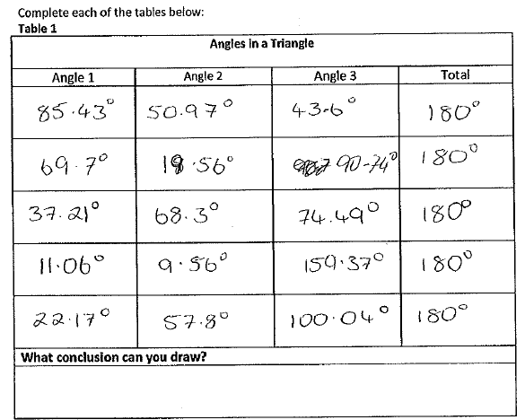
Common Misconceptions/Knowledge Gap
Conclusion Missing

Slide 41
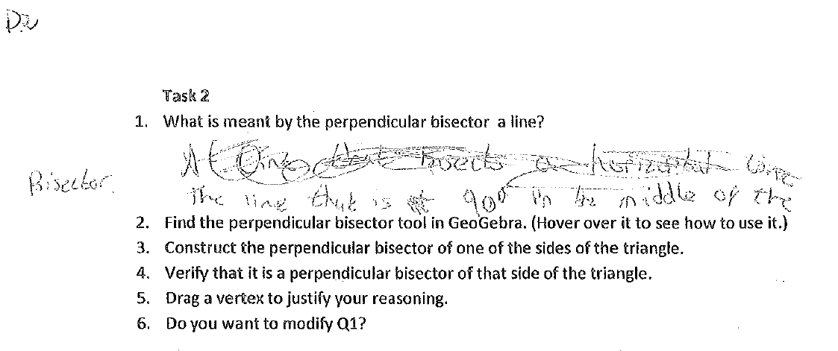
Student work
Difficulty verbalising

Slide 42
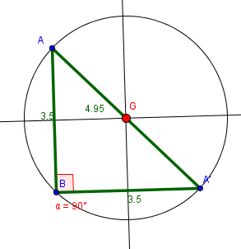
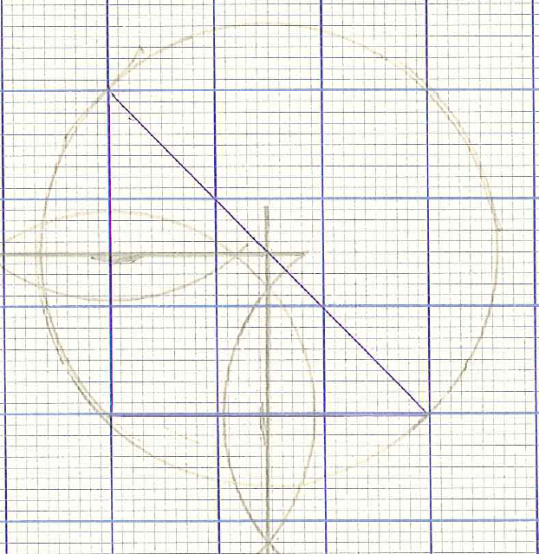
Common Misconceptions
Student should do the construction on blank paper. Using a compass demands skill and in this case the compass has “collapsed” a bit so that the circle is not just one clear curve.
Some students did not label the
circumcentre and circumcircle

Slide 43
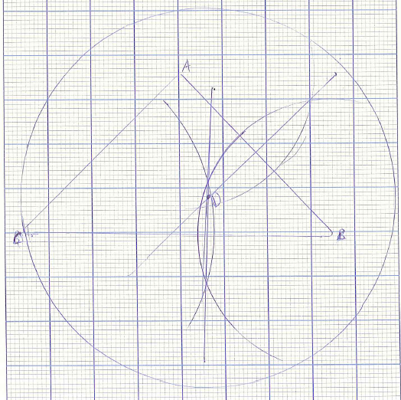
Common Misconceptions
Perpendicular drawn but not a perpendicular bisector.

Slide 44
Common Misconceptions
Poor drawing equipment - Lack of accuracy

Slide 45
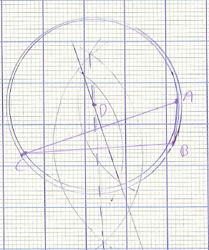
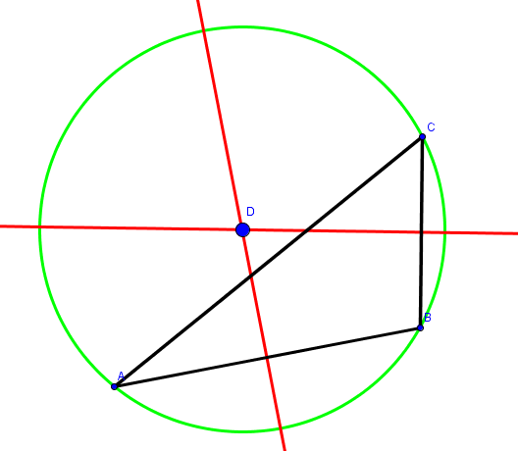
Common Misconceptions
Lack of accuracy

Slide 46
Common Misconceptions/Gaps
Students, being used to static drawings, were not always inclined to investigate variations in their constructions using GeoGebra
Students hid construction lines on GeoGebra sometimes and then were inclined to erase them on their manual drawings
On measuring angles, students often got the reflex angle so they had to consider whether the rotation should be clockwise or anticlockwise.
Students sometimes did not construct the point of intersection of the perpendicular bisectors of the sides of the triangle.
Most students constructed the circumcircle for acute angled triangles unless otherwise directed.

Slide 47
Addressing Misconceptions
Recommendations
Revise JC constructions first using both GeoGebra and manual techniques.
A worksheet with a variety of pre-drawn triangles on the circumcircle to guide students for the manual drawing ( to avoid all acute angled triangles). (Homework: Construct the circumcircle for the remaining type of triangle.)
Good compasses and sharp pencils!
Students need blank sheets for constructions.
Students need to make large drawings to improve accuracy. ( -not too large or compasses are over- extended)
Students should label key features in their construction
Use of GeoGebra for theorems

Slide 48
Summary
The understandings we gained regarding students’ learning constructions as a result of being involved in the research lesson
By using GeoGebra students were able to see what varied and what remained invariant when a particular shape was altered.
When it came to the manual drawing they understood why they were doing it and how it worked.
They enjoyed using ICT

Slide 49
Teaching Strategies
What did I notice about my own teaching?
What was difficult?
Transferring what they learned in GeoGebra to the manual construction e.g. bisecting a line segment/angle.
Accuracy in the manual drawings
Seeing the relationship between the vertices and the circumcentre
Potential difficulty: Keeping students solely focussed on GeoGebra given that they can access other software on the computer

Slide 50
Teaching Strategies
How did I engage and sustain students’ interest and attention during the lesson?
The students had clear tasks of increasing complexity to complete outlined on a worksheet
They were building up to a final task of drawing the circumcircle of acute, obtuse and right angled triangles and could see that all the previous tasks were needed as prior knowledge for this task.

Slide 51
Teaching Strategies
How did I assess what students knew and understood during the lesson?
I dragged the vertices of their GeoGebra constructions to see that they were “indestructible”
I asked students to write down the steps needed and then to carry out the construction of the circumcircle manually, emphasising accuracy.
Students had to be able to construct the circumcircle for acute, right angled and obtuse angled triangles.

Slide 52
Teaching Strategies
How did I put closure to the lesson?
Asking students to download GeoGebra and use the student CD to revise the construction
Students had to repeat the manual construction for whichever triangle they had not constructed in class.

Slide 53
Reflections on Lesson Study Process
Strengths & Weaknesses
As a mathematics team how has Lesson Study impacted on the way we work with other colleagues?
More collaboration on the learning occurring in a classroom
Greater awareness of resources required
Better use of ICT
Personally, how has Lesson Study supported my growth as a teacher?
Realisation that planning cannot be overemphasised
Recommendations as to how Lesson Study could be integrated into a school context.
As a means of self-evaluation
Carried out during “Croke Park” hours

