Slide 1





Maths Counts
Insights into Lesson Study

Slide 2

Loreto Abbey Dalkey
Ann Nolan, Paula O’Shea, Mary Kavanagh
First years (2 Groups)
Applications of HCF and LCM to Problem Solving

Slide 3
Insights into Lesson Study
Introduction: Focus of Lesson
Student Learning : What we learned about students’ understanding based on data collected
Teaching Strategies: What we noticed about our own teaching
Strengths & Weaknesses of adopting the Lesson Study process

Slide 4
Introduction
Applications of HCF and LCM to Problem Solving
Reason for study:
Realised we needed to go further than just the skills of HCF and LCM, because students tend not to apply their prior knowledge and skills to problem solving.
Sarah is creating individual party bags. She has 9 bags of crisps and 18 fun size bars. If she wants each party bag to be identical, with no food left over, what is the greatest number of party bags Sarah can create?

Slide 5
Introduction
Prior Knowledge:
Natural Numbers
Factors and Multiples
Prime Numbers
Skills of HCF & LCM

Slide 6
Introduction
How we planned the lesson:
Sourced questions
Discussed the methodology to be used
Discussed how we would observe the lesson
Resources used:
Colour coded worksheets and PowerPoint slides
Whiteboard
Feedback Sheet

Slide 7
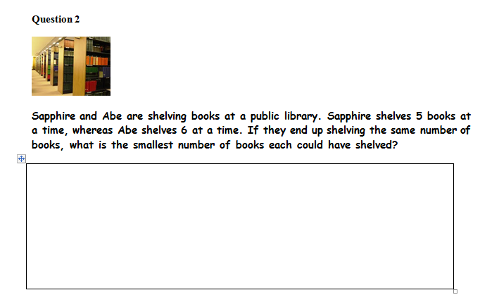
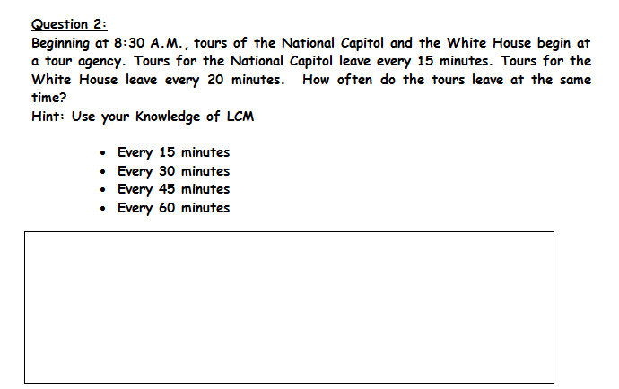
Introduction
Green sheet : No Hints
Pink sheet: Hints

Slide 8
Introduction
Learning Outcomes
Students should be able to:
apply their knowledge of HCF and LCM to context based questions
develop their skills of using prior knowledge of other topics to solve problems

Slide 9
Introduction
Why did we choose to focus on this mathematical area?
Students had just completed their study of the skills of finding HCF and LCM.
It was an appropriate topic to demonstrate to students how to apply their prior knowledge to solve problems.

Slide 10
Introduction
Enduring understandings
In the future students would be encouraged to approach questions using their prior knowledge.

Slide 11
Reflections on the Lesson
Student Learning : What we learned about students’ understanding based on data collected
Teaching Strategies: What we noticed about our own teaching

Slide 12
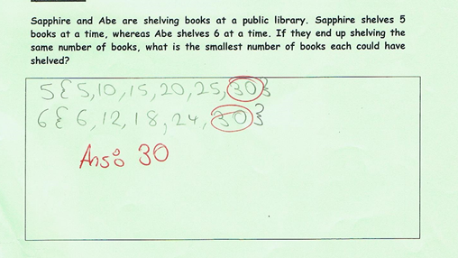
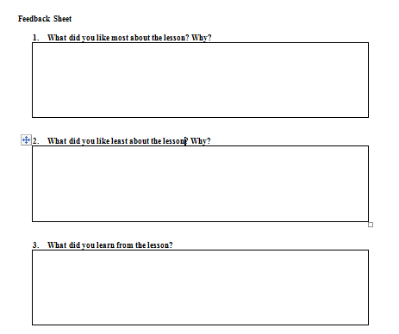
Student Learning
Feedback sheet from students
Data Collected from the Lesson:
Academic e.g. samples of students’ work
Motivation
Social Behaviour

Slide 13
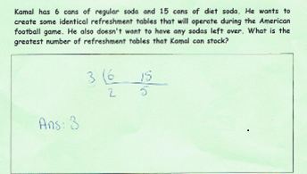
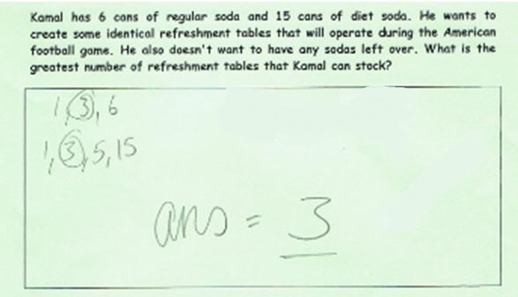
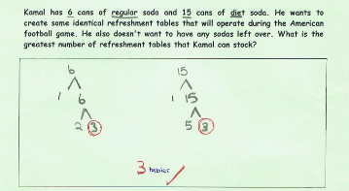
Reflections on the Lesson
Student Learning : We used three methods:
Division Method
List Method
Factor tree method

Slide 14



Reflections on the Lesson
Student Learning :
Confusion between HCF and LCM
Difficulty interpreting the language in the questions
Use of incorrect diagrams
Not all students dislike context based questions
least
greatest

Slide 15

Reflections on the Lesson
Teaching Strategies: What we noticed about our own teaching.
We need to:
Relate the problems to familiar contexts
X
X
X
X

Slide 16

Reflections on the Lesson
Teaching Strategies: What we noticed about our own teaching.
We need to:
Make connections when teaching topics e.g. Venn Diagrams to represent HCF problems
As a maths department follow common methodologies and keep records of methodologies

Slide 17
Student Understanding
What we learned about the way different students understand the content of this topic?
Students have difficulty in their application of HCF and LCM.
We need to use context-based questions to introduce the topic.
Connections need to be made with other topics.
Scaffolding leads to a higher standard of answers.

Slide 18
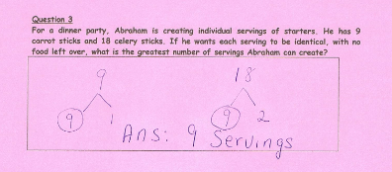
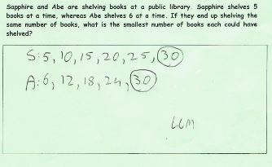
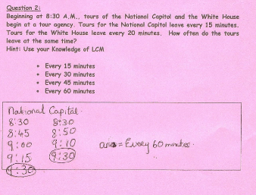
Effective Student Understanding
What effective understanding of this topic looks like:

Slide 19
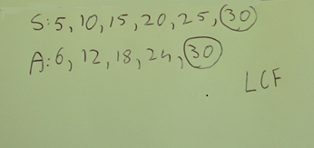
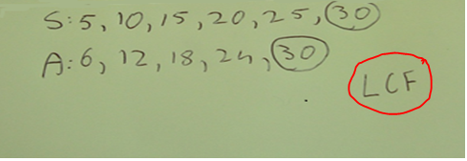
Common Misconceptions
Having the correct method, but mixing up HCF and LCM

Slide 20
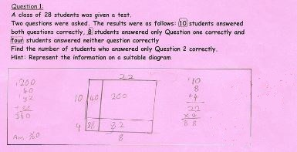
Common Misconceptions
Timing of teaching of topics involving different types of diagrams important, so students do not confuse them.

Slide 21
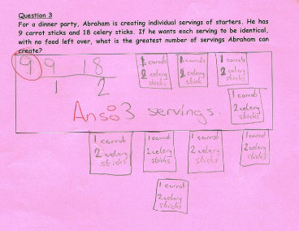
Student Learning
Has the correct application, but misunderstood the word servings for the number of items in a serving

Slide 22


Student Learning
Did not recognise the hidden hints in questions:

Slide 23
Addressing Misconceptions
Recommendations:
Change wording of questions to relate to students’ real-life circumstances, e.g. soda, student names.
Greater emphasis on words like greatest, most, least, smallest when teaching this topic.
Only use two methods to teach the skills of HCF and LCM.
Common methodologies in the maths department.

Slide 24
Summary
The understandings we gained as a result of being involved in the research lesson:
Students need to be encouraged to read the question a few times before answering.
We as teachers need to be careful when sourcing questions to adapt to an Irish context.
Some students enjoy challenges.

Slide 25

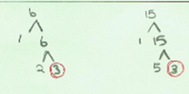
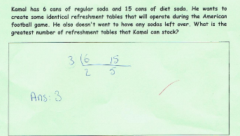
Summary
What did we learn about this content to ensure we had a strong conceptual understanding of this topic?
Connections between this topic and Sets
Availability of different methodologies.
List method
Division method
Factor Tree
method

Slide 26
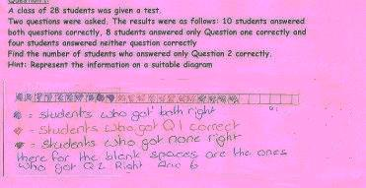
Teaching Strategies
What did I notice about my own teaching?
What was difficult?
Students already had the skill of HCF and LCM hence not introducing a new topic, but not all answers were as expected.
The correct answer can be arrived at in more than one way.

Slide 27
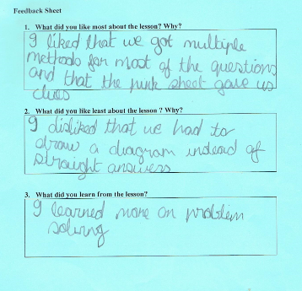
Teaching Strategies
Was it difficult to facilitate and sustain communication and collaboration during the lesson?
Students liked the instant feedback.
Some students did finish ahead of their peers.
Students liked the opportunity to give their comments.

Slide 28
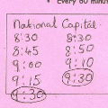
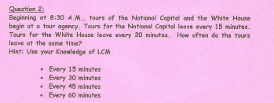
Teaching Strategies
Was it difficult to ask questions to provoke students’ deep thinking?
Why the LCM? Because the question asked for smallest, etc.
What does the 9.30 mean in the context of this question?
What did the question ask?

Slide 29


Teaching Strategies
How did I engage and sustain students’ interest and attention during the lesson?
Used ICT to capture the pictures
Coloured paper
Mixture of questions followed by discussion, followed by more questions
Students received instant feedback

Slide 30
Teaching Strategies
How did I assess what students knew and understood during the lesson?
Teacher observation during lesson
Class discussion
Collected work at the end of class
Feedback sheet

Slide 31
Teaching Strategies
How did I put closure to the lesson?
Focused on the connection between HCF for example and words like highest or greatest. (Class discussion)
Emphasised to students that they should consider: “What prior knowledge do I have?”

Slide 32
Teaching Strategies
What understandings have I developed regarding teaching strategies for this topic as a result of my involvement in Lesson Study?
Only teach two methods
What changes would I make in the future, based on what I have learned in my teaching, to address students’ misconceptions?
Adapt the language of the questions

Slide 33
Reflections on Lesson Study Process
Strengths & Weaknesses
As a mathematics team how has Lesson Study impacted on the way we work with other colleagues?
The advantages of being able to see another teacher’s approach.
The teacher who was observing could focus on the learning and the students’ reactions.
Shared ideas and methodologies.

Slide 34
Reflections on Lesson Study Process
Strengths & Weaknesses
Personally, how has Lesson Study supported my growth as a teacher?
More aware of the need to reflect after class
The need to be constantly making connections between topics
Open to discuss methodologies with colleagues
The need for common approaches in maths department

Slide 35
Reflections on Lesson Study Process
Strengths & Weaknesses
Recommendations as to how Lesson Study could be integrated into a school context.
More time for maths department meetings and these meetings to be devoted to discussing best practice for teaching and learning.
The need for teachers to share resources.

