Slide 1





Maths Counts
Insights into Lesson Study

Slide 2

Wexford Vocational College
Team members:
Annabel Devereux and Sarah Gallagher
Class: First year
Title: “Use of the array model in first year”

Slide 3
Insights into Lesson Study
Introduction: Focus of Lesson
Student Learning : What we learned about students’ understanding based on data collected
Teaching Strategies: What we noticed about our own teaching
Strengths & Weaknesses of adopting the Lesson Study process

Slide 4
Introduction
Topic investigated:
“Use of the array model to make sense of the distributive law in first year”
How we planned the lesson
Resources used:
  Board work
  Student “show me” boards
  Resources from Project Maths workshops on the array model
  Calculators for checking answers
  A PowerPoint to show images of the array model

Slide 5

Prior Knowledge
Place Value
What is multiplication?
Factors
Product
Variables
Terms (in algebra)
Indices
Integers
Combining Terms
Representing multiplication
Simplify the following if possible:
$6 – 7$
$3 – 2 – 4 – 1$
$3x + 2x$
$3x+2$
$x2 + 3x+5x +11$
$2x2+4x + x2+x$
$3x2 – 2x + 4 + x2 – x – 2$
$2x2 – 2x – 1 – 3x2 – 2x – 2$
$x2+2x+1 – 3x2 – x$
$x2 – x + 3 – 2x2+2x + x$

Slide 6


Can you remember learning this?
$$3 × 4 = ?$$
4
3
12 cars

Slide 7


Can you remember learning this?
$$4 × 3 = ?$$
4
3
$$4 × 3 =3×4$$
12 cars

Slide 8
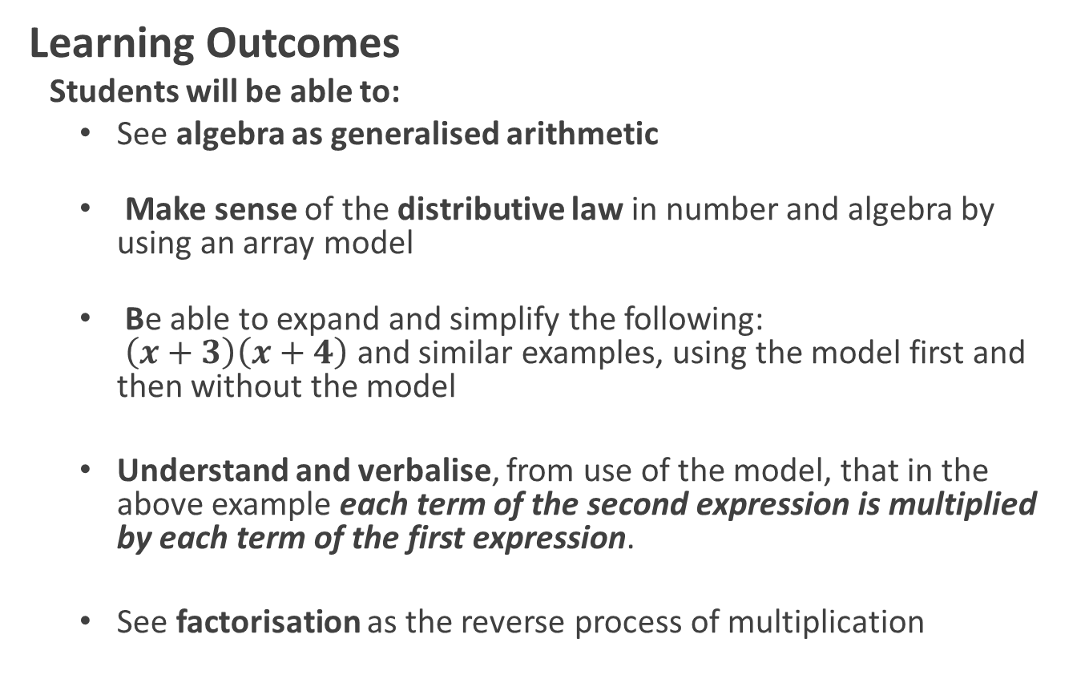
Introduction
Learning Outcomes
Students will be able to:
  See algebra as generalised arithmetic
  Make sense of the distributive law in number and algebra by using an array model
  Be able to expand and simplify the following:
  $\left(x+3\right)\left(x+4\right)$ and similar examples, using the model first and then without the model
  Understand and verbalise, from use of the model, that in the above example each term of the second expression is multiplied by each term of the first expression.
  See factorisation as the reverse process of multiplication

Slide 9

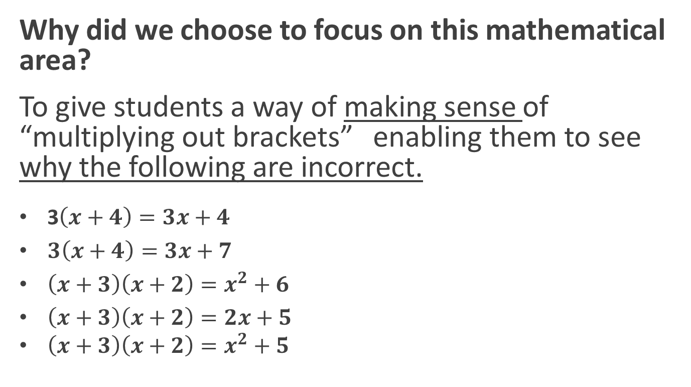
Introduction
Why did we choose to focus on this mathematical area?
To give students a way of making sense of “multiplying out brackets” enabling them to see why the following are incorrect.
3$\left(x+4\right)=3x+4$
$3\left(x+4\right)=3x+7$
$\left(x+3\right)\left(x+2\right)=x^{2}+6$
$\left(x+3\right)\left(x+2\right)=2x+5$
$\left(x+3\right)\left(x+2\right)=x^{2}+5$
We had tried teaching this using rules – it didn’t work!

Slide 10







Model $4 ×27$using the area of a rectangle
Factors
$27$
$4$
Simplify the calculation of area
$20$
$+7$
$4$
4(20)
4(7)
Product
$$4\left(27\right)=4\left(20+7\right)=4\left(20\right)+4\left(7\right)=80+28=108$$
Give me two factors of 108?

Slide 11




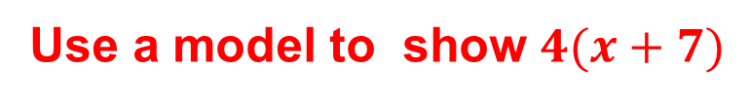


Use a model to show $4(x+7)$
$$x+7$$
$4$
$x$
$+7$
$4$
$$4(x)$$
$4(7)$
Factors
Product
$$4\left(x+7\right)=4\left(x\right)+4\left(7\right)=4x+28$$
??
Can you verify your answer?
What are the factors of $4x+28$?

Slide 12

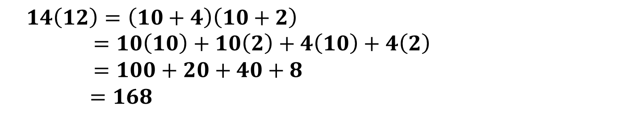
Use the model to calculate $14 × 12$
10
+2
100
20
40
+ 8
168
10
10(10)
10(2)
+4
4(10)
4(2)
Factors
$$14\left(12\right)=\left(10+4\right)\left(10+2\right) =10\left(10\right)+10\left(2\right)+4\left(10\right)+4\left(2\right) =100+20+40+8$$
$=168$
Product

Slide 13

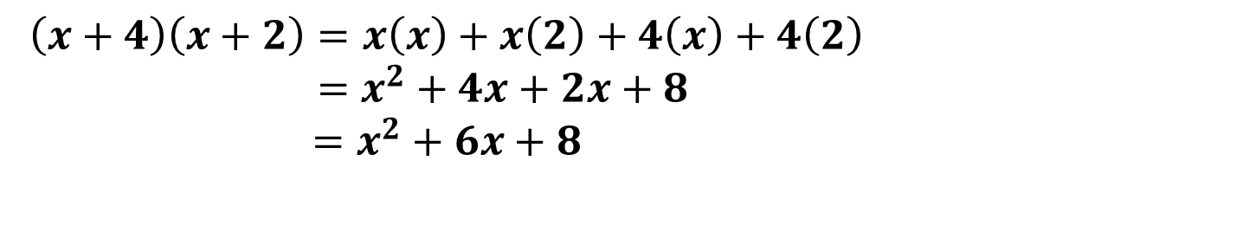
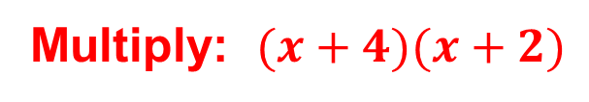







Multiply: $(x+4)(x+2)$
$x$
$+2$
$x$
$$x^{2}$$
$+2x$
$+4$
$$+4x$$
$8$
Factors
$$\left(x+4\right)\left(x+2\right)=x\left(x\right)+x\left(2\right)+4\left(x\right)+4\left(2\right)$$
$=x^{2}+4x+2x+8$
$=x^{2}+6x+8$
Product
Can you verify your answer?

Slide 14
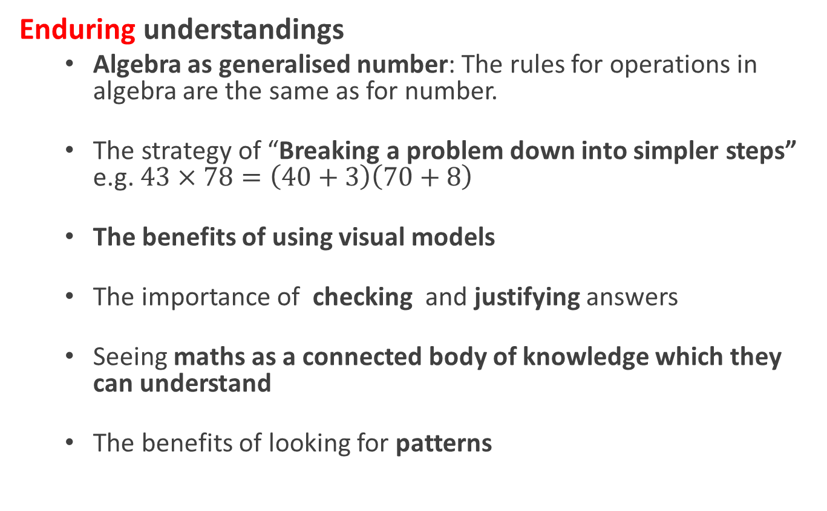
Introduction
Enduring understandings
  Algebra as generalised number: The rules for operations in algebra are the same as for number.
  The strategy of “Breaking a problem down into simpler steps”
  e.g. $43×78=\left(40+3\right)\left(70+8\right)$
  The benefits of using visual models
  The importance of checking and justifying answers
  Seeing maths as a connected body of knowledge which they can understand
  The benefits of looking for patterns

Slide 15
Reflections on the Lesson
Student Learning : What we learned about students’ understanding based on data collected
Teaching Strategies: What we noticed about our own teaching

Slide 16
Student Learning
Data Collected from the Lesson:
  Academic, e.g. samples of students’ work
  Motivation
  Social Behaviour

Slide 17
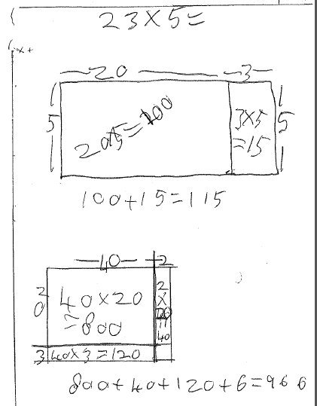



Factors
Product
$$23×5=\left(20+3\right)5=\left(20\right)5+3\left(5\right)=100+15=115$$
Question not written down
$$42×23$$
$$42×23=\left(40+2\right)\left(20+3\right) =40\left(20)+40(3\right)+2\left(20\right)+2\left(3\right)$$
$$=800+40+120+6=966$$

Slide 18
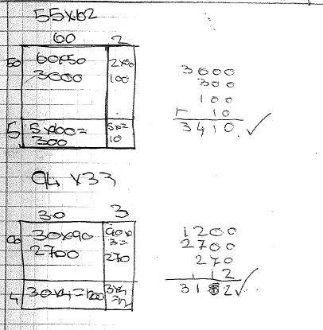




$$55$$
$$55×62$$
$$94×33$$
$$55$$
Computation error: Student not checking work

Slide 19
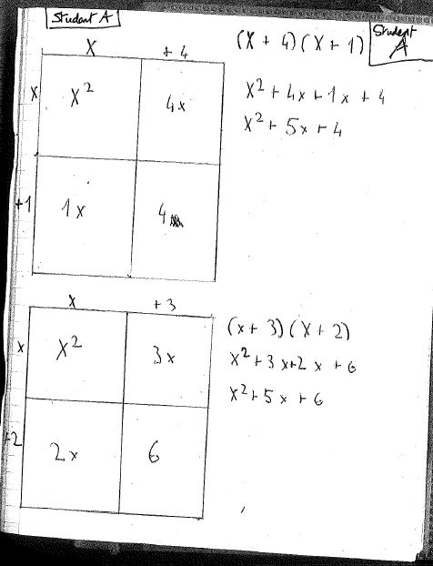


First row:
$$What are the factors of$$
${ x}^{2}$+4x?
Second row:
$$What are the factors of$$
$$x+4?$$
First column:
$$What are the factors of$$
${ x}^{2}+1x$?
Second column:
$$What are the factors of$$
$4x+4$?
Checking answers?

Slide 20
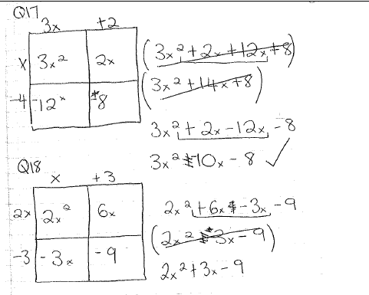
Student initially ignores (-) sign
but then corrects this.
Student is not writing down the
question
Not checking answers

Slide 21
Motivation and Social Behaviour
Students discussed the activity with each other in their groups – “Why did you do that?”, “What did you get for that?” etc.
Students tended to ask questions of each other before asking the teacher when working in groups.
All students were engaged with the activities.
Students were encouraged by the fact that they could achieve.
With encouragement, students used correct terminology.
Students began to find it a bit tedious to have to draw the model every time: opportune time to look for patterns!

Slide 22
Student Understanding
What we learned about the way different students understand the content of this topic:
  The visual array model, linked to area, helped students to make sense of what they had previously seen as a series of steps
  Confidence building was required throughout the lesson.
  Making sense of the skill and achieving success helped to build that confidence.
  Working in groups helped students. The group took on the responsibility for the learning. They could discuss, check each other’s work and support each other.

Slide 23
Student Understanding
What we learned about the way different students understand the content of this topic:
  Making the link between number and algebra was the key to demystifying the algebra.
  Using a strategy to check their work would have enabled students to be more independent but many did not spend the time on this.
  Students began to use the model in a very mechanical way if not constantly reminded to use mathematical symbols and equations.
  Some students needed to write dimensions on all parts of the model.

Slide 24
Reflections on the Lesson
Teaching Strategies: What we noticed about our own teaching
  We changed our methodology: We now teach the topic of multiplying binomial expressions by beginning with a model.
  We encouraged students to rely on us less than usual and to use the group, as well as “checking strategies” to see if they were right.
  We used questioning and linked to prior knowledge to help students construct their own learning and in some cases linked to future work as in asking “what are the factors of …”
  We spent less time showing students than we would have with rules only, as they could use the model very quickly.
  The use of I.T. added variety and appealed to students

Slide 25
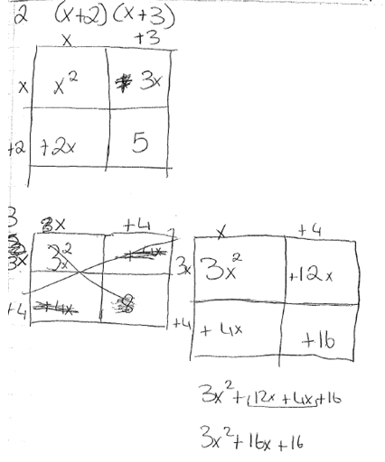
Common Misconceptions
Misconceptions/ Knowledge Gap

Slide 26
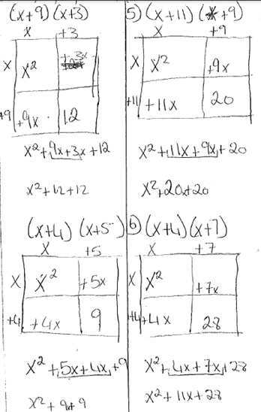
Common Misconceptions

Slide 27
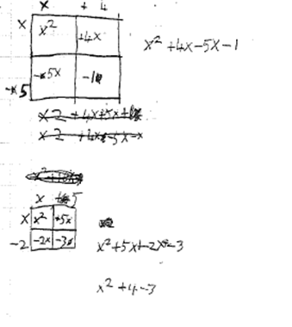
Common Misconceptions

Slide 28
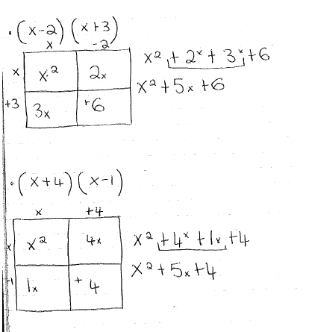
Common Misconceptions

Slide 29
Addressing Misconceptions
Recommendations:
  Check prior knowledge before use of the array model
  Tell students to always write down the question in order that they will link this type of question to the array model so they will know when to use it.
  Tell students who have difficulty, to write in the dimensions on the sides of all the rectangles which make up the model.
  Possibly confine questions to natural numbers until students are comfortable with the model and can do questions without it.
  Ask students to write down what each row of the array model achieves in mathematical language

Slide 30
Teaching Strategies
What did I notice about my own teaching? What was difficult?
Students were reluctant to use the model for numbers initially given that they had calculators. Hence we moved quite quickly to algebra.
It was difficult to get students to write down formally what they were doing through the use of the model, given that they had the answer from the model.
Some students had to be reminded to relate the model to the question and not just to mechanically fill in boxes.
Some students did not willingly carry out checks and justify their answers.

Slide 31
Teaching Strategies
How did I engage and sustain students’ interest and attention during the lesson?
  Students worked in small groups
  Students used peer assessment
  Students could work independently of the teacher
  Students were encouraged to ask questions
  Using a combination of the array model, I.T. and board work added interest to the lesson
  Students liked using “show-me” boards and they facilitated assessment

Slide 32
Teaching Strategies
How did I assess what students knew and understood during the lesson?
    Allowing students to work in groups and checking if they were completing the given assignments
    Asking students at various stages to answer questions on their show me boards and to show those answers
    Listening to students’ conversations about the assignments
    Asking questions which required students to justify their answers.
    Asking students to make up their own questions of a similar type and justifying the answers to those questions

Slide 33
Teaching Strategies
How did I put closure to the lesson?
  Students summarised briefly in their copies what they had learned to do in the lesson.
  Homework was given based on the array model
  Students were asked to verify their answers when doing the homework questions using substitution.

Slide 34
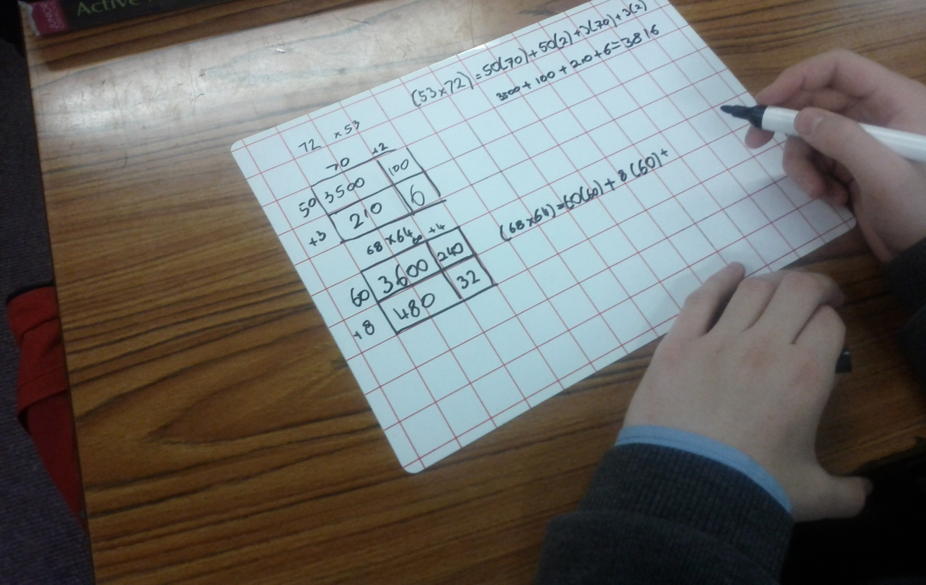
Array model for multiplying double digit numbers;
showing multiplication steps

Slide 35
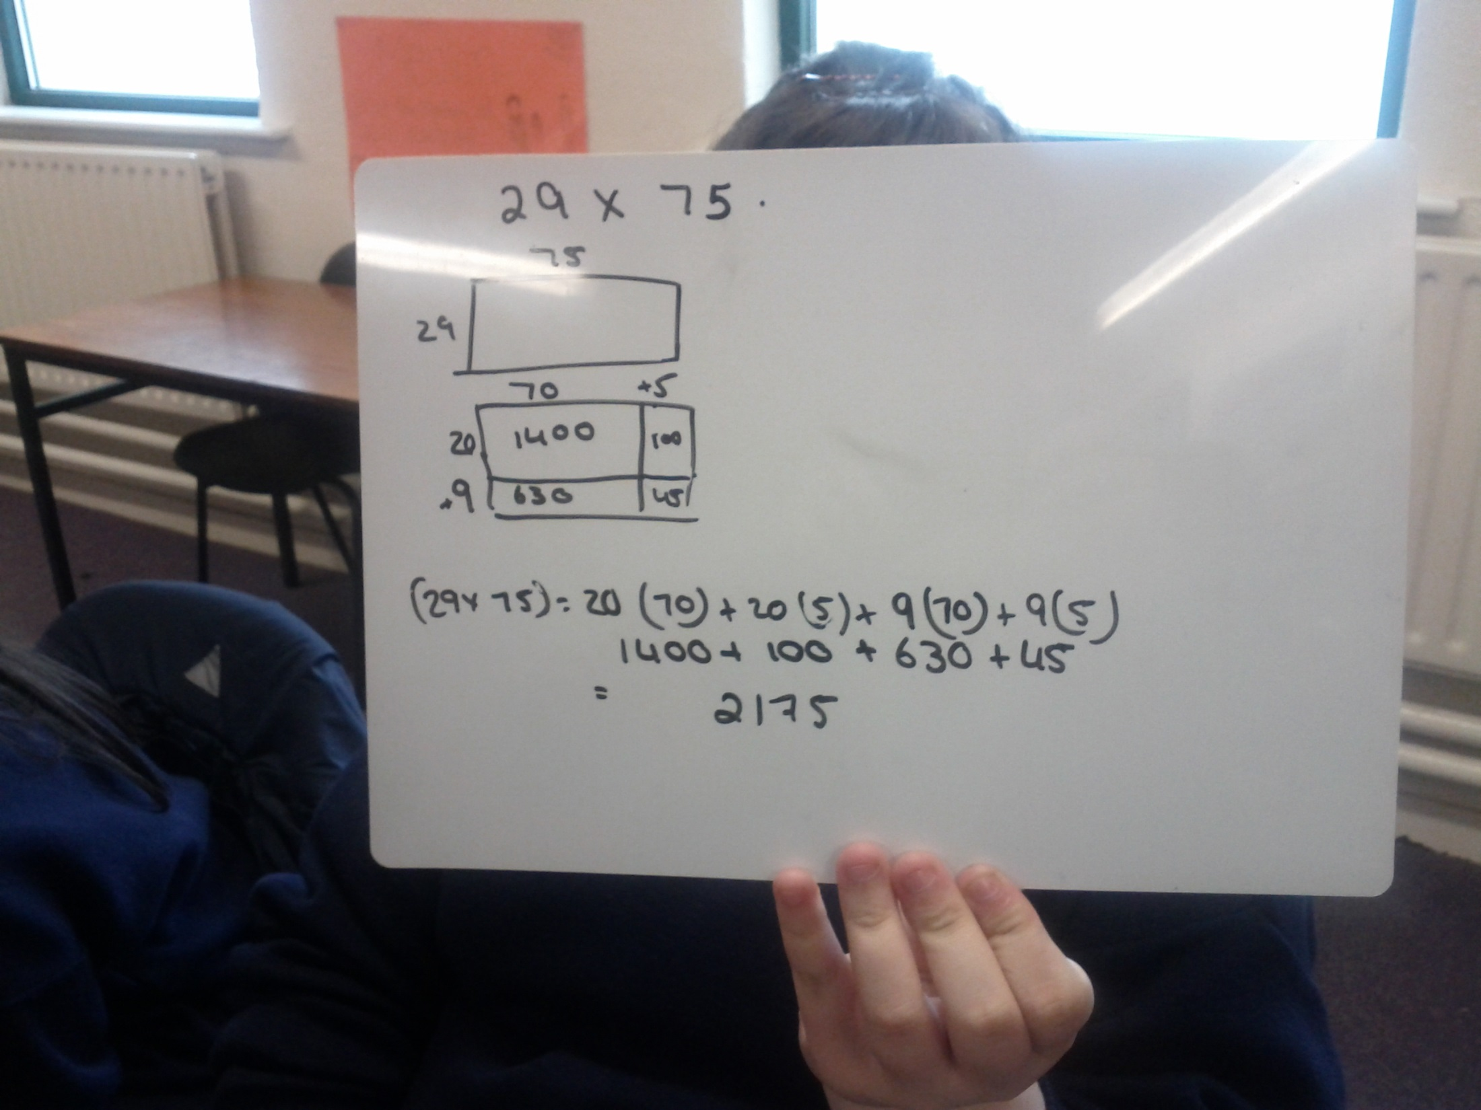
Using array model to find the product of two double-digit numbers

Slide 36
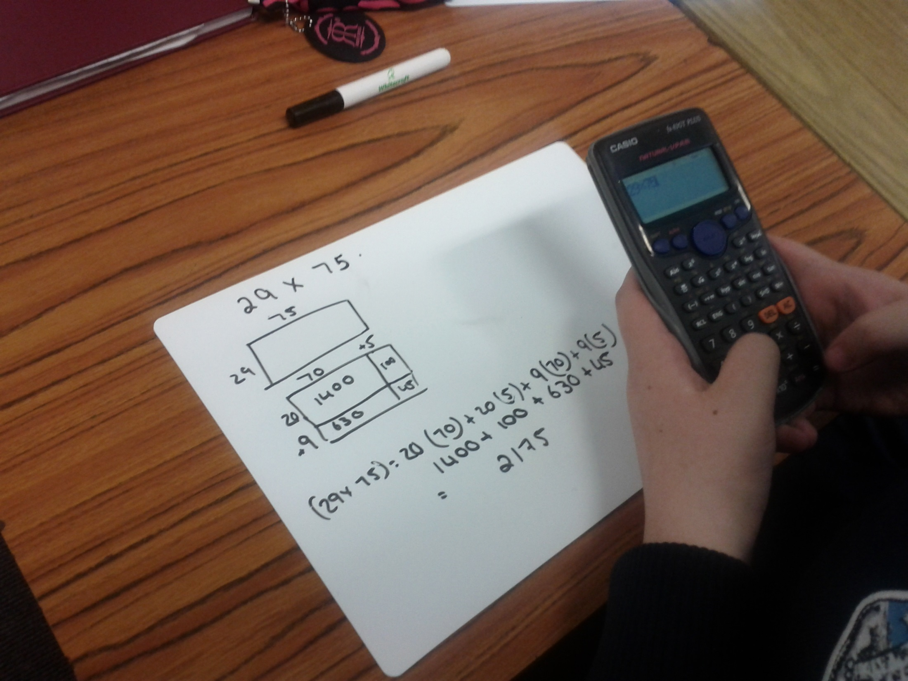
Checking the answer with a calculator

Slide 37
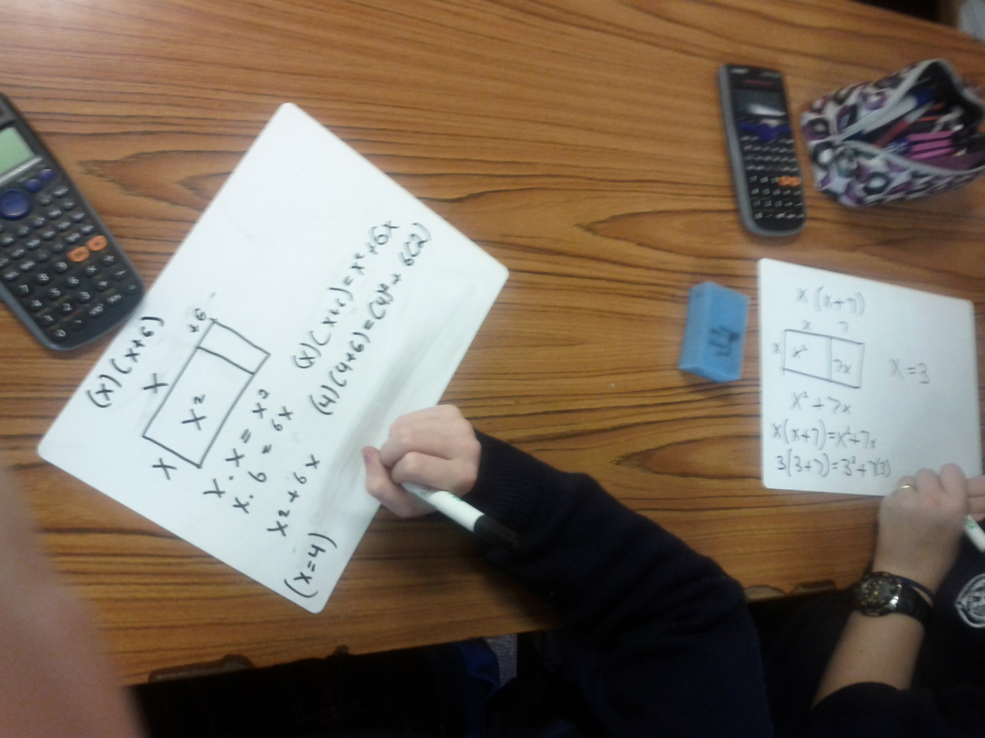

Slide 38
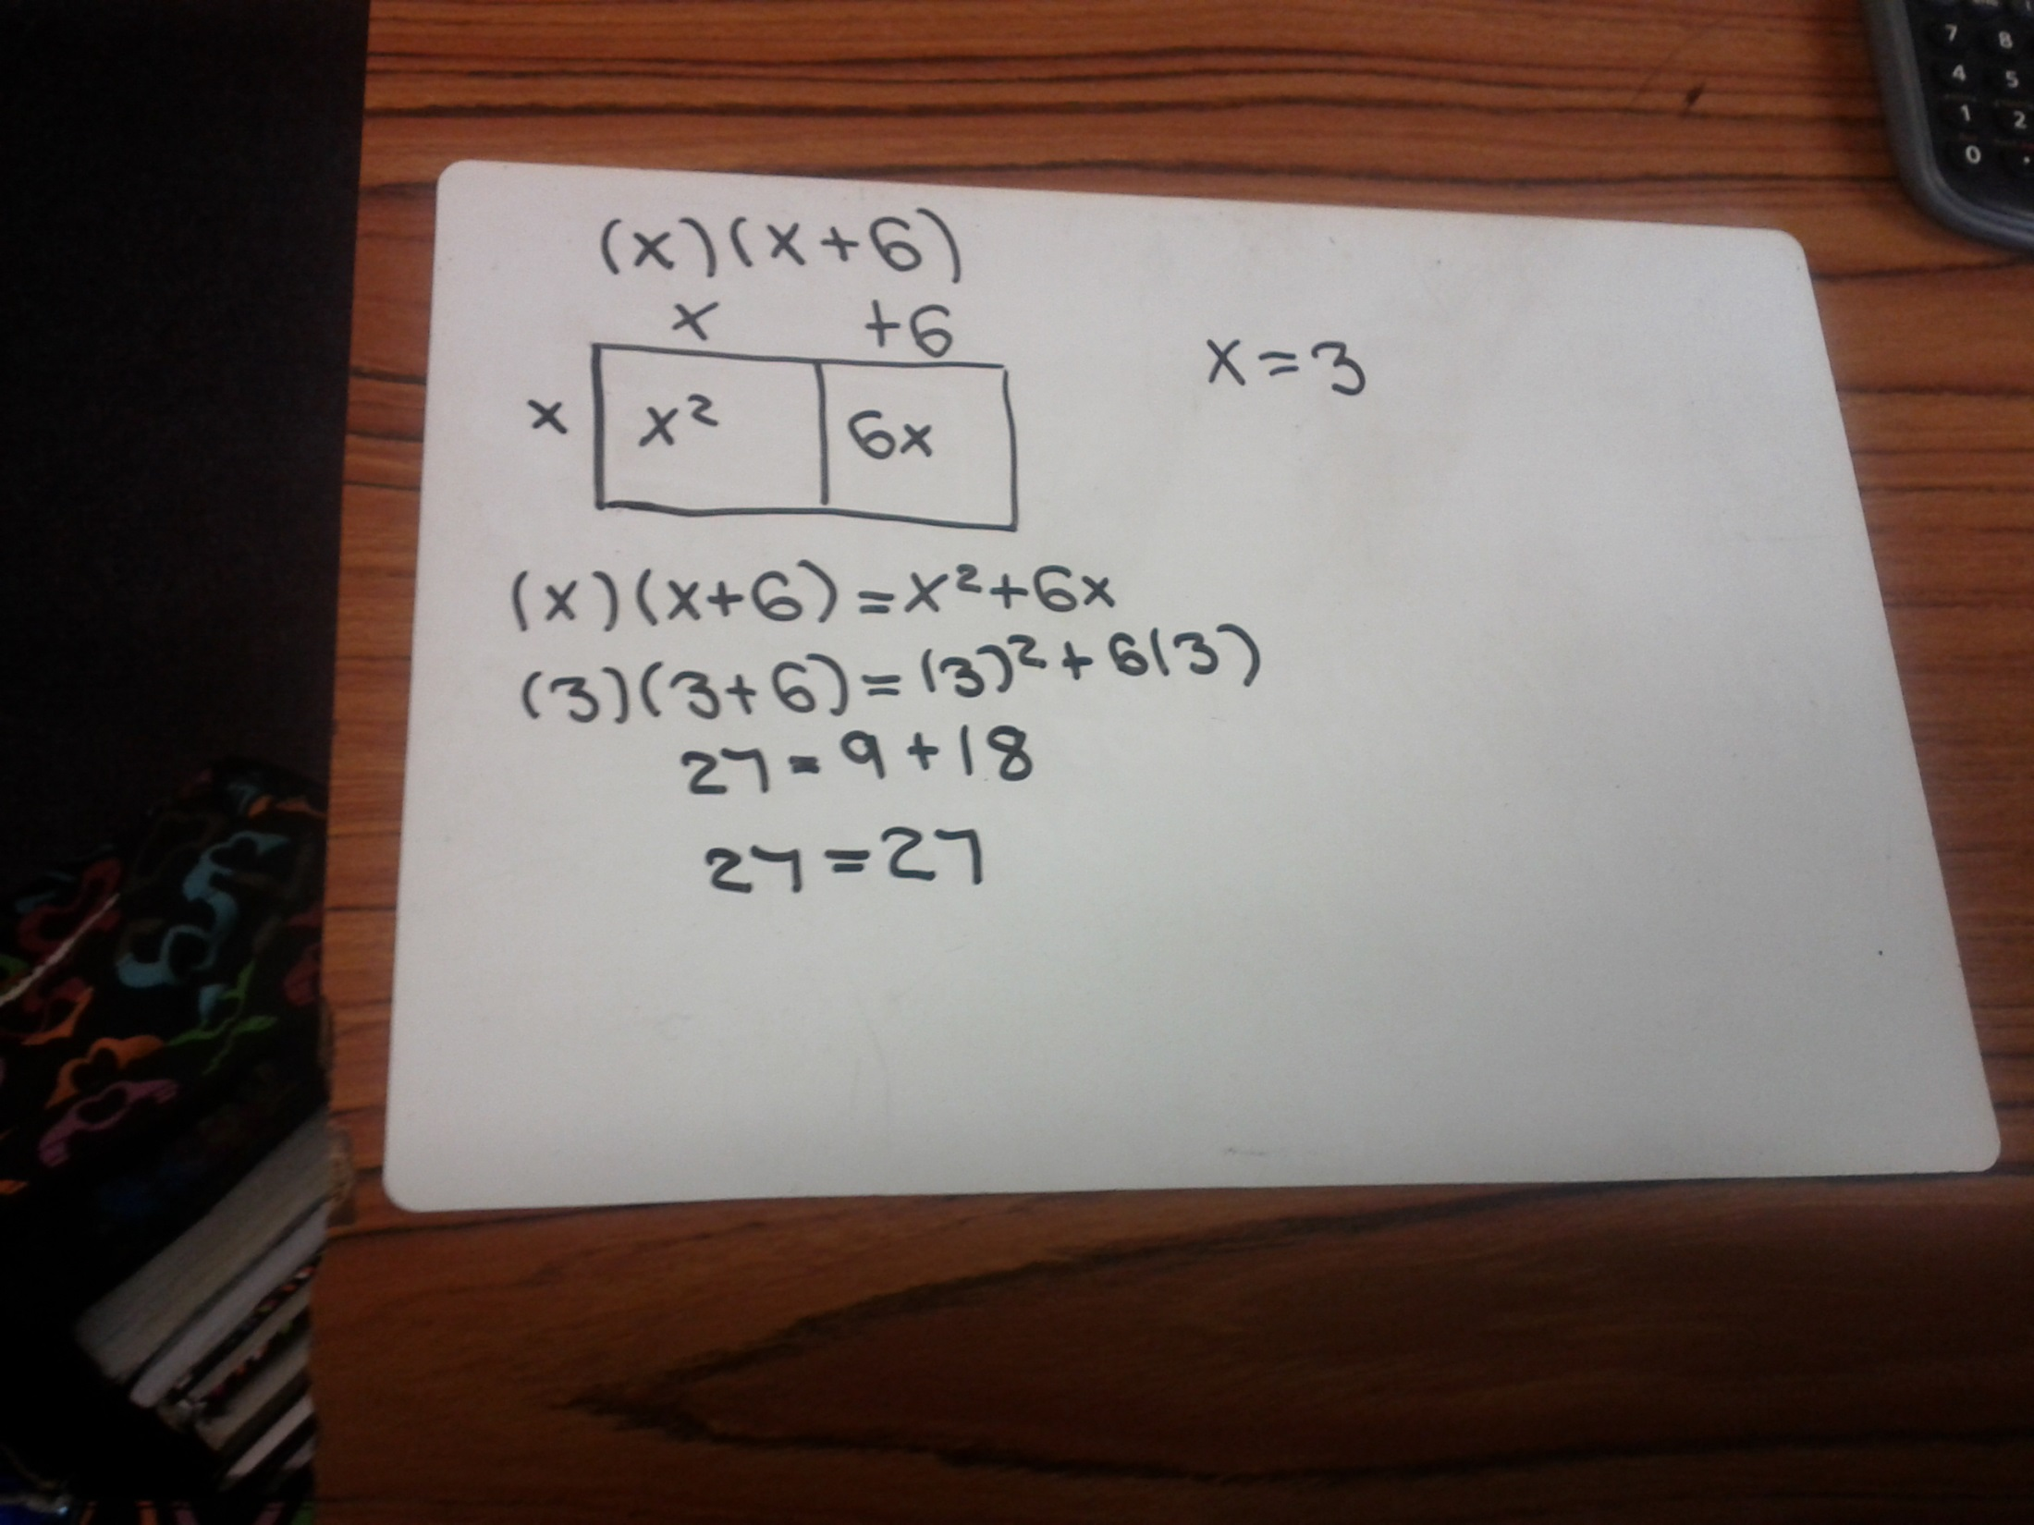
Moving onto variables and checking the answer

Slide 39
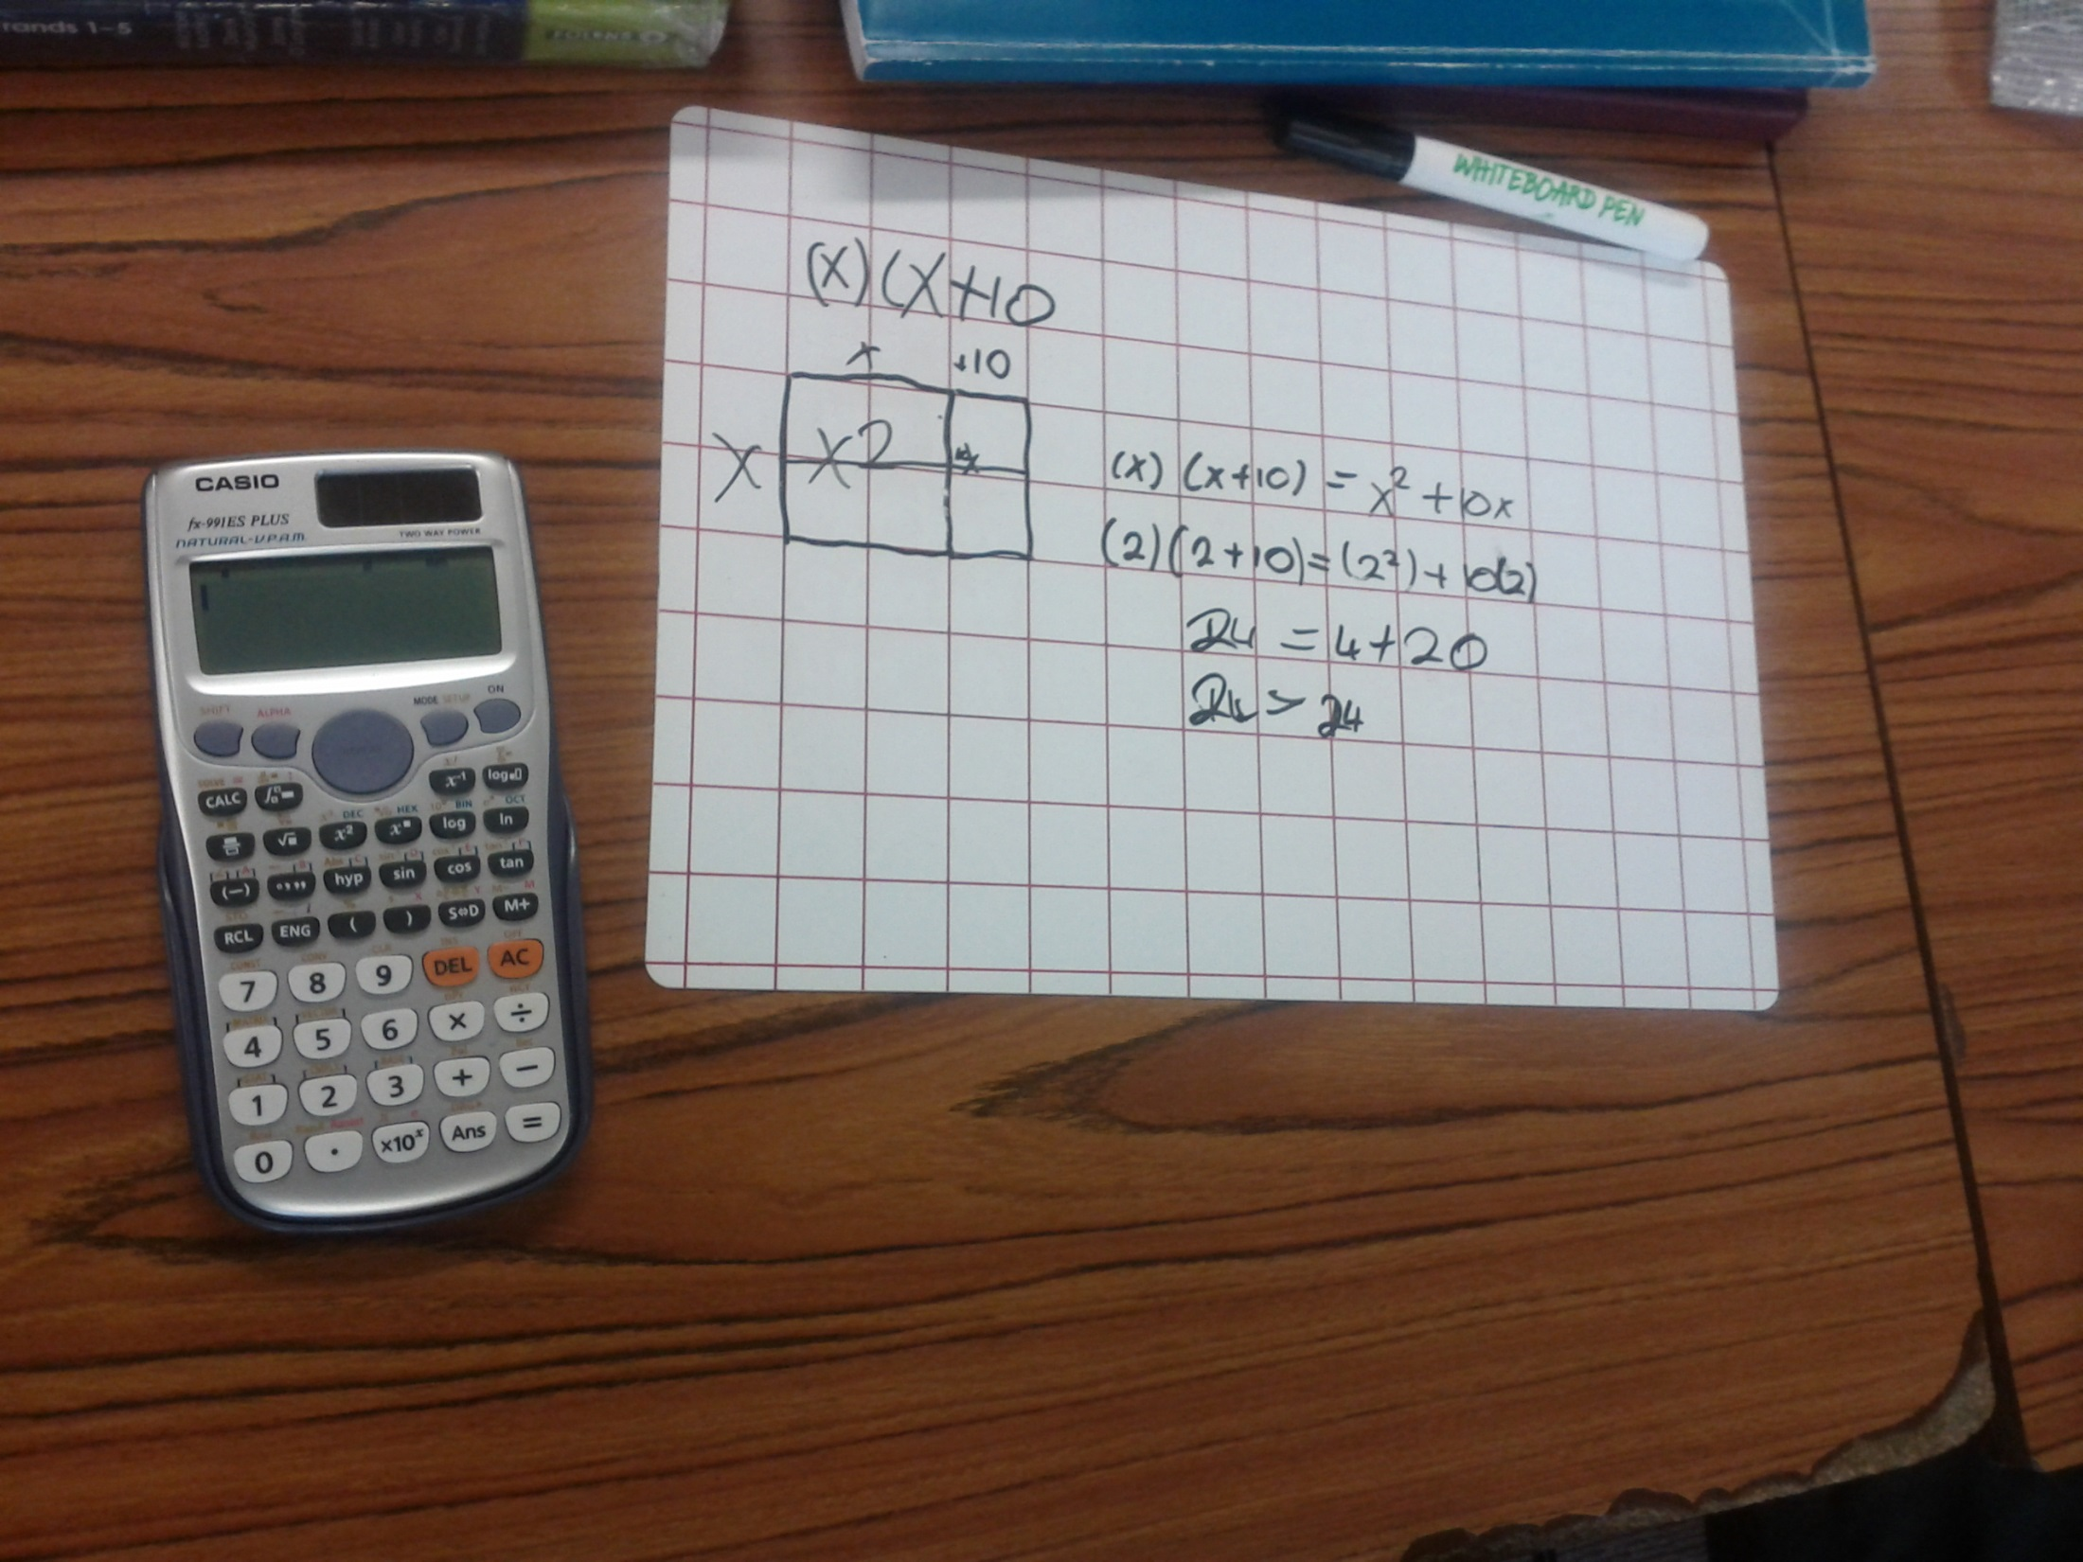

Slide 40
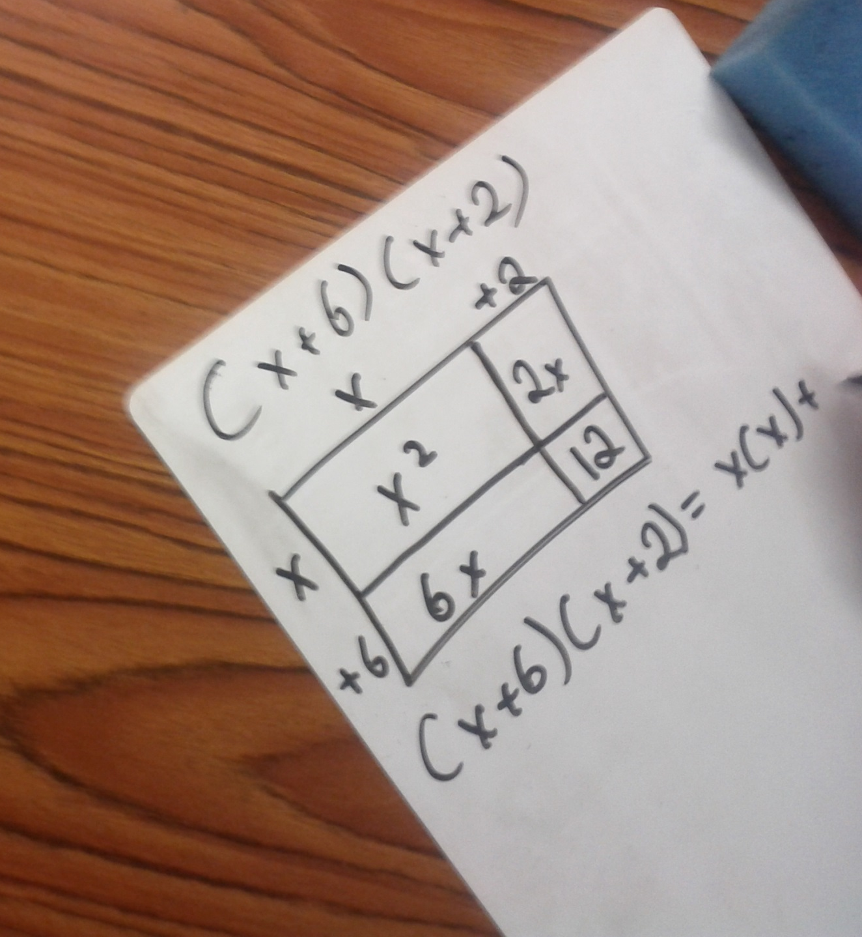
Multiplying two binomials using the array model

Slide 41
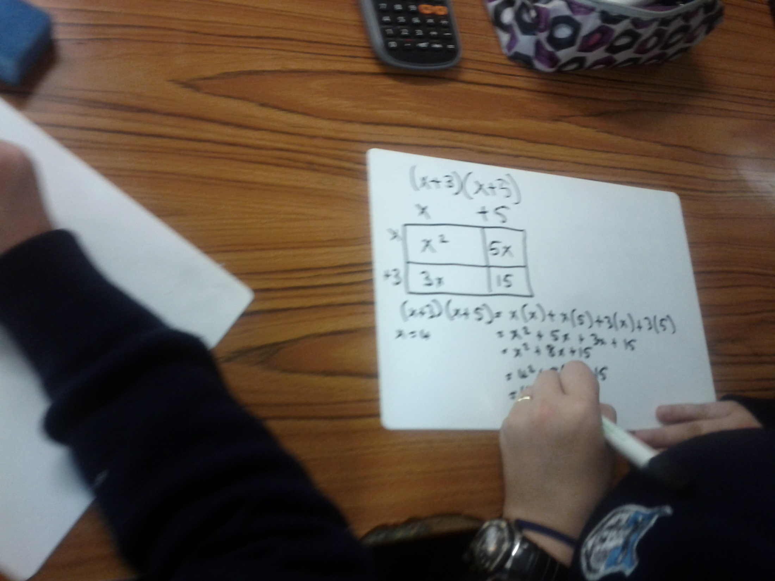

Slide 42
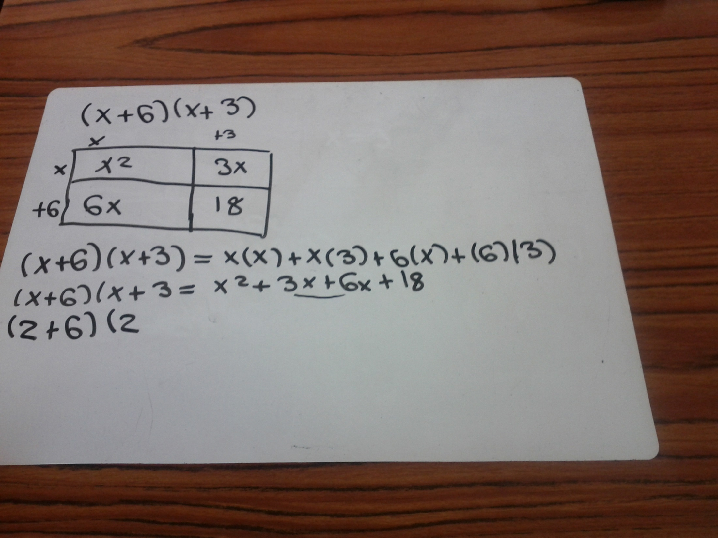

Slide 43
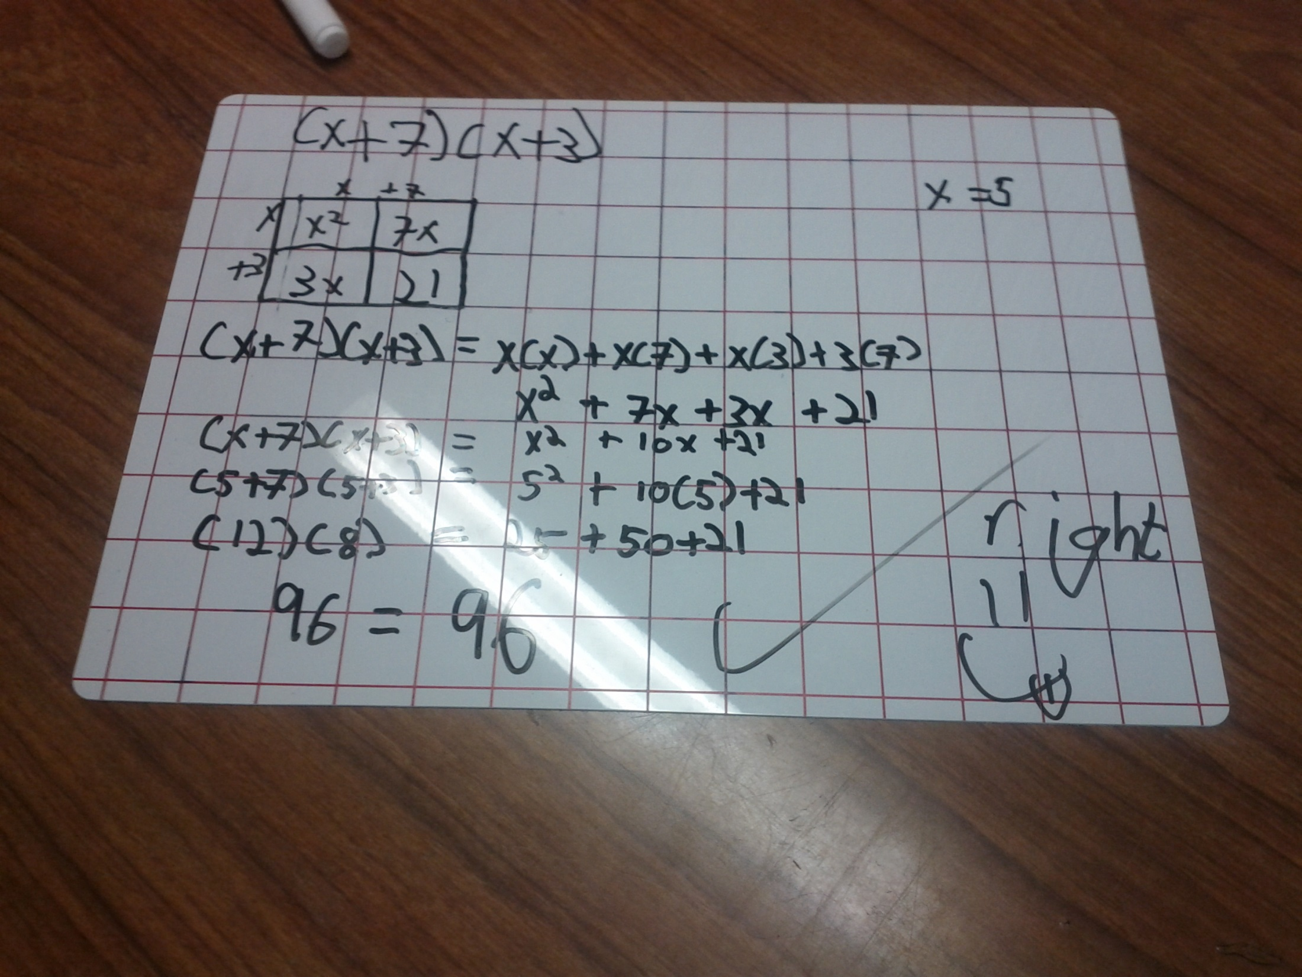
Using the model, showing the steps and verifying the answer

Slide 44
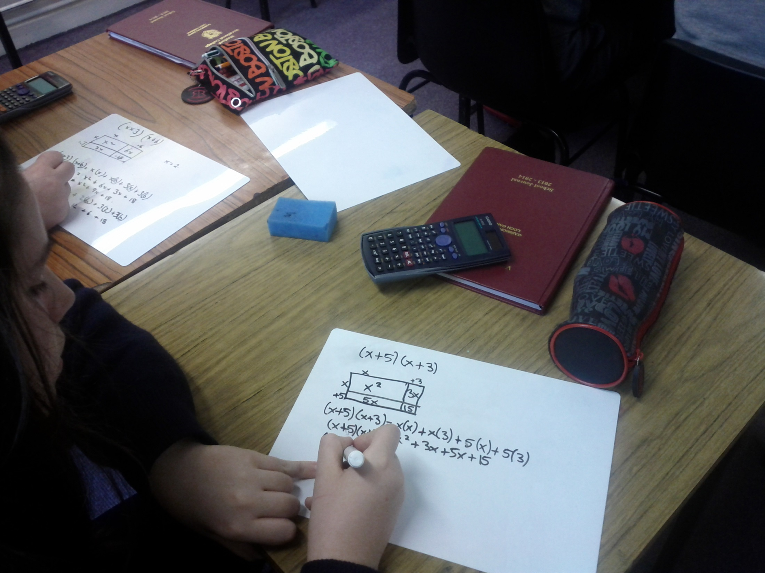
Students devising their own questions

Slide 45
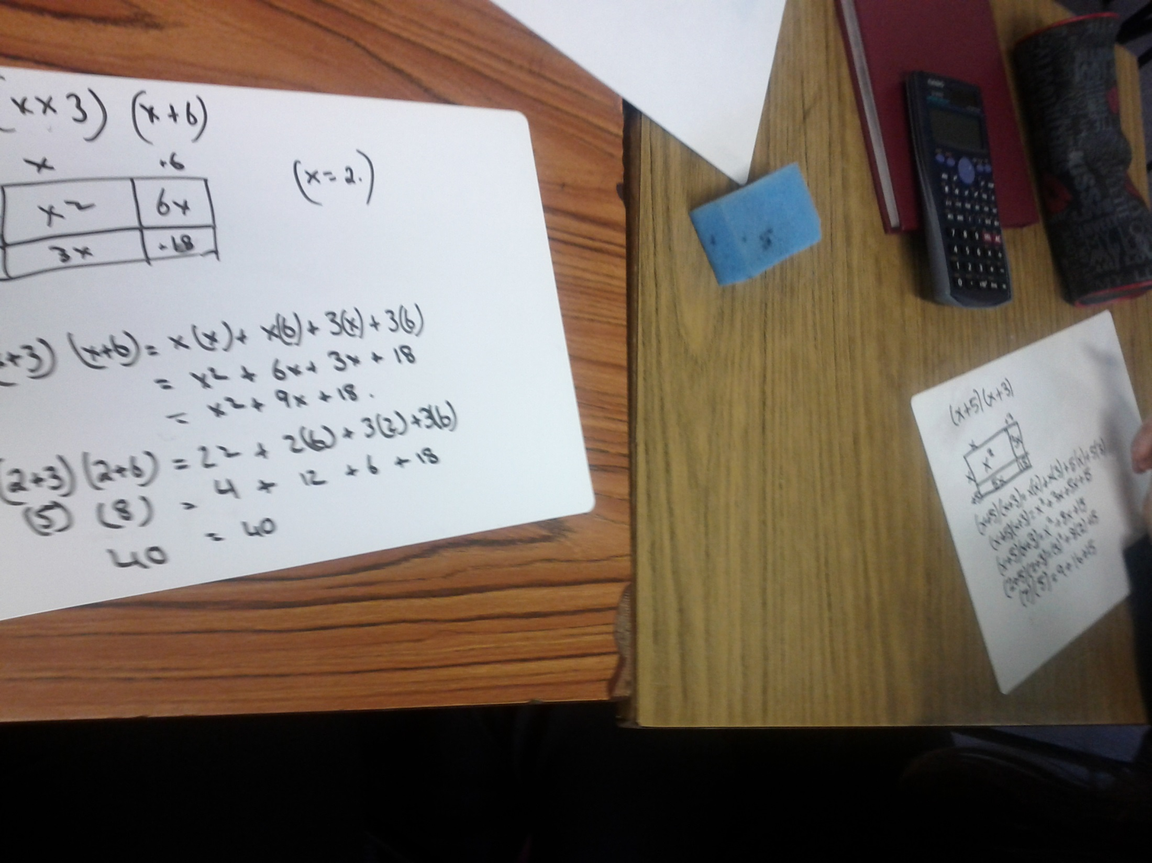

Slide 46
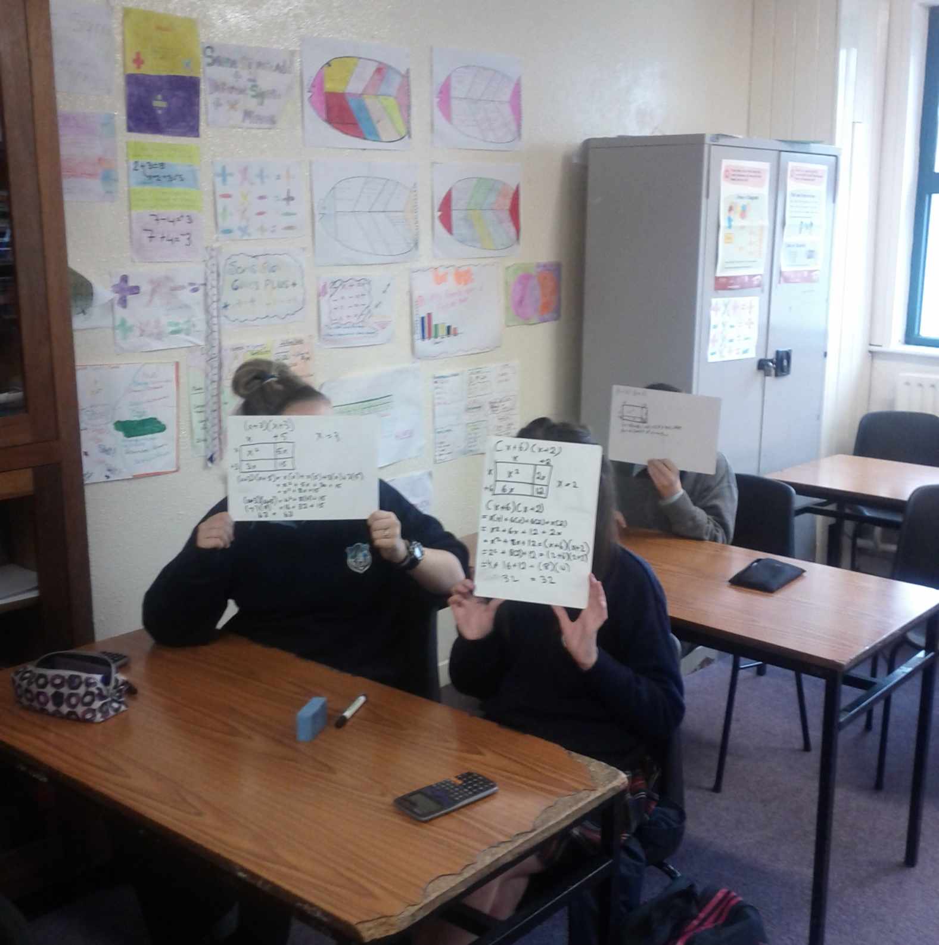
Assessing the learning

Slide 47
Reflections on Lesson Study Process
Strengths & Weaknesses
As a mathematics team how has Lesson Study impacted on the way we work with other colleagues?
  It focussed on teaching methodologies – “how to teach ” rather than “what to teach”
  It affected our attitudes to sequencing of topics given how the prior knowledge of classes can vary
  It facilitated sharing of ideas and resources
  It was useful to focus in on a small section of the course which was giving rise to recurring problems.
  It saves time in the long run if the initial problem is solved.
  It needs a whole department approach to be really effective.
  It requires time!

Slide 48
Reflections on Lesson Study Process
Strengths & Weaknesses
  Personally, how has Lesson Study supported my growth as a teacher?
  It was useful to be an observer in a classroom observing how students were learning. This made it easier when I had to teach the topic in my own class as I had gained insights into students’ thinking around misconceptions they were having.
  It showed the benefits of reflecting on my teaching with a view to improving students’ understanding.

Slide 49
Reflections on Lesson Study Process
  Recommendations as to how Lesson Study could be integrated into a school context.
  I would recommend that departments choose a small area, e.g. abuse of cancelling, applying percentages; look at some student work, try to figure out what the student is thinking, e.g. what prior knowledge is missing, and proceed from there.
  If one small area is dealt with each year it will impact on so many other areas on the course.

