Slide 1
Key Skills in Mathematics
Deirdre Murphy
Athy College, Kildare
dmurphy@athycollege.ie

Slide 3
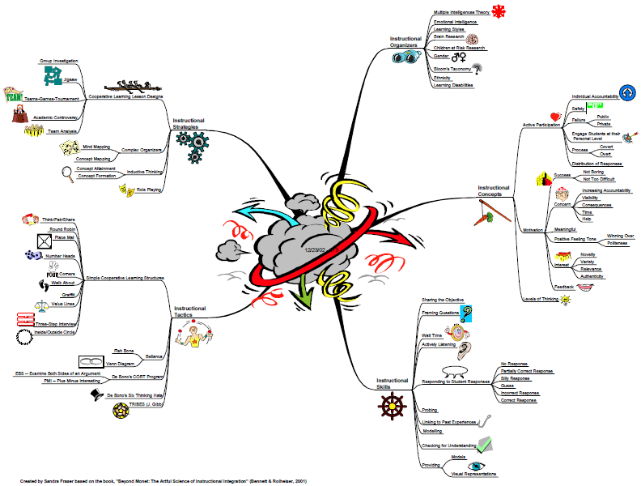

Slide 4
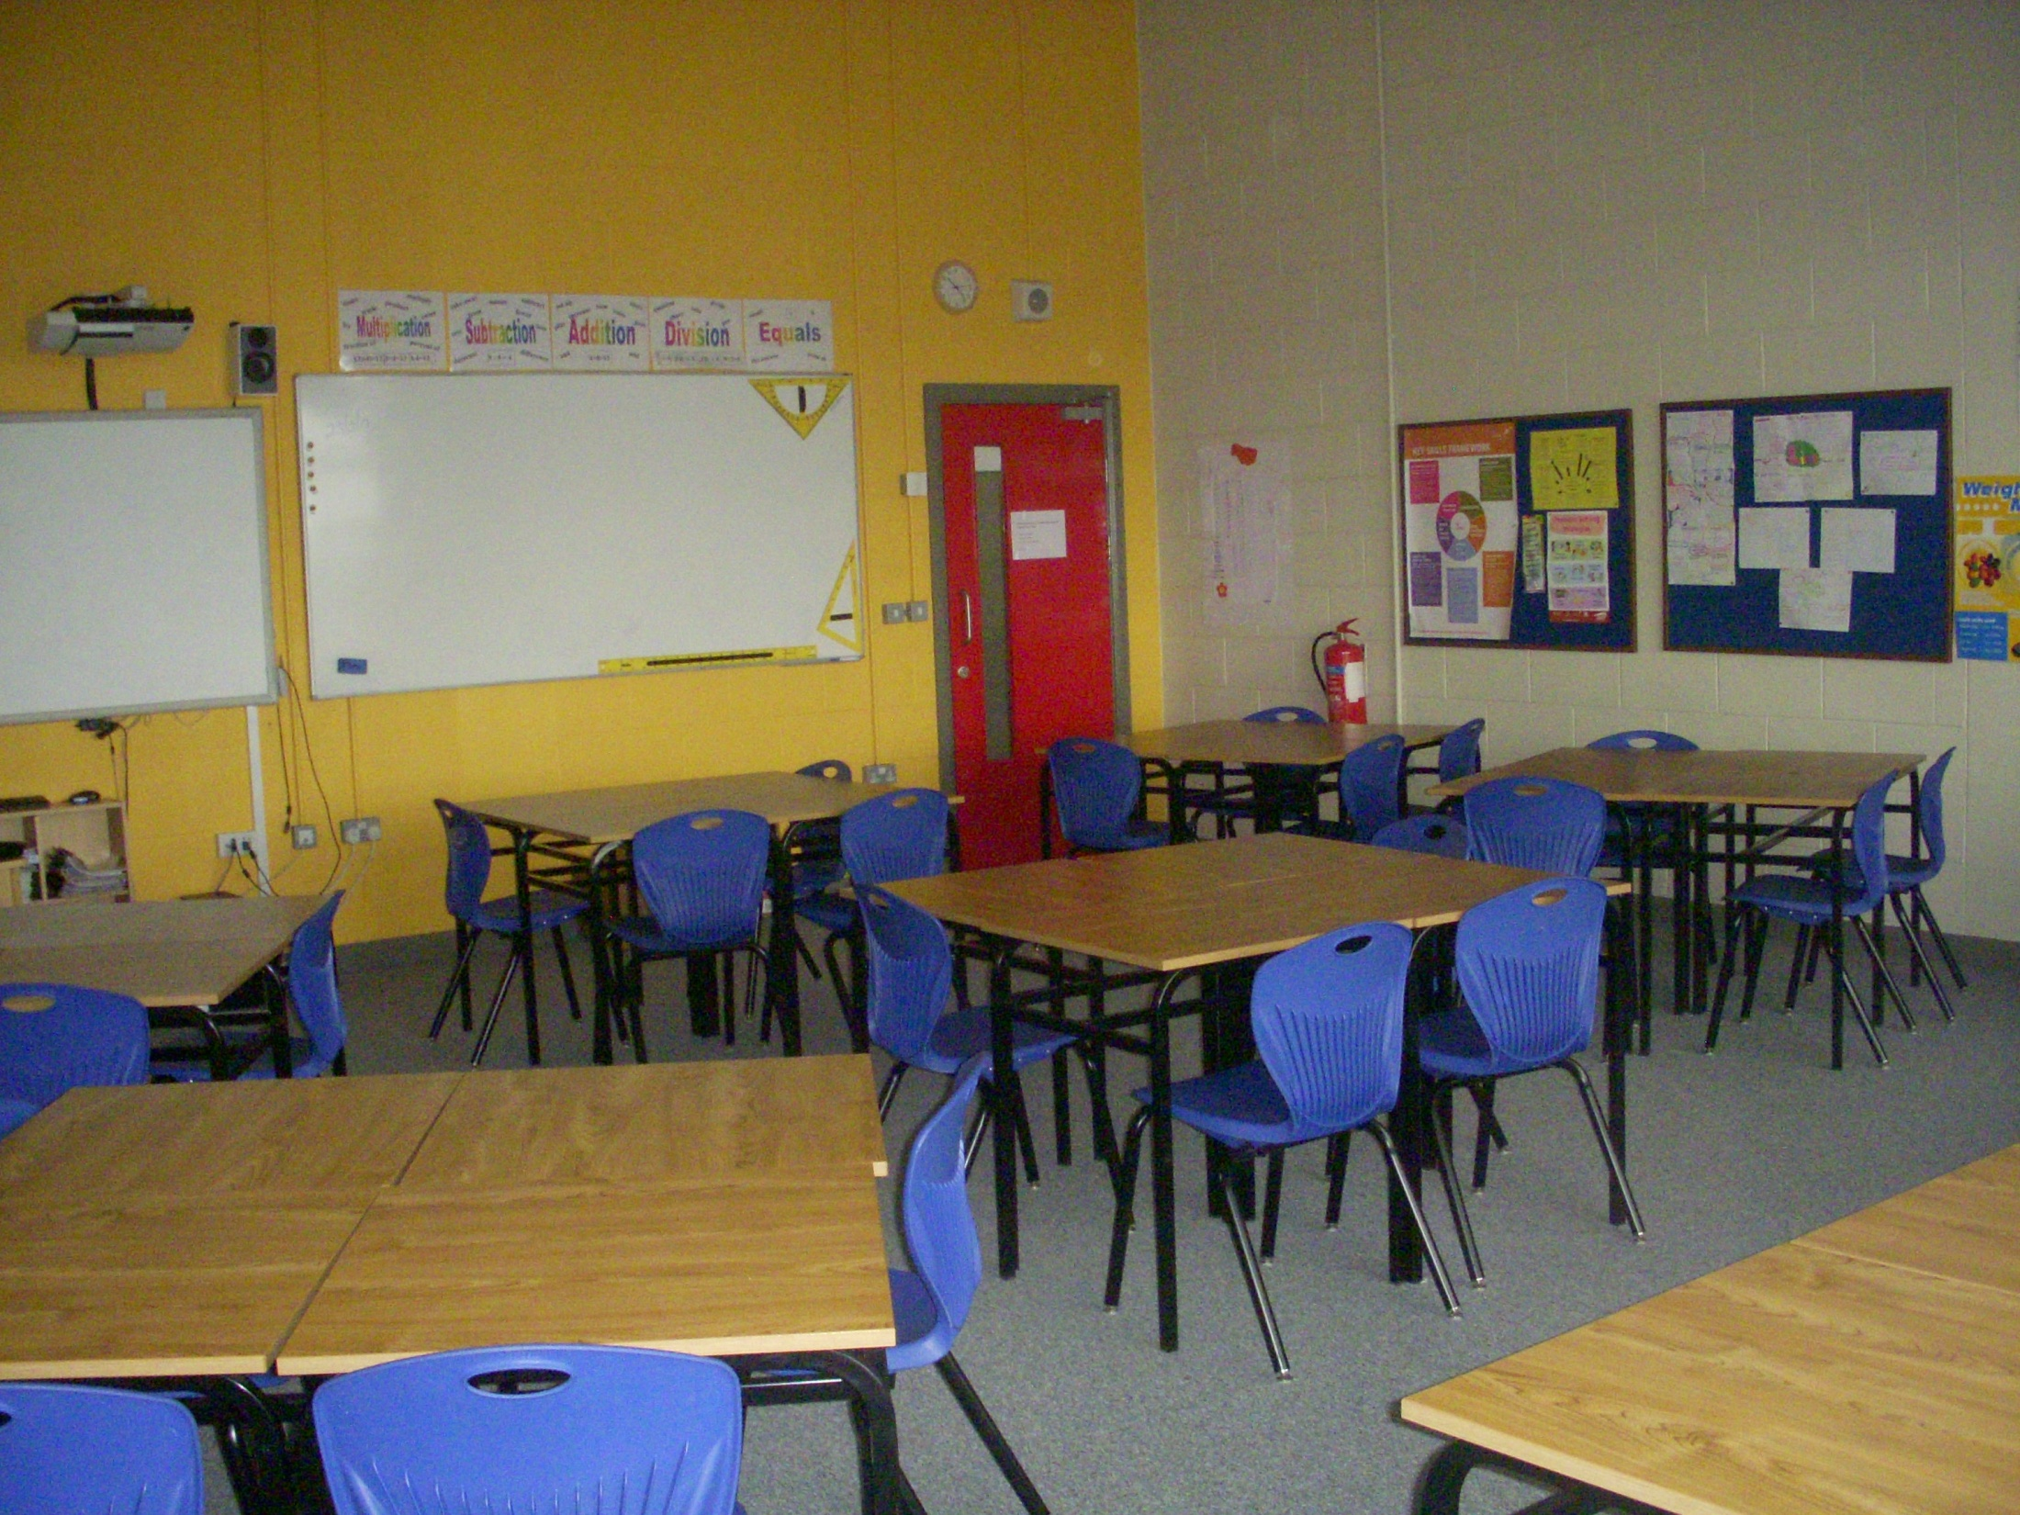
Room Layout - Opening the lines of communication.

Slide 5
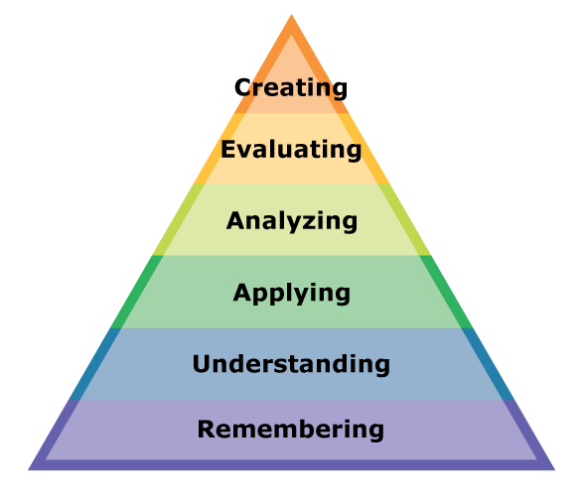
Instructional Tactic: Think Pair Share
Works well in 2’s or 3’s
Instructional Skills also incorporated:
No hands
Framing questions (Bloom’s Taxonomy)
Responding to student responses

Slide 6
Think Pair Share
Knowledge (Recall)
Yesterday we looked at right angled triangles; just think for a minute about the new terms we learned. Can you remember the name given to the longest side in a right angled triangle? (Pause) Turn to your partner and tell each other what you think it is called.

Slide 7
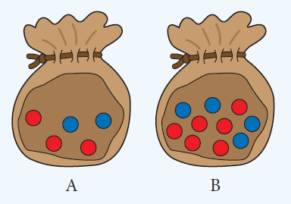
Think Pair Share
Analysis (Compare)
Look at the following diagram; think for a minute. Which bag, A or B, has the highest probability of red?

Slide 8
Think Pair Share
Reflect on learning:
What did you learn today that was easy/difficult to understand?
Think back to the learning objective; have you achieved the target?
Think about something that interested you about the lesson?
What did you do well today?
What could you have done better today?

Slide 9
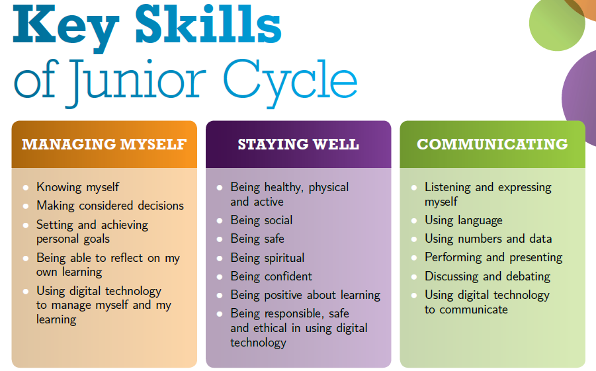
☑
☑
☑
☑
☑

Slide 10
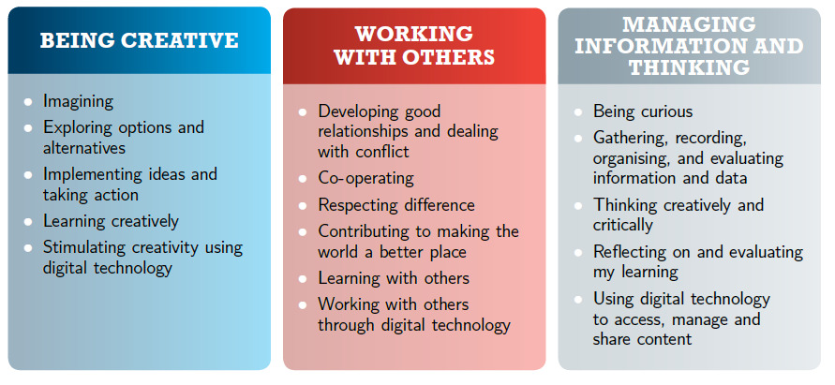
☑
☑
☑
☑
☑
☑
☑
☑

Slide 11
Instructional Tactic: Placemat
Works well in 2’s, 3’s or 4’s
Similar to think-pair-share; individual workspace and space for collaboration.
Incorporate other instructional tactics such as:
Lettered heads
Round Robin

Slide 12
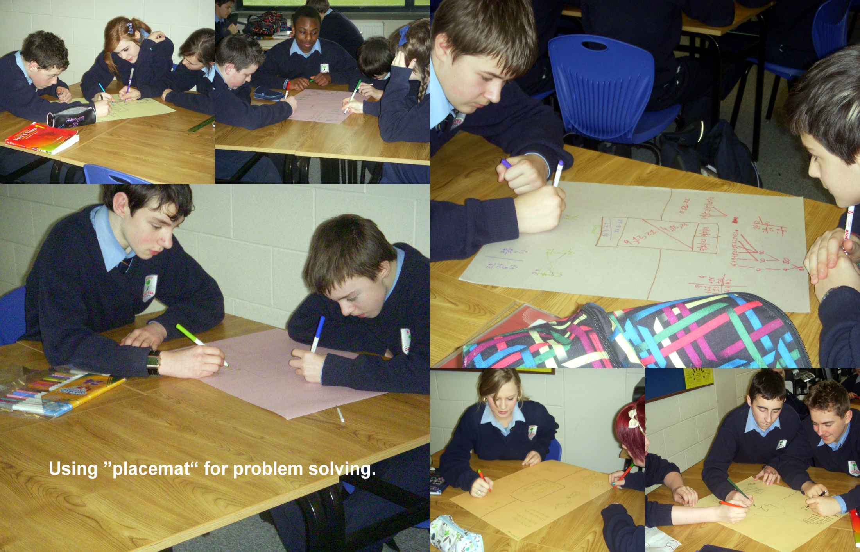

Slide 13
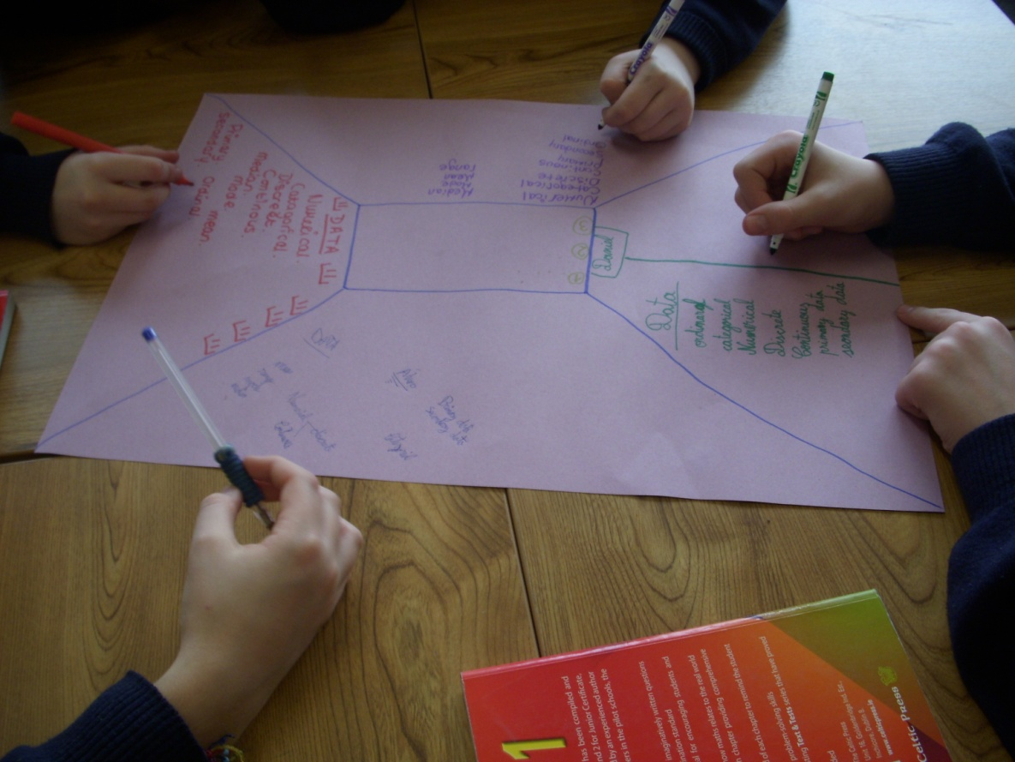
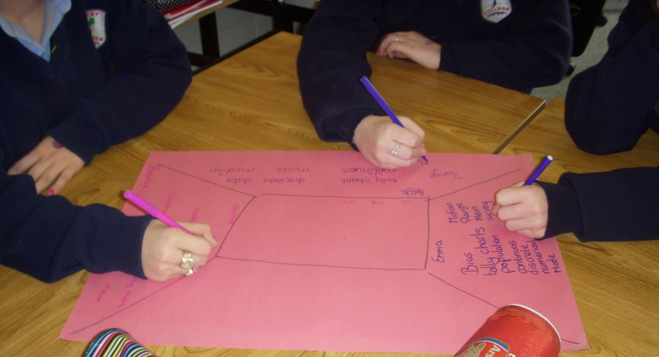
Placemat for Preparing Mindmaps

Slide 15
Placemat for comparative work

Slide 16
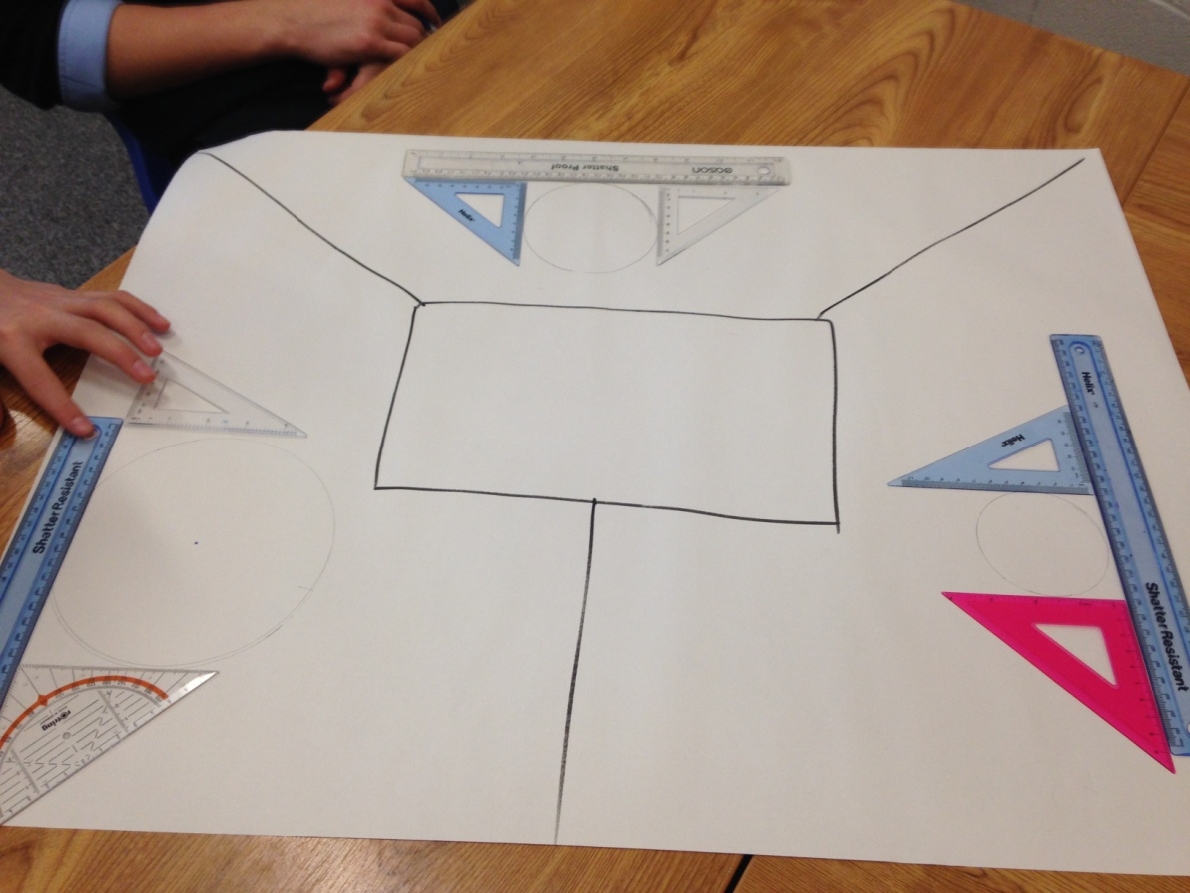

Slide 19
☑
☑
☑
☑
☑
☑

Slide 20
☑
☑
☑
☑
☑
☑
☑
☑
☑
☑
☑
☑

Slide 21
Instructional Strategy: Jigsaw
Works well in 2’s and 3’s
Useful for peer teaching or revision of a topic

Slide 22
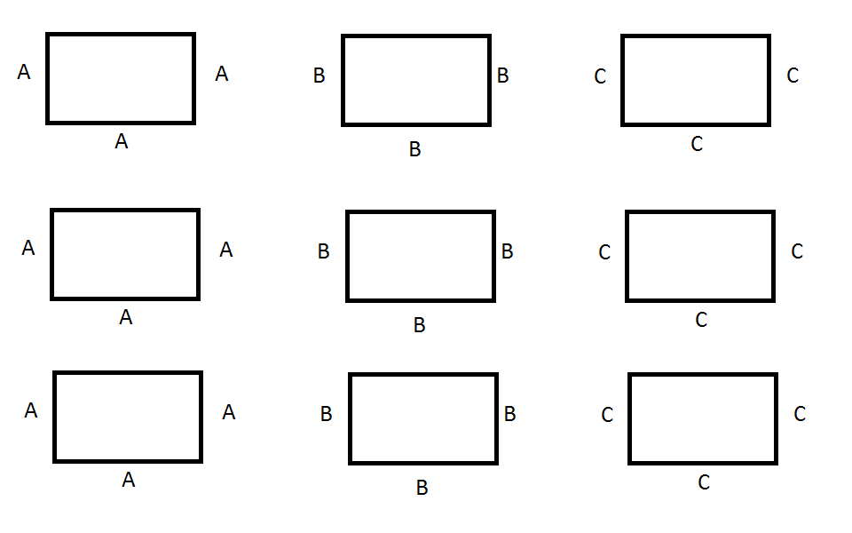
Jigsaw: Phase 1
Students in groups are given a task to complete.

Slide 23
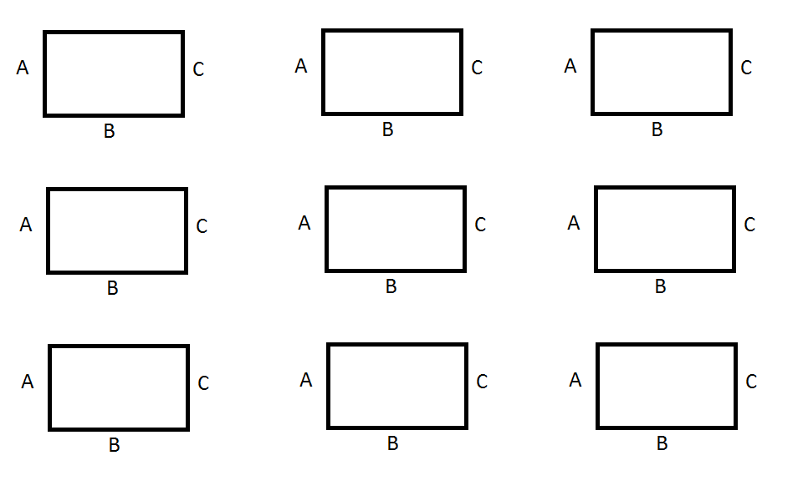
Jigsaw: Phase 2
Once the task is complete, new groups are formed to share the outcome of the task.

Slide 24
☑
☑
☑
☑
☑
☑
☑

Slide 25
☑
☑
☑
☑
☑
☑
☑
☑
☑
☑
☑
☑

Slide 26
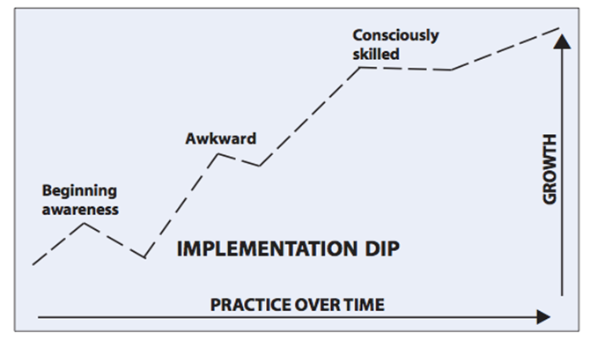

Slide 27
Johnson’s 5 Basic Elements of Effective Group Work
Positive Interdependence
Working together supportively
Individual Accountability
Responsible for own learning
Face to Face Interaction
Physical layout
Collaborative Skills
Social, Communication, Critical Thinking skills
Processing
Reflection

