Slide 1
Reflections on Practice
Maths Counts 2016

Slide 2
Title of Lesson
A Quick Way to Add Numbers

Slide 3
Martina Scully and Peggy Lynch - St. Flannan’s College
Desmond Fry - Glenstal Abbey
Anna Quilter - Kildysart Community College
Pearse Ryan - Kilrush Community School
Olive Dillon - Children’s Ark School

Slide 4
Details
5th Year Ordinary Level, St. Flannan’s College - all students had done higher level junior cert and many had tried higher leaving cert.
Originally the lesson was planned as an 80 min lesson but this was reduced to 55 mins due to mock exams.
It was taught on the 8th of Feb 2016
We decided on a stand alone lesson but we do feel it could be used as an introduction to algebra or sequence and series.

Slide 5
Student Learning Goals
As a result of studying this topic students will be able to:
Sum 1 to n and n to m
See the limitations of number and the need for algebra
Approach problem solving using a variety of different methods.

Slide 6
Mathematics syllabus
Strand 3.1-Number
Synthesis and problem-solving skills

Slide 7
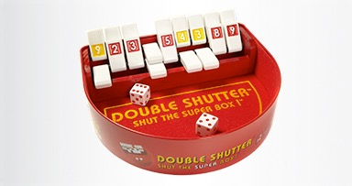
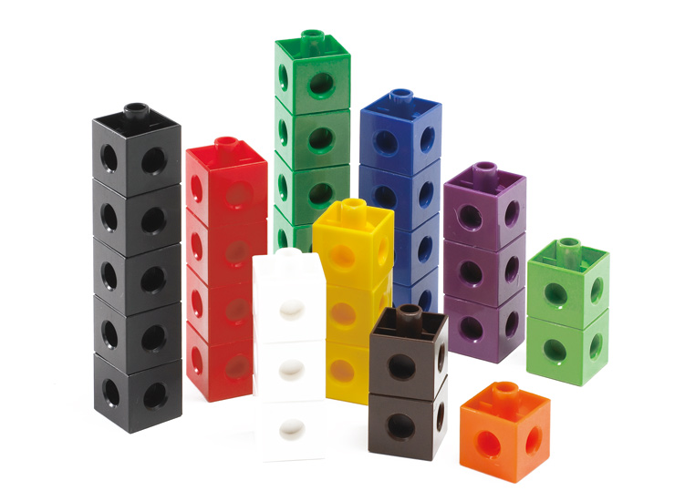
Design of Lesson
The lesson is divided into three tasks
Task 1 - The students have to find as many ways as possible to sum the numbers 1 to 10. After the initial introduction they work away on their own for 15 to 20 mins
During this time the teacher goes around the classroom looking at their work and picking students who have produced the anticipated responses.
The class then regroups and the students come up to the board and show their workings on the board. The teachers goes from the more basic strategy to the more advanced.
Task 2 - Sum the numbers 1 to 100, The students work on this individually for 10 mins. Again the responses are put on the board.
Task 3 - Sum the numbers 50 to 100. - this could be a homework exercise.

Slide 8
Steps of Lesson - Timeline
Introduction - Explaining task 1 | 5 mins
Task 1 - Sum up the numbers 1 to 10 in as many ways as you can | 15 - 20 mins
Board work | 15 - 20 mins
Task 2 - Sum up the numbers 1 to 100 in as many ways as you can | 10 - 15mins
Board work | 10 - 15mins
Task 3 - Sum 51 to 100 | 5 mins
Board work | 5 mins

Slide 9
Preparation for lesson
Martina Scully gave the lesson
She had the anticipated answers for each task written on card and had magnets to attach to the boards.
All materials were distributed around the classroom before the lesson.
The class was arranged in a semicircle.

Slide 10
Anticipated Responses
R 1: 1+2+3+4….+10=55 using mental arithmetic and/or a calculator. (1 to 10 and 10 to 1).
R:2 Rectangle with 11 rows and 10 columns or vice versa based on the triangular pattern of the linking cubes.
R.3: Pairing
R.4: Factors
R.5: 5(11)

Slide 11
Post lesson work for students
Task 3 will be given as homework if necessary
Summing different patterns e.g. even numbers, odd numbers etc. can be looked at in the next lesson

Slide 12
Materials
Students were given placemats, markers and dusters
linking cubes are distributed among the students
squared paper - 1 to 100
rulers

Slide 13
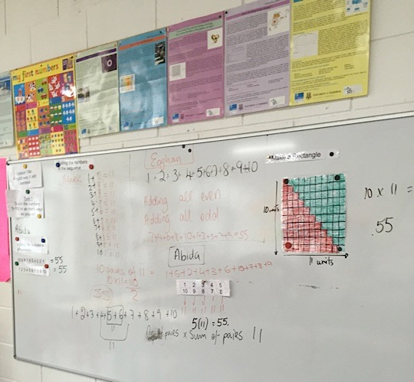
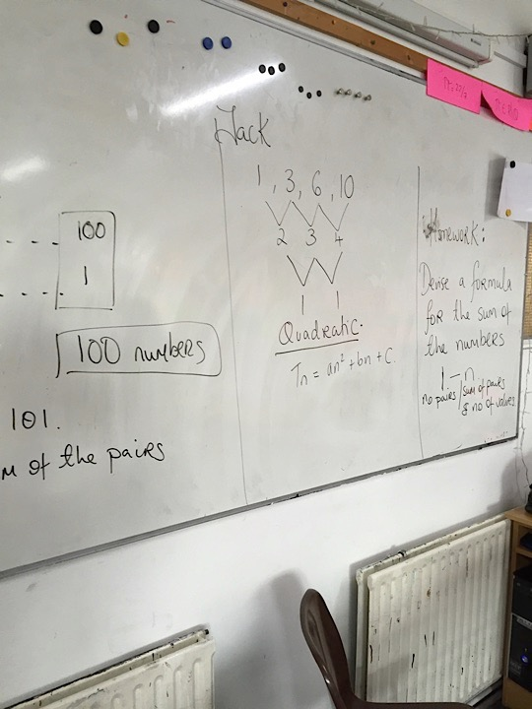
Board Plan
The board plan will run over two boards from left to right and will build from the introduction, through task 1, task 2 and task 3 using the actual responses as anticipated in the above order.

Slide 14
Plan for Peer Observation
All team members are involved in observing the lesson.
Photos of the students’ work will be taken to document what is happening.
Notes of the students’ work will be made as relates to the anticipated responses.
The observing team members will not interfere in the class and will not interact with the students once the class has begun.

Slide 15
Findings
Task 1 proved very difficult for the students due to the fact that they did not seem to understand the meaning of sum which we as a group had not anticipated at all.
When the teacher had explained the idea of sum the students went on to add the numbers 1 to 10 in various orders. Again this was something that we had not anticipated.
The students really kept busy being busy.

Slide 16
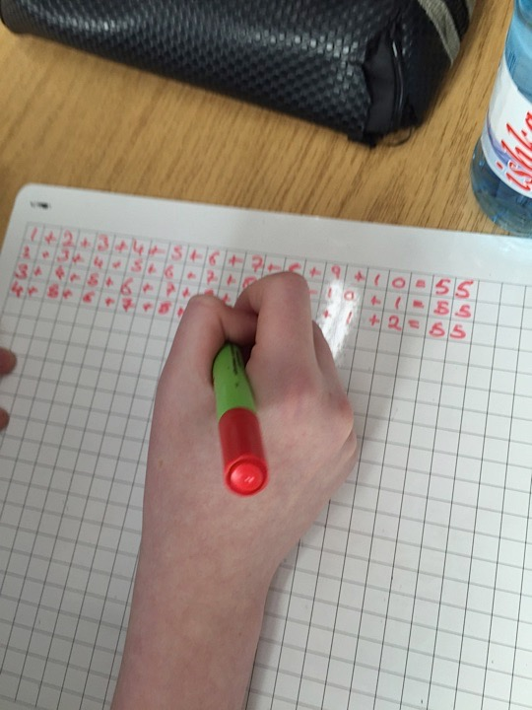
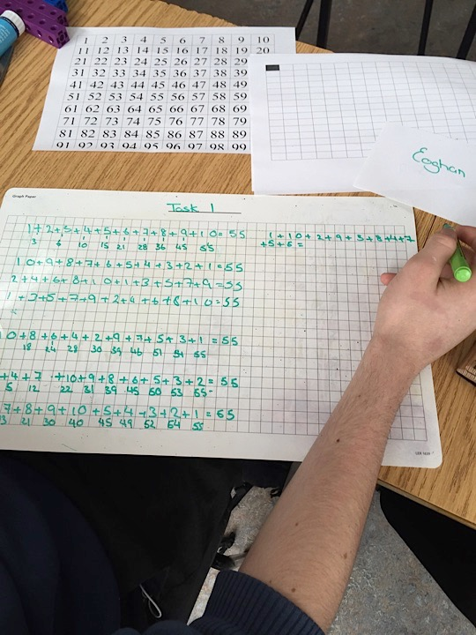

Slide 17
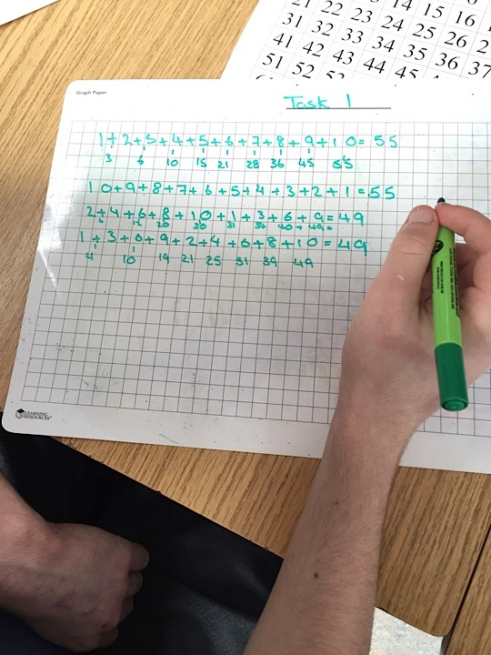
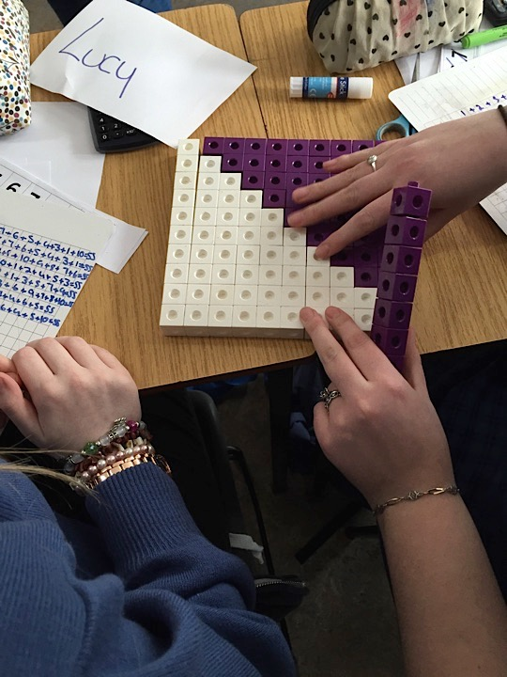
With a lot of scaffolding from Martina the students produced good work.

Slide 18
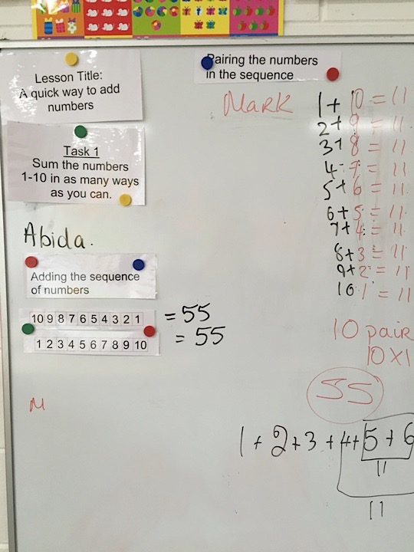
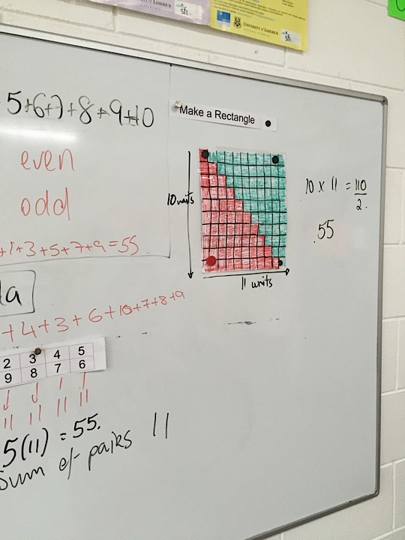

Slide 19
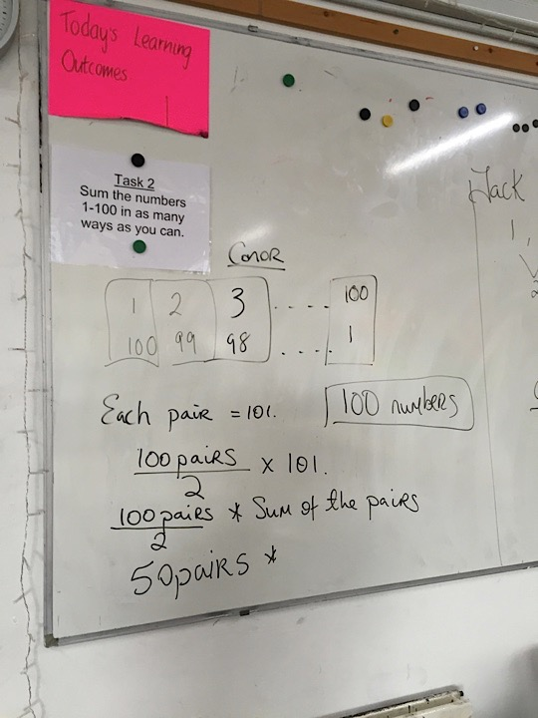
Task 2 was tackled much better by the students

Slide 20
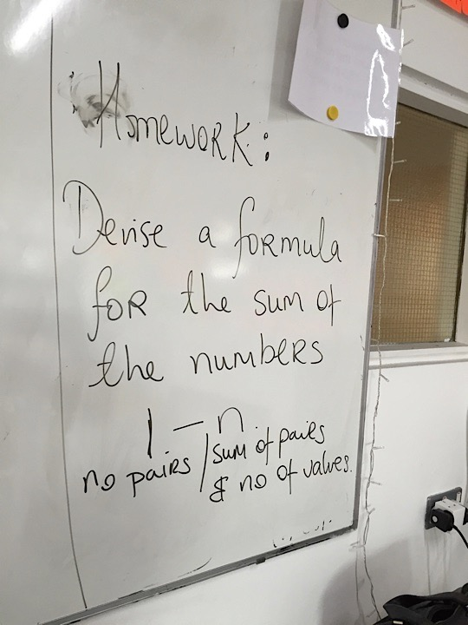
Homework

Slide 21
Findings/Student Learning
Misconceptions - sum and ways.
The students were very wary of the observers. (7 observers , 18 students)
Students were very uncomfortable with us taking photographs of their work and so they kept trying to look busy. .
Their use of the blocks - instead of pairing or making a regular shape they just repeated the reordering of the numbers

Slide 22
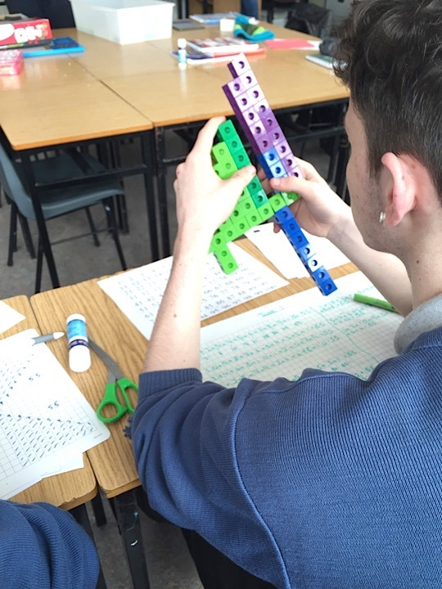

Slide 23
Repeat Lesson
The lesson was repeated with a mixed ability transition year group in the same school as all of us felt completely deflated after the observed lesson.
Having spent more time clarifying what we meant by “sum” and “ways” and a lot of questioning by the students, they spent 15mins on task 1.
They were completely relaxed with no observers even though photos were taken.
One student came up with the second difference method but she held off displaying his work until end of task 2. Timing changed slightly too

Slide 24
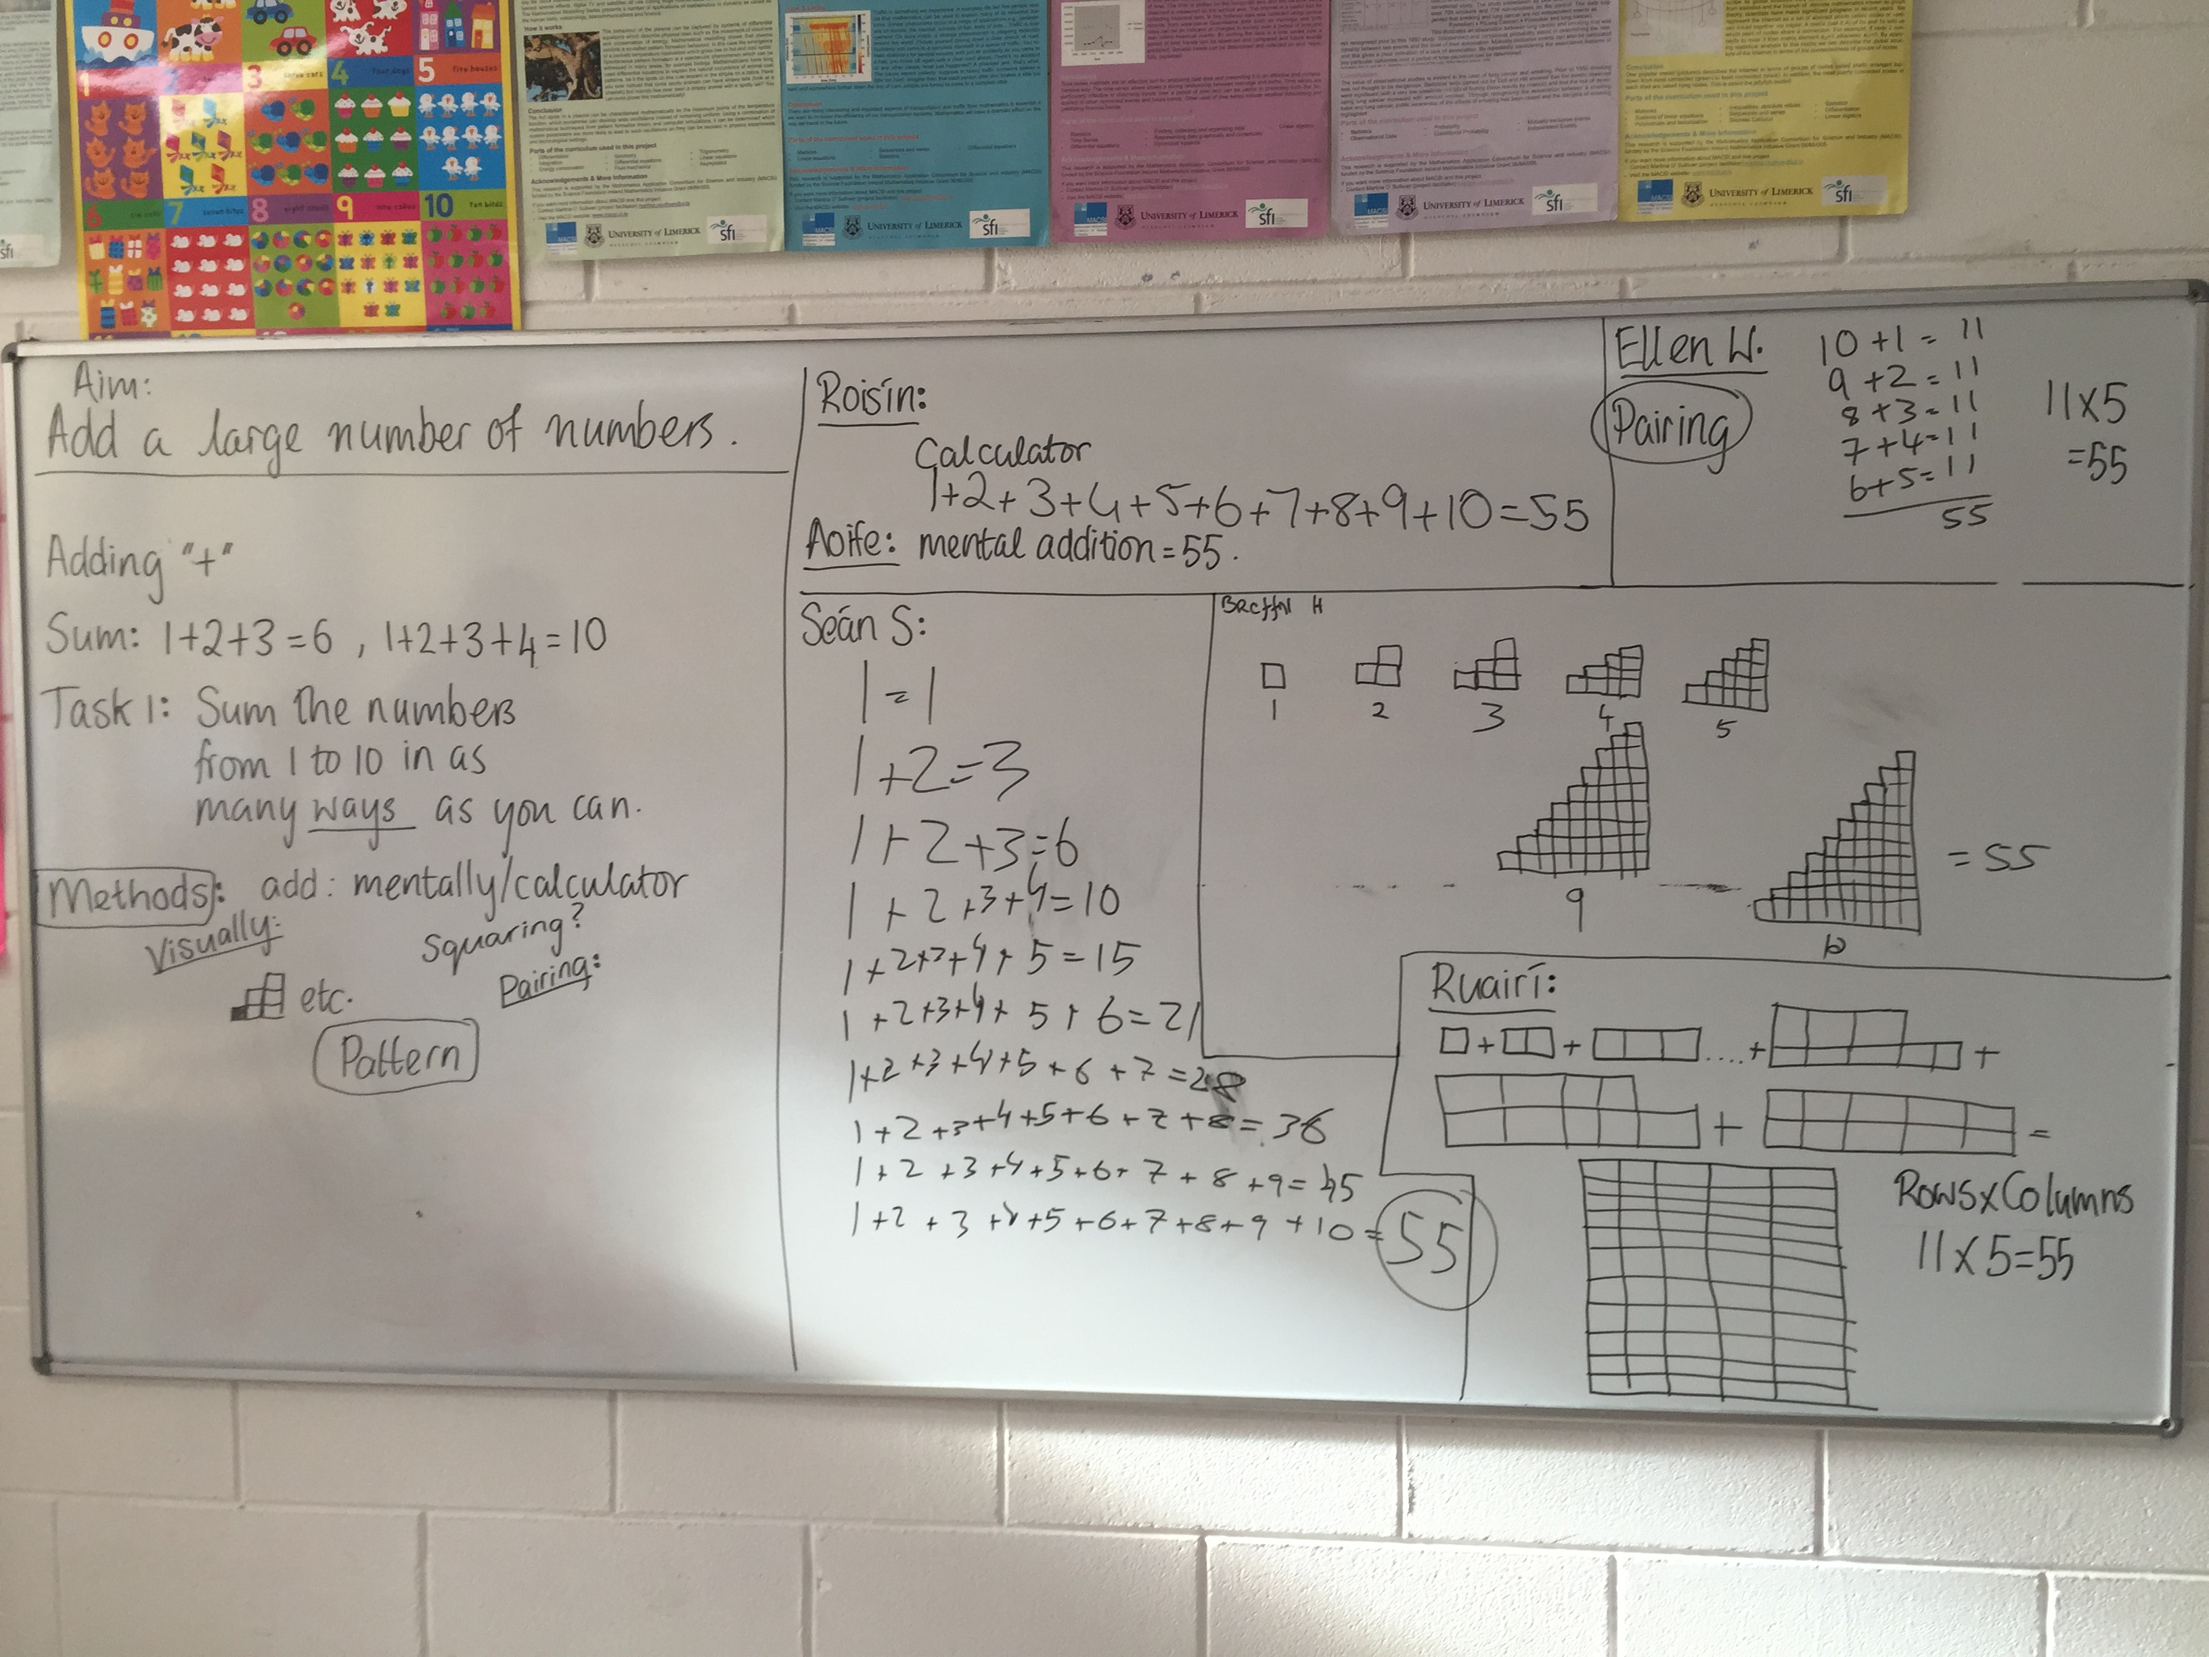

Slide 25
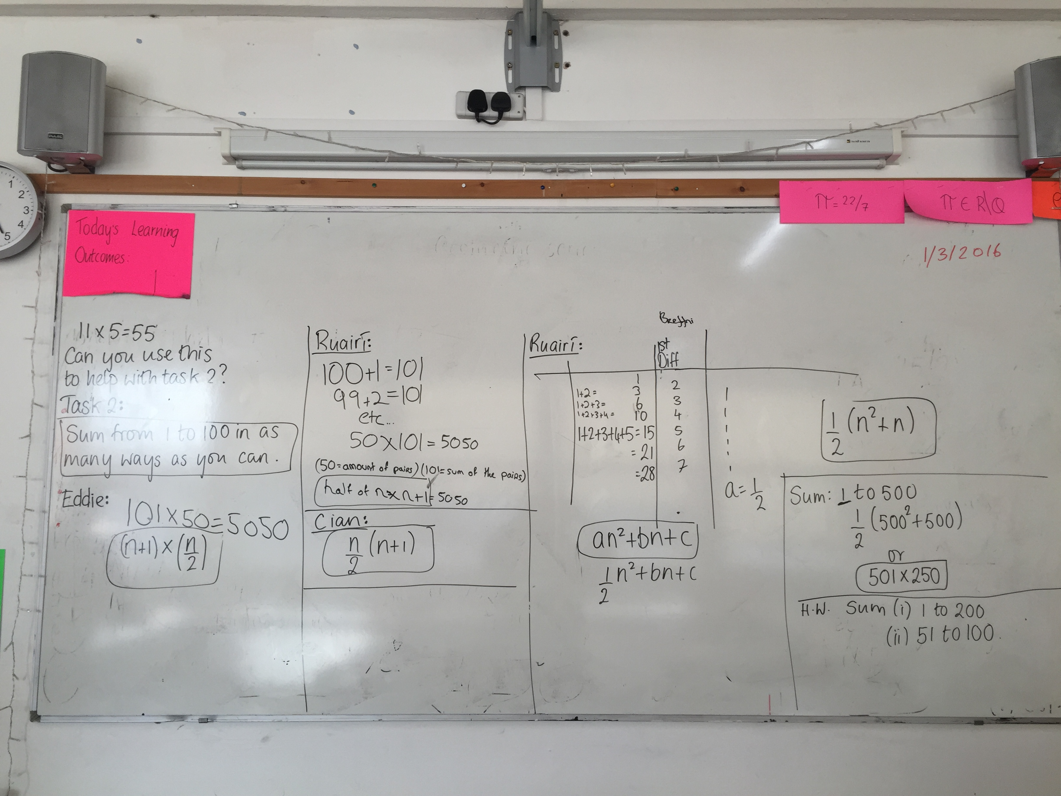

Slide 26
Recommendations
When doing this lesson we would strongly recommend the following:
Spend some time at the beginning discussing and clarifying the idea of sum
Give the example of 1+2+3+4+5+6+7+8+9+10=55 and state that this is one way of getting 55 and they find more ways.
Tell students not to rub out their work or don’t use placemats
Timeline - Intro 10mins, task 1 - 15mins, board work 15mins, Task 2 - 12mins and board work 8mins.
Homework - Sum 1 to 200 and 51 to 100

Slide 27
Any Questions?

Slide 28
Thank You!
Maths Counts 2016

