Slide 1
Reflections on Practice
Maths Counts 2016

Slide 2
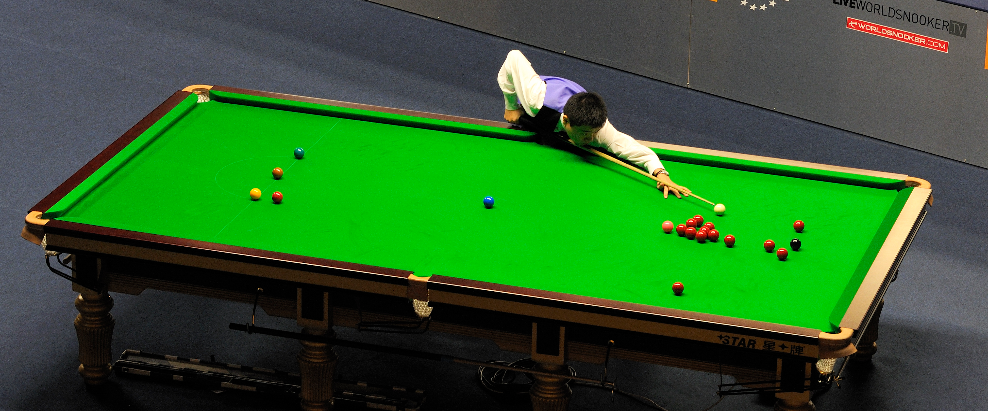
Introducing Algebra with Snöoker
Conleth Dillon Sheila Ahern Karina Lynn Rebecca Mulvihill

Slide 3
Planning
Six teachers collaborated in the planning, design, teaching/observation and review of this lesson formally meeting on seven occassions over a four month period.
The aim was to create a class that looked at a “key moment” in students’ maths learning. Evenually we decided to look at “introducing the variable and algebraic expressions” building on students understanding of number and using the familiar context of snooker.
This class also presents an alternative to the problematic “apples and bananas” approach to adding like terms.

Slide 4
Rationale
Our aim was to introduce Algebra building on ideas from research on Algebraic Reasoning
Begin algebra with relationships rather than procedures.
Teach the skills in different ways to reach a variety of learners.
Best practice links algebra skills to number skills.
Avoid informal short cuts.
Teach algebra as a problem solving tool.
The importance of mathematical literacy.
https://www.edu.gov.on.ca/eng/literacynumeracy/PayingAttentiontoAlgebra.pdf

Slide 5
The Class
Class: First Year Mixed Ability Boys
Duration: 45 minute lesson
Date: 24th February 2016
Topic: Introduction to Algebra

Slide 6
Student Learning Goals
Junior Cycle Syllabus, Strand 4

Slide 7
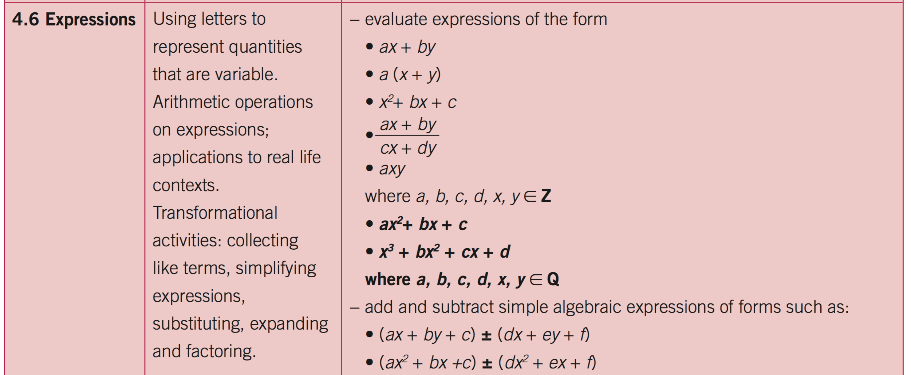
Student Learning Goals
Junior Cycle Syllabus, Strand 4

Slide 8
Aims of the lesson
That students would:
Understand that numbers can be expressed in different ways.
Understand that letters can be used to represent numbers.
Recognise and add like terms.
Express simple algebraic expressions in a factorised form.
Use substitution to evaluate expressions.
Use and understand terms such as: expanded, simplified, factorised and variable.
Have a positive engaging introduction to algebra and algebraic thinking.

Slide 9
Design of Lesson
The lesson contained 5 key student tasks, these are outlined in the following slides.
Task 1: Numberic expressions
Task 2: Verbalising expressions
Task 3: Algebraic expressions
Task 4: Substituting to evaluate expressions
Task 5: Reflecting on our learning

Slide 10
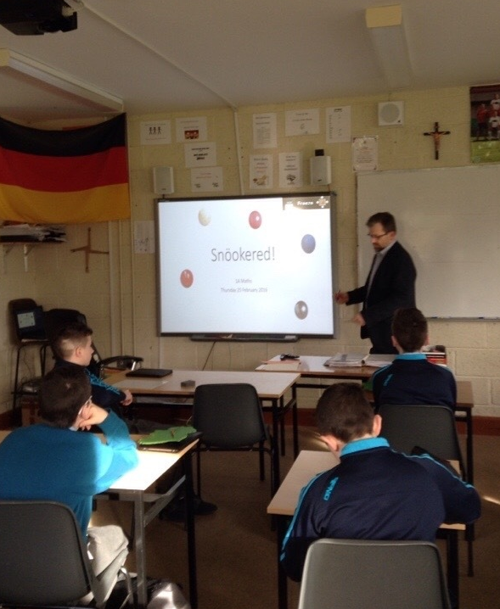
Design of Lesson
Task 1: Numberic expressions
Students watched a video clip of a snooker player potting 3 red and 3 black balls.
They were asked:
“What did the player score?”
“Can you write down 3 different ways of working out the score?”

Slide 11
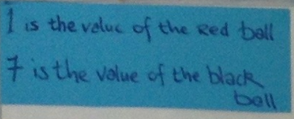
Design of Lesson
Task 1: Numberic expressions
The anticipated questions “What is the value of the black ball?” and “What is the value of the red ball?” were clarified at the beginning .
Task 1: Board-work
Task 1: Student work
Students then worked independently on the task.

Slide 12
Design of Lesson
Task 1: Numberic expressions
We planned to have students come to the board and explain three particular strategies beginning with the simplest.
Method 1: “Adding up the numbers one at a time” (Expanded)
Task 1: Board-work
Task 1: Student work

Slide 13
Design of Lesson
Task 1: Numberic expressions
Selected students presented and explaind their approaches on the whiteboard.
Method 2: “Bringing the same numbers together” (Simplified)
Task 1: Student work
Task 1: Board-work
Task 1: Student work

Slide 14
Design of Lesson
Task 1: Numberic expressions
The teacher added prepared headings to the students’ work as they presented.
Method 3: “Groups of the same value” (Factorised)
Task 1: Student work
Task 1: Board-work

Slide 15
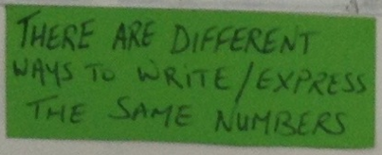
Design of Lesson
Task 1: Numberic expressions
When all three methods were presented a short discussion took place comparing these methods.
As hoped students themselves articulated that the same numbers can be expressed in different ways.
Task 1: Board-work
Task 1: Board-work

Slide 16
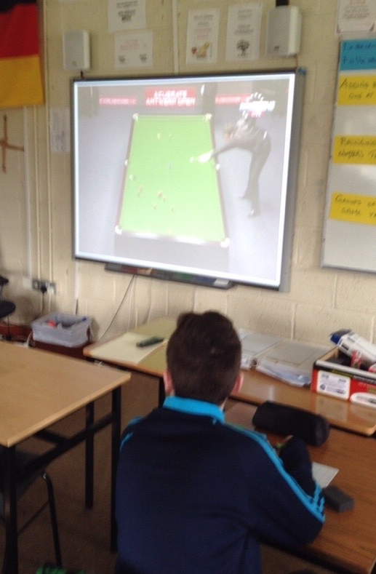
Design of Lesson
Task 2: Verbalising expressions
Students watched a video clip of a “snöoker” player potting a 3 red and 3 purple balls. It was explained that “snöoker”, is a game like snooker but balls have different values to the more familiar game.
They were asked:
“Write out in words three ways to work out how much the player had scored.”
Students worked independently.

Slide 17
Design of Lesson
Task 2: Verbalising expressions
Selected students were asked to come up to the whiteboard and explain particular strategies.
The teacher stuck up prepared sheets with these anticipated approaches and headings
Task 2: Student work
Method 1:
“Adding up the Values one at a time” (Expanded)
Task 2: Board-work

Slide 18
Design of Lesson
Task 2: Verbalising expressions
Method 2:
“Bringing the same values together” (Simplified)
Task 2: Board-work
Task 2: Student work

Slide 19
Design of Lesson
Task 2: Verbalising expressions
Method 3:
“Groups of the same value” (Factorised)
Task 2: Student work
Task 2: Board-work

Slide 20
Design of Lesson
Task 3: Algebraic expressions
Students were asked:
“Can you think of a more efficient way expressing these verbal expressions?”
Students were again given a short time for independent work and to write down their ideas.
Task 2: Board-work

Slide 21
Design of Lesson
Task 3: Algebraic expressions
Students were asked:
“Can you think of a more efficient way expressing/writing these verbal expressions?”
As hoped many students came up with the idea of using letters to represent ‘the value of” the balls.
It was decided by the students to let “R” stand for “the value of the red ball” and “P” represent “the value of the purple ball.”
Task 3: Student work
Task 3: Board-work

Slide 22
Design of Lesson
Task 3: Algebraic expressions
Students were then asked:
“Can you represent the verbal expressions of the snöoker score using these letters in three different ways?”
After time for independent work students presented their ideas.
Task 3: Board-work

Slide 23
Design of Lesson
Task 4: Substituting to evaluate
Task 4: Board-work
Students were asked:
“If we know that the value of a red ball is 10 points and the value of a purple ball is 20 points, how many points does the snöoker player score in the clip?”
“Can you use a number of methods to work out the score?”
Task 4: Student work

Slide 24
Design of Lesson
Task 4: Reflecting on our learning
Students were asked to reflect on “What did I learn today?
Task 5: Student work
Task 5: Student work

Slide 25
Homework

Slide 26
Peer Observation
One teacher moved through the room recording the lesson using LessonNote App and took multiple photographs of the students’ work.
Four teachers, at the side of the room, observed and noted students’ interaction with the class with an emphasis on:
How are they engaged during each task?
How are they learning/successfully completing tasks?
Student questions and responses.
Quality of independent written work.
How are they explaining when at the board?
Evidence that the stated learning outcomes and aims of the lesson are being achieved?

Slide 27
Findings
Students were very engaged throughout this lesson even faced with challenging tasks.
We were surprised and delighted to see that students themselves came up with all the approaches, ideas and solutions required for each task without prompting, including:
Phrases such as “the value of..”
Expressing numbers in expanded, simplified and factorised expressions.
The need for and use of the variable – which some students practically invented for themselves.
How to evaluate by substitution.

Slide 28
Findings
We were surprised how easliy and naturally students started using new highlighted key terminology such as expanded, simplified and factorised.
Students seemed confident and willing to share their ideas in fornt of the class.
It was obvious that students were able to build on and apply previous knowledge and gained knowledge as they moved through the phases of the class. The visual aid of the board-work was an essential element in progressing the students learning.

Slide 29
Findings
Giving students time, space to think and a platform share their mathematical ideas is very interesting and worthwhile.
Task 5: Student work

Slide 30
Findings
Some misconceptions were identified in the student reflections highlighting their potential as a valuable formative assment tool. These misconceptions would be addressed in subsequent lessons.
The learning aims of the class seemed to be comprehensively met by the majority of the students.
The students themselves expressed how much they both enjoyed and learnt from the lesson.

Slide 31
Board Plan

Slide 32
Recommendations
Plan, plan, plan!
Anticipate student responses and misconceptions
Carefully plan the board-work
Facilitate the learning
Explore different methodologies
Engage the whole Maths Department
Try this lesson with your own students

