Slide 1
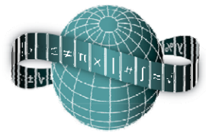
Reflections on Practice
Maths Counts 2016

Slide 2
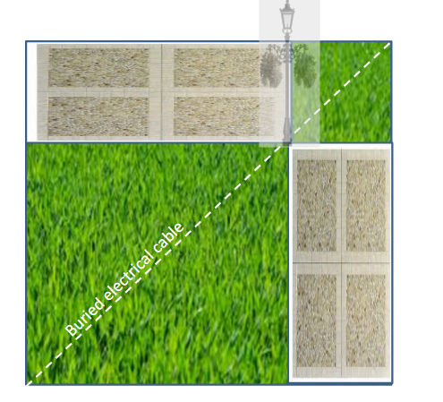
Structured Problem Solving
Finding the minimum combined area possible by sizing two rectangles

Slide 3
Teacher: John Hartery Lesson plan developed by: Emily Campbell, Ciara Power, John Hartery, Gobnait Ni Scanaill, Erica Owens. Ardscoil Na Mara, Tramore, Waterford.

Slide 4
Details
3rd Year Higher Level
40 minute lesson
10/3/2016
Revise Patterns and Area & Volume, extend quadratic equations and functions

Slide 5
Student Learning Goals
Students to appreciate that mathematics can be used to solve real world problems
Students to appreciate that algebra is a tool for making sense of certain situations
Foster my students to become independent problem solvers
Students to become more creative when devising approaches and methods to solve problems
Emphasise to students that a problem can have several equally valid methods of solution
Build students’ enthusiasm for the subject by engaging them with stimulating activities
Students to connect and review number patterns in a different context

Slide 6
Student Learning Goals
Students to understand that noticing patterns and using algebra are both relevant techniques that can be applied to problems that initially may seem unconnected.
Students to be able to represent the area of a rectangle (or other 2D shape) using variables.
As a result of studying this topic students will be able to:
“write an expression in variables for the area of a rectangle and find the value of the variable that minimizes (or maximizes) that area.”

Slide 7
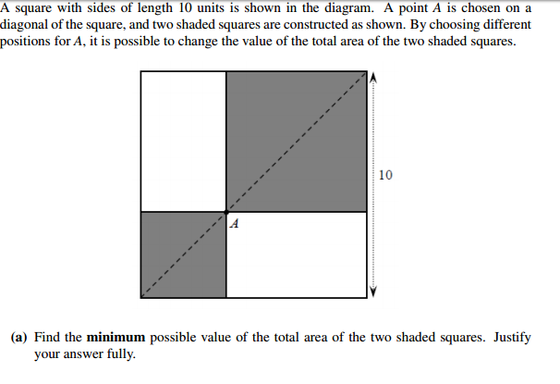
Design of Lesson
Choice of question/problem
Open to various methods/solutions
Geometry
Patterns
Algebra
Quadratic
Function

Slide 8
Design of Lesson
Present structured problem solving approach 5 mins
M aths or M istakes
A llows
T hinking to
H appen
Encourage students to try a number of approaches
Explain about the importance of trying to get from specific to general
3 + 4 = 4 + 3 is this always true? Specific
a + b = b + a is this always true? Rule

Slide 9
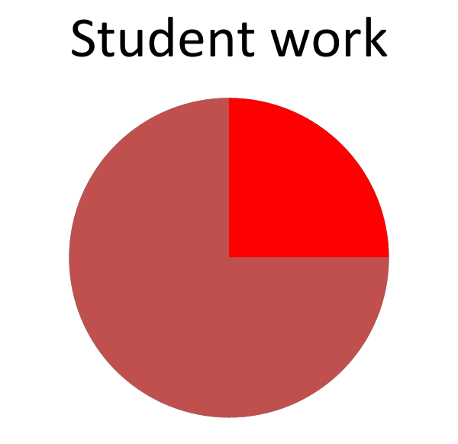
Design of Lesson
3 - 4 = 4 - 3 is this ever true? Specific
a - b = b - a is this ever true? Rule
Revised Area of Square/Rectangle and wrote formulae on board
Handed out materials for class, placemats, graph paper and gave instructions on log book, calculators use
Gave context of problem using presentation of white board
Gave students 15 minutes to work on problem..set timer

Slide 10
Design of Lesson
Prepared PowerPoint on Problem/Context
Designed and photocopied place mats on A3
Designed Whiteboard layout
Agreed flow of lesson and timing
Produced PowerPoint for expected results and printed these results on A3
Designed record sheet in line with expected results
Produced list of question types to analyse students responses and feedback in detail
Students invited to display their solutions on whiteboard

Slide 11
Design of Lesson
Students were not set homework but were told to reflect on the process
Suggest how it might have been improved.. Materials, PowerPoint, GeoGebra
Extra clarity needed in 5 minute
“What would have made their task easier?”

Slide 12
Materials
Designed and photocopied place mats on A3
Designed and photocopied graph paper on A3
Produced PowerPoint for expected results and printed these results on A3
GeoGebra file

Slide 13
Plan for Peer Observation
Record of result types R1 to R7
R1: Trial and improvement
R2: Visual inclination
R3: Ordered list/table
R4: Graph from table
R5: Algebraic expression
R6: Graph from algebra
R7: Quadratic Function/Rule

Slide 14
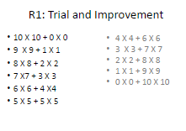
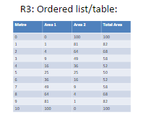
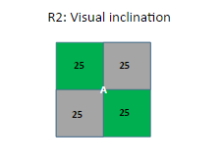
R1 to R3

Slide 15
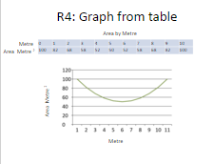
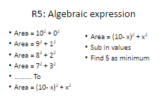
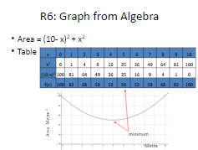
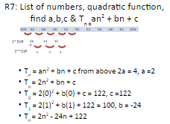
R4 to R7

Slide 16
Plan for Peer Observation
Students to work independently but were seated in pairs, 3’s and 4’s to observe each others progress and discuss methods
Students brought their solutions to whiteboard for display. They presented their solutions to the class.
Teacher quizzed student and students commented on solution and compared solution to their own and offered comment/suggestions and questions

Slide 17
Findings
Geometric type solutions dominated
Expected more number/ type explorations/solutions
Very few tables tried
Some students delved into algebra
Trigonometry appeared as a method

Slide 18
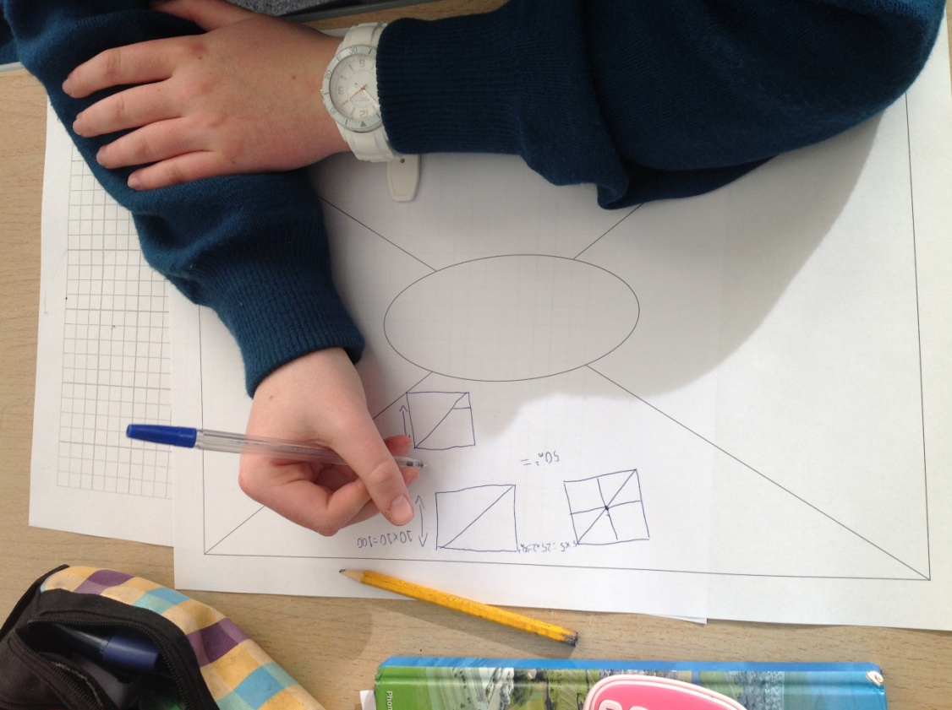
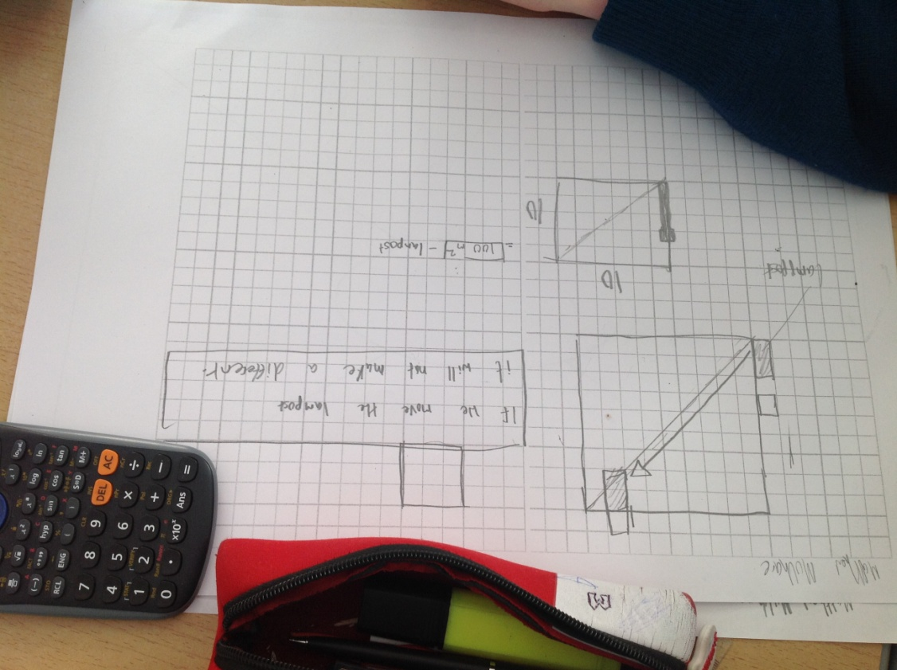
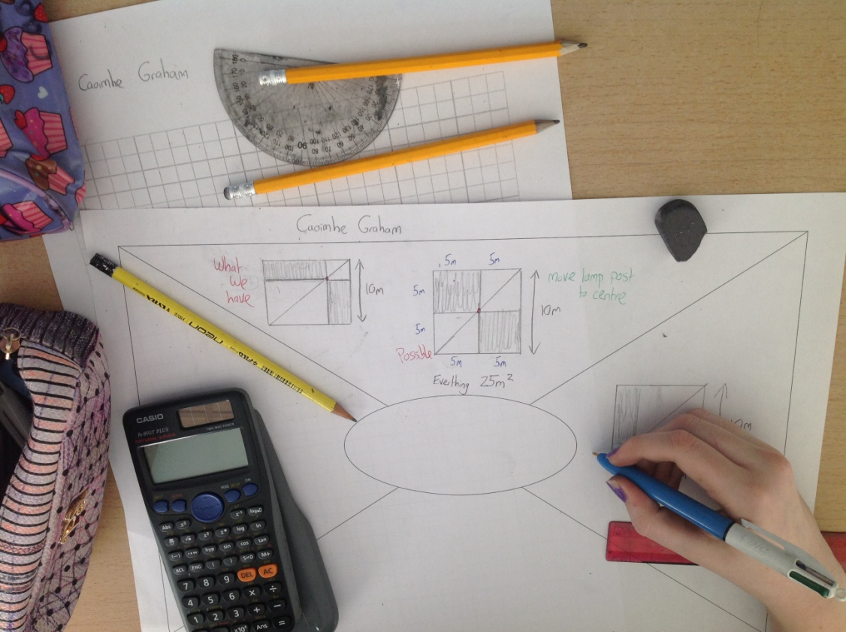
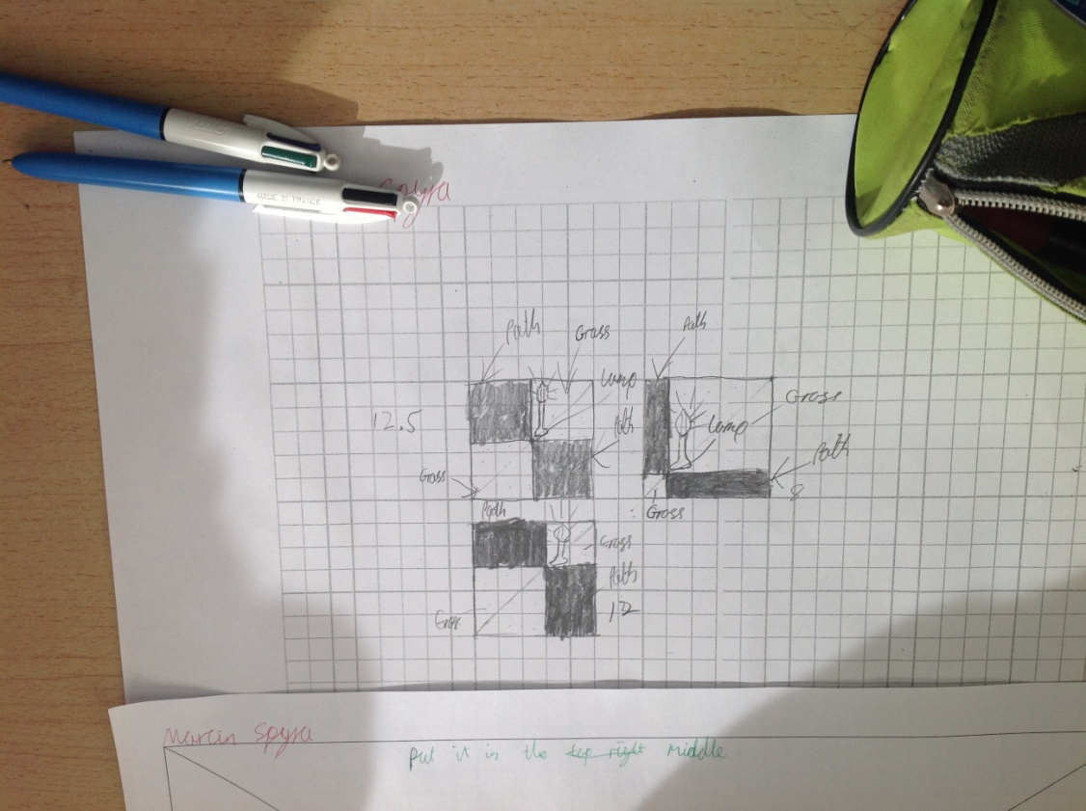
Findings

Slide 19
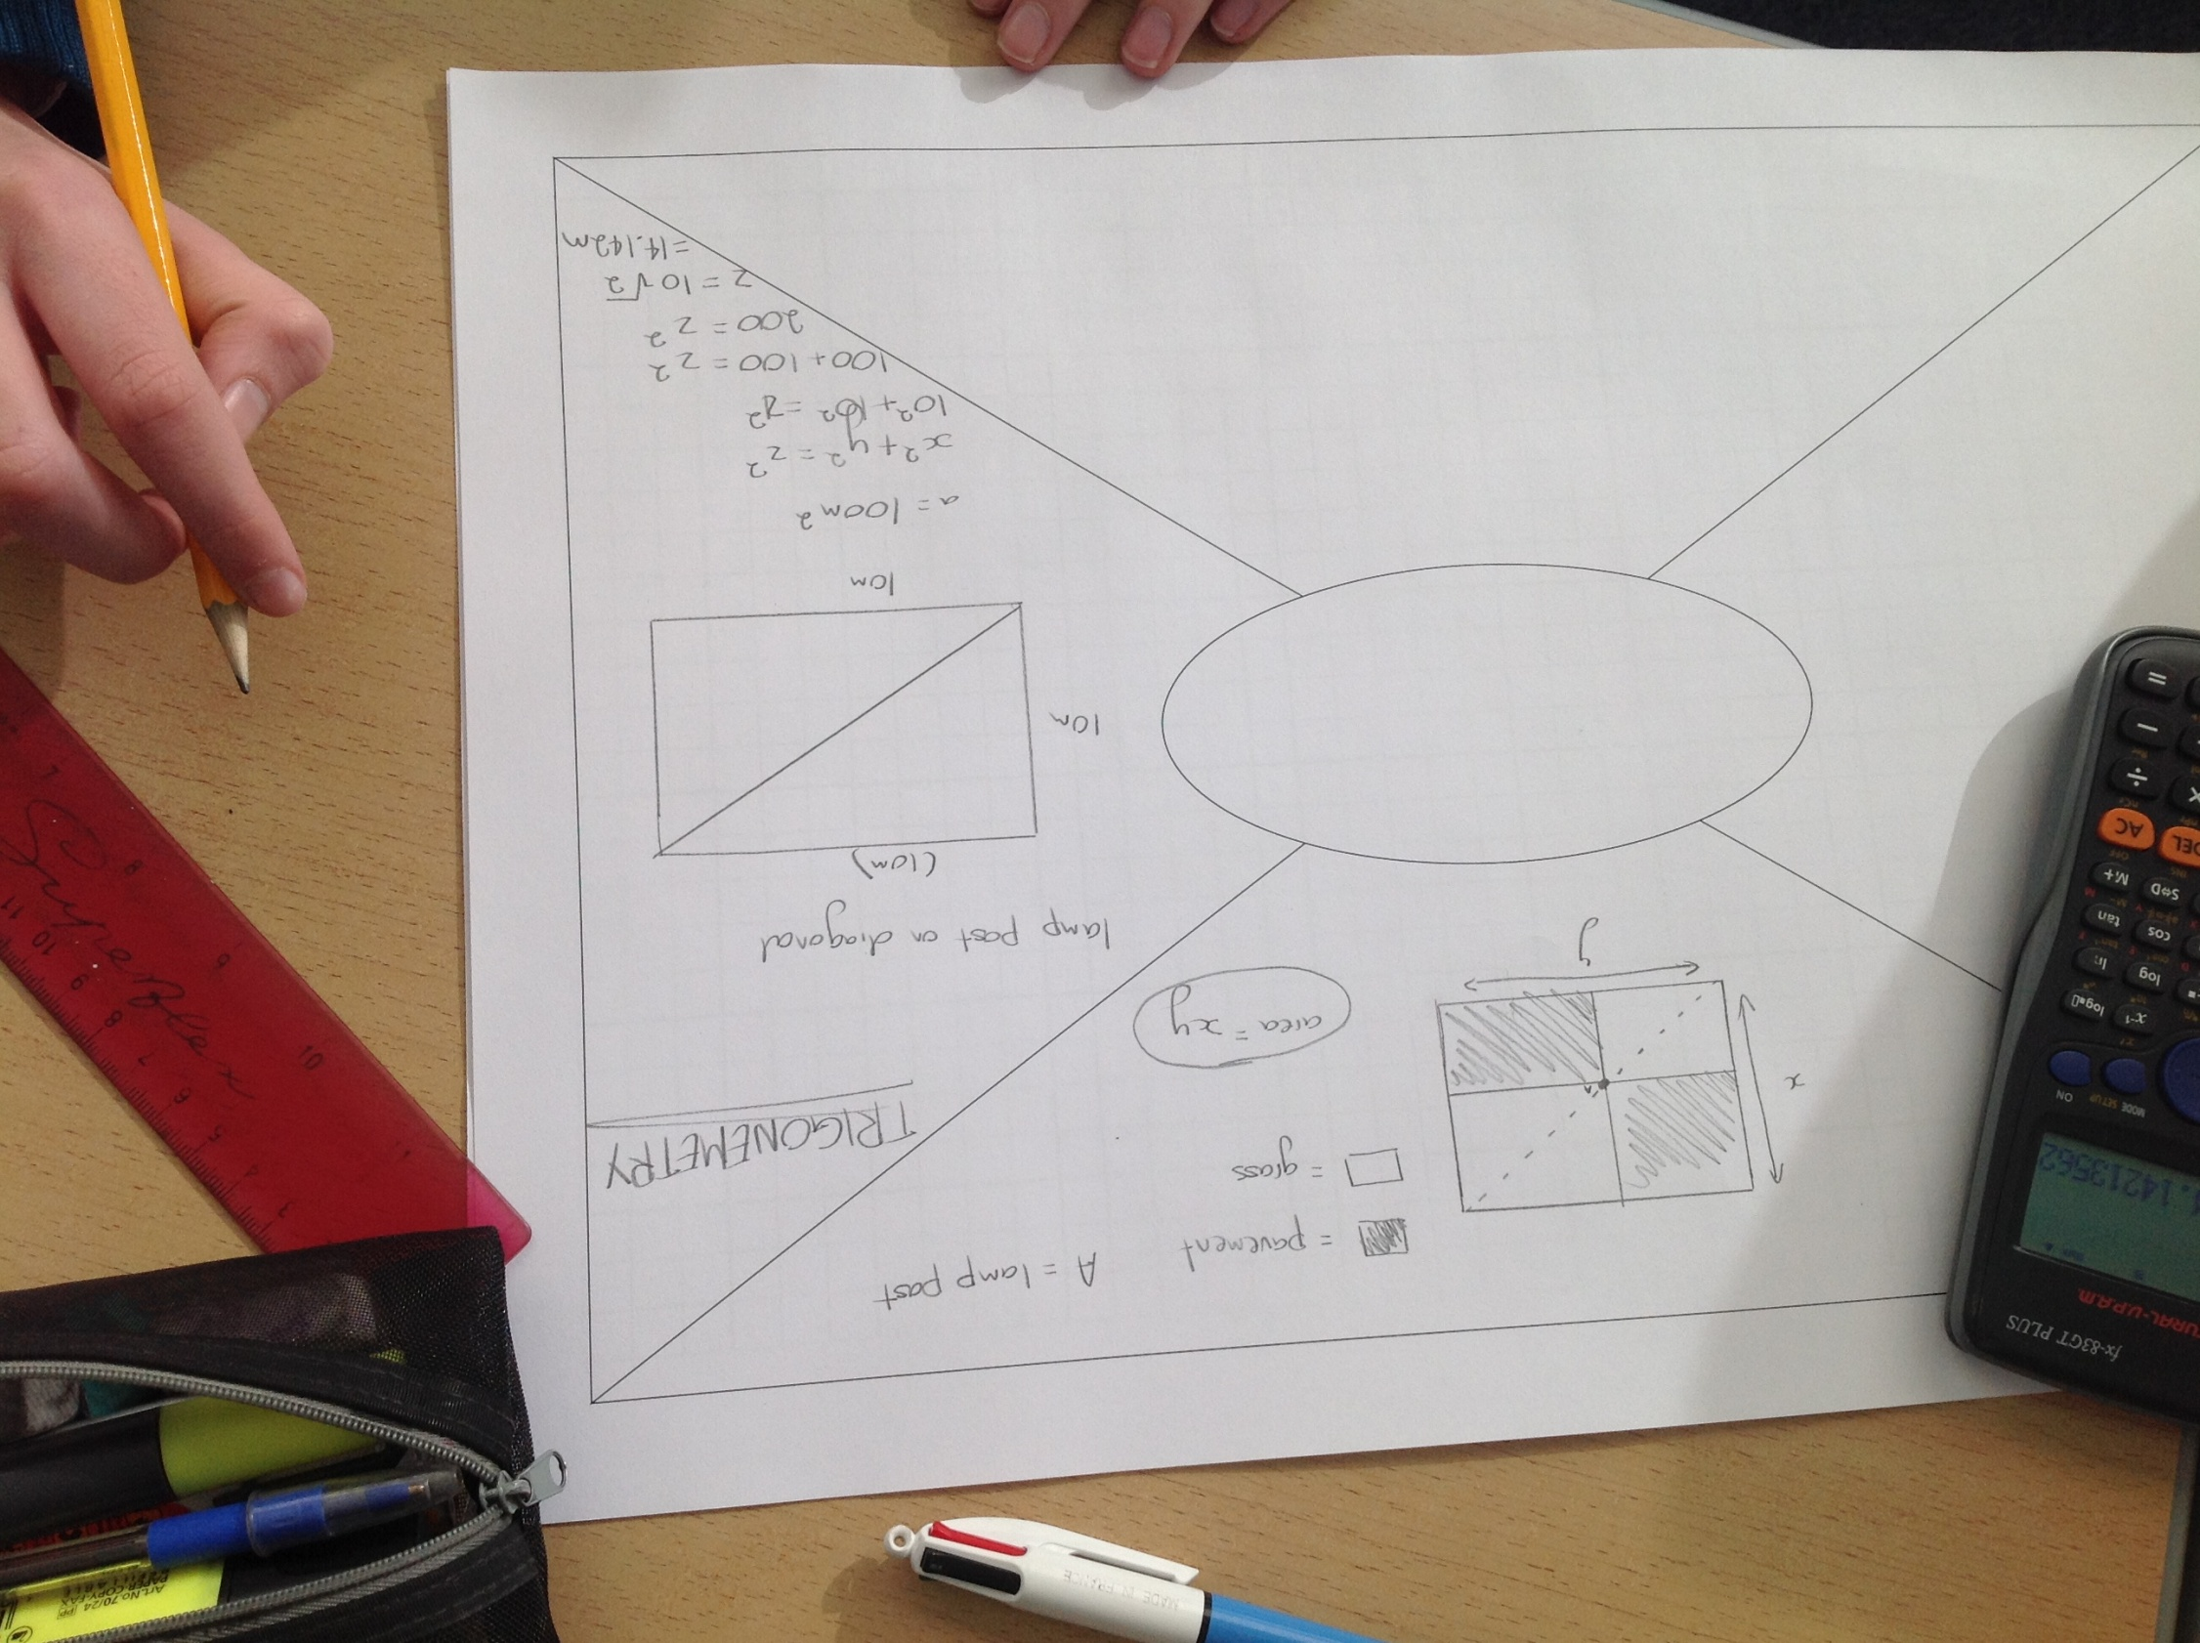
Findings

Slide 20
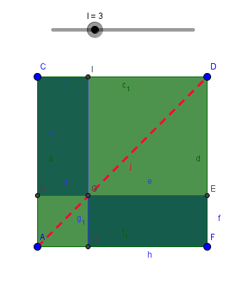
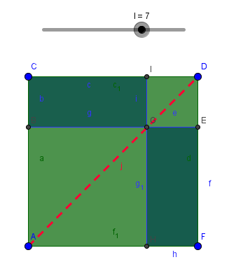
Findings/Student Learning
Students enjoyed this lesson
Difficulty around movement of lamp post and visualising this..GeoGebra
Applying more higher level type solutions..getting to a rule in algebra
Resizing of rectangles and movement /changes in sides of smaller rectangles

Slide 21
Findings/Student Learning
Results by Table
Table 1 | Table 2 | Table 3
R1 R2 | R1 | R1 R2
Table 4 | Table 5 | Table 6
R1 | R1 | R1 R2
Table 7 | Table 8 | Table 9
 | R2 R3

Slide 22
Findings/Student Learning
Most students tried a variety of methods
Geometry dominated
Trigonometry approach was one result teachers had not planned for
Students had to reflect and refine their “best” solution on table mat

Slide 23
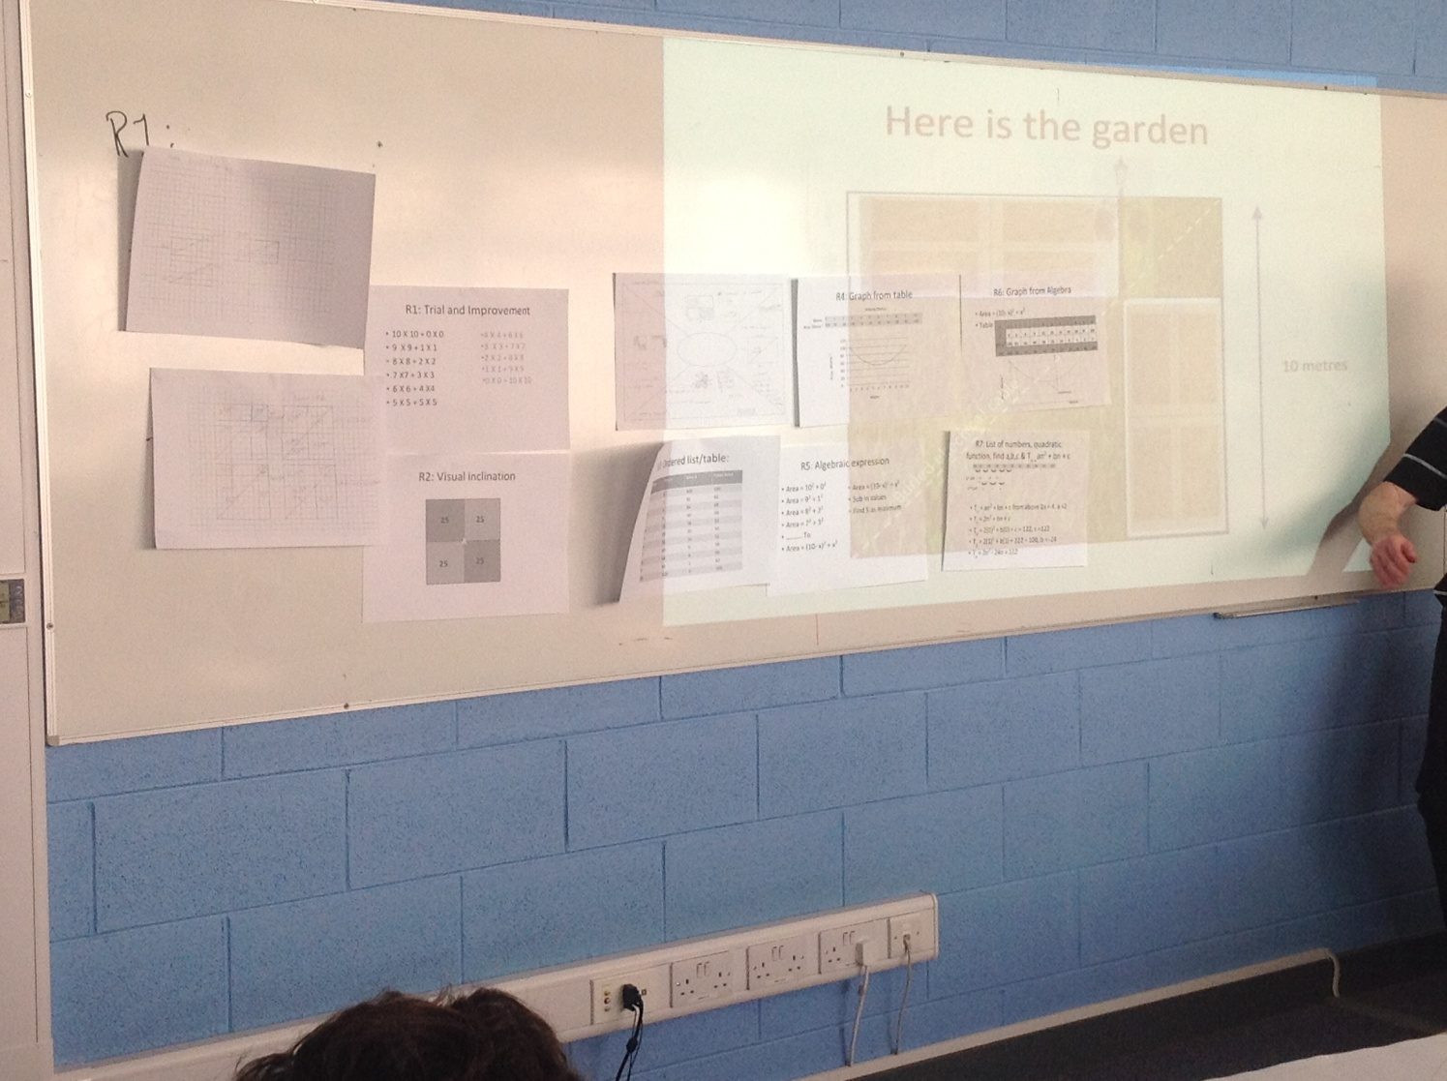
Findings/Student Learning

Slide 24
Board Plan

Slide 25
Recommendations
Tie lesson into Quadratic Functions
Use as extension question for Quadratic Functions
Emphasize perfect square pattern
Emphasize function x²
Revise x² algebra tile

Slide 26
Sources Used
Recent PISA studies
Page 26 of 3rd year teacher’s handbook
Page 32 of 3rd year teacher’s handbook
SEC Exam Papers

Slide 27
Any Questions?

Slide 28
Thank You!
Maths Counts 2016

