Slide 1
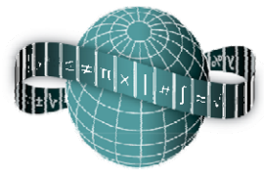
Reflections on Practice
Maths Counts 2016

Slide 2
Research Lesson
Proof of Mathematical Statements
with the use of
Axiom 4: SSS, SAS, ASA, RHS
(Congruent Triangle conditions)

Slide 3
Teachers
Lynn Anderson
Aoife Finnerty
Sinead Mahon
Louise McEvaddy
Julie Ryan

Slide 4
Details
Ms.Anderson’s Third Year Higher Level
Lesson Length: 50 mins
Friday, 27th February 2016
Lesson |  | # of lesson periods
1st Year | Prior Knowledge CIC | 7
Year 3
1 | Revision of key Geometrical terms from CIC | 2
2 | Introduction to Geometry and the axioms 1- 3, highlighting their role | 1
3 | Introduction to formal proof: Theorem 1 | 1
4 | Axiom 4 SSS, SAS | 1
5 | Axiom 4: ASA, RHS | 1
6 | The value and application of Axiom 4 | 1
7 | Axiom 5 and the continuation of Formal Proofs | 1

Slide 5
Student Learning Goals
Aims of the Lesson:
The aims for students: (Thematic Goals)
To appreciate that mathematics has contributed greatly through geometry to architecture and design
To appreciate that mathematics can be used to communicate thinking effectively
To become more creative when devising approaches and methods to solve problems
To build enthusiasm for the subject by engaging them with stimulating activities and challenges
To connect topics and develop strategies to investigate relationships and justify conclusions mathematically.

Slide 6
Lesson Specific Goals
Understand the concept of congruency.
Create congruent triangles.
To recognise that simple constructions of different types of line segments can create a unique set/pairs of congruent shapes in quadrilaterals.
Using congruency to justify their own geometrical decisions.
Learning Outcomes:
As a result of studying this topic students will be able to:
Understand congruency can refer to any set of shapes
Use axiom 4 appropriately to provide reasoning to justify congruency(as per syllabus)
Build upon axiom 4 to provide reasoning when asked in a formal proof setting
Identify when to use SSS, SAS, ASA, RHS and appreciate on certain occasions you can use one or more of these to validate congruency.

Slide 7
Design of Lesson
This involved 5 sessions and on-line work
Session 1: An introduction to Reflections on Practice: Problem Solving Lessons
Session 2: Drumcondra Research Lesson and selection of the topic; Geometry
Session 3: Finding a suitable problem to link with the curriculum and the selected group
Session 4: Developing the lesson plan, investigating the curriculum and developing the board plan
Session 5: Finalising the board and lesson plans. Preparing for the peer observation and Aims for Evaluation.
Research Lesson
After Lesson: Post Lesson Reflection

Slide 8
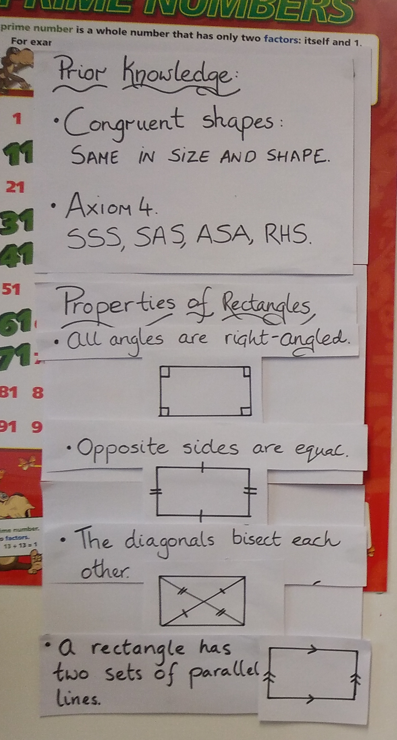
Flow of the Lesson
Prior Knowledge-5 mins
Prior Knowledge:

Slide 9
Flow of the Lesson:
Posing the Task
2. Posing the Task
E is equidistant from all four vertices. Find the coordinates of E in as many ways as possible. 5 min

Slide 10
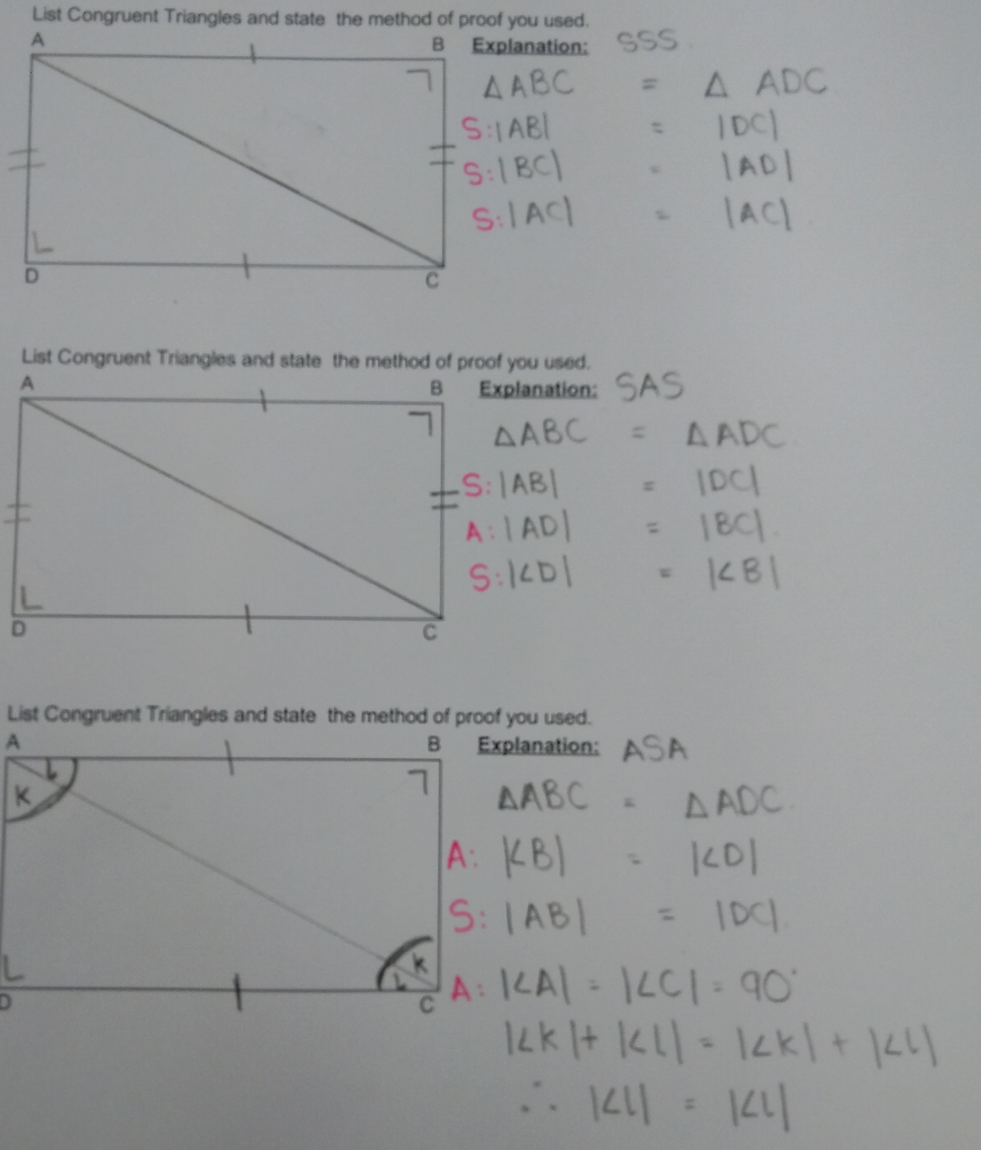
Flow of the Lesson
Students Working on Task-15 mins

Slide 11
Flow of the Lesson
Students on task

Slide 12
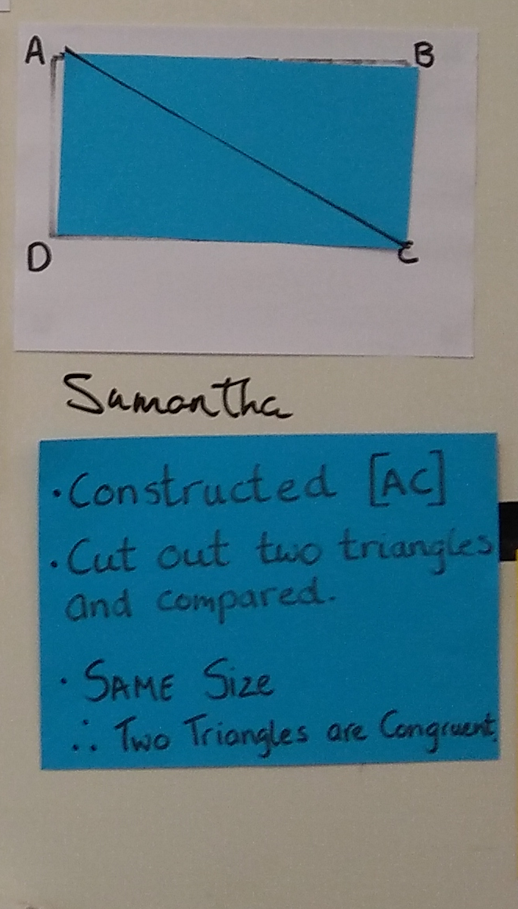
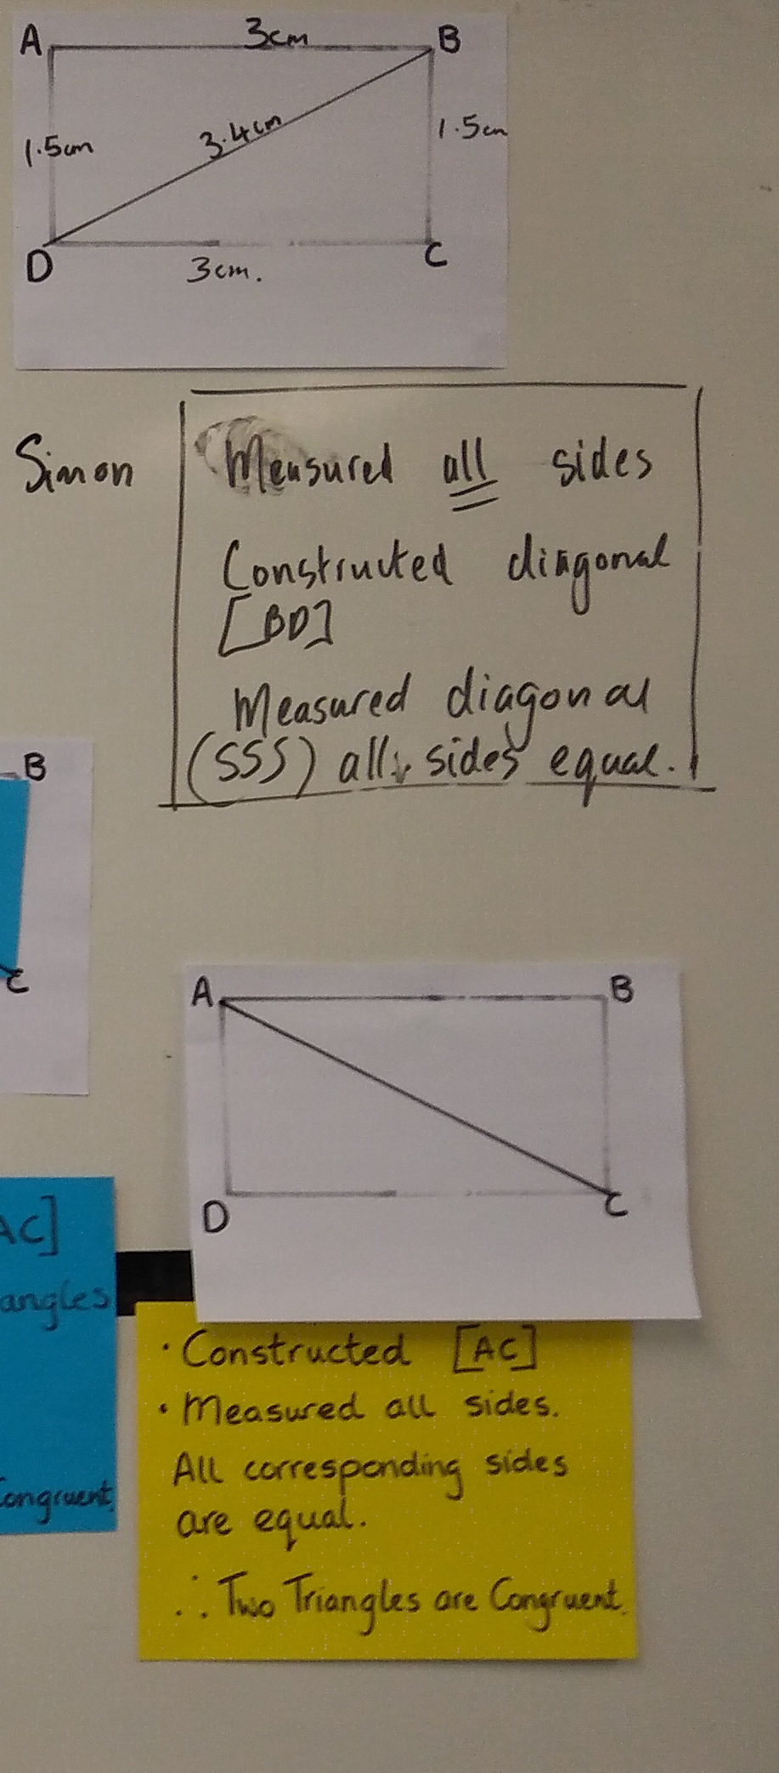
Flow of the Lesson
Comparing and Discussion-15 mins

Slide 13
Flow of the Lesson:
Summing up & Reflection-10 mins
Notes:
No time for comparison/identifying similarities

Slide 14
Materials
Worksheet
Compass
Ruler and/or set square
Scissors
Pencil

Slide 15
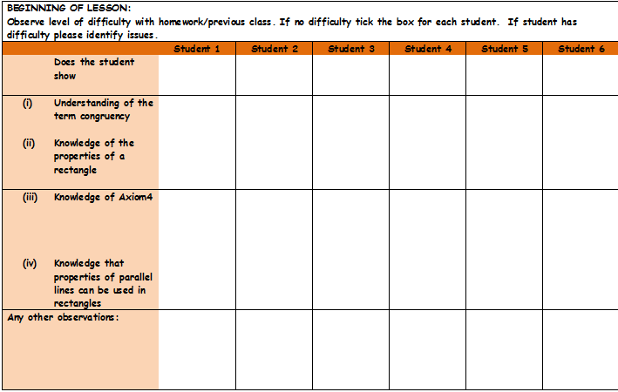
Plan for Peer Observation
A Student Observation Record was developed to assess students understanding of the task, achievement of the set goal and use of appropriate language/symbols.
Photographic evidence was gathered on the student’s work and key moments during the lesson were recorded.
Work completed on the board by students was recorded.
Teachers took responsibility for observing / recording the work of particular groups of students

Slide 16
Findings
Students were:
highly engaged and enjoyed the challenge set.
given an opportunity to self–correct and encouraged to make sure they had used correct sides/angles.
able to provide solutions and verbalise their reason behind answers given.
Interested in the whole class discussion, enjoyed listening to other students explanations and expressed any difficulties they had in the understanding of any explanations.

Slide 17
Findings/Student Learning
Learning Goals were achieved, however there was a distinct pattern observed.
SSS – Most popular method
RHS – Very popular method
ASA – 2 students attempted this-only one successfully. They did come up with an alternative ASA solution using the right angle.
Alternate Angles – Students had some difficulty explaining the term.
Some confusion between corresponding and alternate angles was identified and will be addressed during next lesson.
Cutting out to show congruency is an excellent idea.
The multiple approaches strategy proved highly successful, enabling students to compare and analyse other answers
The board plan is extremely beneficial but it requires an awful lot of work and preparation.
“I am going to do this exact lesson with my leaving certs this evening”

Slide 18
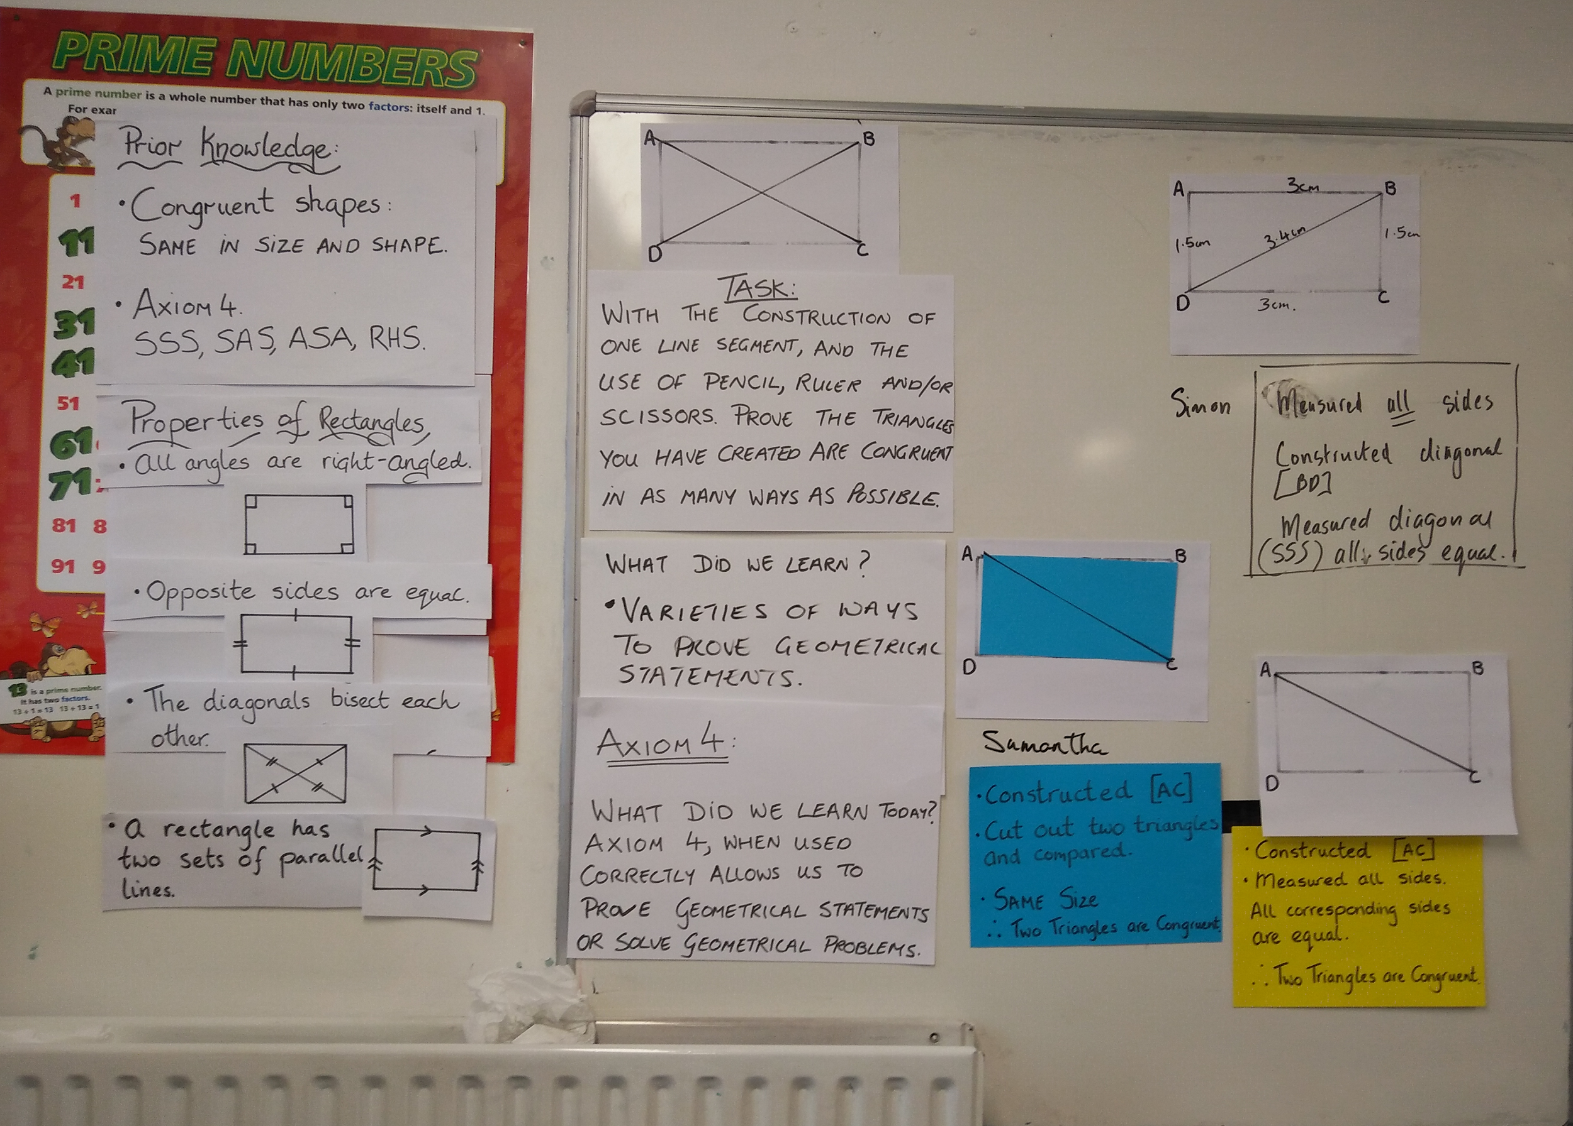
Board Plan: (1)

Slide 19
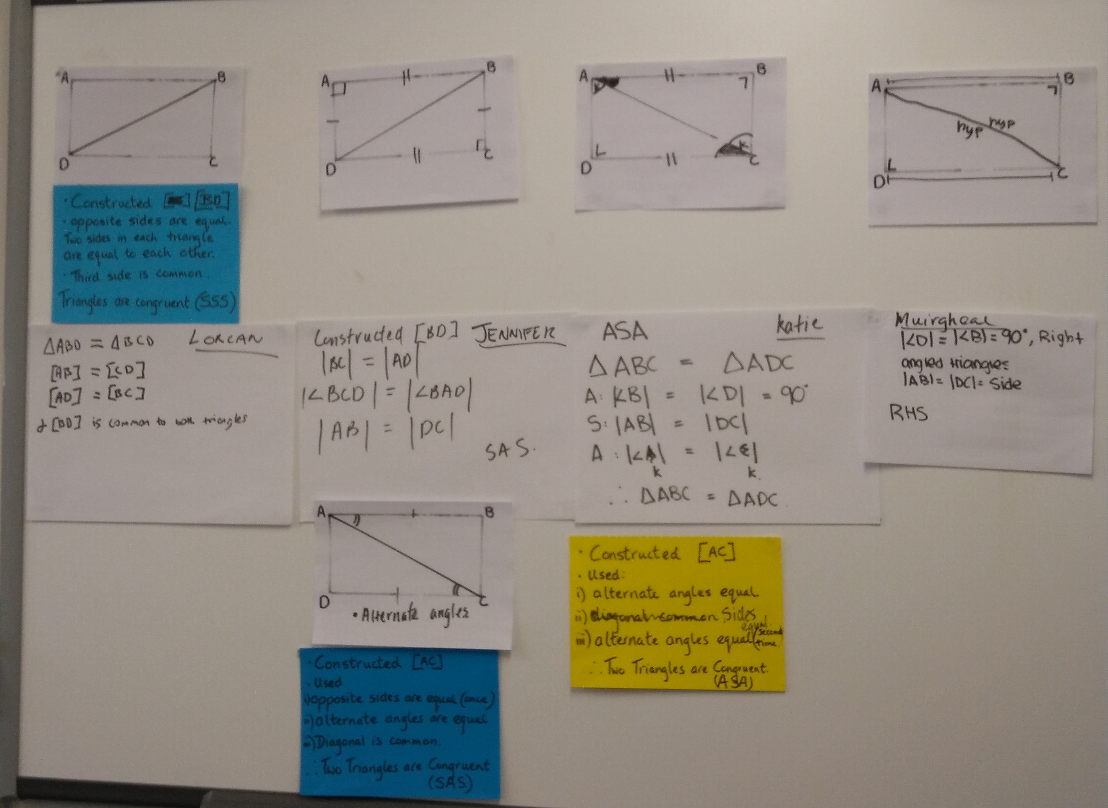
Board Plan (2)

Slide 20
Recommendations
The duration of the lesson proved challenging. An hour long lesson would be more suitable to allow a greater opportunity for discussion during the lesson. This would allow students to verbalise what they have learned and compare the different types of solutions and identify any similarities between them.
Prepare diagrams for the board based on both diagonal AC and diagonal BD.
Task clarification is essential and should not be rushed as it can hinder individuals work on task.
The observation experience resulted in some students being reluctant to present to their peers as a whole group. We felt that some students were intimidated. A process that the students will also take time adjusting to.

Slide 21
Any Questions?

Slide 22
Sources Used
www.projectmaths.ie
Junior Certificate Syllabus
Active Maths 1and 2
Text and Tests 1 and 2
Project Maths Handbooks for Second and Third Year
Junior Cert Maths Syllabus for Higher and Ordinary

Slide 23
Thank You!
Maths Counts 2016

