Slide 1
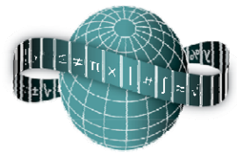
Reflections on Practice
Horst Punzet
Jennifer Duffy
Marcella Price
Rathdown School

Slide 2
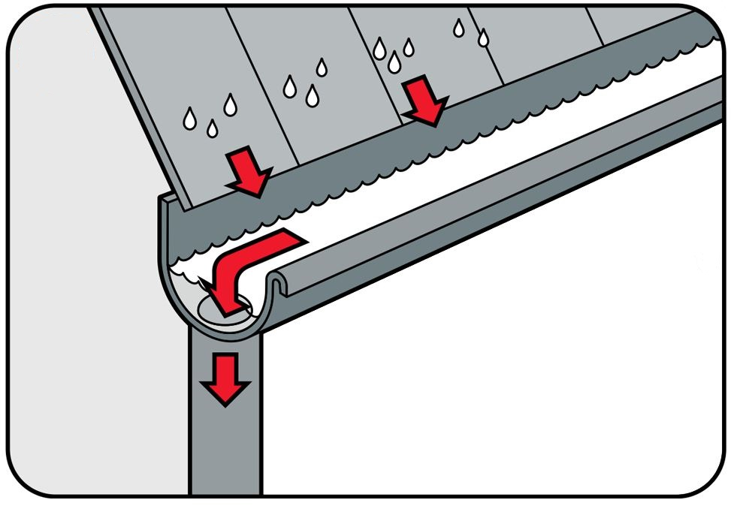
Designing the perfect gutter

Slide 3
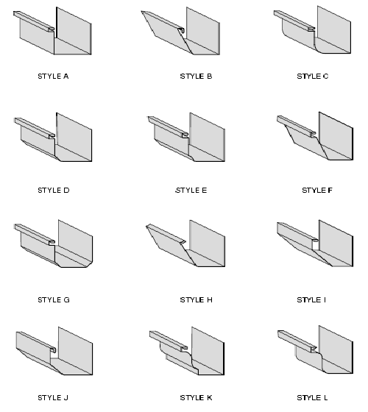
Designing the perfect gutter

Slide 4
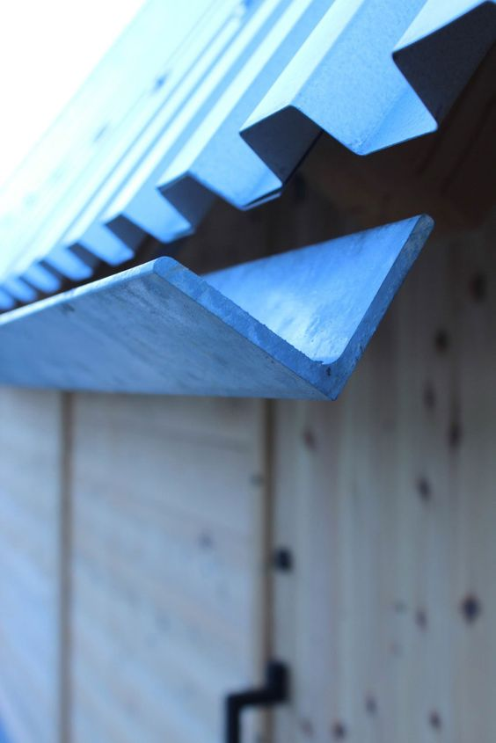
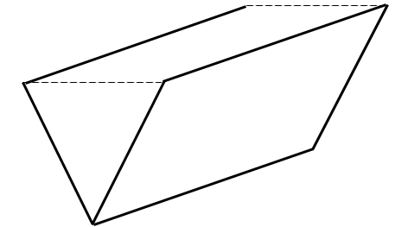
Design considerations:
Only fold in half
Maximize volume
Which way to fold?
Material costs
Installation costs
Maintenance costs

Slide 5
Key skills

Slide 6
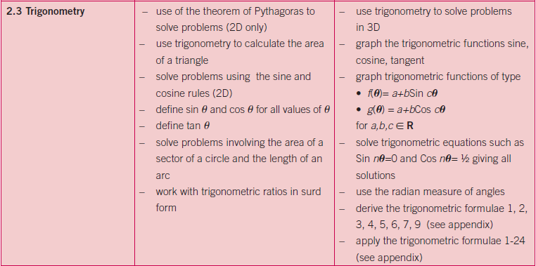
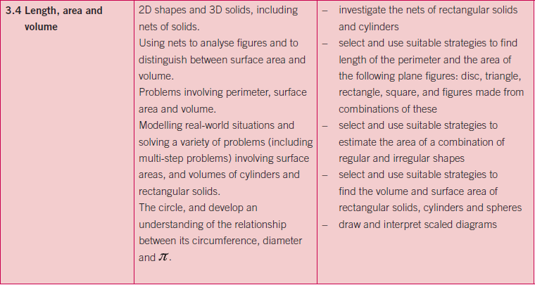
Syllabus skills

Slide 7
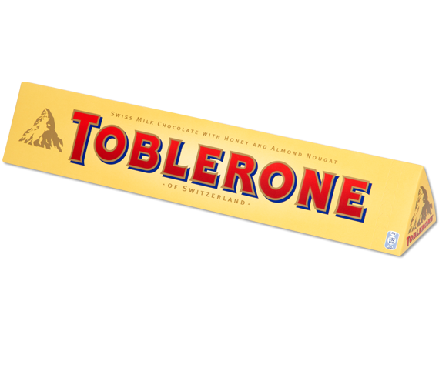
Lesson | Topic | # of lesson periods
1 | Right angled triangles and Pythagoras’ theorem | 2
2 | Finding the length of a side in a right–angled triangle | 1
3 | Using trigonometry to solve practical problems | 2
4 |  | 2
5 | The Sine Rule | 2
6 | The Cosine Rule | 2
7 | Nets of 3 dimensional shapes | 2
8 | Volume of prisms | 2
9 | To optimize the design of a rain gutter using one fold | 2 × 35 min. (#9 = research lesson)
10 | To optimize the design of a rain gutter using multiple folds | 8
1
2
Area of triangle = ab sin C

Slide 8
Flow of the lesson
Introduction
Use project management skills to develop best options
Use mathematics to solve real world problems
Use recent topics such as trigonometry, and volume of 3D shapes and nets, to investigate the design of a rain gutter for a building which will give the maximum flow

Slide 9
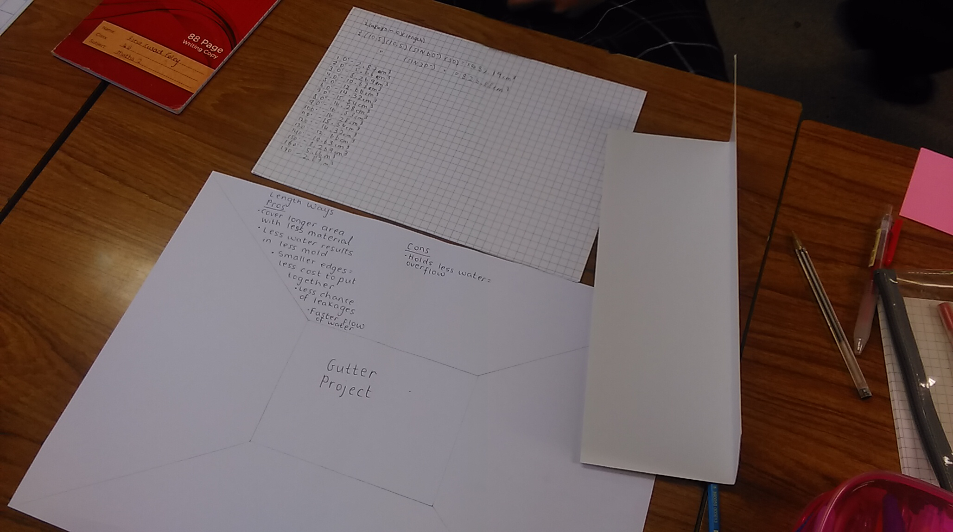
Flow of the lesson
Posing the task
Students will work in groups of 3 or 4
They will be given a piece of cardboard and asked to design a gutter by folding the cardboard in half
Each group will be given an A3 size placemat, graph paper and A4 size cardboard sheets
The task is to optimize the design of the gutter to achieve the maximum flow of water.
Each group must prepare a graph to illustrate their results
Each group will present their findings

Slide 10
Orientation

Slide 11
Methodology
Volume = Length × Cross Sectional Area
θ
10·5 cm
10·5 cm
θ

Slide 12
Methodology
1
2
Area of triangle = ab sin C
1
2
10·5 cm
Area of triangle = (10·5)(10·5)sin θ
θ
Area of triangle = 55·125sin θ

Slide 13
Methodology
x
1
2
Area of triangle = base × height
θ
10·5² – x²
y
10·5 cm
(2x)² = 10·5² + 10·5² – 2(10·5)(10·5)cos θ

Slide 14
Methodology
10·5 cm
10·5sinϕ
ϕ
10·5cosϕ

Slide 15
1800
1650
1500
1350
1200
Volume (cm³)
1050
900
750
600
450
300
150
0
30°
60°
90°
120°
150°
180°
Angle (degrees)

Slide 16
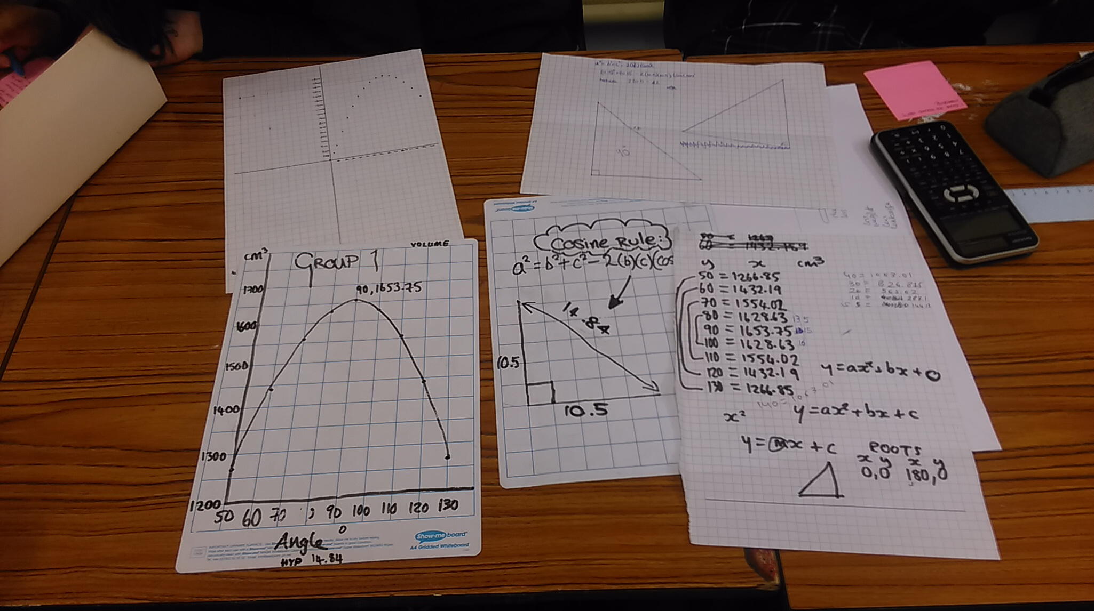
Group 1

Slide 17
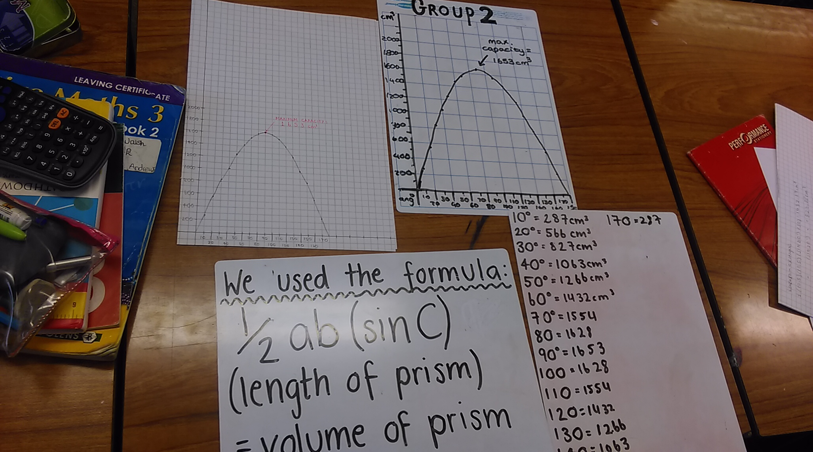
Group 2

Slide 18
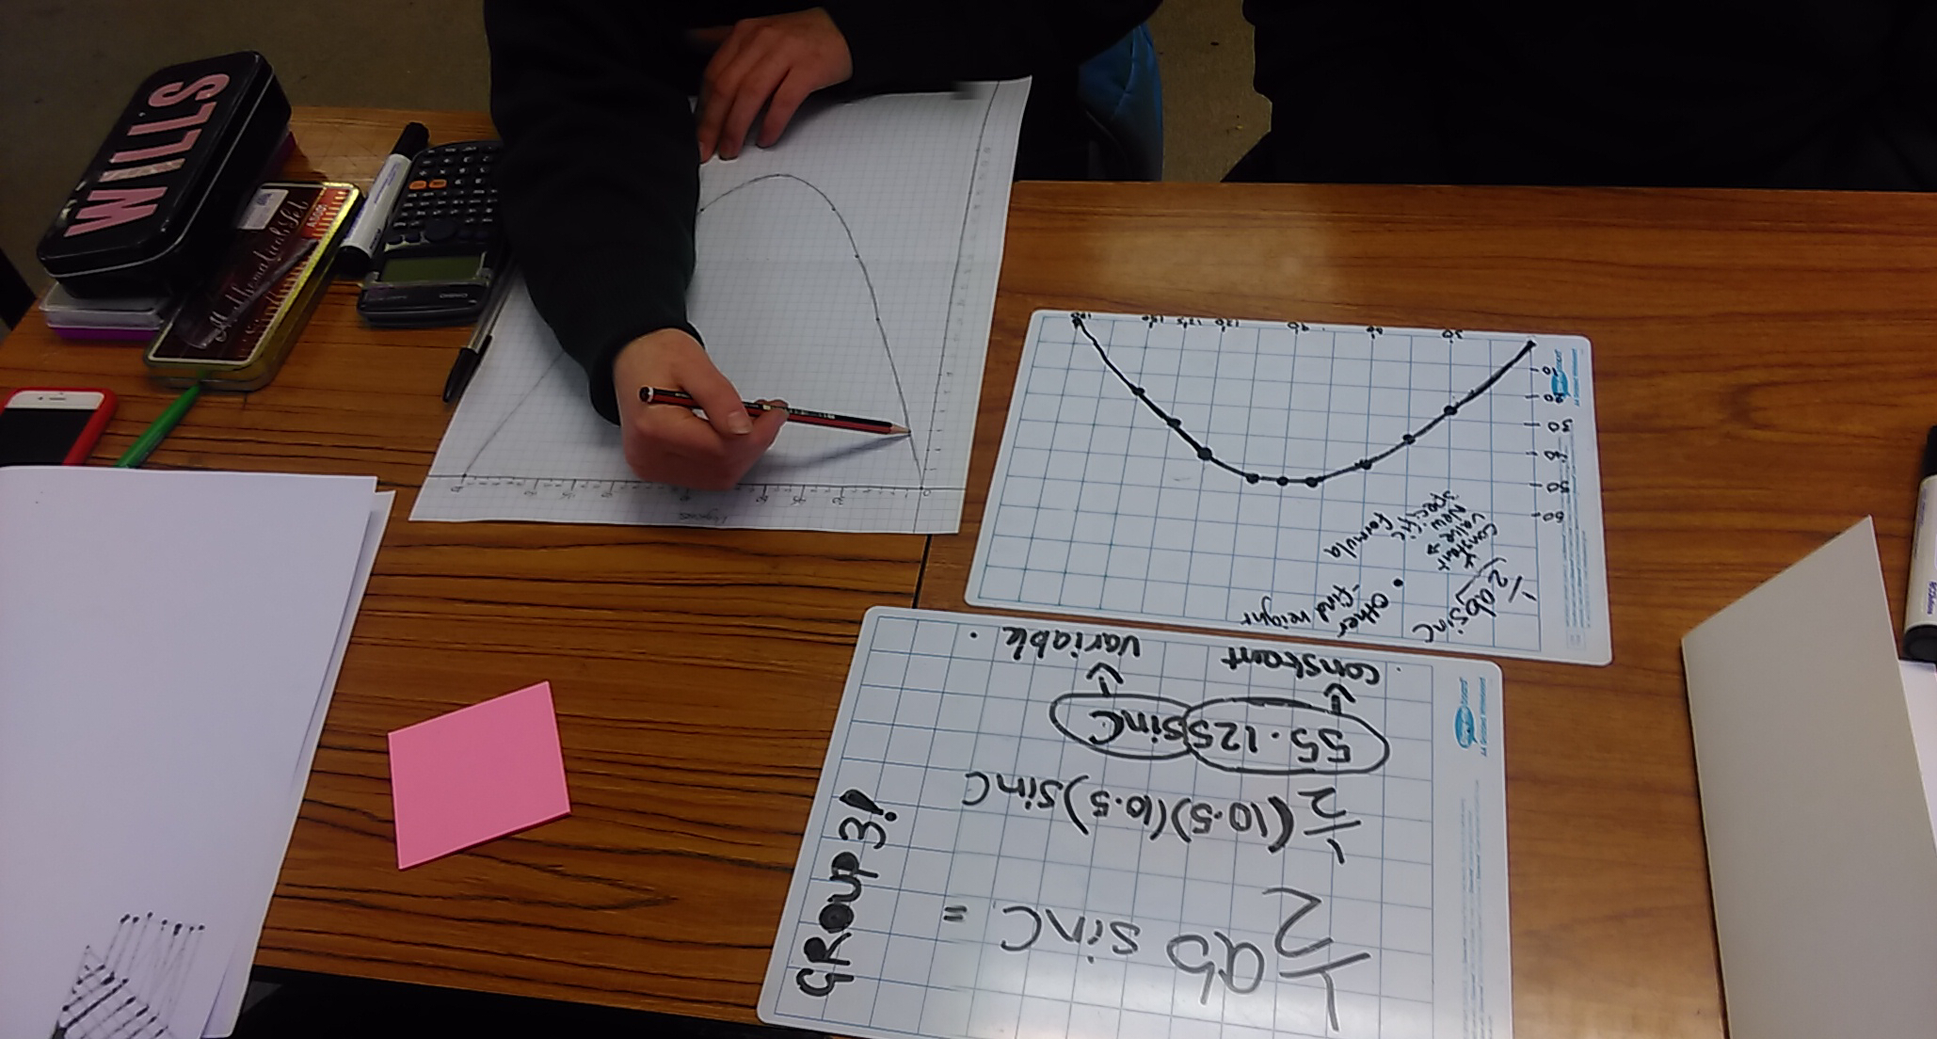
Group 3

Slide 19
Conclusions
Maximum volume was 1653·75 cm³
Maximum occurs when angle is 90°
55·125 is a constant and sinθ is a variable

Slide 20
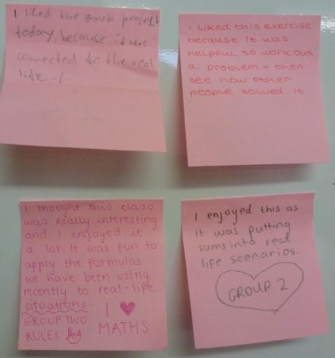
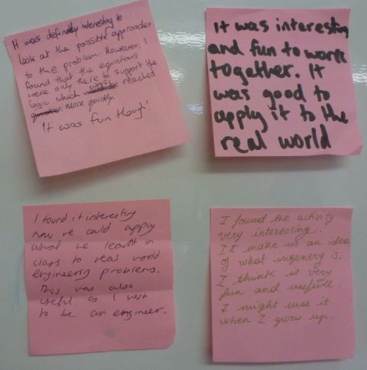
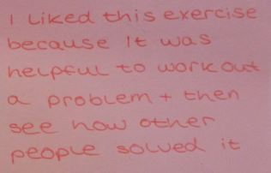
Student feedback

Slide 21
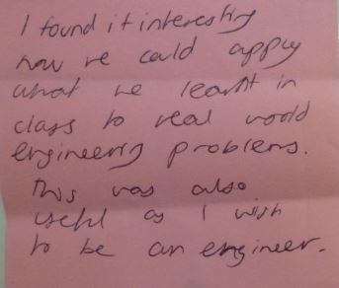
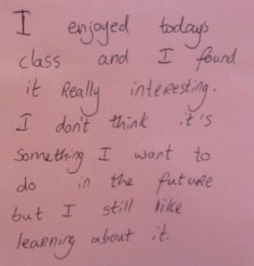
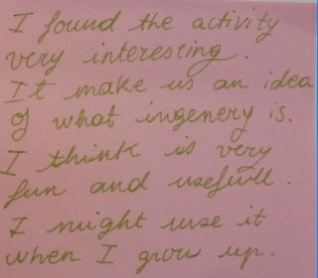
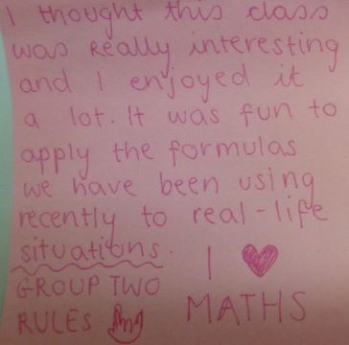
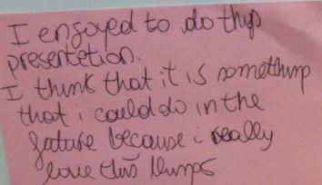
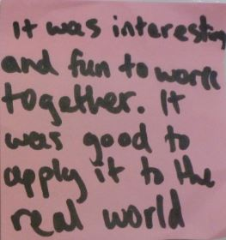
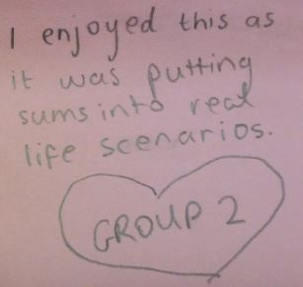
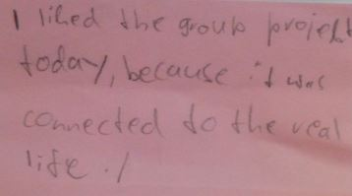

Slide 22
Follow on work
4 sides
A = 0·5(10·5)²
V = 55·125× 30
V = 1653·75 cm³
V= x(21– 2x)
5·25 cm
x
(21– 2x)
10·5 cm
Options,Nom:LeCadre,Fond:faux,Cadre:faux,xmin:56.69291,ymin:56.69291,xmax:481.8898,ymax:361.4173,MainLevee:faux,GrilleAimantee:faux,AfficheGrille:faux,echelleFigure:1,lGrille:1,hGrille:1|MultiPage1:0,TextBox16:#cen(polyA),OptionButton12:vrai,Label59:212.5984:152.3622,,Label122:,Image1.BackColor:0,Image1.ControlTipText:Solid 0.75 pt,CheckBox5:faux,Image5.BackColor:16777215,TextBox66:50,OptionButton39:vrai,OptionButton40:faux,OptionButton49:faux,OptionButton50:faux,TextBox74:,CheckBox7:faux,CheckBox8:faux,Label60:-10:-10,Label62:,Label63:,Label68:0;0,Label87:0|MultiPage1:0,TextBox16:A,OptionButton38:vrai,TextBox70:3.919689,TextBox69:#cen(polyA),TextBox71:0,TextBox72:free,Label58:° with,Label76:0,,Label122:,Image1.BackColor:0,Image1.ControlTipText:Solid 0.75 pt,CheckBox5:faux,Image5.BackColor:16777215,TextBox66:50,OptionButton39:vrai,OptionButton40:faux,OptionButton49:faux,OptionButton50:faux,TextBox74:,CheckBox7:faux,CheckBox8:faux,Label60:10:3.433291E-07,Label62:,Label63:,Label68:,Label87:9.790027:15.125|MultiPage1:1,TextBox1:[#cen(polyA)A],Label72:0,0,OptionButton15:vrai,Label75:,,Label122:,Image1.BackColor:0,Image1.ControlTipText:Continuous 0.75 pt,CheckBox5:faux,Image5.BackColor:16777215,TextBox66:50,OptionButton39:vrai,OptionButton40:faux,OptionButton49:faux,OptionButton50:faux,TextBox74:,CheckBox7:vrai,CheckBox8:faux,Label60:-10:-10,Label62:,Label63:,Label68:,Label87:88.98996:15.125|MultiPage1:0,TextBox16:B,OptionButton38:vrai,TextBox70:3.919689,TextBox69:#cen(polyA),TextBox71:45,TextBox72:(#cen(polyA)A),Label58:° with,Label76:0,,Label122:,Image1.BackColor:0,Image1.ControlTipText:Solid 0.75 pt,CheckBox5:faux,Image5.BackColor:16777215,TextBox66:50,OptionButton39:vrai,OptionButton40:faux,OptionButton49:faux,OptionButton50:faux,TextBox74:,CheckBox7:faux,CheckBox8:faux,Label60:7.071067:-7.071069,Label62:,Label63:,Label68:,Label87:8.91004:15.125|MultiPage1:1,TextBox1:[#cen(polyA)B],Label72:0,0,OptionButton15:vrai,Label75:,,Label122:,Image1.BackColor:0,Image1.ControlTipText:Continuous 0.75 pt,CheckBox5:faux,Image5.BackColor:16777215,TextBox66:50,OptionButton39:vrai,OptionButton40:faux,OptionButton49:faux,OptionButton50:faux,TextBox74:,CheckBox7:vrai,CheckBox8:faux,Label60:-10:-10,Label62:,Label63:,Label68:,Label87:88.11004:15.125|MultiPage1:0,TextBox16:C,OptionButton38:vrai,TextBox70:3.919689,TextBox69:#cen(polyA),TextBox71:45,TextBox72:(#cen(polyA)B),Label58:° with,Label76:0,,Label122:,Image1.BackColor:0,Image1.ControlTipText:Solid 0.75 pt,CheckBox5:faux,Image5.BackColor:16777215,TextBox66:50,OptionButton39:vrai,OptionButton40:faux,OptionButton49:faux,OptionButton50:faux,TextBox74:,CheckBox7:faux,CheckBox8:faux,Label60:-3.433289E-07:-10,Label62:,Label63:,Label68:,Label87:8.91004:15.125|MultiPage1:1,TextBox1:[#cen(polyA)C],Label72:0,0,OptionButton15:vrai,Label75:,,Label122:,Image1.BackColor:0,Image1.ControlTipText:Continuous 0.75 pt,CheckBox5:faux,Image5.BackColor:16777215,TextBox66:50,OptionButton39:vrai,OptionButton40:faux,OptionButton49:faux,OptionButton50:faux,TextBox74:,CheckBox7:vrai,CheckBox8:faux,Label60:-10:-10,Label62:,Label63:,Label68:,Label87:88.11004:15.125|MultiPage1:0,TextBox16:D,OptionButton38:vrai,TextBox70:3.919689,TextBox69:#cen(polyA),TextBox71:45,TextBox72:(#cen(polyA)C),Label58:° with,Label76:0,,Label122:,Image1.BackColor:0,Image1.ControlTipText:Solid 0.75 pt,CheckBox5:faux,Image5.BackColor:16777215,TextBox66:50,OptionButton39:vrai,OptionButton40:faux,OptionButton49:faux,OptionButton50:faux,TextBox74:,CheckBox7:faux,CheckBox8:faux,Label60:-7.071068:-7.071068,Label62:,Label63:,Label68:,Label87:9.790027:15.125|MultiPage1:1,TextBox1:[#cen(polyA)D],Label72:0,0,OptionButton15:vrai,Label75:,,Label122:,Image1.BackColor:0,Image1.ControlTipText:Continuous 0.75 pt,CheckBox5:faux,Image5.BackColor:16777215,TextBox66:50,OptionButton39:vrai,OptionButton40:faux,OptionButton49:faux,OptionButton50:faux,TextBox74:,CheckBox7:vrai,CheckBox8:faux,Label60:-10:-10,Label62:,Label63:,Label68:,Label87:88.98996:15.125|MultiPage1:0,TextBox16:E,OptionButton38:vrai,TextBox70:3.919689,TextBox69:#cen(polyA),TextBox71:45,TextBox72:(#cen(polyA)D),Label58:° with,Label76:0,,Label122:,Image1.BackColor:0,Image1.ControlTipText:Solid 0.75 pt,CheckBox5:faux,Image5.BackColor:16777215,TextBox66:50,OptionButton39:vrai,OptionButton40:faux,OptionButton49:faux,OptionButton50:faux,TextBox74:,CheckBox7:faux,CheckBox8:faux,Label60:-10:3.43329E-07,Label62:,Label63:,Label68:,Label87:8.030054:15.125|MultiPage1:1,TextBox1:[#cen(polyA)E],Label72:0,0,OptionButton15:vrai,Label75:,,Label122:,Image1.BackColor:0,Image1.ControlTipText:Continuous 0.75 pt,CheckBox5:faux,Image5.BackColor:16777215,TextBox66:50,OptionButton39:vrai,OptionButton40:faux,OptionButton49:faux,OptionButton50:faux,TextBox74:,CheckBox7:vrai,CheckBox8:faux,Label60:-10:-10,Label62:,Label63:,Label68:,Label87:87.23006:15.125|MultiPage1:0,TextBox16:F,OptionButton38:vrai,TextBox70:3.919689,TextBox69:#cen(polyA),TextBox71:45,TextBox72:(#cen(polyA)E),Label58:° with,Label76:0,,Label122:,Image1.BackColor:0,Image1.ControlTipText:Solid 0.75 pt,CheckBox5:faux,Image5.BackColor:16777215,TextBox66:50,OptionButton39:vrai,OptionButton40:faux,OptionButton49:faux,OptionButton50:faux,TextBox74:,CheckBox7:faux,CheckBox8:faux,Label60:-7.071068:7.071067,Label62:,Label63:,Label68:,Label87:7.15:15.125|MultiPage1:1,TextBox1:[#cen(polyA)F],Label72:0,0,OptionButton15:vrai,Label75:,,Label122:,Image1.BackColor:0,Image1.ControlTipText:Continuous 0.75 pt,CheckBox5:faux,Image5.BackColor:16777215,TextBox66:50,OptionButton39:vrai,OptionButton40:faux,OptionButton49:faux,OptionButton50:faux,TextBox74:,CheckBox7:vrai,CheckBox8:faux,Label60:-10:-10,Label62:,Label63:,Label68:,Label87:86.35:15.125|MultiPage1:0,TextBox16:G,OptionButton38:vrai,TextBox70:3.919689,TextBox69:#cen(polyA),TextBox71:45,TextBox72:(#cen(polyA)F),Label58:° with,Label76:0,,Label122:,Image1.BackColor:0,Image1.ControlTipText:Solid 0.75 pt,CheckBox5:faux,Image5.BackColor:16777215,TextBox66:50,OptionButton39:vrai,OptionButton40:faux,OptionButton49:faux,OptionButton50:faux,TextBox74:,CheckBox7:faux,CheckBox8:faux,Label60:-3.433291E-07:10,Label62:,Label63:,Label68:,Label87:9.790027:15.125|MultiPage1:1,TextBox1:[#cen(polyA)G],Label72:0,0,OptionButton15:vrai,Label75:,,Label122:,Image1.BackColor:0,Image1.ControlTipText:Continuous 0.75 pt,CheckBox5:faux,Image5.BackColor:16777215,TextBox66:50,OptionButton39:vrai,OptionButton40:faux,OptionButton49:faux,OptionButton50:faux,TextBox74:,CheckBox7:vrai,CheckBox8:faux,Label60:-10:-10,Label62:,Label63:,Label68:,Label87:88.98996:15.125|MultiPage1:0,TextBox16:H,OptionButton38:vrai,TextBox70:3.919689,TextBox69:#cen(polyA),TextBox71:45,TextBox72:(#cen(polyA)G),Label58:° with,Label76:0,,Label122:,Image1.BackColor:0,Image1.ControlTipText:Solid 0.75 pt,CheckBox5:faux,Image5.BackColor:16777215,TextBox66:50,OptionButton39:vrai,OptionButton40:faux,OptionButton49:faux,OptionButton50:faux,TextBox74:,CheckBox7:faux,CheckBox8:faux,Label60:7.071067:7.071068,Label62:,Label63:,Label68:,Label87:9.790027:15.125|MultiPage1:1,TextBox1:[#cen(polyA)H],Label72:0,0,OptionButton15:vrai,Label75:,,Label122:,Image1.BackColor:0,Image1.ControlTipText:Continuous 0.75 pt,CheckBox5:faux,Image5.BackColor:16777215,TextBox66:50,OptionButton39:vrai,OptionButton40:faux,OptionButton49:faux,OptionButton50:faux,TextBox74:,CheckBox7:vrai,CheckBox8:faux,Label60:-10:-10,Label62:,Label63:,Label68:,Label87:88.98996:15.125|MultiPage1:2,TextBox54:polyABCDEFGH,TextBox55:ABCDEFGH,OptionButton31:vrai,,Label122:,Image1.BackColor:0,Image1.ControlTipText:Continuous 0.75 pt,CheckBox5:faux,Image5.BackColor:16777215,TextBox66:50,OptionButton39:vrai,OptionButton40:faux,OptionButton49:faux,OptionButton50:faux,TextBox74:,CheckBox7:vrai,CheckBox8:faux,Label60:-10:-10,Label62:,Label63:,Label68:,Label87:97.01994:15.125|

Slide 23
Follow on work
6 sides
A = 0·5(7)²sin60°
× 3
V = 63·65× 30
V = 1910 cm³
60°
7 cm
Options,Nom:LeCadre,Fond:faux,Cadre:faux,xmin:56.69291,ymin:56.69291,xmax:481.8898,ymax:361.4173,MainLevee:faux,GrilleAimantee:faux,AfficheGrille:faux,echelleFigure:1,lGrille:1,hGrille:1|MultiPage1:0,TextBox16:#cen(polyA),OptionButton12:vrai,Label59:212.5984:152.3622,,Label122:,Image1.BackColor:0,Image1.ControlTipText:Solid 0.75 pt,CheckBox5:faux,Image5.BackColor:16777215,TextBox66:50,OptionButton39:vrai,OptionButton40:faux,OptionButton49:faux,OptionButton50:faux,TextBox74:,CheckBox7:faux,CheckBox8:faux,Label60:-10:-10,Label62:,Label63:,Label68:0;0,Label87:0|MultiPage1:0,TextBox16:A,OptionButton38:vrai,TextBox70:3,TextBox69:#cen(polyA),TextBox71:0,TextBox72:free,Label58:° with,Label76:0,,Label122:,Image1.BackColor:0,Image1.ControlTipText:Solid 0.75 pt,CheckBox5:faux,Image5.BackColor:16777215,TextBox66:50,OptionButton39:vrai,OptionButton40:faux,OptionButton49:faux,OptionButton50:faux,TextBox74:,CheckBox7:faux,CheckBox8:faux,Label60:10:4.485798E-07,Label62:,Label63:,Label68:,Label87:9.790027:15.125|MultiPage1:1,TextBox1:[#cen(polyA)A],Label72:0,0,OptionButton15:vrai,Label75:,,Label122:,Image1.BackColor:0,Image1.ControlTipText:Continuous 0.75 pt,CheckBox5:faux,Image5.BackColor:16777215,TextBox66:50,OptionButton39:vrai,OptionButton40:faux,OptionButton49:faux,OptionButton50:faux,TextBox74:,CheckBox7:vrai,CheckBox8:faux,Label60:-10:-10,Label62:,Label63:,Label68:,Label87:88.98996:15.125|MultiPage1:0,TextBox16:B,OptionButton38:vrai,TextBox70:3,TextBox69:#cen(polyA),TextBox71:60,TextBox72:(#cen(polyA)A),Label58:° with,Label76:0,,Label122:,Image1.BackColor:0,Image1.ControlTipText:Solid 0.75 pt,CheckBox5:faux,Image5.BackColor:16777215,TextBox66:50,OptionButton39:vrai,OptionButton40:faux,OptionButton49:faux,OptionButton50:faux,TextBox74:,CheckBox7:faux,CheckBox8:faux,Label60:5.000001:-8.660254,Label62:,Label63:,Label68:,Label87:8.91004:15.125|MultiPage1:1,TextBox1:[#cen(polyA)B],Label72:0,0,OptionButton15:vrai,Label75:,,Label122:,Image1.BackColor:0,Image1.ControlTipText:Continuous 0.75 pt,CheckBox5:faux,Image5.BackColor:16777215,TextBox66:50,OptionButton39:vrai,OptionButton40:faux,OptionButton49:faux,OptionButton50:faux,TextBox74:,CheckBox7:vrai,CheckBox8:faux,Label60:-10:-10,Label62:,Label63:,Label68:,Label87:88.11004:15.125|MultiPage1:0,TextBox16:C,OptionButton38:vrai,TextBox70:3,TextBox69:#cen(polyA),TextBox71:60,TextBox72:(#cen(polyA)B),Label58:° with,Label76:0,,Label122:,Image1.BackColor:0,Image1.ControlTipText:Solid 0.75 pt,CheckBox5:faux,Image5.BackColor:16777215,TextBox66:50,OptionButton39:vrai,OptionButton40:faux,OptionButton49:faux,OptionButton50:faux,TextBox74:,CheckBox7:faux,CheckBox8:faux,Label60:-5:-8.660254,Label62:,Label63:,Label68:,Label87:8.91004:15.125|MultiPage1:1,TextBox1:[#cen(polyA)C],Label72:0,0,OptionButton15:vrai,Label75:,,Label122:,Image1.BackColor:0,Image1.ControlTipText:Continuous 0.75 pt,CheckBox5:faux,Image5.BackColor:16777215,TextBox66:50,OptionButton39:vrai,OptionButton40:faux,OptionButton49:faux,OptionButton50:faux,TextBox74:,CheckBox7:vrai,CheckBox8:faux,Label60:-10:-10,Label62:,Label63:,Label68:,Label87:88.11004:15.125|MultiPage1:0,TextBox16:D,OptionButton38:vrai,TextBox70:3,TextBox69:#cen(polyA),TextBox71:60,TextBox72:(#cen(polyA)C),Label58:° with,Label76:0,,Label122:,Image1.BackColor:0,Image1.ControlTipText:Solid 0.75 pt,CheckBox5:faux,Image5.BackColor:16777215,TextBox66:50,OptionButton39:vrai,OptionButton40:faux,OptionButton49:faux,OptionButton50:faux,TextBox74:,CheckBox7:faux,CheckBox8:faux,Label60:-10:4.485799E-07,Label62:,Label63:,Label68:,Label87:9.790027:15.125|MultiPage1:1,TextBox1:[#cen(polyA)D],Label72:0,0,OptionButton15:vrai,Label75:,,Label122:,Image1.BackColor:0,Image1.ControlTipText:Continuous 0.75 pt,CheckBox5:faux,Image5.BackColor:16777215,TextBox66:50,OptionButton39:vrai,OptionButton40:faux,OptionButton49:faux,OptionButton50:faux,TextBox74:,CheckBox7:vrai,CheckBox8:faux,Label60:-10:-10,Label62:,Label63:,Label68:,Label87:88.98996:15.125|MultiPage1:0,TextBox16:E,OptionButton38:vrai,TextBox70:3,TextBox69:#cen(polyA),TextBox71:60,TextBox72:(#cen(polyA)D),Label58:° with,Label76:0,,Label122:,Image1.BackColor:0,Image1.ControlTipText:Solid 0.75 pt,CheckBox5:faux,Image5.BackColor:16777215,TextBox66:50,OptionButton39:vrai,OptionButton40:faux,OptionButton49:faux,OptionButton50:faux,TextBox74:,CheckBox7:faux,CheckBox8:faux,Label60:-5:8.660254,Label62:,Label63:,Label68:,Label87:8.030054:15.125|MultiPage1:1,TextBox1:[#cen(polyA)E],Label72:0,0,OptionButton15:vrai,Label75:,,Label122:,Image1.BackColor:0,Image1.ControlTipText:Continuous 0.75 pt,CheckBox5:faux,Image5.BackColor:16777215,TextBox66:50,OptionButton39:vrai,OptionButton40:faux,OptionButton49:faux,OptionButton50:faux,TextBox74:,CheckBox7:vrai,CheckBox8:faux,Label60:-10:-10,Label62:,Label63:,Label68:,Label87:87.23006:15.125|MultiPage1:0,TextBox16:F,OptionButton38:vrai,TextBox70:3,TextBox69:#cen(polyA),TextBox71:60,TextBox72:(#cen(polyA)E),Label58:° with,Label76:0,,Label122:,Image1.BackColor:0,Image1.ControlTipText:Solid 0.75 pt,CheckBox5:faux,Image5.BackColor:16777215,TextBox66:50,OptionButton39:vrai,OptionButton40:faux,OptionButton49:faux,OptionButton50:faux,TextBox74:,CheckBox7:faux,CheckBox8:faux,Label60:5.000001:8.660254,Label62:,Label63:,Label68:,Label87:7.15:15.125|MultiPage1:1,TextBox1:[#cen(polyA)F],Label72:0,0,OptionButton15:vrai,Label75:,,Label122:,Image1.BackColor:0,Image1.ControlTipText:Continuous 0.75 pt,CheckBox5:faux,Image5.BackColor:16777215,TextBox66:50,OptionButton39:vrai,OptionButton40:faux,OptionButton49:faux,OptionButton50:faux,TextBox74:,CheckBox7:vrai,CheckBox8:faux,Label60:-10:-10,Label62:,Label63:,Label68:,Label87:86.35:15.125|MultiPage1:2,TextBox54:polyABCDEF,TextBox55:ABCDEF,OptionButton31:vrai,,Label122:,Image1.BackColor:0,Image1.ControlTipText:Continuous 0.75 pt,CheckBox5:faux,Image5.BackColor:16777215,TextBox66:50,OptionButton39:vrai,OptionButton40:faux,OptionButton49:faux,OptionButton50:faux,TextBox74:,CheckBox7:vrai,CheckBox8:faux,Label60:-10:-10,Label62:,Label63:,Label68:,Label87:77.43996:15.125|
Options,Nom:LeCadre,Fond:faux,Cadre:faux,xmin:56.69291,ymin:56.69291,xmax:481.8898,ymax:361.4173,MainLevee:faux,GrilleAimantee:faux,AfficheGrille:faux,echelleFigure:1,lGrille:1,hGrille:1|MultiPage1:0,TextBox16:#cen(polyA),OptionButton12:vrai,Label59:212.5984:152.3622,,Label122:,Image1.BackColor:0,Image1.ControlTipText:Solid 0.75 pt,CheckBox5:faux,Image5.BackColor:16777215,TextBox66:50,OptionButton39:vrai,OptionButton40:faux,OptionButton49:faux,OptionButton50:faux,TextBox74:,CheckBox7:faux,CheckBox8:faux,Label60:-10:-10,Label62:,Label63:,Label68:0;0,Label87:0|MultiPage1:0,TextBox16:A,OptionButton38:vrai,TextBox70:3.919689,TextBox69:#cen(polyA),TextBox71:0,TextBox72:free,Label58:° with,Label76:0,,Label122:,Image1.BackColor:0,Image1.ControlTipText:Solid 0.75 pt,CheckBox5:faux,Image5.BackColor:16777215,TextBox66:50,OptionButton39:vrai,OptionButton40:faux,OptionButton49:faux,OptionButton50:faux,TextBox74:,CheckBox7:faux,CheckBox8:faux,Label60:10:3.433291E-07,Label62:,Label63:,Label68:,Label87:9.790027:15.125|MultiPage1:1,TextBox1:[#cen(polyA)A],Label72:0,0,OptionButton15:vrai,Label75:,,Label122:,Image1.BackColor:0,Image1.ControlTipText:Continuous 0.75 pt,CheckBox5:faux,Image5.BackColor:16777215,TextBox66:50,OptionButton39:vrai,OptionButton40:faux,OptionButton49:faux,OptionButton50:faux,TextBox74:,CheckBox7:vrai,CheckBox8:faux,Label60:-10:-10,Label62:,Label63:,Label68:,Label87:88.98996:15.125|MultiPage1:0,TextBox16:B,OptionButton38:vrai,TextBox70:3.919689,TextBox69:#cen(polyA),TextBox71:45,TextBox72:(#cen(polyA)A),Label58:° with,Label76:0,,Label122:,Image1.BackColor:0,Image1.ControlTipText:Solid 0.75 pt,CheckBox5:faux,Image5.BackColor:16777215,TextBox66:50,OptionButton39:vrai,OptionButton40:faux,OptionButton49:faux,OptionButton50:faux,TextBox74:,CheckBox7:faux,CheckBox8:faux,Label60:7.071067:-7.071069,Label62:,Label63:,Label68:,Label87:8.91004:15.125|MultiPage1:1,TextBox1:[#cen(polyA)B],Label72:0,0,OptionButton15:vrai,Label75:,,Label122:,Image1.BackColor:0,Image1.ControlTipText:Continuous 0.75 pt,CheckBox5:faux,Image5.BackColor:16777215,TextBox66:50,OptionButton39:vrai,OptionButton40:faux,OptionButton49:faux,OptionButton50:faux,TextBox74:,CheckBox7:vrai,CheckBox8:faux,Label60:-10:-10,Label62:,Label63:,Label68:,Label87:88.11004:15.125|MultiPage1:0,TextBox16:C,OptionButton38:vrai,TextBox70:3.919689,TextBox69:#cen(polyA),TextBox71:45,TextBox72:(#cen(polyA)B),Label58:° with,Label76:0,,Label122:,Image1.BackColor:0,Image1.ControlTipText:Solid 0.75 pt,CheckBox5:faux,Image5.BackColor:16777215,TextBox66:50,OptionButton39:vrai,OptionButton40:faux,OptionButton49:faux,OptionButton50:faux,TextBox74:,CheckBox7:faux,CheckBox8:faux,Label60:-3.433289E-07:-10,Label62:,Label63:,Label68:,Label87:8.91004:15.125|MultiPage1:1,TextBox1:[#cen(polyA)C],Label72:0,0,OptionButton15:vrai,Label75:,,Label122:,Image1.BackColor:0,Image1.ControlTipText:Continuous 0.75 pt,CheckBox5:faux,Image5.BackColor:16777215,TextBox66:50,OptionButton39:vrai,OptionButton40:faux,OptionButton49:faux,OptionButton50:faux,TextBox74:,CheckBox7:vrai,CheckBox8:faux,Label60:-10:-10,Label62:,Label63:,Label68:,Label87:88.11004:15.125|MultiPage1:0,TextBox16:D,OptionButton38:vrai,TextBox70:3.919689,TextBox69:#cen(polyA),TextBox71:45,TextBox72:(#cen(polyA)C),Label58:° with,Label76:0,,Label122:,Image1.BackColor:0,Image1.ControlTipText:Solid 0.75 pt,CheckBox5:faux,Image5.BackColor:16777215,TextBox66:50,OptionButton39:vrai,OptionButton40:faux,OptionButton49:faux,OptionButton50:faux,TextBox74:,CheckBox7:faux,CheckBox8:faux,Label60:-7.071068:-7.071068,Label62:,Label63:,Label68:,Label87:9.790027:15.125|MultiPage1:1,TextBox1:[#cen(polyA)D],Label72:0,0,OptionButton15:vrai,Label75:,,Label122:,Image1.BackColor:0,Image1.ControlTipText:Continuous 0.75 pt,CheckBox5:faux,Image5.BackColor:16777215,TextBox66:50,OptionButton39:vrai,OptionButton40:faux,OptionButton49:faux,OptionButton50:faux,TextBox74:,CheckBox7:vrai,CheckBox8:faux,Label60:-10:-10,Label62:,Label63:,Label68:,Label87:88.98996:15.125|MultiPage1:0,TextBox16:E,OptionButton38:vrai,TextBox70:3.919689,TextBox69:#cen(polyA),TextBox71:45,TextBox72:(#cen(polyA)D),Label58:° with,Label76:0,,Label122:,Image1.BackColor:0,Image1.ControlTipText:Solid 0.75 pt,CheckBox5:faux,Image5.BackColor:16777215,TextBox66:50,OptionButton39:vrai,OptionButton40:faux,OptionButton49:faux,OptionButton50:faux,TextBox74:,CheckBox7:faux,CheckBox8:faux,Label60:-10:3.43329E-07,Label62:,Label63:,Label68:,Label87:8.030054:15.125|MultiPage1:1,TextBox1:[#cen(polyA)E],Label72:0,0,OptionButton15:vrai,Label75:,,Label122:,Image1.BackColor:0,Image1.ControlTipText:Continuous 0.75 pt,CheckBox5:faux,Image5.BackColor:16777215,TextBox66:50,OptionButton39:vrai,OptionButton40:faux,OptionButton49:faux,OptionButton50:faux,TextBox74:,CheckBox7:vrai,CheckBox8:faux,Label60:-10:-10,Label62:,Label63:,Label68:,Label87:87.23006:15.125|MultiPage1:0,TextBox16:F,OptionButton38:vrai,TextBox70:3.919689,TextBox69:#cen(polyA),TextBox71:45,TextBox72:(#cen(polyA)E),Label58:° with,Label76:0,,Label122:,Image1.BackColor:0,Image1.ControlTipText:Solid 0.75 pt,CheckBox5:faux,Image5.BackColor:16777215,TextBox66:50,OptionButton39:vrai,OptionButton40:faux,OptionButton49:faux,OptionButton50:faux,TextBox74:,CheckBox7:faux,CheckBox8:faux,Label60:-7.071068:7.071067,Label62:,Label63:,Label68:,Label87:7.15:15.125|MultiPage1:1,TextBox1:[#cen(polyA)F],Label72:0,0,OptionButton15:vrai,Label75:,,Label122:,Image1.BackColor:0,Image1.ControlTipText:Continuous 0.75 pt,CheckBox5:faux,Image5.BackColor:16777215,TextBox66:50,OptionButton39:vrai,OptionButton40:faux,OptionButton49:faux,OptionButton50:faux,TextBox74:,CheckBox7:vrai,CheckBox8:faux,Label60:-10:-10,Label62:,Label63:,Label68:,Label87:86.35:15.125|MultiPage1:0,TextBox16:G,OptionButton38:vrai,TextBox70:3.919689,TextBox69:#cen(polyA),TextBox71:45,TextBox72:(#cen(polyA)F),Label58:° with,Label76:0,,Label122:,Image1.BackColor:0,Image1.ControlTipText:Solid 0.75 pt,CheckBox5:faux,Image5.BackColor:16777215,TextBox66:50,OptionButton39:vrai,OptionButton40:faux,OptionButton49:faux,OptionButton50:faux,TextBox74:,CheckBox7:faux,CheckBox8:faux,Label60:-3.433291E-07:10,Label62:,Label63:,Label68:,Label87:9.790027:15.125|MultiPage1:1,TextBox1:[#cen(polyA)G],Label72:0,0,OptionButton15:vrai,Label75:,,Label122:,Image1.BackColor:0,Image1.ControlTipText:Continuous 0.75 pt,CheckBox5:faux,Image5.BackColor:16777215,TextBox66:50,OptionButton39:vrai,OptionButton40:faux,OptionButton49:faux,OptionButton50:faux,TextBox74:,CheckBox7:vrai,CheckBox8:faux,Label60:-10:-10,Label62:,Label63:,Label68:,Label87:88.98996:15.125|MultiPage1:0,TextBox16:H,OptionButton38:vrai,TextBox70:3.919689,TextBox69:#cen(polyA),TextBox71:45,TextBox72:(#cen(polyA)G),Label58:° with,Label76:0,,Label122:,Image1.BackColor:0,Image1.ControlTipText:Solid 0.75 pt,CheckBox5:faux,Image5.BackColor:16777215,TextBox66:50,OptionButton39:vrai,OptionButton40:faux,OptionButton49:faux,OptionButton50:faux,TextBox74:,CheckBox7:faux,CheckBox8:faux,Label60:7.071067:7.071068,Label62:,Label63:,Label68:,Label87:9.790027:15.125|MultiPage1:1,TextBox1:[#cen(polyA)H],Label72:0,0,OptionButton15:vrai,Label75:,,Label122:,Image1.BackColor:0,Image1.ControlTipText:Continuous 0.75 pt,CheckBox5:faux,Image5.BackColor:16777215,TextBox66:50,OptionButton39:vrai,OptionButton40:faux,OptionButton49:faux,OptionButton50:faux,TextBox74:,CheckBox7:vrai,CheckBox8:faux,Label60:-10:-10,Label62:,Label63:,Label68:,Label87:88.98996:15.125|MultiPage1:2,TextBox54:polyABCDEFGH,TextBox55:ABCDEFGH,OptionButton31:vrai,,Label122:,Image1.BackColor:0,Image1.ControlTipText:Continuous 0.75 pt,CheckBox5:faux,Image5.BackColor:16777215,TextBox66:50,OptionButton39:vrai,OptionButton40:faux,OptionButton49:faux,OptionButton50:faux,TextBox74:,CheckBox7:vrai,CheckBox8:faux,Label60:-10:-10,Label62:,Label63:,Label68:,Label87:97.01994:15.125|

Slide 24
Follow on work
8 sides
A = 0·5(6·86)²sin45°
× 4
V = 66·55× 30
V = 1997 cm³
45°
5·25 cm
Options,Nom:LeCadre,Fond:faux,Cadre:faux,xmin:56.69291,ymin:56.69291,xmax:481.8898,ymax:361.4173,MainLevee:faux,GrilleAimantee:faux,AfficheGrille:faux,echelleFigure:1,lGrille:1,hGrille:1|MultiPage1:0,TextBox16:#cen(polyA),OptionButton12:vrai,Label59:212.5984:152.3622,,Label122:,Image1.BackColor:0,Image1.ControlTipText:Solid 0.75 pt,CheckBox5:faux,Image5.BackColor:16777215,TextBox66:50,OptionButton39:vrai,OptionButton40:faux,OptionButton49:faux,OptionButton50:faux,TextBox74:,CheckBox7:faux,CheckBox8:faux,Label60:-10:-10,Label62:,Label63:,Label68:0;0,Label87:0|MultiPage1:0,TextBox16:A,OptionButton38:vrai,TextBox70:3.919689,TextBox69:#cen(polyA),TextBox71:0,TextBox72:free,Label58:° with,Label76:0,,Label122:,Image1.BackColor:0,Image1.ControlTipText:Solid 0.75 pt,CheckBox5:faux,Image5.BackColor:16777215,TextBox66:50,OptionButton39:vrai,OptionButton40:faux,OptionButton49:faux,OptionButton50:faux,TextBox74:,CheckBox7:faux,CheckBox8:faux,Label60:10:3.433291E-07,Label62:,Label63:,Label68:,Label87:9.790027:15.125|MultiPage1:1,TextBox1:[#cen(polyA)A],Label72:0,0,OptionButton15:vrai,Label75:,,Label122:,Image1.BackColor:0,Image1.ControlTipText:Continuous 0.75 pt,CheckBox5:faux,Image5.BackColor:16777215,TextBox66:50,OptionButton39:vrai,OptionButton40:faux,OptionButton49:faux,OptionButton50:faux,TextBox74:,CheckBox7:vrai,CheckBox8:faux,Label60:-10:-10,Label62:,Label63:,Label68:,Label87:88.98996:15.125|MultiPage1:0,TextBox16:B,OptionButton38:vrai,TextBox70:3.919689,TextBox69:#cen(polyA),TextBox71:45,TextBox72:(#cen(polyA)A),Label58:° with,Label76:0,,Label122:,Image1.BackColor:0,Image1.ControlTipText:Solid 0.75 pt,CheckBox5:faux,Image5.BackColor:16777215,TextBox66:50,OptionButton39:vrai,OptionButton40:faux,OptionButton49:faux,OptionButton50:faux,TextBox74:,CheckBox7:faux,CheckBox8:faux,Label60:7.071067:-7.071069,Label62:,Label63:,Label68:,Label87:8.91004:15.125|MultiPage1:1,TextBox1:[#cen(polyA)B],Label72:0,0,OptionButton15:vrai,Label75:,,Label122:,Image1.BackColor:0,Image1.ControlTipText:Continuous 0.75 pt,CheckBox5:faux,Image5.BackColor:16777215,TextBox66:50,OptionButton39:vrai,OptionButton40:faux,OptionButton49:faux,OptionButton50:faux,TextBox74:,CheckBox7:vrai,CheckBox8:faux,Label60:-10:-10,Label62:,Label63:,Label68:,Label87:88.11004:15.125|MultiPage1:0,TextBox16:C,OptionButton38:vrai,TextBox70:3.919689,TextBox69:#cen(polyA),TextBox71:45,TextBox72:(#cen(polyA)B),Label58:° with,Label76:0,,Label122:,Image1.BackColor:0,Image1.ControlTipText:Solid 0.75 pt,CheckBox5:faux,Image5.BackColor:16777215,TextBox66:50,OptionButton39:vrai,OptionButton40:faux,OptionButton49:faux,OptionButton50:faux,TextBox74:,CheckBox7:faux,CheckBox8:faux,Label60:-3.433289E-07:-10,Label62:,Label63:,Label68:,Label87:8.91004:15.125|MultiPage1:1,TextBox1:[#cen(polyA)C],Label72:0,0,OptionButton15:vrai,Label75:,,Label122:,Image1.BackColor:0,Image1.ControlTipText:Continuous 0.75 pt,CheckBox5:faux,Image5.BackColor:16777215,TextBox66:50,OptionButton39:vrai,OptionButton40:faux,OptionButton49:faux,OptionButton50:faux,TextBox74:,CheckBox7:vrai,CheckBox8:faux,Label60:-10:-10,Label62:,Label63:,Label68:,Label87:88.11004:15.125|MultiPage1:0,TextBox16:D,OptionButton38:vrai,TextBox70:3.919689,TextBox69:#cen(polyA),TextBox71:45,TextBox72:(#cen(polyA)C),Label58:° with,Label76:0,,Label122:,Image1.BackColor:0,Image1.ControlTipText:Solid 0.75 pt,CheckBox5:faux,Image5.BackColor:16777215,TextBox66:50,OptionButton39:vrai,OptionButton40:faux,OptionButton49:faux,OptionButton50:faux,TextBox74:,CheckBox7:faux,CheckBox8:faux,Label60:-7.071068:-7.071068,Label62:,Label63:,Label68:,Label87:9.790027:15.125|MultiPage1:1,TextBox1:[#cen(polyA)D],Label72:0,0,OptionButton15:vrai,Label75:,,Label122:,Image1.BackColor:0,Image1.ControlTipText:Continuous 0.75 pt,CheckBox5:faux,Image5.BackColor:16777215,TextBox66:50,OptionButton39:vrai,OptionButton40:faux,OptionButton49:faux,OptionButton50:faux,TextBox74:,CheckBox7:vrai,CheckBox8:faux,Label60:-10:-10,Label62:,Label63:,Label68:,Label87:88.98996:15.125|MultiPage1:0,TextBox16:E,OptionButton38:vrai,TextBox70:3.919689,TextBox69:#cen(polyA),TextBox71:45,TextBox72:(#cen(polyA)D),Label58:° with,Label76:0,,Label122:,Image1.BackColor:0,Image1.ControlTipText:Solid 0.75 pt,CheckBox5:faux,Image5.BackColor:16777215,TextBox66:50,OptionButton39:vrai,OptionButton40:faux,OptionButton49:faux,OptionButton50:faux,TextBox74:,CheckBox7:faux,CheckBox8:faux,Label60:-10:3.43329E-07,Label62:,Label63:,Label68:,Label87:8.030054:15.125|MultiPage1:1,TextBox1:[#cen(polyA)E],Label72:0,0,OptionButton15:vrai,Label75:,,Label122:,Image1.BackColor:0,Image1.ControlTipText:Continuous 0.75 pt,CheckBox5:faux,Image5.BackColor:16777215,TextBox66:50,OptionButton39:vrai,OptionButton40:faux,OptionButton49:faux,OptionButton50:faux,TextBox74:,CheckBox7:vrai,CheckBox8:faux,Label60:-10:-10,Label62:,Label63:,Label68:,Label87:87.23006:15.125|MultiPage1:0,TextBox16:F,OptionButton38:vrai,TextBox70:3.919689,TextBox69:#cen(polyA),TextBox71:45,TextBox72:(#cen(polyA)E),Label58:° with,Label76:0,,Label122:,Image1.BackColor:0,Image1.ControlTipText:Solid 0.75 pt,CheckBox5:faux,Image5.BackColor:16777215,TextBox66:50,OptionButton39:vrai,OptionButton40:faux,OptionButton49:faux,OptionButton50:faux,TextBox74:,CheckBox7:faux,CheckBox8:faux,Label60:-7.071068:7.071067,Label62:,Label63:,Label68:,Label87:7.15:15.125|MultiPage1:1,TextBox1:[#cen(polyA)F],Label72:0,0,OptionButton15:vrai,Label75:,,Label122:,Image1.BackColor:0,Image1.ControlTipText:Continuous 0.75 pt,CheckBox5:faux,Image5.BackColor:16777215,TextBox66:50,OptionButton39:vrai,OptionButton40:faux,OptionButton49:faux,OptionButton50:faux,TextBox74:,CheckBox7:vrai,CheckBox8:faux,Label60:-10:-10,Label62:,Label63:,Label68:,Label87:86.35:15.125|MultiPage1:0,TextBox16:G,OptionButton38:vrai,TextBox70:3.919689,TextBox69:#cen(polyA),TextBox71:45,TextBox72:(#cen(polyA)F),Label58:° with,Label76:0,,Label122:,Image1.BackColor:0,Image1.ControlTipText:Solid 0.75 pt,CheckBox5:faux,Image5.BackColor:16777215,TextBox66:50,OptionButton39:vrai,OptionButton40:faux,OptionButton49:faux,OptionButton50:faux,TextBox74:,CheckBox7:faux,CheckBox8:faux,Label60:-3.433291E-07:10,Label62:,Label63:,Label68:,Label87:9.790027:15.125|MultiPage1:1,TextBox1:[#cen(polyA)G],Label72:0,0,OptionButton15:vrai,Label75:,,Label122:,Image1.BackColor:0,Image1.ControlTipText:Continuous 0.75 pt,CheckBox5:faux,Image5.BackColor:16777215,TextBox66:50,OptionButton39:vrai,OptionButton40:faux,OptionButton49:faux,OptionButton50:faux,TextBox74:,CheckBox7:vrai,CheckBox8:faux,Label60:-10:-10,Label62:,Label63:,Label68:,Label87:88.98996:15.125|MultiPage1:0,TextBox16:H,OptionButton38:vrai,TextBox70:3.919689,TextBox69:#cen(polyA),TextBox71:45,TextBox72:(#cen(polyA)G),Label58:° with,Label76:0,,Label122:,Image1.BackColor:0,Image1.ControlTipText:Solid 0.75 pt,CheckBox5:faux,Image5.BackColor:16777215,TextBox66:50,OptionButton39:vrai,OptionButton40:faux,OptionButton49:faux,OptionButton50:faux,TextBox74:,CheckBox7:faux,CheckBox8:faux,Label60:7.071067:7.071068,Label62:,Label63:,Label68:,Label87:9.790027:15.125|MultiPage1:1,TextBox1:[#cen(polyA)H],Label72:0,0,OptionButton15:vrai,Label75:,,Label122:,Image1.BackColor:0,Image1.ControlTipText:Continuous 0.75 pt,CheckBox5:faux,Image5.BackColor:16777215,TextBox66:50,OptionButton39:vrai,OptionButton40:faux,OptionButton49:faux,OptionButton50:faux,TextBox74:,CheckBox7:vrai,CheckBox8:faux,Label60:-10:-10,Label62:,Label63:,Label68:,Label87:88.98996:15.125|MultiPage1:2,TextBox54:polyABCDEFGH,TextBox55:ABCDEFGH,OptionButton31:vrai,,Label122:,Image1.BackColor:0,Image1.ControlTipText:Continuous 0.75 pt,CheckBox5:faux,Image5.BackColor:16777215,TextBox66:50,OptionButton39:vrai,OptionButton40:faux,OptionButton49:faux,OptionButton50:faux,TextBox74:,CheckBox7:vrai,CheckBox8:faux,Label60:-10:-10,Label62:,Label63:,Label68:,Label87:97.01994:15.125|

Slide 25
Follow on work
10 sides
A = 0·5(6·8)²sin36°
× 5
V = 67·86 × 30
V = 2036 cm³
36°
Options,Nom:LeCadre,Fond:faux,Cadre:faux,xmin:56.69291,ymin:56.69291,xmax:481.8898,ymax:361.4173,MainLevee:faux,GrilleAimantee:faux,AfficheGrille:faux,echelleFigure:1,lGrille:1,hGrille:1|MultiPage1:0,TextBox16:#cen(polyA),OptionButton12:vrai,Label59:212.5984:152.3622,,Label122:,Image1.BackColor:0,Image1.ControlTipText:Solid 0.75 pt,CheckBox5:faux,Image5.BackColor:16777215,TextBox66:50,OptionButton39:vrai,OptionButton40:faux,OptionButton49:faux,OptionButton50:faux,TextBox74:,CheckBox7:faux,CheckBox8:faux,Label60:-10:-10,Label62:,Label63:,Label68:0;0,Label87:0|MultiPage1:0,TextBox16:A,OptionButton38:vrai,TextBox70:4.854102,TextBox69:#cen(polyA),TextBox71:0,TextBox72:free,Label58:° with,Label76:0,,Label122:,Image1.BackColor:0,Image1.ControlTipText:Solid 0.75 pt,CheckBox5:faux,Image5.BackColor:16777215,TextBox66:50,OptionButton39:vrai,OptionButton40:faux,OptionButton49:faux,OptionButton50:faux,TextBox74:,CheckBox7:faux,CheckBox8:faux,Label60:10:1.663425E-06,Label62:,Label63:,Label68:,Label87:9.790027:15.125|MultiPage1:1,TextBox1:[#cen(polyA)A],Label72:0,0,OptionButton15:vrai,Label75:,,Label122:,Image1.BackColor:0,Image1.ControlTipText:Continuous 0.75 pt,CheckBox5:faux,Image5.BackColor:16777215,TextBox66:50,OptionButton39:vrai,OptionButton40:faux,OptionButton49:faux,OptionButton50:faux,TextBox74:,CheckBox7:vrai,CheckBox8:faux,Label60:-10:-10,Label62:,Label63:,Label68:,Label87:88.98996:15.125|MultiPage1:0,TextBox16:B,OptionButton38:vrai,TextBox70:4.854102,TextBox69:#cen(polyA),TextBox71:36,TextBox72:(#cen(polyA)A),Label58:° with,Label76:0,,Label122:,Image1.BackColor:0,Image1.ControlTipText:Solid 0.75 pt,CheckBox5:faux,Image5.BackColor:16777215,TextBox66:50,OptionButton39:vrai,OptionButton40:faux,OptionButton49:faux,OptionButton50:faux,TextBox74:,CheckBox7:faux,CheckBox8:faux,Label60:8.090168:-5.877855,Label62:,Label63:,Label68:,Label87:8.91004:15.125|MultiPage1:1,TextBox1:[#cen(polyA)B],Label72:0,0,OptionButton15:vrai,Label75:,,Label122:,Image1.BackColor:0,Image1.ControlTipText:Continuous 0.75 pt,CheckBox5:faux,Image5.BackColor:16777215,TextBox66:50,OptionButton39:vrai,OptionButton40:faux,OptionButton49:faux,OptionButton50:faux,TextBox74:,CheckBox7:vrai,CheckBox8:faux,Label60:-10:-10,Label62:,Label63:,Label68:,Label87:88.11004:15.125|MultiPage1:0,TextBox16:C,OptionButton38:vrai,TextBox70:4.854102,TextBox69:#cen(polyA),TextBox71:36,TextBox72:(#cen(polyA)B),Label58:° with,Label76:0,,Label122:,Image1.BackColor:0,Image1.ControlTipText:Solid 0.75 pt,CheckBox5:faux,Image5.BackColor:16777215,TextBox66:50,OptionButton39:vrai,OptionButton40:faux,OptionButton49:faux,OptionButton50:faux,TextBox74:,CheckBox7:faux,CheckBox8:faux,Label60:3.090163:-9.510568,Label62:,Label63:,Label68:,Label87:8.91004:15.125|MultiPage1:1,TextBox1:[#cen(polyA)C],Label72:0,0,OptionButton15:vrai,Label75:,,Label122:,Image1.BackColor:0,Image1.ControlTipText:Continuous 0.75 pt,CheckBox5:faux,Image5.BackColor:16777215,TextBox66:50,OptionButton39:vrai,OptionButton40:faux,OptionButton49:faux,OptionButton50:faux,TextBox74:,CheckBox7:vrai,CheckBox8:faux,Label60:-10:-10,Label62:,Label63:,Label68:,Label87:88.11004:15.125|MultiPage1:0,TextBox16:D,OptionButton38:vrai,TextBox70:4.854102,TextBox69:#cen(polyA),TextBox71:36,TextBox72:(#cen(polyA)C),Label58:° with,Label76:0,,Label122:,Image1.BackColor:0,Image1.ControlTipText:Solid 0.75 pt,CheckBox5:faux,Image5.BackColor:16777215,TextBox66:50,OptionButton39:vrai,OptionButton40:faux,OptionButton49:faux,OptionButton50:faux,TextBox74:,CheckBox7:faux,CheckBox8:faux,Label60:-3.090173:-9.510564,Label62:,Label63:,Label68:,Label87:9.790027:15.125|MultiPage1:1,TextBox1:[#cen(polyA)D],Label72:0,0,OptionButton15:vrai,Label75:,,Label122:,Image1.BackColor:0,Image1.ControlTipText:Continuous 0.75 pt,CheckBox5:faux,Image5.BackColor:16777215,TextBox66:50,OptionButton39:vrai,OptionButton40:faux,OptionButton49:faux,OptionButton50:faux,TextBox74:,CheckBox7:vrai,CheckBox8:faux,Label60:-10:-10,Label62:,Label63:,Label68:,Label87:88.98996:15.125|MultiPage1:0,TextBox16:E,OptionButton38:vrai,TextBox70:4.854102,TextBox69:#cen(polyA),TextBox71:36,TextBox72:(#cen(polyA)D),Label58:° with,Label76:0,,Label122:,Image1.BackColor:0,Image1.ControlTipText:Solid 0.75 pt,CheckBox5:faux,Image5.BackColor:16777215,TextBox66:50,OptionButton39:vrai,OptionButton40:faux,OptionButton49:faux,OptionButton50:faux,TextBox74:,CheckBox7:faux,CheckBox8:faux,Label60:-8.090176:-5.877845,Label62:,Label63:,Label68:,Label87:8.030054:15.125|MultiPage1:1,TextBox1:[#cen(polyA)E],Label72:0,0,OptionButton15:vrai,Label75:,,Label122:,Image1.BackColor:0,Image1.ControlTipText:Continuous 0.75 pt,CheckBox5:faux,Image5.BackColor:16777215,TextBox66:50,OptionButton39:vrai,OptionButton40:faux,OptionButton49:faux,OptionButton50:faux,TextBox74:,CheckBox7:vrai,CheckBox8:faux,Label60:-10:-10,Label62:,Label63:,Label68:,Label87:87.23006:15.125|MultiPage1:0,TextBox16:F,OptionButton38:vrai,TextBox70:4.854102,TextBox69:#cen(polyA),TextBox71:36,TextBox72:(#cen(polyA)E),Label58:° with,Label76:0,,Label122:,Image1.BackColor:0,Image1.ControlTipText:Solid 0.75 pt,CheckBox5:faux,Image5.BackColor:16777215,TextBox66:50,OptionButton39:vrai,OptionButton40:faux,OptionButton49:faux,OptionButton50:faux,TextBox74:,CheckBox7:faux,CheckBox8:faux,Label60:-10:1.303292E-05,Label62:,Label63:,Label68:,Label87:7.15:15.125|MultiPage1:1,TextBox1:[#cen(polyA)F],Label72:0,0,OptionButton15:vrai,Label75:,,Label122:,Image1.BackColor:0,Image1.ControlTipText:Continuous 0.75 pt,CheckBox5:faux,Image5.BackColor:16777215,TextBox66:50,OptionButton39:vrai,OptionButton40:faux,OptionButton49:faux,OptionButton50:faux,TextBox74:,CheckBox7:vrai,CheckBox8:faux,Label60:-10:-10,Label62:,Label63:,Label68:,Label87:86.35:15.125|MultiPage1:0,TextBox16:G,OptionButton38:vrai,TextBox70:4.854102,TextBox69:#cen(polyA),TextBox71:36,TextBox72:(#cen(polyA)F),Label58:° with,Label76:0,,Label122:,Image1.BackColor:0,Image1.ControlTipText:Solid 0.75 pt,CheckBox5:faux,Image5.BackColor:16777215,TextBox66:50,OptionButton39:vrai,OptionButton40:faux,OptionButton49:faux,OptionButton50:faux,TextBox74:,CheckBox7:faux,CheckBox8:faux,Label60:-8.090167:5.877857,Label62:,Label63:,Label68:,Label87:9.790027:15.125|MultiPage1:1,TextBox1:[#cen(polyA)G],Label72:0,0,OptionButton15:vrai,Label75:,,Label122:,Image1.BackColor:0,Image1.ControlTipText:Continuous 0.75 pt,CheckBox5:faux,Image5.BackColor:16777215,TextBox66:50,OptionButton39:vrai,OptionButton40:faux,OptionButton49:faux,OptionButton50:faux,TextBox74:,CheckBox7:vrai,CheckBox8:faux,Label60:-10:-10,Label62:,Label63:,Label68:,Label87:88.98996:15.125|MultiPage1:0,TextBox16:H,OptionButton38:vrai,TextBox70:4.854102,TextBox69:#cen(polyA),TextBox71:36,TextBox72:(#cen(polyA)G),Label58:° with,Label76:0,,Label122:,Image1.BackColor:0,Image1.ControlTipText:Solid 0.75 pt,CheckBox5:faux,Image5.BackColor:16777215,TextBox66:50,OptionButton39:vrai,OptionButton40:faux,OptionButton49:faux,OptionButton50:faux,TextBox74:,CheckBox7:faux,CheckBox8:faux,Label60:-3.090165:9.510567,Label62:,Label63:,Label68:,Label87:9.790027:15.125|MultiPage1:1,TextBox1:[#cen(polyA)H],Label72:0,0,OptionButton15:vrai,Label75:,,Label122:,Image1.BackColor:0,Image1.ControlTipText:Continuous 0.75 pt,CheckBox5:faux,Image5.BackColor:16777215,TextBox66:50,OptionButton39:vrai,OptionButton40:faux,OptionButton49:faux,OptionButton50:faux,TextBox74:,CheckBox7:vrai,CheckBox8:faux,Label60:-10:-10,Label62:,Label63:,Label68:,Label87:88.98996:15.125|MultiPage1:0,TextBox16:I,OptionButton38:vrai,TextBox70:4.854102,TextBox69:#cen(polyA),TextBox71:36,TextBox72:(#cen(polyA)H),Label58:° with,Label76:0,,Label122:,Image1.BackColor:0,Image1.ControlTipText:Solid 0.75 pt,CheckBox5:faux,Image5.BackColor:16777215,TextBox66:50,OptionButton39:vrai,OptionButton40:faux,OptionButton49:faux,OptionButton50:faux,TextBox74:,CheckBox7:faux,CheckBox8:faux,Label60:3.090178:9.510563,Label62:,Label63:,Label68:,Label87:4.454987:15.125|MultiPage1:1,TextBox1:[#cen(polyA)I],Label72:0,0,OptionButton15:vrai,Label75:,,Label122:,Image1.BackColor:0,Image1.ControlTipText:Continuous 0.75 pt,CheckBox5:faux,Image5.BackColor:16777215,TextBox66:50,OptionButton39:vrai,OptionButton40:faux,OptionButton49:faux,OptionButton50:faux,TextBox74:,CheckBox7:vrai,CheckBox8:faux,Label60:-10:-10,Label62:,Label63:,Label68:,Label87:83.65492:15.125|MultiPage1:0,TextBox16:J,OptionButton38:vrai,TextBox70:4.854102,TextBox69:#cen(polyA),TextBox71:36,TextBox72:(#cen(polyA)I),Label58:° with,Label76:0,,Label122:,Image1.BackColor:0,Image1.ControlTipText:Solid 0.75 pt,CheckBox5:faux,Image5.BackColor:16777215,TextBox66:50,OptionButton39:vrai,OptionButton40:faux,OptionButton49:faux,OptionButton50:faux,TextBox74:,CheckBox7:faux,CheckBox8:faux,Label60:8.090172:5.87785,Label62:,Label63:,Label68:,Label87:5.334973:15.125|MultiPage1:1,TextBox1:[#cen(polyA)J],Label72:0,0,OptionButton15:vrai,Label75:,,Label122:,Image1.BackColor:0,Image1.ControlTipText:Continuous 0.75 pt,CheckBox5:faux,Image5.BackColor:16777215,TextBox66:50,OptionButton39:vrai,OptionButton40:faux,OptionButton49:faux,OptionButton50:faux,TextBox74:,CheckBox7:vrai,CheckBox8:faux,Label60:-10:-10,Label62:,Label63:,Label68:,Label87:84.53497:15.125|MultiPage1:2,TextBox54:polyABCDEFGHIJ,TextBox55:ABCDEFGHIJ,OptionButton31:vrai,,Label122:,Image1.BackColor:0,Image1.ControlTipText:Continuous 0.75 pt,CheckBox5:faux,Image5.BackColor:16777215,TextBox66:50,OptionButton39:vrai,OptionButton40:faux,OptionButton49:faux,OptionButton50:faux,TextBox74:,CheckBox7:vrai,CheckBox8:faux,Label60:-10:-10,Label62:,Label63:,Label68:,Label87:106.81:15.125|
4·2 cm
Options,Nom:LeCadre,Fond:faux,Cadre:faux,xmin:56.69291,ymin:56.69291,xmax:481.8898,ymax:361.4173,MainLevee:faux,GrilleAimantee:faux,AfficheGrille:faux,echelleFigure:1,lGrille:1,hGrille:1|MultiPage1:0,TextBox16:#cen(polyA),OptionButton12:vrai,Label59:212.5984:152.3622,,Label122:,Image1.BackColor:0,Image1.ControlTipText:Solid 0.75 pt,CheckBox5:faux,Image5.BackColor:16777215,TextBox66:50,OptionButton39:vrai,OptionButton40:faux,OptionButton49:faux,OptionButton50:faux,TextBox74:,CheckBox7:faux,CheckBox8:faux,Label60:-10:-10,Label62:,Label63:,Label68:0;0,Label87:0|MultiPage1:0,TextBox16:A,OptionButton38:vrai,TextBox70:3.919689,TextBox69:#cen(polyA),TextBox71:0,TextBox72:free,Label58:° with,Label76:0,,Label122:,Image1.BackColor:0,Image1.ControlTipText:Solid 0.75 pt,CheckBox5:faux,Image5.BackColor:16777215,TextBox66:50,OptionButton39:vrai,OptionButton40:faux,OptionButton49:faux,OptionButton50:faux,TextBox74:,CheckBox7:faux,CheckBox8:faux,Label60:10:3.433291E-07,Label62:,Label63:,Label68:,Label87:9.790027:15.125|MultiPage1:1,TextBox1:[#cen(polyA)A],Label72:0,0,OptionButton15:vrai,Label75:,,Label122:,Image1.BackColor:0,Image1.ControlTipText:Continuous 0.75 pt,CheckBox5:faux,Image5.BackColor:16777215,TextBox66:50,OptionButton39:vrai,OptionButton40:faux,OptionButton49:faux,OptionButton50:faux,TextBox74:,CheckBox7:vrai,CheckBox8:faux,Label60:-10:-10,Label62:,Label63:,Label68:,Label87:88.98996:15.125|MultiPage1:0,TextBox16:B,OptionButton38:vrai,TextBox70:3.919689,TextBox69:#cen(polyA),TextBox71:45,TextBox72:(#cen(polyA)A),Label58:° with,Label76:0,,Label122:,Image1.BackColor:0,Image1.ControlTipText:Solid 0.75 pt,CheckBox5:faux,Image5.BackColor:16777215,TextBox66:50,OptionButton39:vrai,OptionButton40:faux,OptionButton49:faux,OptionButton50:faux,TextBox74:,CheckBox7:faux,CheckBox8:faux,Label60:7.071067:-7.071069,Label62:,Label63:,Label68:,Label87:8.91004:15.125|MultiPage1:1,TextBox1:[#cen(polyA)B],Label72:0,0,OptionButton15:vrai,Label75:,,Label122:,Image1.BackColor:0,Image1.ControlTipText:Continuous 0.75 pt,CheckBox5:faux,Image5.BackColor:16777215,TextBox66:50,OptionButton39:vrai,OptionButton40:faux,OptionButton49:faux,OptionButton50:faux,TextBox74:,CheckBox7:vrai,CheckBox8:faux,Label60:-10:-10,Label62:,Label63:,Label68:,Label87:88.11004:15.125|MultiPage1:0,TextBox16:C,OptionButton38:vrai,TextBox70:3.919689,TextBox69:#cen(polyA),TextBox71:45,TextBox72:(#cen(polyA)B),Label58:° with,Label76:0,,Label122:,Image1.BackColor:0,Image1.ControlTipText:Solid 0.75 pt,CheckBox5:faux,Image5.BackColor:16777215,TextBox66:50,OptionButton39:vrai,OptionButton40:faux,OptionButton49:faux,OptionButton50:faux,TextBox74:,CheckBox7:faux,CheckBox8:faux,Label60:-3.433289E-07:-10,Label62:,Label63:,Label68:,Label87:8.91004:15.125|MultiPage1:1,TextBox1:[#cen(polyA)C],Label72:0,0,OptionButton15:vrai,Label75:,,Label122:,Image1.BackColor:0,Image1.ControlTipText:Continuous 0.75 pt,CheckBox5:faux,Image5.BackColor:16777215,TextBox66:50,OptionButton39:vrai,OptionButton40:faux,OptionButton49:faux,OptionButton50:faux,TextBox74:,CheckBox7:vrai,CheckBox8:faux,Label60:-10:-10,Label62:,Label63:,Label68:,Label87:88.11004:15.125|MultiPage1:0,TextBox16:D,OptionButton38:vrai,TextBox70:3.919689,TextBox69:#cen(polyA),TextBox71:45,TextBox72:(#cen(polyA)C),Label58:° with,Label76:0,,Label122:,Image1.BackColor:0,Image1.ControlTipText:Solid 0.75 pt,CheckBox5:faux,Image5.BackColor:16777215,TextBox66:50,OptionButton39:vrai,OptionButton40:faux,OptionButton49:faux,OptionButton50:faux,TextBox74:,CheckBox7:faux,CheckBox8:faux,Label60:-7.071068:-7.071068,Label62:,Label63:,Label68:,Label87:9.790027:15.125|MultiPage1:1,TextBox1:[#cen(polyA)D],Label72:0,0,OptionButton15:vrai,Label75:,,Label122:,Image1.BackColor:0,Image1.ControlTipText:Continuous 0.75 pt,CheckBox5:faux,Image5.BackColor:16777215,TextBox66:50,OptionButton39:vrai,OptionButton40:faux,OptionButton49:faux,OptionButton50:faux,TextBox74:,CheckBox7:vrai,CheckBox8:faux,Label60:-10:-10,Label62:,Label63:,Label68:,Label87:88.98996:15.125|MultiPage1:0,TextBox16:E,OptionButton38:vrai,TextBox70:3.919689,TextBox69:#cen(polyA),TextBox71:45,TextBox72:(#cen(polyA)D),Label58:° with,Label76:0,,Label122:,Image1.BackColor:0,Image1.ControlTipText:Solid 0.75 pt,CheckBox5:faux,Image5.BackColor:16777215,TextBox66:50,OptionButton39:vrai,OptionButton40:faux,OptionButton49:faux,OptionButton50:faux,TextBox74:,CheckBox7:faux,CheckBox8:faux,Label60:-10:3.43329E-07,Label62:,Label63:,Label68:,Label87:8.030054:15.125|MultiPage1:1,TextBox1:[#cen(polyA)E],Label72:0,0,OptionButton15:vrai,Label75:,,Label122:,Image1.BackColor:0,Image1.ControlTipText:Continuous 0.75 pt,CheckBox5:faux,Image5.BackColor:16777215,TextBox66:50,OptionButton39:vrai,OptionButton40:faux,OptionButton49:faux,OptionButton50:faux,TextBox74:,CheckBox7:vrai,CheckBox8:faux,Label60:-10:-10,Label62:,Label63:,Label68:,Label87:87.23006:15.125|MultiPage1:0,TextBox16:F,OptionButton38:vrai,TextBox70:3.919689,TextBox69:#cen(polyA),TextBox71:45,TextBox72:(#cen(polyA)E),Label58:° with,Label76:0,,Label122:,Image1.BackColor:0,Image1.ControlTipText:Solid 0.75 pt,CheckBox5:faux,Image5.BackColor:16777215,TextBox66:50,OptionButton39:vrai,OptionButton40:faux,OptionButton49:faux,OptionButton50:faux,TextBox74:,CheckBox7:faux,CheckBox8:faux,Label60:-7.071068:7.071067,Label62:,Label63:,Label68:,Label87:7.15:15.125|MultiPage1:1,TextBox1:[#cen(polyA)F],Label72:0,0,OptionButton15:vrai,Label75:,,Label122:,Image1.BackColor:0,Image1.ControlTipText:Continuous 0.75 pt,CheckBox5:faux,Image5.BackColor:16777215,TextBox66:50,OptionButton39:vrai,OptionButton40:faux,OptionButton49:faux,OptionButton50:faux,TextBox74:,CheckBox7:vrai,CheckBox8:faux,Label60:-10:-10,Label62:,Label63:,Label68:,Label87:86.35:15.125|MultiPage1:0,TextBox16:G,OptionButton38:vrai,TextBox70:3.919689,TextBox69:#cen(polyA),TextBox71:45,TextBox72:(#cen(polyA)F),Label58:° with,Label76:0,,Label122:,Image1.BackColor:0,Image1.ControlTipText:Solid 0.75 pt,CheckBox5:faux,Image5.BackColor:16777215,TextBox66:50,OptionButton39:vrai,OptionButton40:faux,OptionButton49:faux,OptionButton50:faux,TextBox74:,CheckBox7:faux,CheckBox8:faux,Label60:-3.433291E-07:10,Label62:,Label63:,Label68:,Label87:9.790027:15.125|MultiPage1:1,TextBox1:[#cen(polyA)G],Label72:0,0,OptionButton15:vrai,Label75:,,Label122:,Image1.BackColor:0,Image1.ControlTipText:Continuous 0.75 pt,CheckBox5:faux,Image5.BackColor:16777215,TextBox66:50,OptionButton39:vrai,OptionButton40:faux,OptionButton49:faux,OptionButton50:faux,TextBox74:,CheckBox7:vrai,CheckBox8:faux,Label60:-10:-10,Label62:,Label63:,Label68:,Label87:88.98996:15.125|MultiPage1:0,TextBox16:H,OptionButton38:vrai,TextBox70:3.919689,TextBox69:#cen(polyA),TextBox71:45,TextBox72:(#cen(polyA)G),Label58:° with,Label76:0,,Label122:,Image1.BackColor:0,Image1.ControlTipText:Solid 0.75 pt,CheckBox5:faux,Image5.BackColor:16777215,TextBox66:50,OptionButton39:vrai,OptionButton40:faux,OptionButton49:faux,OptionButton50:faux,TextBox74:,CheckBox7:faux,CheckBox8:faux,Label60:7.071067:7.071068,Label62:,Label63:,Label68:,Label87:9.790027:15.125|MultiPage1:1,TextBox1:[#cen(polyA)H],Label72:0,0,OptionButton15:vrai,Label75:,,Label122:,Image1.BackColor:0,Image1.ControlTipText:Continuous 0.75 pt,CheckBox5:faux,Image5.BackColor:16777215,TextBox66:50,OptionButton39:vrai,OptionButton40:faux,OptionButton49:faux,OptionButton50:faux,TextBox74:,CheckBox7:vrai,CheckBox8:faux,Label60:-10:-10,Label62:,Label63:,Label68:,Label87:88.98996:15.125|MultiPage1:2,TextBox54:polyABCDEFGH,TextBox55:ABCDEFGH,OptionButton31:vrai,,Label122:,Image1.BackColor:0,Image1.ControlTipText:Continuous 0.75 pt,CheckBox5:faux,Image5.BackColor:16777215,TextBox66:50,OptionButton39:vrai,OptionButton40:faux,OptionButton49:faux,OptionButton50:faux,TextBox74:,CheckBox7:vrai,CheckBox8:faux,Label60:-10:-10,Label62:,Label63:,Label68:,Label87:97.01994:15.125|

Slide 26
Follow on work
12 sides
A = 0·5(6·76)²sin30°
× 6
V = 65·54 × 30
V = 2056 cm³
30°
Options,Nom:LeCadre,Fond:faux,Cadre:faux,xmin:56.69291,ymin:56.69291,xmax:481.8898,ymax:361.4173,MainLevee:faux,GrilleAimantee:faux,AfficheGrille:faux,echelleFigure:1,lGrille:1,hGrille:1|MultiPage1:0,TextBox16:#cen(polyA),OptionButton12:vrai,Label59:212.5984:152.3622,,Label122:,Image1.BackColor:0,Image1.ControlTipText:Solid 0.75 pt,CheckBox5:faux,Image5.BackColor:16777215,TextBox66:50,OptionButton39:vrai,OptionButton40:faux,OptionButton49:faux,OptionButton50:faux,TextBox74:,CheckBox7:faux,CheckBox8:faux,Label60:-10:-10,Label62:,Label63:,Label68:0;0,Label87:0|MultiPage1:0,TextBox16:A,OptionButton38:vrai,TextBox70:5.795555,TextBox69:#cen(polyA),TextBox71:0,TextBox72:free,Label58:° with,Label76:0,,Label122:,Image1.BackColor:0,Image1.ControlTipText:Solid 0.75 pt,CheckBox5:faux,Image5.BackColor:16777215,TextBox66:50,OptionButton39:vrai,OptionButton40:faux,OptionButton49:faux,OptionButton50:faux,TextBox74:,CheckBox7:faux,CheckBox8:faux,Label60:10:-1.161011E-07,Label62:,Label63:,Label68:,Label87:9.790027:15.125|MultiPage1:1,TextBox1:[#cen(polyA)A],Label72:0,0,OptionButton15:vrai,Label75:,,Label122:,Image1.BackColor:0,Image1.ControlTipText:Continuous 0.75 pt,CheckBox5:faux,Image5.BackColor:16777215,TextBox66:50,OptionButton39:vrai,OptionButton40:faux,OptionButton49:faux,OptionButton50:faux,TextBox74:,CheckBox7:vrai,CheckBox8:faux,Label60:-10:-10,Label62:,Label63:,Label68:,Label87:88.98996:15.125|MultiPage1:0,TextBox16:B,OptionButton38:vrai,TextBox70:5.795555,TextBox69:#cen(polyA),TextBox71:30,TextBox72:(#cen(polyA)A),Label58:° with,Label76:0,,Label122:,Image1.BackColor:0,Image1.ControlTipText:Solid 0.75 pt,CheckBox5:faux,Image5.BackColor:16777215,TextBox66:50,OptionButton39:vrai,OptionButton40:faux,OptionButton49:faux,OptionButton50:faux,TextBox74:,CheckBox7:faux,CheckBox8:faux,Label60:8.660255:-4.999998,Label62:,Label63:,Label68:,Label87:8.91004:15.125|MultiPage1:1,TextBox1:[#cen(polyA)B],Label72:0,0,OptionButton15:vrai,Label75:,,Label122:,Image1.BackColor:0,Image1.ControlTipText:Continuous 0.75 pt,CheckBox5:faux,Image5.BackColor:16777215,TextBox66:50,OptionButton39:vrai,OptionButton40:faux,OptionButton49:faux,OptionButton50:faux,TextBox74:,CheckBox7:vrai,CheckBox8:faux,Label60:-10:-10,Label62:,Label63:,Label68:,Label87:88.11004:15.125|MultiPage1:0,TextBox16:C,OptionButton38:vrai,TextBox70:5.795555,TextBox69:#cen(polyA),TextBox71:30,TextBox72:(#cen(polyA)B),Label58:° with,Label76:0,,Label122:,Image1.BackColor:0,Image1.ControlTipText:Solid 0.75 pt,CheckBox5:faux,Image5.BackColor:16777215,TextBox66:50,OptionButton39:vrai,OptionButton40:faux,OptionButton49:faux,OptionButton50:faux,TextBox74:,CheckBox7:faux,CheckBox8:faux,Label60:5.000002:-8.660254,Label62:,Label63:,Label68:,Label87:8.91004:15.125|MultiPage1:1,TextBox1:[#cen(polyA)C],Label72:0,0,OptionButton15:vrai,Label75:,,Label122:,Image1.BackColor:0,Image1.ControlTipText:Continuous 0.75 pt,CheckBox5:faux,Image5.BackColor:16777215,TextBox66:50,OptionButton39:vrai,OptionButton40:faux,OptionButton49:faux,OptionButton50:faux,TextBox74:,CheckBox7:vrai,CheckBox8:faux,Label60:-10:-10,Label62:,Label63:,Label68:,Label87:88.11004:15.125|MultiPage1:0,TextBox16:D,OptionButton38:vrai,TextBox70:5.795555,TextBox69:#cen(polyA),TextBox71:30,TextBox72:(#cen(polyA)C),Label58:° with,Label76:0,,Label122:,Image1.BackColor:0,Image1.ControlTipText:Solid 0.75 pt,CheckBox5:faux,Image5.BackColor:16777215,TextBox66:50,OptionButton39:vrai,OptionButton40:faux,OptionButton49:faux,OptionButton50:faux,TextBox74:,CheckBox7:faux,CheckBox8:faux,Label60:-4.644046E-07:-10,Label62:,Label63:,Label68:,Label87:9.790027:15.125|MultiPage1:1,TextBox1:[#cen(polyA)D],Label72:0,0,OptionButton15:vrai,Label75:,,Label122:,Image1.BackColor:0,Image1.ControlTipText:Continuous 0.75 pt,CheckBox5:faux,Image5.BackColor:16777215,TextBox66:50,OptionButton39:vrai,OptionButton40:faux,OptionButton49:faux,OptionButton50:faux,TextBox74:,CheckBox7:vrai,CheckBox8:faux,Label60:-10:-10,Label62:,Label63:,Label68:,Label87:88.98996:15.125|MultiPage1:0,TextBox16:E,OptionButton38:vrai,TextBox70:5.795555,TextBox69:#cen(polyA),TextBox71:30,TextBox72:(#cen(polyA)D),Label58:° with,Label76:0,,Label122:,Image1.BackColor:0,Image1.ControlTipText:Solid 0.75 pt,CheckBox5:faux,Image5.BackColor:16777215,TextBox66:50,OptionButton39:vrai,OptionButton40:faux,OptionButton49:faux,OptionButton50:faux,TextBox74:,CheckBox7:faux,CheckBox8:faux,Label60:-5.000002:-8.660253,Label62:,Label63:,Label68:,Label87:8.030054:15.125|MultiPage1:1,TextBox1:[#cen(polyA)E],Label72:0,0,OptionButton15:vrai,Label75:,,Label122:,Image1.BackColor:0,Image1.ControlTipText:Continuous 0.75 pt,CheckBox5:faux,Image5.BackColor:16777215,TextBox66:50,OptionButton39:vrai,OptionButton40:faux,OptionButton49:faux,OptionButton50:faux,TextBox74:,CheckBox7:vrai,CheckBox8:faux,Label60:-10:-10,Label62:,Label63:,Label68:,Label87:87.23006:15.125|MultiPage1:0,TextBox16:F,OptionButton38:vrai,TextBox70:5.795555,TextBox69:#cen(polyA),TextBox71:30,TextBox72:(#cen(polyA)E),Label58:° with,Label76:0,,Label122:,Image1.BackColor:0,Image1.ControlTipText:Solid 0.75 pt,CheckBox5:faux,Image5.BackColor:16777215,TextBox66:50,OptionButton39:vrai,OptionButton40:faux,OptionButton49:faux,OptionButton50:faux,TextBox74:,CheckBox7:faux,CheckBox8:faux,Label60:-8.660252:-5.000003,Label62:,Label63:,Label68:,Label87:7.15:15.125|MultiPage1:1,TextBox1:[#cen(polyA)F],Label72:0,0,OptionButton15:vrai,Label75:,,Label122:,Image1.BackColor:0,Image1.ControlTipText:Continuous 0.75 pt,CheckBox5:faux,Image5.BackColor:16777215,TextBox66:50,OptionButton39:vrai,OptionButton40:faux,OptionButton49:faux,OptionButton50:faux,TextBox74:,CheckBox7:vrai,CheckBox8:faux,Label60:-10:-10,Label62:,Label63:,Label68:,Label87:86.35:15.125|MultiPage1:0,TextBox16:G,OptionButton38:vrai,TextBox70:5.795555,TextBox69:#cen(polyA),TextBox71:30,TextBox72:(#cen(polyA)F),Label58:° with,Label76:0,,Label122:,Image1.BackColor:0,Image1.ControlTipText:Solid 0.75 pt,CheckBox5:faux,Image5.BackColor:16777215,TextBox66:50,OptionButton39:vrai,OptionButton40:faux,OptionButton49:faux,OptionButton50:faux,TextBox74:,CheckBox7:faux,CheckBox8:faux,Label60:-10:-1.161016E-07,Label62:,Label63:,Label68:,Label87:9.790027:15.125|MultiPage1:1,TextBox1:[#cen(polyA)G],Label72:0,0,OptionButton15:vrai,Label75:,,Label122:,Image1.BackColor:0,Image1.ControlTipText:Continuous 0.75 pt,CheckBox5:faux,Image5.BackColor:16777215,TextBox66:50,OptionButton39:vrai,OptionButton40:faux,OptionButton49:faux,OptionButton50:faux,TextBox74:,CheckBox7:vrai,CheckBox8:faux,Label60:-10:-10,Label62:,Label63:,Label68:,Label87:88.98996:15.125|MultiPage1:0,TextBox16:H,OptionButton38:vrai,TextBox70:5.795555,TextBox69:#cen(polyA),TextBox71:30,TextBox72:(#cen(polyA)G),Label58:° with,Label76:0,,Label122:,Image1.BackColor:0,Image1.ControlTipText:Solid 0.75 pt,CheckBox5:faux,Image5.BackColor:16777215,TextBox66:50,OptionButton39:vrai,OptionButton40:faux,OptionButton49:faux,OptionButton50:faux,TextBox74:,CheckBox7:faux,CheckBox8:faux,Label60:-8.660252:5.000005,Label62:,Label63:,Label68:,Label87:9.790027:15.125|MultiPage1:1,TextBox1:[#cen(polyA)H],Label72:0,0,OptionButton15:vrai,Label75:,,Label122:,Image1.BackColor:0,Image1.ControlTipText:Continuous 0.75 pt,CheckBox5:faux,Image5.BackColor:16777215,TextBox66:50,OptionButton39:vrai,OptionButton40:faux,OptionButton49:faux,OptionButton50:faux,TextBox74:,CheckBox7:vrai,CheckBox8:faux,Label60:-10:-10,Label62:,Label63:,Label68:,Label87:88.98996:15.125|MultiPage1:0,TextBox16:I,OptionButton38:vrai,TextBox70:5.795555,TextBox69:#cen(polyA),TextBox71:30,TextBox72:(#cen(polyA)H),Label58:° with,Label76:0,,Label122:,Image1.BackColor:0,Image1.ControlTipText:Solid 0.75 pt,CheckBox5:faux,Image5.BackColor:16777215,TextBox66:50,OptionButton39:vrai,OptionButton40:faux,OptionButton49:faux,OptionButton50:faux,TextBox74:,CheckBox7:faux,CheckBox8:faux,Label60:-5:8.660254,Label62:,Label63:,Label68:,Label87:4.454987:15.125|MultiPage1:1,TextBox1:[#cen(polyA)I],Label72:0,0,OptionButton15:vrai,Label75:,,Label122:,Image1.BackColor:0,Image1.ControlTipText:Continuous 0.75 pt,CheckBox5:faux,Image5.BackColor:16777215,TextBox66:50,OptionButton39:vrai,OptionButton40:faux,OptionButton49:faux,OptionButton50:faux,TextBox74:,CheckBox7:vrai,CheckBox8:faux,Label60:-10:-10,Label62:,Label63:,Label68:,Label87:83.65492:15.125|MultiPage1:0,TextBox16:J,OptionButton38:vrai,TextBox70:5.795555,TextBox69:#cen(polyA),TextBox71:30,TextBox72:(#cen(polyA)I),Label58:° with,Label76:0,,Label122:,Image1.BackColor:0,Image1.ControlTipText:Solid 0.75 pt,CheckBox5:faux,Image5.BackColor:16777215,TextBox66:50,OptionButton39:vrai,OptionButton40:faux,OptionButton49:faux,OptionButton50:faux,TextBox74:,CheckBox7:faux,CheckBox8:faux,Label60:-4.644043E-07:10,Label62:,Label63:,Label68:,Label87:5.334973:15.125|MultiPage1:1,TextBox1:[#cen(polyA)J],Label72:0,0,OptionButton15:vrai,Label75:,,Label122:,Image1.BackColor:0,Image1.ControlTipText:Continuous 0.75 pt,CheckBox5:faux,Image5.BackColor:16777215,TextBox66:50,OptionButton39:vrai,OptionButton40:faux,OptionButton49:faux,OptionButton50:faux,TextBox74:,CheckBox7:vrai,CheckBox8:faux,Label60:-10:-10,Label62:,Label63:,Label68:,Label87:84.53497:15.125|MultiPage1:0,TextBox16:K,OptionButton38:vrai,TextBox70:5.795555,TextBox69:#cen(polyA),TextBox71:30,TextBox72:(#cen(polyA)J),Label58:° with,Label76:0,,Label122:,Image1.BackColor:0,Image1.ControlTipText:Solid 0.75 pt,CheckBox5:faux,Image5.BackColor:16777215,TextBox66:50,OptionButton39:vrai,OptionButton40:faux,OptionButton49:faux,OptionButton50:faux,TextBox74:,CheckBox7:faux,CheckBox8:faux,Label60:5:8.660254,Label62:,Label63:,Label68:,Label87:9.790027:15.125|MultiPage1:1,TextBox1:[#cen(polyA)K],Label72:0,0,OptionButton15:vrai,Label75:,,Label122:,Image1.BackColor:0,Image1.ControlTipText:Continuous 0.75 pt,CheckBox5:faux,Image5.BackColor:16777215,TextBox66:50,OptionButton39:vrai,OptionButton40:faux,OptionButton49:faux,OptionButton50:faux,TextBox74:,CheckBox7:vrai,CheckBox8:faux,Label60:-10:-10,Label62:,Label63:,Label68:,Label87:88.98996:15.125|MultiPage1:0,TextBox16:L,OptionButton38:vrai,TextBox70:5.795555,TextBox69:#cen(polyA),TextBox71:30,TextBox72:(#cen(polyA)K),Label58:° with,Label76:0,,Label122:,Image1.BackColor:0,Image1.ControlTipText:Solid 0.75 pt,CheckBox5:faux,Image5.BackColor:16777215,TextBox66:50,OptionButton39:vrai,OptionButton40:faux,OptionButton49:faux,OptionButton50:faux,TextBox74:,CheckBox7:faux,CheckBox8:faux,Label60:8.660254:5,Label62:,Label63:,Label68:,Label87:8.030054:15.125|MultiPage1:1,TextBox1:[#cen(polyA)L],Label72:0,0,OptionButton15:vrai,Label75:,,Label122:,Image1.BackColor:0,Image1.ControlTipText:Continuous 0.75 pt,CheckBox5:faux,Image5.BackColor:16777215,TextBox66:50,OptionButton39:vrai,OptionButton40:faux,OptionButton49:faux,OptionButton50:faux,TextBox74:,CheckBox7:vrai,CheckBox8:faux,Label60:-10:-10,Label62:,Label63:,Label68:,Label87:87.23006:15.125|MultiPage1:2,TextBox54:polyABCDEFGHIJKL,TextBox55:ABCDEFGHIJKL,OptionButton31:vrai,,Label122:,Image1.BackColor:0,Image1.ControlTipText:Continuous 0.75 pt,CheckBox5:faux,Image5.BackColor:16777215,TextBox66:50,OptionButton39:vrai,OptionButton40:faux,OptionButton49:faux,OptionButton50:faux,TextBox74:,CheckBox7:vrai,CheckBox8:faux,Label60:-10:-10,Label62:,Label63:,Label68:,Label87:124.5751:15.125|
3·5 cm
Options,Nom:LeCadre,Fond:faux,Cadre:faux,xmin:56.69291,ymin:56.69291,xmax:481.8898,ymax:361.4173,MainLevee:faux,GrilleAimantee:faux,AfficheGrille:faux,echelleFigure:1,lGrille:1,hGrille:1|MultiPage1:0,TextBox16:#cen(polyA),OptionButton12:vrai,Label59:212.5984:152.3622,,Label122:,Image1.BackColor:0,Image1.ControlTipText:Solid 0.75 pt,CheckBox5:faux,Image5.BackColor:16777215,TextBox66:50,OptionButton39:vrai,OptionButton40:faux,OptionButton49:faux,OptionButton50:faux,TextBox74:,CheckBox7:faux,CheckBox8:faux,Label60:-10:-10,Label62:,Label63:,Label68:0;0,Label87:0|MultiPage1:0,TextBox16:A,OptionButton38:vrai,TextBox70:3.919689,TextBox69:#cen(polyA),TextBox71:0,TextBox72:free,Label58:° with,Label76:0,,Label122:,Image1.BackColor:0,Image1.ControlTipText:Solid 0.75 pt,CheckBox5:faux,Image5.BackColor:16777215,TextBox66:50,OptionButton39:vrai,OptionButton40:faux,OptionButton49:faux,OptionButton50:faux,TextBox74:,CheckBox7:faux,CheckBox8:faux,Label60:10:3.433291E-07,Label62:,Label63:,Label68:,Label87:9.790027:15.125|MultiPage1:1,TextBox1:[#cen(polyA)A],Label72:0,0,OptionButton15:vrai,Label75:,,Label122:,Image1.BackColor:0,Image1.ControlTipText:Continuous 0.75 pt,CheckBox5:faux,Image5.BackColor:16777215,TextBox66:50,OptionButton39:vrai,OptionButton40:faux,OptionButton49:faux,OptionButton50:faux,TextBox74:,CheckBox7:vrai,CheckBox8:faux,Label60:-10:-10,Label62:,Label63:,Label68:,Label87:88.98996:15.125|MultiPage1:0,TextBox16:B,OptionButton38:vrai,TextBox70:3.919689,TextBox69:#cen(polyA),TextBox71:45,TextBox72:(#cen(polyA)A),Label58:° with,Label76:0,,Label122:,Image1.BackColor:0,Image1.ControlTipText:Solid 0.75 pt,CheckBox5:faux,Image5.BackColor:16777215,TextBox66:50,OptionButton39:vrai,OptionButton40:faux,OptionButton49:faux,OptionButton50:faux,TextBox74:,CheckBox7:faux,CheckBox8:faux,Label60:7.071067:-7.071069,Label62:,Label63:,Label68:,Label87:8.91004:15.125|MultiPage1:1,TextBox1:[#cen(polyA)B],Label72:0,0,OptionButton15:vrai,Label75:,,Label122:,Image1.BackColor:0,Image1.ControlTipText:Continuous 0.75 pt,CheckBox5:faux,Image5.BackColor:16777215,TextBox66:50,OptionButton39:vrai,OptionButton40:faux,OptionButton49:faux,OptionButton50:faux,TextBox74:,CheckBox7:vrai,CheckBox8:faux,Label60:-10:-10,Label62:,Label63:,Label68:,Label87:88.11004:15.125|MultiPage1:0,TextBox16:C,OptionButton38:vrai,TextBox70:3.919689,TextBox69:#cen(polyA),TextBox71:45,TextBox72:(#cen(polyA)B),Label58:° with,Label76:0,,Label122:,Image1.BackColor:0,Image1.ControlTipText:Solid 0.75 pt,CheckBox5:faux,Image5.BackColor:16777215,TextBox66:50,OptionButton39:vrai,OptionButton40:faux,OptionButton49:faux,OptionButton50:faux,TextBox74:,CheckBox7:faux,CheckBox8:faux,Label60:-3.433289E-07:-10,Label62:,Label63:,Label68:,Label87:8.91004:15.125|MultiPage1:1,TextBox1:[#cen(polyA)C],Label72:0,0,OptionButton15:vrai,Label75:,,Label122:,Image1.BackColor:0,Image1.ControlTipText:Continuous 0.75 pt,CheckBox5:faux,Image5.BackColor:16777215,TextBox66:50,OptionButton39:vrai,OptionButton40:faux,OptionButton49:faux,OptionButton50:faux,TextBox74:,CheckBox7:vrai,CheckBox8:faux,Label60:-10:-10,Label62:,Label63:,Label68:,Label87:88.11004:15.125|MultiPage1:0,TextBox16:D,OptionButton38:vrai,TextBox70:3.919689,TextBox69:#cen(polyA),TextBox71:45,TextBox72:(#cen(polyA)C),Label58:° with,Label76:0,,Label122:,Image1.BackColor:0,Image1.ControlTipText:Solid 0.75 pt,CheckBox5:faux,Image5.BackColor:16777215,TextBox66:50,OptionButton39:vrai,OptionButton40:faux,OptionButton49:faux,OptionButton50:faux,TextBox74:,CheckBox7:faux,CheckBox8:faux,Label60:-7.071068:-7.071068,Label62:,Label63:,Label68:,Label87:9.790027:15.125|MultiPage1:1,TextBox1:[#cen(polyA)D],Label72:0,0,OptionButton15:vrai,Label75:,,Label122:,Image1.BackColor:0,Image1.ControlTipText:Continuous 0.75 pt,CheckBox5:faux,Image5.BackColor:16777215,TextBox66:50,OptionButton39:vrai,OptionButton40:faux,OptionButton49:faux,OptionButton50:faux,TextBox74:,CheckBox7:vrai,CheckBox8:faux,Label60:-10:-10,Label62:,Label63:,Label68:,Label87:88.98996:15.125|MultiPage1:0,TextBox16:E,OptionButton38:vrai,TextBox70:3.919689,TextBox69:#cen(polyA),TextBox71:45,TextBox72:(#cen(polyA)D),Label58:° with,Label76:0,,Label122:,Image1.BackColor:0,Image1.ControlTipText:Solid 0.75 pt,CheckBox5:faux,Image5.BackColor:16777215,TextBox66:50,OptionButton39:vrai,OptionButton40:faux,OptionButton49:faux,OptionButton50:faux,TextBox74:,CheckBox7:faux,CheckBox8:faux,Label60:-10:3.43329E-07,Label62:,Label63:,Label68:,Label87:8.030054:15.125|MultiPage1:1,TextBox1:[#cen(polyA)E],Label72:0,0,OptionButton15:vrai,Label75:,,Label122:,Image1.BackColor:0,Image1.ControlTipText:Continuous 0.75 pt,CheckBox5:faux,Image5.BackColor:16777215,TextBox66:50,OptionButton39:vrai,OptionButton40:faux,OptionButton49:faux,OptionButton50:faux,TextBox74:,CheckBox7:vrai,CheckBox8:faux,Label60:-10:-10,Label62:,Label63:,Label68:,Label87:87.23006:15.125|MultiPage1:0,TextBox16:F,OptionButton38:vrai,TextBox70:3.919689,TextBox69:#cen(polyA),TextBox71:45,TextBox72:(#cen(polyA)E),Label58:° with,Label76:0,,Label122:,Image1.BackColor:0,Image1.ControlTipText:Solid 0.75 pt,CheckBox5:faux,Image5.BackColor:16777215,TextBox66:50,OptionButton39:vrai,OptionButton40:faux,OptionButton49:faux,OptionButton50:faux,TextBox74:,CheckBox7:faux,CheckBox8:faux,Label60:-7.071068:7.071067,Label62:,Label63:,Label68:,Label87:7.15:15.125|MultiPage1:1,TextBox1:[#cen(polyA)F],Label72:0,0,OptionButton15:vrai,Label75:,,Label122:,Image1.BackColor:0,Image1.ControlTipText:Continuous 0.75 pt,CheckBox5:faux,Image5.BackColor:16777215,TextBox66:50,OptionButton39:vrai,OptionButton40:faux,OptionButton49:faux,OptionButton50:faux,TextBox74:,CheckBox7:vrai,CheckBox8:faux,Label60:-10:-10,Label62:,Label63:,Label68:,Label87:86.35:15.125|MultiPage1:0,TextBox16:G,OptionButton38:vrai,TextBox70:3.919689,TextBox69:#cen(polyA),TextBox71:45,TextBox72:(#cen(polyA)F),Label58:° with,Label76:0,,Label122:,Image1.BackColor:0,Image1.ControlTipText:Solid 0.75 pt,CheckBox5:faux,Image5.BackColor:16777215,TextBox66:50,OptionButton39:vrai,OptionButton40:faux,OptionButton49:faux,OptionButton50:faux,TextBox74:,CheckBox7:faux,CheckBox8:faux,Label60:-3.433291E-07:10,Label62:,Label63:,Label68:,Label87:9.790027:15.125|MultiPage1:1,TextBox1:[#cen(polyA)G],Label72:0,0,OptionButton15:vrai,Label75:,,Label122:,Image1.BackColor:0,Image1.ControlTipText:Continuous 0.75 pt,CheckBox5:faux,Image5.BackColor:16777215,TextBox66:50,OptionButton39:vrai,OptionButton40:faux,OptionButton49:faux,OptionButton50:faux,TextBox74:,CheckBox7:vrai,CheckBox8:faux,Label60:-10:-10,Label62:,Label63:,Label68:,Label87:88.98996:15.125|MultiPage1:0,TextBox16:H,OptionButton38:vrai,TextBox70:3.919689,TextBox69:#cen(polyA),TextBox71:45,TextBox72:(#cen(polyA)G),Label58:° with,Label76:0,,Label122:,Image1.BackColor:0,Image1.ControlTipText:Solid 0.75 pt,CheckBox5:faux,Image5.BackColor:16777215,TextBox66:50,OptionButton39:vrai,OptionButton40:faux,OptionButton49:faux,OptionButton50:faux,TextBox74:,CheckBox7:faux,CheckBox8:faux,Label60:7.071067:7.071068,Label62:,Label63:,Label68:,Label87:9.790027:15.125|MultiPage1:1,TextBox1:[#cen(polyA)H],Label72:0,0,OptionButton15:vrai,Label75:,,Label122:,Image1.BackColor:0,Image1.ControlTipText:Continuous 0.75 pt,CheckBox5:faux,Image5.BackColor:16777215,TextBox66:50,OptionButton39:vrai,OptionButton40:faux,OptionButton49:faux,OptionButton50:faux,TextBox74:,CheckBox7:vrai,CheckBox8:faux,Label60:-10:-10,Label62:,Label63:,Label68:,Label87:88.98996:15.125|MultiPage1:2,TextBox54:polyABCDEFGH,TextBox55:ABCDEFGH,OptionButton31:vrai,,Label122:,Image1.BackColor:0,Image1.ControlTipText:Continuous 0.75 pt,CheckBox5:faux,Image5.BackColor:16777215,TextBox66:50,OptionButton39:vrai,OptionButton40:faux,OptionButton49:faux,OptionButton50:faux,TextBox74:,CheckBox7:vrai,CheckBox8:faux,Label60:-10:-10,Label62:,Label63:,Label68:,Label87:97.01994:15.125|

Slide 27
Follow on work
14 sides
A = 0·5(6·76)²sin30°
× 6
V = 69·02 × 30
V = 2071 cm³
25·7°
Options,Nom:LeCadre,Fond:faux,Cadre:faux,xmin:56.69291,ymin:56.69291,xmax:481.8898,ymax:361.4173,MainLevee:faux,GrilleAimantee:faux,AfficheGrille:faux,echelleFigure:1,lGrille:1,hGrille:1|MultiPage1:0,TextBox16:#cen(polyA),OptionButton12:vrai,Label59:212.5984:152.3622,,Label122:,Image1.BackColor:0,Image1.ControlTipText:Solid 0.75 pt,CheckBox5:faux,Image5.BackColor:16777215,TextBox66:50,OptionButton39:vrai,OptionButton40:faux,OptionButton49:faux,OptionButton50:faux,TextBox74:,CheckBox7:faux,CheckBox8:faux,Label60:-10:-10,Label62:,Label63:,Label68:0;0,Label87:0|MultiPage1:0,TextBox16:A,OptionButton38:vrai,TextBox70:6.740939,TextBox69:#cen(polyA),TextBox71:0,TextBox72:free,Label58:° with,Label76:0,,Label122:,Image1.BackColor:0,Image1.ControlTipText:Solid 0.75 pt,CheckBox5:faux,Image5.BackColor:16777215,TextBox66:50,OptionButton39:vrai,OptionButton40:faux,OptionButton49:faux,OptionButton50:faux,TextBox74:,CheckBox7:faux,CheckBox8:faux,Label60:10:1.197818E-06,Label62:,Label63:,Label68:,Label87:9.790027:15.125|MultiPage1:1,TextBox1:[#cen(polyA)A],Label72:0,0,OptionButton15:vrai,Label75:,,Label122:,Image1.BackColor:0,Image1.ControlTipText:Continuous 0.75 pt,CheckBox5:faux,Image5.BackColor:16777215,TextBox66:50,OptionButton39:vrai,OptionButton40:faux,OptionButton49:faux,OptionButton50:faux,TextBox74:,CheckBox7:vrai,CheckBox8:faux,Label60:-10:-10,Label62:,Label63:,Label68:,Label87:88.98996:15.125|MultiPage1:0,TextBox16:B,OptionButton38:vrai,TextBox70:6.740939,TextBox69:#cen(polyA),TextBox71:25.7142857142857,TextBox72:(#cen(polyA)A),Label58:° with,Label76:0,,Label122:,Image1.BackColor:0,Image1.ControlTipText:Solid 0.75 pt,CheckBox5:faux,Image5.BackColor:16777215,TextBox66:50,OptionButton39:vrai,OptionButton40:faux,OptionButton49:faux,OptionButton50:faux,TextBox74:,CheckBox7:faux,CheckBox8:faux,Label60:9.009689:-4.338835,Label62:,Label63:,Label68:,Label87:8.91004:15.125|MultiPage1:1,TextBox1:[#cen(polyA)B],Label72:0,0,OptionButton15:vrai,Label75:,,Label122:,Image1.BackColor:0,Image1.ControlTipText:Continuous 0.75 pt,CheckBox5:faux,Image5.BackColor:16777215,TextBox66:50,OptionButton39:vrai,OptionButton40:faux,OptionButton49:faux,OptionButton50:faux,TextBox74:,CheckBox7:vrai,CheckBox8:faux,Label60:-10:-10,Label62:,Label63:,Label68:,Label87:88.11004:15.125|MultiPage1:0,TextBox16:C,OptionButton38:vrai,TextBox70:6.740939,TextBox69:#cen(polyA),TextBox71:25.7142857142857,TextBox72:(#cen(polyA)B),Label58:° with,Label76:0,,Label122:,Image1.BackColor:0,Image1.ControlTipText:Solid 0.75 pt,CheckBox5:faux,Image5.BackColor:16777215,TextBox66:50,OptionButton39:vrai,OptionButton40:faux,OptionButton49:faux,OptionButton50:faux,TextBox74:,CheckBox7:faux,CheckBox8:faux,Label60:6.234897:-7.818316,Label62:,Label63:,Label68:,Label87:8.91004:15.125|MultiPage1:1,TextBox1:[#cen(polyA)C],Label72:0,0,OptionButton15:vrai,Label75:,,Label122:,Image1.BackColor:0,Image1.ControlTipText:Continuous 0.75 pt,CheckBox5:faux,Image5.BackColor:16777215,TextBox66:50,OptionButton39:vrai,OptionButton40:faux,OptionButton49:faux,OptionButton50:faux,TextBox74:,CheckBox7:vrai,CheckBox8:faux,Label60:-10:-10,Label62:,Label63:,Label68:,Label87:88.11004:15.125|MultiPage1:0,TextBox16:D,OptionButton38:vrai,TextBox70:6.740939,TextBox69:#cen(polyA),TextBox71:25.7142857142857,TextBox72:(#cen(polyA)C),Label58:° with,Label76:0,,Label122:,Image1.BackColor:0,Image1.ControlTipText:Solid 0.75 pt,CheckBox5:faux,Image5.BackColor:16777215,TextBox66:50,OptionButton39:vrai,OptionButton40:faux,OptionButton49:faux,OptionButton50:faux,TextBox74:,CheckBox7:faux,CheckBox8:faux,Label60:2.22521:-9.749279,Label62:,Label63:,Label68:,Label87:9.790027:15.125|MultiPage1:1,TextBox1:[#cen(polyA)D],Label72:0,0,OptionButton15:vrai,Label75:,,Label122:,Image1.BackColor:0,Image1.ControlTipText:Continuous 0.75 pt,CheckBox5:faux,Image5.BackColor:16777215,TextBox66:50,OptionButton39:vrai,OptionButton40:faux,OptionButton49:faux,OptionButton50:faux,TextBox74:,CheckBox7:vrai,CheckBox8:faux,Label60:-10:-10,Label62:,Label63:,Label68:,Label87:88.98996:15.125|MultiPage1:0,TextBox16:E,OptionButton38:vrai,TextBox70:6.740939,TextBox69:#cen(polyA),TextBox71:25.7142857142857,TextBox72:(#cen(polyA)D),Label58:° with,Label76:0,,Label122:,Image1.BackColor:0,Image1.ControlTipText:Solid 0.75 pt,CheckBox5:faux,Image5.BackColor:16777215,TextBox66:50,OptionButton39:vrai,OptionButton40:faux,OptionButton49:faux,OptionButton50:faux,TextBox74:,CheckBox7:faux,CheckBox8:faux,Label60:-2.22521:-9.749279,Label62:,Label63:,Label68:,Label87:8.030054:15.125|MultiPage1:1,TextBox1:[#cen(polyA)E],Label72:0,0,OptionButton15:vrai,Label75:,,Label122:,Image1.BackColor:0,Image1.ControlTipText:Continuous 0.75 pt,CheckBox5:faux,Image5.BackColor:16777215,TextBox66:50,OptionButton39:vrai,OptionButton40:faux,OptionButton49:faux,OptionButton50:faux,TextBox74:,CheckBox7:vrai,CheckBox8:faux,Label60:-10:-10,Label62:,Label63:,Label68:,Label87:87.23006:15.125|MultiPage1:0,TextBox16:F,OptionButton38:vrai,TextBox70:6.740939,TextBox69:#cen(polyA),TextBox71:25.7142857142857,TextBox72:(#cen(polyA)E),Label58:° with,Label76:0,,Label122:,Image1.BackColor:0,Image1.ControlTipText:Solid 0.75 pt,CheckBox5:faux,Image5.BackColor:16777215,TextBox66:50,OptionButton39:vrai,OptionButton40:faux,OptionButton49:faux,OptionButton50:faux,TextBox74:,CheckBox7:faux,CheckBox8:faux,Label60:-6.234897:-7.818316,Label62:,Label63:,Label68:,Label87:7.15:15.125|MultiPage1:1,TextBox1:[#cen(polyA)F],Label72:0,0,OptionButton15:vrai,Label75:,,Label122:,Image1.BackColor:0,Image1.ControlTipText:Continuous 0.75 pt,CheckBox5:faux,Image5.BackColor:16777215,TextBox66:50,OptionButton39:vrai,OptionButton40:faux,OptionButton49:faux,OptionButton50:faux,TextBox74:,CheckBox7:vrai,CheckBox8:faux,Label60:-10:-10,Label62:,Label63:,Label68:,Label87:86.35:15.125|MultiPage1:0,TextBox16:G,OptionButton38:vrai,TextBox70:6.740939,TextBox69:#cen(polyA),TextBox71:25.7142857142857,TextBox72:(#cen(polyA)F),Label58:° with,Label76:0,,Label122:,Image1.BackColor:0,Image1.ControlTipText:Solid 0.75 pt,CheckBox5:faux,Image5.BackColor:16777215,TextBox66:50,OptionButton39:vrai,OptionButton40:faux,OptionButton49:faux,OptionButton50:faux,TextBox74:,CheckBox7:faux,CheckBox8:faux,Label60:-9.009687:-4.33884,Label62:,Label63:,Label68:,Label87:9.790027:15.125|MultiPage1:1,TextBox1:[#cen(polyA)G],Label72:0,0,OptionButton15:vrai,Label75:,,Label122:,Image1.BackColor:0,Image1.ControlTipText:Continuous 0.75 pt,CheckBox5:faux,Image5.BackColor:16777215,TextBox66:50,OptionButton39:vrai,OptionButton40:faux,OptionButton49:faux,OptionButton50:faux,TextBox74:,CheckBox7:vrai,CheckBox8:faux,Label60:-10:-10,Label62:,Label63:,Label68:,Label87:88.98996:15.125|MultiPage1:0,TextBox16:H,OptionButton38:vrai,TextBox70:6.740939,TextBox69:#cen(polyA),TextBox71:25.7142857142857,TextBox72:(#cen(polyA)G),Label58:° with,Label76:0,,Label122:,Image1.BackColor:0,Image1.ControlTipText:Solid 0.75 pt,CheckBox5:faux,Image5.BackColor:16777215,TextBox66:50,OptionButton39:vrai,OptionButton40:faux,OptionButton49:faux,OptionButton50:faux,TextBox74:,CheckBox7:faux,CheckBox8:faux,Label60:-10:-4.373331E-07,Label62:,Label63:,Label68:,Label87:9.790027:15.125|MultiPage1:1,TextBox1:[#cen(polyA)H],Label72:0,0,OptionButton15:vrai,Label75:,,Label122:,Image1.BackColor:0,Image1.ControlTipText:Continuous 0.75 pt,CheckBox5:faux,Image5.BackColor:16777215,TextBox66:50,OptionButton39:vrai,OptionButton40:faux,OptionButton49:faux,OptionButton50:faux,TextBox74:,CheckBox7:vrai,CheckBox8:faux,Label60:-10:-10,Label62:,Label63:,Label68:,Label87:88.98996:15.125|MultiPage1:0,TextBox16:I,OptionButton38:vrai,TextBox70:6.740939,TextBox69:#cen(polyA),TextBox71:25.7142857142857,TextBox72:(#cen(polyA)H),Label58:° with,Label76:0,,Label122:,Image1.BackColor:0,Image1.ControlTipText:Solid 0.75 pt,CheckBox5:faux,Image5.BackColor:16777215,TextBox66:50,OptionButton39:vrai,OptionButton40:faux,OptionButton49:faux,OptionButton50:faux,TextBox74:,CheckBox7:faux,CheckBox8:faux,Label60:-9.009689:4.338836,Label62:,Label63:,Label68:,Label87:4.454987:15.125|MultiPage1:1,TextBox1:[#cen(polyA)I],Label72:0,0,OptionButton15:vrai,Label75:,,Label122:,Image1.BackColor:0,Image1.ControlTipText:Continuous 0.75 pt,CheckBox5:faux,Image5.BackColor:16777215,TextBox66:50,OptionButton39:vrai,OptionButton40:faux,OptionButton49:faux,OptionButton50:faux,TextBox74:,CheckBox7:vrai,CheckBox8:faux,Label60:-10:-10,Label62:,Label63:,Label68:,Label87:83.65492:15.125|MultiPage1:0,TextBox16:J,OptionButton38:vrai,TextBox70:6.740939,TextBox69:#cen(polyA),TextBox71:25.7142857142857,TextBox72:(#cen(polyA)I),Label58:° with,Label76:0,,Label122:,Image1.BackColor:0,Image1.ControlTipText:Solid 0.75 pt,CheckBox5:faux,Image5.BackColor:16777215,TextBox66:50,OptionButton39:vrai,OptionButton40:faux,OptionButton49:faux,OptionButton50:faux,TextBox74:,CheckBox7:faux,CheckBox8:faux,Label60:-6.234893:7.818319,Label62:,Label63:,Label68:,Label87:5.334973:15.125|MultiPage1:1,TextBox1:[#cen(polyA)J],Label72:0,0,OptionButton15:vrai,Label75:,,Label122:,Image1.BackColor:0,Image1.ControlTipText:Continuous 0.75 pt,CheckBox5:faux,Image5.BackColor:16777215,TextBox66:50,OptionButton39:vrai,OptionButton40:faux,OptionButton49:faux,OptionButton50:faux,TextBox74:,CheckBox7:vrai,CheckBox8:faux,Label60:-10:-10,Label62:,Label63:,Label68:,Label87:84.53497:15.125|MultiPage1:0,TextBox16:K,OptionButton38:vrai,TextBox70:6.740939,TextBox69:#cen(polyA),TextBox71:25.7142857142857,TextBox72:(#cen(polyA)J),Label58:° with,Label76:0,,Label122:,Image1.BackColor:0,Image1.ControlTipText:Solid 0.75 pt,CheckBox5:faux,Image5.BackColor:16777215,TextBox66:50,OptionButton39:vrai,OptionButton40:faux,OptionButton49:faux,OptionButton50:faux,TextBox74:,CheckBox7:faux,CheckBox8:faux,Label60:-2.225202:9.749281,Label62:,Label63:,Label68:,Label87:9.790027:15.125|MultiPage1:1,TextBox1:[#cen(polyA)K],Label72:0,0,OptionButton15:vrai,Label75:,,Label122:,Image1.BackColor:0,Image1.ControlTipText:Continuous 0.75 pt,CheckBox5:faux,Image5.BackColor:16777215,TextBox66:50,OptionButton39:vrai,OptionButton40:faux,OptionButton49:faux,OptionButton50:faux,TextBox74:,CheckBox7:vrai,CheckBox8:faux,Label60:-10:-10,Label62:,Label63:,Label68:,Label87:88.98996:15.125|MultiPage1:0,TextBox16:L,OptionButton38:vrai,TextBox70:6.740939,TextBox69:#cen(polyA),TextBox71:25.7142857142857,TextBox72:(#cen(polyA)K),Label58:° with,Label76:0,,Label122:,Image1.BackColor:0,Image1.ControlTipText:Solid 0.75 pt,CheckBox5:faux,Image5.BackColor:16777215,TextBox66:50,OptionButton39:vrai,OptionButton40:faux,OptionButton49:faux,OptionButton50:faux,TextBox74:,CheckBox7:faux,CheckBox8:faux,Label60:2.225211:9.749279,Label62:,Label63:,Label68:,Label87:8.030054:15.125|MultiPage1:1,TextBox1:[#cen(polyA)L],Label72:0,0,OptionButton15:vrai,Label75:,,Label122:,Image1.BackColor:0,Image1.ControlTipText:Continuous 0.75 pt,CheckBox5:faux,Image5.BackColor:16777215,TextBox66:50,OptionButton39:vrai,OptionButton40:faux,OptionButton49:faux,OptionButton50:faux,TextBox74:,CheckBox7:vrai,CheckBox8:faux,Label60:-10:-10,Label62:,Label63:,Label68:,Label87:87.23006:15.125|MultiPage1:0,TextBox16:M,OptionButton38:vrai,TextBox70:6.740939,TextBox69:#cen(polyA),TextBox71:25.7142857142857,TextBox72:(#cen(polyA)L),Label58:° with,Label76:0,,Label122:,Image1.BackColor:0,Image1.ControlTipText:Solid 0.75 pt,CheckBox5:faux,Image5.BackColor:16777215,TextBox66:50,OptionButton39:vrai,OptionButton40:faux,OptionButton49:faux,OptionButton50:faux,TextBox74:,CheckBox7:faux,CheckBox8:faux,Label60:6.234902:7.818312,Label62:,Label63:,Label68:,Label87:11.55:15.125|MultiPage1:1,TextBox1:[#cen(polyA)M],Label72:0,0,OptionButton15:vrai,Label75:,,Label122:,Image1.BackColor:0,Image1.ControlTipText:Continuous 0.75 pt,CheckBox5:faux,Image5.BackColor:16777215,TextBox66:50,OptionButton39:vrai,OptionButton40:faux,OptionButton49:faux,OptionButton50:faux,TextBox74:,CheckBox7:vrai,CheckBox8:faux,Label60:-10:-10,Label62:,Label63:,Label68:,Label87:90.75:15.125|MultiPage1:0,TextBox16:N,OptionButton38:vrai,TextBox70:6.740939,TextBox69:#cen(polyA),TextBox71:25.7142857142857,TextBox72:(#cen(polyA)M),Label58:° with,Label76:0,,Label122:,Image1.BackColor:0,Image1.ControlTipText:Solid 0.75 pt,CheckBox5:faux,Image5.BackColor:16777215,TextBox66:50,OptionButton39:vrai,OptionButton40:faux,OptionButton49:faux,OptionButton50:faux,TextBox74:,CheckBox7:faux,CheckBox8:faux,Label60:9.009691:4.338831,Label62:,Label63:,Label68:,Label87:9.790027:15.125|MultiPage1:1,TextBox1:[#cen(polyA)N],Label72:0,0,OptionButton15:vrai,Label75:,,Label122:,Image1.BackColor:0,Image1.ControlTipText:Continuous 0.75 pt,CheckBox5:faux,Image5.BackColor:16777215,TextBox66:50,OptionButton39:vrai,OptionButton40:faux,OptionButton49:faux,OptionButton50:faux,TextBox74:,CheckBox7:vrai,CheckBox8:faux,Label60:-10:-10,Label62:,Label63:,Label68:,Label87:88.98996:15.125|MultiPage1:2,TextBox54:polyABCDEFGHIJKLMN,TextBox55:ABCDEFGHIJKLMN,OptionButton31:vrai,,Label122:,Image1.BackColor:0,Image1.ControlTipText:Continuous 0.75 pt,CheckBox5:faux,Image5.BackColor:16777215,TextBox66:50,OptionButton39:vrai,OptionButton40:faux,OptionButton49:faux,OptionButton50:faux,TextBox74:,CheckBox7:vrai,CheckBox8:faux,Label60:-10:-10,Label62:,Label63:,Label68:,Label87:145.97:15.125|
3 cm
Options,Nom:LeCadre,Fond:faux,Cadre:faux,xmin:56.69291,ymin:56.69291,xmax:481.8898,ymax:361.4173,MainLevee:faux,GrilleAimantee:faux,AfficheGrille:faux,echelleFigure:1,lGrille:1,hGrille:1|MultiPage1:0,TextBox16:#cen(polyA),OptionButton12:vrai,Label59:212.5984:152.3622,,Label122:,Image1.BackColor:0,Image1.ControlTipText:Solid 0.75 pt,CheckBox5:faux,Image5.BackColor:16777215,TextBox66:50,OptionButton39:vrai,OptionButton40:faux,OptionButton49:faux,OptionButton50:faux,TextBox74:,CheckBox7:faux,CheckBox8:faux,Label60:-10:-10,Label62:,Label63:,Label68:0;0,Label87:0|MultiPage1:0,TextBox16:A,OptionButton38:vrai,TextBox70:3.919689,TextBox69:#cen(polyA),TextBox71:0,TextBox72:free,Label58:° with,Label76:0,,Label122:,Image1.BackColor:0,Image1.ControlTipText:Solid 0.75 pt,CheckBox5:faux,Image5.BackColor:16777215,TextBox66:50,OptionButton39:vrai,OptionButton40:faux,OptionButton49:faux,OptionButton50:faux,TextBox74:,CheckBox7:faux,CheckBox8:faux,Label60:10:3.433291E-07,Label62:,Label63:,Label68:,Label87:9.790027:15.125|MultiPage1:1,TextBox1:[#cen(polyA)A],Label72:0,0,OptionButton15:vrai,Label75:,,Label122:,Image1.BackColor:0,Image1.ControlTipText:Continuous 0.75 pt,CheckBox5:faux,Image5.BackColor:16777215,TextBox66:50,OptionButton39:vrai,OptionButton40:faux,OptionButton49:faux,OptionButton50:faux,TextBox74:,CheckBox7:vrai,CheckBox8:faux,Label60:-10:-10,Label62:,Label63:,Label68:,Label87:88.98996:15.125|MultiPage1:0,TextBox16:B,OptionButton38:vrai,TextBox70:3.919689,TextBox69:#cen(polyA),TextBox71:45,TextBox72:(#cen(polyA)A),Label58:° with,Label76:0,,Label122:,Image1.BackColor:0,Image1.ControlTipText:Solid 0.75 pt,CheckBox5:faux,Image5.BackColor:16777215,TextBox66:50,OptionButton39:vrai,OptionButton40:faux,OptionButton49:faux,OptionButton50:faux,TextBox74:,CheckBox7:faux,CheckBox8:faux,Label60:7.071067:-7.071069,Label62:,Label63:,Label68:,Label87:8.91004:15.125|MultiPage1:1,TextBox1:[#cen(polyA)B],Label72:0,0,OptionButton15:vrai,Label75:,,Label122:,Image1.BackColor:0,Image1.ControlTipText:Continuous 0.75 pt,CheckBox5:faux,Image5.BackColor:16777215,TextBox66:50,OptionButton39:vrai,OptionButton40:faux,OptionButton49:faux,OptionButton50:faux,TextBox74:,CheckBox7:vrai,CheckBox8:faux,Label60:-10:-10,Label62:,Label63:,Label68:,Label87:88.11004:15.125|MultiPage1:0,TextBox16:C,OptionButton38:vrai,TextBox70:3.919689,TextBox69:#cen(polyA),TextBox71:45,TextBox72:(#cen(polyA)B),Label58:° with,Label76:0,,Label122:,Image1.BackColor:0,Image1.ControlTipText:Solid 0.75 pt,CheckBox5:faux,Image5.BackColor:16777215,TextBox66:50,OptionButton39:vrai,OptionButton40:faux,OptionButton49:faux,OptionButton50:faux,TextBox74:,CheckBox7:faux,CheckBox8:faux,Label60:-3.433289E-07:-10,Label62:,Label63:,Label68:,Label87:8.91004:15.125|MultiPage1:1,TextBox1:[#cen(polyA)C],Label72:0,0,OptionButton15:vrai,Label75:,,Label122:,Image1.BackColor:0,Image1.ControlTipText:Continuous 0.75 pt,CheckBox5:faux,Image5.BackColor:16777215,TextBox66:50,OptionButton39:vrai,OptionButton40:faux,OptionButton49:faux,OptionButton50:faux,TextBox74:,CheckBox7:vrai,CheckBox8:faux,Label60:-10:-10,Label62:,Label63:,Label68:,Label87:88.11004:15.125|MultiPage1:0,TextBox16:D,OptionButton38:vrai,TextBox70:3.919689,TextBox69:#cen(polyA),TextBox71:45,TextBox72:(#cen(polyA)C),Label58:° with,Label76:0,,Label122:,Image1.BackColor:0,Image1.ControlTipText:Solid 0.75 pt,CheckBox5:faux,Image5.BackColor:16777215,TextBox66:50,OptionButton39:vrai,OptionButton40:faux,OptionButton49:faux,OptionButton50:faux,TextBox74:,CheckBox7:faux,CheckBox8:faux,Label60:-7.071068:-7.071068,Label62:,Label63:,Label68:,Label87:9.790027:15.125|MultiPage1:1,TextBox1:[#cen(polyA)D],Label72:0,0,OptionButton15:vrai,Label75:,,Label122:,Image1.BackColor:0,Image1.ControlTipText:Continuous 0.75 pt,CheckBox5:faux,Image5.BackColor:16777215,TextBox66:50,OptionButton39:vrai,OptionButton40:faux,OptionButton49:faux,OptionButton50:faux,TextBox74:,CheckBox7:vrai,CheckBox8:faux,Label60:-10:-10,Label62:,Label63:,Label68:,Label87:88.98996:15.125|MultiPage1:0,TextBox16:E,OptionButton38:vrai,TextBox70:3.919689,TextBox69:#cen(polyA),TextBox71:45,TextBox72:(#cen(polyA)D),Label58:° with,Label76:0,,Label122:,Image1.BackColor:0,Image1.ControlTipText:Solid 0.75 pt,CheckBox5:faux,Image5.BackColor:16777215,TextBox66:50,OptionButton39:vrai,OptionButton40:faux,OptionButton49:faux,OptionButton50:faux,TextBox74:,CheckBox7:faux,CheckBox8:faux,Label60:-10:3.43329E-07,Label62:,Label63:,Label68:,Label87:8.030054:15.125|MultiPage1:1,TextBox1:[#cen(polyA)E],Label72:0,0,OptionButton15:vrai,Label75:,,Label122:,Image1.BackColor:0,Image1.ControlTipText:Continuous 0.75 pt,CheckBox5:faux,Image5.BackColor:16777215,TextBox66:50,OptionButton39:vrai,OptionButton40:faux,OptionButton49:faux,OptionButton50:faux,TextBox74:,CheckBox7:vrai,CheckBox8:faux,Label60:-10:-10,Label62:,Label63:,Label68:,Label87:87.23006:15.125|MultiPage1:0,TextBox16:F,OptionButton38:vrai,TextBox70:3.919689,TextBox69:#cen(polyA),TextBox71:45,TextBox72:(#cen(polyA)E),Label58:° with,Label76:0,,Label122:,Image1.BackColor:0,Image1.ControlTipText:Solid 0.75 pt,CheckBox5:faux,Image5.BackColor:16777215,TextBox66:50,OptionButton39:vrai,OptionButton40:faux,OptionButton49:faux,OptionButton50:faux,TextBox74:,CheckBox7:faux,CheckBox8:faux,Label60:-7.071068:7.071067,Label62:,Label63:,Label68:,Label87:7.15:15.125|MultiPage1:1,TextBox1:[#cen(polyA)F],Label72:0,0,OptionButton15:vrai,Label75:,,Label122:,Image1.BackColor:0,Image1.ControlTipText:Continuous 0.75 pt,CheckBox5:faux,Image5.BackColor:16777215,TextBox66:50,OptionButton39:vrai,OptionButton40:faux,OptionButton49:faux,OptionButton50:faux,TextBox74:,CheckBox7:vrai,CheckBox8:faux,Label60:-10:-10,Label62:,Label63:,Label68:,Label87:86.35:15.125|MultiPage1:0,TextBox16:G,OptionButton38:vrai,TextBox70:3.919689,TextBox69:#cen(polyA),TextBox71:45,TextBox72:(#cen(polyA)F),Label58:° with,Label76:0,,Label122:,Image1.BackColor:0,Image1.ControlTipText:Solid 0.75 pt,CheckBox5:faux,Image5.BackColor:16777215,TextBox66:50,OptionButton39:vrai,OptionButton40:faux,OptionButton49:faux,OptionButton50:faux,TextBox74:,CheckBox7:faux,CheckBox8:faux,Label60:-3.433291E-07:10,Label62:,Label63:,Label68:,Label87:9.790027:15.125|MultiPage1:1,TextBox1:[#cen(polyA)G],Label72:0,0,OptionButton15:vrai,Label75:,,Label122:,Image1.BackColor:0,Image1.ControlTipText:Continuous 0.75 pt,CheckBox5:faux,Image5.BackColor:16777215,TextBox66:50,OptionButton39:vrai,OptionButton40:faux,OptionButton49:faux,OptionButton50:faux,TextBox74:,CheckBox7:vrai,CheckBox8:faux,Label60:-10:-10,Label62:,Label63:,Label68:,Label87:88.98996:15.125|MultiPage1:0,TextBox16:H,OptionButton38:vrai,TextBox70:3.919689,TextBox69:#cen(polyA),TextBox71:45,TextBox72:(#cen(polyA)G),Label58:° with,Label76:0,,Label122:,Image1.BackColor:0,Image1.ControlTipText:Solid 0.75 pt,CheckBox5:faux,Image5.BackColor:16777215,TextBox66:50,OptionButton39:vrai,OptionButton40:faux,OptionButton49:faux,OptionButton50:faux,TextBox74:,CheckBox7:faux,CheckBox8:faux,Label60:7.071067:7.071068,Label62:,Label63:,Label68:,Label87:9.790027:15.125|MultiPage1:1,TextBox1:[#cen(polyA)H],Label72:0,0,OptionButton15:vrai,Label75:,,Label122:,Image1.BackColor:0,Image1.ControlTipText:Continuous 0.75 pt,CheckBox5:faux,Image5.BackColor:16777215,TextBox66:50,OptionButton39:vrai,OptionButton40:faux,OptionButton49:faux,OptionButton50:faux,TextBox74:,CheckBox7:vrai,CheckBox8:faux,Label60:-10:-10,Label62:,Label63:,Label68:,Label87:88.98996:15.125|MultiPage1:2,TextBox54:polyABCDEFGH,TextBox55:ABCDEFGH,OptionButton31:vrai,,Label122:,Image1.BackColor:0,Image1.ControlTipText:Continuous 0.75 pt,CheckBox5:faux,Image5.BackColor:16777215,TextBox66:50,OptionButton39:vrai,OptionButton40:faux,OptionButton49:faux,OptionButton50:faux,TextBox74:,CheckBox7:vrai,CheckBox8:faux,Label60:-10:-10,Label62:,Label63:,Label68:,Label87:97.01994:15.125|

Slide 28
Follow on work
16 sides
A = 0·5(6·73)²sin22·5°
× 8
V = 69·27 × 30
V = 2078 cm³
Options,Nom:LeCadre,Fond:faux,Cadre:faux,xmin:56.69291,ymin:56.69291,xmax:481.8898,ymax:361.4173,MainLevee:faux,GrilleAimantee:faux,AfficheGrille:faux,echelleFigure:1,lGrille:1,hGrille:1|MultiPage1:0,TextBox16:#cen(polyA),OptionButton12:vrai,Label59:212.5984:152.3622,,Label122:,Image1.BackColor:0,Image1.ControlTipText:Solid 0.75 pt,CheckBox5:faux,Image5.BackColor:16777215,TextBox66:50,OptionButton39:vrai,OptionButton40:faux,OptionButton49:faux,OptionButton50:faux,TextBox74:,CheckBox7:faux,CheckBox8:faux,Label60:-10:-10,Label62:,Label63:,Label68:0;0,Label87:0|MultiPage1:0,TextBox16:A,OptionButton38:vrai,TextBox70:7.688746,TextBox69:#cen(polyA),TextBox71:0,TextBox72:free,Label58:° with,Label76:0,,Label122:,Image1.BackColor:0,Image1.ControlTipText:Solid 0.75 pt,CheckBox5:faux,Image5.BackColor:16777215,TextBox66:50,OptionButton39:vrai,OptionButton40:faux,OptionButton49:faux,OptionButton50:faux,TextBox74:,CheckBox7:faux,CheckBox8:faux,Label60:10:-2.916663E-06,Label62:,Label63:,Label68:,Label87:9.790027:15.125|MultiPage1:1,TextBox1:[#cen(polyA)A],Label72:0,0,OptionButton15:vrai,Label75:,,Label122:,Image1.BackColor:0,Image1.ControlTipText:Continuous 0.75 pt,CheckBox5:faux,Image5.BackColor:16777215,TextBox66:50,OptionButton39:vrai,OptionButton40:faux,OptionButton49:faux,OptionButton50:faux,TextBox74:,CheckBox7:vrai,CheckBox8:faux,Label60:-10:-10,Label62:,Label63:,Label68:,Label87:88.98996:15.125|MultiPage1:0,TextBox16:B,OptionButton38:vrai,TextBox70:7.688746,TextBox69:#cen(polyA),TextBox71:22.5,TextBox72:(#cen(polyA)A),Label58:° with,Label76:0,,Label122:,Image1.BackColor:0,Image1.ControlTipText:Solid 0.75 pt,CheckBox5:faux,Image5.BackColor:16777215,TextBox66:50,OptionButton39:vrai,OptionButton40:faux,OptionButton49:faux,OptionButton50:faux,TextBox74:,CheckBox7:faux,CheckBox8:faux,Label60:9.238795:-3.826834,Label62:,Label63:,Label68:,Label87:8.91004:15.125|MultiPage1:1,TextBox1:[#cen(polyA)B],Label72:0,0,OptionButton15:vrai,Label75:,,Label122:,Image1.BackColor:0,Image1.ControlTipText:Continuous 0.75 pt,CheckBox5:faux,Image5.BackColor:16777215,TextBox66:50,OptionButton39:vrai,OptionButton40:faux,OptionButton49:faux,OptionButton50:faux,TextBox74:,CheckBox7:vrai,CheckBox8:faux,Label60:-10:-10,Label62:,Label63:,Label68:,Label87:88.11004:15.125|MultiPage1:0,TextBox16:C,OptionButton38:vrai,TextBox70:7.688746,TextBox69:#cen(polyA),TextBox71:22.5,TextBox72:(#cen(polyA)B),Label58:° with,Label76:0,,Label122:,Image1.BackColor:0,Image1.ControlTipText:Solid 0.75 pt,CheckBox5:faux,Image5.BackColor:16777215,TextBox66:50,OptionButton39:vrai,OptionButton40:faux,OptionButton49:faux,OptionButton50:faux,TextBox74:,CheckBox7:faux,CheckBox8:faux,Label60:7.071067:-7.071069,Label62:,Label63:,Label68:,Label87:8.91004:15.125|MultiPage1:1,TextBox1:[#cen(polyA)C],Label72:0,0,OptionButton15:vrai,Label75:,,Label122:,Image1.BackColor:0,Image1.ControlTipText:Continuous 0.75 pt,CheckBox5:faux,Image5.BackColor:16777215,TextBox66:50,OptionButton39:vrai,OptionButton40:faux,OptionButton49:faux,OptionButton50:faux,TextBox74:,CheckBox7:vrai,CheckBox8:faux,Label60:-10:-10,Label62:,Label63:,Label68:,Label87:88.11004:15.125|MultiPage1:0,TextBox16:D,OptionButton38:vrai,TextBox70:7.688746,TextBox69:#cen(polyA),TextBox71:22.5,TextBox72:(#cen(polyA)C),Label58:° with,Label76:0,,Label122:,Image1.BackColor:0,Image1.ControlTipText:Solid 0.75 pt,CheckBox5:faux,Image5.BackColor:16777215,TextBox66:50,OptionButton39:vrai,OptionButton40:faux,OptionButton49:faux,OptionButton50:faux,TextBox74:,CheckBox7:faux,CheckBox8:faux,Label60:3.82683:-9.238797,Label62:,Label63:,Label68:,Label87:9.790027:15.125|MultiPage1:1,TextBox1:[#cen(polyA)D],Label72:0,0,OptionButton15:vrai,Label75:,,Label122:,Image1.BackColor:0,Image1.ControlTipText:Continuous 0.75 pt,CheckBox5:faux,Image5.BackColor:16777215,TextBox66:50,OptionButton39:vrai,OptionButton40:faux,OptionButton49:faux,OptionButton50:faux,TextBox74:,CheckBox7:vrai,CheckBox8:faux,Label60:-10:-10,Label62:,Label63:,Label68:,Label87:88.98996:15.125|MultiPage1:0,TextBox16:E,OptionButton38:vrai,TextBox70:7.688746,TextBox69:#cen(polyA),TextBox71:22.5,TextBox72:(#cen(polyA)D),Label58:° with,Label76:0,,Label122:,Image1.BackColor:0,Image1.ControlTipText:Solid 0.75 pt,CheckBox5:faux,Image5.BackColor:16777215,TextBox66:50,OptionButton39:vrai,OptionButton40:faux,OptionButton49:faux,OptionButton50:faux,TextBox74:,CheckBox7:faux,CheckBox8:faux,Label60:-2.667261E-06:-10,Label62:,Label63:,Label68:,Label87:8.030054:15.125|MultiPage1:1,TextBox1:[#cen(polyA)E],Label72:0,0,OptionButton15:vrai,Label75:,,Label122:,Image1.BackColor:0,Image1.ControlTipText:Continuous 0.75 pt,CheckBox5:faux,Image5.BackColor:16777215,TextBox66:50,OptionButton39:vrai,OptionButton40:faux,OptionButton49:faux,OptionButton50:faux,TextBox74:,CheckBox7:vrai,CheckBox8:faux,Label60:-10:-10,Label62:,Label63:,Label68:,Label87:87.23006:15.125|MultiPage1:0,TextBox16:F,OptionButton38:vrai,TextBox70:7.688746,TextBox69:#cen(polyA),TextBox71:22.5,TextBox72:(#cen(polyA)E),Label58:° with,Label76:0,,Label122:,Image1.BackColor:0,Image1.ControlTipText:Solid 0.75 pt,CheckBox5:faux,Image5.BackColor:16777215,TextBox66:50,OptionButton39:vrai,OptionButton40:faux,OptionButton49:faux,OptionButton50:faux,TextBox74:,CheckBox7:faux,CheckBox8:faux,Label60:-3.82684:-9.238793,Label62:,Label63:,Label68:,Label87:7.15:15.125|MultiPage1:1,TextBox1:[#cen(polyA)F],Label72:0,0,OptionButton15:vrai,Label75:,,Label122:,Image1.BackColor:0,Image1.ControlTipText:Continuous 0.75 pt,CheckBox5:faux,Image5.BackColor:16777215,TextBox66:50,OptionButton39:vrai,OptionButton40:faux,OptionButton49:faux,OptionButton50:faux,TextBox74:,CheckBox7:vrai,CheckBox8:faux,Label60:-10:-10,Label62:,Label63:,Label68:,Label87:86.35:15.125|MultiPage1:0,TextBox16:G,OptionButton38:vrai,TextBox70:7.688746,TextBox69:#cen(polyA),TextBox71:22.5,TextBox72:(#cen(polyA)F),Label58:° with,Label76:0,,Label122:,Image1.BackColor:0,Image1.ControlTipText:Solid 0.75 pt,CheckBox5:faux,Image5.BackColor:16777215,TextBox66:50,OptionButton39:vrai,OptionButton40:faux,OptionButton49:faux,OptionButton50:faux,TextBox74:,CheckBox7:faux,CheckBox8:faux,Label60:-7.071074:-7.071062,Label62:,Label63:,Label68:,Label87:9.790027:15.125|MultiPage1:1,TextBox1:[#cen(polyA)G],Label72:0,0,OptionButton15:vrai,Label75:,,Label122:,Image1.BackColor:0,Image1.ControlTipText:Continuous 0.75 pt,CheckBox5:faux,Image5.BackColor:16777215,TextBox66:50,OptionButton39:vrai,OptionButton40:faux,OptionButton49:faux,OptionButton50:faux,TextBox74:,CheckBox7:vrai,CheckBox8:faux,Label60:-10:-10,Label62:,Label63:,Label68:,Label87:88.98996:15.125|MultiPage1:0,TextBox16:H,OptionButton38:vrai,TextBox70:7.688746,TextBox69:#cen(polyA),TextBox71:22.5,TextBox72:(#cen(polyA)G),Label58:° with,Label76:0,,Label122:,Image1.BackColor:0,Image1.ControlTipText:Solid 0.75 pt,CheckBox5:faux,Image5.BackColor:16777215,TextBox66:50,OptionButton39:vrai,OptionButton40:faux,OptionButton49:faux,OptionButton50:faux,TextBox74:,CheckBox7:faux,CheckBox8:faux,Label60:-9.238798:-3.826828,Label62:,Label63:,Label68:,Label87:9.790027:15.125|MultiPage1:1,TextBox1:[#cen(polyA)H],Label72:0,0,OptionButton15:vrai,Label75:,,Label122:,Image1.BackColor:0,Image1.ControlTipText:Continuous 0.75 pt,CheckBox5:faux,Image5.BackColor:16777215,TextBox66:50,OptionButton39:vrai,OptionButton40:faux,OptionButton49:faux,OptionButton50:faux,TextBox74:,CheckBox7:vrai,CheckBox8:faux,Label60:-10:-10,Label62:,Label63:,Label68:,Label87:88.98996:15.125|MultiPage1:0,TextBox16:I,OptionButton38:vrai,TextBox70:7.688746,TextBox69:#cen(polyA),TextBox71:22.5,TextBox72:(#cen(polyA)H),Label58:° with,Label76:0,,Label122:,Image1.BackColor:0,Image1.ControlTipText:Solid 0.75 pt,CheckBox5:faux,Image5.BackColor:16777215,TextBox66:50,OptionButton39:vrai,OptionButton40:faux,OptionButton49:faux,OptionButton50:faux,TextBox74:,CheckBox7:faux,CheckBox8:faux,Label60:-10:8.089538E-06,Label62:,Label63:,Label68:,Label87:4.454987:15.125|MultiPage1:1,TextBox1:[#cen(polyA)I],Label72:0,0,OptionButton15:vrai,Label75:,,Label122:,Image1.BackColor:0,Image1.ControlTipText:Continuous 0.75 pt,CheckBox5:faux,Image5.BackColor:16777215,TextBox66:50,OptionButton39:vrai,OptionButton40:faux,OptionButton49:faux,OptionButton50:faux,TextBox74:,CheckBox7:vrai,CheckBox8:faux,Label60:-10:-10,Label62:,Label63:,Label68:,Label87:83.65492:15.125|MultiPage1:0,TextBox16:J,OptionButton38:vrai,TextBox70:7.688746,TextBox69:#cen(polyA),TextBox71:22.5,TextBox72:(#cen(polyA)I),Label58:° with,Label76:0,,Label122:,Image1.BackColor:0,Image1.ControlTipText:Solid 0.75 pt,CheckBox5:faux,Image5.BackColor:16777215,TextBox66:50,OptionButton39:vrai,OptionButton40:faux,OptionButton49:faux,OptionButton50:faux,TextBox74:,CheckBox7:faux,CheckBox8:faux,Label60:-9.238792:3.826842,Label62:,Label63:,Label68:,Label87:5.334973:15.125|MultiPage1:1,TextBox1:[#cen(polyA)J],Label72:0,0,OptionButton15:vrai,Label75:,,Label122:,Image1.BackColor:0,Image1.ControlTipText:Continuous 0.75 pt,CheckBox5:faux,Image5.BackColor:16777215,TextBox66:50,OptionButton39:vrai,OptionButton40:faux,OptionButton49:faux,OptionButton50:faux,TextBox74:,CheckBox7:vrai,CheckBox8:faux,Label60:-10:-10,Label62:,Label63:,Label68:,Label87:84.53497:15.125|MultiPage1:0,TextBox16:K,OptionButton38:vrai,TextBox70:7.688746,TextBox69:#cen(polyA),TextBox71:22.5,TextBox72:(#cen(polyA)J),Label58:° with,Label76:0,,Label122:,Image1.BackColor:0,Image1.ControlTipText:Solid 0.75 pt,CheckBox5:faux,Image5.BackColor:16777215,TextBox66:50,OptionButton39:vrai,OptionButton40:faux,OptionButton49:faux,OptionButton50:faux,TextBox74:,CheckBox7:faux,CheckBox8:faux,Label60:-7.071063:7.071073,Label62:,Label63:,Label68:,Label87:9.790027:15.125|MultiPage1:1,TextBox1:[#cen(polyA)K],Label72:0,0,OptionButton15:vrai,Label75:,,Label122:,Image1.BackColor:0,Image1.ControlTipText:Continuous 0.75 pt,CheckBox5:faux,Image5.BackColor:16777215,TextBox66:50,OptionButton39:vrai,OptionButton40:faux,OptionButton49:faux,OptionButton50:faux,TextBox74:,CheckBox7:vrai,CheckBox8:faux,Label60:-10:-10,Label62:,Label63:,Label68:,Label87:88.98996:15.125|MultiPage1:0,TextBox16:L,OptionButton38:vrai,TextBox70:7.688746,TextBox69:#cen(polyA),TextBox71:22.5,TextBox72:(#cen(polyA)K),Label58:° with,Label76:0,,Label122:,Image1.BackColor:0,Image1.ControlTipText:Solid 0.75 pt,CheckBox5:faux,Image5.BackColor:16777215,TextBox66:50,OptionButton39:vrai,OptionButton40:faux,OptionButton49:faux,OptionButton50:faux,TextBox74:,CheckBox7:faux,CheckBox8:faux,Label60:-3.826828:9.238798,Label62:,Label63:,Label68:,Label87:8.030054:15.125|MultiPage1:1,TextBox1:[#cen(polyA)L],Label72:0,0,OptionButton15:vrai,Label75:,,Label122:,Image1.BackColor:0,Image1.ControlTipText:Continuous 0.75 pt,CheckBox5:faux,Image5.BackColor:16777215,TextBox66:50,OptionButton39:vrai,OptionButton40:faux,OptionButton49:faux,OptionButton50:faux,TextBox74:,CheckBox7:vrai,CheckBox8:faux,Label60:-10:-10,Label62:,Label63:,Label68:,Label87:87.23006:15.125|MultiPage1:0,TextBox16:M,OptionButton38:vrai,TextBox70:7.688746,TextBox69:#cen(polyA),TextBox71:22.5,TextBox72:(#cen(polyA)L),Label58:° with,Label76:0,,Label122:,Image1.BackColor:0,Image1.ControlTipText:Solid 0.75 pt,CheckBox5:faux,Image5.BackColor:16777215,TextBox66:50,OptionButton39:vrai,OptionButton40:faux,OptionButton49:faux,OptionButton50:faux,TextBox74:,CheckBox7:faux,CheckBox8:faux,Label60:8.264565E-06:10,Label62:,Label63:,Label68:,Label87:11.55:15.125|MultiPage1:1,TextBox1:[#cen(polyA)M],Label72:0,0,OptionButton15:vrai,Label75:,,Label122:,Image1.BackColor:0,Image1.ControlTipText:Continuous 0.75 pt,CheckBox5:faux,Image5.BackColor:16777215,TextBox66:50,OptionButton39:vrai,OptionButton40:faux,OptionButton49:faux,OptionButton50:faux,TextBox74:,CheckBox7:vrai,CheckBox8:faux,Label60:-10:-10,Label62:,Label63:,Label68:,Label87:90.75:15.125|MultiPage1:0,TextBox16:N,OptionButton38:vrai,TextBox70:7.688746,TextBox69:#cen(polyA),TextBox71:22.5,TextBox72:(#cen(polyA)M),Label58:° with,Label76:0,,Label122:,Image1.BackColor:0,Image1.ControlTipText:Solid 0.75 pt,CheckBox5:faux,Image5.BackColor:16777215,TextBox66:50,OptionButton39:vrai,OptionButton40:faux,OptionButton49:faux,OptionButton50:faux,TextBox74:,CheckBox7:faux,CheckBox8:faux,Label60:3.826843:9.238791,Label62:,Label63:,Label68:,Label87:9.790027:15.125|MultiPage1:1,TextBox1:[#cen(polyA)N],Label72:0,0,OptionButton15:vrai,Label75:,,Label122:,Image1.BackColor:0,Image1.ControlTipText:Continuous 0.75 pt,CheckBox5:faux,Image5.BackColor:16777215,TextBox66:50,OptionButton39:vrai,OptionButton40:faux,OptionButton49:faux,OptionButton50:faux,TextBox74:,CheckBox7:vrai,CheckBox8:faux,Label60:-10:-10,Label62:,Label63:,Label68:,Label87:88.98996:15.125|MultiPage1:0,TextBox16:O,OptionButton38:vrai,TextBox70:7.688746,TextBox69:#cen(polyA),TextBox71:22.5,TextBox72:(#cen(polyA)N),Label58:° with,Label76:0,,Label122:,Image1.BackColor:0,Image1.ControlTipText:Solid 0.75 pt,CheckBox5:faux,Image5.BackColor:16777215,TextBox66:50,OptionButton39:vrai,OptionButton40:faux,OptionButton49:faux,OptionButton50:faux,TextBox74:,CheckBox7:faux,CheckBox8:faux,Label60:7.071074:7.071062,Label62:,Label63:,Label68:,Label87:9.790027:15.125|MultiPage1:1,TextBox1:[#cen(polyA)O],Label72:0,0,OptionButton15:vrai,Label75:,,Label122:,Image1.BackColor:0,Image1.ControlTipText:Continuous 0.75 pt,CheckBox5:faux,Image5.BackColor:16777215,TextBox66:50,OptionButton39:vrai,OptionButton40:faux,OptionButton49:faux,OptionButton50:faux,TextBox74:,CheckBox7:vrai,CheckBox8:faux,Label60:-10:-10,Label62:,Label63:,Label68:,Label87:88.98996:15.125|MultiPage1:0,TextBox16:P,OptionButton38:vrai,TextBox70:7.688746,TextBox69:#cen(polyA),TextBox71:22.5,TextBox72:(#cen(polyA)O),Label58:° with,Label76:0,,Label122:,Image1.BackColor:0,Image1.ControlTipText:Solid 0.75 pt,CheckBox5:faux,Image5.BackColor:16777215,TextBox66:50,OptionButton39:vrai,OptionButton40:faux,OptionButton49:faux,OptionButton50:faux,TextBox74:,CheckBox7:faux,CheckBox8:faux,Label60:9.238797:3.82683,Label62:,Label63:,Label68:,Label87:7.15:15.125|MultiPage1:1,TextBox1:[#cen(polyA)P],Label72:0,0,OptionButton15:vrai,Label75:,,Label122:,Image1.BackColor:0,Image1.ControlTipText:Continuous 0.75 pt,CheckBox5:faux,Image5.BackColor:16777215,TextBox66:50,OptionButton39:vrai,OptionButton40:faux,OptionButton49:faux,OptionButton50:faux,TextBox74:,CheckBox7:vrai,CheckBox8:faux,Label60:-10:-10,Label62:,Label63:,Label68:,Label87:86.35:15.125|MultiPage1:2,TextBox54:polyABCDEFGHIJKLMNOP,TextBox55:ABCDEFGHIJKLMNOP,OptionButton31:vrai,,Label122:,Image1.BackColor:0,Image1.ControlTipText:Continuous 0.75 pt,CheckBox5:faux,Image5.BackColor:16777215,TextBox66:50,OptionButton39:vrai,OptionButton40:faux,OptionButton49:faux,OptionButton50:faux,TextBox74:,CheckBox7:vrai,CheckBox8:faux,Label60:-10:-10,Label62:,Label63:,Label68:,Label87:162.8551:15.125|
22·5°
2·625 cm
Options,Nom:LeCadre,Fond:faux,Cadre:faux,xmin:56.69291,ymin:56.69291,xmax:481.8898,ymax:361.4173,MainLevee:faux,GrilleAimantee:faux,AfficheGrille:faux,echelleFigure:1,lGrille:1,hGrille:1|MultiPage1:0,TextBox16:#cen(polyA),OptionButton12:vrai,Label59:212.5984:152.3622,,Label122:,Image1.BackColor:0,Image1.ControlTipText:Solid 0.75 pt,CheckBox5:faux,Image5.BackColor:16777215,TextBox66:50,OptionButton39:vrai,OptionButton40:faux,OptionButton49:faux,OptionButton50:faux,TextBox74:,CheckBox7:faux,CheckBox8:faux,Label60:-10:-10,Label62:,Label63:,Label68:0;0,Label87:0|MultiPage1:0,TextBox16:A,OptionButton38:vrai,TextBox70:3.919689,TextBox69:#cen(polyA),TextBox71:0,TextBox72:free,Label58:° with,Label76:0,,Label122:,Image1.BackColor:0,Image1.ControlTipText:Solid 0.75 pt,CheckBox5:faux,Image5.BackColor:16777215,TextBox66:50,OptionButton39:vrai,OptionButton40:faux,OptionButton49:faux,OptionButton50:faux,TextBox74:,CheckBox7:faux,CheckBox8:faux,Label60:10:3.433291E-07,Label62:,Label63:,Label68:,Label87:9.790027:15.125|MultiPage1:1,TextBox1:[#cen(polyA)A],Label72:0,0,OptionButton15:vrai,Label75:,,Label122:,Image1.BackColor:0,Image1.ControlTipText:Continuous 0.75 pt,CheckBox5:faux,Image5.BackColor:16777215,TextBox66:50,OptionButton39:vrai,OptionButton40:faux,OptionButton49:faux,OptionButton50:faux,TextBox74:,CheckBox7:vrai,CheckBox8:faux,Label60:-10:-10,Label62:,Label63:,Label68:,Label87:88.98996:15.125|MultiPage1:0,TextBox16:B,OptionButton38:vrai,TextBox70:3.919689,TextBox69:#cen(polyA),TextBox71:45,TextBox72:(#cen(polyA)A),Label58:° with,Label76:0,,Label122:,Image1.BackColor:0,Image1.ControlTipText:Solid 0.75 pt,CheckBox5:faux,Image5.BackColor:16777215,TextBox66:50,OptionButton39:vrai,OptionButton40:faux,OptionButton49:faux,OptionButton50:faux,TextBox74:,CheckBox7:faux,CheckBox8:faux,Label60:7.071067:-7.071069,Label62:,Label63:,Label68:,Label87:8.91004:15.125|MultiPage1:1,TextBox1:[#cen(polyA)B],Label72:0,0,OptionButton15:vrai,Label75:,,Label122:,Image1.BackColor:0,Image1.ControlTipText:Continuous 0.75 pt,CheckBox5:faux,Image5.BackColor:16777215,TextBox66:50,OptionButton39:vrai,OptionButton40:faux,OptionButton49:faux,OptionButton50:faux,TextBox74:,CheckBox7:vrai,CheckBox8:faux,Label60:-10:-10,Label62:,Label63:,Label68:,Label87:88.11004:15.125|MultiPage1:0,TextBox16:C,OptionButton38:vrai,TextBox70:3.919689,TextBox69:#cen(polyA),TextBox71:45,TextBox72:(#cen(polyA)B),Label58:° with,Label76:0,,Label122:,Image1.BackColor:0,Image1.ControlTipText:Solid 0.75 pt,CheckBox5:faux,Image5.BackColor:16777215,TextBox66:50,OptionButton39:vrai,OptionButton40:faux,OptionButton49:faux,OptionButton50:faux,TextBox74:,CheckBox7:faux,CheckBox8:faux,Label60:-3.433289E-07:-10,Label62:,Label63:,Label68:,Label87:8.91004:15.125|MultiPage1:1,TextBox1:[#cen(polyA)C],Label72:0,0,OptionButton15:vrai,Label75:,,Label122:,Image1.BackColor:0,Image1.ControlTipText:Continuous 0.75 pt,CheckBox5:faux,Image5.BackColor:16777215,TextBox66:50,OptionButton39:vrai,OptionButton40:faux,OptionButton49:faux,OptionButton50:faux,TextBox74:,CheckBox7:vrai,CheckBox8:faux,Label60:-10:-10,Label62:,Label63:,Label68:,Label87:88.11004:15.125|MultiPage1:0,TextBox16:D,OptionButton38:vrai,TextBox70:3.919689,TextBox69:#cen(polyA),TextBox71:45,TextBox72:(#cen(polyA)C),Label58:° with,Label76:0,,Label122:,Image1.BackColor:0,Image1.ControlTipText:Solid 0.75 pt,CheckBox5:faux,Image5.BackColor:16777215,TextBox66:50,OptionButton39:vrai,OptionButton40:faux,OptionButton49:faux,OptionButton50:faux,TextBox74:,CheckBox7:faux,CheckBox8:faux,Label60:-7.071068:-7.071068,Label62:,Label63:,Label68:,Label87:9.790027:15.125|MultiPage1:1,TextBox1:[#cen(polyA)D],Label72:0,0,OptionButton15:vrai,Label75:,,Label122:,Image1.BackColor:0,Image1.ControlTipText:Continuous 0.75 pt,CheckBox5:faux,Image5.BackColor:16777215,TextBox66:50,OptionButton39:vrai,OptionButton40:faux,OptionButton49:faux,OptionButton50:faux,TextBox74:,CheckBox7:vrai,CheckBox8:faux,Label60:-10:-10,Label62:,Label63:,Label68:,Label87:88.98996:15.125|MultiPage1:0,TextBox16:E,OptionButton38:vrai,TextBox70:3.919689,TextBox69:#cen(polyA),TextBox71:45,TextBox72:(#cen(polyA)D),Label58:° with,Label76:0,,Label122:,Image1.BackColor:0,Image1.ControlTipText:Solid 0.75 pt,CheckBox5:faux,Image5.BackColor:16777215,TextBox66:50,OptionButton39:vrai,OptionButton40:faux,OptionButton49:faux,OptionButton50:faux,TextBox74:,CheckBox7:faux,CheckBox8:faux,Label60:-10:3.43329E-07,Label62:,Label63:,Label68:,Label87:8.030054:15.125|MultiPage1:1,TextBox1:[#cen(polyA)E],Label72:0,0,OptionButton15:vrai,Label75:,,Label122:,Image1.BackColor:0,Image1.ControlTipText:Continuous 0.75 pt,CheckBox5:faux,Image5.BackColor:16777215,TextBox66:50,OptionButton39:vrai,OptionButton40:faux,OptionButton49:faux,OptionButton50:faux,TextBox74:,CheckBox7:vrai,CheckBox8:faux,Label60:-10:-10,Label62:,Label63:,Label68:,Label87:87.23006:15.125|MultiPage1:0,TextBox16:F,OptionButton38:vrai,TextBox70:3.919689,TextBox69:#cen(polyA),TextBox71:45,TextBox72:(#cen(polyA)E),Label58:° with,Label76:0,,Label122:,Image1.BackColor:0,Image1.ControlTipText:Solid 0.75 pt,CheckBox5:faux,Image5.BackColor:16777215,TextBox66:50,OptionButton39:vrai,OptionButton40:faux,OptionButton49:faux,OptionButton50:faux,TextBox74:,CheckBox7:faux,CheckBox8:faux,Label60:-7.071068:7.071067,Label62:,Label63:,Label68:,Label87:7.15:15.125|MultiPage1:1,TextBox1:[#cen(polyA)F],Label72:0,0,OptionButton15:vrai,Label75:,,Label122:,Image1.BackColor:0,Image1.ControlTipText:Continuous 0.75 pt,CheckBox5:faux,Image5.BackColor:16777215,TextBox66:50,OptionButton39:vrai,OptionButton40:faux,OptionButton49:faux,OptionButton50:faux,TextBox74:,CheckBox7:vrai,CheckBox8:faux,Label60:-10:-10,Label62:,Label63:,Label68:,Label87:86.35:15.125|MultiPage1:0,TextBox16:G,OptionButton38:vrai,TextBox70:3.919689,TextBox69:#cen(polyA),TextBox71:45,TextBox72:(#cen(polyA)F),Label58:° with,Label76:0,,Label122:,Image1.BackColor:0,Image1.ControlTipText:Solid 0.75 pt,CheckBox5:faux,Image5.BackColor:16777215,TextBox66:50,OptionButton39:vrai,OptionButton40:faux,OptionButton49:faux,OptionButton50:faux,TextBox74:,CheckBox7:faux,CheckBox8:faux,Label60:-3.433291E-07:10,Label62:,Label63:,Label68:,Label87:9.790027:15.125|MultiPage1:1,TextBox1:[#cen(polyA)G],Label72:0,0,OptionButton15:vrai,Label75:,,Label122:,Image1.BackColor:0,Image1.ControlTipText:Continuous 0.75 pt,CheckBox5:faux,Image5.BackColor:16777215,TextBox66:50,OptionButton39:vrai,OptionButton40:faux,OptionButton49:faux,OptionButton50:faux,TextBox74:,CheckBox7:vrai,CheckBox8:faux,Label60:-10:-10,Label62:,Label63:,Label68:,Label87:88.98996:15.125|MultiPage1:0,TextBox16:H,OptionButton38:vrai,TextBox70:3.919689,TextBox69:#cen(polyA),TextBox71:45,TextBox72:(#cen(polyA)G),Label58:° with,Label76:0,,Label122:,Image1.BackColor:0,Image1.ControlTipText:Solid 0.75 pt,CheckBox5:faux,Image5.BackColor:16777215,TextBox66:50,OptionButton39:vrai,OptionButton40:faux,OptionButton49:faux,OptionButton50:faux,TextBox74:,CheckBox7:faux,CheckBox8:faux,Label60:7.071067:7.071068,Label62:,Label63:,Label68:,Label87:9.790027:15.125|MultiPage1:1,TextBox1:[#cen(polyA)H],Label72:0,0,OptionButton15:vrai,Label75:,,Label122:,Image1.BackColor:0,Image1.ControlTipText:Continuous 0.75 pt,CheckBox5:faux,Image5.BackColor:16777215,TextBox66:50,OptionButton39:vrai,OptionButton40:faux,OptionButton49:faux,OptionButton50:faux,TextBox74:,CheckBox7:vrai,CheckBox8:faux,Label60:-10:-10,Label62:,Label63:,Label68:,Label87:88.98996:15.125|MultiPage1:2,TextBox54:polyABCDEFGH,TextBox55:ABCDEFGH,OptionButton31:vrai,,Label122:,Image1.BackColor:0,Image1.ControlTipText:Continuous 0.75 pt,CheckBox5:faux,Image5.BackColor:16777215,TextBox66:50,OptionButton39:vrai,OptionButton40:faux,OptionButton49:faux,OptionButton50:faux,TextBox74:,CheckBox7:vrai,CheckBox8:faux,Label60:-10:-10,Label62:,Label63:,Label68:,Label87:97.01994:15.125|

Slide 29
Follow on work
2100
2000
1900
1800
Volume (cm³)
1700
1600
1500
4
6
8
10
12
14
16
Sides of half polygon

Slide 30
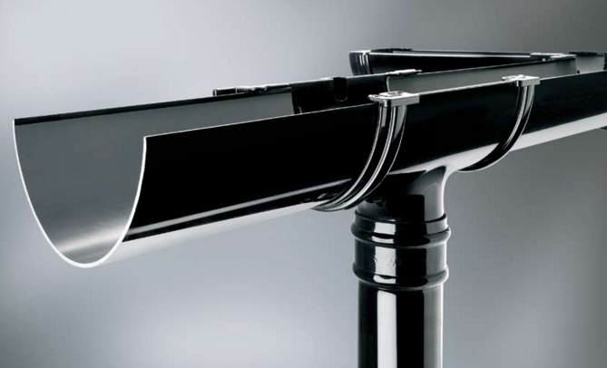
n → ∞

