Slide 1
Reflections on Practice
Maths Counts 2016

Slide 2
Caitríona Cronin & Aoife Geoghegan St. Mary’s Academy & St. Leo’s College, Carlow

Slide 3
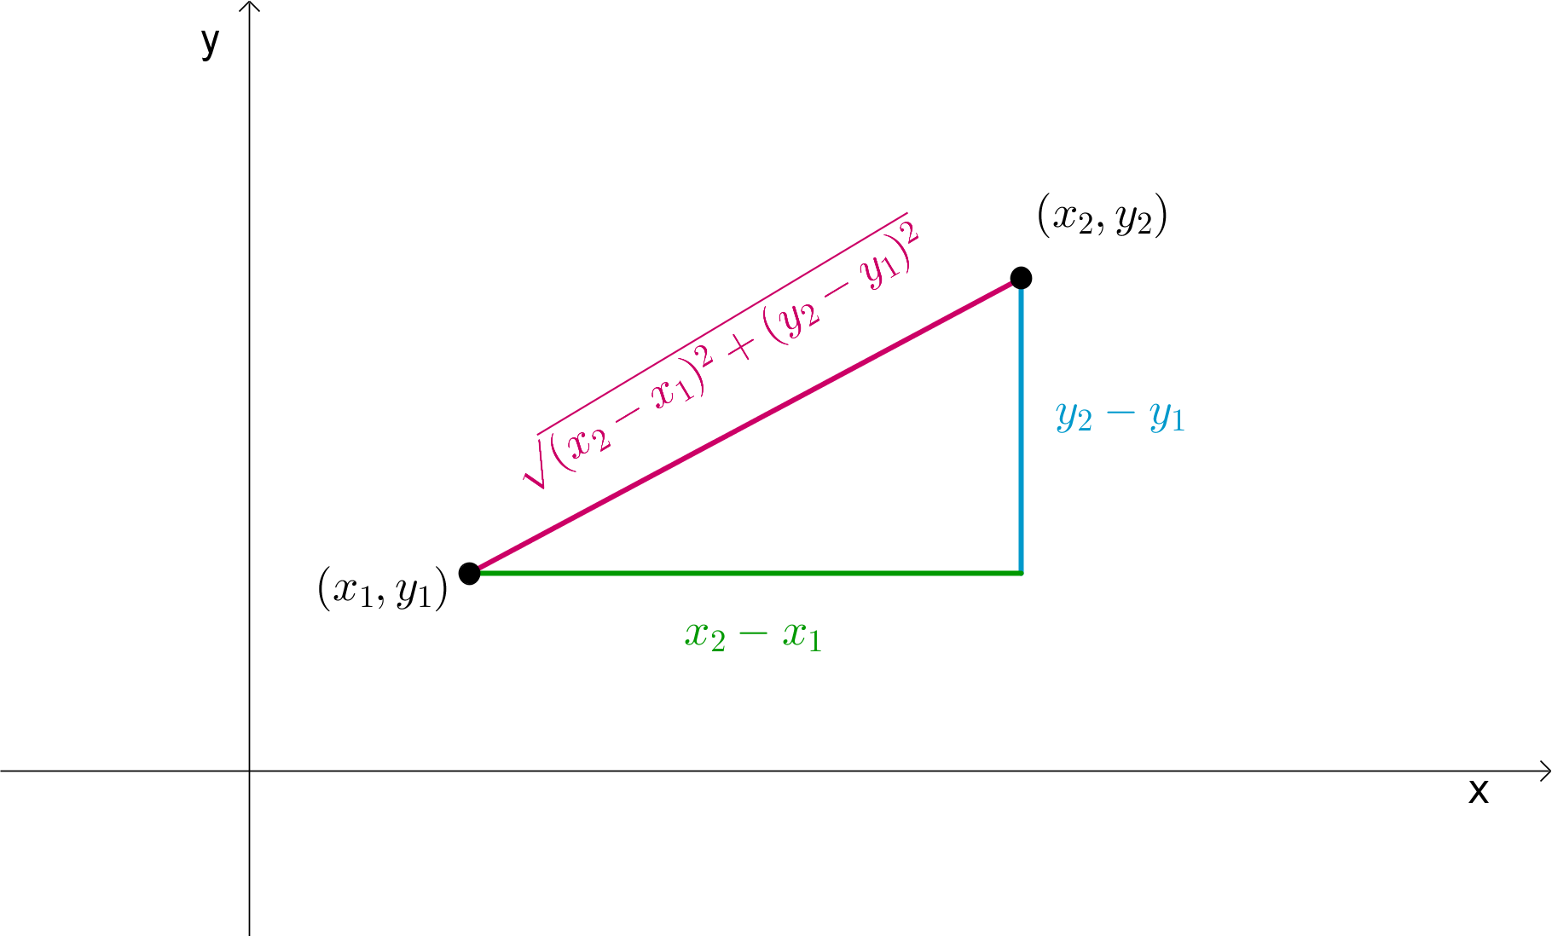
Over to you
How can you introduce the distance formula in co-ordinate geometry to maximise student understanding?

Slide 4
Details
Taught on 29/02/2016
Taught to second years[mixed ability, 30 boys]
Lesson lasted 60 minutes
Observed by two teachers
Lesson is a bridge between Trigonometry and Co-ordinate Geometry.

Slide 5
Student Learning Goals
Students should be able to:
recognise the co-ordinate plane on a street map.
discuss and determine what is the most direct route between two points.
probe the meaning of the most direct route.
forge a link between the shortest route, a right-angled triangle and Pythagoras’ Theorem.

Slide 6
Design of Lesson
Initial idea for lesson came from Dara O’ Briain’s ‘School of Hard Sums’.
Plan for lesson was for students to find their way to the distance formula for co-ordinate geometry through problem solving.

Slide 7
Lesson Steps
TASK 1 - Consolidating prior-knowledge ie. Co-ordinate Plane, Pythagoras’ Theorem and Key Terms (10 minutes)
TASK 2 – Distribute map. Locate and plot co-ordinates on map (5 minutes)
TASK 3 - Introduction to problem. Allow time for student discussion and encouragement towards finding shortest distance between two points (20 minutes)
PHOTO - Display student work and discuss differentiation in student solutions (10 minutes)
TASK 4 - To reinforce how to find shortest distance students were given a second problem on same map (10 minutes)

Slide 8
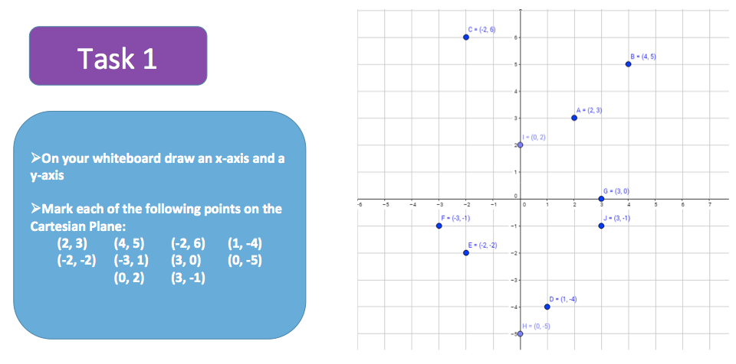
TASK 1 : Consolidating prior-knowledge
ie. Co-ordinate Plane, Pythagoras’ Theorem and Key Terms (10 minutes)

Slide 9
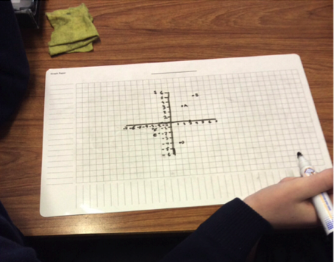

Slide 10
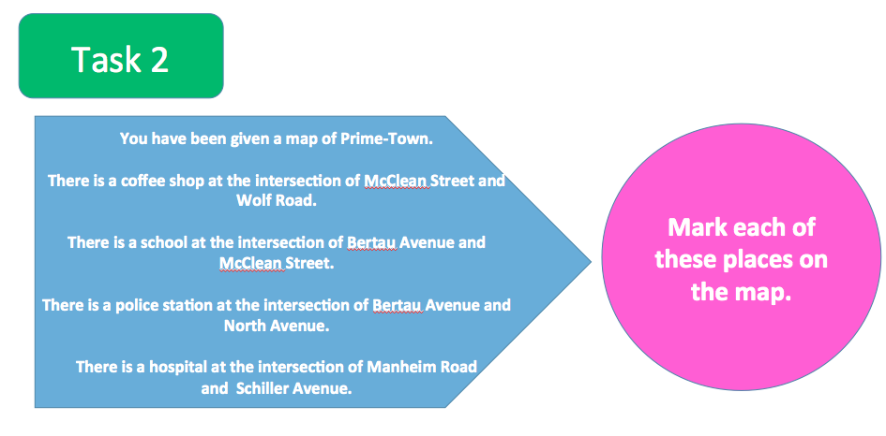
TASK 2 – Distribute map. Locate and plot
co-ordinates on map (5 minutes)

Slide 11
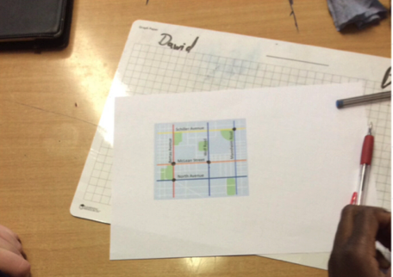

Slide 12
TASK 3 - Introduction to problem. Allow time for student discussion and encouragement towards finding shortest distance between two points (20 minutes)

Slide 13
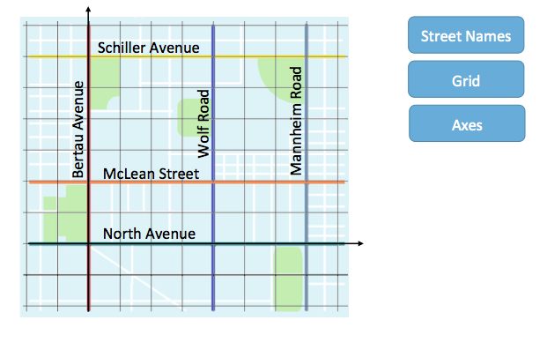

Slide 14
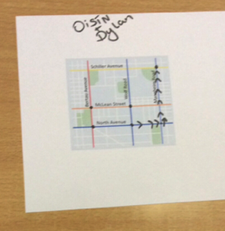
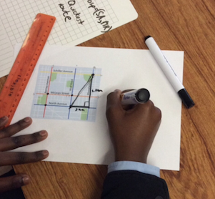

Slide 15
TASK 4 - To reinforce how to find shortest distance students were given a second problem on same map (10 minutes)

Slide 16
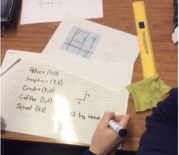
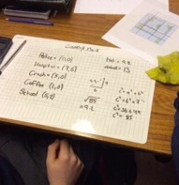

Slide 17
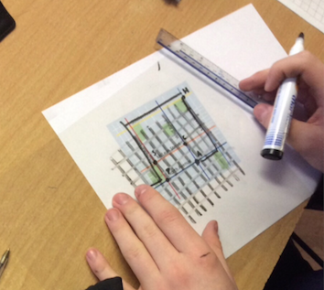
Materials
Whiteboards with grids
Street map
Transparencies of grids – differentiation
Powerpoint

Slide 18
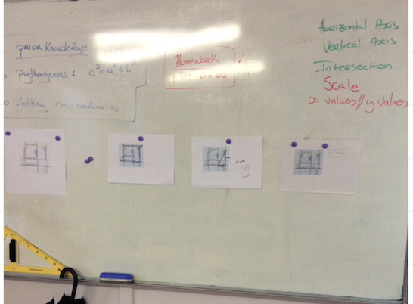
Board Plan
Display of Student Work
Powerpoint

Slide 19
Plan for Peer Observation
Teacher-student interaction
Take note of student discussion
Photograph student work
Look for evidence of student understanding/ difficulties
Student feedback
Use Lesson Note

Slide 20
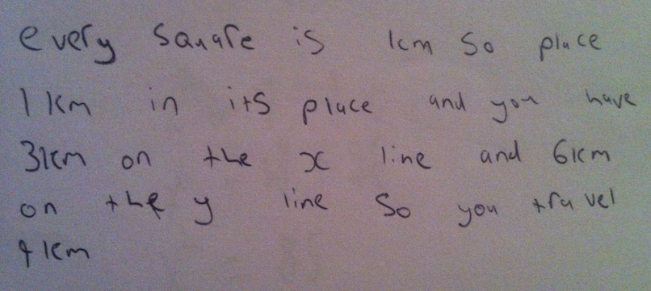
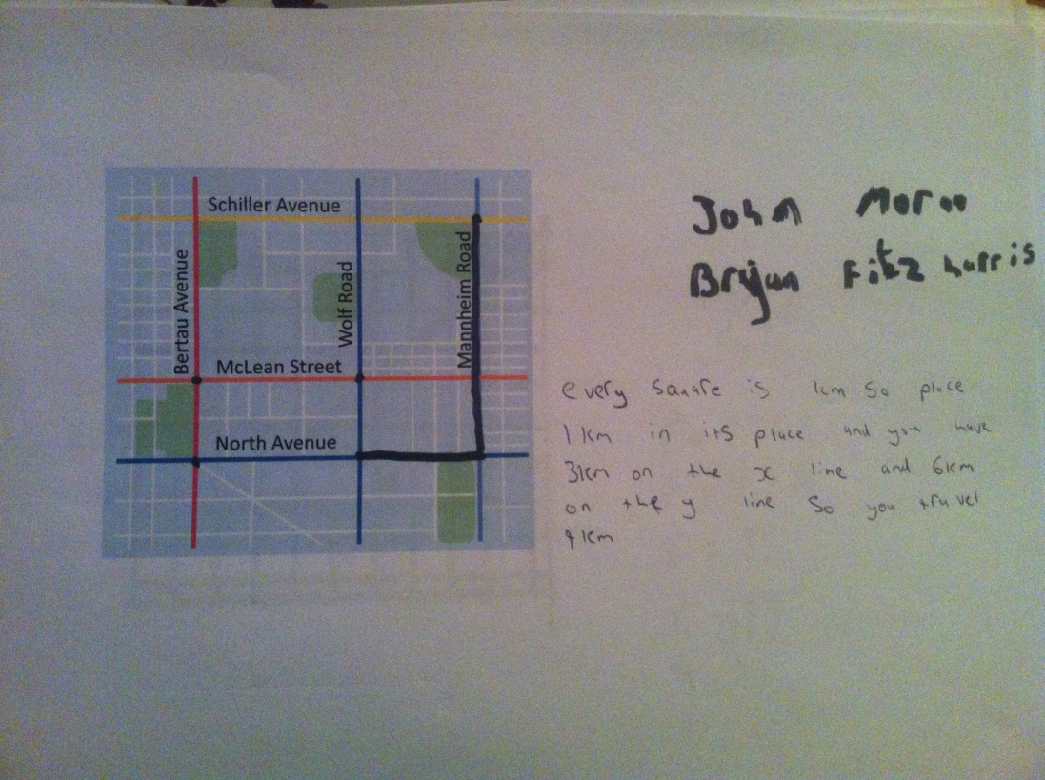
Findings/ Student Learning
Students were engaged in the problem.
Most students put forward a valid solution to the problem.
However, it took some students time to recognise that the shortest distance was the hypotenuse of the triangle.
Unexpected discussion about scale from use of ruler to find distance.

Slide 21
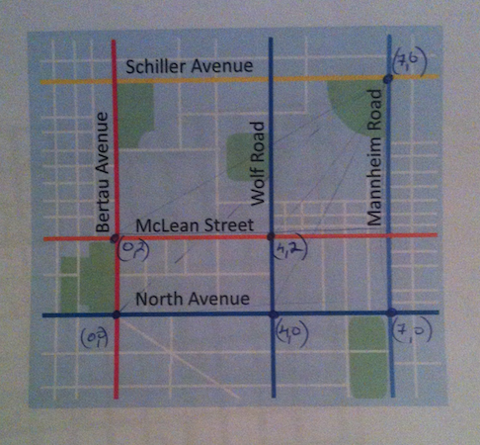
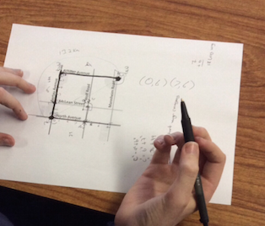
Findings contd.
Some students jumped to the usefulness of co-ordinates on street map to problem solve.
Not all students made the link between the street map and the co-ordinate plane.

Slide 22
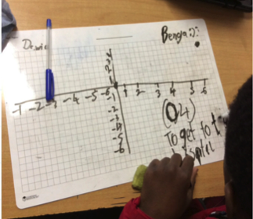
Findings contd.
Students were willing to work in pairs and share their ideas.

Slide 23
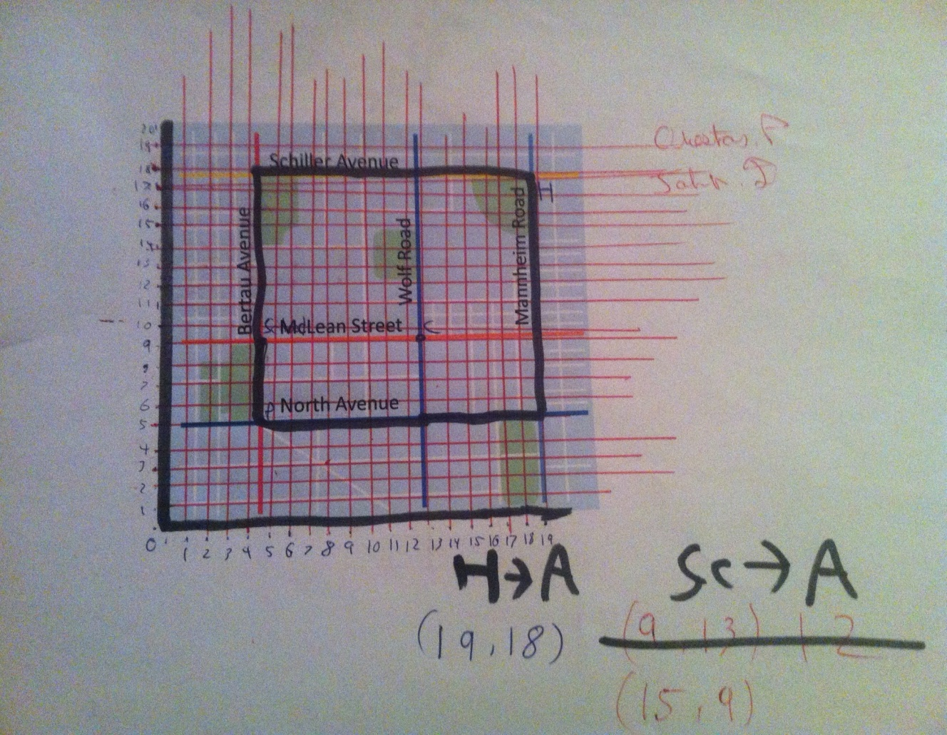
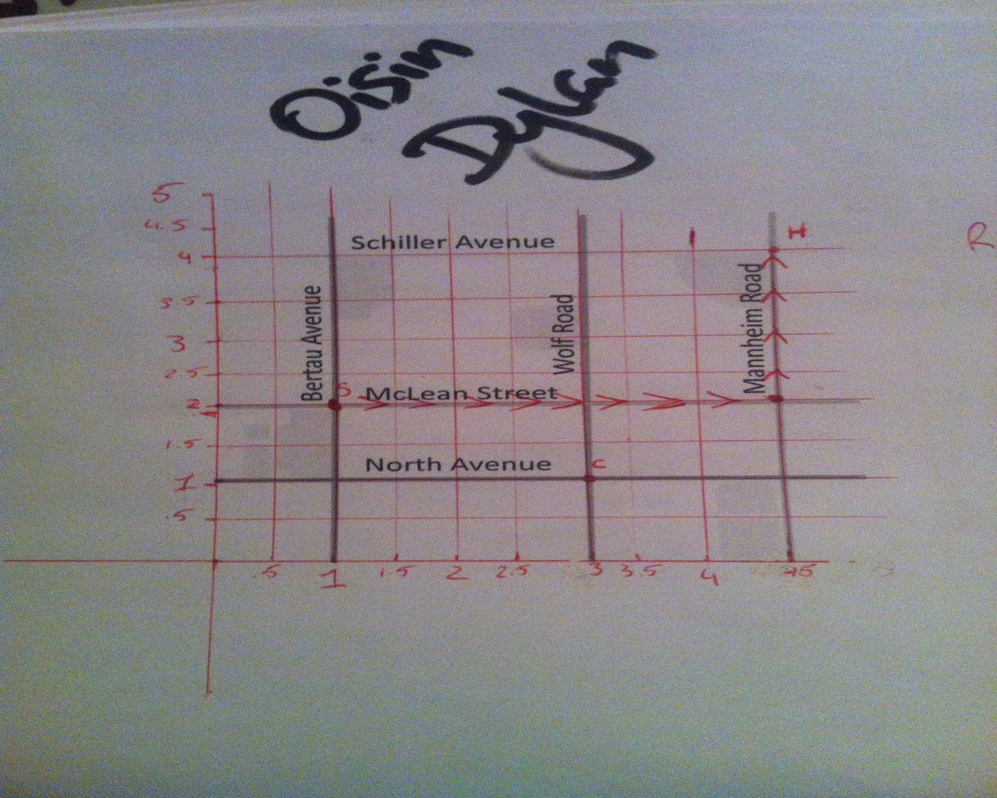
Findings contd.
All students used Pythagoras’ Theorem to support their problem solving.
Variety in student interpretation of grid
Tiny Grid
Half Units

Slide 24
Student Feedback
I liked it because the equations made sense. We applied them to real life.
I found the class very interesting. I liked it very much. It was something different.
I thought the class was very challenging. It really got me thinking. I learned a lot.
I liked using the whiteboards but the questions that we did were very hard.
Bit more fun than a normal class of a teacher standing at the top of a class and talking away. Group work is fun.

Slide 25
It was too hard to understand.
Not very hard but I learned that using a grid helps. Whiteboards are a good idea.
I liked it because it was fun, it kept me working and I learned how to do coordinating.
I didn’t really learn anything because my partner didn’t let me do anything.

Slide 26
Recommendations
Underestimated the amount of time it would take to complete all four tasks and make connection between problem and distance formula.
Recommend splitting lesson over 2 classes. Use second lesson to further explore the formula.

Slide 27
Any Questions?

Slide 28
Sources Used
Dara O’Briain, Channel 4
cnx.org (street map)

Slide 29
Thank You!
Maths Counts 2016

