Slide 1
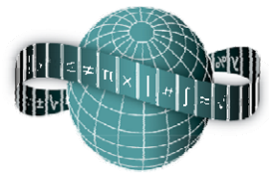
Reflections on Practice
Maths Counts 2016

Slide 2
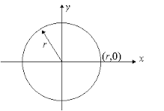
Equacirc: The Equation of Circle with centre (0,0)

Slide 3
Danielle McGuire – Our Lady’s Secondary School, Castleblaney, Co. Monaghan Mary Jordan – Largy College, Clones, Co. Monaghan

Slide 4
Details
40 minutes
5th Year Ordinary Level
26th January 2016

Slide 5
Where lesson fits into the courses

Slide 6
Student Learning Goals
I would like my students to become more creative when devising approaches and methods to solve problems.
The students should be able to understand that the deviation of the formula for the equation of the circle is based on Pythagoras theorem
Develop communication and presentation skill

Slide 7
Student Learning Goals
For students to connect synthetic geometry and algebra
To improve students psychomotor skills
To apply their previous knowledge and skills to solve problems in familiar and unfamiliar contexts
To represent information graphically

Slide 8
Design of Lesson
Introduction
Check students previous knowledge. Ask them what a radius is. How to find the length of a line (distance formula) and what information they know about different shapes.

Slide 9
Design of Lesson
We are looking for the formulas from the students such as the distance formula and Pythagoras theorem. We will have to go through other formulas in order to get the ones that are required for this lesson.

Slide 10
Previous Knowledge

Slide 11
Design of Lesson
Posing a task:
Task 1: We will give the students a point (3,4) and the centre point (0,0) and ask students to construct a circle.

Slide 12
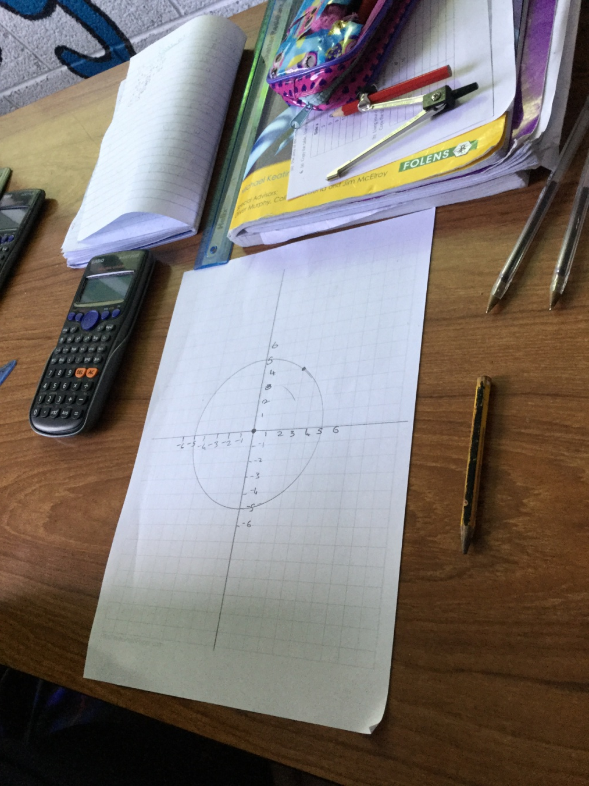
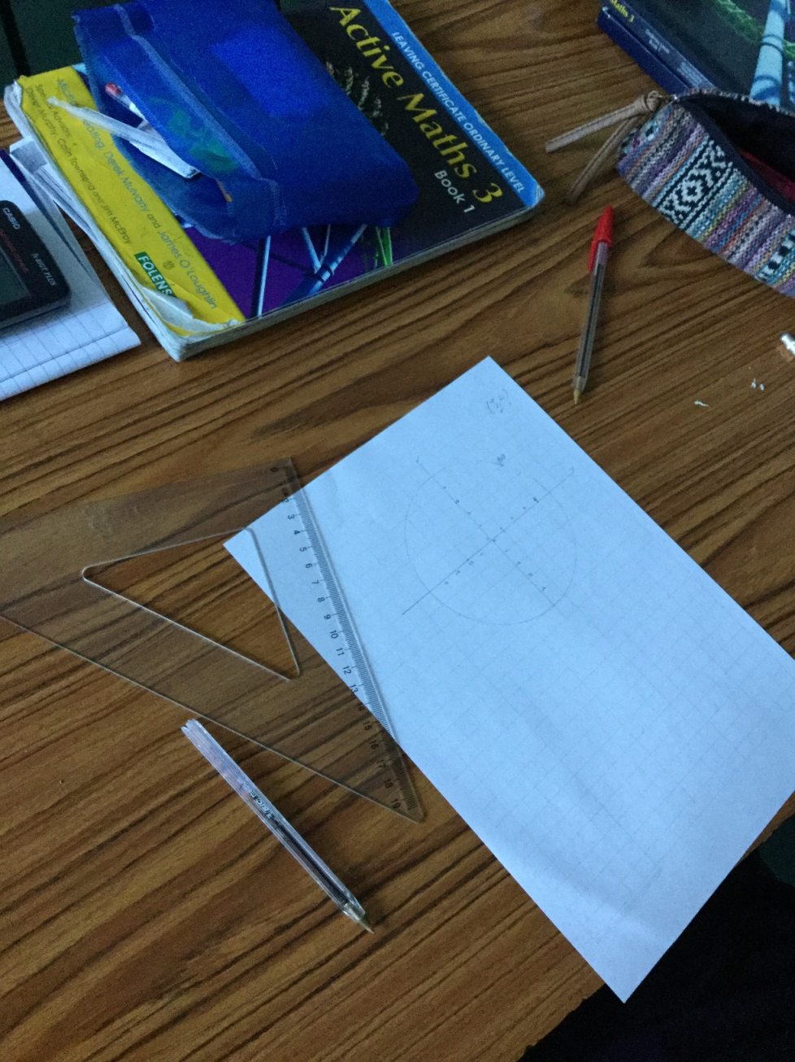

Slide 13
Design of Lesson
Anticipated student response:
We expect that students will try measuring the radius by using a ruler. They may also use the distance formula or some may decide to use Pythagoras’ theorem.

Slide 14
Design of Lesson
Task 2: Students will have to find other points on the circle and check if the radius is the same all the way around the circle.

Slide 16
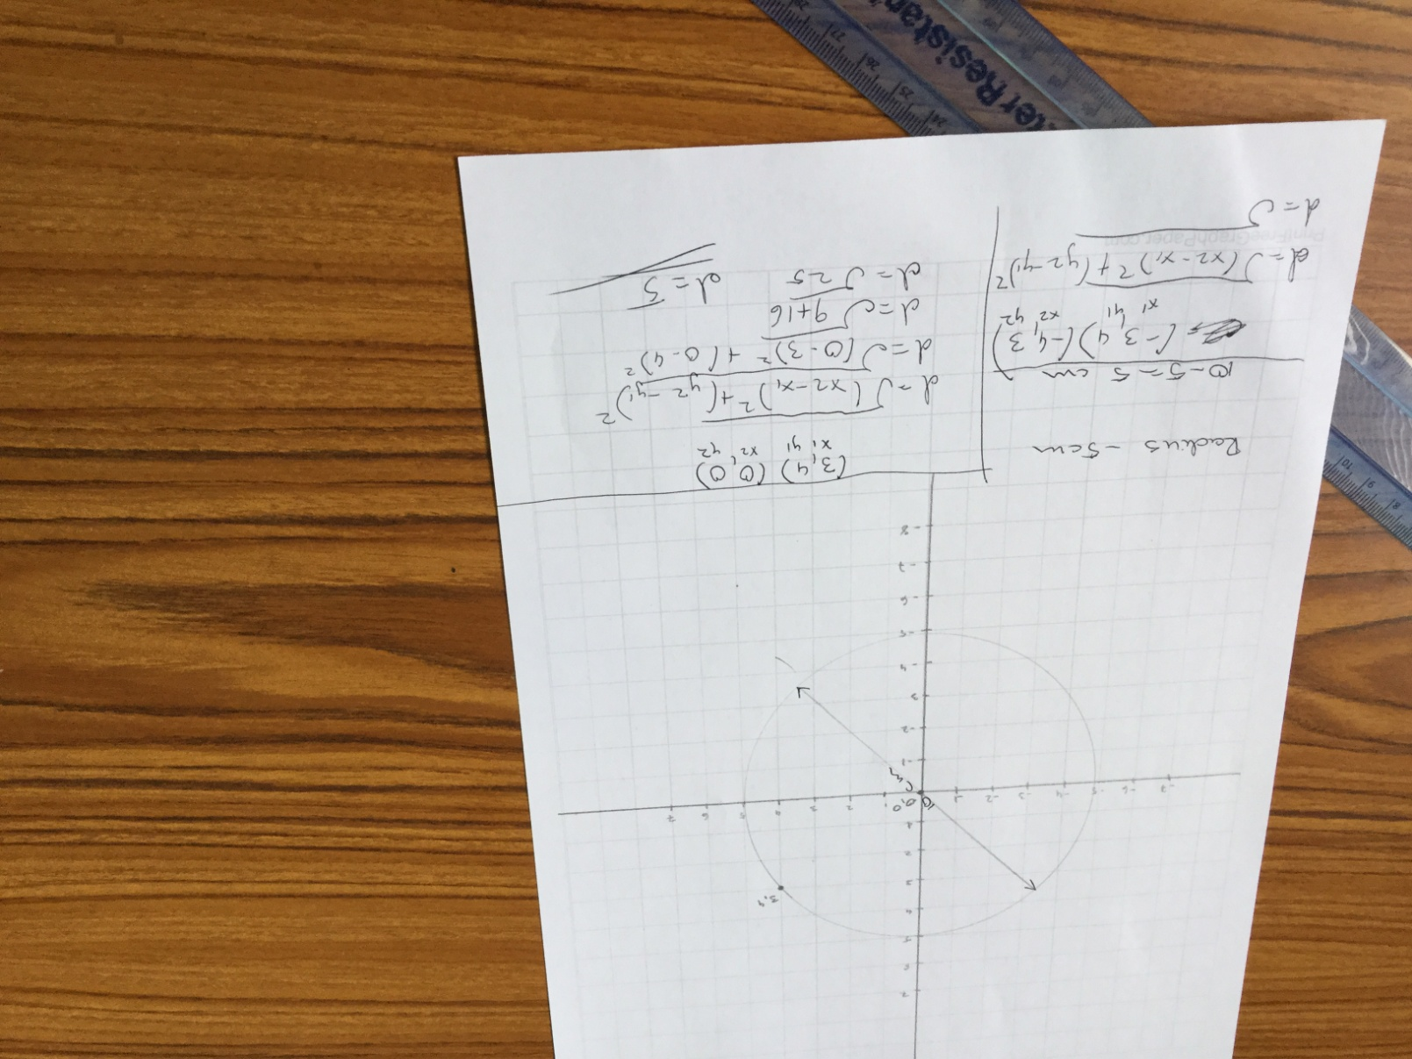

Slide 17
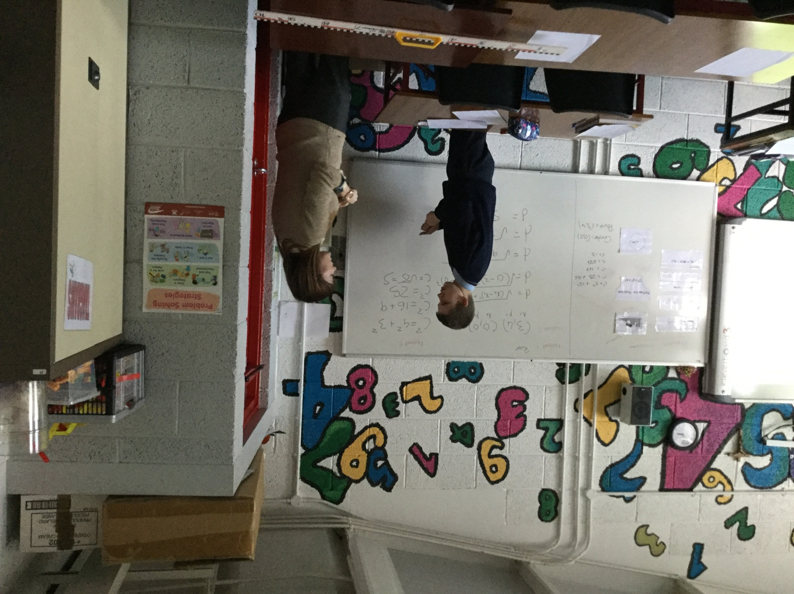

Slide 18
Design of Lesson
We will be checking to see if the students can recognise that using different points, the radius will be the same all the way around the circle. If students recognise this they should be able to proceed to find the equation of the circle.

Slide 19
Design of Lesson
Comparing and discussing:
Students will then compare the different methods of finding the radius, measuring with a ruler, using the distance formula and Pythagoras’ theorem. This will show which method is more accurate.

Slide 20
Materials
To give to students
Graph Paper (boxes of 1 cm)
Compass
Formula and Tables Booklet

Slide 21
Materials
For use on board
Geogebra template
Magnetic laminated formula cards

Slide 22
Plan for Peer Observation
Photos of students work
Seating Plan
Observation Sheet

Slide 24
Findings
Students were able to use their previous knowledge in order to construct the circle.
Most of the students began by using a ruler or counting boxes to find the radius.
When encouraged to use more than one method students then explored and discovered that the distance formula and Pythagoras theorem also lead you to find the radius

Slide 25
Findings/Student Learning
Difficulties: Linking previous knowledge of x and y axis to drawing a circle on a coordinate diagram
Surprising ideas: students quick use of Pythagoras theorem to find the length of radius which in turn lead them to find the equation of the circle.
Surprising ideas: use of compass and ruler to find radius

Slide 26
Board Plan

Slide 27
Recommendations
Could use geostrips to conclude that the radius is the same the whole way around the circle. By using geostrips to create a right angled triangle and attaching it to a board, this will demonstrate how we arrived at our formula for the circle with center (0,0)

Slide 28
Sources Used
Project Maths website
Geogebra app on iPad
Textbooks

Slide 29
Any Questions?

Slide 30
Thank You!
Maths Counts 2016

