Slide 1
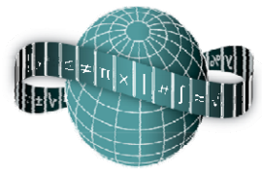
Reflections on Practice
Maths Counts 2016

Slide 2
A fixed perimeter does not imply a fixed area.

Slide 3
Catriona Hassey, Laura Guest, Mitch McGuckin (teacher of the lesson) and Margaret Rumley all Midleton College. Michael Moynihan retired from Colaiste an Spioraid Naoimh, Bishopstown. Celeste Quinlan Mc Egan College, Macroom.

Slide 4
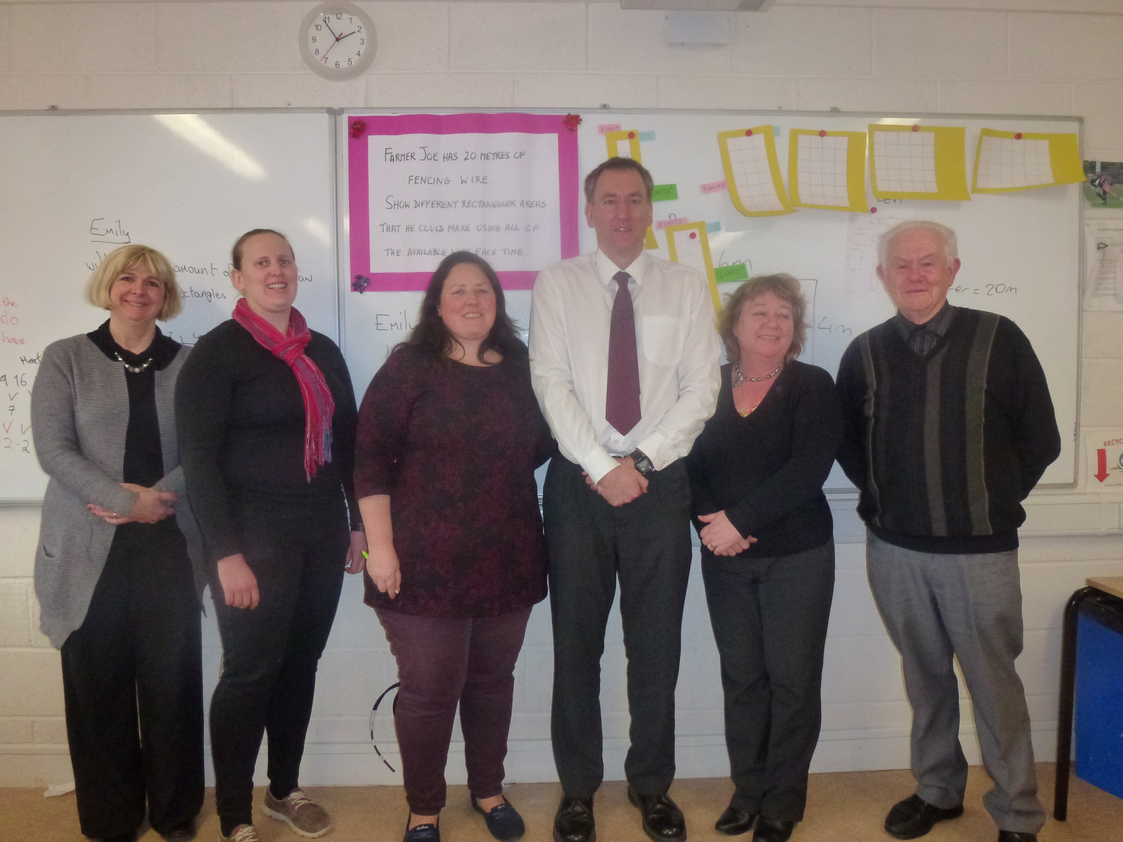

Slide 5
Details
Strong 2nd year higher level class group
50 minute lesson
Lesson taught on Tuesday 1/3/2016
Class had covered perimeter and area, functions, graphing functions and quadratic patterns

Slide 6
Student Learning Goals
To develop an understanding of the relationship between the area and perimeter of a rectangular shape.
For students to know and understand that a fixed perimeter does not imply a fixed area.
To develop the ability to present the data, in tabular and graphic formats, to illustrate the pattern of findings.

Slide 7
Design of Lesson
5 meetings in Cork to prepare for the lesson.
After much thought and discussion, the lesson was presented in 3 parts.

Slide 8
Details
1. Farmer Joe has 20m of fencing wire.
Show different rectangular areas that he could make; using all of the available wire each time. (~20 minutes including introduction and board work)
2. Students to record & present their work in another way.
(~15 minutes)
3. Prove that the areas have a quadratic pattern.
Derive the “rule” for this quadratic pattern.
(~15 minutes)

Slide 9
Materials
Students were given:
Dotted grid (1cm) paper
Graph paper with axes
Blank paper
20cm lengths of wire

Slide 10
Findings/Student Learning
One or two students initially went astray and mixed up perimeter and area but most had no trouble drawing the different rectangles.
When asked to comment on their results many students came up with “fixed perimeter does not give a fixed area”.
(Learning goal achieved!)

Slide 11
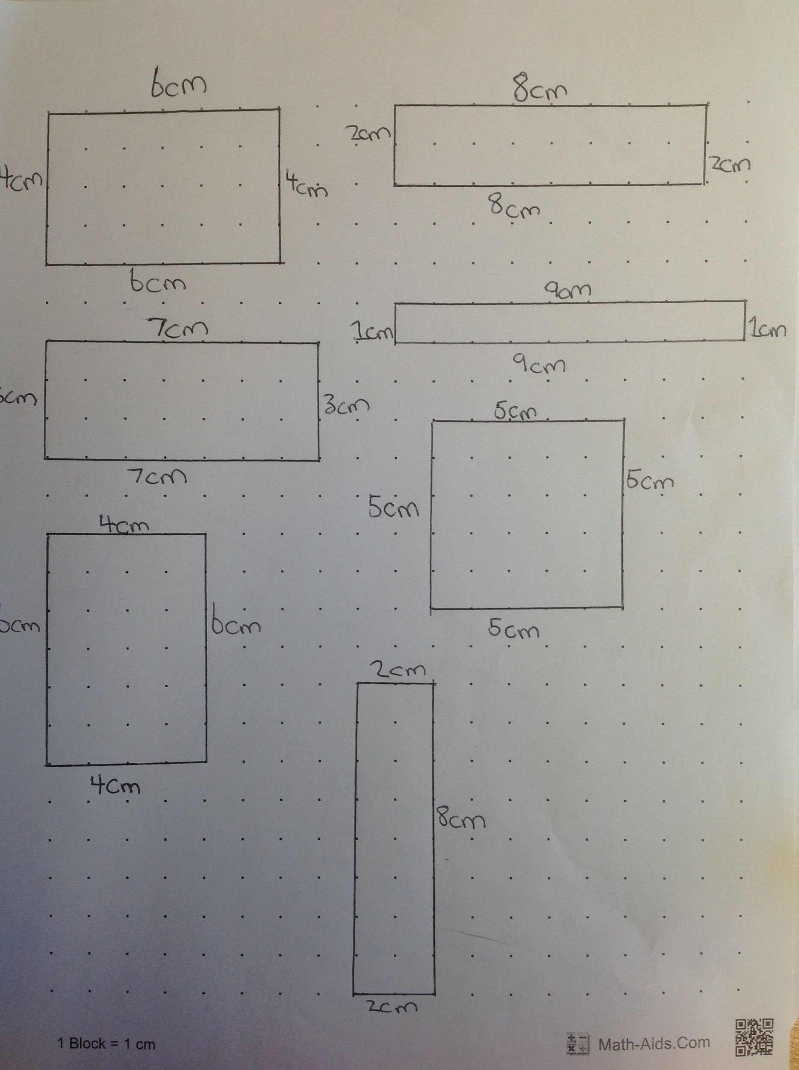
Findings/Student Learning

Slide 12
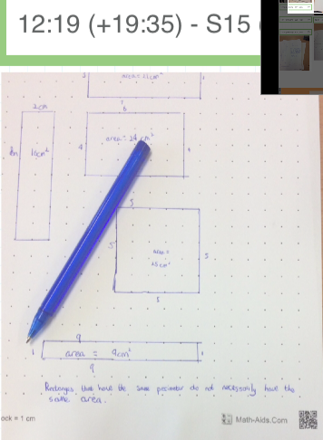
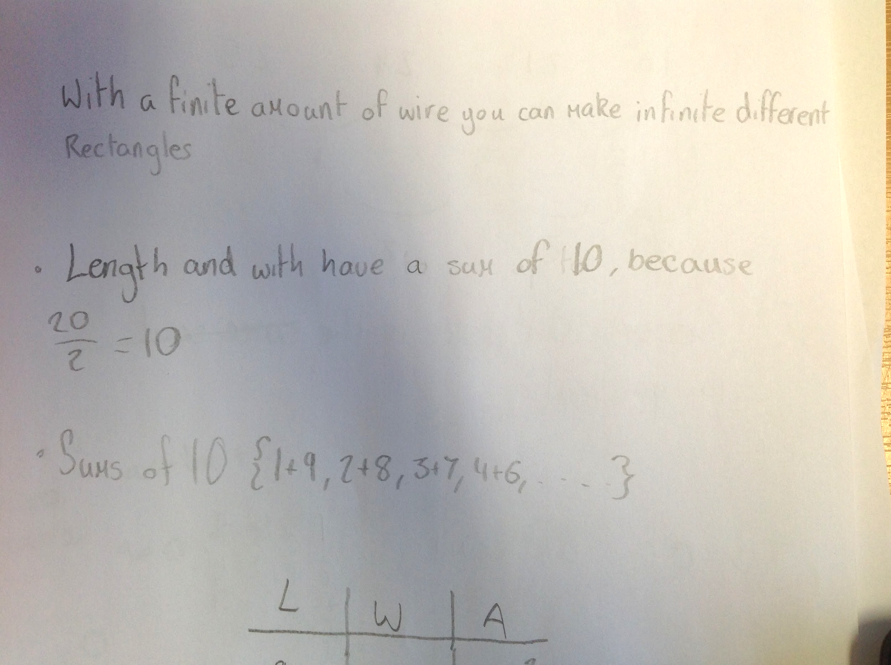
Findings/Student Learning
“Rectangles that have the same perimeter do not necessarily have the same area”

Slide 13
Findings/Student Learning
When asked to present their results in a different way:
Many used an ordered list or a table. A couple of students started working on an algebraic expression, but none drew a graph (even with graph paper provided).

Slide 14
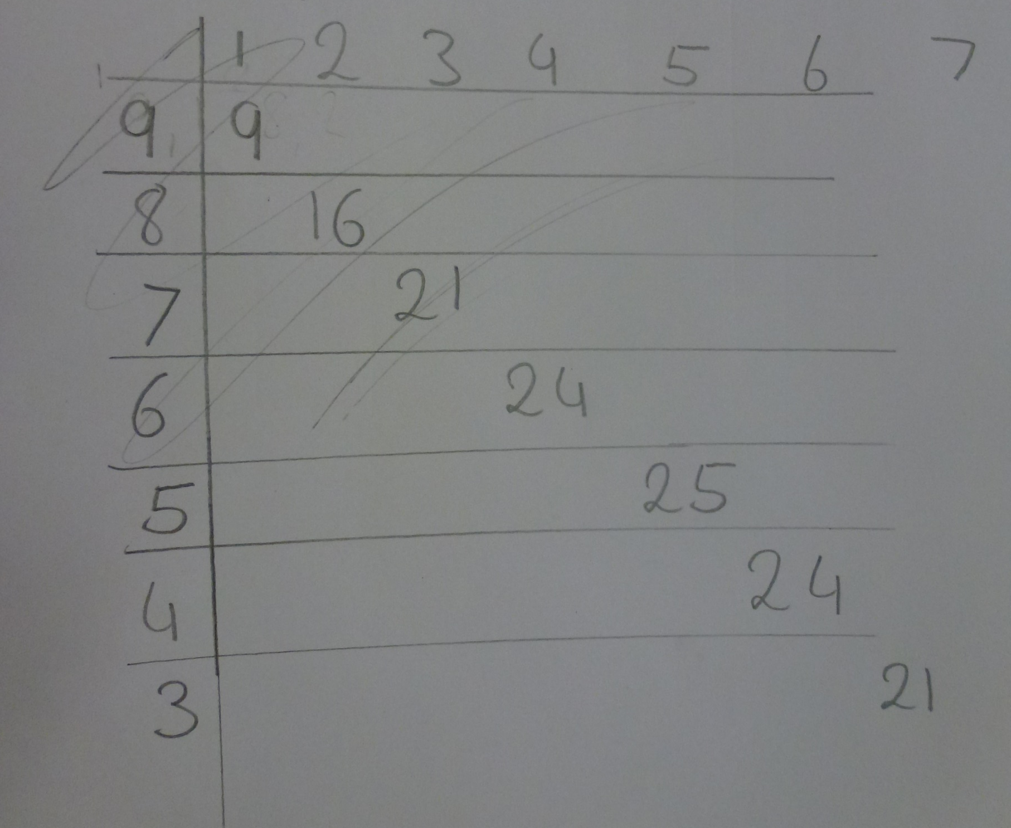
Findings/Student Learning

Slide 15
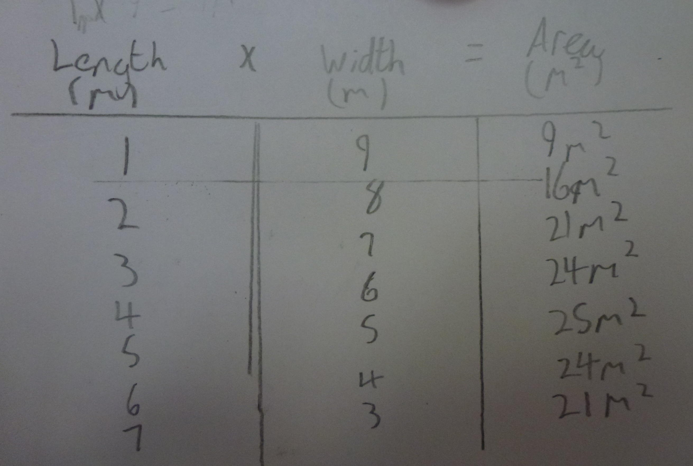
Findings/Student Learning

Slide 16
Findings/Student Learning
On the day of the lesson there wasn’t as much time as hoped for to develop the quadratic expression, but all the class recognised the quadratic pattern and some of the stronger students derived the correct expression.

Slide 17
Findings/Student Learning

Slide 18
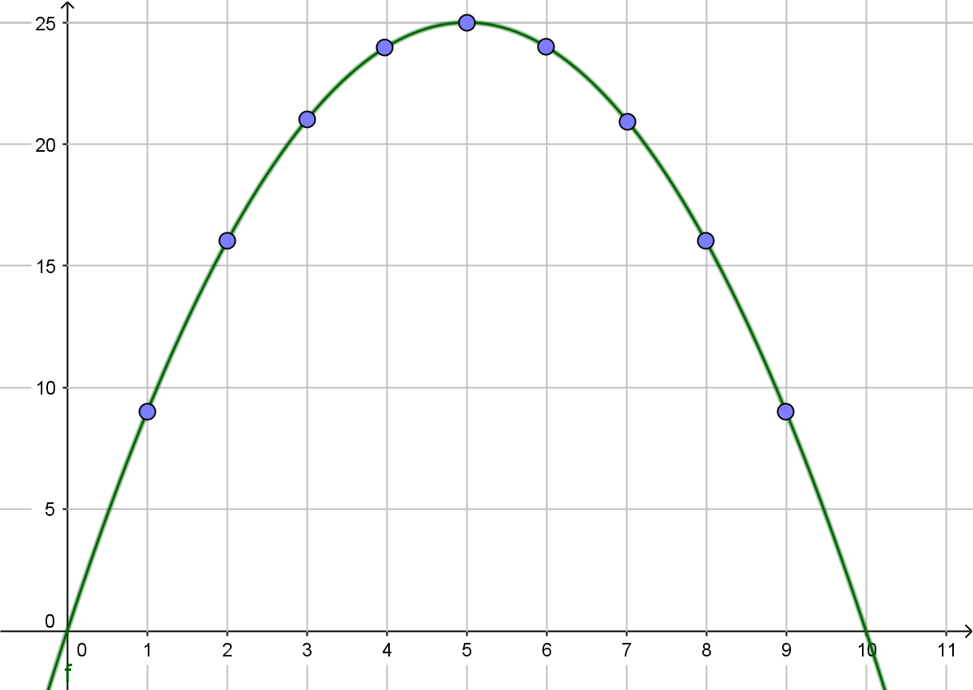
Homework
Graph area versus width of rectangular field and pick out the maximum area from your graph.

Slide 19
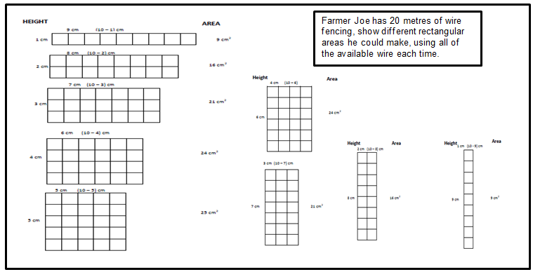
Board Plan (1 of 3)

Slide 20
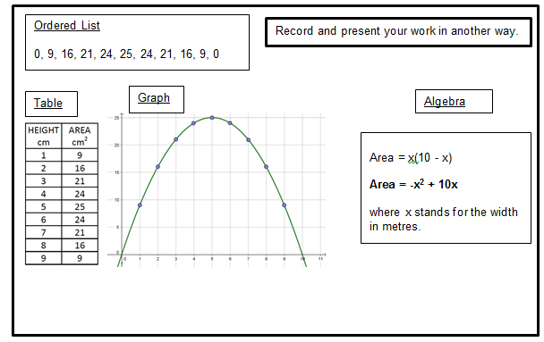
Board Plan (2 of 3)

Slide 21
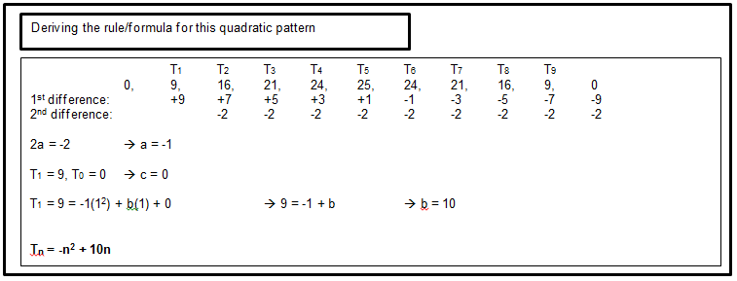
Board Plan (3 of 3)

Slide 22
Recommendations
The lengths of wire were not used by the students and we recommend not providing them.
Depending on the class group, further scaffolding could be provided by giving students: an empty table, the labelled axes for a graph, the general form of a quadratic function ….

Slide 23
Recommendations
Timing! Even with 50 minutes, time was tight and the teacher was under pressure to move things along faster than he would have liked.
This was partly because the students were more reticent than normal with all the “strangers” in the room. Timing of this lesson should be planned carefully. It could possibly be done over 2 classes.

Slide 24
Recommendations
A nice variation on this problem that was trialled on different class groups along the way is to ask students what is the largest area that can possibly be fenced off (any shape this time!) using 20m of perimeter fencing wire.

Slide 25
Any Questions?

Slide 26
Sources Used
Junior Certificate Maths Syllabus (pg 23, 27)
Second Year Teacher’s Handbook (pg 31)
Text & Tests 2 textbook

Slide 27
Thank You!
Maths Counts 2016

