Slide 1


Reflections on Practice
Maths Counts 2016

Slide 2

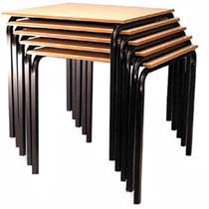
How many people will be seated at 10 tables?
A Real World example of a Linear Patterns Problem
Notes:
2

Slide 3
Names:
Genna O’Callaghan
Shauna Mulligan
Siobhan Creamer
Virginia Shanahan-Desmond
School names:
St. Oliver’s Community College
Drogheda Grammar School
Notes:
3

Slide 4
Details
Level of lesson plan: Junior Cert – Common Introductory Course
Length of lesson: 45 minutes
Date: 9th February 2016
Where lesson fits into the course from your lesson plan: Number Patterns as an Introduction to Algebra
Notes:
4

Slide 5
Student Learning Goals
The students should be able to:
Find the 4th (next) and 10th term of the given pattern by using a variety of methods including diagrams, pictures, tables and words
Find the common difference in order to find the nth term
Explain the pattern and it’s relationship using words and numbers
Notes:
5

Slide 6
Learning Outcomes
From this lesson, students should be able to:
Use tables, diagrams, graphs, words and numbers to find the 4th term and the 10th term
Find the common difference between consecutive patterns in order to determine the next term
Verbalize their findings

Slide 7
Design of Lesson
Planning the problem-solving lesson:
We adapted a Leaving Cert Ordinary Level question on Linear Patterns to suit a Junior Cert 1st year class in order to introduce problem solving
We created the lesson to suit a 45 minute class to give students enough time to settle, to explore the problem fully and to recap on their findings
After deciding on the lesson, we had to prepare the materials students would use to help solve the problem
Notes:
7

Slide 8
Design of Lesson
We prepared a template for the peer observers where they could note down how students were doing, names of students who came up with a particular method, any misconceptions students were having etc
Homework was given from their textbook which was similar to the class activity
The misconceptions were addressed the following day in class, we spoke again about all the solutions students came up with and continued on to finding the nth term of a linear sequence

Slide 9
Materials
Materials prepared before the lesson:
We printed the problem to give each student which included the first three terms of the sequence
Individual squares representing the tables
Paper stars representing people/chairs
Paper, pens, pencils, rulers
Graph paper
Title headings for each solution
Peer observation feedback forms
Student feedback forms
Notes:
9

Slide 10
Plan for Peer Observation
Each of the 5 observers were designated 6 pupils each to concentrate on.
The evaluation sheets included information on:
  Pupil reactions to the problem
  Approaches to the problem
  Misconceptions
  Student use of the materials provided
  Approaches to the solution
Notes:
10

Slide 11
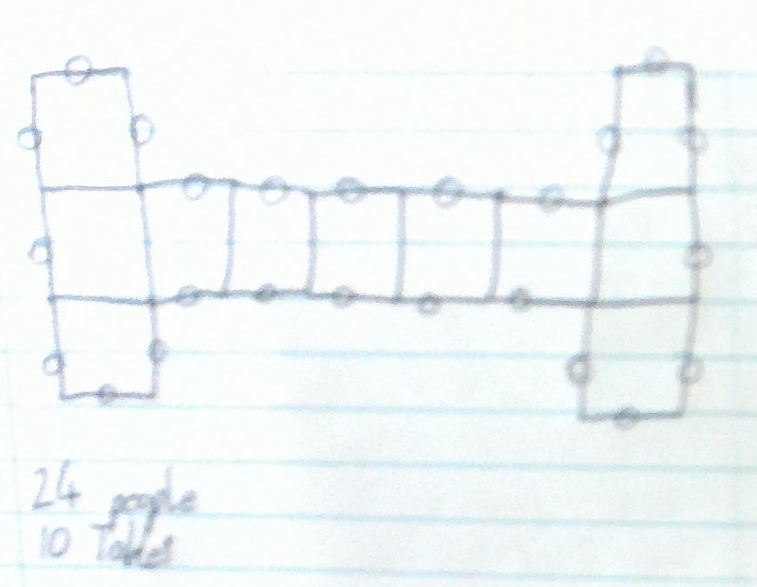
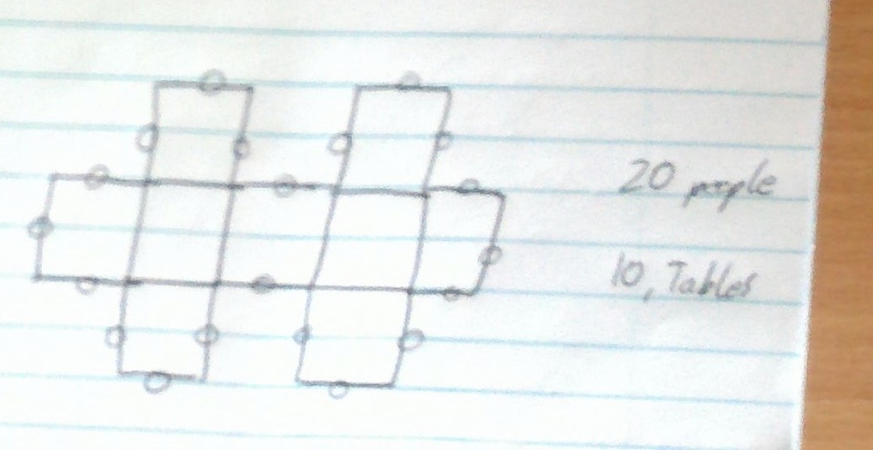
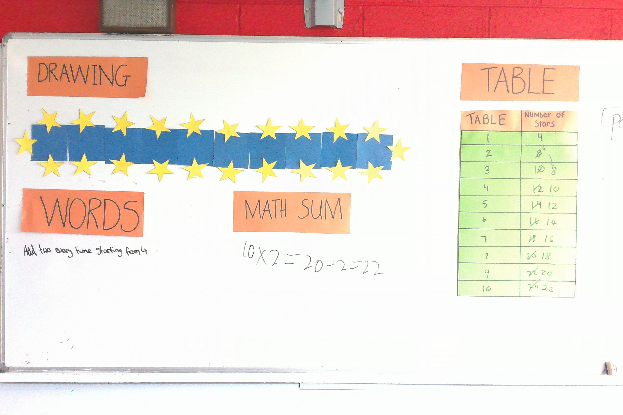
Findings
Students came up with all of our pre-prepared solutions to the problem
One student came up with a ‘Maths sum’ solution which we had not thought of
One misconception a student had was not keeping the tables in a straight line
Notes:
11

Slide 12
Findings/Student Learning
Initially students struggled to think of other solutions which didn’t involve using the squares and stars
Students asked questions during the lesson however in this method of teaching, these could only be addressed at the start of the lesson
Most students did not use the graph paper to draw a graphed solution, even though the axes were drawn on for them
One student had an excellent solution which we did not see until the end, she found the 10th term, demonstrated using the nth term method
Notes:
12

Slide 13
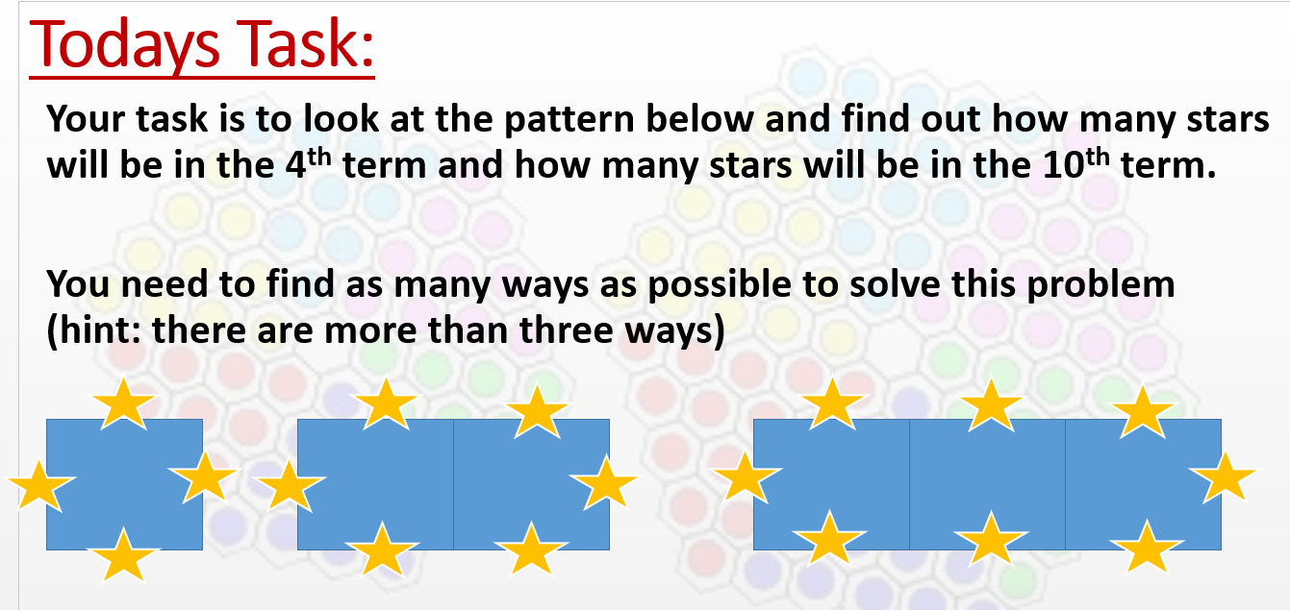
The task given to students

Slide 14
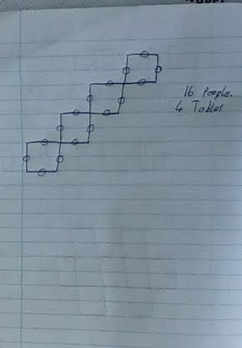
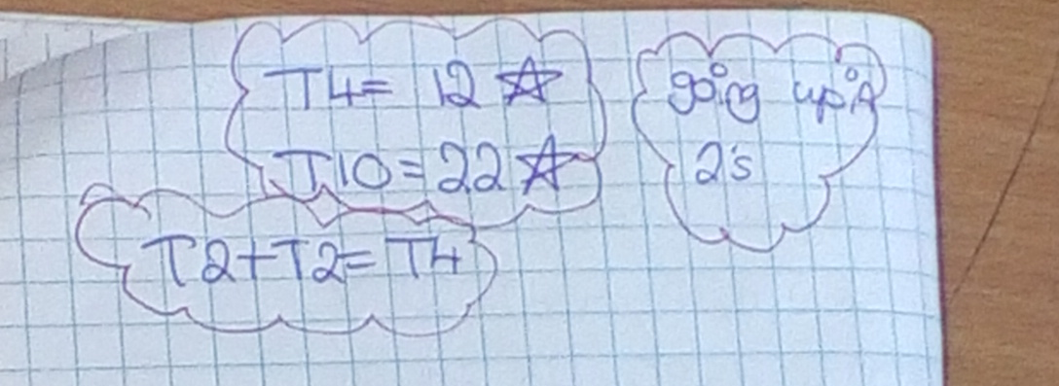
Misconceptions

Slide 15
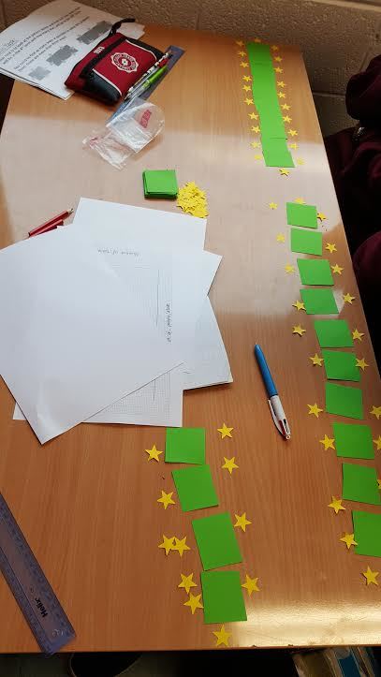
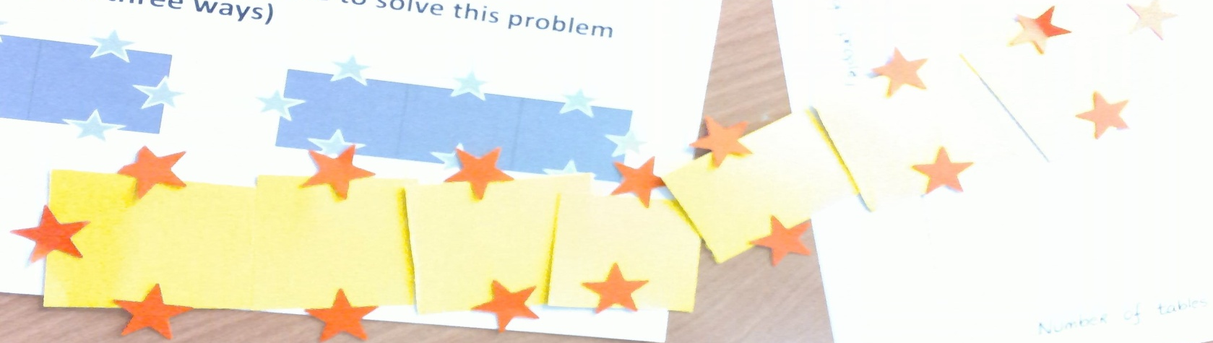
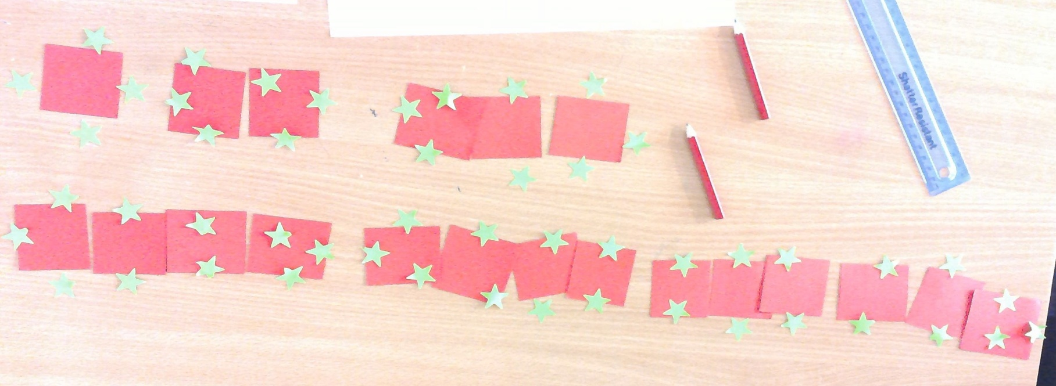
Using the squares and stars

Slide 16
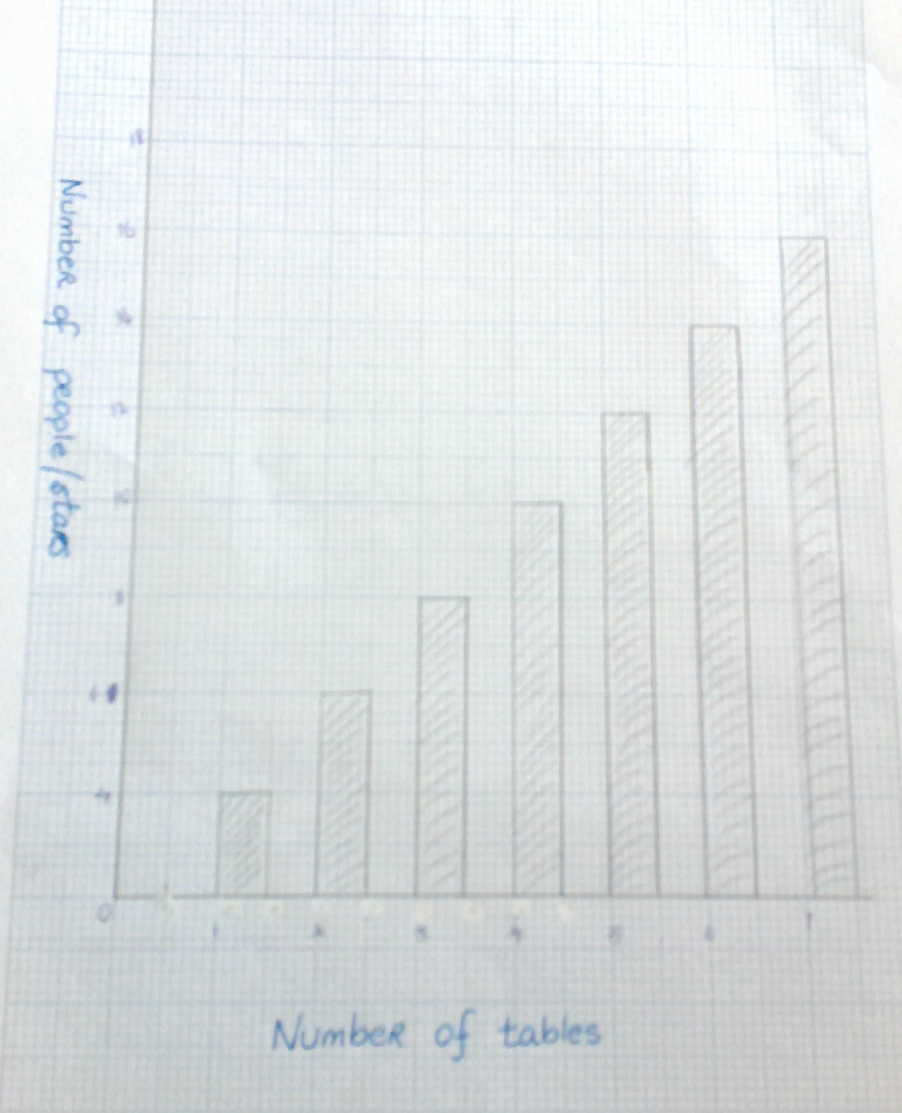
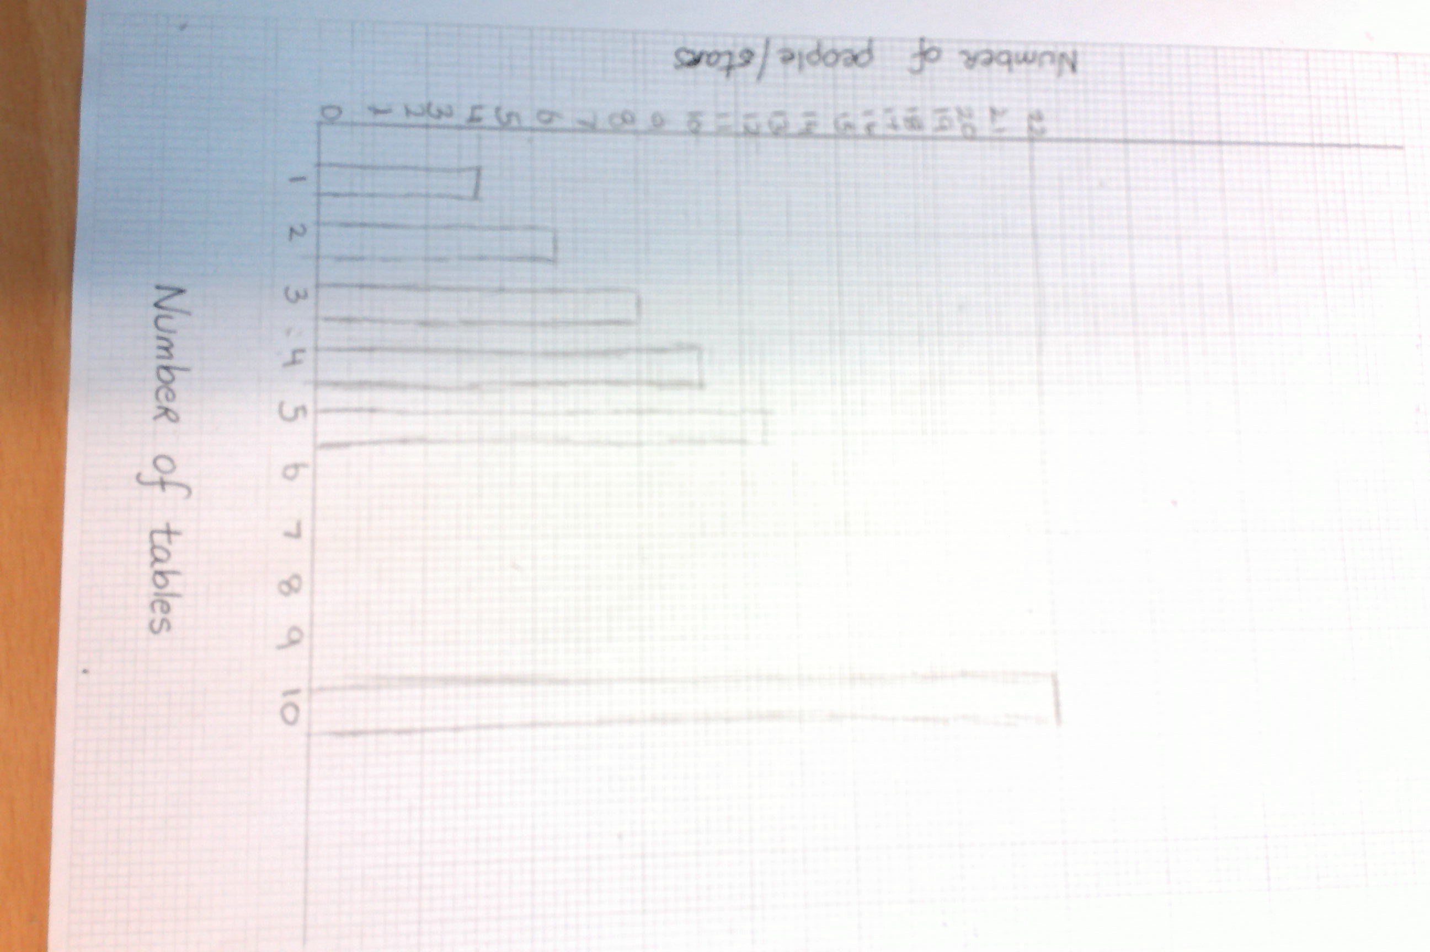
Graphing the solution

Slide 17
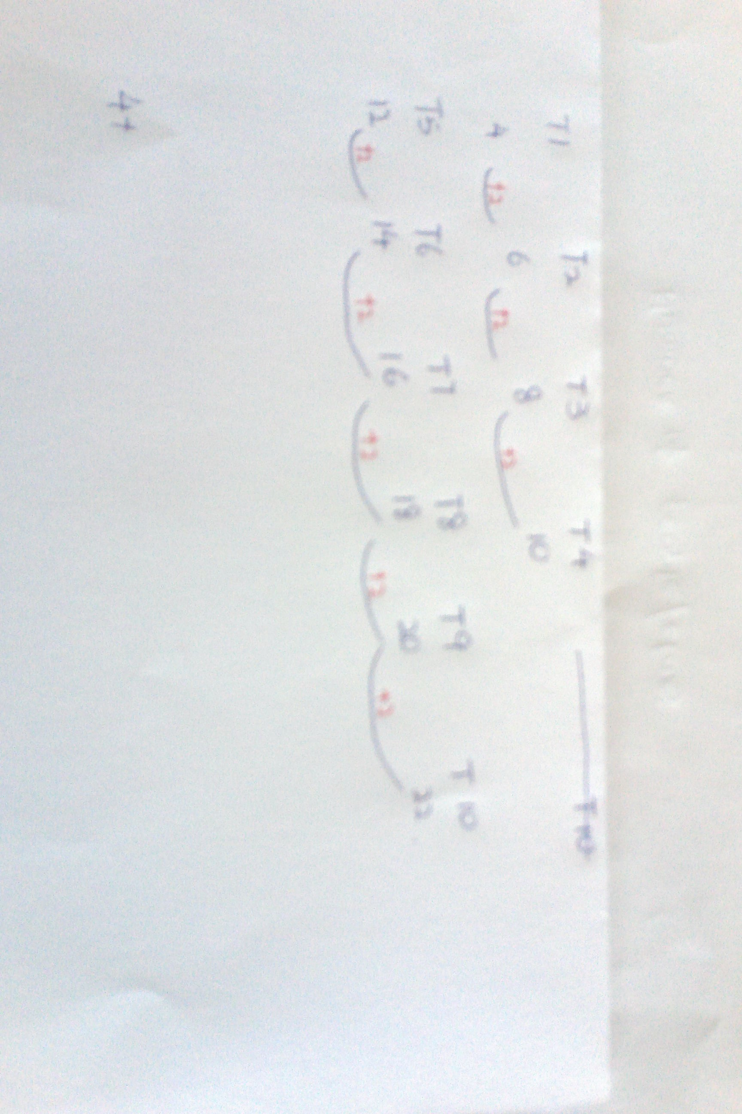
The common difference

Slide 18
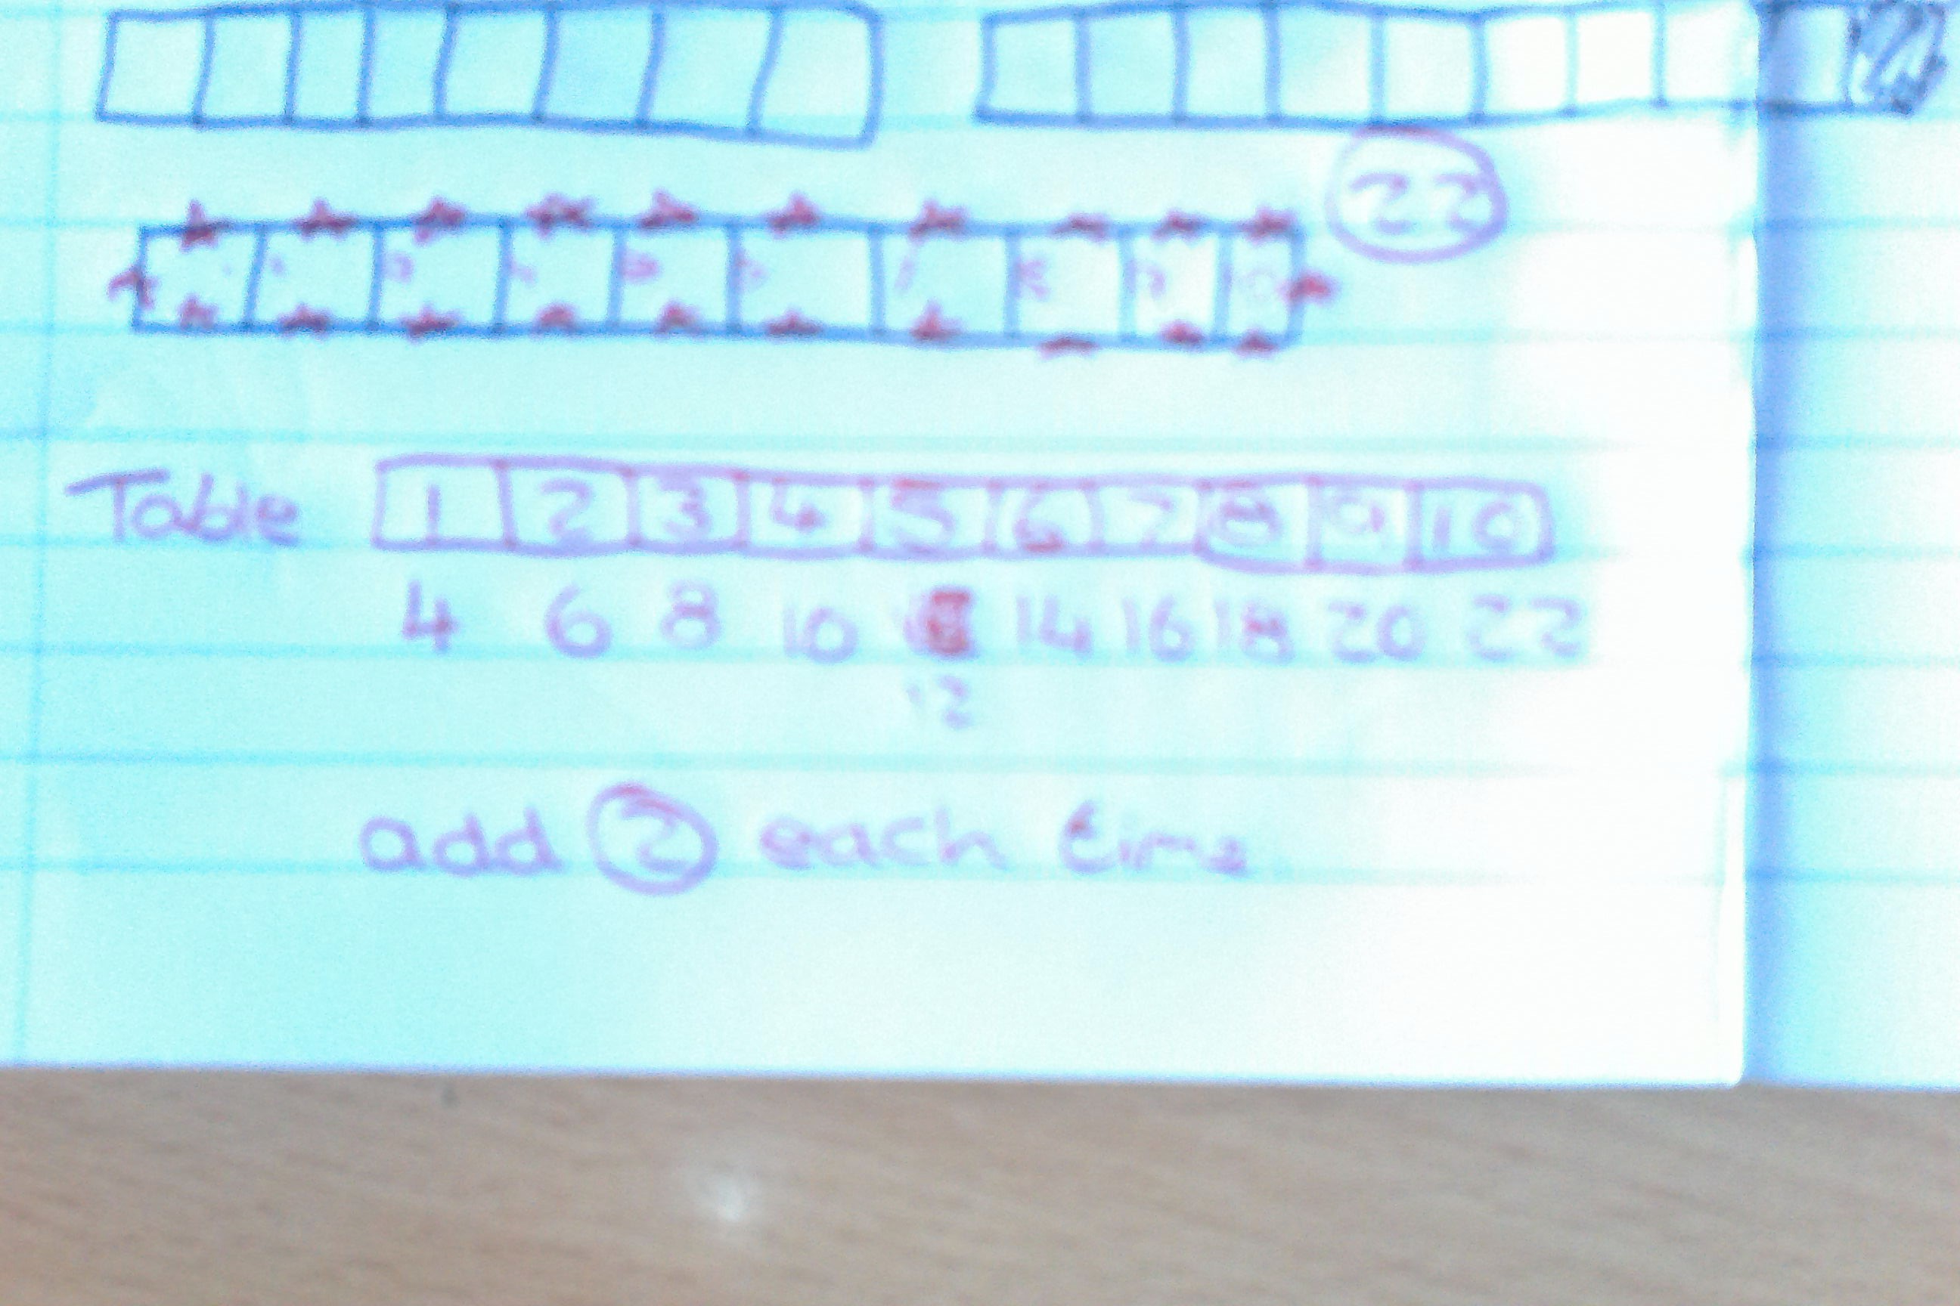
The common difference

Slide 19
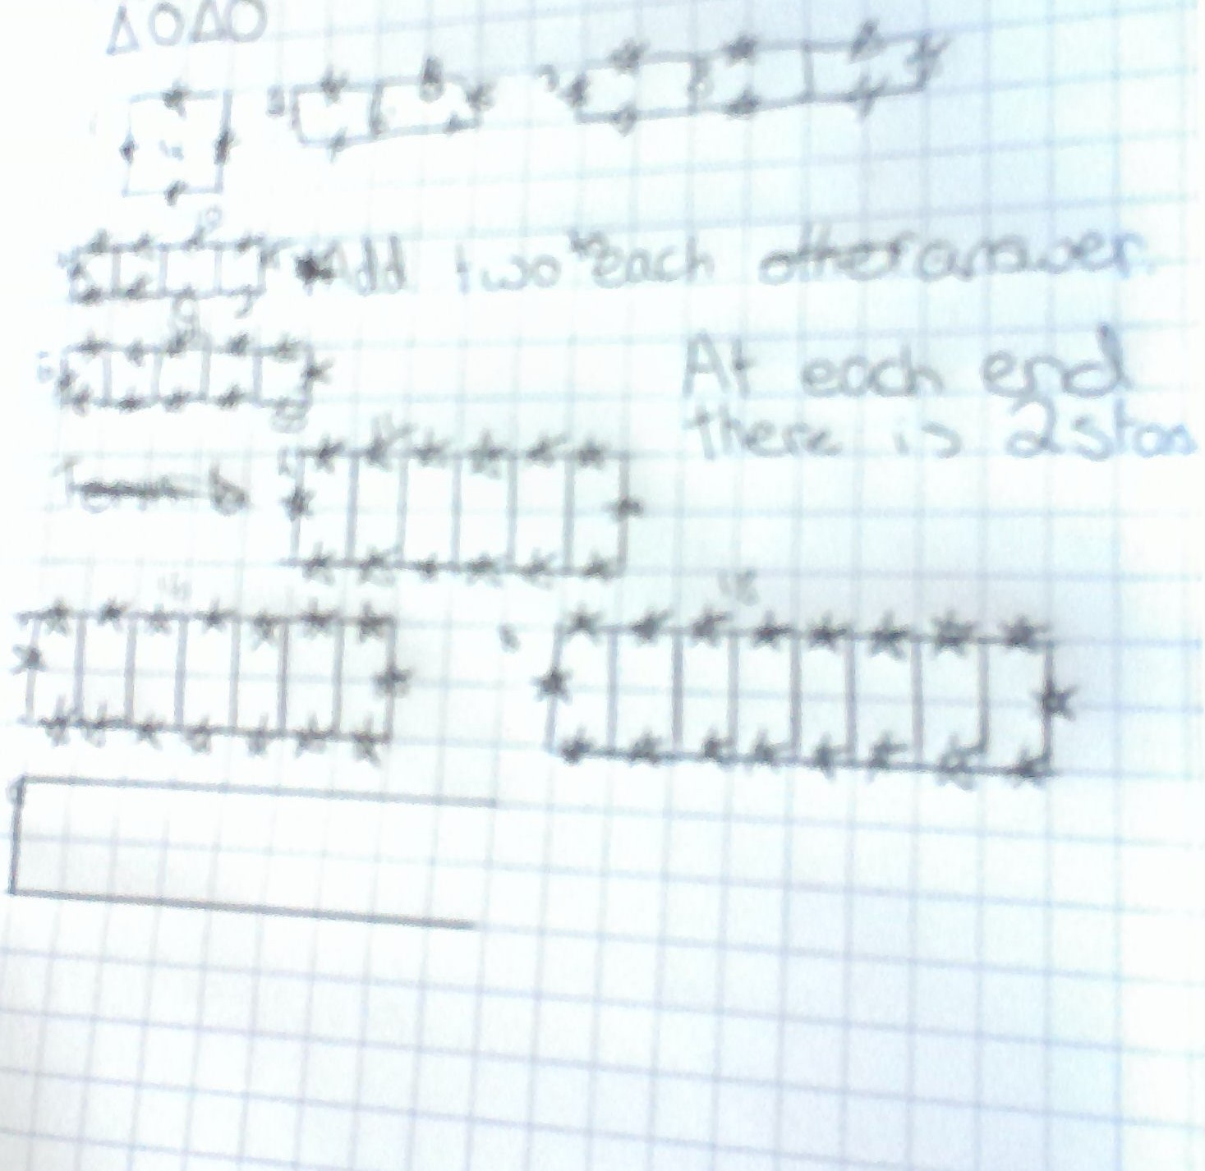
Drawing it

Slide 20
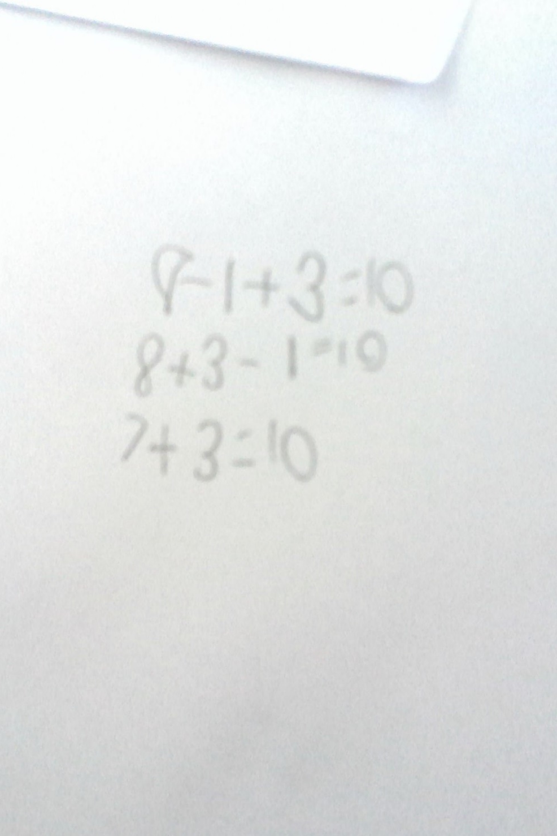

Slide 21
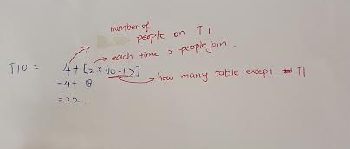
The nth term method

Slide 22
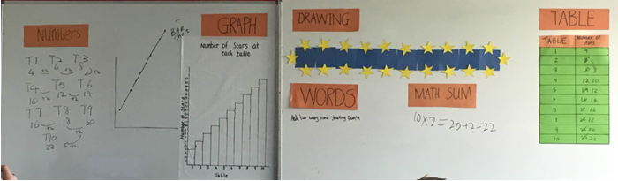
Board Plan
We had a double board which allowed us to display all student solutions together.
One thing we would include the next time would be the students name above their solutions
Notes:
22

Slide 23
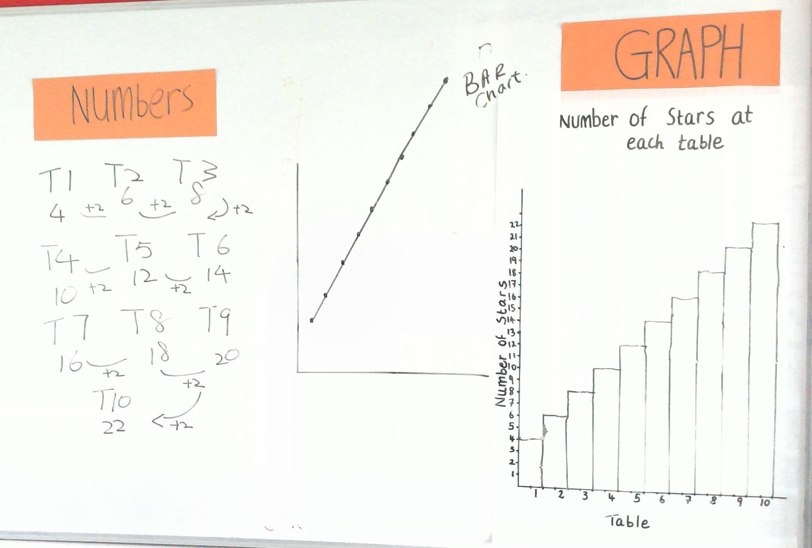

Slide 25
Recommendations
Add student names to their solutions
Omit drawing axis on the graph paper
Plan the lesson to suit a normal 30-35 minute lesson
Notes:
25

Slide 26

Notes:
26

Slide 27
Sources Used
Insert what sources you consulted for your lesson study
www.projectmaths.ie
http://www.ncca.ie/en/Curriculum_and_Assessment/Post-Primary_Education/Project_Maths/Syllabuses_and_Assessment/JC_Maths_English_2013.pdf
www.examinations.ie
http://maths.qahs.org.uk/files/2014/05/DevelopingFormulae.pdf
Folens textbook
Texts and Tests textbook
Notes:
27

Slide 28
Thank You!
Maths Counts 2016

