Slide 1
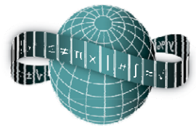
Using Linear Patterns to Foster Algebraic Reasoning
Maths Counts 2016

Slide 2
Cathy Cradock & Hilary Griffin St. Leo’s Carlow

Slide 3
Over to you
What should students learn when they study linear patterns?

Slide 4
Details
Taught on 29/02/2016
Taught to first years [mixed ability, 30 girls]
Lesson lasted 40 minutes
Observed by three teachers

Slide 5
Context within scheme of work
Students have studied sets, natural numbers, the fundamental principle of counting, integers, rational numbers, decimals, percentages and probability.
This is the first introduction to Patterns and Algebra

Slide 6
Teachers are aware of the importance of stressing multiplication as a process of repeated addition and introducing the concept of like terms when teaching natural numbers
It is hoped that as a department we will be able to create a suite of lesson plans to allow a seamless transition from patterns to algebra
it is hoped that as a department we will be able to create a suite of lesson plans to allow a
seamless transition from patterns to algebra

Slide 7
Student Learning Goals
Students will recognise linear patterns
Students will develop rules to describe the relationship between two variables
Students will understand the power of the rule to describe the general term

Slide 8
Design of Lesson
Our Project Maths RDO facilitated a number of sessions and explained the process of teaching through problem solving
Evolving a lesson plan from presenting students with a problem to solve was very appealing
Meeting times were flexible and with much difficulty we managed to meet as a team on a number of occasions

Slide 9
Using linear patterns to foster students’ algebraic reasoning
Students are presented with a linear pattern and asked to predict the pattern a number of steps further on. Students are then asked to extend their prediction and write down a description of the relationship between the two variables.

Slide 10
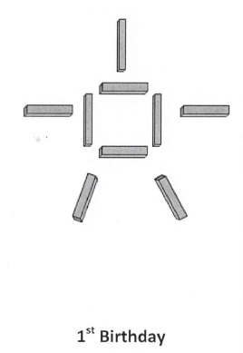
Meet Ted

Slide 11
The purpose of our lesson was to make expressing the growth of a pattern as easy as possible for students
Ted’s growth is a very natural progression of adding to arms and legs

Slide 13
Through discussion and predicting student responses it emerged that Ted needed some tweaking
When we posed the question ‘what stays the same each time’ we realised it was likely that students would develop some misconceptions

Slide 14
This is Ted at birth
This stage was essential in eliminating misconceptions
It also gives a very basic understanding of what can be very complex: time 0

Slide 15
Aim of lesson shared with students at start of lesson
“Be able to describe the growth pattern in your own words and use this understanding to identify how many matchsticks are needed for any term in the pattern.”
Key words such as ‘term’ are explained at this stage

Slide 16
Introduction to task
The students are introduced to images of Ted at birth and then at his 1st,2nd and 3rd birthdays

Slide 17
Student Activity
In pairs, students must replicate ted on his first, second and third birthday.
The students then make the fourth and fifth term of the pattern.
Timing: 5 minutes

Slide 18
The students are asked how many matchsticks will be needed to make Ted on his 20th and 100th birthday.
A variety of ideas to generate the number of matchsticks for Ted’s 20th and 100th birthday are encouraged
Students work in a groups of 4 sharing their ideas
Timing: 10 minutes

Slide 19
Stray and stay
Each group of 4 is broken, teacher assigns numbers 1 or 2 to each student
Those numbered 1 are the ‘teachers’ and they stay put, those numbered 2 are the ‘students’
The students visit other tables where the ‘teacher’ explains the method used by their group
Timing: 10 minutes

Slide 20
Differentiation
Where appropriate, students were encouraged to extend their thinking
’What rule would work for every single term?’
‘If I used ---- matchsticks, how old is Ted’
A sheet with prompting questions was given to groups struggling with task

Slide 21
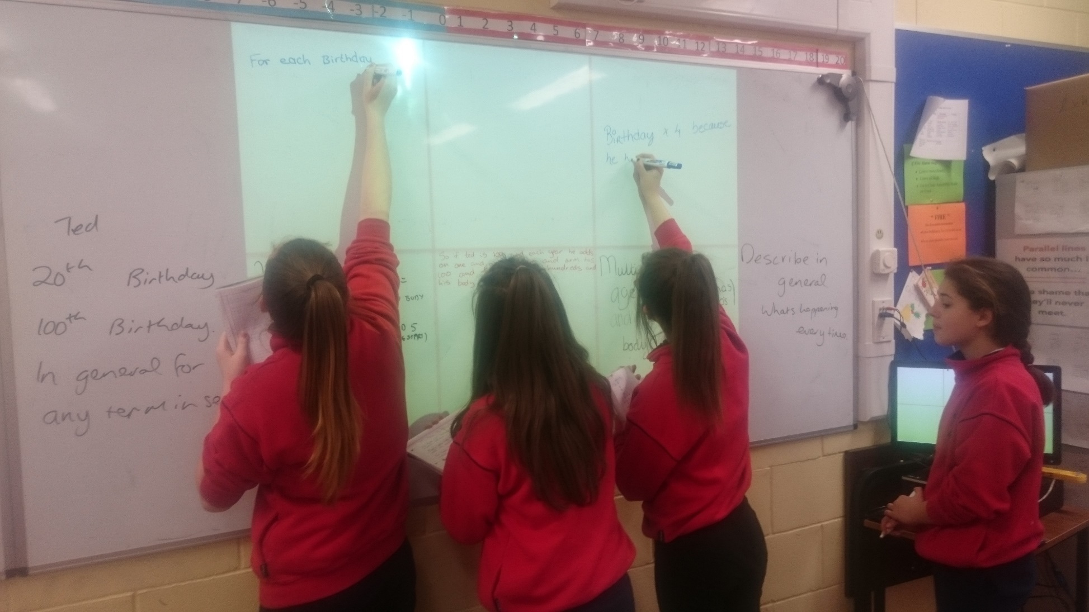
Board work: Assessment for learning
The board is divided into sections and students described their method on the board

Slide 23
Students provided a variety of algorithms
Students had no difficulty expressing the growth of the pattern
One group even explained how the repeated addition for successive terms becomes multiplication

Slide 24
Teacher feedback, consolidation and extension of learning
Teacher extended task: what would I do if I wanted to know how many matchsticks needed when Ted is 200 years old
Use think-pair-share

Slide 25
Teacher feedback, consolidation and extension of learning
Students volunteered other methods which we didn’t predict (they involved using stage 2 as a starting point or using stage 5 as a starting point)
This is scary!!
Teacher responded with ‘Let’s test it’ and the methods were subsequently accepted by the class

Slide 26
Teacher then extended the discussion to a sentence to describe the general term
Students could also be encouraged to replace words with symbols in order to save time writing sentences
Homework sheets were assigned and clarified, time was given to commence homework

Slide 28
Materials
The PowerPoint to show stages of Ted’s life is essential
Each pair was provided with a box of match sticks
Prompting questions were prepared to assist any group struggling with task
Homework sheets

Slide 29
Plan for Peer Observation
Three teachers observed the lesson
Photographs were taken and also notes for feedback were taken
Observing teachers questioned students for understanding

Slide 30
Findings
Students found the tasks relatively easy and completed the tasks quickly
Students really enjoyed the ‘Stray and Stay’

Slide 31
Findings/Student Learning
Misconceptions:
we had expected students to use a table format or to attempt to build more shapes with matchsticks but mostly they went straight to the algorithm

Slide 32
Difficulties:
Students completed the Ted task very easily but difficulties arose when extending their learning to the homework task
Confusion:
Tasks need to be explained very clearly

Slide 33
Insights:
Students find the work easier than anticipated and would have been put off by a teacher led lesson over explaining and not allowing them to come up with own method
surprising ideas?
Student questionnaire

Slide 34
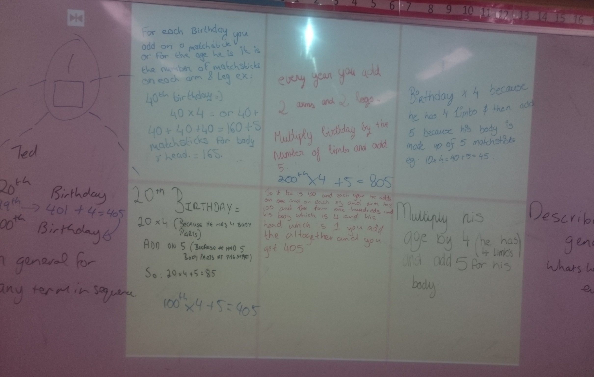
Board Plan
Insert pictures of Board Plan

Slide 35
Recommendations
Students could be encouraged to apply their reasoning to describe relationships in other subjects e.g. Hooke’s Law in science
Difficulties may arise as this would require some planning between departments

Slide 36
Quicken pace of lesson and get a second(very easy) linear pattern covered – the solution could be shared early on and time spent on the reasoning

Slide 37
Any Questions?

Slide 38
Thank You!
Maths Counts 2016

