Slide 1
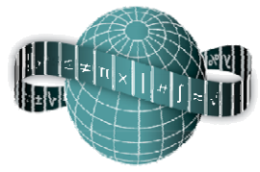
Reflections on Practice
Maths Counts 2016

Slide 2
Multiple Approaches Problem Solving in Geometry
School | Carndonagh Community School, Co. Donegal.
Teachers Involved | Sharon Coyle Siobhán Coll
Notes:
Hannahs Name was in but I took it out??

Slide 3
Details of our lesson
3rd Year Higher Level
40 minutes
25th February 2016
Previous Lesson | Theorems (INSERT NUMBERS) Revision of CIC
Research Lesson | Lesson discussed today
Planned Next Lesson | LINK UP WITH FLOW OF LESSON FROM OFFICIAL PLAN

Slide 4
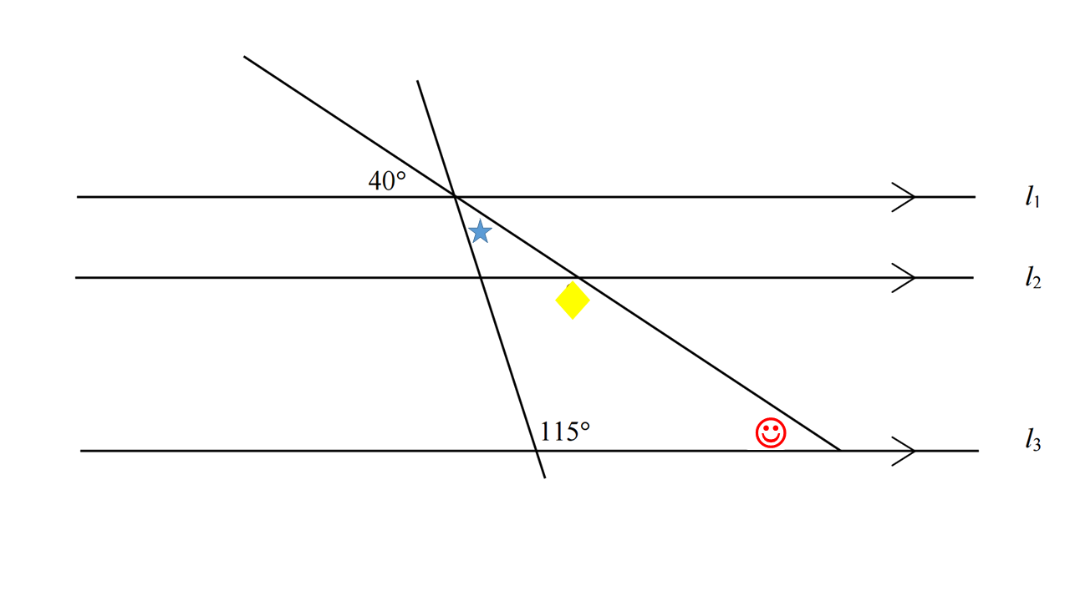
Our Question
Notes:
Kieran had this done

Slide 5
Student Learning Goals
Identifying and discussing keywords in geometry
Correctly measure angles using protractor
Apply the results of all theorems, converses and corollaries to solve problems
Notes:
Keywords: Vertically Opposite Angles, Transversals, Alternate, Corresponding, angles sum to 180

Slide 6
Design of Lesson
Both teachers were involved in planning this lesson
We decided on the learning goals
We chose the questions from SEC 2013 paper 2, question 9 as it covered a variety of geometric topics
We identified the key mathematical language relating to this topic
Teaching and Learning plan researched - www.projectmaths.ie
Siobhán was elected to teach the lesson

Slide 7
Materials
PowerPoint Presentation, reviewing on the importance of geometry through visual examples
Notes:
*Done

Slide 8
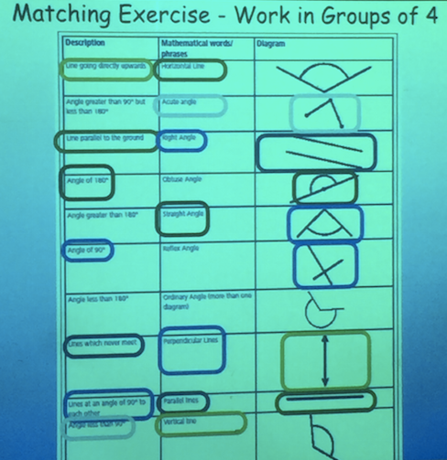
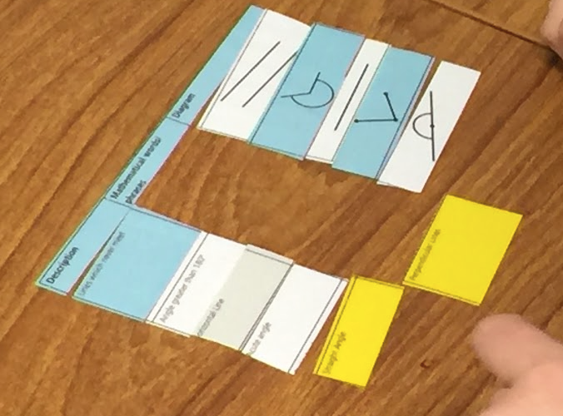
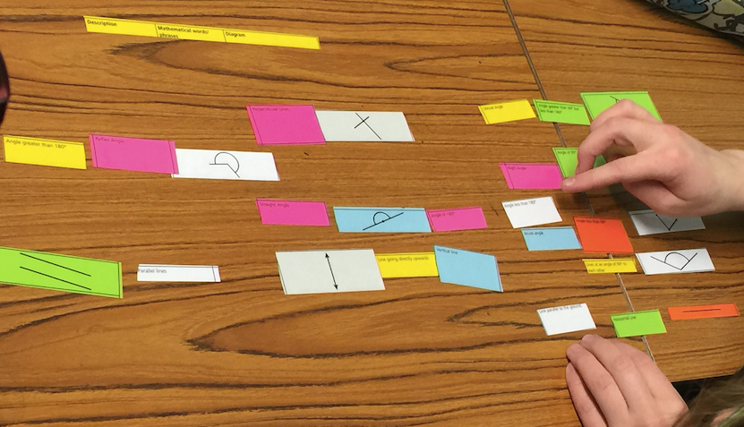
Materials
Matching exercise with key geometry terms
Notes:
*Done

Slide 9
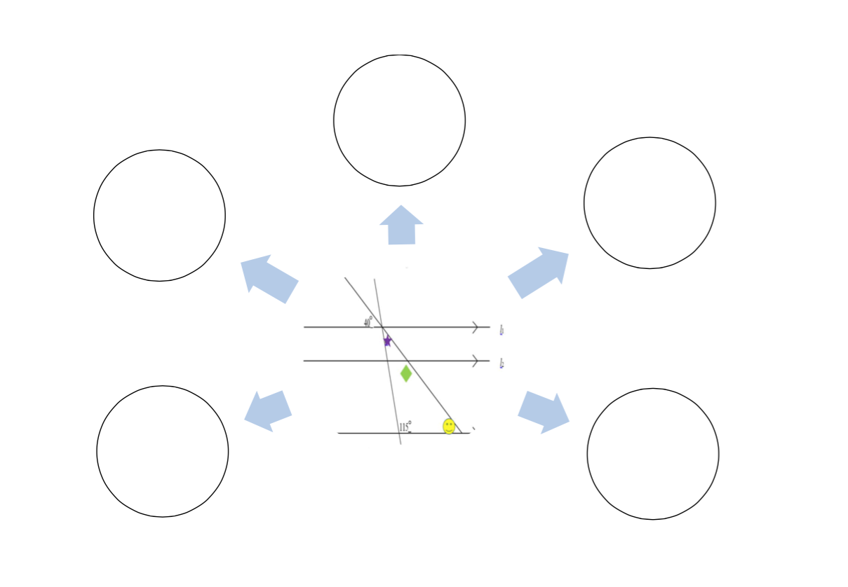
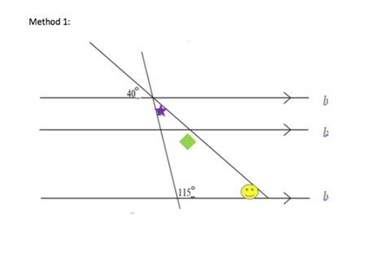
Materials
Students Worksheet with the problem
Notes:
*Done

Slide 10
Actual Worksheet (A4)

Slide 11
Plan for Peer Observation
The lesson was observed by a Project Maths RDO and another Mathematics Teacher
Ethics
A permission letter was issued to parents
Evidence was collected using:
An observation template
Pictures were taken of student work
Student questions were noted.
Students Learning Outcomes were noted
Notes:
*Done but needs pictures of students work

Slide 12
Unexpected Findings

Slide 13
Unexpected Findings
Use of Protractor
Students were very reluctant to use the protractor
Reluctance
Students were very reluctant to come up to the board to verbalise their thinking and solutions. This may have been down to the presence of other adults in the room.

Slide 14
Unexpected Findings
Use of Trigonometry:
One group of students used the method of trigonometric ratios to solve the problem without realising there was no right angle triangles.
Non-Visualisation of a Circle:
No students were able to visualise a full circle being 360 degrees to find the measure of the angles .

Slide 15
Unexpected Findings
Use of Exterior Angles and Congruent Triangles:
Interestingly one group used the exterior angle theorem to solve the problem while another group used congruent triangles.
Use the diagram rather than the worksheet:
Students focused mainly on writing their solution directly onto the diagram instead of using the space around.
Notes:
*added in 2 last slides here

Slide 16
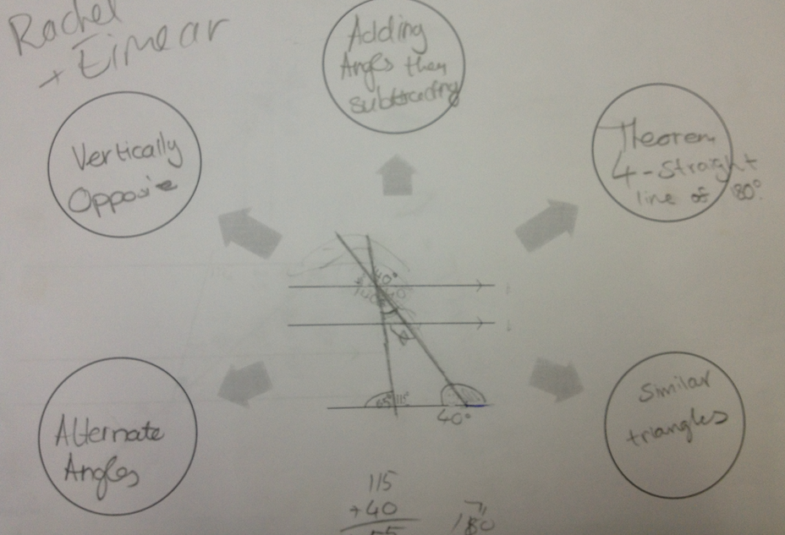
Pictures of Student Work
Notes:
Need pics from worksheet

Slide 17
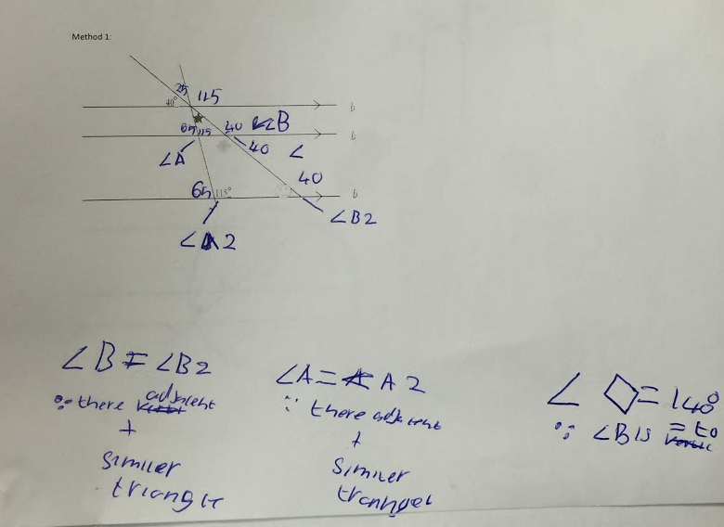
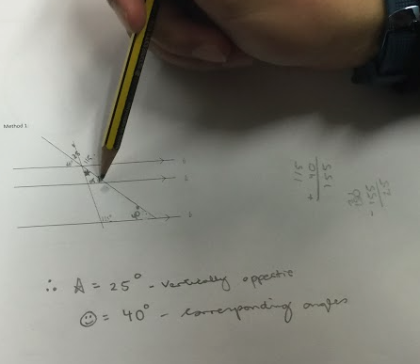
Pictures of Student Work
Notes:
Need pics from worksheet

Slide 18
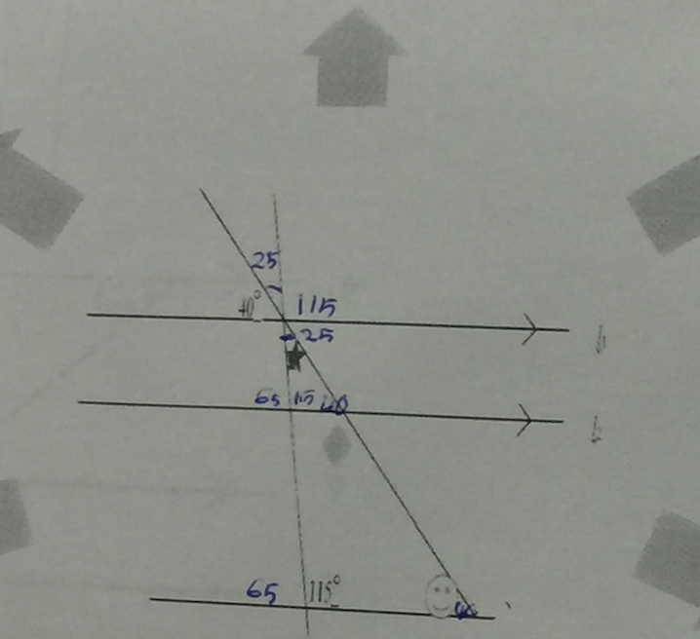
Pictures of Student Work
Notes:
Need pics from worksheet

Slide 19
Findings
Similar triangle (pics)
Struggled to come up with 5 methods
Key words but difficulty applying
Reluctance
Extreme confusion → Alternate/Corresponding

Slide 20
Findings/Student Learning
Discuss what the study suggests about students’ learning this should include:
Misconceptions
Difficulties
Confusion
Insights
Surprising ideas

Slide 21
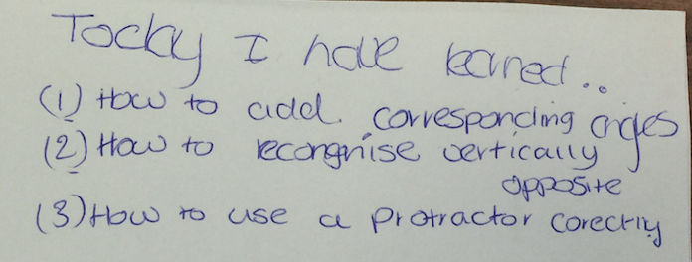
Evidence of Student Learning

Slide 22
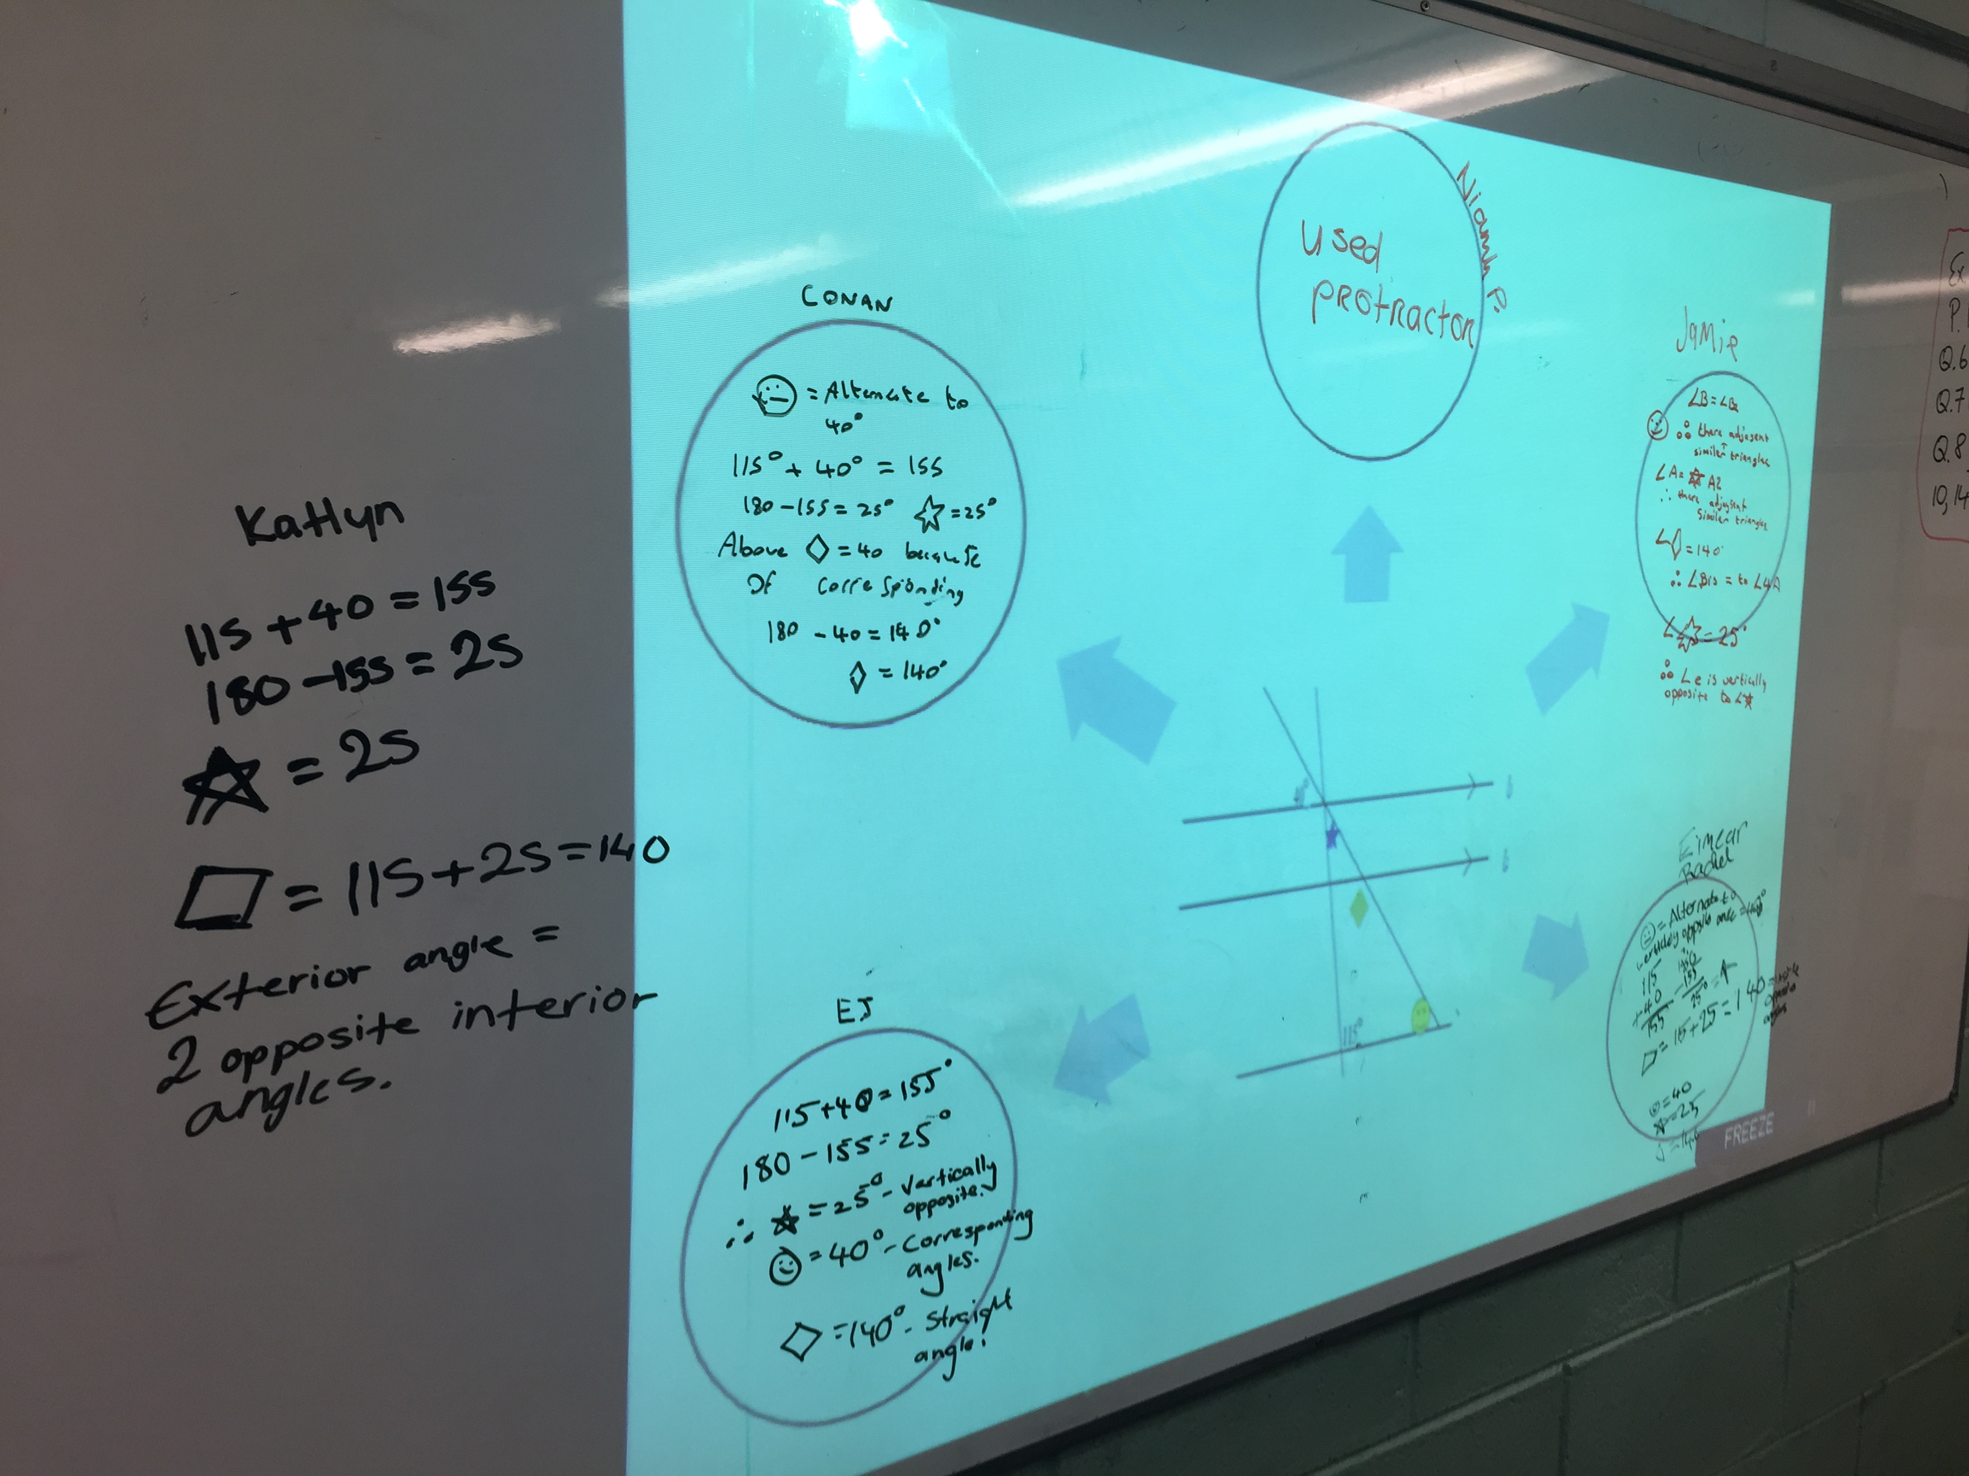
Board Plan

Slide 23
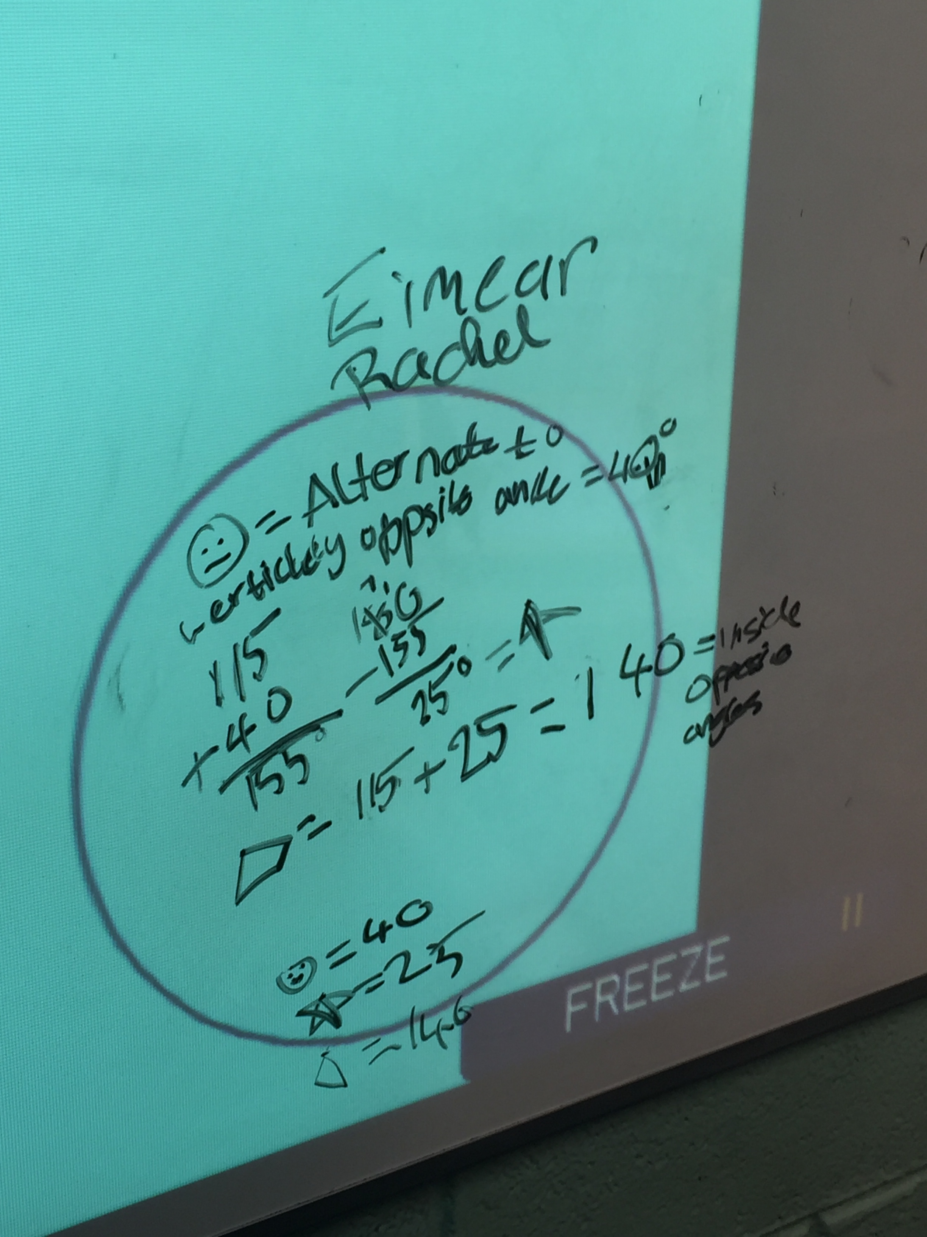
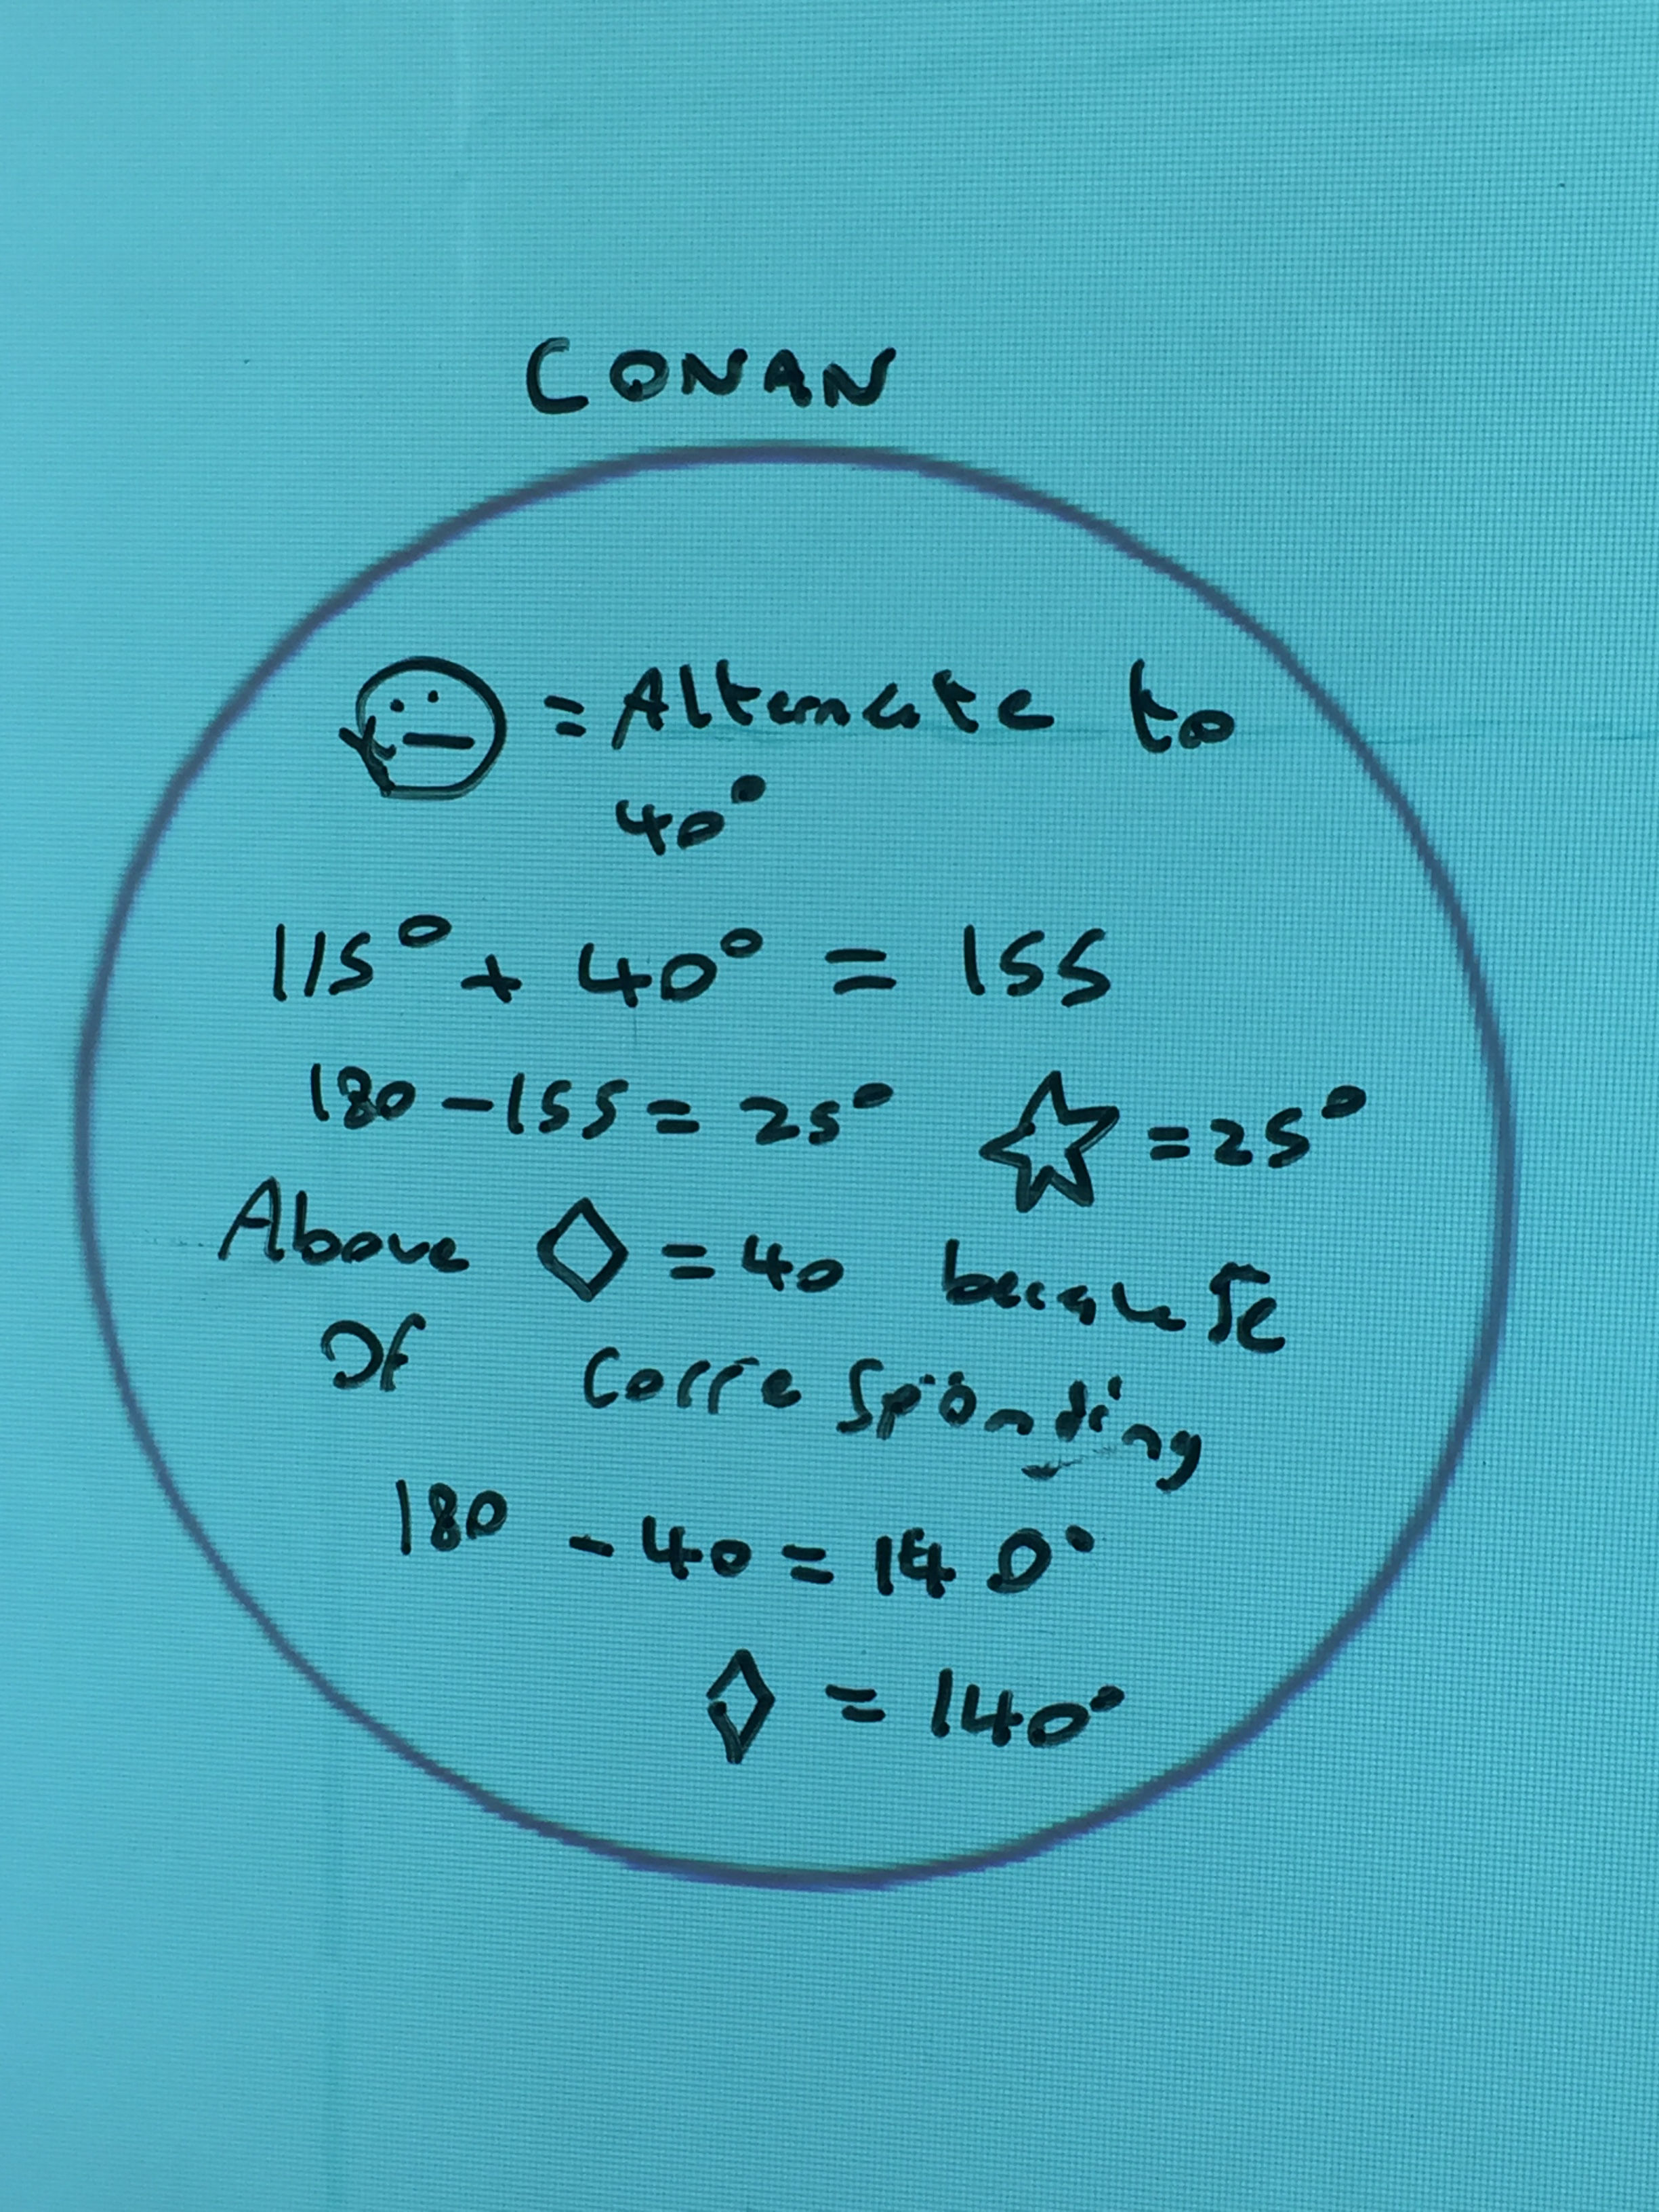
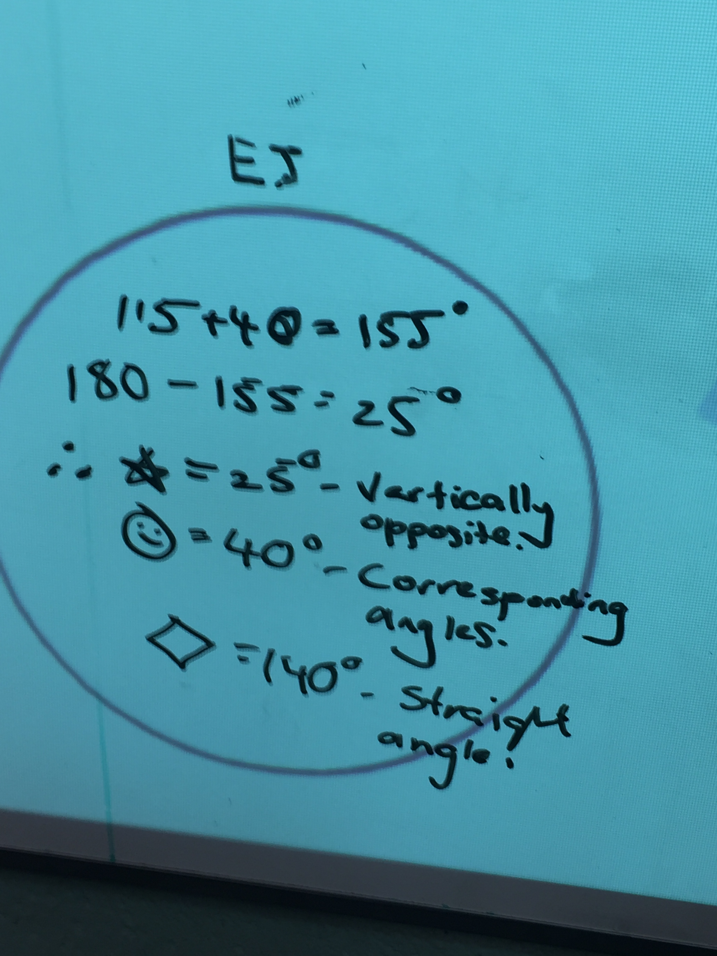
Board Plan

Slide 24
Recommendations
Timing → Pose task in a double class
(more time for workings and discussions)
Updated matching exercise at beginning
(more relevant to the problem)
Larger diagram
(easier for students to work on)
Notes:
*Done

Slide 25
Any Questions?
Notes:
I just copied your question mark from last years

Slide 26
Sources Used
Geometry Teaching and Learning Plans on www.projectmaths.ie
Junior Certificate Syllabus
Active Maths Textbooks
Text and Tests Textbooks
Past Examination Papers
Google Searches on Multiple Approach Problem Solving in Geometry
www.projectmaths.ie
Notes:
Kieran had this slide done

Slide 27
Thank You!
Maths Counts 2016

