Slide 1
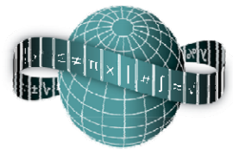
Reflections on Practice
Maths Counts 2016

Slide 2
Problem solving leading to proof
The topic being reflected on was:
Geometry and Problem solving leading to formal proof

Slide 3
Who was involved in the reflection
Sharon Mack Nicola Doyle & Claire Shorthall St Marks Community School, Tallaght. Gillian Beere Colaiste Bride, Clondalkin.

Slide 4
Details of target students
2nd year Higher Level
45 Minute class
Geometry -
Review and Extend the prior knowledge of the student, using investigative methods leading to formal proof.

Slide 5
Aims of the lesson
To appreciate the value of a proof, realizing the importance of “never assuming”
Encourage independent learning
Promote creativity and imagination
Build enthusiasm by engaging with stimulating activities
Encourage students to be comfortable in trying different methods to solve problems, and to realise that there are often numerous valid approaches to do this.

Slide 6
Student Learning Goals
Students will see many approaches to proving the sum of all angles in a triangle is ${180}^{0}$ through:
Peer teaching
Discovery learning
Use of prior knowledge
They will appreciate the value of proof and realize the importance of never assuming.

Slide 7
Topic of Lesson
We decided on a topic and discussed as a group the area the students found difficult.
We all agreed from past experience that, while most students did remember, they lacked an understanding of why the sum of the angles in a triangle is ${180}^{0}$
We set a goal for students to realize the importance of never assuming.

Slide 8
Design of the Lesson
Place students in groups being mindful of ability levels (1min)
Recap on previous lesson (5mins)
Pose the question - What does the sum of the angles inside a triangle equal? Discuss (2mins)

Slide 9
Design of the Lesson
One member of each group holds up their triangle and gives their decision. Students then see their triangles are different yet they have all made the same decision. (1min)
Students are then asked how can this be true since all the triangles are different and asked could they prove their decision. (5mins)

Slide 10
Design of the Lesson
Ask students to prove this in as many ways as possible (15mins)
Conclusions, discussion and close of lesson (15mins)

Slide 11
Steps of the Lesson
Hand out triangle worksheet, scissors, protractor and let them work (5mins)
Hand out second worksheet with parallel lines and a transversal (10mins)
Circulate and observe while the students work, taking notes of different methods used keeping interaction with students to a minimum.
Choose which students to call to the board

Slide 12
Steps of the Lesson
Call students to the board starting with most naive answer to most sophisticated
Each student puts their name on the board with their solution (10mins)
Recap on learning outcomes set out, emphasizing it was all their work and give ownership linking to proof (6mins)
Photo taken of the board

Slide 13
Materials
Paper
Scissors
Protractor
Rulers and Pencils
Worksheets (acute, scalene, right angle, obtuse, parallel lines)

Slide 14
Plan for Peer Observation
We wanted to collect data, observe strategies student used, listen to class discussion, look at different methods, take photographs.
We also wanted to look for evidence of group interaction and peer and independent learning.

Slide 15
Anticipated Responses
Our plan was:
To have all possible solutions ready to show.
Talk through each one, starting with the simplest or most obvious
Have students explain their methods
Discuss any unexpected solutions
Discuss any errors or misconceptions

Slide 16
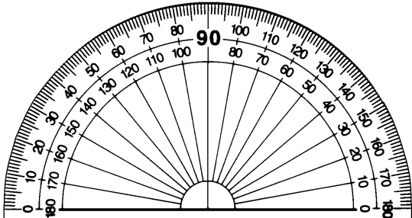
Anticipated Response 1
Use of protractor to measure the angles inside the triangle.
Add the answers to give ${180}^{0}$

Slide 17
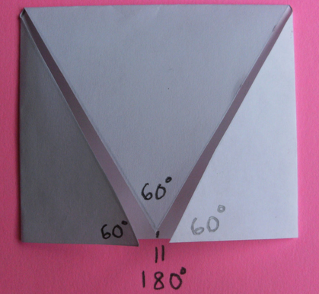
Anticipated Response 2
Fold the corners of the triangle in to make a straight line angle

Slide 18
Anticipated Response 3
Cut the corners off the triangle and line the together to form one straight line angle

Slide 19
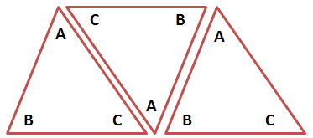
Anticipated Response 4
Line up the angles using three corresponding triangles, to form a straight line

Slide 20
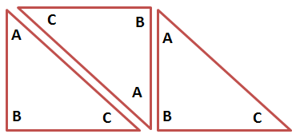
Anticipated Response 5
Line up the angles using three right triangles, to form a straight line

Slide 21
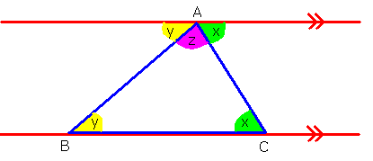
Anticipated Response 6
Use knowledge of straight line angles and alternate angles to prove it

Slide 22
Flow of the lesson

Slide 23
How the lesson began:
Students were reminded of the prior knowledge required in order to proceed with this lesson.
During the previous week we had been studying angles, in particular, alternate angles and straight line angles.

Slide 24
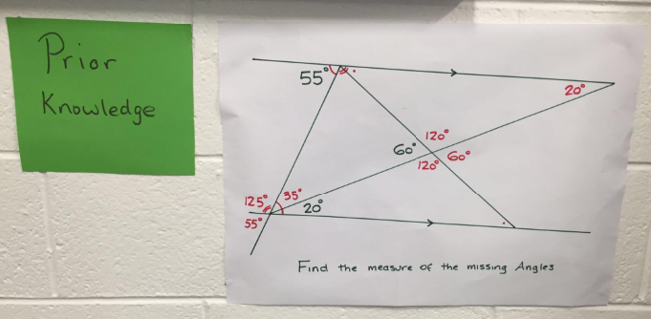
Board Plan for prior knowledge

Slide 25
Materials provided:
Worksheets with printed triangles (acute, scalene, right angle, obtuse, parallel lines)
Paper
Scissors
Protractor
Rulers and Pencils

Slide 26
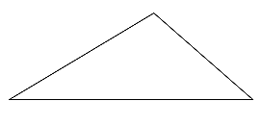
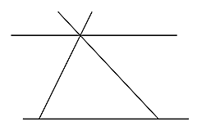
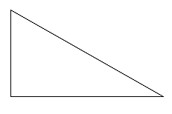
Pictures of worksheets

Slide 27
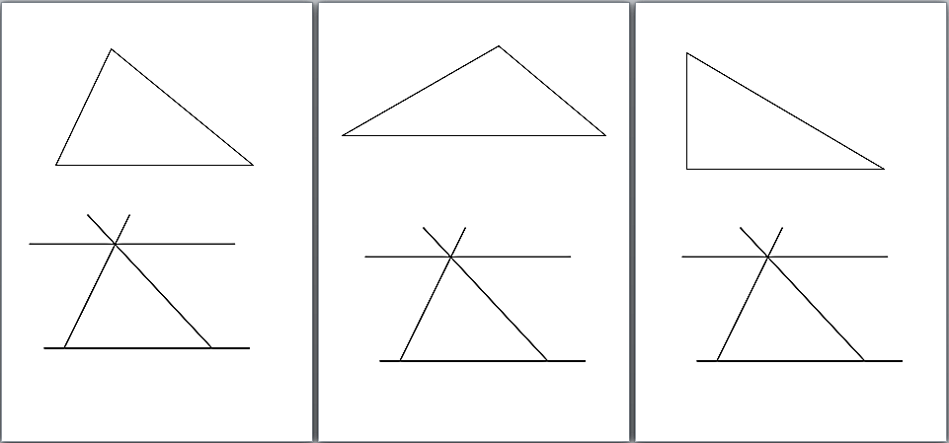
Pictures of worksheets

Slide 28
Posing the Question
What do the size of the angles inside a triangle add to?
Is this true for all triangles?
In how many different ways can you prove this?

Slide 29
Findings
The most common approach by the students was the use of the protractor to measure angles.

Slide 30
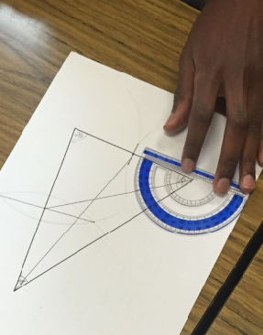
Student at work

Slide 31
Findings
Other students began by cutting out triangles without fully knowing why.

Slide 32
Student at work

Slide 33
Findings
Some students cut the corners off the triangles
- some tried to put them in a circle
- some eventually lined the angles along a ruler

Slide 34
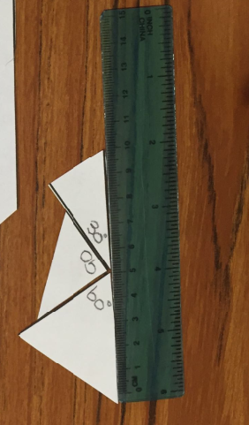
Student at work

Slide 35
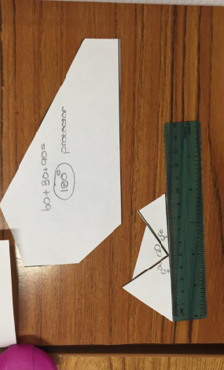
Student at work

Slide 36
Findings
Some students cut out three triangles and lined up the angles to form a straight line.

Slide 37
Student at work

Slide 38
Findings
It was 10 minutes before students began to fold the triangles
Initially there was confusion about which way to fold the triangle, but eventually some students succeeded..

Slide 39
Student at work

Slide 40
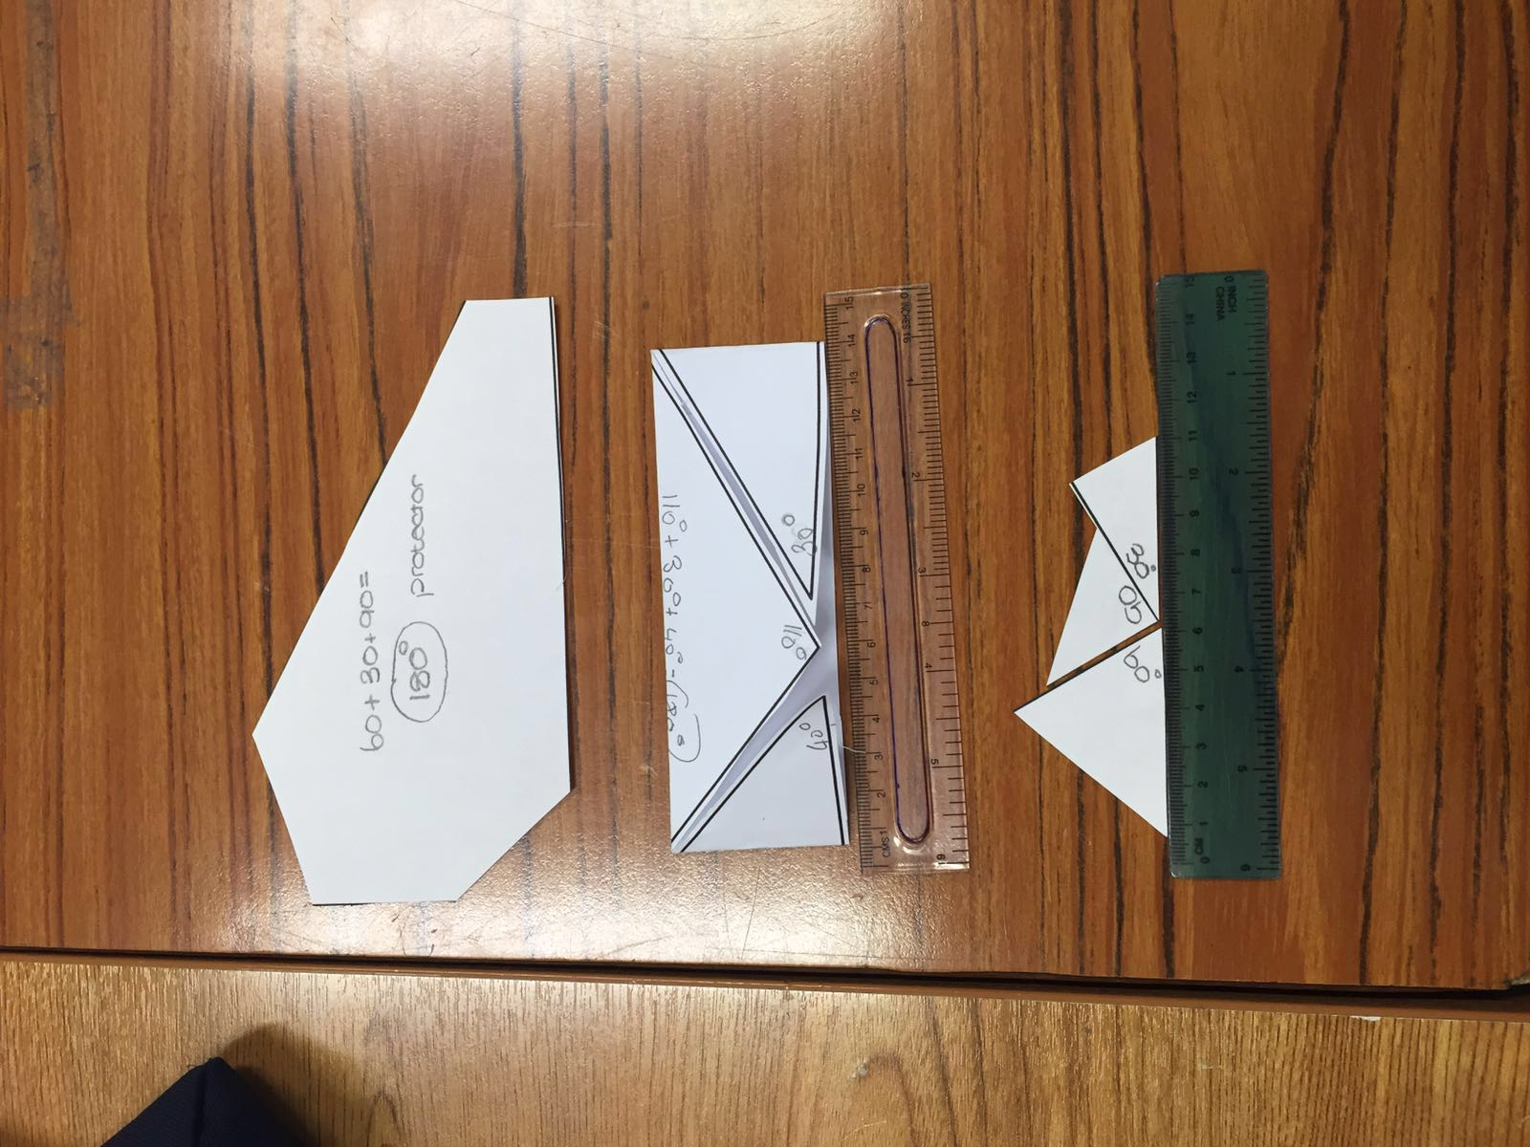
Students work

Slide 41
Findings
Eventually, one student discovered using alternate angles and straight line angles to prove that the angles inside any triangle added to give ${180}^{0}$

Slide 42
Findings
All anticipated answers were solved by the class
Different approaches to the same solution

Slide 43
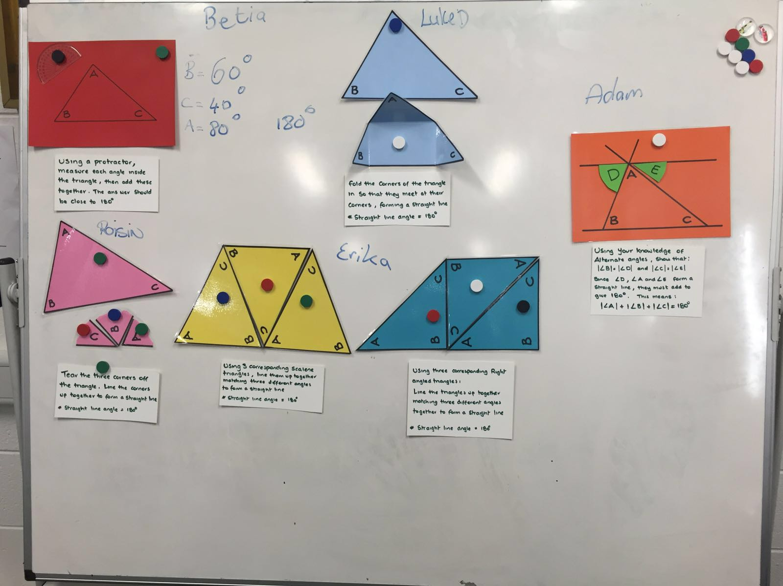
Board at close of lesson

Slide 44
Discussion and close of lesson:
Our plan was:
To have all possible solutions physically ready to show.
Talk through each one, starting with the simplest or most obvious
Have students explain their methods
Discuss any unexpected solutions
Discuss any errors or misconceptions

Slide 45
Misconceptions
One student cut triangles in half not knowing why he was doing so.
Other students cut out angles and made a circle
Misconceptions led to findings in some cases

Slide 46
Recommendations
Have scissors/ protractor etc in a bag on the table before students arrive
Hand out all worksheets together
Tell them the number of possible solutions that ‘you’ could find to encourage them to find at least that many ways independently or as a group.

Slide 47
Any Questions?

Slide 48
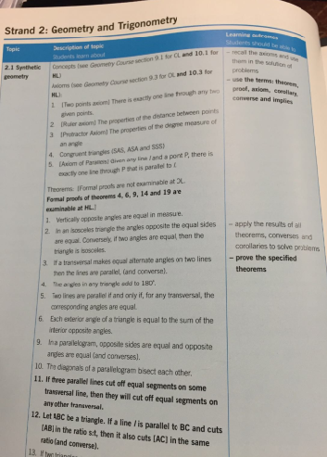
Sources Used
Syllabus

Slide 49
Thank You!
Maths Counts 2016

