Slide 1
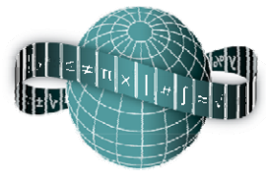
Reflections on Practice
Maths Counts 2016

Slide 2
Exploration of properties of basic geometric shapes
School | Deele College, Raphoe, Co. Donegal
Teachers Involved | Maureen O’Donnell Caitriona O’Malley Paddy Flood Steven Gibson Vivienne Doherty Leah Harkin

Slide 3
Details of our lesson
6th Year Ordinary Level
35 minutes
7th March 2016
Previous Lesson | Coordinate geometry – length & Pythagoras
Research Lesson | Basic geometric problem – area of square
Planned Next Lesson | Extension activities that may arise

Slide 4
Our Question – Find area of quadrilateral PQRS

Slide 5
Student Learning Goals
solve problems involving the length of sides and area of triangles, squares and rectangles, along with combinations
use the theorem of Pythagoras to solve problems involving right-angled triangles
calculate the length of a line segment and area of a triangle using coordinate geometry formulae
use trigonometry to calculate the area of a triangle
explore links between various approaches to solving problems
devise appropriate mathematical models and use appropriate techniques to analyse problems
work effectively as a group
communicate mathematical work effectively

Slide 6
Design of Lesson
Pre-evaluation and Plan
Inform students in advance about arrangements - guest and extra teachers and observation
Work in groups of four
Outline solutions
Teacher group develops outline solutions based on anticipated responses
Students will develop these on whiteboard
Differentiation
Differentiated level of discussion - level of questioning
Extra work to do
Help for students with difficulties
Other issues
Are the flow, content and methodologies of the lesson effectively achieving the learning outcomes?

Slide 7
Materials
A3, A4 Worksheets
Blank paper
Geometry equipment
Scissors
Calculators

Slide 8
Plan for Peer Observation
Plan to observe students
each teacher will observe one group of four
each teacher will be given observation templates
What to observe
how effectively are the groups going about the problem?
what difficulties or confusion are being encountered?
presentation of work?
dynamics of group work - recommendations to make these more effective
preparation to communicate solution on whiteboard to class - effective?

Slide 9
Unexpected Findings
Extent of student engagement
Group self-correction : |PQ|≠3
Importance of adequate time
Variety of approaches
Student tendency to round off
Clarity of student comments

Slide 10
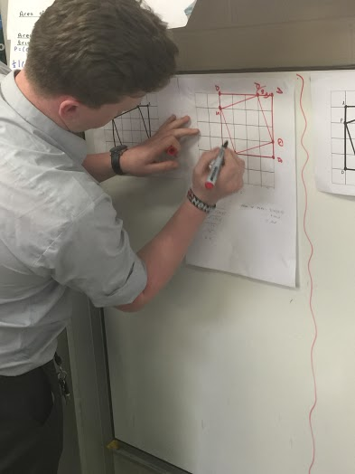
Pictures of Student Work

Slide 11
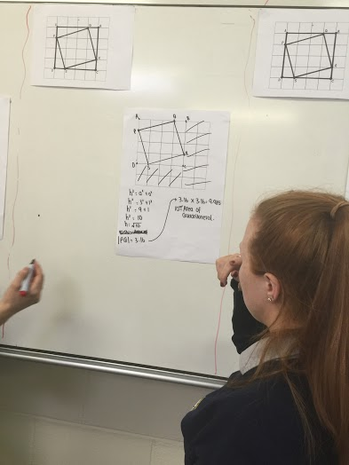
Findings / Student Learning
Tendency to early misunderstandings
Competence in use of Pythagoras
Allow groups time to explore problems

Slide 12
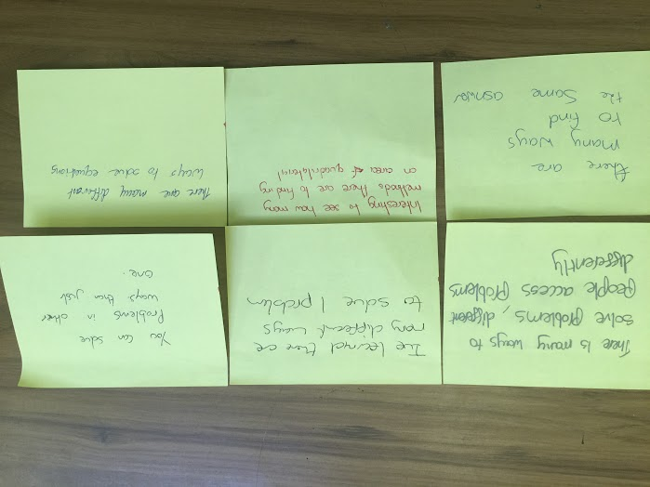
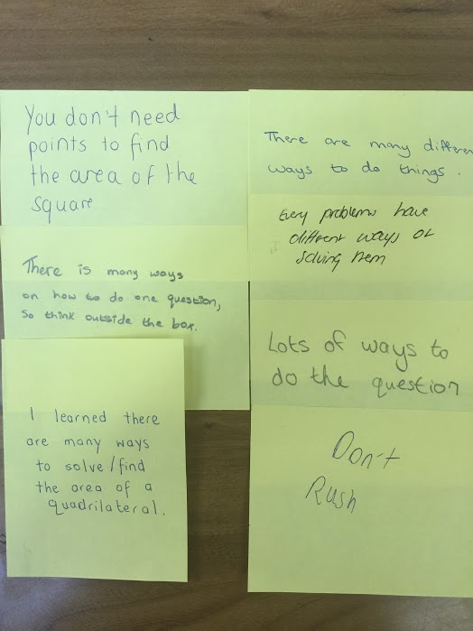
Evidence of Student Learning

Slide 14
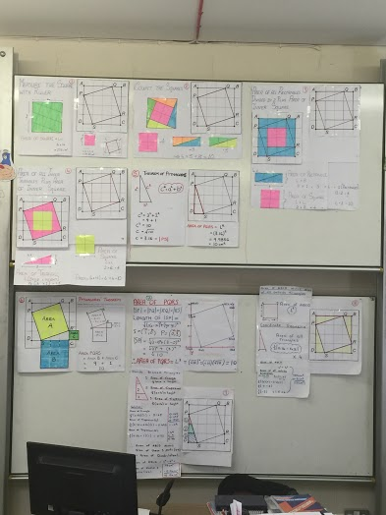
Board Plan

Slide 15
Recommendations
Give time to explore, discuss
Don’t interfere at early stage
Cultivate idea of varied approaches
Monitor workings of groups
Importance of communication and presentation by students

Slide 16
Sources Used
Active Maths Textbook
Text and Tests Textbook
Past Examination Papers
Project Maths Workshops 2, 3, 6, 9, 10
NCCA J.C 2016, L.C 2015 Syllabuses
Google Searches on Multiple Approach Problem Solving in Geometry
www.projectmaths.ie
Geometry Teaching and Learning Plans on www.projectmaths.ie

Slide 17
Any Questions?

Slide 18
Thank You!
Maths Counts 2016

