Slide 1
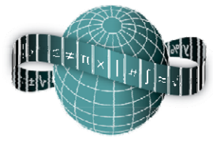
Reflections on Practice
Maths Counts 2016

Slide 2
Research Lesson
Deepening the understanding of the properties of a parallelogram.
(linking synthetic to coordinate geometry)

Slide 3
Teachers: Deirdre Newell, Sandra Níc Ghiolla Mhuire, Thérèse Ruane PTA: Lynn Anderson

Slide 4
Details
Second Year Mixed Ability
Lesson Length: 50min
Friday 4th March 2016
Lesson | Number of Periods
Students have learned to plot points, find the midpoint by formula and to observe translations | 7
Revision of reading points, plotting coordinates and the name of quadrants | 1
Revision of the use of the midpoint formula and the use of this to solve for unknown values. Main focus to develop integer and coordinate work. | 1
Reflections on practice Lesson: Problem Solving | 1
Reinforcement: discussion about parallelograms and other quadrilaterals | 1
Slope: Using the parallelogram given, looking at the slope properties in parallelograms | 1

Slide 5
Student Learning Goals
Students should be able to:
Make connections
Identify the unique attributes of parallelograms through analysis and problem solving
Deepen their understanding of shapes and properties.
Develop the skill of listening to each others thoughts.
Using and connecting synthetic geometry in a coordinate problem.
Identify that there are a variety of ways to solve problems and they are all equally valid.
Develop an appreciation that Mathematics can be used to communicate thinking effectively
Become independent learners
Become more creative with Maths

Slide 6
Design of Lesson
This involved 5 sessions and on-line work
Night 1: An introduction to Reflections on Practice: Problem Solving Lessons
Night 2: Drumcondra Research Lesson and selection of the topic, Geometry
Night 3: Finding a suitable problem to link with the curriculum and the group selected
Night 4: Developing the lesson plan, investigating the curriculum, developing the board plan
Night 5: Finalising the board plan, and lesson. Preparing for the peer observation: Aims for Evaluation.
Research Lesson & Post Lesson Reflection

Slide 7
Materials
Worksheet
Compass
Ruler
Scissors
Pencil

Slide 8
Flow of the Lesson:
Introduction 5min
Recap of prior knowledge to include reading a point from a Cartesian plane, basic formulae we have met in co-ordinate geometry and key properties of a parallelogram.

Slide 9
Flow of the Lesson:
Posing the Task 10min

Slide 10
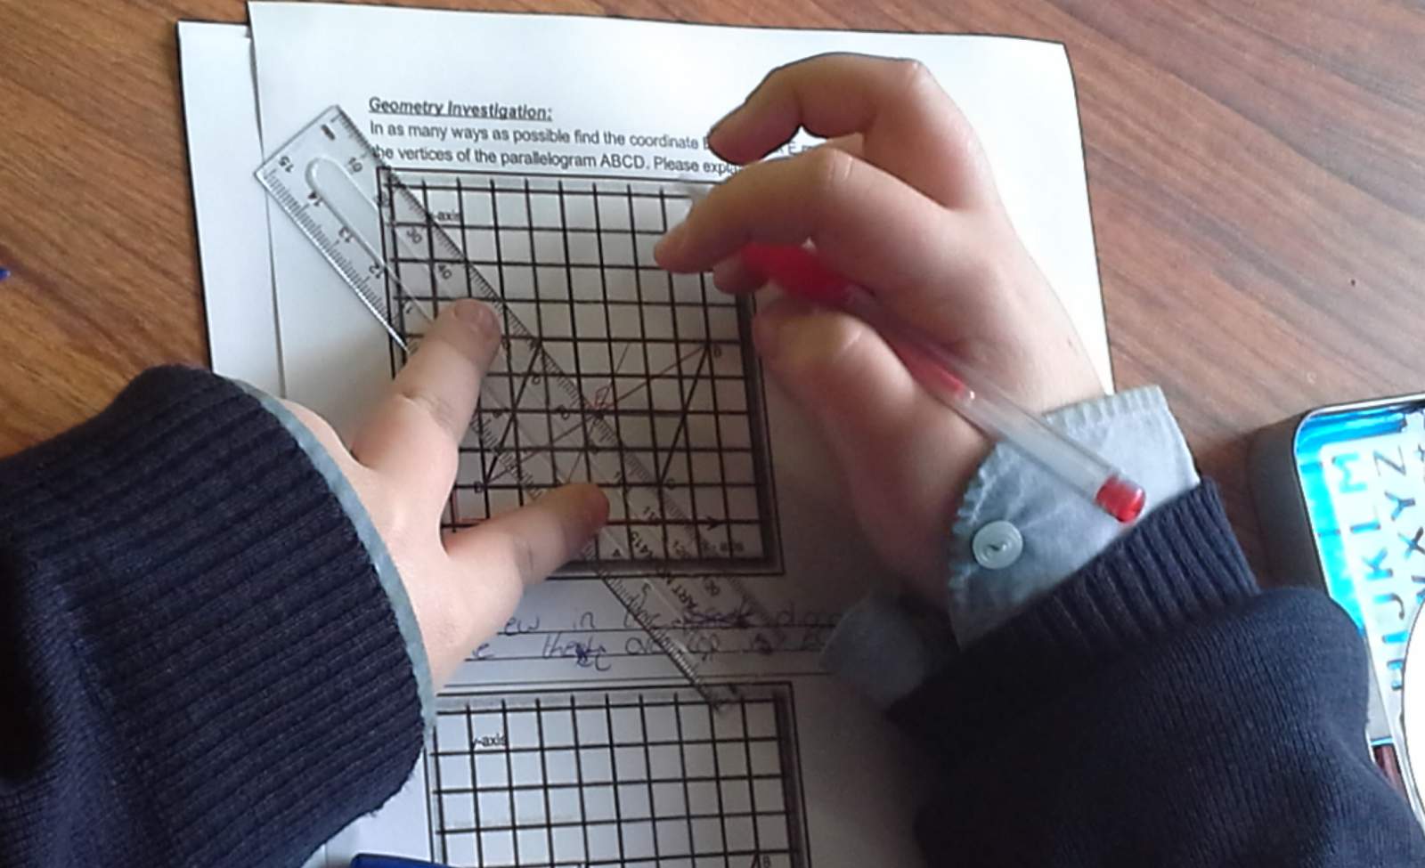
Flow of the Lesson:
Students working on Task 15 min

Slide 11
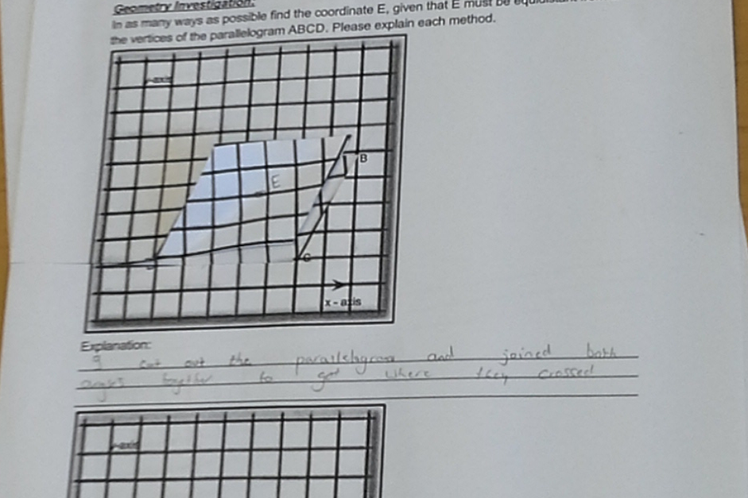
Students on Task:

Slide 12
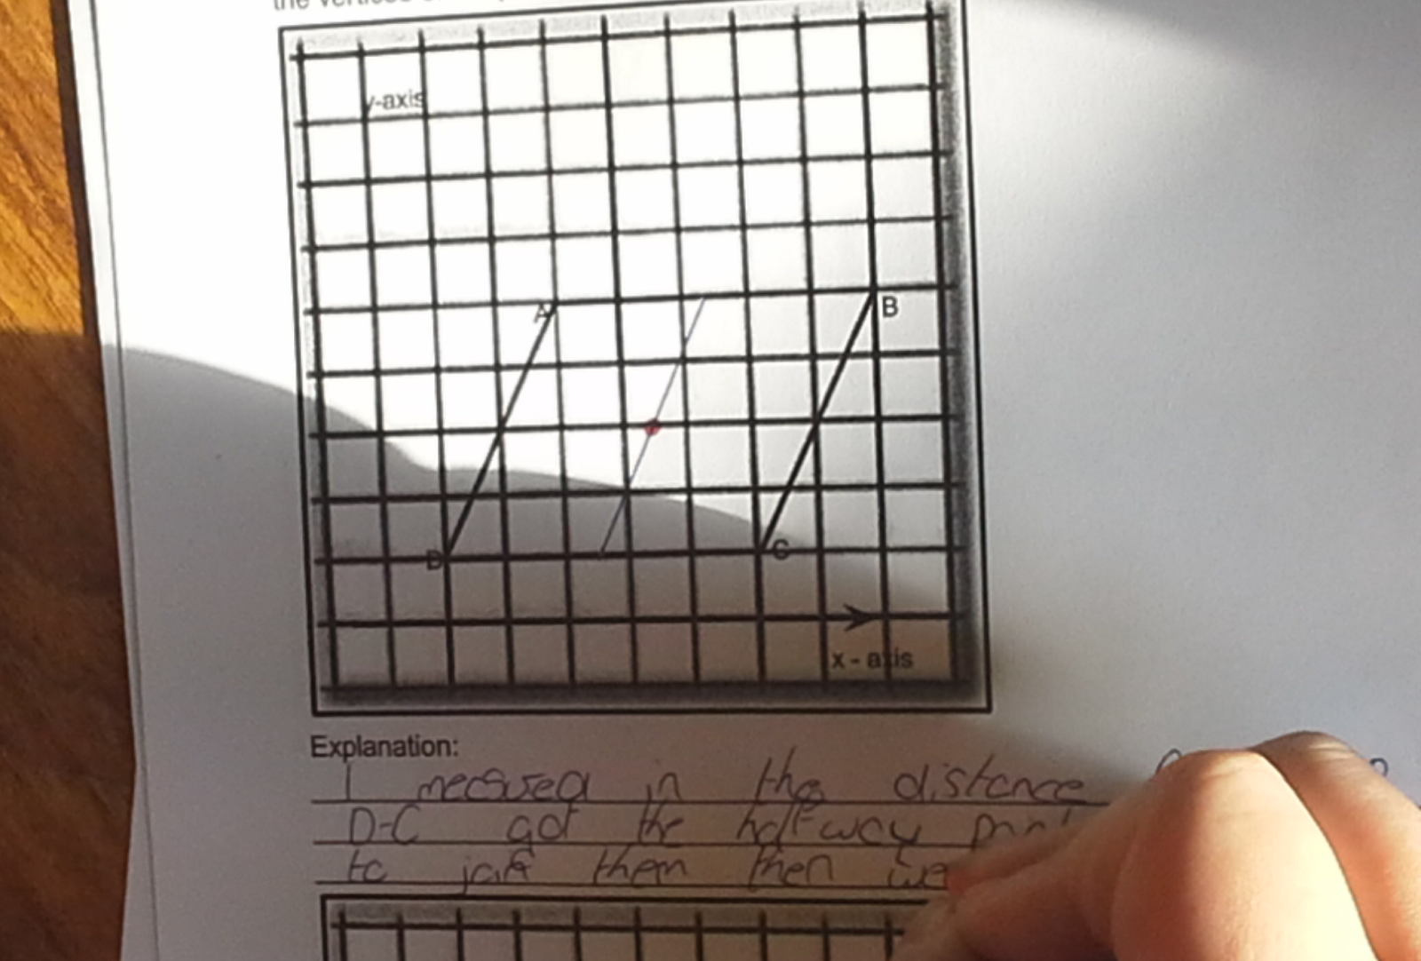
Students on Task:

Slide 13
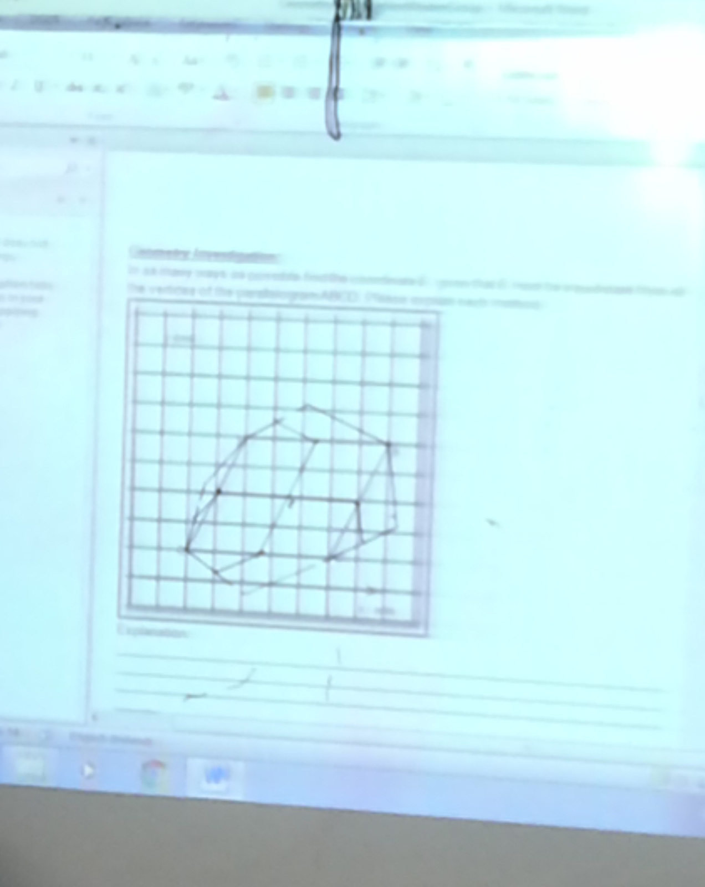
Flow of the Lesson:
Comparing and Discussing 15 min

Slide 14
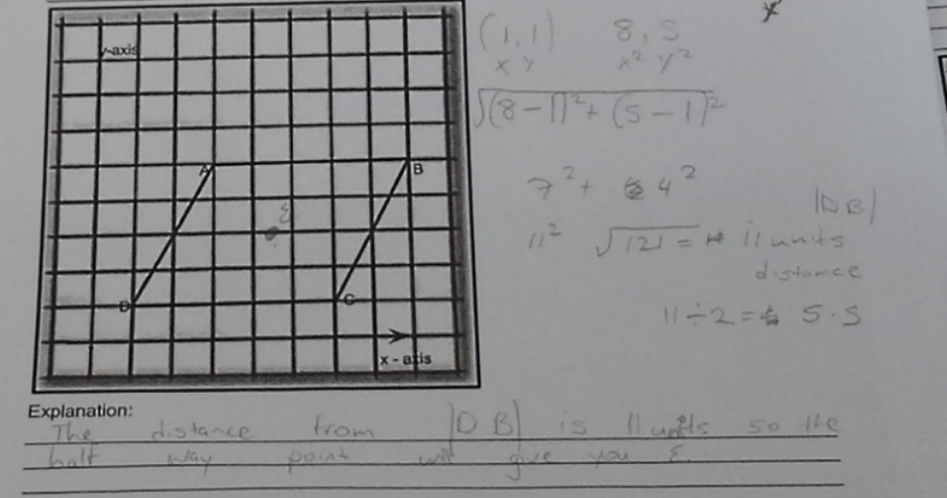
Comparing and Discussing

Slide 15
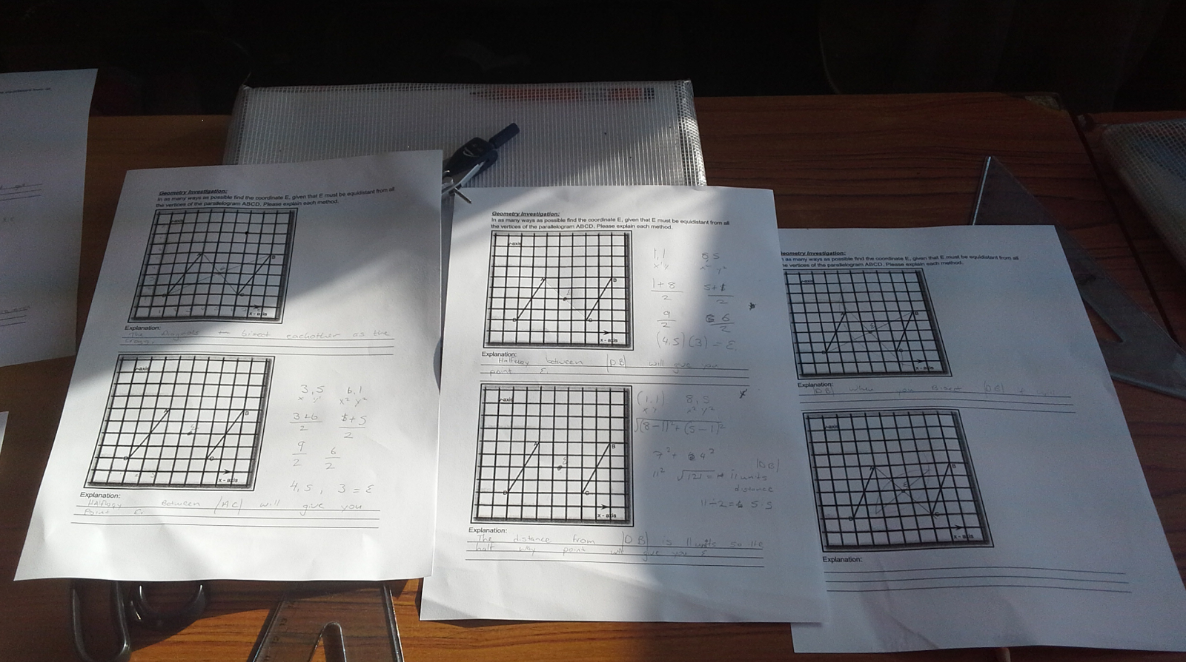
Flow of the Lesson:
Summing Up 5 min

Slide 16
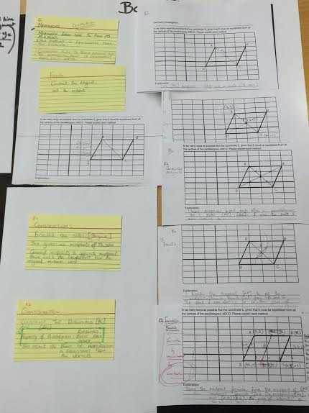
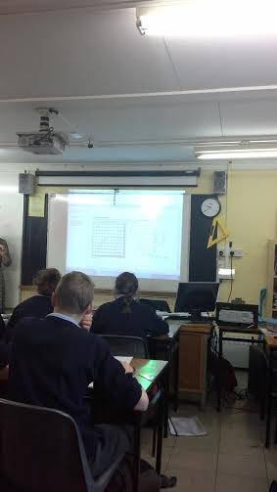
Board Plan
7 methods planned plus 2 alternative methods

Slide 17
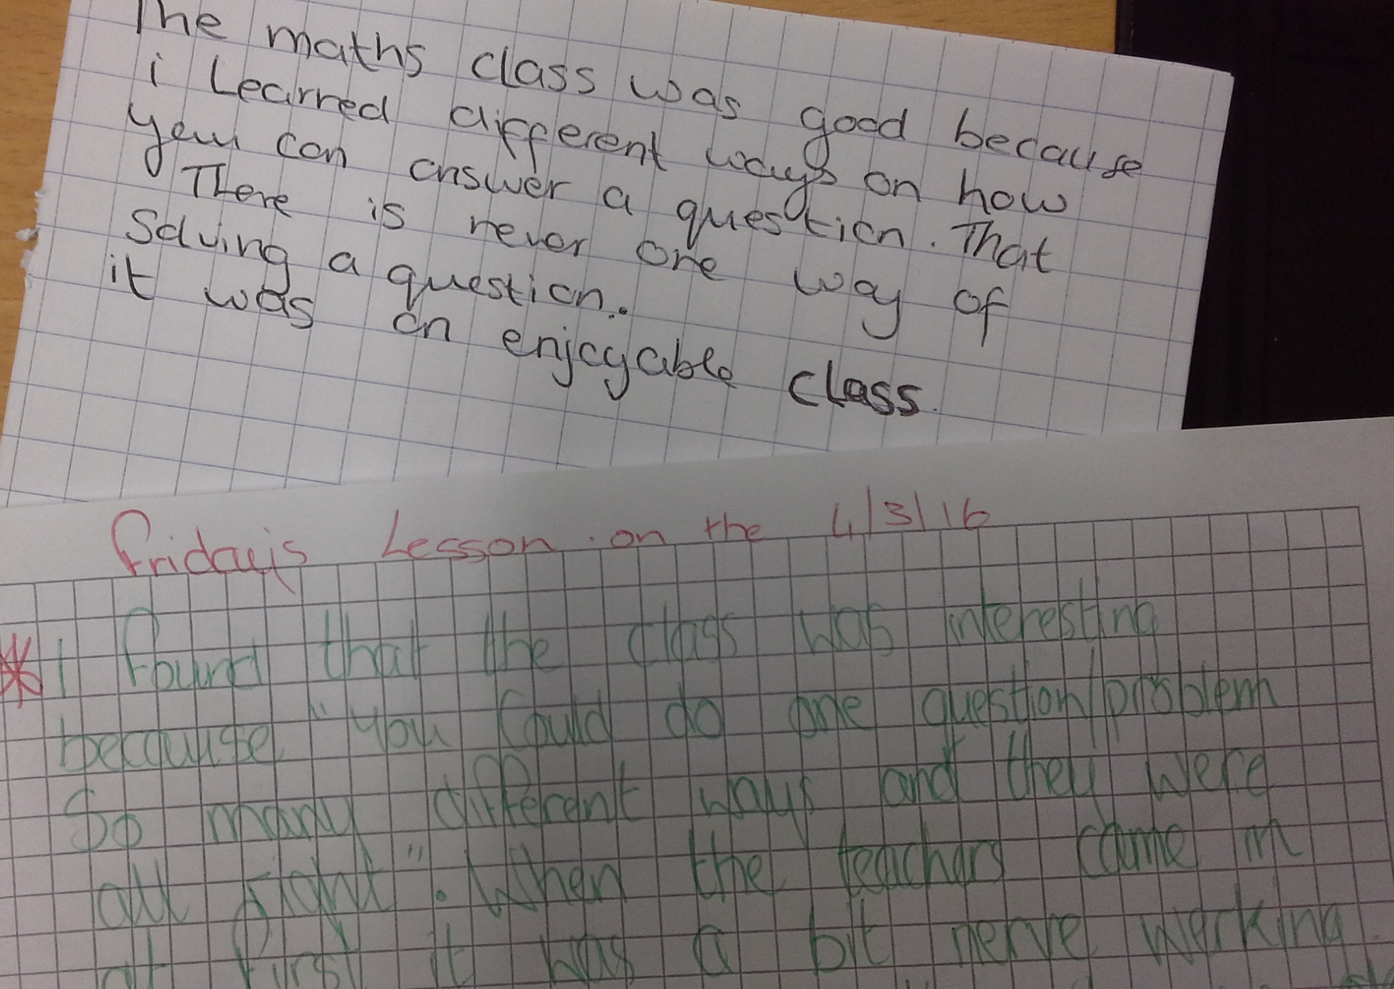
Flow of the Lesson:
Student Reflection

Slide 18
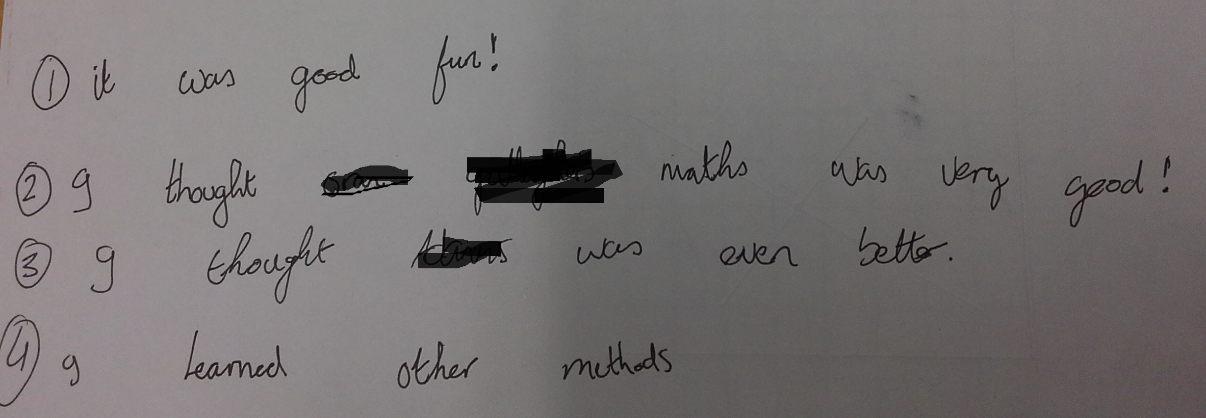
Student Reflection

Slide 19
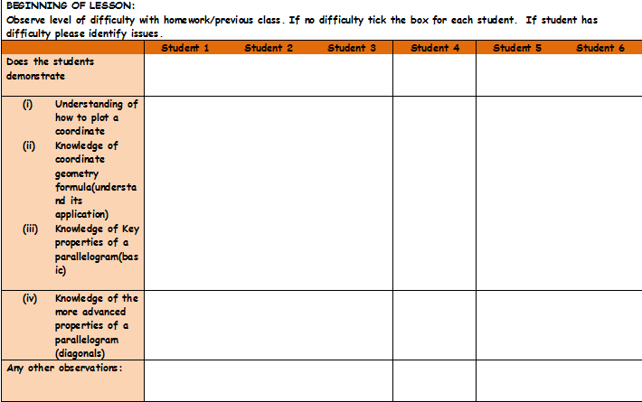
Plan for Peer Observation
Student Observation Record was developed. Assessing did students understand the task, achieve the goal set, use appropriate language and symbols.
Photographic evidence was gathered on the student’s work.
Work done on the board by students was recorded.

Slide 20
Findings
Students were highly engaged and enjoyed the challenge set.
All students found the correct solution and were all able to validate their work using at least one alternative method.
Students were given an opportunity to self –correct (incorrect use of brackets in distance formula)
Students were given an opportunity to provide solutions and verbalise their reason behind answers given.
Students found the whole class discussion interesting, they enjoyed listening to other students explanations and expressed any difficulties they had in understanding alternative methods.

Slide 21
Findings/Student Learning
Students initially were slow to discuss the properties of parallelograms, however once they gained confidence most properties were identified.
Students had a very clear understanding of the task
Most students solved the problem on the first go by the construction of the two diagonals, the challenge then became to find another valid solution.
No misconceptions arose during this problem.
The value of selecting an appropriate problem and creating a forum for discussion is immense. Students were intrigued by their classmates solution.
The students did come with two alternative solutions that we had not anticipated. One student constructed the diagonal and used the distance formula to find E. Another student used the division of a line segment to find the midpoint of each side and connected these to find E.

Slide 22
Recommendations
The length of time of the lesson proved challenging at the end. To create a greater opportunity for discussion the lesson should be approx 5-10 min longer. This should allow for students to verbalise what they learned, to compare and analyse the different types of solutions.
The worksheet could include a reflection for the end of the lesson, or this could be done in the students exercise copy.
e.g: What did you learn from doing this task?
List four things you know about parallelograms?
Boardplan was difficult to achieve due to the limitations of Irish classrooms.(board space/room space)
Observation record sheets proved too detailed and difficult to use. Substantial photographic evidence and main events were noted providing a good record of the lesson.
(LessonNote could ease recording)

Slide 23
Sources Used
www.projectmaths.ie
Project Maths Handbooks for First Year and Second Year
Junior Cert Maths Syllabus for Higher and Ordinary
Active Maths 1
Text and Tests 1

Slide 24
Any Questions?

Slide 25
Thank You!
Maths Counts 2016

