Slide 1
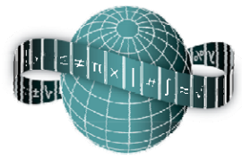
Reflections on Practice
Maths Counts 2016

Slide 2
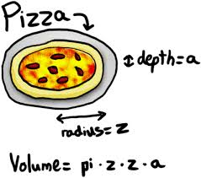
Over to you
The relationship between the volume of a cylinder and its height and radius.

Slide 3
Cara Shanahan, Stephanie Hassett Colaiste Dun Iascaigh Gerry Dowling, Annette O’ Donnell Scoil Aireagail

Slide 4
Details
Third Year Higher Level
40 minutes
26th January 2016
Problem solving lesson for volume

Slide 5
Student Learning Goals
For students to understand:
The relationship between the volume of a cylinder and its radius.
To see that as the radius changes, the volume changes in proportion.
Be able to comfortably use the volume of a cylinder formula.
π is a constant and height, h, is a constant in this task.
Scale factor – the effect of scaling.
Estimation is a useful skill.

Slide 6
Design of Lesson
We met and thought of an area the students had difficulty with. We focussed on geometry. We looked for a task that would have real meaning for the student involving a problem solving approach.
Steps of the lesson providing enough detail for other teachers to use it in their classes (include timing)
Include preparation for the lesson – revision of 3D shapes and volume
Include post-lesson work for students – homework involved tripling the tank to assess students understanding

Slide 7
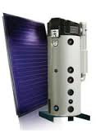
The Task
Your parents need to replace their hot water tank, to facilitate installing a solar panel. They cannot change the height of the tank but they can double the width of the tank to fit inside the hot press.
If the previous tank could hold 100l, can we predict what the new tank will hold?
Find as many ways as possible to answer the question

Slide 8
Teaching Activity | Points of Consideration
This column shows the major events and flow of the lesson. | This column shows additional moves, questions, or statements that the teacher may need to make to help students. This column identifies what the teacher should look for to determine whether to proceed, and what observers should look for to determine the effectiveness of the lesson.
1. Introduction (5 minutes) Discuss Prior knowledge of volume of cylinders formula, and that π is a constant. | Get students to give formula and where to find it, What do the symbols and letters mean? Terms written beside each other means multiply. Terms: width, diameter, radius
2. Posing the Task (2 minutes) + (10 minutes) Your parents need to replace their hot water tank, to facilitate installing a solar panel. They cannot change the height of the tank but they can double the width of the tank to fit inside the hot press. If the previous tank could hold 100l, can we predict what the new tank will hold? You have 3 shapes in cylinders in front of you to help you explore this problem. | Ask students are they clear about the instructions and do they have any questions. Tell the students they will have 10 minutes to solve the problem in as many ways as possible. They will need to present their data on a sheet (maybe on a table) and will be called to the board.

Slide 9
3. Anticipated Student Responses (20 minutes) Students will double the volume = 200l See how much cat litter physically fits in the smallest cylinder and use that to fill other cylinders. Or fill biggest and see how many times that fills the smallest. Draw how many of the smallest cylinder fit in the biggest cylinder. Measure the diameter and height of the pipes and calculate using the formula. Use values of cylinder 1 and 2 and substitute into formula. Formula : π(r)²h , π(2r)²h … Try different values into the formula Draw a table of results from their calculations and see a pattern. | Present on the board. Start with the most concrete solution, physically acting out the task. Trying different values instead of r Measure and calculate objects Algebraically manipulate formula Answers could be given in many different forms – in terms of π, etc. See appendix for mathematical answers to potential student responses.

Slide 10
4. Comparing and Discussing Ask students to make connections between the different methods. “Can anyone see similarities between the strategies?” “Would you have any preference for a particular strategy? Why?” “Do you have a problem with any of the strategy? Why?” “Does it matter if you substitute a number for h? Why?” “What is the advantage of leaving the answers in terms of π?” | Focus on doubling the volume. Does this lead to an answer about the tank. Is doubling the radius that same as doubling the diameter?
5. Summing up (3 minutes) Make a statement, can we predict the volume for any cylinder when the radius is doubled and the height remains the same? Now make of note of what you have you learned today? Write down at least 2 of the strategies used above to help you with your homework. Assessment: What would happen if the width of the tank is tripled?

Slide 11
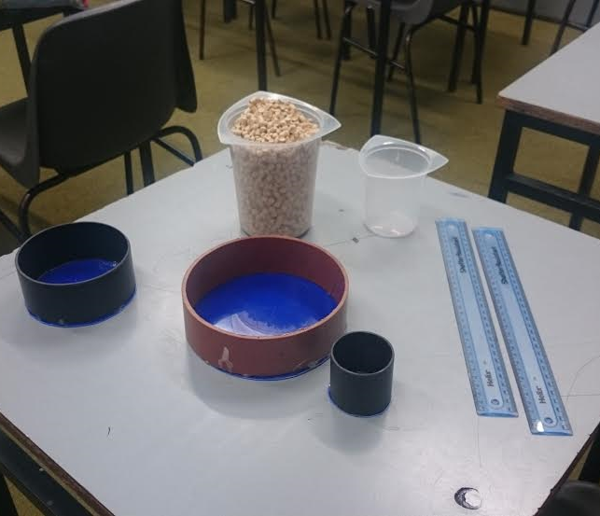
Materials
3 Cylinders
Cat Litter
Rulers
Containers
Worksheets
White board

Slide 12
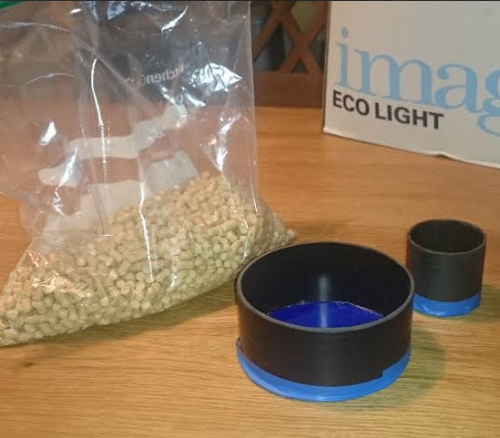
Materials
Modified set up
Only 2 cylinders
No beakers

Slide 13
Plan for Peer Observation
We divided the room into sections so each observer had only 5-6 students to observe
We designed a Student Observation Record to take notes on specific parts of the lesson
3 parts of the class – beginning of lesson, during lesson and during the discussion

Slide 14
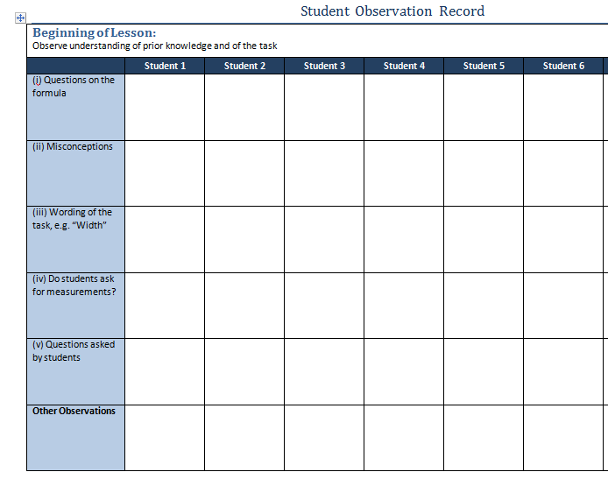

Slide 15
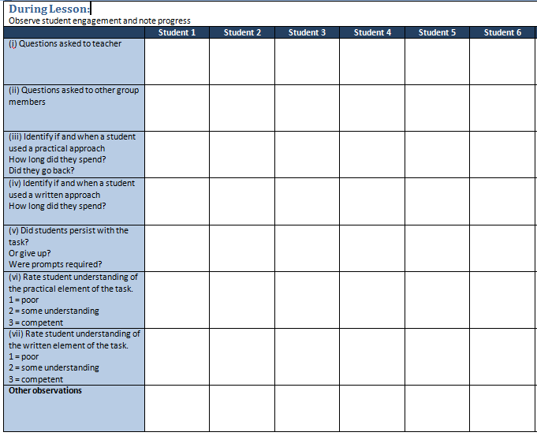

Slide 16
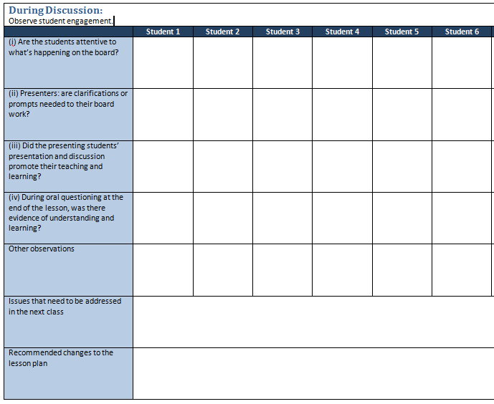

Slide 17
Findings
The student’s most common mistake: multiplying by 2 = 200L
Some students measured the cylinder and substituted the values into formula but they did not make any connection between the sizes of the cylinder and the relationship of 4 times the volume.
The majority tried to substitute some values into the formula.
A lot of students left their answers in terms of Pi.
Most students did the supporting materials.
Students did not draw a conclusion until they were prompted.

Slide 18
Student’s Work
Most common mistake was to multiply by 2 and get 200l

Slide 19
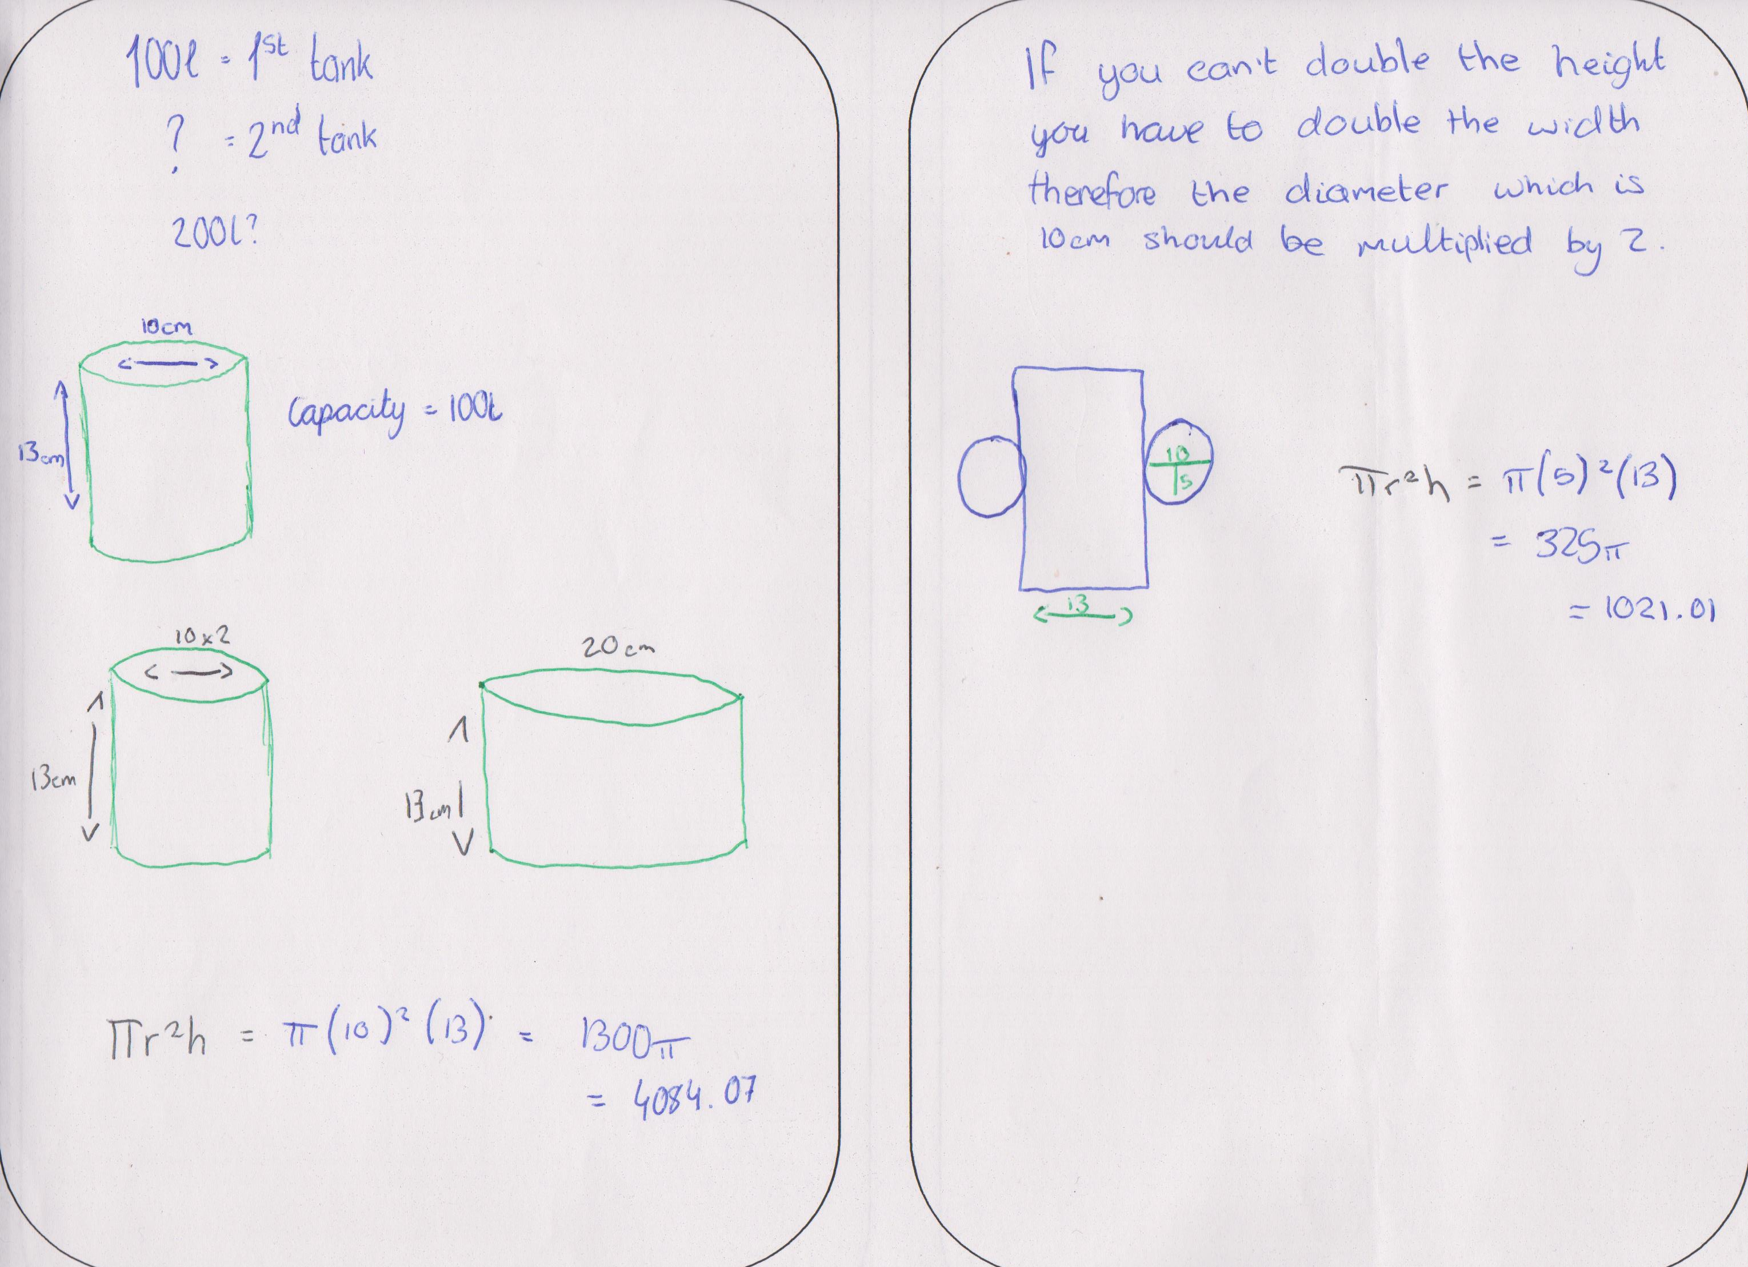
Student’s Work
Students tried to draw diagrams to help

Slide 20
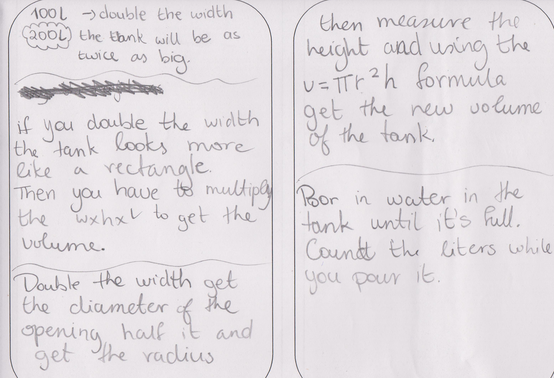
Student’s Work
Students tried to write the solution in English

Slide 21
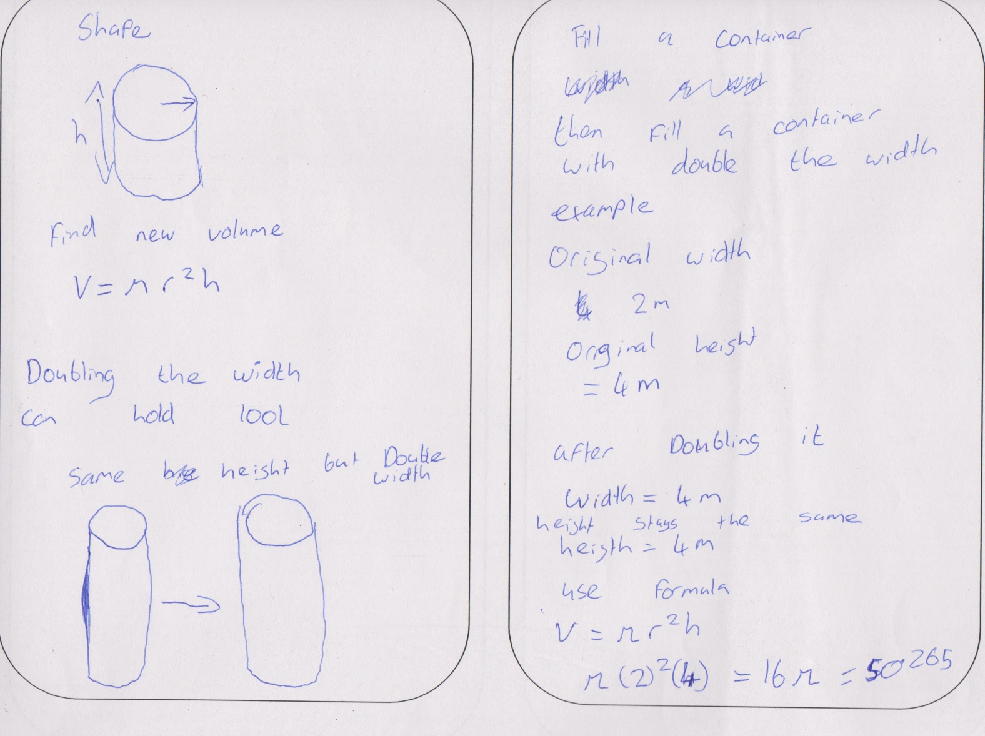
Student’s Work
Students tried to substitute values with numbers

Slide 22
Student’s Work
Student’s tried Algebra – substituting with variables like x and y

Slide 23
Student’s Work
One student did work it out correctly
Continued to see the pattern

Slide 24
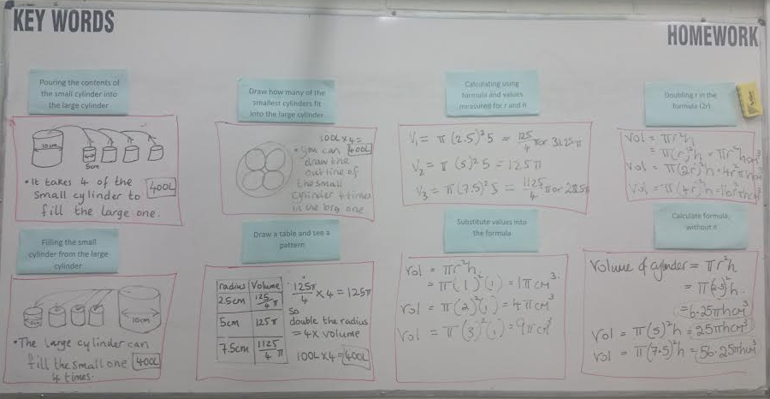
Board Plan

Slide 25
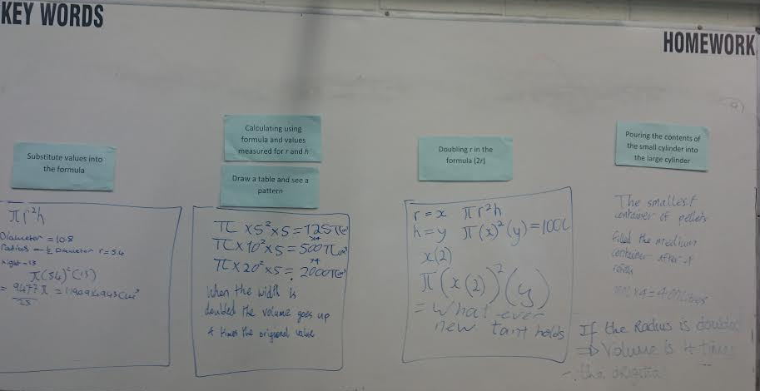
Board Plan

Slide 26
Findings/Student Learning
The formula was used by most students. The practical element was not utilised.
By the end of the lesson, most students understood the concept, they were able to do the homework task.
Students were engaged. They learned a lot from one another during the presentations.

Slide 27
Findings/Student Learning
Misconceptions
Some students struggled to see the tank was a cylinder shape.
Students struggled with 2D and 3D. Some confused surface area and volume.
Many expected the answer to be 200l because of doubling. They predicted that the radius and volume were directly proportional as opposed to proportional to the radius squared.
Students didn’t recognise the cut pipes as cylinders.
There was confusion between the measuring jugs and the pipes.
Majority did not use supporting materials, possibly due to nerves as so many adults in the room.
They did not notice the ratio of the pipes 3:2:1
One student used x and y as the variables, rather r and h.

Slide 28
Recommendations
In the previous lesson, explore cylinders in more detail, more everyday examples.
During Prior Knowledge, ask for and show everyday examples of a cylinder.
State the goal at the beginning of the lesson. The goal is to find out how much the new tank will hold.
Show a clear picture of a hot water tank.
The posing of the task needs longer.
Read the question clearly and make clarifications.
Simplify the props – just a bag of cat litter and 2 cylinders.
Ideally, bring students up to present concrete practical approaches first.
Emphasise the conclusion.
Put student’s name over the work to give student’s ownership.

Slide 29
Any Questions?

Slide 30
Sources Used
Syllabus
Textbooks
Websites: fast.wistia.net, www.educationworld.com, ltodd.wikispaces, www.tes.com
Resources: plastic pipes with diameter 5cm, 10cm and 15cm, all with height of 5cm and cat litter.

Slide 31
Thank You!
Maths Counts 2016

