Slide 1
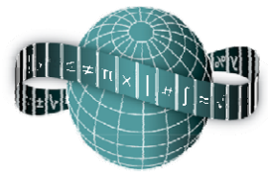
Reflections on Practice
Maths Counts 2016

Slide 2
Over to you
Representing simultaneous equations graphically

Slide 3
Lisa Carolan,Coláiste Chú Chulainn Amy Savage, Coláiste Chú Chulainn & Michael Kieran, St.Fintina’s, Longwood

Slide 4
Details
Junior Cycle, 2nd years
1 hour
8th February
Algebra, Patterns, Co-Ordinate Geometry and Functions

Slide 5
Student Learning Goals
Lesson |  | number of lesson periods
CoOrdinate Geometry | Drawing a Graph to represent lines | 10
Number Patterns | Representing a word problem in a variety of ways table graphs thinking it out finding a general formula | 3
Algebra - simultaneous equations | Solve first degree equations in one or two variables, with coefficients elements of Z and solutions also elements of Z. Draw graphs of the following functions and interpret equations of the form f(x) = g(x) as a comparison of functions • f(x) = ax + b, where a, b ∈Z | 3

Slide 6
Design of Lesson
First we decided on the topic of the lesson. We then created a problem which could be solved using various methods, including with linear graphs.
We anticipated student responses and designed a layout for the board.
Students attempted another problem in the method of their choice for homework.

Slide 7
Design of Lesson
Step 1: Prior knowledge. Presented students with a linear graph and asked them to find the slope and the y intercept, then form the equation using y=mx+c. (5mins)
Step 2: Present students with the problem. Give them time for any questions as they were not allowed during the solving time. (5mins)
Step 3: Students are given 25 minutes to solve the problem in as many ways as possible. Students were observed by the teacher and members of the team. (25mins)
Step 4: From teacher’s observation, students are called to the board to demonstrate the various methods of solving the problem.
Step 5: The solutions are discussed as a whole class and students recorded the answers by taking a picture on their iPad.

Slide 8
Materials
Question Sheet with problem, Graph Paper, Rulers and plain paper

Slide 9
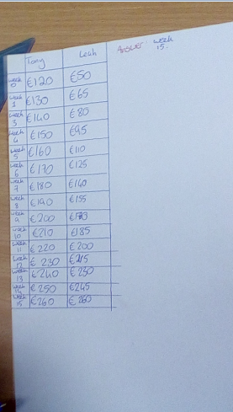
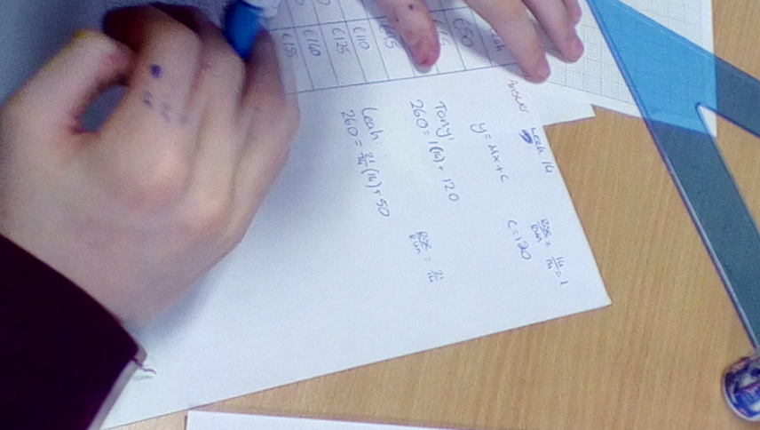
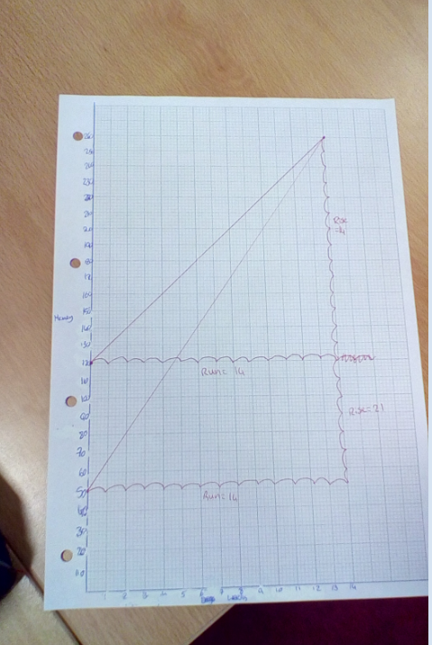
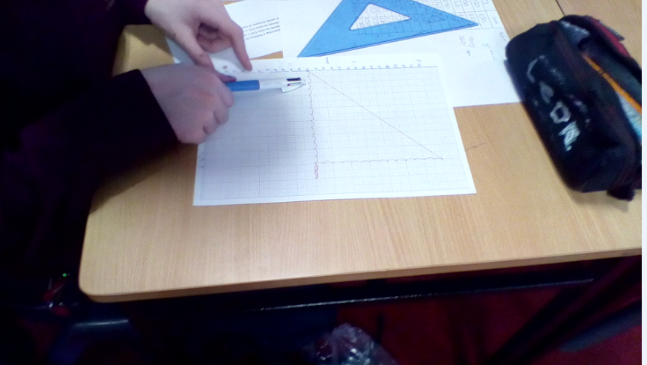
Plan for Peer Observation

Slide 10
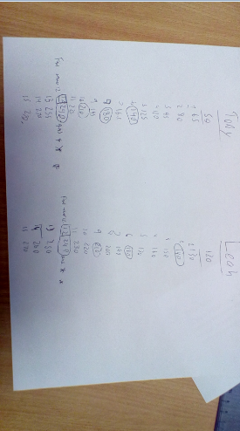
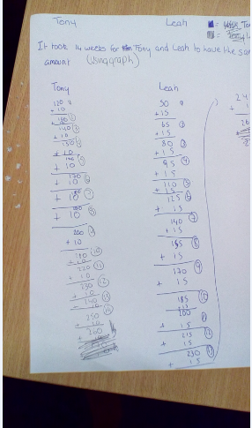
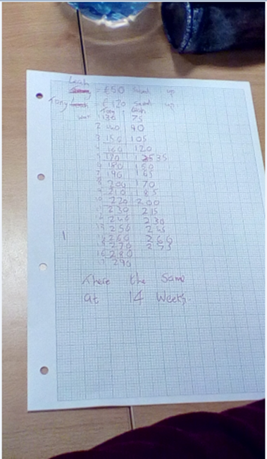
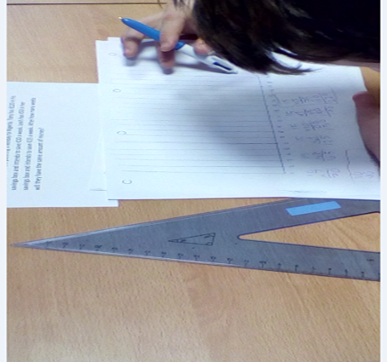

Slide 11
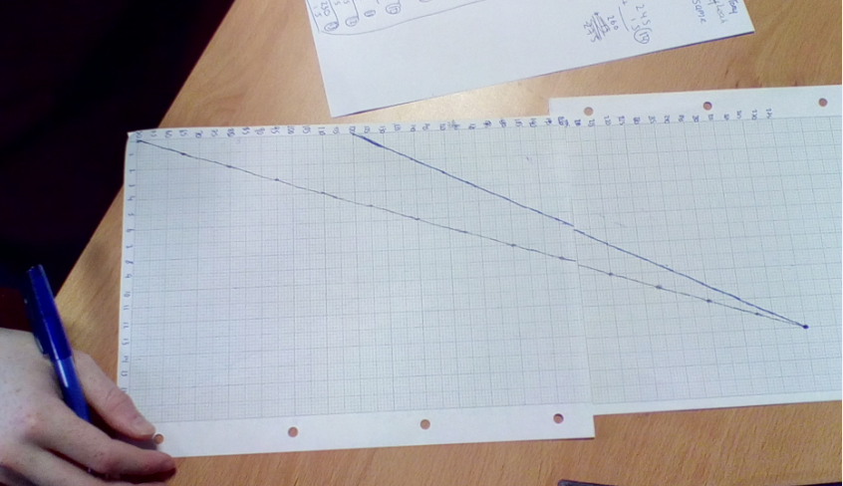
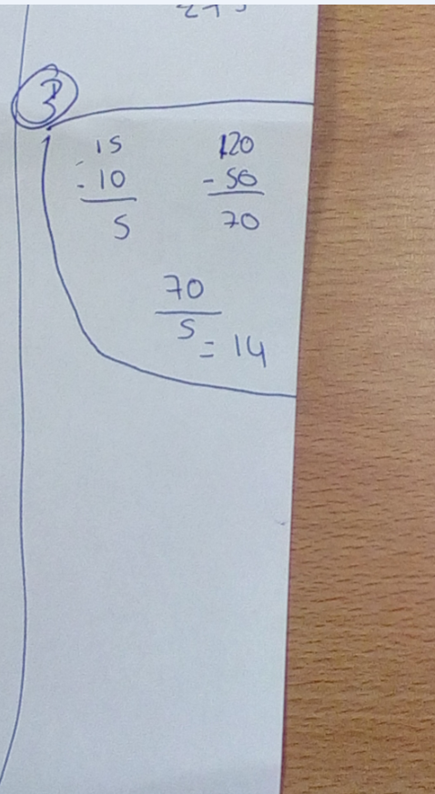
Findings

Slide 12
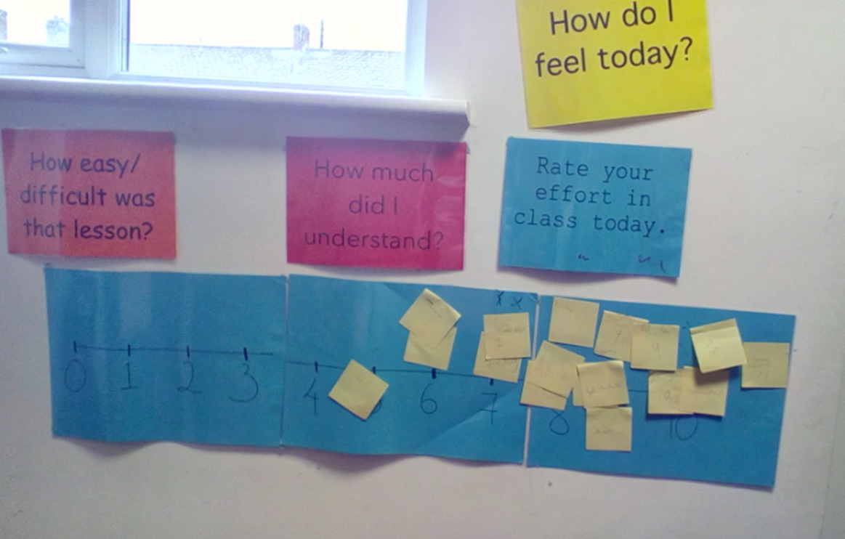

Slide 13
Findings/Student Learning
In general we were very impressed with the students findings
Difficulties/ Misconceptions - Starting on week 0, scaling the graph, plotted every point instead of plotting just two points and drawing a line through them
Surprising- One student found the algorithm involved in simultaneous equations without any variables

Slide 14
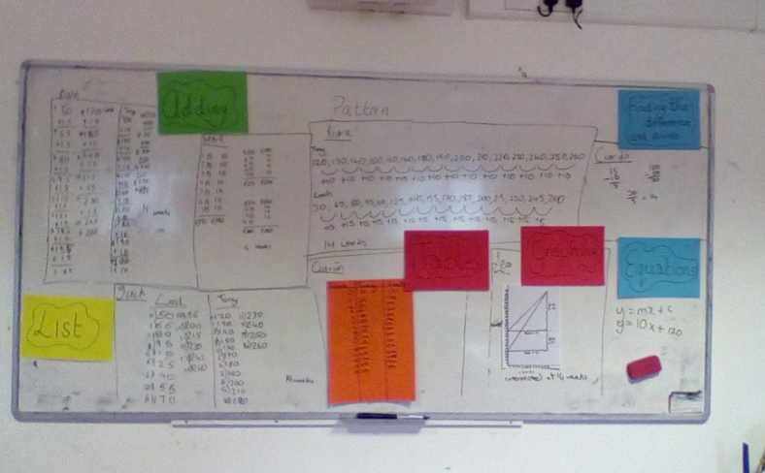
Board Plan

Slide 15
Recommendations
More time in the working out period
Get students to verbalize their work more when they are at the board
Have a strategy in place to encourage students with low motivation
If possible get students to take pictures of the board plan at the end of the lesson
Maybe pick a problem which has a lower value for the solution set

Slide 16
Any Questions?

Slide 17
Sources Used
Junior Cycle HL 2014 P1 Q9
Maths in Action 2 OL
www.projectmaths.ie
Question with coins (from project math's website)
Syllabus

Slide 18
Thank You!
Maths Counts 2016

