Slide 1


Reflections on Practice
Maths Counts 2016

Slide 2
An Introduction to Patterns
Re-Thinking
Teaching Patterns

Slide 3

Ms. Nicola Connolly
Ms. Elaine Higgins
Presentation College
Currylea,
Tuam,
Co. Galway

Slide 4
This Research Lesson
First year students
Lesson taught on the 25/02/2016 (40 minute class)
An Introduction to Patterns: Students have no prior knowledge of Patterns or Algebra.

Slide 5
Student Learning Outcomes
As a result of actively participating in this lesson students should be able to:
Present the numbers given using matchsticks
Describe the pattern in their own words
Describe the pattern using a mathematical expression.

Slide 6
Why we choose this topic to Research:
Elaine and I decided on this research lesson as we always find this topic challenging to introduce to students with no prior knowledge of algebra.
We would never have considered using a problem solving approach to introduce Patterns .

Slide 7
Design of Lesson
To prepare for this lesson we had to:
Become problem solvers ourselves
See the problem through the eyes of the students
Anticipate the students’ responses to Task 1 and Task 2.

Slide 8
Design of Research Lesson
Time | Task
0 – 5 minutes | Give out matchsticks to students and pose Task 1. The teacher ensures that all students understand what is being asked .
5 – 10 minutes | Students work on Task 1 individually while the teacher walks around the classroom to observe their work in preparation for board work.
10 – 20 minutes | Select students from the class with representations similar to anticipated responses, to come to the board.

Slide 9
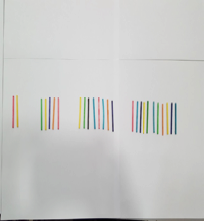
Anticipated Responses
Task 1:
Arrange the matchsticks to present the numbers 2, 5, 8, 11 in as many different ways as possible.

Slide 10

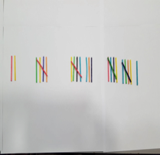
Anticipated Students’ Responses

Slide 11
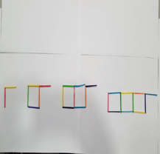
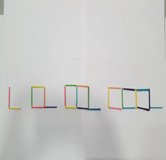
Anticipated Students’ Responses

Slide 12
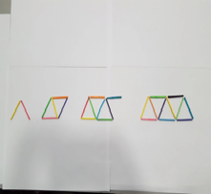
Anticipated Students’ Responses

Slide 13
Design of Research Lesson
Time | Task
20 – 25 minutes | Pose Task 2 and get students to work in pairs to come up with a mathematical sentence to explain how they get from one stage to the next using maths symbols. The teacher walked around the classroom to observe their work.
25 – 35 minutes | Teacher brought students to the board to explain their strategies.
35 – 40 minutes | Teacher reminds students what they have learned themselves through problem solving.

Slide 14
Anticipated Responses
Task 2:
Can you come up with a mathematical sentence to explain how you get from one stage to the next using maths symbols?

Slide 15
Anticipated Students’ Respones

Slide 16
Materials/Sources used
Big bag of coloured matchsticks
Students predicted answers printed and laminated as posters
Syllabus
Textbooks
First Year Teachers Handbook
Japanese Textbook
www.projectmaths.ie

Slide 17
Plan for Classroom Observation
Seating plan was given to each observer .
Each observer had an iPad and downloaded the app LessonNote to observe the lesson.

Slide 18
Findings
There were misconceptions:
Students didn’t fully understand what we wanted them to do with the matchsticks.
The initial question must be very clear, it will either curtail or give students the opportunity to extend their knowledge.
If the lesson was being taught again we would show students one example of arranging the matchsticks to illustate the sequence of numbers to help them understand exactly what we required .

Slide 19
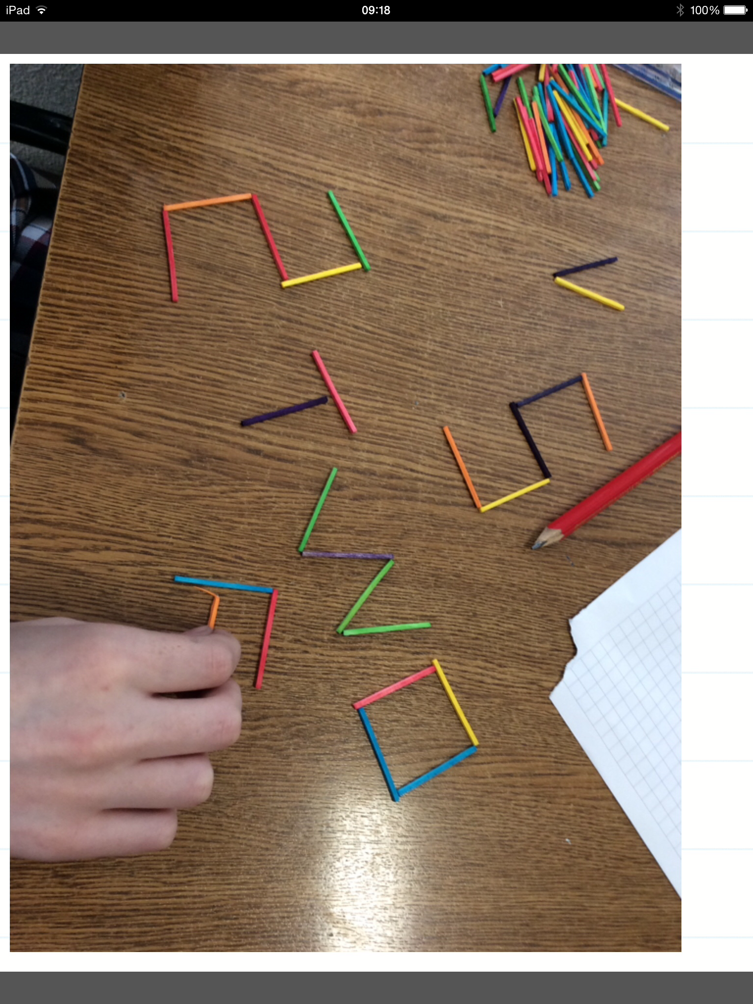
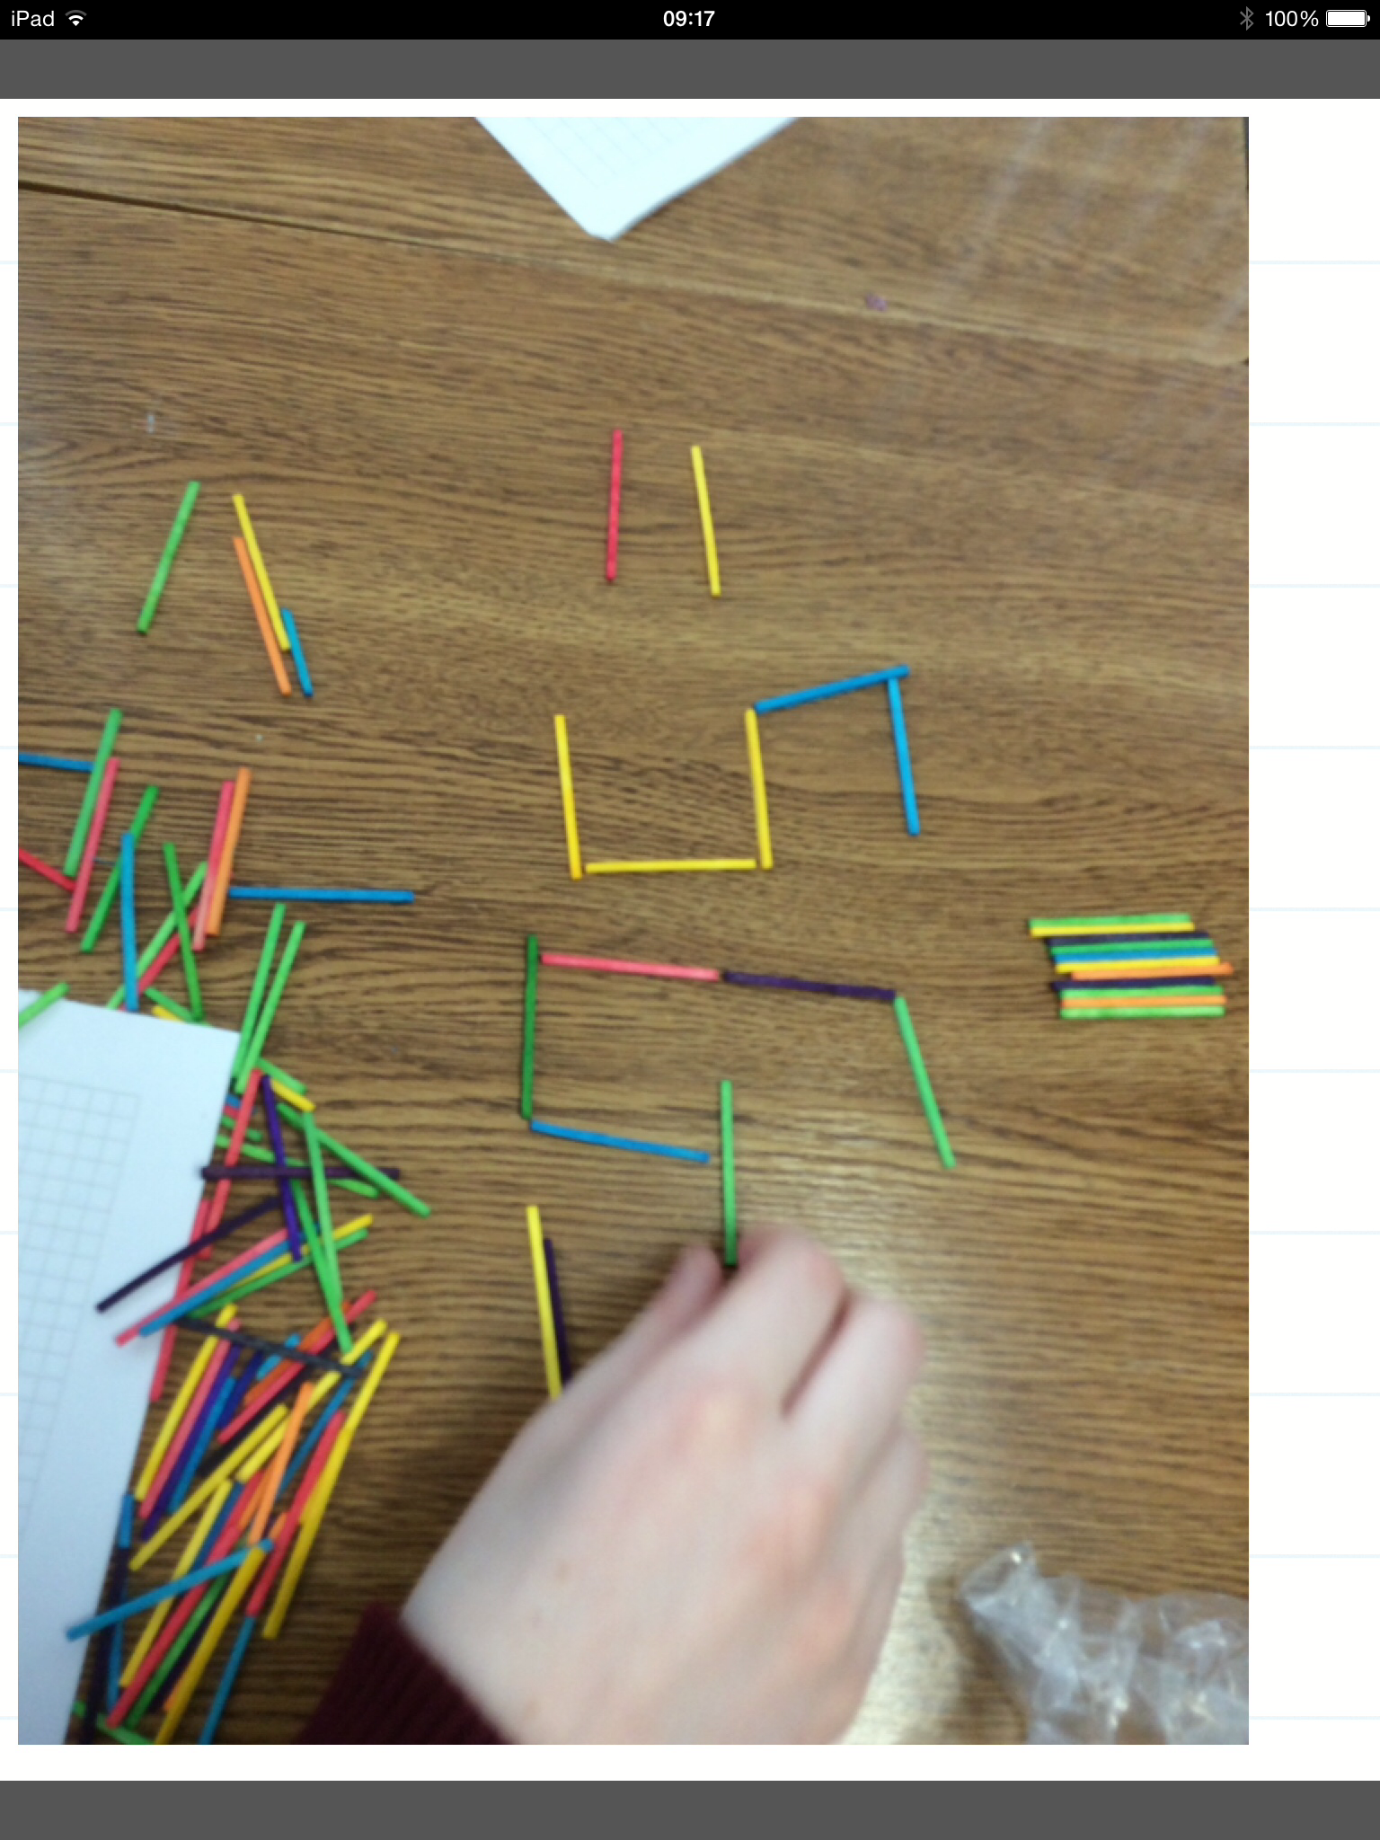
Otherwise you could get this…

Slide 20
Findings
.
Students worked better individually than in pairs:
During pair work one student just confirmed to the other that their work must be correct if they had both come up with the same mathematical sentence, then they didn’t put themselves under anymore pressure to come up with another strategy.

Slide 21
Findings
However the way we posed the question to the students may have contributed to them only coming up with one mathematical sentence.
Posed Question:
Can you come up with a mathematical sentence to explain how you get from one stage to the next using maths symbols?
On reflection our Proposed Question would read:
Can you come up with as many mathematical sentences as possible to explain how you get from one stage to the next using maths symbols?

Slide 22
Surprises
Nine minutes into the class one student recognised the presence of a pattern. Immediately all the students could identify with her discovery.
Students recognised that 3 was being added to the first stage but were struggling to identify that it was multiples of 3 that was being added to each stage of the pattern.
The teacher had to orchestrate the lesson to highlight this.
Once students saw what the teacher wrote on the board they called out “multiplying by 3”.

Slide 23
Surprises
Lesson concluded with students reflections which were collected at the end of class
There was evidence of students realising that a pattern revolves around:
The first stage which remains constant throughout.
Multiples of a number.
These were our goals for this research lesson which we achieved.

Slide 24
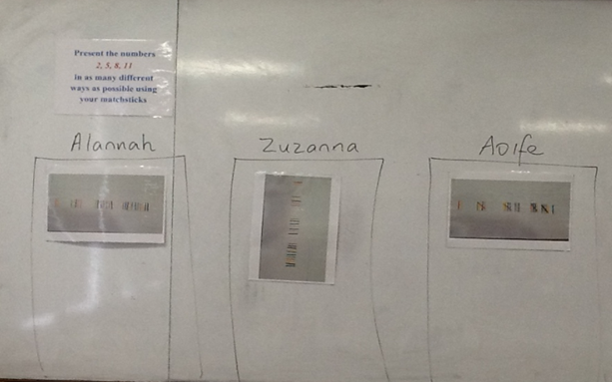
Students’ Work

Slide 25
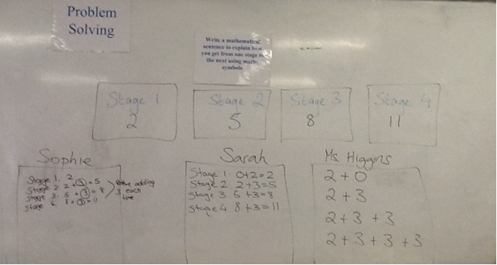
Student’s Work

Slide 26
Reteaching how to teach Patterns
We saw it as a chapter in the book and had no real rationale as to why we were teaching it.
Elaine and I decided on this research lesson as we always find this topic challenging to introduce to students with no prior knowledge of algebra.
Now we know it is the gateway to teaching algebra and would use this lesson in the future to introduce Patterns with modifications to the questions posed.

Slide 27
The Next Day:
In the following lesson the teacher recapped on the research lesson and began from:
Stage 1: 2 + 0 (3)
Stage 2: 2 + 1 (3)
Stage 3: 2 + 2 (3)
Stage 4: 2 + 3 (3)

Slide 28
The Next Day
.
She then asked students to see could they identify the link between each stage and the multiple of 3.
Students very quickly realised that the multiple of 3 was one less than the stage and almost immediately were able to work out stage 100..

Slide 29

Any Questions?

Slide 30
Thank You!
Maths Counts 2016

